Slide 1


Optimization for and by
Machine Learning
Presentation for PhD thesis defense
Pritish Mohapatra
PhD candidate, CVIT, IIIT Hyderabad
Advisors:
Prof. C.V. Jawahar, IIIT Hyderabad
Prof. M. Pawan Kumar, University Of Oxford

Slide 2
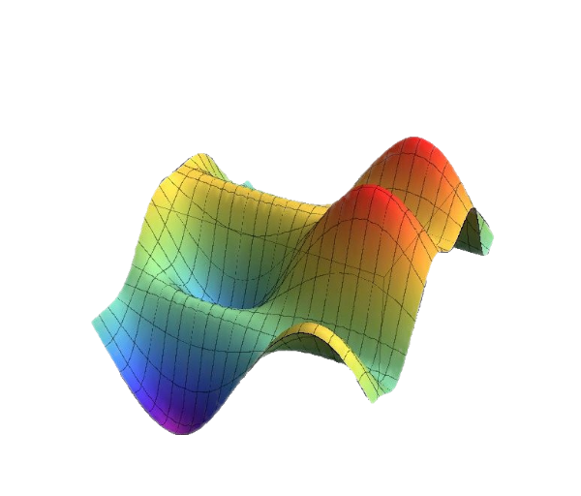
Optimization for Machine Learning
The prediction/inference problem
Score function
Output space

Slide 3
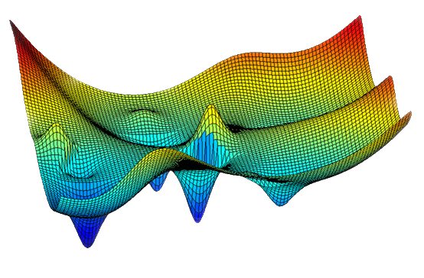
Optimization for Machine Learning
The learning problem
[ Empirical Risk Minimization ]
Expected Loss
Parameter space

Slide 4
Optimization by Machine Learning
Non-convex objective function
Non-convex / discrete feasible space
Requires human expertise and tedious effort for exploiting the structure of the problem for efficient optimization.
Can we learn to efficiently optimize by automatically exploring and exploiting the structure of the problem ?

Slide 5
Contributions
Optimization for Machine Learning
Better updates for optimization
  P. Mohapatra, P. K. Dokania, C. V. Jawahar and M. Pawan Kumar, Partial Linearization based Optimization for Multi-class SVM, ECCV, 2016.
Faster updates for optimization
  P. Mohapatra, C. V. Jawahar and M. Pawan Kumar, Efficient Optimization for Average Precision SVM, NeurIPS, 2014.
  P. Mohapatra, M. Rolinek, C. V. Jawahar, V. Kolmogorov and M. Pawan Kumar, Efficient Optimization for Rank-based Loss Functions, CVPR, 2018.
Optimization by Machine Learning
  P. Mohapatra, C. V. Jawahar and M. Pawan Kumar, Learning to Round for Discrete Labeling Problems, AISTATS, 2018.

Slide 6
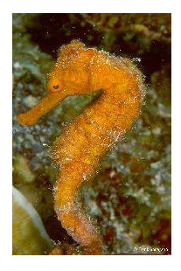
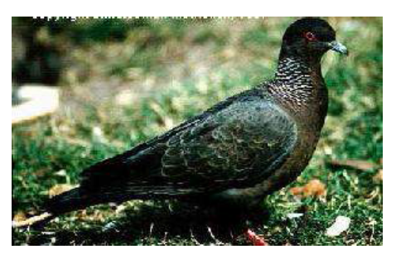
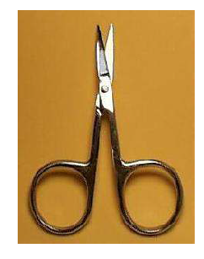
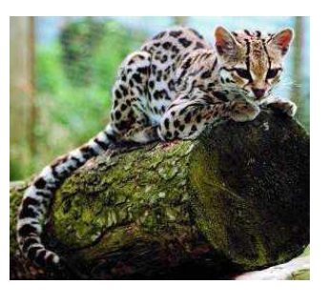
Multi-class classification
Example:
Given an image, classify it into one of the object categories.
Set of object categories:
{ Wild cat, Pigeon, Scissors, Sea horse }
Prediction:

Slide 7
Multi-class Support Vector Machine (MC-SVM)
Input: x ϵ X ; Output: y ϵ Y , where Y = {1,…, c} & c is the no. of classes
Feature representation for sample: ϕ(x)
Joint Feature map for sample and candidate class:
Prediction:
Learning:
Tsochantaridis, et al. "Large margin methods for structured and interdependent output variables." JMLR, 2005

Slide 8
MC-SVM learning problem
Primal:
Dual:
Tsochantaridis, et al. "Large margin methods for structured and interdependent output variables." JMLR, 2005

Slide 9
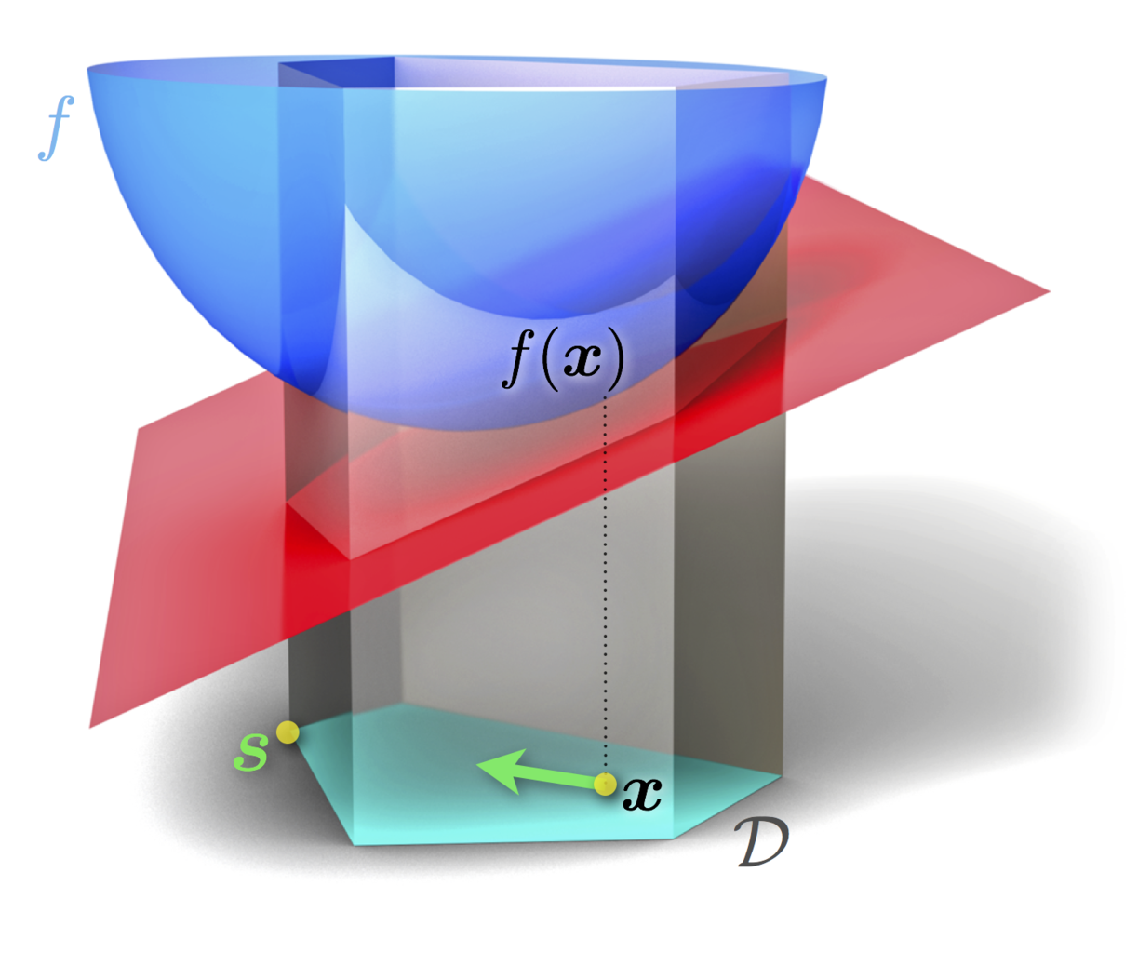
Frank-Wolfe algorithm
Jaggi et al., "Revisiting Frank-Wolfe: Projection-free sparse convex optimization." ICML, 2013
Image credit: https://commons.wikimedia.org/wiki/File:Frank-Wolfe_Algorithm.png

Slide 10
Frank-Wolfe algorithm
Optimization algorithm for the dual learning problem
k=0, Initialize α^{k}.
Repeat until convergence:
Return optimal α.
Local Linear approximation
(in Frank-Wolfe)
Construct local approximation T^{k}(α)
Compute:
Compute optimal step size .
Update
k ← k+1
Jaggi et al., "Revisiting Frank-Wolfe: Projection-free sparse convex optimization." ICML, 2013
Linearization of only the Error term

Slide 11
Partial-linearization based algorithm [ECCV 2016]
Optimization algorithm for the dual learning problem
k=0, Initialize α^{k}.
Repeat until convergence:
Return optimal α.
Local Partial-linear approximation¹
Construct local approximation T^{k}(α)
Compute:
Compute optimal step size .
Update
k ← k+1
Substitute
Error term
¹ M. Patriksson, “Partial linearization methods in
nonlinear programming. Journal of Optimization
Theory and Applications”, Springer, 1993.
Linearization of only the Error term

Slide 12
Partial-linearization algorithm
Appropriate design of substitute function:
Temperature: Non-negative hyper-parameter
Resulting problem is efficiently optimizable
Captures information about violation of each primal constraint

Slide 13
Partial-linearization algorithm
Appropriate design of substitute function:
Temperature: Non-negative hyper-parameter
Corresponding update direction:
Link: Illustrative numerical example

Slide 14

Partial-linearization algorithm
In primal space, new update direction corresponds to expectation over all constraints.
Max-oracle
( , Walking)
( , Jumping)
( , Running)
( , Sitting)
Exp-oracle

Slide 15
Partial-linearization algorithm
Partial-linearization is a generalization of other methods:
For Temperature: τ=0,
Partial-Linearization
↕
Frank-Wolfe
For τ>0, can have potentially better update direction
For Step-size: γ=1,
Partial-Linearization
↕
Exponentiated-Gradient
For γ<1, can have potentially better update step
Jaggi et al., Revisiting Frank-Wolfe: Projection-free sparse convex optimization, ICML’13
Collins et al., Exponentiated Gradient Algorithms for Conditional Random Fields and Max-Margin Markov Networks, JMLR’08

Slide 16
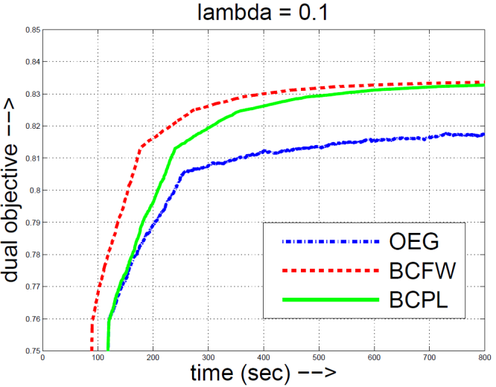
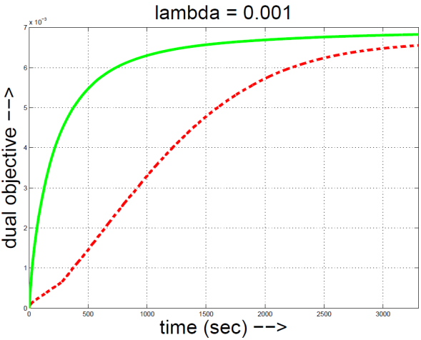
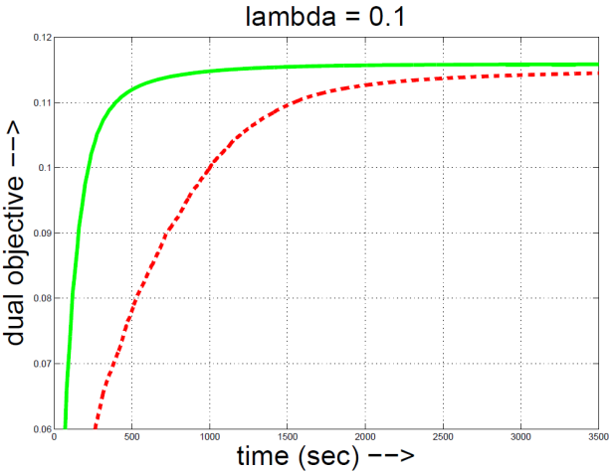
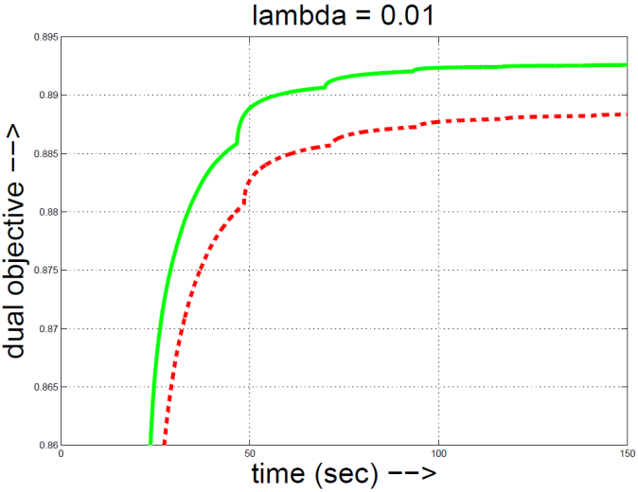
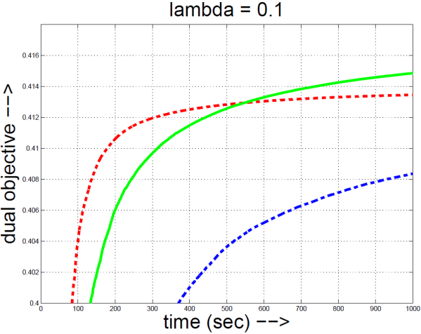
Partial-linearization algorithm
Example training curves for different tasks
(Dual objective Vs. time (sec) )
Action Classification
Object Recognition (CIFAR-10)
Object Recognition (Pascal VOC)
Gesture Recognition
Hand written word recognition

Slide 17
Partial-linearization algorithm
Comparison of mean training time (in seconds)
BCFW: Block-coordinate Frank-Wolfe
BCPL: Block-coordinate Partial Linearization
Action Classification
Object Recognition (CIFAR-10)
Object Recognition (Pascal VOC)
Gesture Recognition
Link: Results for Structured-SVM models

Slide 18
Contributions
Optimization for Machine Learning
Better updates for optimization
  P. Mohapatra, P. K. Dokania, C. V. Jawahar and M. Pawan Kumar, Partial Linearization based Optimization for Multi-class SVM, ECCV, 2016.
Faster updates for optimization (exploiting structure of the loss function)
  P. Mohapatra, C. V. Jawahar and M. Pawan Kumar, Efficient Optimization for Average Precision SVM, NeurIPS, 2014.
  P. Mohapatra, M. Rolinek, C. V. Jawahar, V. Kolmogorov and M. Pawan Kumar, Efficient Optimization for Rank-based Loss Functions, CVPR, 2018.
Optimization by Machine Learning
  P. Mohapatra, C. V. Jawahar and M. Pawan Kumar, Learning to Round for Discrete Labeling Problems, AISTATS, 2018.

Slide 19
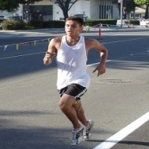

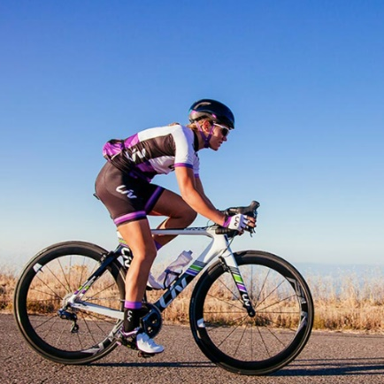
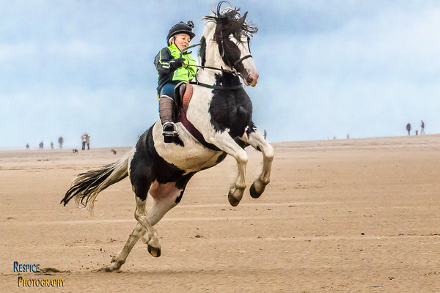

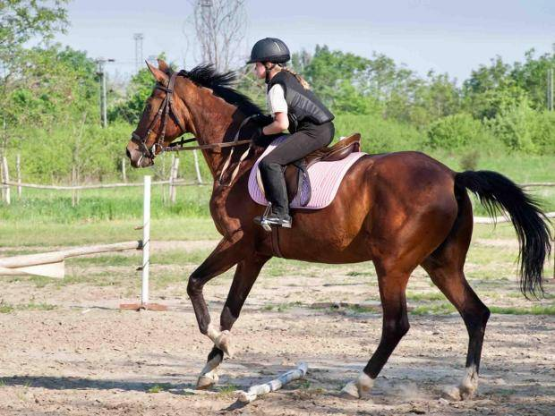
Evaluating quality of prediction: Ranking
“Jumping” Ranking
Rank 1
Rank 2
Rank 3
Rank 4
Rank 5
Rank 6

Slide 20





Evaluating quality of prediction: Ranking
Standard pipeline
Collect dataset : { , , , , , , … }
Learn your favourite model
Model assigns a score to each sample
Sort the samples according to score for ranking
Evaluate using a ranking measures

Slide 21
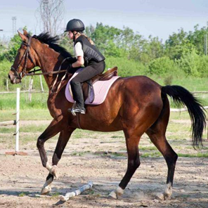
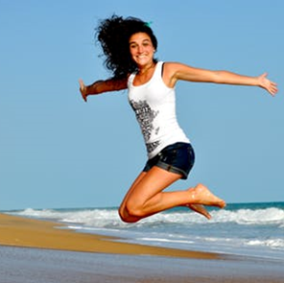
Evaluating quality of prediction: Ranking
Rank 1
Rank 2
Rank 3
Rank 4
Rank 5
Rank 6
Average Precision = 0.83
Accuracy = 0.67
0.75

Slide 22
Evaluating quality of prediction: Ranking
Standard pipeline
Collect dataset : { , , , , , , … }
Learn your favourite model
by optimizing a simple loss like the 0-1 loss
by optimizing the rank-based loss
Model assigns a score to each sample
Sort the samples according to score for ranking
Evaluate using a ranking measure like AP or NDCG

Slide 23
Optimizing rank-based loss for learning
Rank-based loss functions are generally piece-wise constant.
So, instead optimize a surrogate.
Loss function as constraints on classification rates + differentiable surrogates for classification rates
  Goh et al., NeurIPS, 2016
  Eban et al., AISTATS, 2017
  Narasimhan et al., AISTATS, 2018
  Cotter et al., JMLR, 2019
  Narasimhan et al., NeurIPS, 2019
  Kumar et al., ICML, 2021
Convex surrogates for specific rank based loss functions
  Yue et al., SIGIR, 2007
  Chakravarty et al., KDD, 2008
  Narasimhan et al., ICML, 2013
  Kar et al., NeurIPS, 2014
  Narasimhan et al., ICML, 2015

Slide 24
Optimizing Structured Hinge Surrogate
Structured Hinge Surrogate to the loss function:
Gradient:
Loss augmented inference (LAI)
Loss score
Most violating ranking
Yue et al., SIGIR 2007; Chakrabarti et al., KDD 2008 (Max-margin upper-bound minimization)
Song et al., ICML 2016 (Direct loss minimization)

Slide 25
Optimizing rank-based loss for learning
Performance Vs. Training time
~ 4% improvement
~ 5x slower
Rank-based
loss
Rank-based
loss
0-1
loss
Ranking measure
Training Time
0-1
loss
Yue, Finley, Radlinski and Joachims, SIGIR 2007
Chakrabarti, Khanna, Sawant and Bhattacharyya, KDD 2008
Notes:
There has been some work in this direction showing that you do get significant improvement in performance by optimizing rank-based loss functions for learning model parameters. However, the improvement comes at the expense of a considerably slower training process. This is generally because of the gradient estimation procedure for the rank-based loss functions.

Slide 26
Optimizing Structured Hinge Surrogate
Structured Hinge Surrogate to the loss function:
Gradient:
Loss augmented inference (LAI)
Loss score
Focus: Structure of the loss function !
Most violating ranking
Yue et al., SIGIR 2007; Chakrabarti et al., KDD 2008 (Max-margin upper-bound minimization)
Song et al., ICML 2016 (Direct loss minimization)

Slide 27
Structure of loss functions
Decomposable loss functions
Can be written as a summation of terms that depend on individual samples.
Can be optimized by individually optimizing each term in the summation
Examples: 0-1 loss, Hamming loss

Slide 28
Structure of loss functions
Non-decomposable loss functions
Can be written as a summation of terms that depend on individual samples.
X
Optimization is difficult: Cannot be optimized by individually optimizing each term in the summation
X
X
Examples: Losses based on AP, NDCG, F1-Score

Slide 29





QS-suitable loss functions
Structure for efficient optimization of non-decomposable loss:
Interleaving rank of a –ve sample
= No. of +ve samples preceding it
…
1
1
2
2
Notes:
We claim that any rank-based loss function that has the following structure should be efficiently optimizable. The loss function should be additively decomposable onto terms that are functions of the interleaving rank of negative samples.

Slide 30
QS-suitable loss functions
Structure for efficient optimization:
We call these loss functions “QS-suitable”
Includes AP-loss and NDCG-loss

Slide 31
QS-suitable loss functions
Structure for efficient optimization:
Two key properties:
Negative-decomposability property
Interleaving-dependence property

Slide 32
Negative Decomposability Property
Structure for efficient optimization:
Most violating ranking:
Optimal interleaving rank of individual negative samples can be computed independently

Slide 33
Interleaving Dependence Property
Structure for efficient optimization:
Candidate ranking:
Interleaving pattern:

Slide 34
Interleaving Dependence Property
Structure for efficient optimization:
Most-violating ranking has partial-ordering structure,
score(x_{i}) >= score(x_{j}) ⬄ r(x_{i}) <= r(x_{j})
Scores of
Scores of
Scores of
Scores of
,
>
,
…
>
Notes:
score(xi) >= score(xj) ⬄ r(xi) <= r(xj)

Slide 35

Optimization algorithm
Algorithm for computing gradient:
Induce the partial-ordering structure
Compute the optimal interleaving rank

Slide 36
Baseline algorithm
Algorithm for computing gradient:
Induce the partial-ordering structure
  Sort the +ve samples
  Sort the –ve samples
Compute the optimal interleaving rank
O( P log P )
O( N log N )

Slide 37

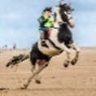
Baseline algorithm
Algorithm for computing gradient:
Induce the partial-ordering structure
  Sort the +ve samples
  Sort the –ve samples
Compute the optimal interleaving rank
  Compute the optimal interleaving rank for each –ve sample independently
O( P log P )
O( N log N )
O( P N )

Slide 38
Baseline algorithm
Algorithm for computing gradient:
Induce the partial-ordering structure
  Sort the +ve samples
  Sort the –ve samples
Compute the optimal interleaving rank
  Compute the optimal interleaving rank for each –ve sample independently
For N > P
O( P log P )
O( N log N )
O( P N )

Slide 39
Quicksort flavoured algorithm
Pivot
Pivot
Algorithm for computing gradient:
Induce the partial-ordering structure
  Sort the +ve samples
  Quicksort flavoured algorithm
  Sort only the chosen pivots
Compute the optimal interleaving rank
  Quicksort flavoured algorithm
  Compute only for the chosen pivots.
  Cheaply assign for many.
O( P log P )
Repeat recursively
O( N log P
+ P log N )

Slide 40
Computational Complexity
For N > P
O( P log P + N log P + P log N )
O( N log P )
Vs.
O( N log N + NP )
This is the best you can do with any comparison based algorithm !
Can further speed-up the algorithm by exploiting the additional structure of specific loss functions like AP loss ¹
¹ P. Mohapatra, C. V. Jawahar and M. Pawan Kumar, Efficient Optimization for Average Precision SVM, NeurIPS, 2014

Slide 41
Experiments and Results
Improvement of > 4 %
Improvement of > 1 %

Slide 42
Experiments and Results

Slide 43
Experiments and Results

Slide 44
Experiments and Results
Improvement of > 7 %

Slide 45
Experiments and Results

Slide 46
Experiments and Results
Link: More empirical results

Slide 47
Optimizing rank-based loss functions: Summary
Improvement
Good to optimize a rank-based loss function to learn a ranking model
Rank-based
loss
0-1
loss
Ranking Measure
Inefficient
Rank-based
loss
Expensive to optimize a rank-based loss
Training Time
0-1
loss
Rank-based loss satisfies the QS-suitable structure ?
Efficient
Efficient to optimize the rank–based loss
Rank-based
loss
Training Time
0-1
loss

Slide 48
Contributions
Optimization for Machine Learning
Better updates for optimization
  P. Mohapatra, P. K. Dokania, C. V. Jawahar and M. Pawan Kumar, Partial Linearization based Optimization for Multi-class SVM, ECCV, 2016.
Faster updates for optimization (exploiting structure of the loss function)
  P. Mohapatra, C. V. Jawahar and M. Pawan Kumar, Efficient Optimization for Average Precision SVM, NeurIPS, 2014.
  P. Mohapatra, M. Rolinek, C. V. Jawahar, V. Kolmogorov and M. Pawan Kumar, Efficient Optimization for Rank-based Loss Functions, CVPR, 2018.
Optimization by Machine Learning
  P. Mohapatra, C. V. Jawahar and M. Pawan Kumar, Learning to Round for Discrete Labeling Problems, AISTATS, 2018.

Slide 49
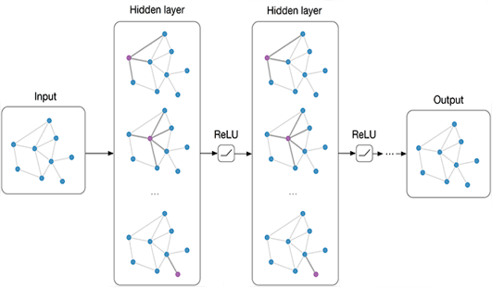
Learning to Optimize
Learning to optimize for combinatorial problems
Direct prediction and end-to-end learning
O. Vinyals, M. Fortunato, N. Jaitly, Pointer networks. NeurIPS, 2015
I. Bello, H. Pham, Q.V. Le, M. Norouzi, S. Bengio, Neural combinatorial optimization. 2017
A. Nowak, S. Villar, A.S. Bandeira, J. Bruna, A note on learning algorithms for quadratic assignment with graph neural networks. arXiv preprint arXiv:1706.07450, 2017
W. Kool, M. Welling, Attention solves your TSP, arXiv preprint arXiv:1803.08475, 2018
Image credit: https://tkipf.github.io/graph-convolutional-networks/

Slide 50
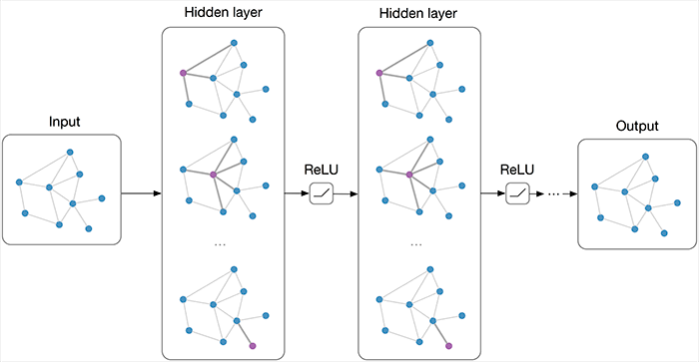
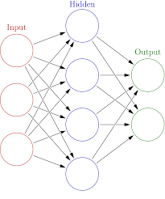
Learning to Optimize
Learning to optimize for combinatorial problems
Using a learnable module as part of a human-designed algorithm
H. Dai, E.B. Khalil, Y. Zhang, B. Dilkina, L.Song, Learning combinatorial optimization algorithms over graphs. arXiv preprint arXiv:1704.01665, 2017
Z. Li, Q. Chen, V. Koltun, Combinatorial optimization with graph convolutional networks and guided tree search. NeurIPS, 2018
Y. Tang, S. Agrawal, Y. Faenza, Reinforcement Learning for Integer Programming: Learning to Cut, arXiv preprint arXiv:1906.04859, 2019
Learnable module
Human-designed algorithm

Slide 51
Discrete Labeling Problem
Variables:
Labels:
Example labeling:
Quality of each labeling is measured by an Energy function
Energy Function:
For simplicity we will be considering only pairwise potentials

Slide 52
Discrete Labeling Problem
Energy Function:
We want to find the labeling with the minimum energy
Optimization Problem Formulation:

Slide 53
Continuous Relaxation + Rounding
{0,1}
[0,1]
Formulate
Relax
Discrete Labelling Problem
Integer Programming Formulation
Continuous Relaxation
Solve
{0,1}
[0,1]
We propose a rounding procedure that can be learned from data for any specific type of Discrete Labeling Problem
Round
Integer Solution
Fractional Solution

Slide 54
Randomized Rounding Procedures
Complete Rounding
Use the same random number r to sample an integer solution for all the random variables simultaneously.
Label random variables simultaneously
r = 0.2
0.1 0.3 0.6
0
1
0 1 0

Slide 55
Rounding as Sampling from Latent Variable Model
Direct sampling from P(X), where P(X) is parameterized by the fractional solutions, that is:
Eg.: Complete rounding
Sampling from the joint distribution P(X,Z) and then marginalizing out the latent variable Z, that is:
Eg.: Interval rounding, Hierarchical rounding
Learnable stochastic latent variable models !
Using deep neural nets
Link: Illustrative example

Slide 56
Deep Latent Variable Model for Rounding
Deep Latent variable model for Rounding
Fractional Solution
Encoder (α)
Decoder (β)
Convolution
Deconvolution
Sampling
Complete Rounding
Minimize the expected energy of the output integral solution
+ Entropy
regularization
Link: Details
Integer Solution

Slide 57
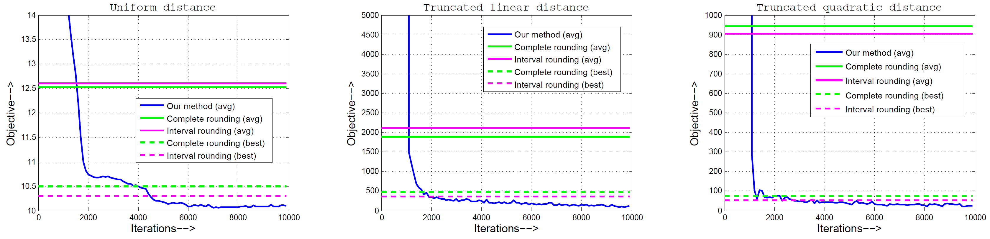
Experiments and Results
Discrete labeling of densely connected graphs
Dataset: Collection of 100 synthetically generated densely connected graphs.
Fractional Solutions: We use the efficient proximal LP solver proposed by [1]
to obtain fractional solutions for training our model.
Results:
Objective function Vs. iterations during optimization over the training set.
[1] Ajanthan et al., Efficient linear programming for dense CRFs, CVPR, 2017

Slide 58
Rounding as Sampling from Latent Variable Model
Discrete labeling of densely connected graphs
Average (E_avg) and minimum (E_min) obtained by different methods on the test set.

Slide 59
Rounding as Sampling from Latent Variable Model
Semantic segmentation of images
Dataset: MSRC image segmentation dataset.
Fractional Solution: Two different sets of fractional solutions,
1) Primal solutions obtained by solving a continuous relaxation [2] of the original primal problem.
2) Primal feasible solutions computed using expected min-marginals obtained from TRW-S.
Results:
Average (E_avg) and minimum (E_min) obtained by different methods on the test set.

Slide 60
Directions for future work
Extension of the proposed method towards efficient optimization of rank-based loss functions for multiple levels of relevance.
Encoding structure of output space using logic rules. Designing better relaxations and optimization methods for learning with such models.
Exploring graph attention models for developing learnable local search methods for solving combinatorial problems.

Slide 61
List of Publications
P. Mohapatra, M. Rolinek, C. V. Jawahar, V. Kolmogorov and M. Pawan Kumar, Efficient
Optimization for Rank-based Loss Functions, arXiv preprint arXiv:1604.08269, 2016.
In IEEE Conference on Computer Vision and Pattern Recognition (CVPR), 2018.
P. Mohapatra, C. V. Jawahar and M. Pawan Kumar, Learning to Round for Discrete Labeling
Problems, International Conference on Artificial Intelligence and Statistics (AISTATS), 2018.
P. Mohapatra, P. K. Dokania, C. V. Jawahar and M. Pawan Kumar, Partial Linearization based
Optimization for Multi-class SVM. In European Conference on Computer Vision (ECCV), 2016.
A. Behl, P. Mohapatra, C. V. Jawahar and M. Pawan Kumar, Optimizing Average Precision
using Weakly Supervised Data, IEEE Transactions on Pattern Analysis and Machine
Intelligence (TPAMI), 2015.
P. Mohapatra, C. V. Jawahar and M. Pawan Kumar, Efficient Optimization for Average
Precision SVM, In Proceedings of Advances in Neural Information Processing Systems
(NeurIPS), 2014.

Slide 62
Thank you

