Slide 1
Computational Displays
On Enhancing Displays using Computation
Pawan Harish
PhD. Guide: Prof. P.J.Narayanan

Slide 2
What’s the need?
Displays have many limitations today:
  Low Intensity Resolution
    Maximum of 5M pixels – Apple’s Retina display
  Displaying and Rendering More Pixels
    Graphics cards cannot render very large resolutions
  Low Refresh Rate
    Maximum 240Hz using Samsung Blue Phase
  Planarity
    Nearly all displays are planar
  Lack of 3D viewing
    Very few examples of 3D displays exist
  Lack of Interaction
    Getting more attention but still far from being natural

Slide 3
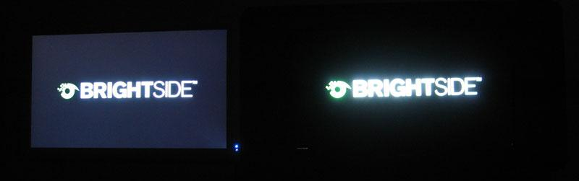
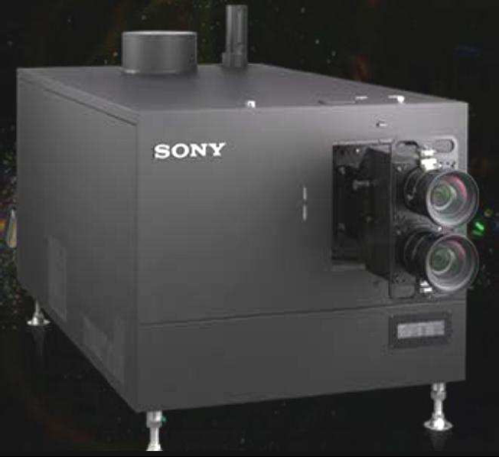
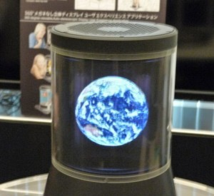
Market Solutions and Future Trends
Market uses a direct (brute force) approach which needs ever new technologies (which are hard to come by) to push the display design.
Direct methods can only go as far as the technology and feasibility allows them.
Intelligent use of display technology is needed without depending too much on physical, chemical and metallurgical means.
High Dynamic Range Display by BrightSide
4K Sony Projector
Sony’s 3D display

Slide 4
Computational Displays
Computation today is cheap and abundantly available.
Using computation to enhance systems has been tried with success in many domains such as computational photography, computational biology, etc.
The concept is to get more out of a base system using algorithmic modifications along with prior knowledge about the system.
We extend the notion of algorithmic modification to displays and propose to enhance displays using computation.
We call such displays Computational Displays.
These displays enhance capabilities of current displays by careful use of computation.

Slide 5
Hypothesis and Scope
Hypothesis:
  Computation, if used intelligently along with other methods, can compensate for many of the display shortcomings.
Scope:
  The systems proposed in this thesis use standard hardware along with computation to enhance displays.
  We focus is on intra display processes - where multiple conventional displays are used in order to gain more out of a system.
  Limited inter-display processes without hardware modification is also explored.

Slide 6
Computational Displays as a Subject
There are two ways in which computation can enhace display capabilities
  Hardware Modifications:
    Creates specialized hardware that is used in conjunction with computation to solve the specific display problem
    Examples: Tensor Displays, Wobulation, Content Adaptive resolution enhacement etc.
  Algorithmic Modifications
    Treats displays as black boxes
    We use this line of thought in this thesis.
    Examples: FTVR, Object appearance editing, Display Walls etc.

Slide 7
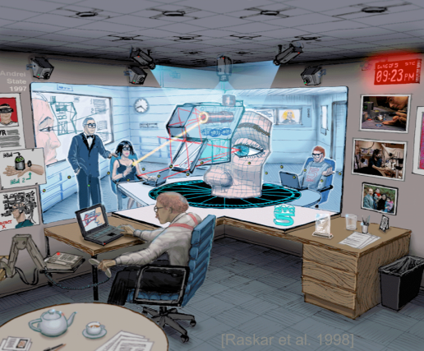
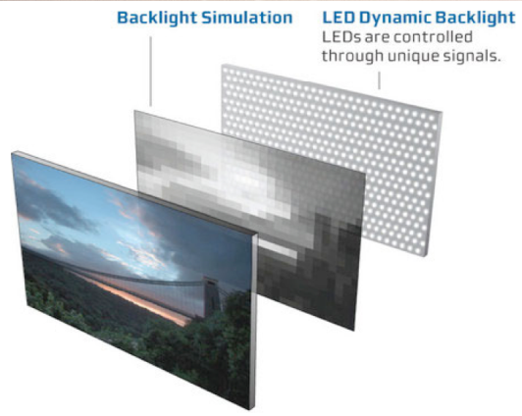
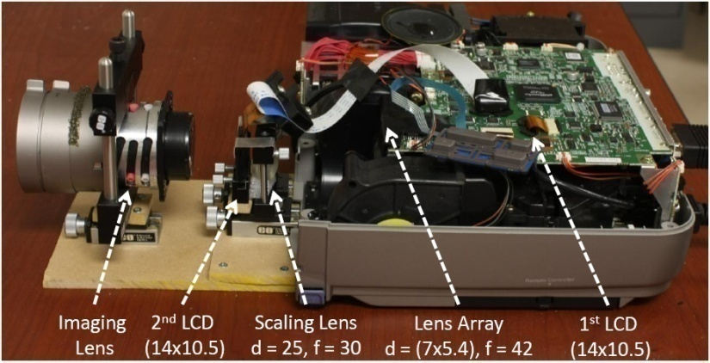
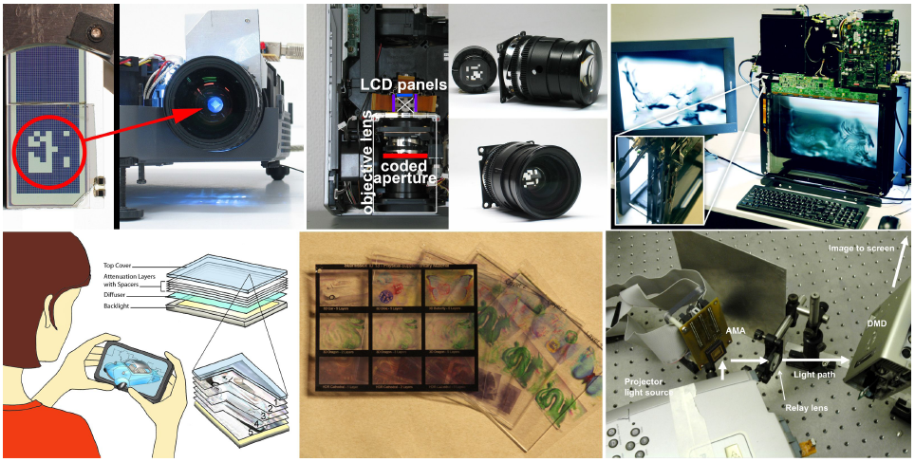
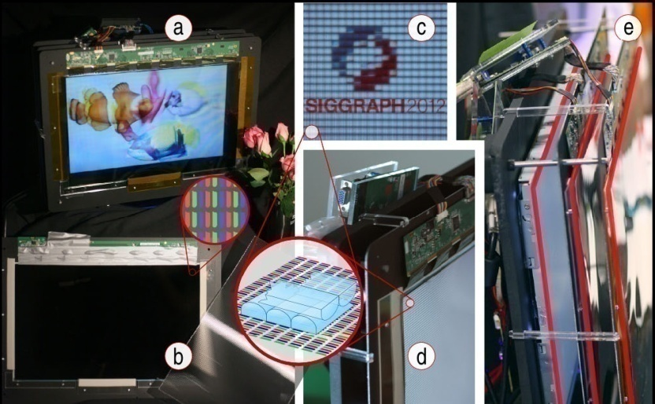
Related Work: Hardware Modifications
Intra Display Interactions
  Positive: Fast and Efficient
  Negative: Costly, Non-Sclable,Technology dependent, Limited applicability, Requires specialized content.

Slide 8
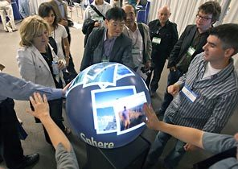
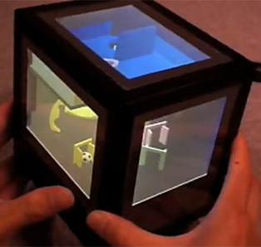
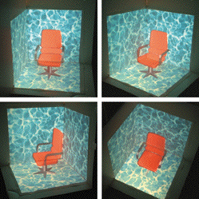
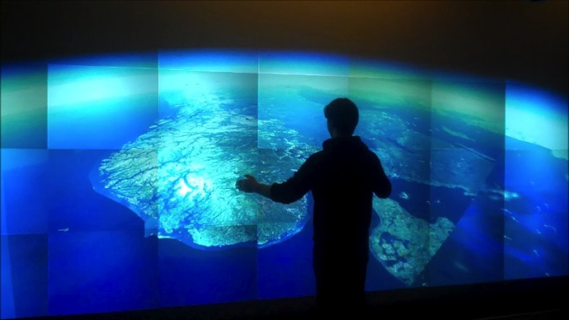
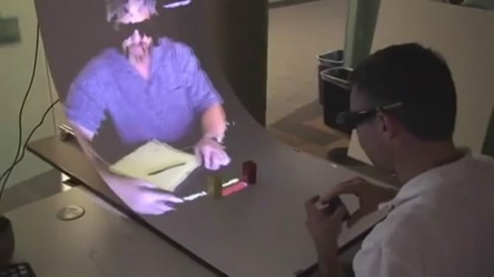
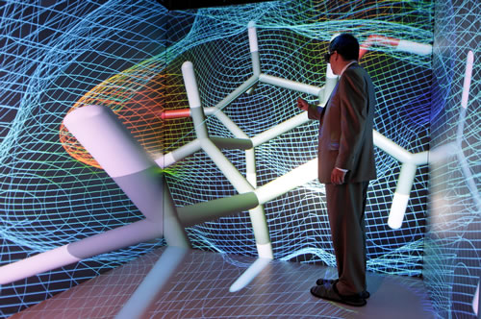
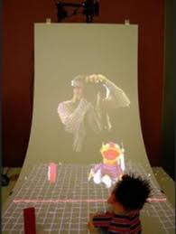
Related Work: Algorithmic Modifications
Inter Display Interactions
  Positive: Cheap, Sclable,Technology independent, Larger applicability, Uses conventional content.
  Negative: Slower, but acceptable with enough computation. Usually requires more input parameters.

Slide 9
What We Explore and Why
Focus+Context, spatial resolution
  Many visualization application require both focus and context in a scene (medical, astronomical data etc.)
  Creating a large single display is very expensive
  Many people have asked us for the code of our project: Bio, Topology, Physics. There is a need for such a display.
Non-Planar displays
  Interactive views in physical space is more immersive and fun.
  New motion capture methods are wasted with flat displays.
High Dynamic Range display
  There are ways to capture HDR (12 bit cameras), but hard to display.
  Very few examples of HDR displays exist
Physical Processes Complexity
These are a set orthogonal fundamental display problems with varying physical processes. Showing solutions in these dimensions validates our hypothesis by example.

Slide 10
The Approach
Need to devise a generic framework on how to enhance displays using computation
User Input
COMPUTATIONAL DISPLAY
IMAGE GENERATION ALGORITHMS
Sub-Image Generation
Conventional Display
IMAGE
AGGREGATION
-
Physical Processes
(Arrangement/ Optics/ Inverse mapping/ Mixing)
Standard Content
Load Distribution
(Single/ Distributed/ Parallel)
Sub-Image Generation
Conventional Display
User
Sub-Image Generation
Conventional Display
Prior Knowledge
(Mapping)
Sub-Image Generation
Conventional Display

Slide 11
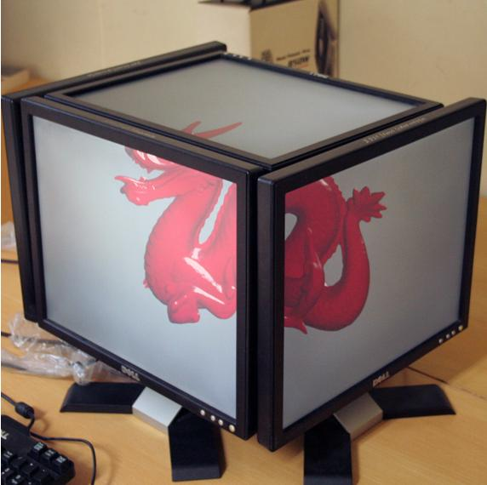
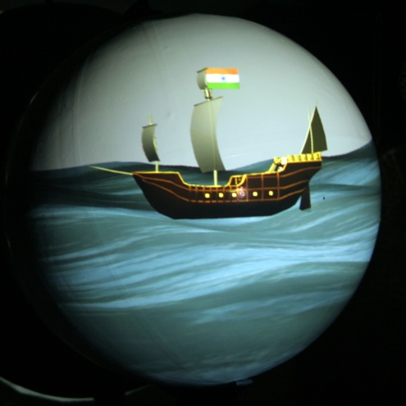
View Dependent Multi-Planar Displays
Pawan Harish and P.J.Narayanan
1. IEEE Transactions on Visualization and Computer Graphics, 2013
2. SIGGRAPH Virtual Reality Continnum and its Applications in Industry, 2009

Slide 12


Architectural Design
View Dependent Triangle Sorting
View Dependent Rendering
Dynamic Scene
View Dependent
Facet Rendering
Display Geometry
Quilt Image Rendering
Depth Correcting Shaders
Head Tracker
Per Facet VBO
Predefined Image Mapping, Y_{i}
Quilt Image N
Quilt Image 2
Quilt Image 1 of all Facet Images
Rendered Display

Slide 13
As a Computational Display
User Input
MILTIPLANAR DISPLAY AS A COMPUTATIONAL DISPLAY
IMAGE GENERATION ALGORITHMS
Homography Transformation and Quilt Image Rendering
Display
Facets – LCD, Projected
Standard Content
Parallel
Scene
Culling and triangle Sorting
Sub-Image Generation
Conventional Display
Physical facet arrangement as
described by input Display Configuration
User
Sub-Image Generation
Conventional Display
Prior Knowledge
(Mapping)
Sub-Image Generation
Conventional Display
Physical Processes Involved: Viewer’s head position, Display Geometry, Facet Orientation, Display W.R.T. Viewer.
Algorithmic Modifications: Homography, Parallel Culling and Rendering.

Slide 14
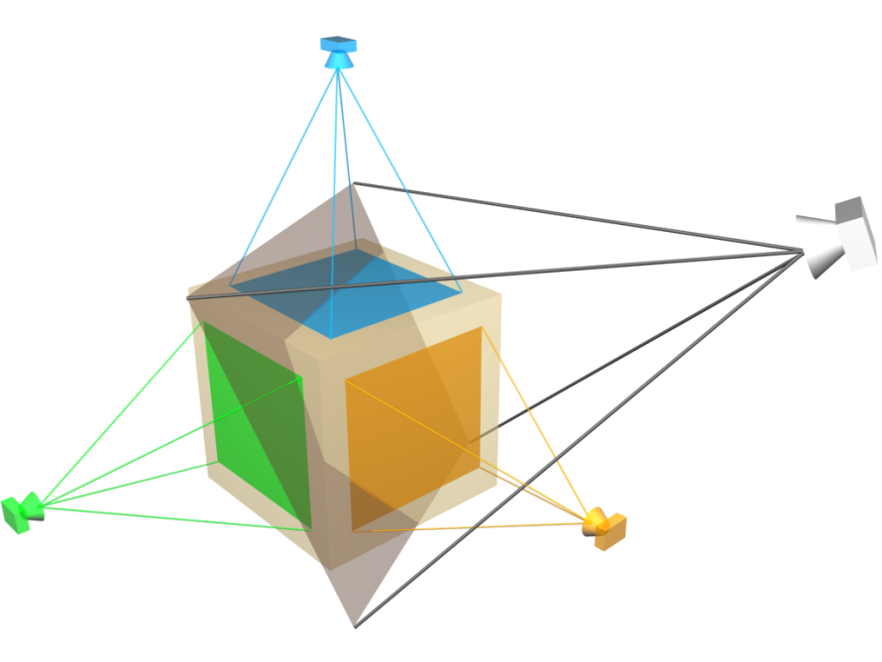
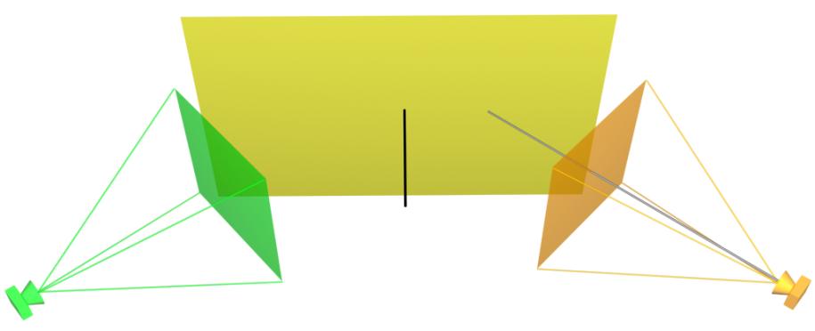
Rendering approach
C₁
Observing plane
Virtual Plane
Multiplanar Display
C_{v}
Distance d from C_{i}
Display Facet
Normal n in C_{i} Frame
Viewer Camera
Camera C_{v}
Camera C_{i}
[R|T] to Camera C_{i}
C₃
C₂
Problems: Pixel Interpolation, Non-integer Pixles and Per-Pixel Normalization
Homography can be used to pre-warp facet images to generate corrective image on virtual plane
Can lead to depth errors – we fix these using per-pixel operations in a pixel shader.
Pixel
Shader
H
V
P_{d}
P
M_{v}
H
Homography
Viewport
Scaling
Perspective
Division
Projection
ModelView
Homography
Canonical Space [-1,1]

Slide 15
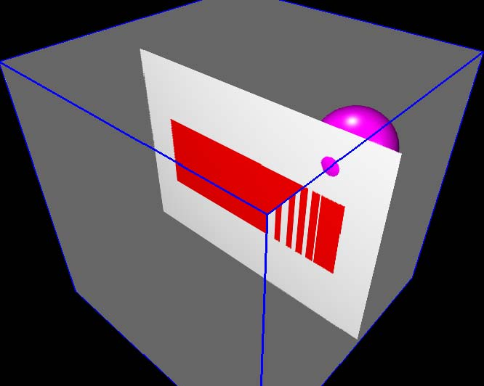
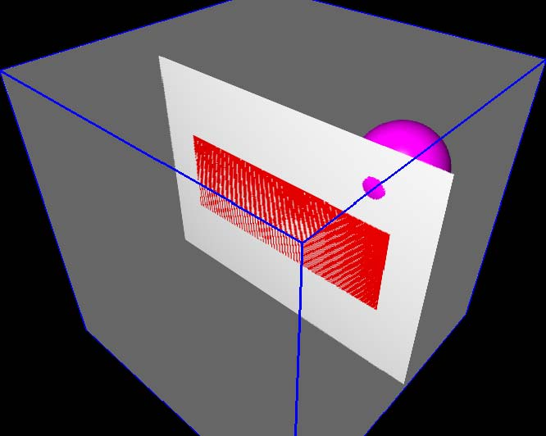
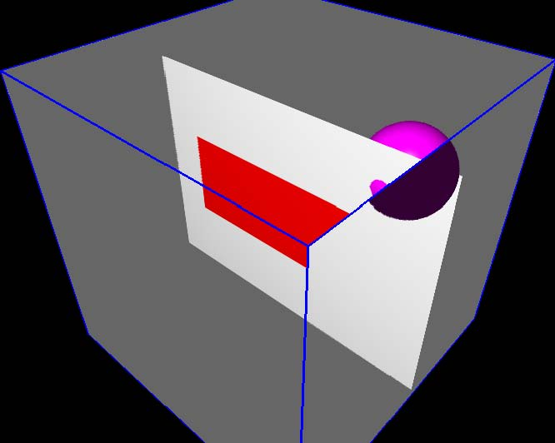

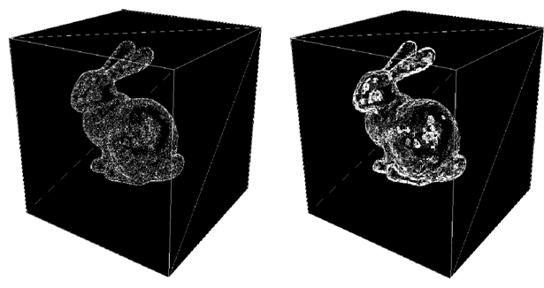
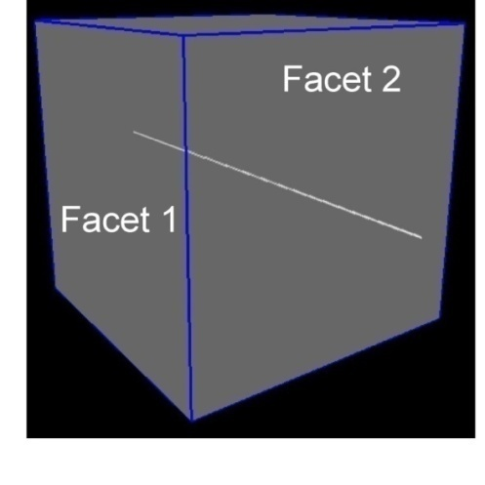
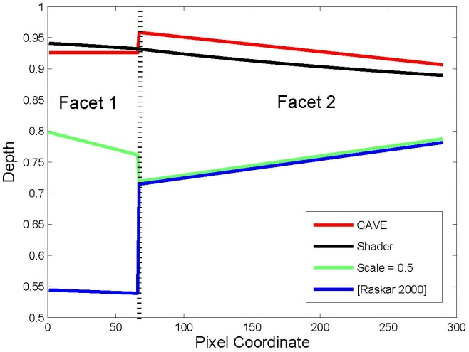
Quality Evaluation
Only our method produces consistent values across the facet boundaries, ensuring consistent collective rendering.
Visual difference between the two methods. Clearly PTM produces more errors, even at 16 times the image size
CAVE
Scale <1
Raskar
Our Method
Comparision with other approaches
Comparision with Projective Texture Mapping

Slide 16
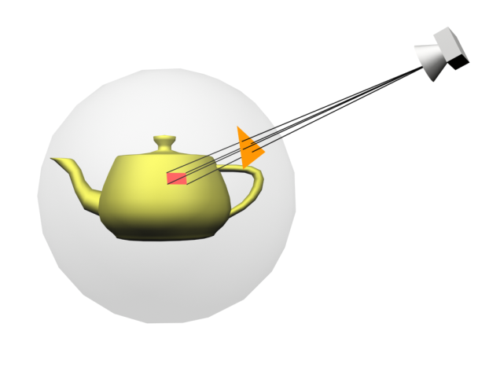
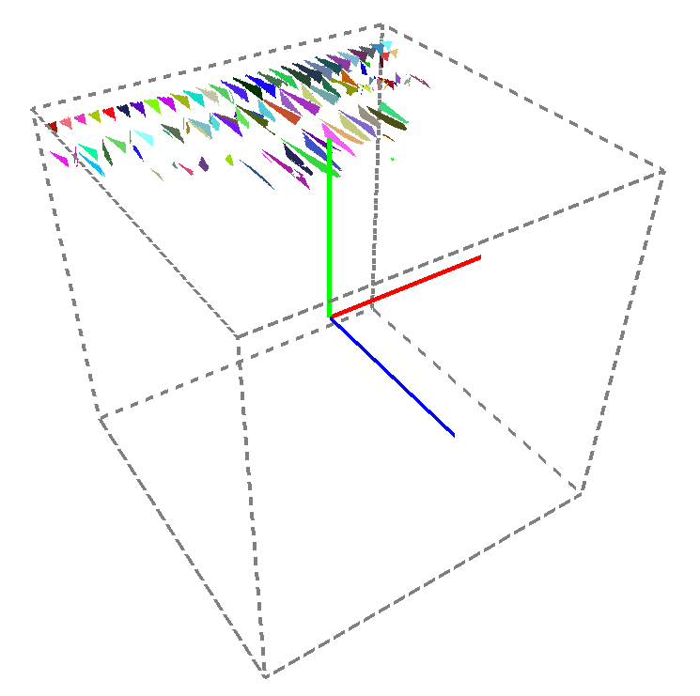

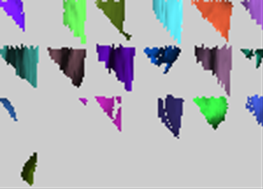

Scalability: Parallel GPU ∆ Sorting and Single Pass Quilt Rendering
Finding Triangles in Each Facet using Ray Casting
Each Facet has a Different Projection Matrix
TEST#1
TEST#2
Output
Pre-Warp triangles in each facet to render all in a single pass
I_{x} = V P_{d} H_{x}PM_{v}[3D]
Y
X
I_{x} = V P_{d} I I {H_{x}PM_{v}[3D]}
Z
I_{Quilt} = VP_{d} II∑_{x}{Y_{x}H_{x}PM_{v}[3D]}

Slide 17
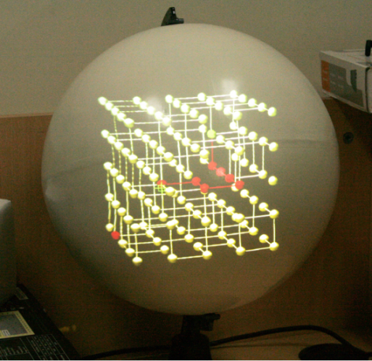
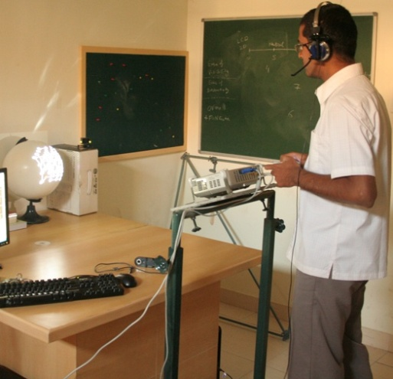
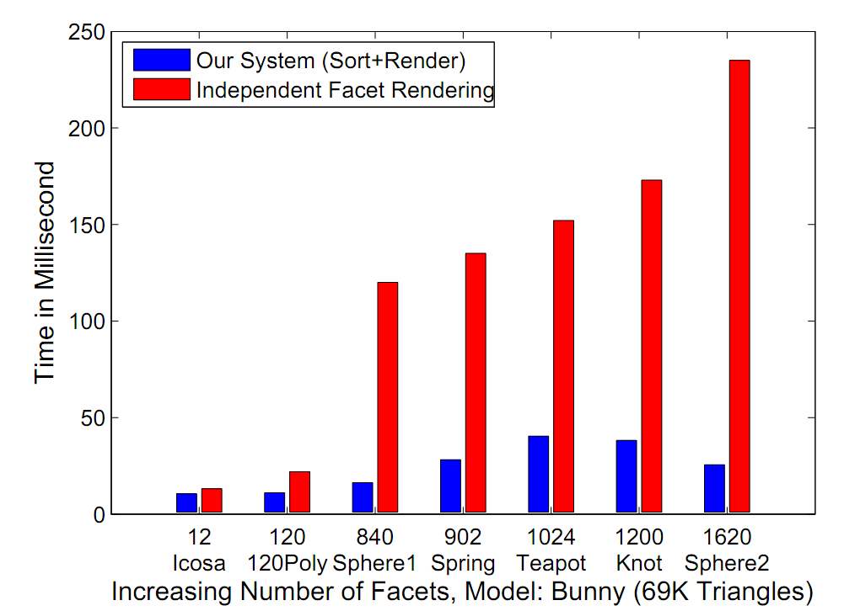
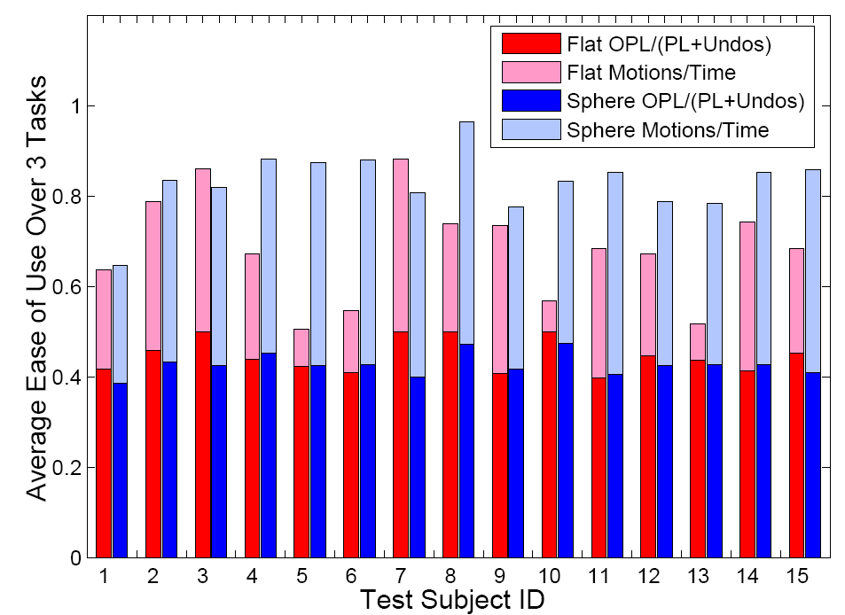
Experimental Evaluation
Spherical display shows better interaction as opposed to an LCD
Our system perform nearly 7-10 times faster.

Slide 18
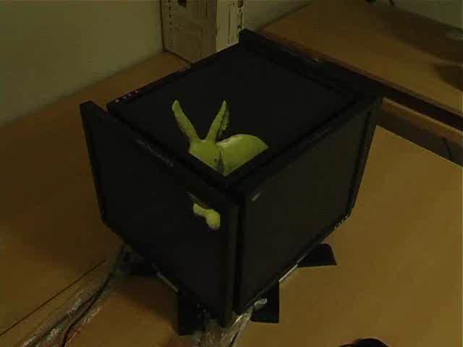
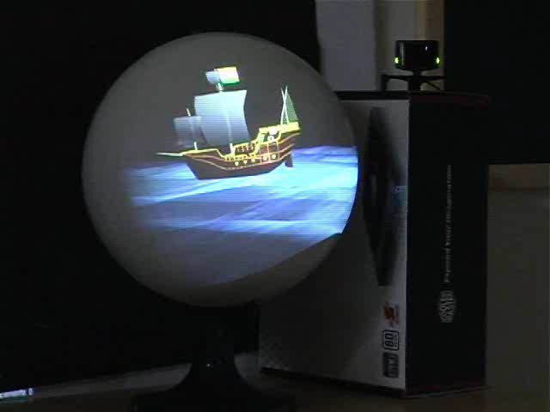
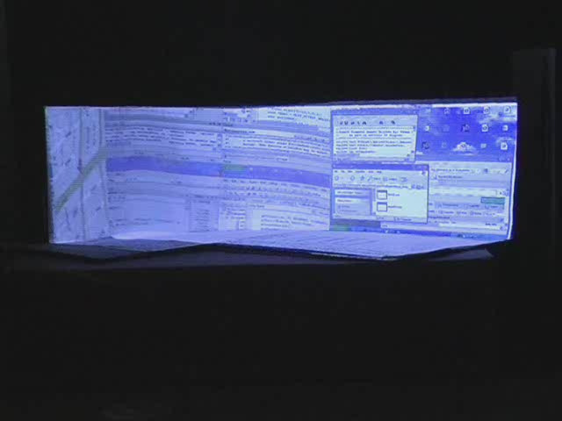
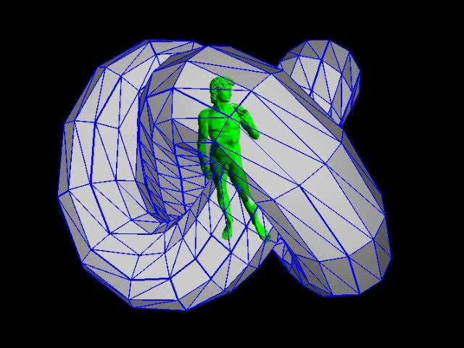
Display Prototypes

Slide 19
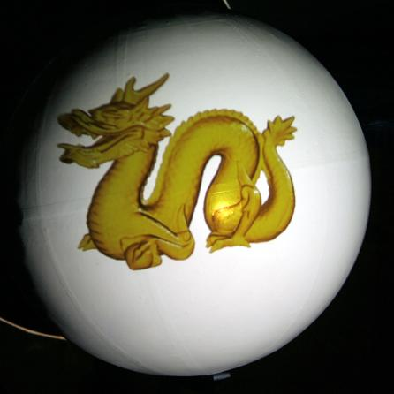
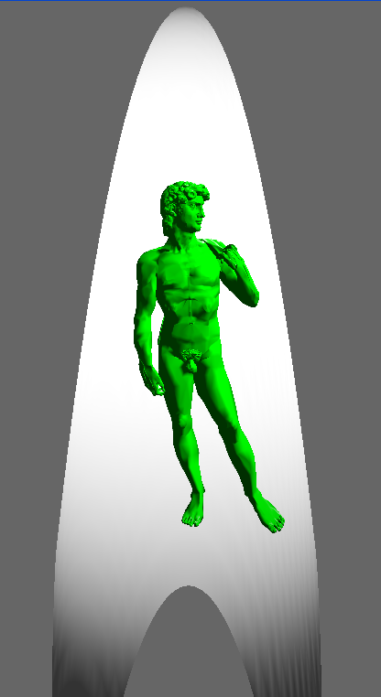
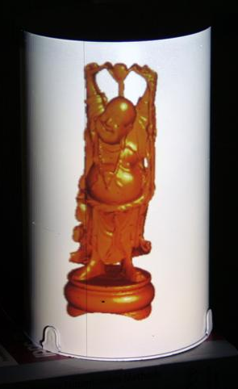
View Dependent Parametric Displays
Pawan Harish and P. J. Narayanan
Joint Virtual Reality Conference of EuroVG-EGVE, 2011

Slide 20
Approach and Problems
Tracked Viewer
Camera
Virtual Plane
Wrapped Texture
Display Parametric form
Fixed Texture Coordinates

Slide 21
As a Computational Display
User Input
PARAMETRIC DISPLAY AS A COMPUTATIONAL DISPLAY
IMAGE GENERATION ALGORITHMS
Per Vertex ray casting to adjust individual vertices on the base texture
Non- Conventional Display, sphere etc., emulated using Conventional Technologies - LCD. Projectors.
Standard Content
Parallel
per-triangle geodesic distance computation and subdivision
Un wrapping the base texture image to display geometry
User
Sub-Image Generation
Prior Knowledge
(Mapping)
Sub-Image Generation
Physical Processes Involved: Viewer’s head position, Display W.R.T viewer, display surface equation and texture coordinates
Algorithmic Modifications: Fully Parallel, Vertex and Triangle processing on S.M. 5.0.

Slide 22

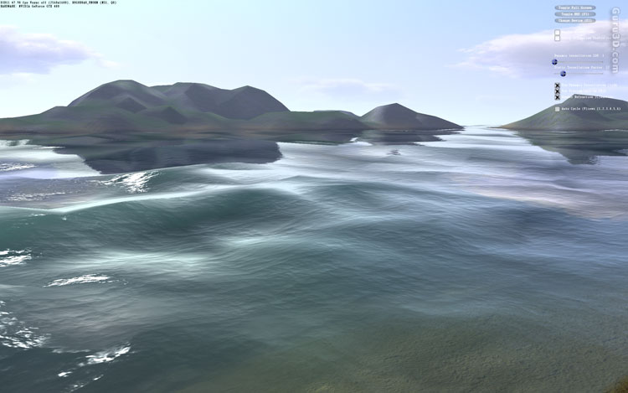
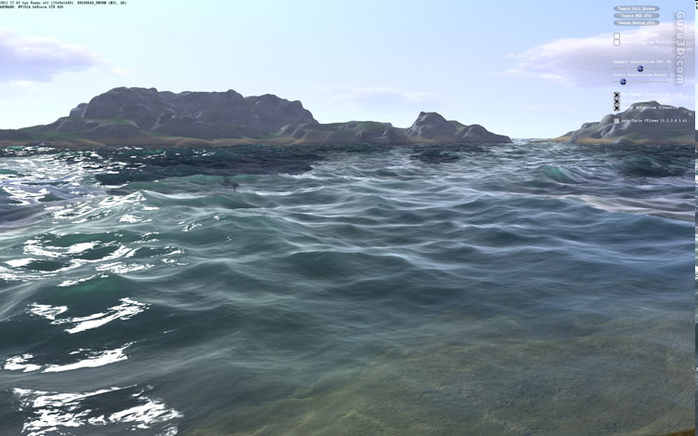
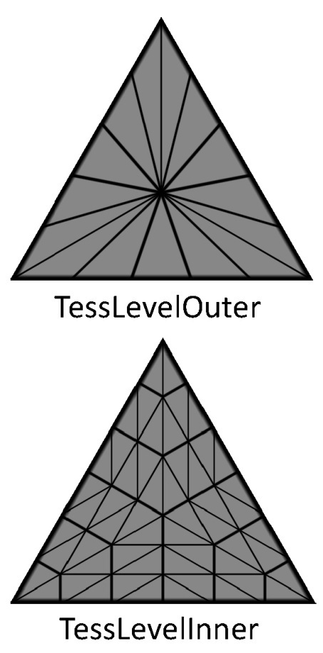
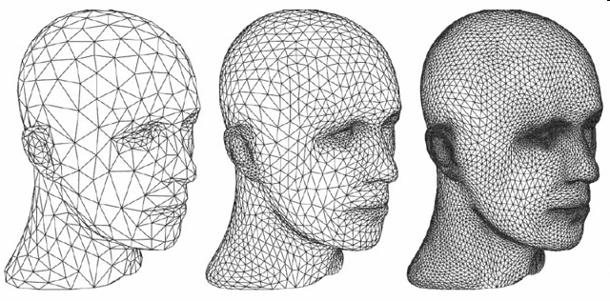
Background: SM 5.0 And DX 11
DirectX 11 and Shader Model 5.0 Tessellation hardware can be used to generate triangles. We use this to approximate Non Linear Rasterization.

Slide 23
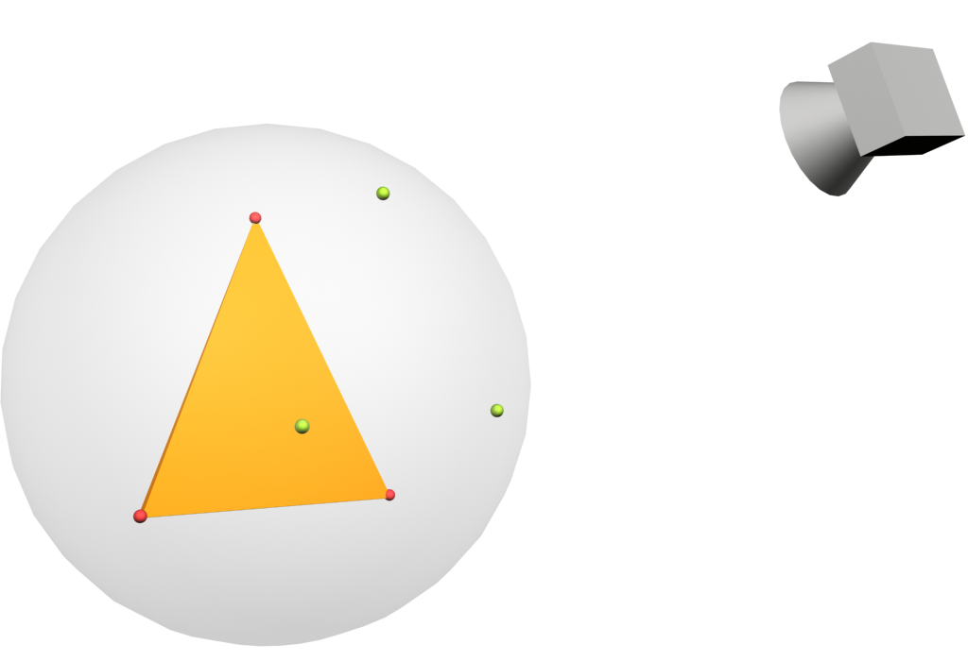

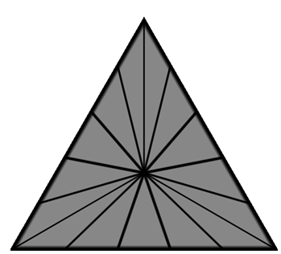
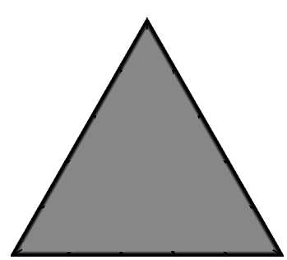
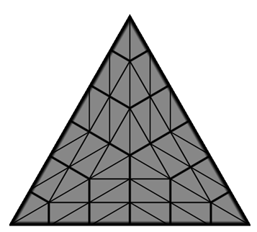
Simulating Non-Linear Rasterization on DX11 Hardware
Set tessellation parameters based in threshold and triangle projection on the surface
  Triangle Projection using per-vertex ray-casting
  Compute geodesic edge length and divide by threshold to get TesslevelOuter parameter
  Set TesslevelInner as Max(TesslevelOuter[1:3])
4. Set TesslevelInner as Maximum of TesslevelOuter
2. Compute Geodesic Edge Length – We use Great Circle Distance for Sphere
3. Divide Edge length by threshold and set TessleveOuter
1. Project Triangle Vertices using per vertex Ray Casting

Slide 24
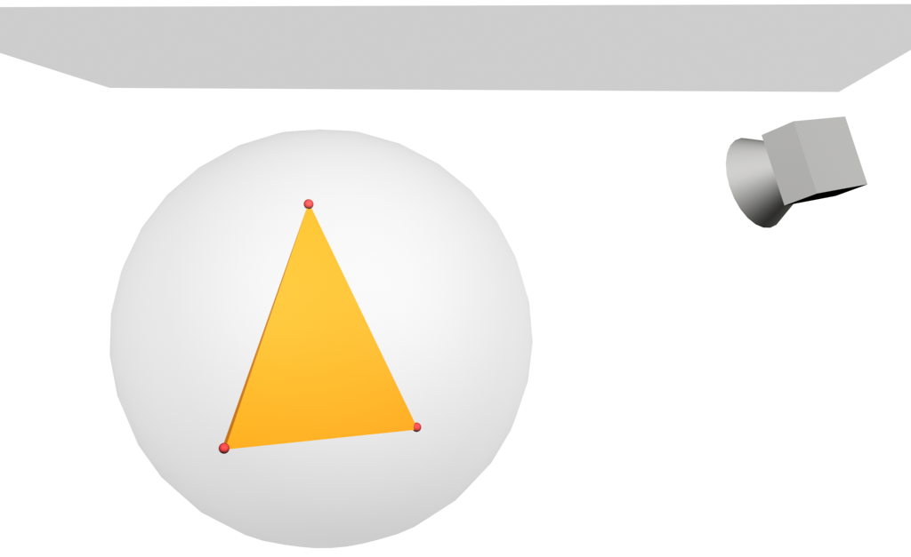
Simulating Non-Linear Rasterization on DX11 Hardware
Modify mesh based on inverse mapping from surface to the base texture image.
  Project newly formed vertices using per-vertex ray casting
  Unwrap the intersection point using inverse mapping
  Move vertices in the base texture space to compensate for display curvature
Base Texture
4. Propagate the motion to the world space
5. Rasterize the modified mesh to generate base texture
1. Project newly formed triangles
2. Unwrap the intersection points using mapping
3. Move vertices in (s,t) to compensate for curvature

Slide 25

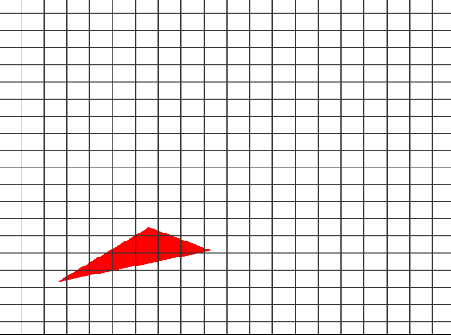
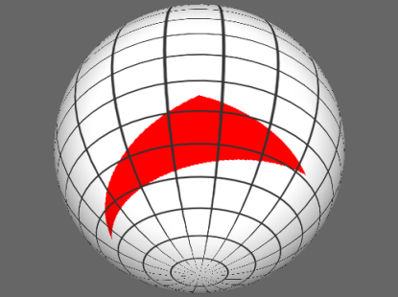




Visual Effect : Simulated and Real
Without Tessellation
With Tessellation
Without Tessellation
With Tessellation
  This method is nearly 20 times faster as compared to multi-planar approach

Slide 26




Display Prototypes

Slide 27




Spatio Temporal Mixing to Increase Intensity Resolution
Pawan Harish, Parikshit Sakurikar, P. J. Narayanan.
1. Indian Conference on Computer Vision, Graphics and Image Processing, 2012
2. CVPR Workshop on Computational Cameras and Displays, 2012
3. Microsoft TechVista ,2013
Our Mehtod
Input Image
Our Mehtod
Input Image

Slide 28
Goal And Approach
Goal:
  Increasing color resolution, possibly adding more bits to the already present color on a display.
  Simple example: showing grey value on a display by flipping black and white colors
Approach:
  We can assume human eye cannot see beyond 30Hz
  With high vertical refresh rate of 120Hz, we can show two 60Hz images and mix the colors in viewer eye.
  This can show a gery pixel on a black and white display adding 1 addtional bit to the existing display.
  Similarly can be done in spatial domain as well
  Extending Dithering and Halftoning to dynamic medium

Slide 29
As a Computational Display
User Input
SPATIO TEMPORAL MIXING AS A COMPUTATIONAL DISPLAY
IMAGE GENERATION ALGORITHMS
Compute sub images or sub pixels for the input image per pixel in parallel based on local attributes. Compute in real time for videos.
Show sub images or sub-pixels by synchronizing with the display clock. Apply temporal and spatial components
Arrange sub pixles or sub images in temporal or spatial manner to produce in-between-intensities.
Standard Content
Pre-Compute the Intensity map in parallel
User
Prior Knowledge
(Mapping)
Physical Processes Involved: Response of the eye with spatially and temporally varying intensities (HVS). Intensities generated by the display (Display Model)
Algorithmic Modifications: Directly Parallel design with a small amount of pre-processing.

Slide 30

Background: HVS and CRT Models
Human Visual System:
  From a distance, spatial arrangement of pixels produces an average intensity.
  Temporally, the visual system can resolve 10 to 12 images per second.
  Spatial and temporal perception is non-separable.
  Perceivable intensity values for a given luminance is represented by just noticeable difference (JND) steps.
The CRT Model:
  Based on the observable values, F(d), and the predicted values T(d) .
  A well accepted model for CRT behavior is the gamma correction model
Excitation Curve
for k^{th} cycle
Luminescent Intensity
Decay Curve for (k-1)^{th} cycle
Time

Slide 31

Decomposing High Bit Intensity Into Lower Bit Intensities
The minimum and maximum values of the input image scale (10-bit) maps to the minimum and maximum of the display scale (8-bit) in the high-bit scale map to a sum of lower bit intensities by incrementally increasing one intensity per sub-image as shown in the table.

Slide 32

Temoral Mixing
Single Frame
Time
We sacrifice vertical refresh rate to gain intensity resolution in this approach. We can divide refreesh into any number of sub-images such that the average of these sub-images produce an intensity not available in the actual display when flipped temporally.
Spatial Component : Consider, the entire screen filled with a single intensity value. Then if all pixels are allotted the same sub-image sequence, the entire screen will change simultaneously resulting in a noticeable flipping artifact.
Temporal Average
Display Clock
The average of sub-image pixel values is perceived by the viewer
1
4
3
Sub Images
2
1

Slide 33
Spatial Mixing
1
2
Each pixel may map to a window of 2x2, 3x3 etc. such that the eye may not perceive individual sub-pixels, but treat the group as a single pixel with average of all sub-pixel intensities. When viewed from a distance these sub-pixels average into a single new intensity not available on the base display.
Temopral Component : Temporal mixing help better perceive the average intensity per super-pixel and also differentiates its identity from its neighbors. This is done by rotating the sub-pixel intensities by one for each display clock cycle.
3
4
Temporal Component To Spatial Mixing

Slide 34
Spatio Temporal Mixing
Display Clock
High bit Sub Images
Each sub-image is 2-bit less than the input image.
4
3
Sub-images are decomposed spatially and flipped temporally to average their intensities
2
1
Combine both approaches into a single system with weightage given to spatial and temporal components.
Can add a maximum of 4 more bits
HVS cannot differentiate between so many levels as there are more levels than allowable number of JNDs
Camera can see these. Hence can be applied to Vision applications

Slide 35








Experimental Results: Camera
10 bit On 8 bit Directly
10 bit On 8 bit Temporally
10 bit On 8 bit Spatially
Luminance Curves for Spatial and Temporal Methods
Luminance Curve for
Spatio-Temporal Method
11 bit On 8 bit Directly
11 bit On 8 bit
Spatio-Temporally

Slide 36

Experimental Results: Humans
The mean error is a good indicatorfor the human perception of 10-bit images.
For the 10-bit images, we see a mean error of 0:8 bands with standard deviation of 0:76 over all subjects.
Our methods produced a low error and were capable of displaying more intensities to a human observer

Slide 37


Garuda: A scalable tiled display wall using commodity PCs
Nirnimesh, Pawan Harish, P. J. Narayanan
1. IEEE Transactions on Visualization and Computer Graphics, 2007
2. Indian Conference on Computer Vision, Graphics and Image Processing, 2006

Slide 38

The Garuda System
Application
Intercept OpenGL
Distribute
Too many; very low level
Chromium
Scalability Poblems
  To arbitrarily large displays
  To arbitrarily large environment models
  Issues: Network, CPU, Graphics, Software
Both are Easy to use
  Application transparency
  Automatic rendering from a standard API without modifying application.
Deals with “objects” and not primitives
Server handles the whole scene and sends selected objects to the clients
  Low-end clients, commodity network, high-end server, distributed rendering. Scales with size.
Caching exploits temporal coherence

Slide 39
As a Computational Display
User Input
GARUDA AS A COMPUTATIONAL DISPLAY
IMAGE GENERATION ALGORITHMS
Client renders its own image based on data received from server
Client Display per Tile – LCD, CRT, projector
Standard Content
Server Culls the scene and transmits the data to clients
Sub-Image Generation
Conventional Display
Physical arrangement of client tiles withing the display wall
User
Sub-Image Generation
Conventional Display
Prior Knowledge
(Mapping)
Sub-Image Generation
Conventional Display
Physical Processes Involved: The location of each client within the larger display is known based on which culling takes place.
Algorithmic Modifications: Serial Culling. Parallel Rendering and Serial Sync results in Distributed rendering.

Slide 40

Data Transmission and Rendering
Server:
  Send visible object list to each client
  Serialize OSG nodes of new objects and send to each client
Client:
  Assemble partial scene graph; cache objects
  Remove objects from cache if full using LRU
Tile-clients start rendering as soon as all objects available
Clients inform server Ready-to-Swap after rendering.
Server asks all clients to swap after all clients inform readiness.
Results in synchronized rendering and minimal display tearing.

Slide 41


Transparent Rendering and Pipelining
No modification to the user’s program. Application isn’t aware it is rendering to a tile.
Makes tiled rendering available to many applications.
All stages of the OSG program are internally pipelined

Slide 42


Experimental Evaluation: Scalability
Increasing the size increases rendering speed due to distributed rendering of the system
Better client hardware, 6600GT, produce 10 times better results

Slide 43




The 4x5, 16M pixel display wall

Slide 44

Conclusions And Future Tangents
Don’t get confused by the Maze

Slide 45





Conclusions
High
(Medium, High)
(High, High)
The hypothesis we considered in this thesis was applied to various unrelated problems in display design.
In each, we applied the same framework to come to a problem-specific design.
We explored one niche of the computational displays landscape, one where computation is heavily used in conjunction with simple physical processes.
Spatio Temporal Mixing
MultiPlanar Displays
Physical Pocess Complexity
(High, Medium)
(Medium, Medium)
Garuda Display Wall
Parametric Displays
Computational Complexity
High
The ideas we explore in this thesis can be extended on to hardware modifications involving optics, mechanical and metallurgical elements. The underlying design, however, should always respect the role of computation and what can be achieved with it when used intelligently.

Slide 46
Future Areas to Explore
The set of problems explored in this thesis are by no means an exhaustive study of the framework we propose.
They do, however, underline a common theme amongst radically different requirements.
Future work can directly use the computational display framework to explore various other problems in this landscape including:
  Increasing the vertical refresh rate of a display.
  Increasing spatial resolution using multiple display elements.
  Interactive experiences on single or multiple displays.
  Touch and interactive gestures on non-planar displays, etc.

Slide 47
Thank You for staying this far ☺
Questions?
Related Publications:
Journal Papers
1. "Designing Prespectively-Correct MultiPlanar Displays", by Pawan Harish and P. J. Narayanan, in IEEE Transactions on Visualization and Computer Graphics, Volume 99, (TVCG) 2012.
2. "Garuda: A Scalable Tiled Display Wall using Commodity PCs", by Nirnimesh, Pawan Harish and P. J. Narayanan, in IEEE Transactions on Visualization and Computer Graphics, (TVCG) 2007. Vol 13, No.5, Pages 864-877, Sep/Oct 2007.
Conference Papers
1. "Increasing Intensity Resolution on a Single Display using Spatio-Temporal Mixing", by Pawan Harish, Parikshit Sakurikar and P. J. Narayanan, in Indian Conference on Computer Vision, Graphics and Image Processing, (ICVGIP) 2012.
2. "View Dependent Rendering to Simple Parametric Display Surfaces" (Short Paper), by Pawan Harish and P. J. Narayanan, in EUROGRAPHICS Joint Virtual Reality Conference of EuroVR-EGVE, (JVRC) 2011. Pages 27-30.
3. "A View Dependent, Polyhedral 3D Display", by Pawan Harish and P. J. Narayanan, in ACM SIGGRAPH Virtual Reality Continuum and its Applications in Industry, (VRCAI) 2009. Pages 71-75.
4. "Culling an Object Hierarchy to a Frustum Hierarchy", by Nirnimesh, Pawan Harish and P. J. Narayanan, in Indian Conference on Vision, Graphics and Image Processing, (ICVGIP) 2006. LNCS 4338, Pages 252-263.
WorkShop Posters
1. "Spatio-Temporal Mixing to Increase Intensity Resolution on a Single Display", by Pawan Harish, Parikshit Sakurikar and P. J. Narayanan, in CVPR Workshop on Computational Cameras and Displays, (CVPRW CCD) 2012.

Slide 48
Changes Made in the Thesis based on Reviewer’s Comments
Merged chapters 1 and 2 into a single chapter to improve readability of the thesis
The conclusions chapter is revised by reiterating the thesis contributions along with more detailed description of the future work.
A visual representation of effect of tessellation is presented in terms of images to better explain its impact.
Chapter 3, Algorithm 6 is now better explained in order for it to be easily implementable
Simulated displays are better explained with processes explaining on how the images are generated, mapped and observed by the user

