Slide 1
Automated Retinal Image Analysis for the detection of Glaucoma
1
Gopal Datt Joshi
Supervisor: Prof. Jayanthi Sivaswamy
Centre for Visual Information Technology (CVIT)
IIIT- Hyderabad

Slide 2
Screening for Glaucoma
2
Glaucoma is a sight-threatening, chronic, optic neuropathy
asymptomatic nature and irreversible blindness
common cause of blindness in India and the world
Screening of people at the risk of glaucoma is crucial to prevent irreversible vision loss
Digital retinal imaging offers effective screening alternatives to manual screening
Our goal is to investigate the potential of an automated pre-screening solution for glaucoma using colour retinal images
can be a most effective screening methodology
Notes:
Chronic: 1. Of long duration; continuing; 2. Lasting for a long period of time or marked by frequent recurrence
Neuropathy: a disease of the eye, characterized by dysfunction or destruction of the optic nerve tissues. The disorder, which can lead to blindness, usually affects only one eye.

Slide 3
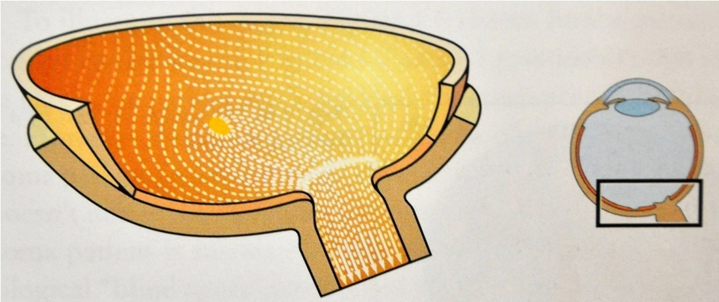
Medical Background
3
In glaucoma, the nerve cells and nerve fibers die progressively
thus the connection between eye and brain is gradually severed
Optic nerve head (optic disk)
Spatial distribution of nerve fibers in retina*
* Source: Flammer, J.. Glaucoma: A guide for patients: An introduction for care-providers; a quick reference. Hogrefe and Huber Publ, Bern, Gottingen, Toronto, Seattle 2006;.

Slide 4
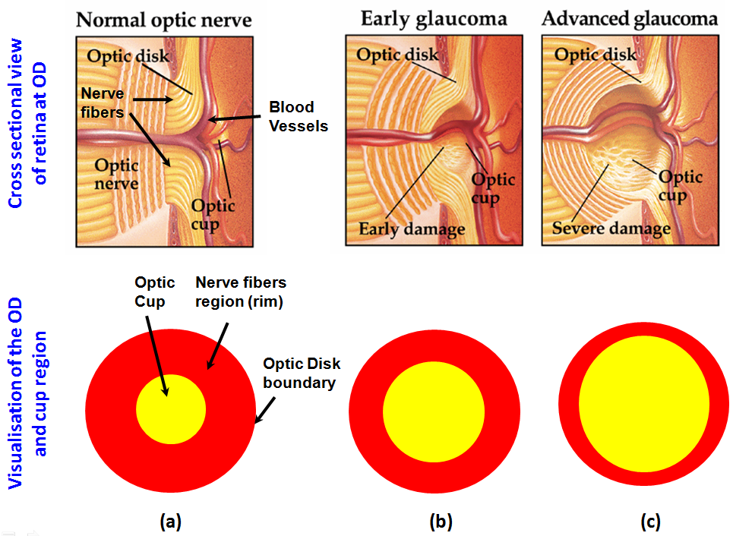
4
The loss in the nerve fibers is particularly apparent at the optic disk (OD)
Cupping: enlargement of cup region in glaucomatous damage
Notes:
Mention about the rim region as well. In term of computational task: we need to identify the optic disk and cup boundary in order to quantify the rim size or amount of retinal nerve fibers loss accordingly to detect glaucomatous demage.

Slide 5
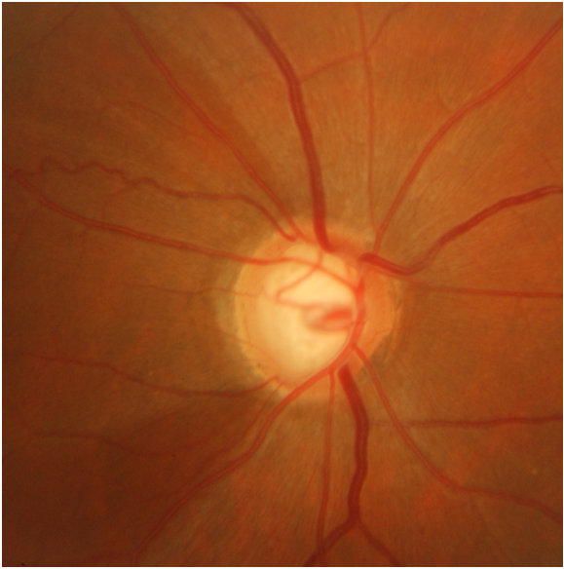
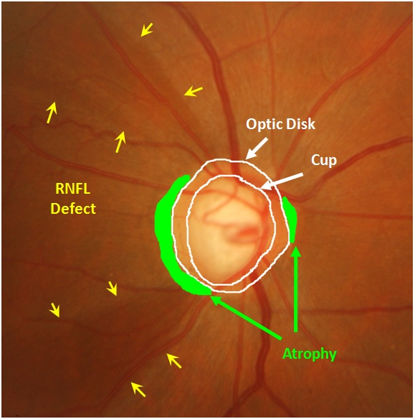
Glaucoma Indicators
5
Example Image
Annotated structures & Indicators
Intra-OD: certain types of deformation in the optic disk (OD) shape and its composition referred as “cupping”.
Peripheral-OD: presence of Peri-papillary Atrophy (PPA) and Retinal Nerve Fiber Layer (RNFL) defect
Notes:
Objective: Detection of individual indicators and integrating findings (evidences)

Slide 6
Related Work
6
Considerable body of existing work focuses on the problem of segmenting OD and cup regions from color retinal images.
System for image-level classification as normal vs. glaucoma
* Using statistical image features-based classification
Use of global features
Geometric Features
Jin et al., 2005; Stapor et al., 2006; Mclntyre et al., 2004
Intensity-based Features
Meier et al., 2007; Bock et al., 2007
Global features are not sufficient to encode local OD deformations
Feature extraction is restricted to the disk region
Notes:
Handling inter-image variation is one of the challenge
Encoding local deformations in glaucomatous changes is difficult to encode by the global features
Limited to the intra-OD region (does not explore the role of peri-papillary indicators)

Slide 7
Thesis Objectives
7
Carry out robust analysis of both intra and peripheral OD indicators
Intra- OD
certain types of deformation in the OD shape and its composition
Peripheral-OD
presence of PPA and RNFL defect
Classify glaucoma by integrating analysis results
Collect data and ground truth to evaluate developed solutions

Slide 8
Outline
8
Optic disk segmentation
Challenges
State of art
Proposed approach
Cup segmentation
Monocular images
Multi-view images
PPA and RNFL detection
Image-level glaucoma classification

Slide 9
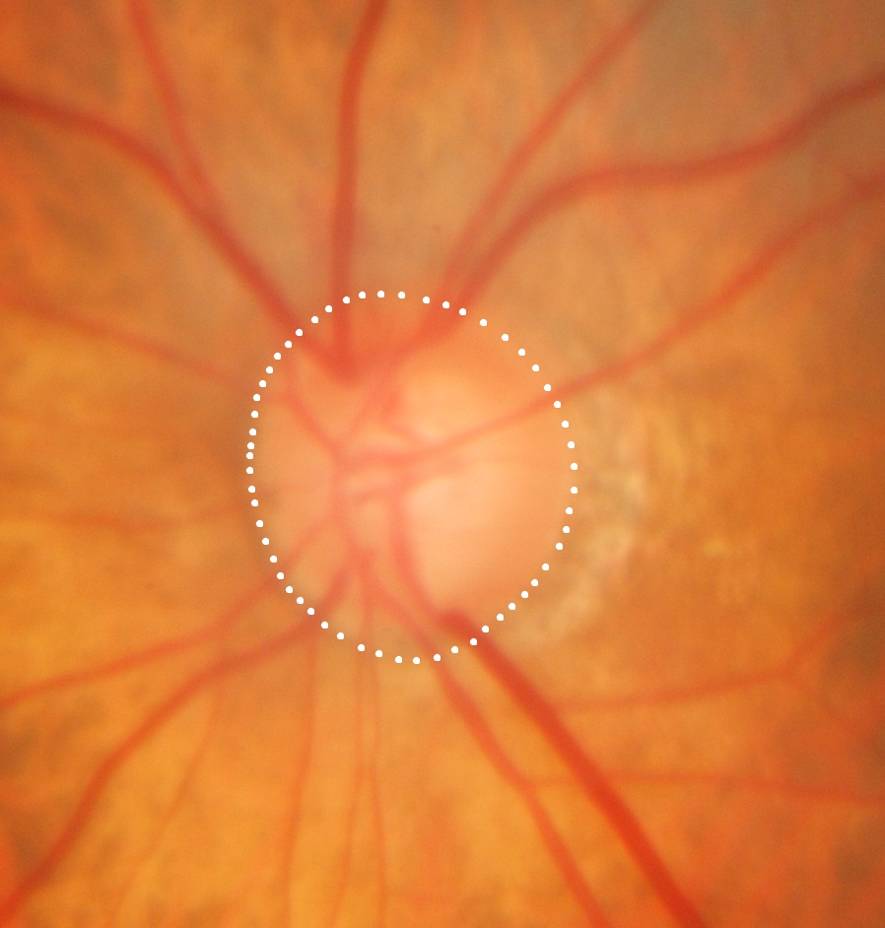
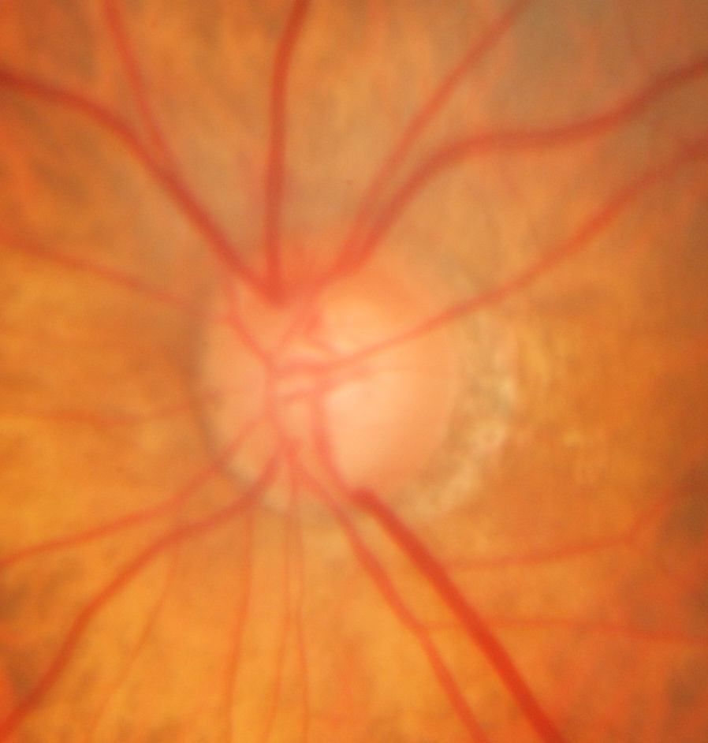
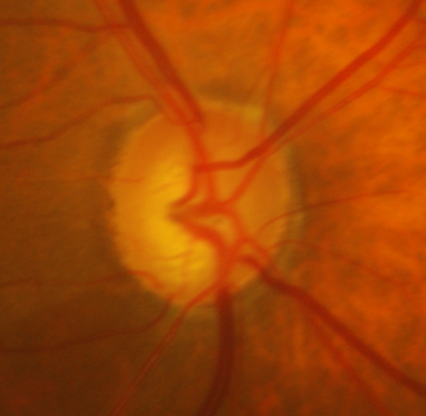
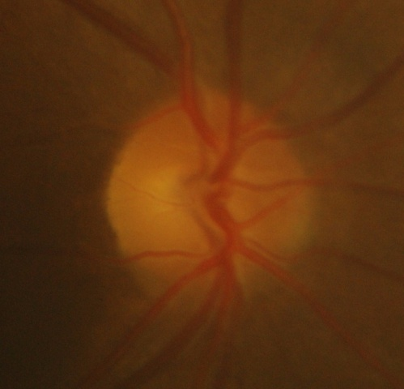
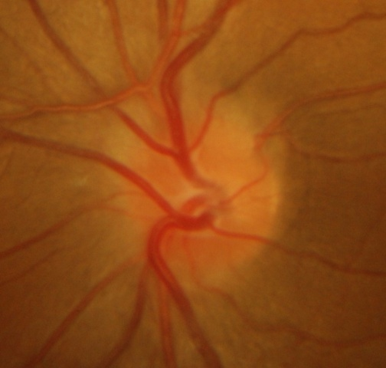
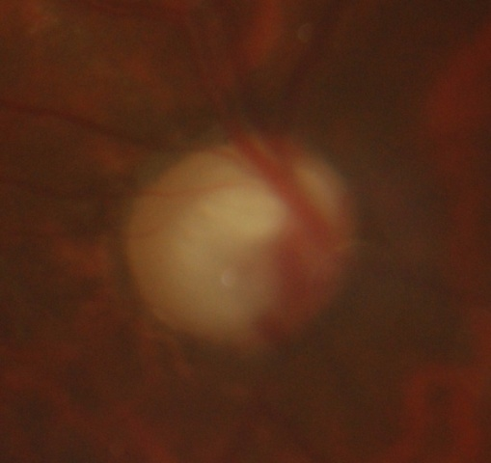
Challenges
9
Irregular disk shape
Blood vessel occlusions
Ill defined boundaries
Atrophy presence
regions around OD with similar image characteristics
Inter and intra image variations
Smooth region transition
Vessels
Atrophy
region
Optic disk boundary
Notes:
Use visual used in the paper to explain depict challenges with the problem. Left side do animations and on the right side keep on adding corresponding name.

Slide 10
OD Segmentation State of the Art
10
Template Matching
early attempts
fails in handling various OD shapes
fixed shape assumption
Gradient-based Active Contour
extensively explored
sensitive to local gradients
arise due to blood vessels & inter-image intensity changes
sensitive to contour initialization
Region-based Active Contour: Chan-Vese (C-V) Model
Advantages:
lower sensitivity to contour initialization and noise
feasibility of segmentation even in the absence of gradient-defined boundaries

Slide 11
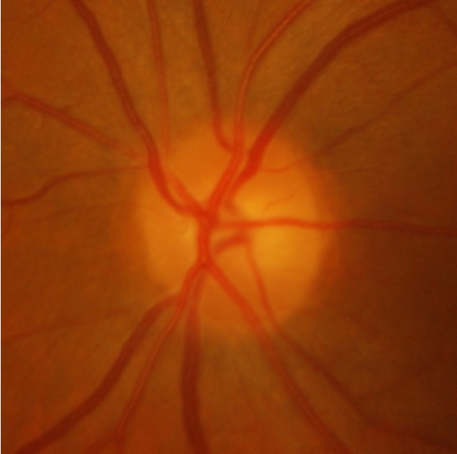
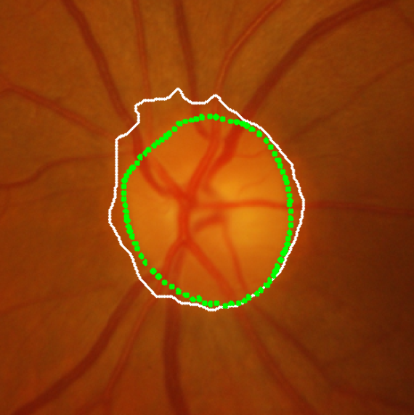
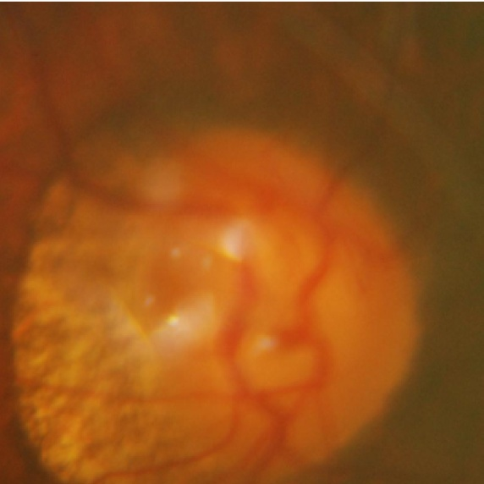
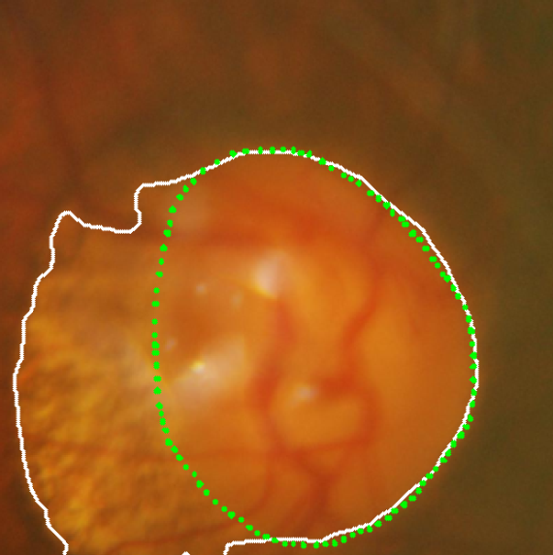
C-V model: Limitations
11
Example of smooth region transition
Assumption
Image consists of statistically homogeneous regions
Leads to poor performance on inhomogeneous objects
C-V model
expert
Example of high atrophy

Slide 12
Our Proposal
12
Improve the C-V model by using
Local instead of global statistics
to extend the scope of the model
Information from multiple feature channels
to bring robustness against distraction near OD region
Notes:
This slide can be deleted and directly move explainig CV model.

Slide 13



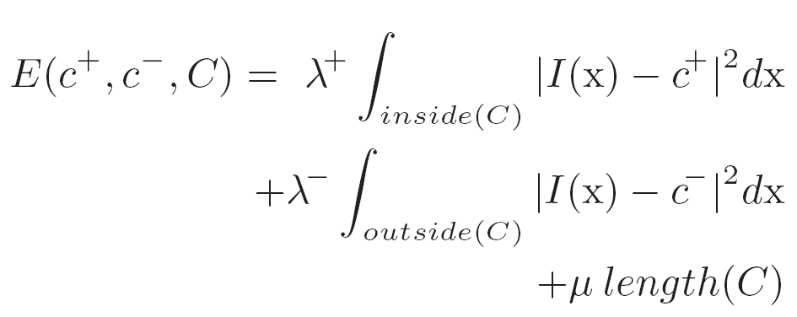
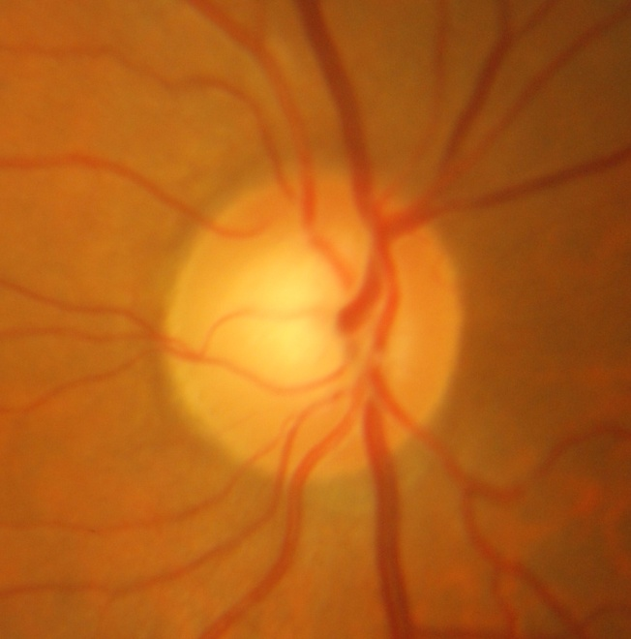
Original Chan Vese (C-V) Model
13
Consider a vector valued image where
in the image domain
The C-V model defines the energy functional as:
contour ‘C’
outside
inside
c+ and c- are two constants to approximate the image intensity inside and outside of the contour C.
λ and µ are weights for the fitting and the regularizing terms, respectively
Notes:
Mumford-Shah functional: find a abstract format to explain the math..

Slide 14
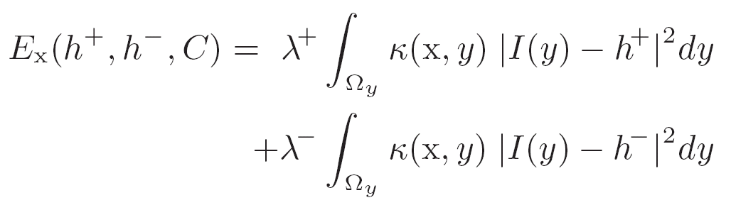

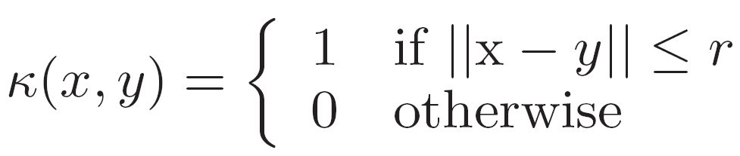
Localising the Energy Functional
14
outside
region
The redefined energy for a point ‘x’
where, h⁺ and h⁻ are two constants that approximate region intensities inside and outside a contour, near the point x
defines a local image domain around a point x with in the radius of r
inside
region
x and y denotes two points in the image I.
This energy is minimum when a point is exactly on the boundary
Notes:
The local function ensure that values of h is only influence by the image information within the local domain
This helps in capturing local boundaries which get missed by a C-V model due to small difference in the global statistics of interior and exterior region of the contour

Slide 15


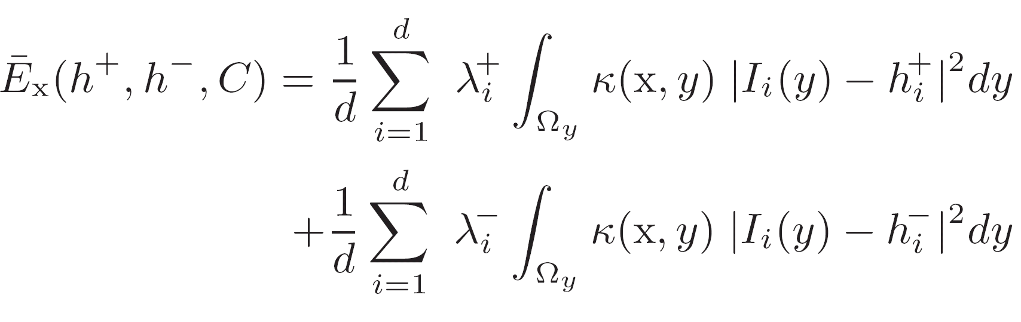

Integration over Multi-feature Channels
15
outside
Integration of information from multiple feature channels is done as:
inside
Notes:
This integration yields a better discriminating representation of image regions and make the proposed model robust to the distractions found near the OD boundaries

Slide 16
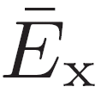
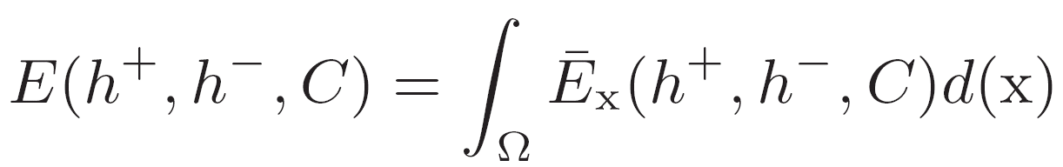
Energy minimisation over all Points
16
The integral of over all points ‘x’ is minimised to obtain entire object boundary, defined as:
An equivalent level-set formulation is defined for curve evolution*
* Refer to the article for the details of level-set formulation.

Slide 17
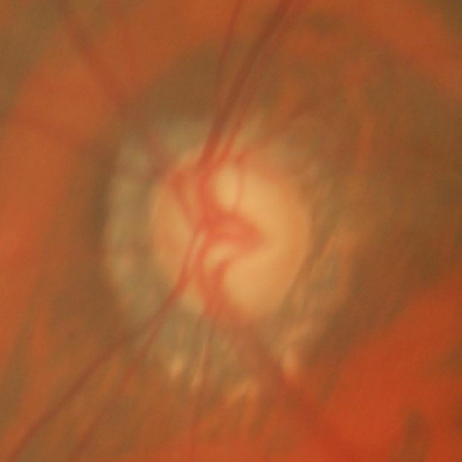
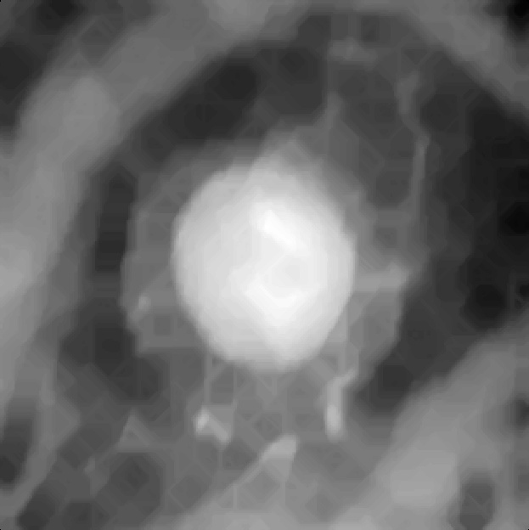
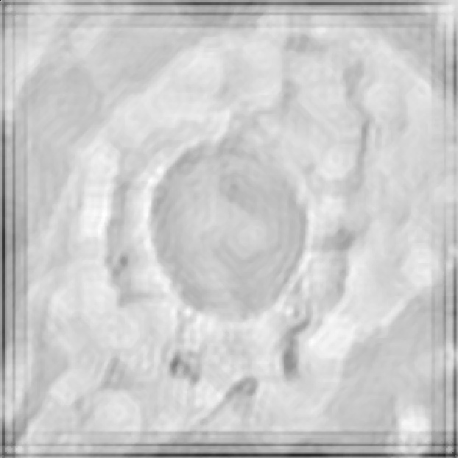
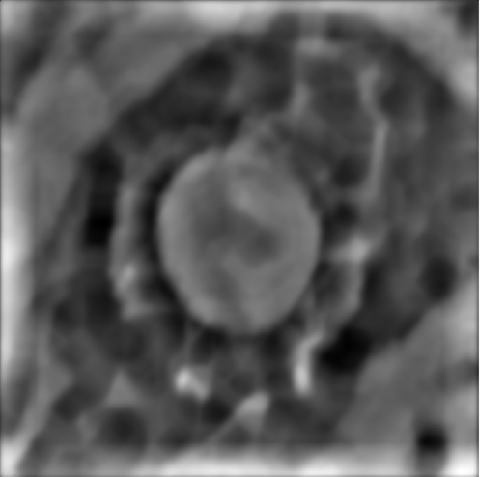



17
Original Colour Image
Red colour space
gives a better discriminative representation of image regions
makes the model robust to distractions near the OD boundaries
Texture Space- 2
Texture Space- 1
Notes:
Get ready a list of texture features attempted .. And get the equation of used filters handy and also a good justification why they are giving good results at boundary.

Slide 18
Experiments
18
Dataset: 138 images of size (2896 x 1944 pixels)
collected from Aravind Eye Hospital, Madurai
Ground Truth: from 3 eye experts
an average OD boundary is derived to compensate for inter-observer variability
Comparison:
With two known active contour models
Basic C-V model
Gradient vector flow (GVF)
Contour initialisation and pre-processing are kept same

Slide 19
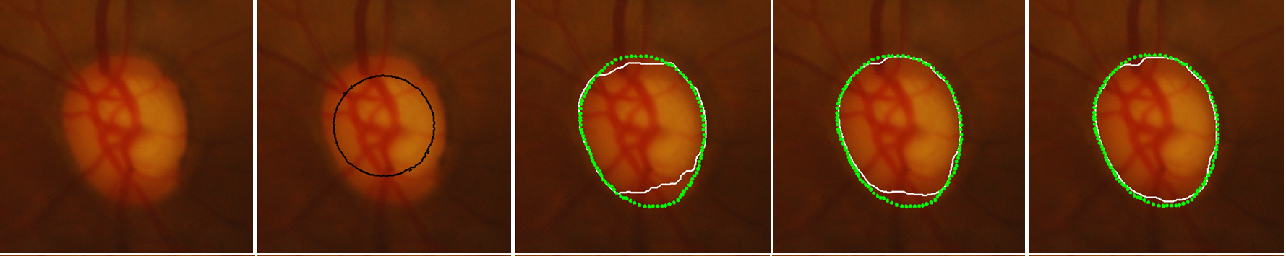
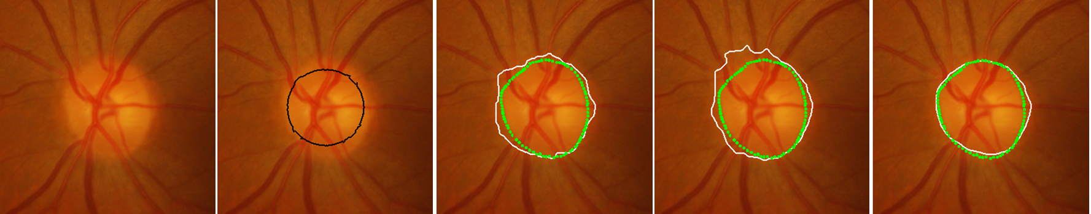
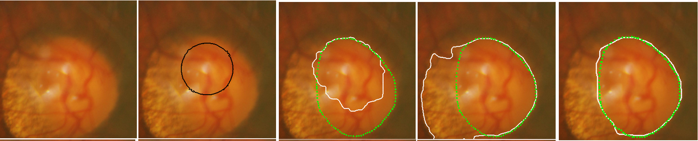
Results
19
Input
Initialisation
GVF
C-V model
Proposed model
Expert Marking
Method’s Result
Notes:
Contour Initialization and pre-processing are kept same for all methods. Took structural level marking on 138 images.
Second Row: Slowly varying gradient boundary (due to local nature, able to avoid over-segmentation)
Third Row: High Atrophy case (due to multiple feature channels able to avoid expansion to the atrophy regions )

Slide 20
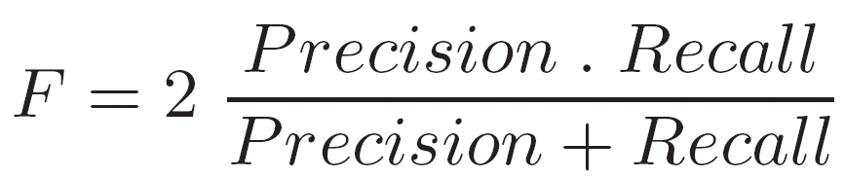
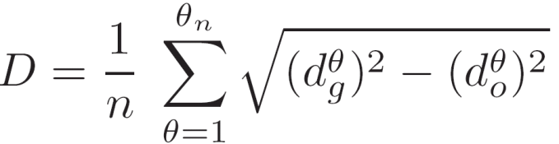

Evaluation Metrics
20
Region-based: pixel wise segmentation accuracy
Boundary-based: boundary localisation accuracy
Let Cg be the boundary marked by the expert and Co be the boundary obtained by the method
Notes:
F is harmonic mean of precision and recall. Why not AM and GM. What F-score is going to capture.
Precision= tp/tp+fp and Recall= tp/tp+fn
Here's an intuitive example showing us why the arithmetic mean is not appropriate. Suppose we are datamining a setting where there are 1% positive examples (and we care about the positive examples). Consider the following two models:
Baseline (blindly predicts all positive): precision of 1%, and recall of 100% Trained (learns to predicts a few positive): precision of 50%, and recall of 20%.
Then the arithmetic mean of precision and recall for the two models are 50.5% and 35%, respectively. But I would argue that the trained model is doing something more meaningful than the baseline, so the arithmetic mean does not agree with with my intuition of which model is better.
On the other hand, the F-score of the baseline is close to 0, whereas the F-score of the trained model is about 30%, which does agree.
AM= (x1+x2)/2 and GM= sqrt(x1x2) HM= 2 *x1 *x2/(x1+x2)
I know the geometric mean is useful to average two quantities that have different ranges, but both precision and recall are probabilities, so should make no substantial difference if it was used as opposed to the harmonic mean
The harmonic mean of two numbers is never higher than the geometrical mean. It also tends towards the least number, minimizing the impact of large outliers and maximizing the impact of small ones. The F-measure therefore tends to privilege balanced systems.

Slide 21
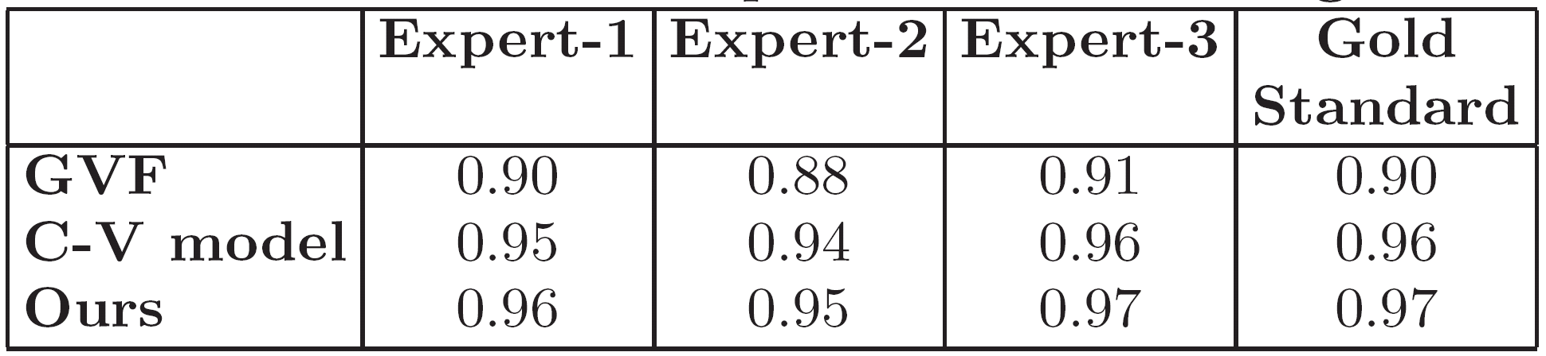
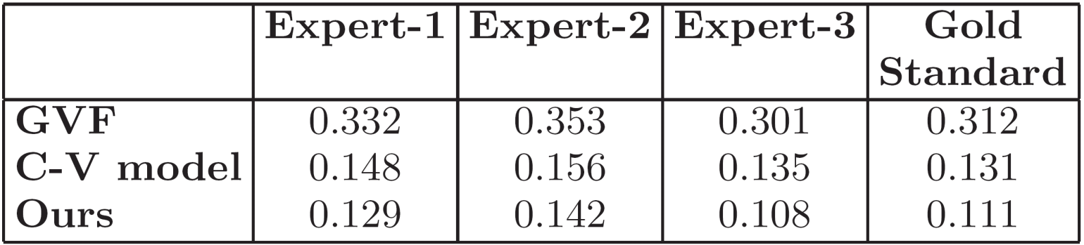
Results on 138 images
21
F-score
Average Boundary Distance
Notes:
State inferences from the tables…

Slide 22
Summary: OD Segmentation
22
The scope of C-V model is extended by localising the energy functional
computational load depends on choice of r
small r ➔ GVF type behaviour; large r➔ C-V type behaviour
Robust active contour model
by integrating multiple image feature channels
Suitable for various OD shapes
no shape prior used

Slide 23
Outline
23
Optic disk segmentation
Challenges
State of art
Proposed approach
Cup segmentation
Monocular images
Multi-view images
PPA and RNFL detection
Image-level glaucoma classification

Slide 24
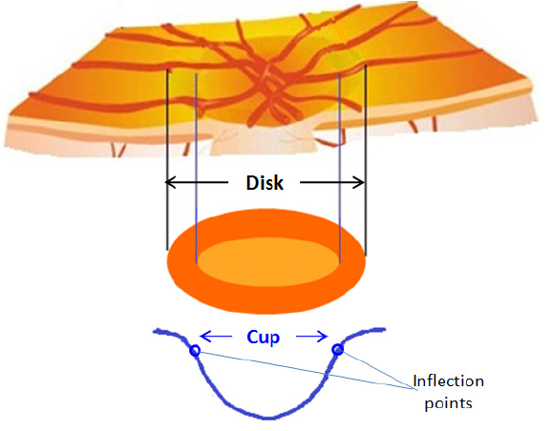
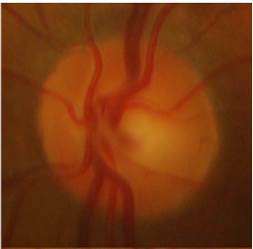
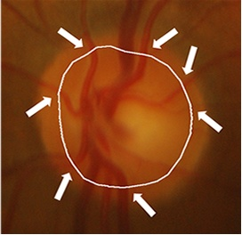
Cup Segmentation: Monocular
24
Challenges
Cup is primarily defined by depth
Cup boundary is not well defined in monocular retinal image
Proposed cup segmentation uses
Appearance: pallor (bright colored) region
Anatomy: vessel bends as depth cues
called as ‘relevant bends’ (r-bends)
Cup boundary through vessel bends
Notes:
The bends of small vessels as they traverse from the disc to the cup, provide a physiological validation for the cup boundary

Slide 25
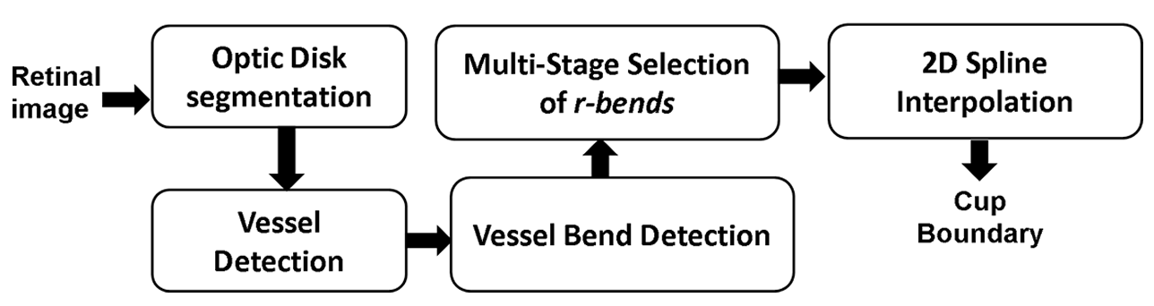
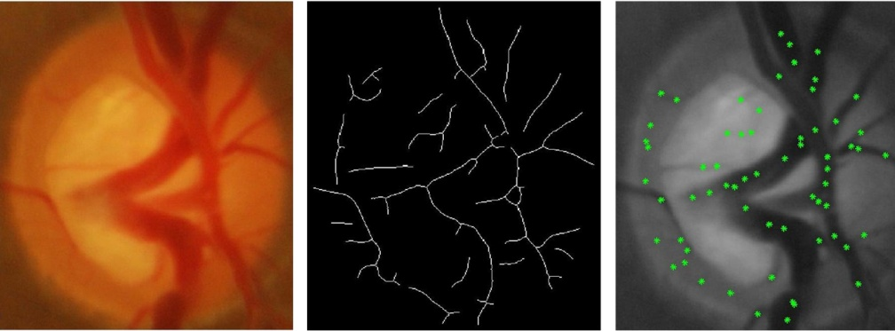
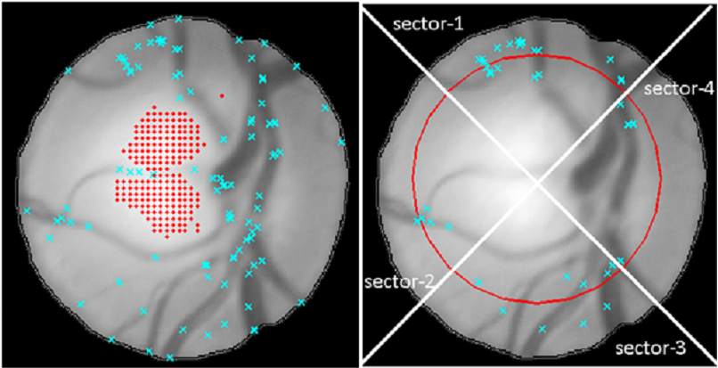
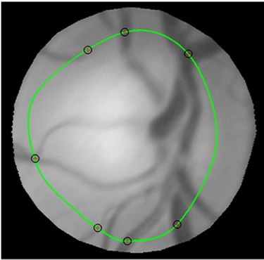
Cup segmentation: Monocular
25
Cropped image
Detected Vessels
Candidate Bends
Multi-stage Selection of r-bends
Final Cup Boundary
Notes:
We choose a local , cubic cardinal spline, which is a generalisation of Catmull-Rom spline, with a shape parameter t. The parameter t helps control the bending behaviour and thus the shape according to the sector. The value of t is kept high in sectors 2&4 as they usually have low vessel density ( r-bends) compared to sector 1&3.

Slide 26
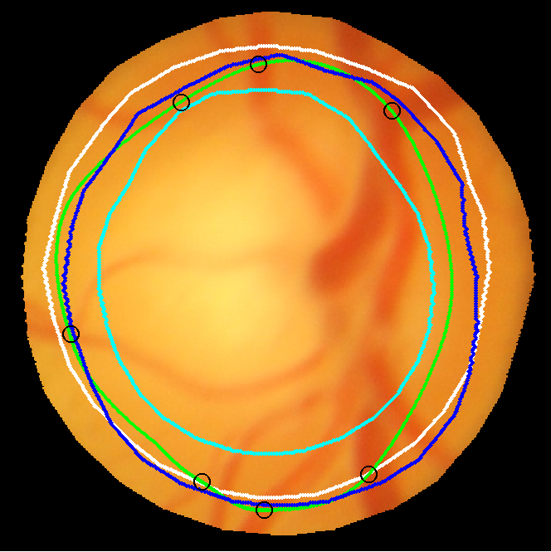
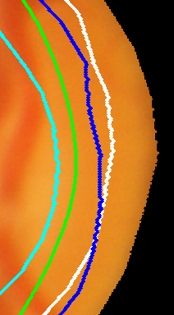
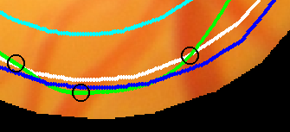
Limitations with Monocular images
26
Consensus on the cup boundary is only at the r-bends
Faculty
Fellow-1
Fellow-2
Method
Inter-observer variability

Slide 27
Alternatives
27
The use of stereo retinal imaging to derive depth information
demands specialized stereo retinal camera
No stereo retinal camera is available in India
high cost of equipment with few clinical usages
For a wider scope of our solution
adopted an ad-hoc procedure to acquire stereo images
multi-view retinal images: sequential acquisition of images by manually varying the position of the monocular camera
Notes:
Motivate: Ad-hoc procedure saying that we could push to get one stereo retinal cemera but deleoped solution will not have any scope in India. Therefore

Slide 28
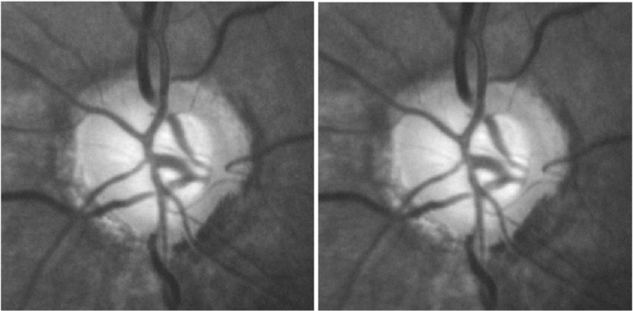
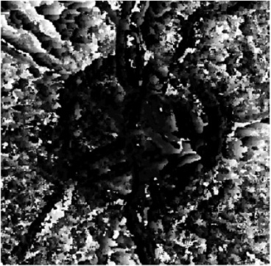
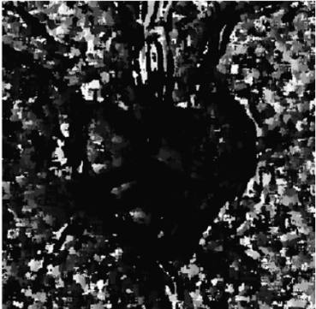
Cup Segmentation: Multi-view Images
28
Challenges
Manual shifting of camera results in inconsistencies in
the degree and direction of stereo separation
the plane of focus and illumination
Anatomical
short baseline imaging through pupil
shallowness of the cup (in mm)
Traditional stereo matching techniques are not applicable to such image pairs
Multi-view image pair
Feature-based
Region-based
Disparity maps
Notes:
Bring motivation from the Indian context of availability of monocular fundus cameras.

Slide 29
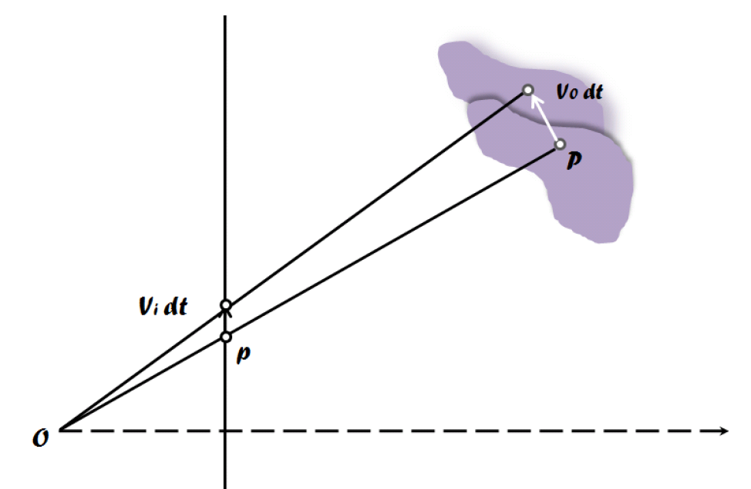
Depth discontinuity at cup boundary
29
Cup region detection is reformulated as cup boundary detection
as boundary is signaled by depth discontinuity
Uses a ‘relative motion’ framework
to derive depth discontinuities
Localisation of depth discontinuities using multiple cues
Discontinuity in motion field
primarily associated with object and depth boundaries
Partial occlusion points
are directly associated with depth discontinuities
Contiguity of discontinuities
spatially contiguous as they arise from objects and their boundaries
Image plane
Displacement of an image point due to relative motion between camera and an object

Slide 30
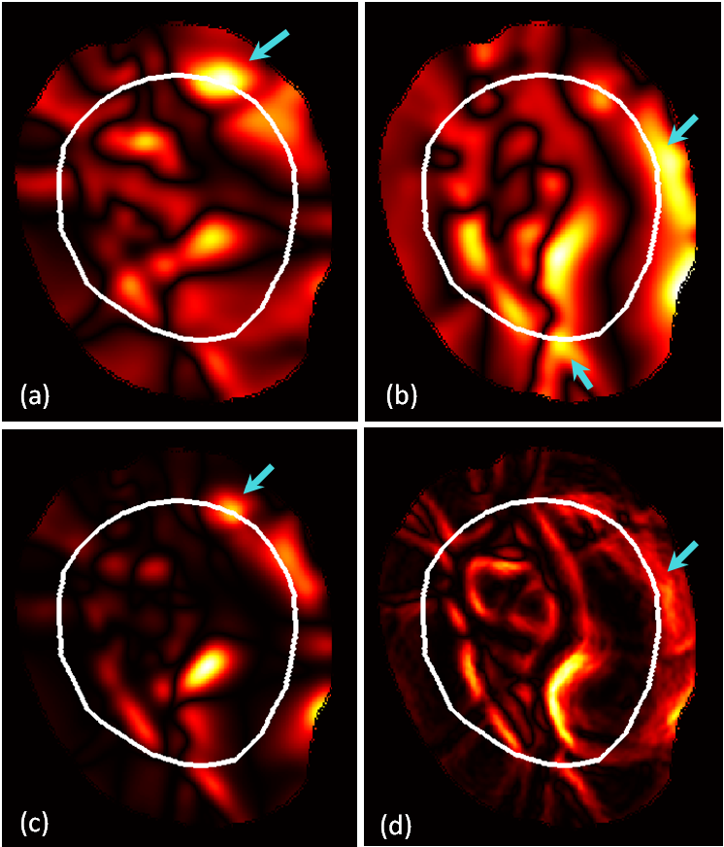
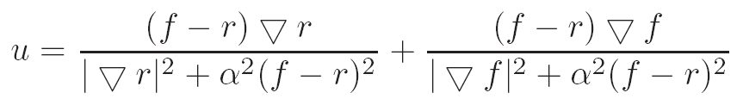
Displacement field: Image Matching between pair images
30
Candidate boundary points are derived from displacement field
Displacement field based on diffuse models
computed between pair images
derived using non-rigid demon registration method
Ux
Uy
Where r and f denotes intensities in reference ‘R’ and floating image ‘F’ and u denotes the displacement field vector.
Uo
Ue (error)
Evidence maps obtained from the computed displacement field between image pair
Notes:
This force was inspired from the optical ﬂow equations, but was renormalized to prevent instabilities for small image gradient values:
Read equation so that you should able to explain each components of it.

Slide 31
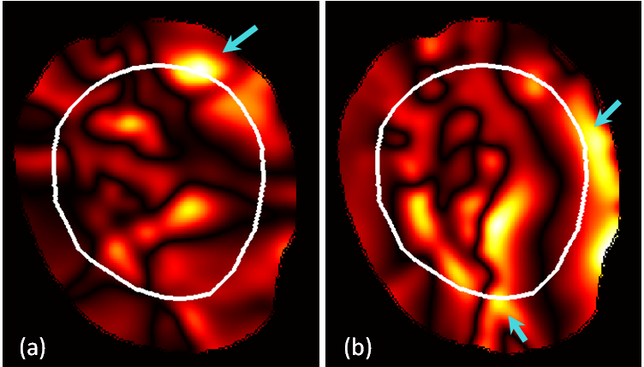
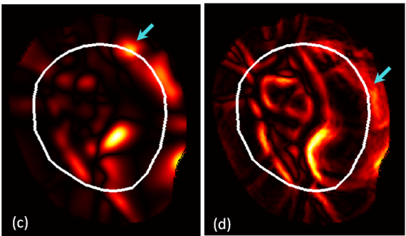


31
Ux
Uy
Uo
em
Evidence Maps
Pruned Binary Evidence Maps
Expert
Estimated Circles
other
Fusion of evidence maps
Fused Evidence map
Radial distribution of intensity
in fused evidence map
Cup boundary representation
using multiple circles

Slide 32

Estimation of Cup Boundary Points
32
Consider all points on multiple circular contours
For a point p (x, y): compute the confidence value as:
Points with high confidence value and correlating with em evidence map are selected for each angular sector.
Depth discontinuity points
at cup boundary
After contiguity constraint
Final Cup Region
Notes:
36 angular sectors Work on this section to talk about weight selection..Mention weight values if required

Slide 33
Experiments
33
Amount of cupping is quantified using two parameters
Vertical C/D : cup-to-disk vertical diameter ratio
Area C/D : cup-to-disk area ratio
Dataset: 138 images of size (2896 x 1944 pixels)
collected from Aravind Eye Hospital, Madurai
Ground Truth: from 3 eye experts
an average boundary is derived to compensate for inter-observer variability

Slide 34
Results
34
 | Normal (33 eyes) |  |  |  | Glaucoma (105 eyes)
 | Monocular (r-bends) |  | Depth Edge-based |  | Monocular (r-bends) |  | Depth Edge-based
 | µ | σ | µ | σ | µ | σ | µ | σ
Expert-1 | 0.26 | 0.15 | 0.21 | 0.16 | 0.09 | 0.08 | 0.10 | 0.07
Expert-2 | 0.18 | 0.11 | 0.13 | 0.11 | 0.10 | 0.08 | 0.11 | 0.08
Expert-3 | 0.21 | 0.11 | 0.16 | 0.13 | 0.10 | 0.08 | 0.07 | 0.05
Expert-4 | 0.21 | 0.13 | 0.17 | 0.13 | 0.09 | 0.08 | 0.09 | 0.06
Estimation error in Vertical C/D
Error reduction of 16 %
 | Normal (33 eyes) |  |  |  | Glaucoma (105 eyes)
 | Monocular (r-bends) |  | Depth Edge-based |  | Monocular (r-bends) |  | Depth Edge-based
 | µ | σ | µ | σ | µ | σ | µ | σ
Expert-1 | 0.33 | 0.20 | 0.30 | 0.21 | 0.12 | 0.11 | 0.10 | 0.08
Expert-2 | 0.25 | 0.15 | 0.22 | 0.17 | 0.12 | 0.10 | 0.12 | 0.08
Expert-3 | 0.29 | 0.17 | 0.26 | 0.18 | 0.12 | 0.11 | 0.10 | 0.08
Expert-4 | 0.28 | 0.17 | 0.26 | 0.18 | 0.10 | 0.09 | 0.08 | 0.06
Estimation error in Area C/D
Error reduction of 13 %
Notes:
CDR: Glaucoma cases its doing better than normal
Multiple images give improvement in normal cases compared to monocular version
CDR only reflect segmentation accuracy in vertical and CAR is overall.. In all situation depth based method is giving better consesnus/ segmentation of cup region.

Slide 35
With an addition retinal view
35
Dataset
Three retinal views
8 glaucomatous and 7 normal eyes
Performance gain over two views
Vertical C/D = error reduction of 33 %
Area C/D = error reduction of 18 %
Our solution gives flexibility to integrate information from multiple views to improve performance

Slide 36
Summary - Cup Segmentation
36
Monocular retinal images
developed a novel, method using vessel bends at the cup boundary
Stereo retinal images
developed a novel, depth discontinuity based method
employs multiple cues (motion boundary and partial occlusion)
shows improvement over monocular-based method
allows integration of multiple retinal views

Slide 37
Outline
37
Optic disk segmentation
Challenges
State of art
Proposed approach
Cup segmentation
Monocular images
Multi-view images
PPA and RNFL detection
Image-level glaucoma classification

Slide 38


Detection of PPA and RNFL defect
38
Challenges:
high amount of inter-image variations
subtle visual separability from the normal image regions
RNFL defect
PPA

Slide 39


Proposed Approach
39
Existing approaches use direct target modeling strategy
sensitive to inter-image variations
Our Solution: Motivated from the effect of local-context on the saliency of individual indicators
Characterize respective indicator relative to the adjacent regions
models the dissimilarity which is exhibited with the adjacent regions
image
Pre-processing
Extract ROI
Feature Extraction
Classification
Yes/no

Slide 40


Local Context-based detection
40
Candidate Region Extraction
Extraction of Contextual Features
Region
Classification
Yes/no

Slide 41



Feature Extraction
41
Background patch
Candidate patch
Background patch
Candidate patch
Optic Disk: reference
Optic Disk: reference
where ‘i’ denotes scan line
where ‘C’ and ‘B’ denote candidate and background image patch
where ‘C’ and ‘B’ denote candidate and background image patch
PPA: Features for a candidate patch
RNFL defect: Features for a candidate patch

Slide 42


42
Direct Target Modeling
Local-Context Modeling
PPA
RNFL Defect

Slide 43

Results: PPA Detection
43
Input
Ground Truth
Output
PPA image patch
Healthy image patch

Slide 44

Results: RNFL defect
44
Input
Ground Truth
Output
RNFL defect sector
Healthy sector

Slide 45


Quantitative Results
45
DM-M = Direct modeling approach with MRF texture features
DM-P = Direct modeling approach with proposed features
LC-P = Local-context (proposed) approach with proposed features
PPA Detection
RNFL defect Detection
Patch-level performance
Patch-level performance
No. of Images : 114 images
Training : 1062 image patches
Testing : 990 image patches
No. of Images : 25 images
Training : 225 image patches
Testing : 150 image patches
Image-level performance (55 test images)
Sensitivity= 0.98
Specificity: 1
Image-level performance (10 test images)
Sensitivity= 0.89
Specificity: 0.89
Notes:
Since occur in early stages and data we are collecting from the clinic where you get maximum moderate cases. That why I was difficult to get early glaucoma cases and hence the test images for both are relatively less in numbers. Working on this front.

Slide 46
Summary PPA and RNFL defect Detection
46
Developed local-context based detection for both supportive glaucoma indicators
The dissimilarity with the adjacent regions is derived using low-level image primitives
The preliminary results show improvement over existing direct target modeling approach
Need for further investigation
to get appropriate pre-processing steps to further reduce the effect of inter-image variations
to select optimal region size to derive contextual feature

Slide 47
Outline
47
Optic disk segmentation
Challenges
State of art
Proposed approach
Cup segmentation
Monocular images
Multi-view images
PPA and RNFL detection
Image-level glaucoma classification

Slide 48

Final Classification System
48
High-level features
Optic Disk Analysis
OD segmentation
Cup segmentation
Detection of Peri-Papillary Atrophy
Integration of evidences
Retinal Image
Decision on the presence of Glaucoma
(Yes/no)
Detection of
RNFL Defect
Low-level Features
Input images
Analysis Components
Integration and Decision
Notes:
Explain difference in high-level and low-level features

Slide 49



High-level image features
49
Vertical C/D
Cup-to-Disk Vertical Diameter Ratio
Area C/D
Cup-to-Disk Area Ratio
cup
Optic Disk
PPA
Superior
RNFL defect
Superior
Vertical C/D
Area C/D
Prob. of RNFL D in inferior
Prob. of RNFL D in superior
Prob. of PPA in inferior
Prob. of PPA in superior
Inferior
Inferior

Slide 50

Low-level image features
50
To gain robustness against inter-image variations
Structural Clustering: to obtain low-level structures such as vessel, edges, pallor, etc.
Features:
Distribution of low-level structures with-in disk, rim and cup region
Structural symmetry along horizontal axis
Notes:
In SC space, features become independent of the image intensity.

Slide 51
Dataset
51
A total of 1962 retinal images of 981 subjects was collected from a glaucoma service center
normal eyes & different stages of glaucomatous eyes
Image specification
30-degree field of view centered on the OD
RGB colour image with JPEG compressed
image size 1900×1600 pixels
Ground truth has two categories: Normal and Glaucomatous
are derived using majority voting from the three senior glaucoma experts’ decision for each eye
Training set of 808 images and testing set of 1154 images are formed.

Slide 52
Classification Scheme
52
A cascade-forward neural network (CFNN) classifier is used for classification
similar to feed-forward neural networks
has weighted connectivity from the input and every previous layer
The number of hidden layers and nodes in each layer are determined using 5-fold cross-validation scheme on training set
Different classification performances are reported using different types of presented features
to demonstrate the role of individual feature type
Final classification performance is reported using a complete set of extracted features
Notes:
Add details to it. Understand hyperbolic tangent sigmoid function details and role in classifier.

Slide 53

53
Sample Classification Results

Slide 54
Performance of Glaucoma Classification
54
 | Description | Area under the ROC Curve (AUC) | Sensitivity | Specificity
1 | Appearance-based global features* | 0.615 | 0.70 | 0.46
2 | Vertical C/D | 0.636 | 0.70 | 0.48
3 | Area C/D | 0.607 | 0.68 | 0.48
4 | Vertical C/D + Area C/D + PPA+ RNFL | 0.728 | 0.80 | 0.48
5 | Low-level image features | 0.676 | 0.76 | 0.48
6. | Proposed System (4+5) | 0.781 | 0.79 | 0.60
Rdiger Bock, Jrg Meier, Lszl G. Nyl, and Georg Michelson. Glaucoma risk index: automated glaucoma detection from color fundus images. Medical Image Analysis, 14(3):471–481, 2010.
Notes:
Tested using same classification scheme for all features to understand relative contribution of individual component in the final performance (except 1)
Make observations and conclusion from this table.

Slide 55
Comparison with Human Experts
55
 | Area under the ROC Curve (AUC) | Agreement
 |  | kappa | 95% CI
Glaucoma fellow I | 0.844 | 0.487 | 0.436-0.538
Glaucoma fellow II | 0.655 | 0.257 | 0.194-0.320
Glaucoma fellow III | 0.766 | 0.368 | 0.311-0.426
General Ophthalmologist I | 0.774 | 0.335 | 0.276-0.394
General Ophthalmologist II | 0.787 | 0.425 | 0.372-0.478
Proposed System | 0.781 | 0.401 | 0.345-0.458
Notes:
Make few observations and strong conclusion from this table.

Slide 56
Observations
56
The inclusion of peri-papillary features improves classification performance
Intra-OD features are more effective in detecting glaucoma as compared to peri-papillary features
The integration of statistical features extracted from the disk region shows a significant improvement in the system performance
indicating scope for new disk features for higher performance
The presented system classification performance closely matches the general ophthalmologists screening performance

Slide 57
Conclusions
57
Proposed a novel glaucoma classification system towards the development of automated glaucoma screening
considered all relevant visual glaucoma indicators
Established feasibility of the proposed solution through a comprehensive evaluation on a large image dataset
Proposed novel segmentation and detection methods for the analysis of different retinal structures and visual changes
Created a large image dataset to enable further development in the area of retinal image analysis for glaucoma screening

Slide 58
Future Work Directions
58
Few work directions are identified towards realizing automated glaucoma screening solution:
Define Image quality based inclusion and exclusion criteria for images
Optimization of system by using
advanced machine learning techniques to capture dependency between intra and peri-papillary indicators
a larger set of training images
possibly a new set of statistical image features
Inclusion of basic patient examination details such as intra-ocular pressure, age, & family history
In last, conduct a population-based study to establish clinical relevance of such screening solution

Slide 59
Thanks for your attention !
59

Slide 60

Publications
60

