Slide 1
Registration of Retinal Images
Yogesh Babu Bathina
Advisor : Jayanthi Sivaswamy
Centre for Visual Information Technology (CVIT)
IIIT-Hyderabad, India

Slide 2
Summary
Introduction to Image registration
Retinal imaging background
  Motivation
  Application
  Challenges
Retinal image registration paradigm
  Relevant literature
Proposed framework
  Vessel enhancement
  Landmark detection
  Radon based descriptor for feature matching
  Transformation estimation at various stages
Experimental setup and results
Conclusion and future work
Feedback, reviews and questions

Slide 3
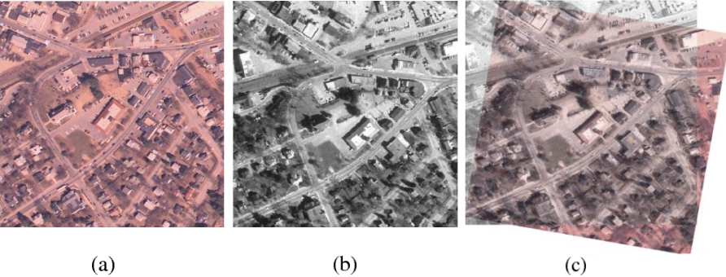
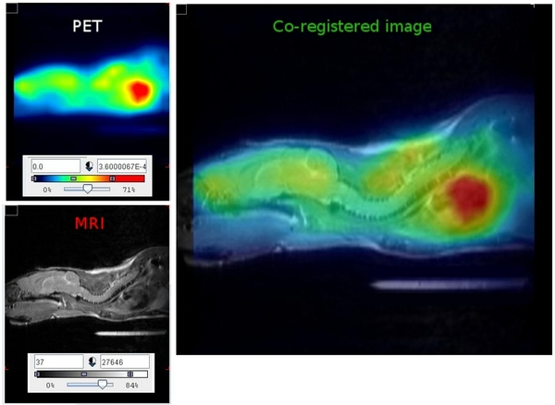

Image Registration
Image Registration is the task of spatially align two or more images of the same scene/object acquired from different sources, view points and time.
T : f (x) → g(x’) ⇔ T (f (x)) = g(x′)
f (x) and g(x′) be two images of the same scene/object, where x=(x₁,x₂) and x’=(x₁’,x₂’) for 2D images. T is the transformation function that maps one image into the coordinates of other.
f (x)
g(x’)
T (f (x)) = g(x′)
T
T
Note : Image registration is not image fusion

Slide 4
Applications of Registration
Remote Sensing: Multi-spectral classification, Environmental monitoring, Change detection, Image mosaicing, Weather forecasting, Integrating information into geographic information systems (GIS)
Computer Vision: Tracking, Stereo-vision, Object recognition, Target localization, Super-resolution images ,etc.
Medicine: Diagnosis, Surgery planning and Intervention, Mosaicing, Tracking, fusion, Super-resolution etc
A generic registration algorithm for all applications?
Geometric and radiometric deformations, noise, image characteristics, required accuracy and stability are to be considered [1].
[1] Barbara Zitova, Jan Flusser, “Image registration methods: a survey” Image and Vision Computing, 2003

Slide 5
Broad Classification of Registration Algorithms
Lisa Gottesfeld Brown, “A Survey of Image Registration Techniques” ACM Computing Surveys, 1992

Slide 6
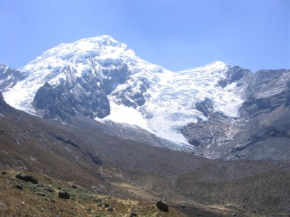
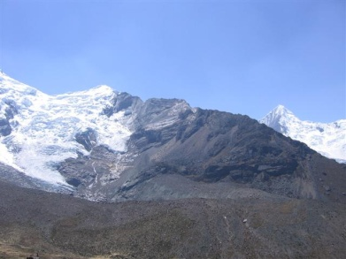
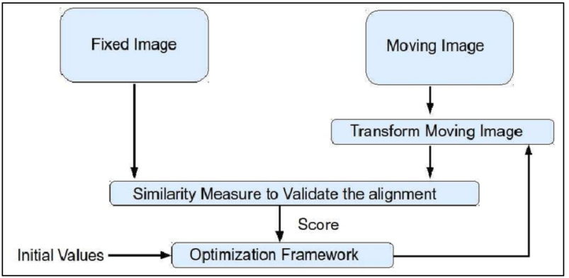
Classification of Registration Algorithms:
Area based methods
Area based registration

Slide 7
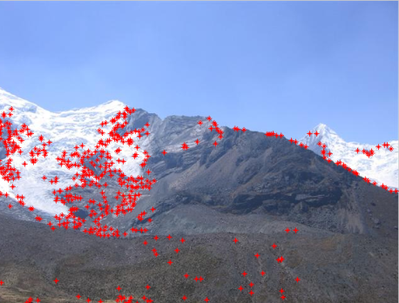
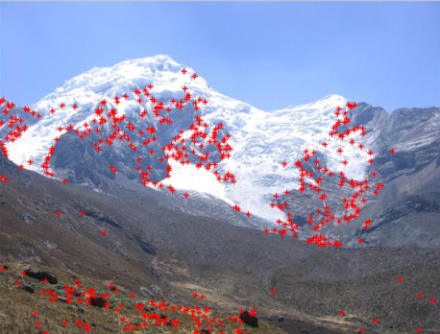

Classification of Registration Algorithms:
Feature based methods
Feature detection
Feature matching
Transformation estimation
Feature based registration

Slide 8
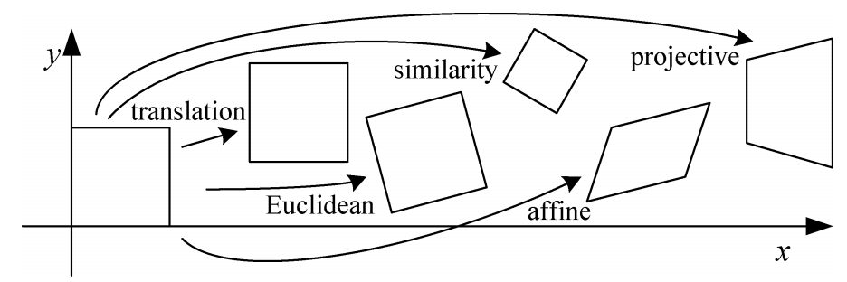
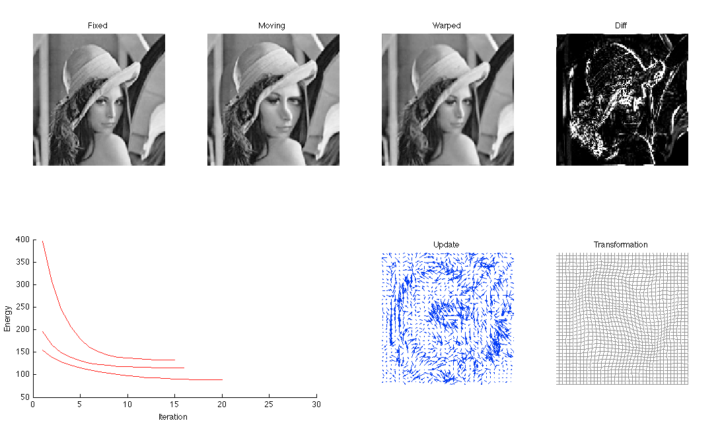
Classification of Registration Algorithms:
Global Vs Local mapping
Global Mapping (rigid)
Local Mapping(non-rigid)

Slide 9
Retinal Imaging Background

Slide 10
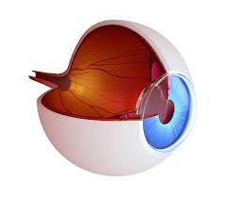
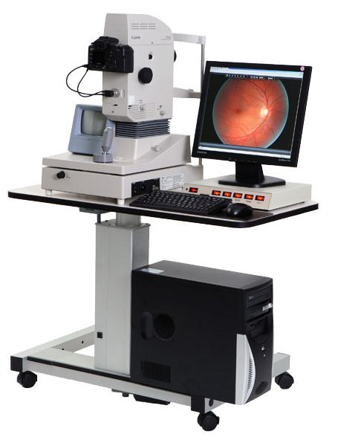
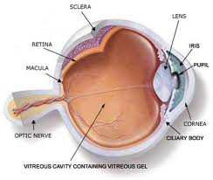
Background: Retinal Imaging
Cross sectional view of the eye
Anatomy of the eye
Retinal Imaging setup

Slide 11
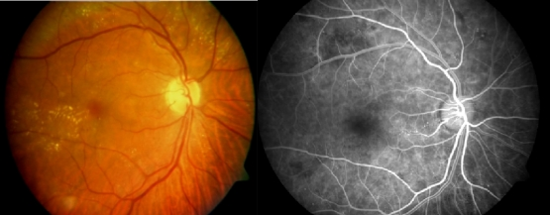
Background: Retinal Images
Optic disk
Macula
Vessels
Color Fundus Image(CFI)
Fluoroscene Fundus Angiogram (FFA)
Obtained under natural light
Non-invasive
Over health of retina
Color image
Single image
Obtained under infrared light
Invasive
Reveals blood flow dynamics
Grayscale image
Time sequence
Red Free Image(RFI) images similar to CFI

Slide 12
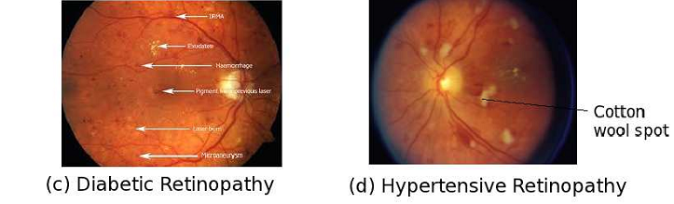
Motivation
Retina is part of the central nervous system.
Excellent indicator of systemic diseases like diabetics[3]
  366 million 2013 and 552 million 2030 affected by diabetics
  75% of diabetic adults develop diabetic retinopathy.
  10% severe visual impairment.
Other systemic diseases include Hypertension, Atherosclerosis, Sickle cell disease, Multiple sclerosis
  Recent research reveals association of retinal vascular signs to cerebrovascular, cardiovascular and metabolic outcomes
[3 ] http://www.hki.org/preventing-blindness

Slide 13
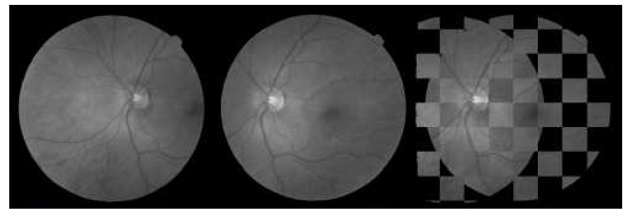
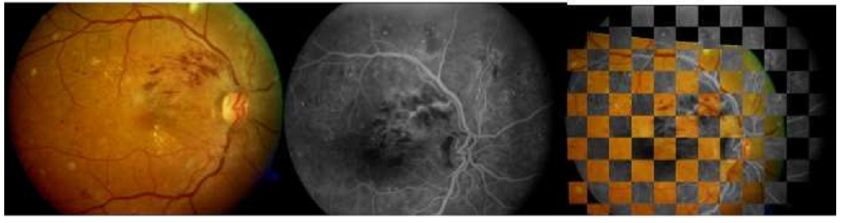
Retinal Image Registration and its Applications
Monomodal Registration
Disease tracking
Image mosaic
Surgery planning
Localization of disorders
Super-resolution
Monomodal retinal image registration -Checkerboard view
Multimodal Registration
Improve anatomical range
for visual inspection
Surgery planning and
intervention
Image Fusion
CAD system evaluation
Multimodal retinal image registration

Slide 14
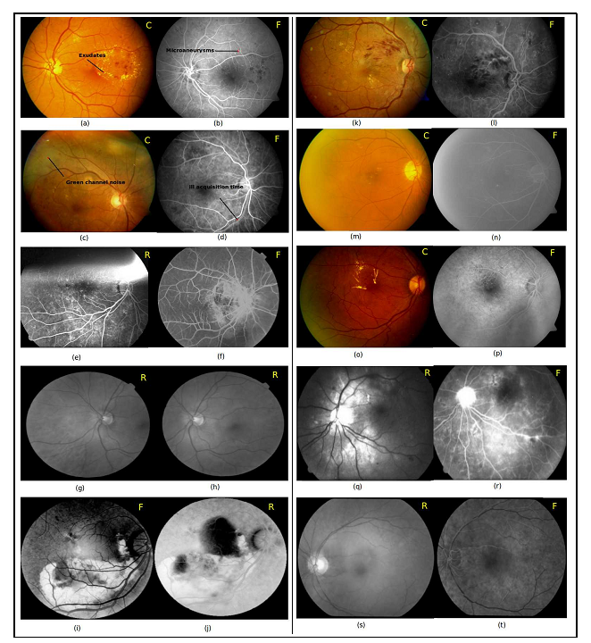
Challenges in retinal Image registration
Retina is a curved surface, induces radial distortion when imaged on to a plane
Images may be acquired from uncalibrated cameras.
Varying resolution
Complementary information in multimodal Images.
ill timed acquisition of FFA images.
Variable field of view and overlap
Poor contrast of images, especially FFA.
Green channel noise, non uniform illumination.
Pathology affected retina

Slide 15
Registration paradigm in computer vision and medical imaging
Computer Vision
Medical imaging
Feature based registration
Global mapping(rigid)
Monomodal/Natural images
Posed as regression problem
Area based registration
Local mapping (non-rigid)
Medical images/ Multimodal
Posed as an optimization problem
Our approach to retinal image registration
Given the advantages of feature based registration, develop a registration scheme for
both monomodal and multimodal retinal image registration.

Slide 16
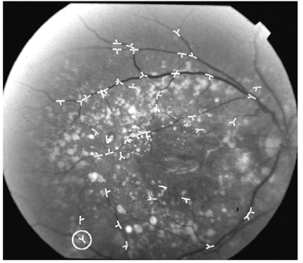
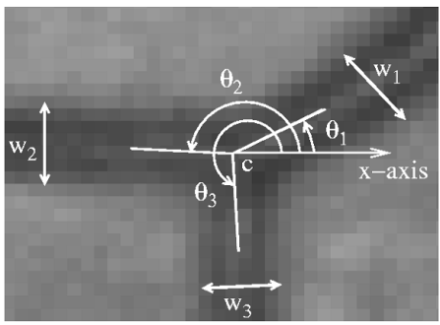
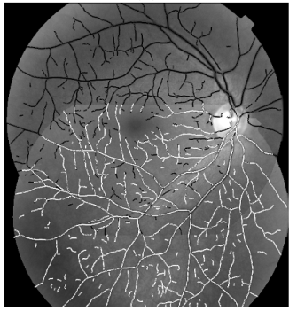
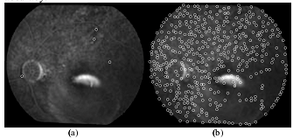
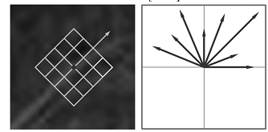
Relevant literature
Charles V. Stewart, Chia ling Tsai, and Badrinath Roysam. The dual-bootstrap iterative closest point algorithm with application to retinal image registration. IEEE Trans. Med. Img, 2007. GDBICP
J. Chen, J. Tian, N. Lee, J. Zheng, R. Smith, and A. Laine. A partial intensity invariant feature descriptor for multimodal retinal image registration. IEEE Trans Biomed Eng, 2010 PIIFD

Slide 17
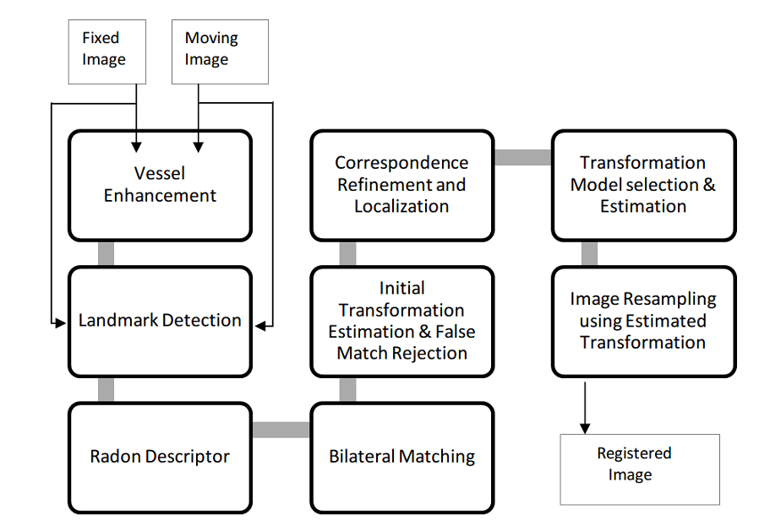
Overview of Proposed Registration Algorithm
Yogesh Babu & Jayanthi Sivaswamy, “Robust registration of poor quality Retinal Images” To be submitted

Slide 18
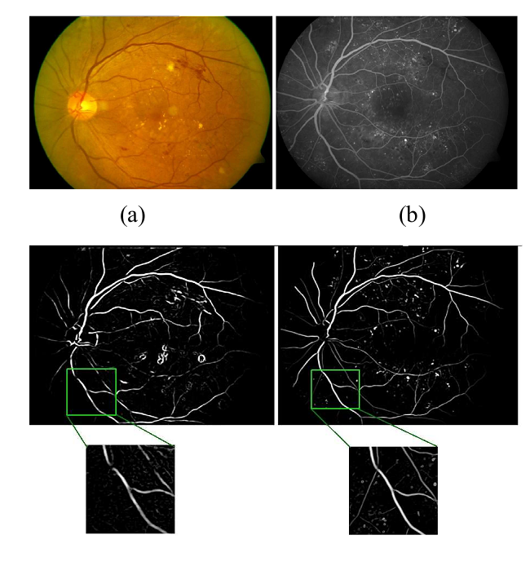
Vessel Enhancement
Goal of vessel enhancement
Single representation
Handle degradations.
Boost tubular structures
Minimize the presence of pathologies
Vessel enhanced subimages of CFI and FFA

Slide 19
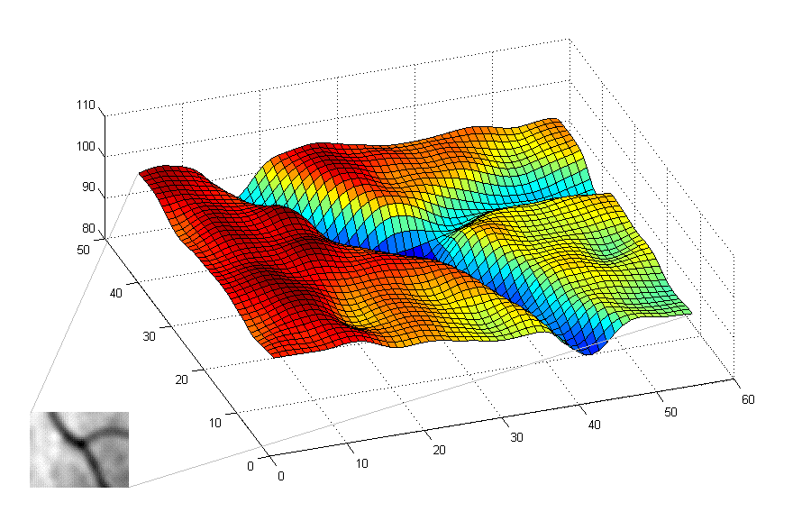

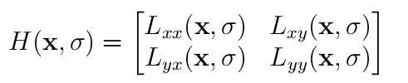
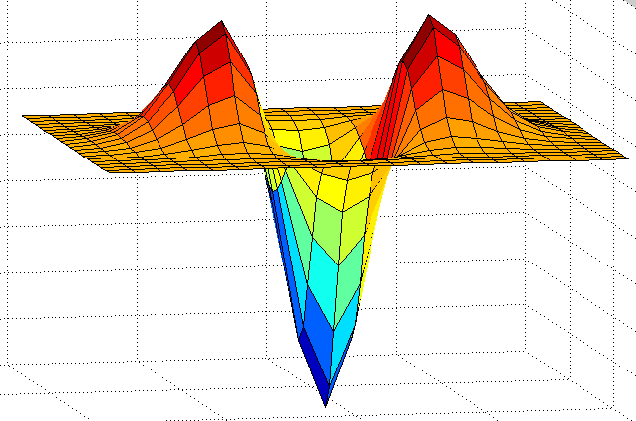
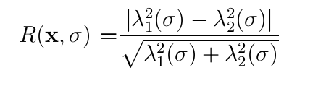
Vessel Enhancement Method
Given an image (x) , where x={x,y}, the
Scale space representation is given by
Hessian matrix
The eigen values (λ₁,λ₂) and eigen vectors (v₁,v₂)
principle curvatures and their orientations.
The vesselness measure for various scales is given by
Topographic view of sub image
L_{xx}
A.Frangi, W. Niessen, Koen L. Vincken, Max A. Viergever, “Multiscale vessel enhancement ﬁltering” MICCAI, 1998

Slide 20




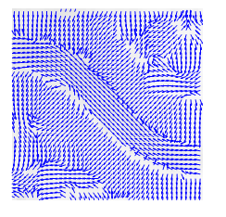
Vessel Enhancement Method
The final vessel enhanced R is given by
The eigen vectors corresponding to R (x) is computed as
Subimage
Vessel enhanced image
Principle minima directions
Landmark detection method
Tony Lindeberg, “Scale-Space Theory in Computer Vision” , KTH, 1994

Slide 21
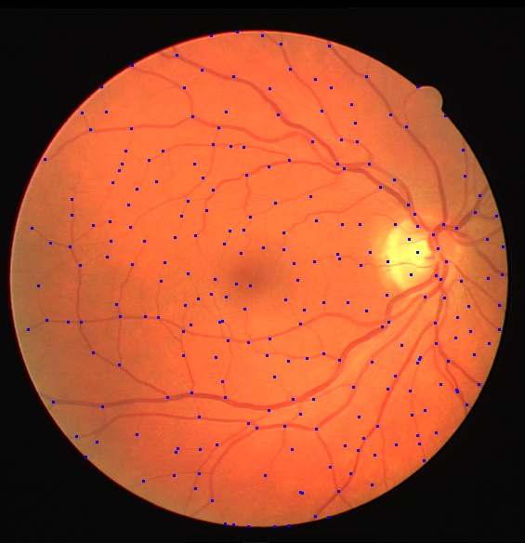
Landmark Detection
Vessels are the best representatives
Junctions/cross-over points are not enough
Proposed new landmark detection characteristics:
They are widely spread
(2)They have maximum presence on vasculature
Vessel junctions & cross over points as landmarks[5]
[5]K.Ram, Y.Babu, J. Sivaswamy, “Curvature orientation histograms for the detection and matching of vascular landmarks in retinal Images” SPIE- Medical Imaging 2009

Slide 22
New Landmark Detection Method

Slide 23
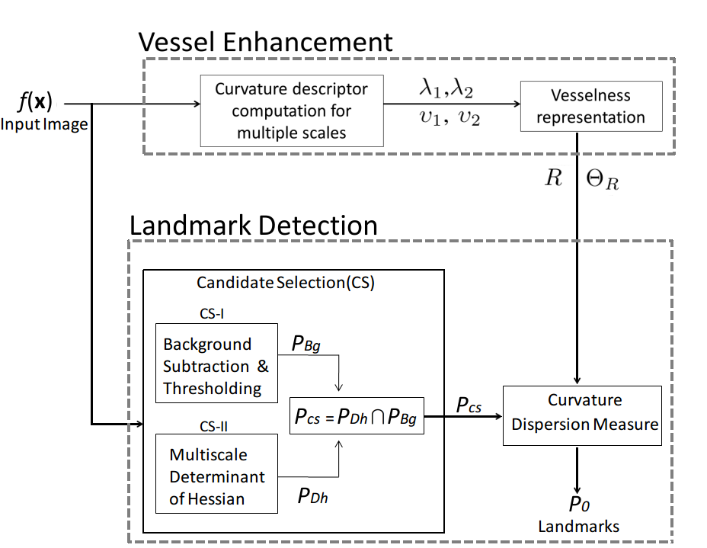
Vessel enhancement and Landmark detection

Slide 24
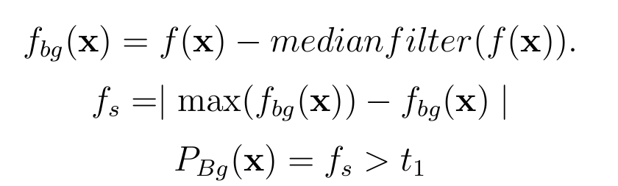
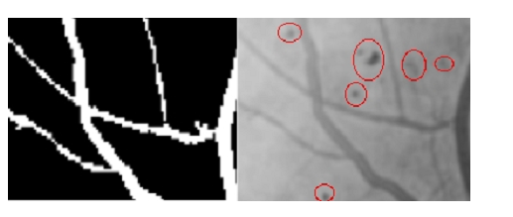
Landmark detection: Candidate Selection stage
CS-I to give a rough structural vessel map
t₁ is the threshold selected as 10% of the max( _{s})
FFA sub-image with lesions Rough structural map P_{Bg}

Slide 25
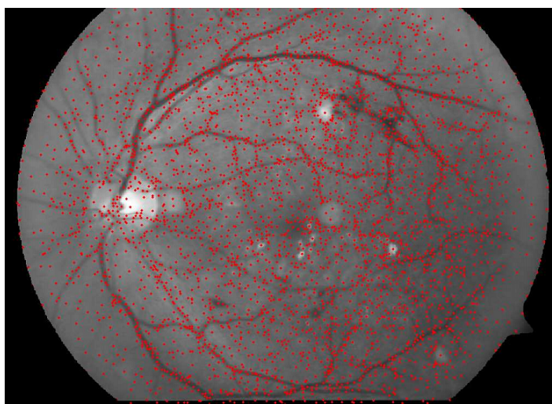
Landmark detection candidate selection stage
CS-II, detects high curvature points using the determinant of Hessian
blob detector.
P_{Dh} candidates through determinant of hessian operator

Slide 26
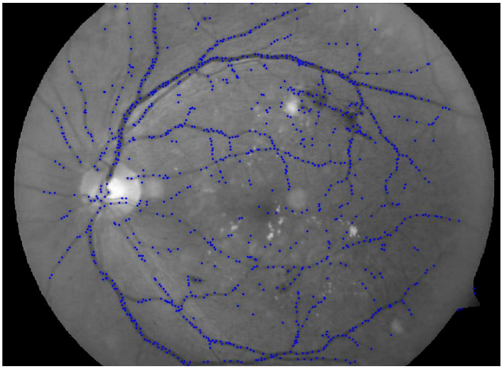
Landmark detection candidate selection stage
P_{Dh} P_{Bg} the output of candidate selection stage on CFI image

Slide 27
Vessel enhancement and Landmark detection

Slide 28
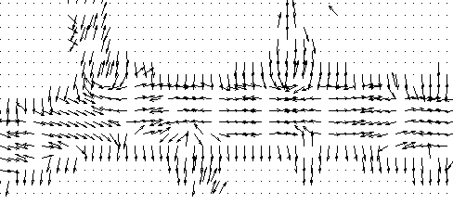
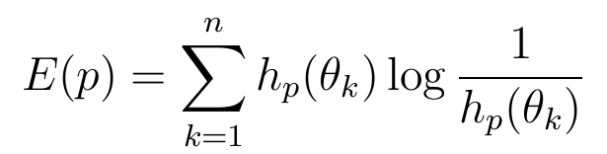
Landmark detection :Curvature Dispersion Measure
Curvature Dispersion measure:
Principle minima orientation map
Final set of landmarks are obtained after non-maximal suppression.
[5]K.Ram, Y.Babu, J. Sivaswamy, “Curvature orientation histograms for the detection and matching of vascular landmarks in retinal Images” SPIE- Medical Imaging 2009

Slide 29
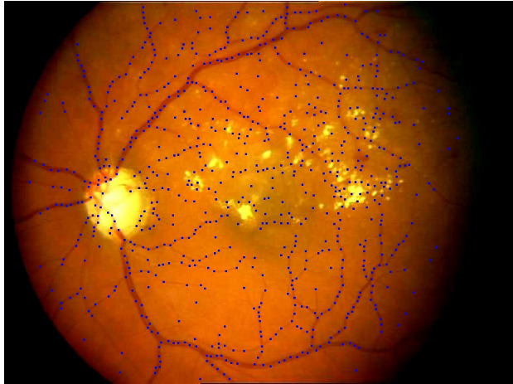
Landmark detection Result
Landmark detection in CFI image

Slide 30
Overview of Proposed Registration Algorithm
P₀
Q₀

Slide 31
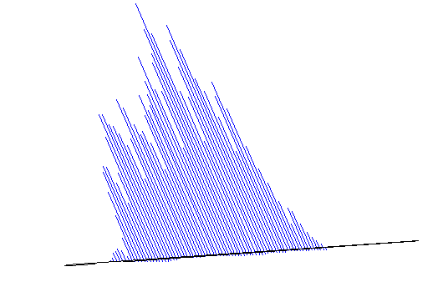
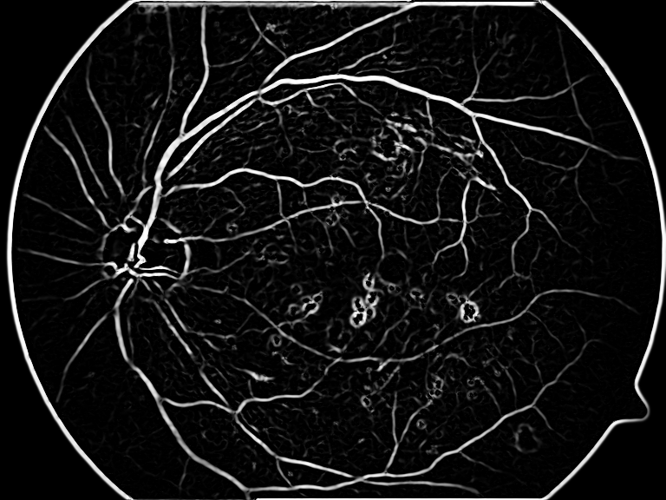

Radon based Descriptor
Radon Transform
For each landmark point:
(1) A patch of wxw is extracted from the vessel enhanced image. w=(w₁,w₂…w_{n}) n=4
(2) Compute the dominant direction in the patch.
(3) Starting from dominant orientation compute radon transform at uniform angular intervals.
(4) Normalise each projection and append profile to form feature vector. Size:720
Yogesh Babu, N.V. Kartheek and Jayanthi Sivaswamy,” Robust matching of multi-modal retinal images using radon transform based local descriptor” ACM-International Health Informatics, Nov- 2010

Slide 32
Overview of Proposed Registration Algorithm
P₀
Q₀
D_{q}
D_{p}

Slide 33
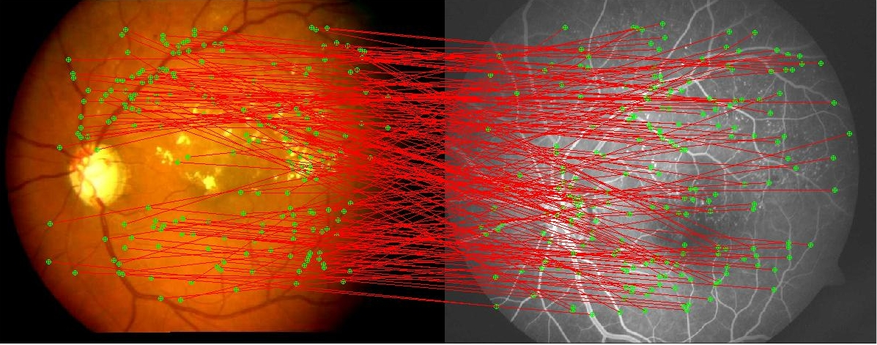
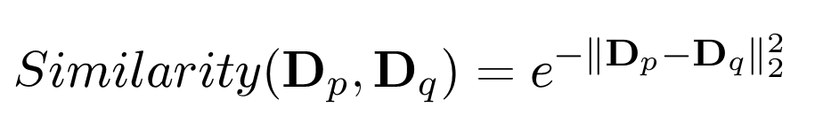
Bilateral matching
Bilateral matching: Euclidean Normalized similarity measure (in (0,1]).
Euclidean normalised similarity measure. http://www .lans.ece.utexas.edu/ strehl/diss/node53.html

Slide 34
Overview of Proposed Registration Algorithm
P₀
Q₀
D_{q}
C₀
D_{p}

Slide 35
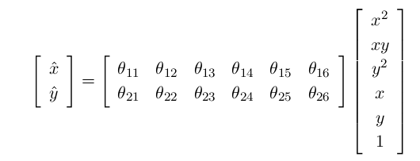
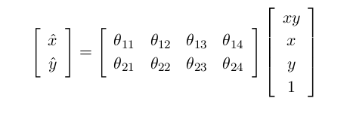

Transformation models for retinal image registration
The appropriate transformation model for registering retinal images is a quadratic model to account for the curved surface of the retina[4]
In low overlap cases, with limited pairs of landmarks, bilinear transformation is used
[4] Can A., Stewart C.V., Roysam B., Tanenbaum H.L,” A feature-based, robust, hierarchical algorithm for registering pairs of images of the curved human retina” PAMI, 2002

Slide 36
Initial transformation estimation and outlier rejection using modified MSAC
Assume affine transformation for outlier rejection.
M-estimator Sample and Consensus (MSAC) framework is used.
Two steps in modified MSAC :
  Hypothesis is based on selection of top few correspondences to generate the Minimal Sample Set. Use Angle-Angle property of similar triangles to discard false matches.
  Verification is based on cost function instead of rank unlike RANSAC algorithm.
Break down criteria is 50%.
Convergence criteria is same as RANSAC
Refinement & localization of correspondences using Normalized cross correlation for
sub-pixel accuracy
https://en.wikipedia.org/wiki/Similarity_(geometry)#Similar_triangles
M. Zuliani. Ransac toolbox for matlab, Nov. 2008,”RANSAC for dummies”.

Slide 37
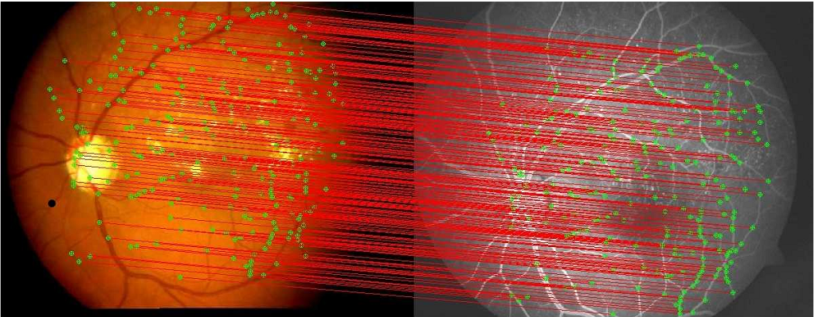
Initial transformation estimation and outlier rejection using modified MSAC result
Correspondence set C₁ after outlier rejection between CFI and FFA

Slide 38
Overview of Proposed Registration Algorithm
C₂
C₁
P₀
Q₀
D_{q}
C₀
D_{p}

Slide 39
Model selection and transformation estimation
The spatial distribution of correspondences pairs is used to determine the transformation models.
This is determined by computing the entropy of the spatial distribution.
Final transformation function is estimated using the standard M-estimators.
Since no closed form solution exists, it is implemented using iteratively reweighted least squares method[4]. No contribution here
Moving image is resampled into the coordinates of the fixed image using bicubic interpolation.
Quadratic Bilinear Affine
[4] Can A., Stewart C.V., Roysam B., Tanenbaum H.L,” A feature-based, robust, hierarchical algorithm for registering pairs of images of the curved human retina” PAMI, 2002

Slide 40
Experimental setup
3 datasets
  Dataset 1: 126 multimodal pairs
  Dataset II :20 monomodal pairs
  Dataset III : 18 multimodal and monomodal pairs (challenge)
Resolution between 256x256 to 1204x1200
Angular resolution between 30° - 50°
Comparison using PIIFD(2011) and GDBICP (gold standard).
Time taken 70-80 Secs.
Evaluation criteria:
  Mean centerline measurement error
  Overall registered images in dataset I,II and III
  Rotational Invariance test
  Scale Invariance test
  Overlap Test

Slide 41
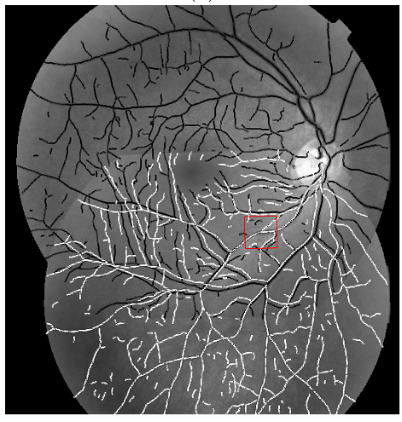
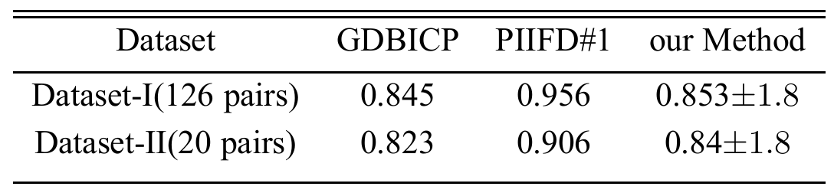
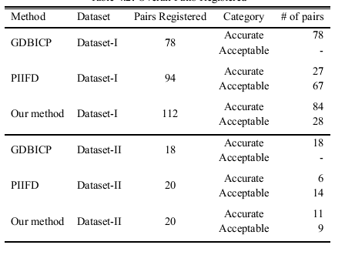
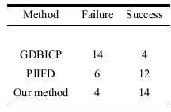
Results
Mean Centerline Measurement Error(M-CME)
  Overall registered images in dataset I,II and III
M-CME
Dataset III 18 images
Charles V. Stewart, Chia ling Tsai, and Badrinath Roysam. The dual-bootstrap iterative closest point algorithm with application to retinal image registration. IEEE Trans. Med. Img, 2007.
J. Chen, J. Tian, N. Lee, J. Zheng, R. Smith, and A. Laine. A partial intensity invariant feature descriptor for multimodal retinal image registration. IEEE Trans Biomed Eng, 2010
Dataset I 126 images Dataset II 20 images

Slide 42
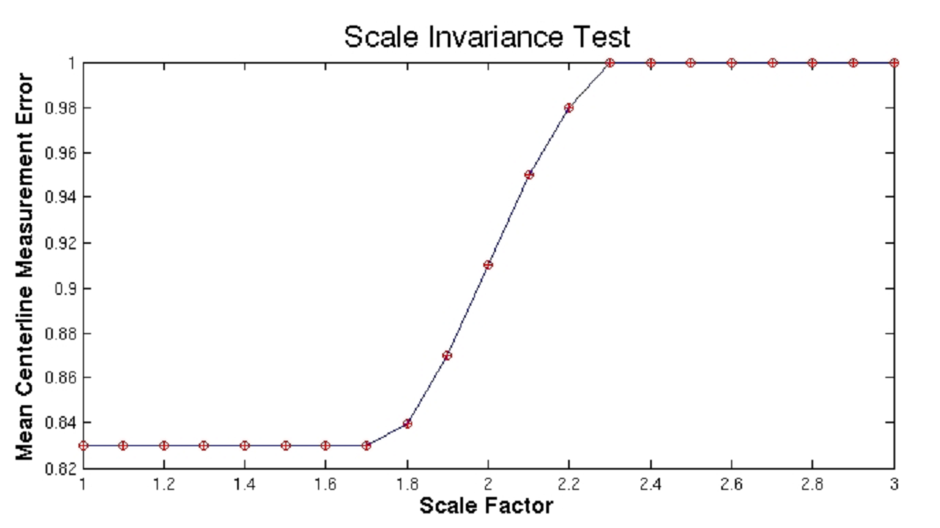

Results
Rotational Invariance test M-CME ±1.8
Scale Invariance test
Invariant up a factor1.8
Overlap Test
Robust up to 25% overlap

Slide 43

Results
Results from dataset I

Slide 44

Results from dataset II

Slide 45

Results from dataset III

Slide 46
Conclusion and future work
A novel registration algorithm to register both multimodal and monomodal retinal Images.
Contributions:
  Vessel enhancement - Minor
  Landmark Detection -Major
  Radon based Descriptor –Major
  Initial transformation estimation – Major(speedup only)
  Transformation model selection –Minor
Out performs existing methods for poor quality images and performs on par with GDBICP for healthy retinal images.
Drawbacks:
  Contrast reversal.
  Algorithm is randomized
  Feature descriptor length 720
  Speed

Slide 47


Future work
Integral Image representation for Faster processing.
Faster background estimation instead of median for landmark detection.
Like PCA-SIFT, reduce dimensionality of the feature vector.
Extend to other modalities.
Super resolution and information fusion
Super resolution
Information fusion

Slide 48



Extension to other modalities
Partial fingerprint matching
Partial fingerprint matching

Slide 49
Reviewers Feedback & Questions
Add conclusion and future work as a separate chapter -Done
In chapter 3: Is a bin size of 15° acceptable for curvature orientation histogram for landmark correspondence?.
  No, We developed a new method to over come these limitations
In chapter 4. what is the computation al cost of using 31x31 medians when most of your images are 3000x3000 in size. How much time does this median filter take.
  Size of images between 256x256 to 1204x1200, Time:6 secs
Also, throughout chapter 4, there are a lot of magic numbers. Is it possible to give some intuition about their values and how sensitive the performace of your approach is to small variations in the values.
  Sensitive parameters: No.of scales, Radon descriptor bins and no.of projections, Curvature dispersion measure(Non maximal suppression).
  Others have little impact: Ex: Median filter may vary between 21-41.

Slide 50
Reviewers Feedback & Questions
Am I correct in thinking that PIIFD performs better than your method for overlaps of less than 30% between images. What are the general overlap percentages for fundus images?
  40% is the minimum overlap.
  PIIFD handles less then 30% (as per publication), we saw drop in accuracy, as per our standard they do not qualify.
  The dataset which they used for evaluation is proprietary. On our dataset, poor registration is seen.

Slide 51
Backup Slides

Slide 52



Results I

Slide 53



Results II

Slide 54



Results III

Slide 55



Results IV

Slide 56



Results V

Slide 57


Classification of Registration algorithms
Area based registration
Feature based registration
Feature detection
Feature matching
Transformation estimation
Image Resampling
Local Mapping(non-rigid)
Global Mapping (rigid)

