Slide 1
Synthesizing Classifiers for Novel Settings
Viresh Ranjan
CVIT,IIIT-H
Adviser: Prof. C. V. Jawahar, IIIT-H
Co-Adviser: Dr. Gaurav Harit, IIT, Jodhpur

Slide 2
Overview
Visual Recognition & Retrieval Tasks.
Challenges in Visual Recognition & Retrieval
  Dataset Shift.
  Large number of categories.
Handling Dataset Shift.
Handling large number of categories.

Slide 3
Overview
Visual Recognition & Retrieval Tasks
Challenges in Visual Recognition & Retrieval
  Dataset Shift
  Large number of categories
Handling Dataset Shift
Handling large number of categories

Slide 4
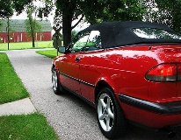
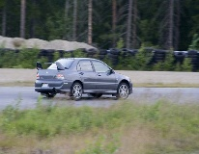
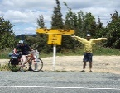

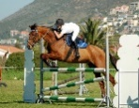

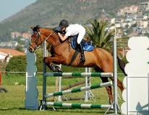

Introduction
Visual Recognition & Retrieval
  Object Recognition
Image labels
Image
Feature Extraction
Classifier
“Car”
“Not Car”
“Car”
“Not Car”

Slide 5




Introduction
Visual Recognition & Retrieval
  Word image retrieval
Image labels
Image
Feature Extraction
Classifier
“room”
“Not room”
“room”
“Not room”

Slide 6
Introduction
Visual Recognition & Retrieval
  Handwritten digit classification
Image labels
Image
Feature Extraction
Classifier
“2”
“Not 2”
“2”
“Not 2”

Slide 7
Overview
Visual Recognition & Retrieval Tasks
Challenges in Visual Recognition & Retrieval
  Dataset Shift
  Large number of categories
Handling Dataset Shift
Handling large number of categories

Slide 8
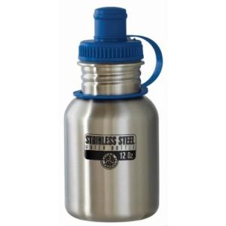
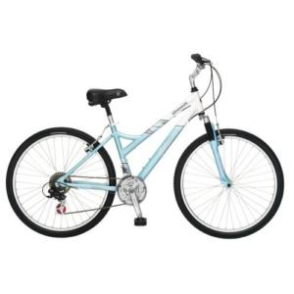
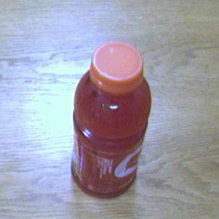
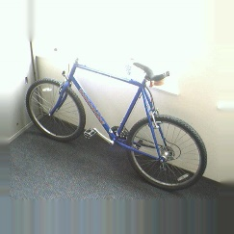
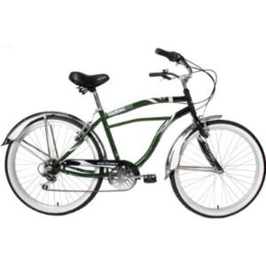
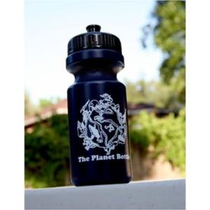
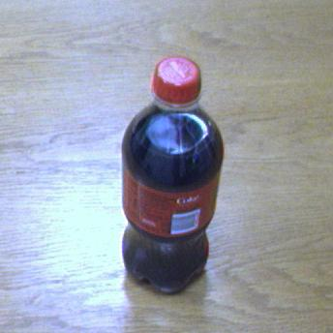
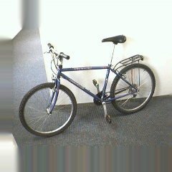
Introduction
Challenges in Visual Recognition & Retrieval
  Dataset Shift
Source (training set)
Target (test set)
Dataset Shift in Object Recognition

Slide 9
Introduction
Challenges in Visual Recognition & Retrieval
  Dataset Shift
Source(training set) Target(test set)
  Printed handwritten
Dataset Shift in digits classification

Slide 10






Introduction
Challenges in Visual Recognition & Retrieval
  Dataset Shift
Source(training set) Target(test set)
Dataset Shift in word image retrieval

Slide 11
Overview
Visual Recognition & Retrieval Tasks
Challenges in Visual Recognition & Retrieval
  Dataset Shift
  Large number of categories
Handling Dataset Shift
Handling large number of categories

Slide 12
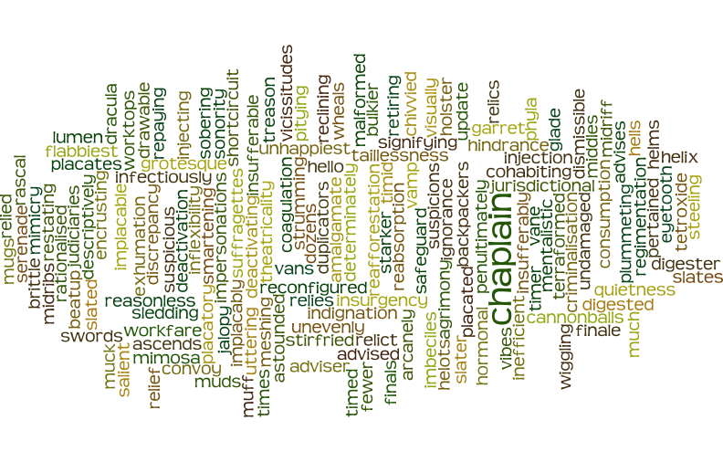
Introduction
Challenges in Visual Recognition & Retrieval
  Dataset Shift
  Too many categories
Around 200K word categories in English language

Slide 13
Introduction
Challenges in Visual Recognition & Retrieval
  Dataset Shift
  Too many categories
Tackling the challenges
  Dataset Shift –i) Domain Adaptation
  ii) Kernelized feature extraction
  Too many categories – Transfer Learning

Slide 14
Overview
Visual Recognition & Retrieval Tasks
Challenges in Visual Recognition & Retrieval
  Dataset Shift
  Large number of categories
Handling Dataset Shift
  Handling Dataset Shift in object recognition by Domain Adaptation
  Handling Dataset Shift in digit classification by Domain Adaptation
  Handling Dataset Shift in word image retrieval by Kernelized Feature Extraction
Handling large number of categories

Slide 15
3. a. Handling Dataset Shift in object recognition by Domain Adaptation

Slide 16
Problem Statement
Source Domain
Target Domain
Given: Labeled Source Domain, Unlabeled Target Domain.
Goal: Classify target domain images.

Slide 17
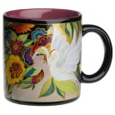



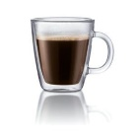
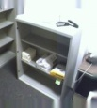
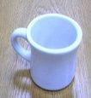
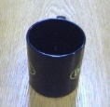

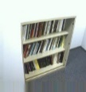
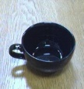
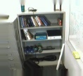
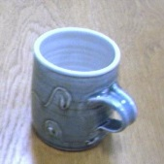
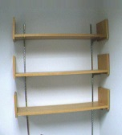
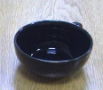


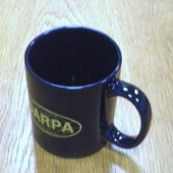


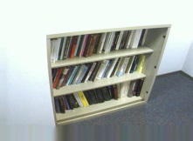


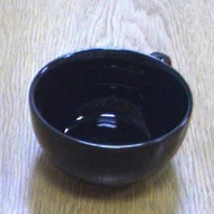
Overview of Domain Adaptation
Labeled Source domain images
Unlabeled Target domain images
Target Classification Target classification
using Source classifier using DA
(a) (b)

Slide 18
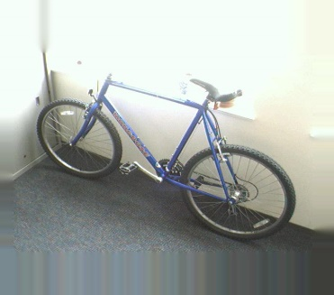
Proposed Approach
Decompose features into:
  Domain Specific features
  Domain Independent features
Domain Specific
Domain Independent
Domain Specific
Domain Independent
Source Domain
Target Domain

Slide 19
Proposed Approach
Discard domain specific features
Discard
Discard
Source Specific
Domain Independent
Target Specific
Domain Independent
Source Domain
Target Domain

Slide 20
Proposed Approach
Train classifiers using domain independent features
Train
Test
Classifier
Domain Independent
Domain Independent
Source Domain
Target Domain

Slide 21
Learning Domain Specific & Domain Independent features
Sparse Representation:
Sparse coefficients
Image
Dictionary
However, above sparse representation cannot separate domain specific & independent features.
How do we separate domain specific & independent features ?

Slide 22
Learning Domain Specific & Domain Independent features
Key idea: domain specific & shared atoms in dictionary.
Coeff. for Source specific atoms
Coeff. for shared atoms
Source image
Source Specific Atoms
Shared Atoms
Coeff. for Target specific atoms
Coeff. for shared atoms
Target image
Target Specific Atoms
Shared Atoms

Slide 23
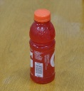
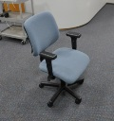

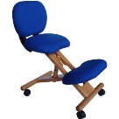
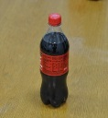
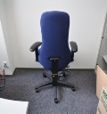

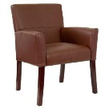
Learning Domain Specific & Domain Independent features
Source Specific Atoms
Shared Atoms
Target Specific Atoms
(1)
(2)
Source Domain
Target Domain

Slide 24
Learning Cross Domain Classifiers
Source specific coeffs.
Coeffs. for shared atoms
Source images
Sparse representation
Target specific coeffs.
Coeffs. for shared atoms
Target images
Sparse representation

Slide 25
Learning Cross Domain Classifiers
Discard domain specific coeffs.
Train classifiers using coeffs. for shared atoms
Source images

Slide 26

Learning Domain Specific & Domain Independent features
Source reconstruction error
Target reconstruction error
(3)
where Y_{s} contains source images, Y_{t} contains target images, D_{s} and D_{t} are source and target dictionary.
(4)
(5)

Slide 27
Experiments
Dataset
  10 object classes from Caltech-256 (C), Webcam(W), Dslr(D) , Amazon(A)
Feature representation
  SURF features
  BOW representation(800 visual words)

Slide 28
Results
Unsupervised Setting(no target labels)
Method | C->A | C->D | A->C | A->W | W->C | W->A | D->A | D->W
MOD_{src} | 39.8 | 42.1 | 37.0 | 36.2 | 19.8 | 26.8 | 30.1 | 55.3
MOD_{tgt} | 44.4 | 44.0 | 36.8 | 38.2 | 30.5 | 35.4 | 34.5 | 69.5
Gopalan et al. | 36.8 | 32.6 | 35.3 | 31.0 | 21.7 | 27.5 | 32.0 | 66.0
Gong et al. | 40.4 | 41.1 | 37.9 | 35.7 | 29.3 | 35.5 | 36.1 | 79.1
Ni et al. | 45.4 | 42.3 | 40.4 | 37.9 | 36.3 | 38.3 | 39.1 | 86.2
PSDL(ours) | 47.6 | 48.5 | 39.8 | 38.9 | 31.8 | 36.0 | 37.9 | 79.1

Slide 29
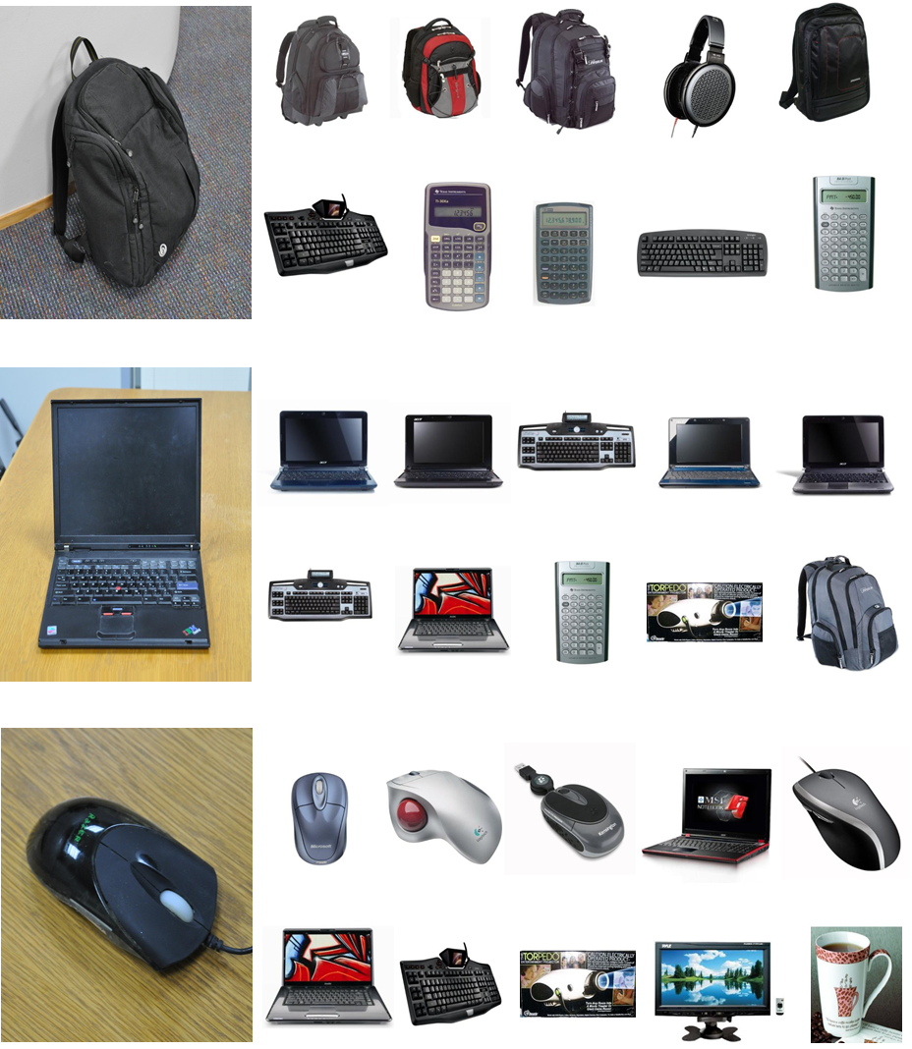
Results
Query
Retrieved Images
PSDL
Original features
PSDL
Original features
PSDL
Original features

Slide 30
Overview
Visual Recognition & Retrieval Tasks
Challenges in Visual Recognition & Retrieval
  Dataset Shift
  Large number of categories
Handling Dataset Shift
  Handling Dataset Shift in word image retrieval by Kernelized Feature Extraction
  Handling Dataset Shift in digit classification by Domain Adaptation.
  Handling Dataset Shift in object recognition by Domain Adaptation
Handling large number of categories

Slide 31
3. b. Handling Dataset Shift in digit classification by Domain Adaptation

Slide 32
Problem Statement
Source Domain
Target Domain
Given: Labeled Source Domain, Unlabeled Target Domain.
Goal: Classify target domain images.

Slide 33
Approach Overview
Common
Subspace
Source
Subspace
Target
Subspace
Source
data
Target
data

Slide 34
Locality Preserving Subspace Alignment(LPSA)
Desired properties for Subspace:
  Preserve local geometry of data.
  Utilize label information.
Locality Preserving Projections(LPP)^{[1]:}
  Preserves local neighborhood.
  Can utilize label information.
^{[1]}X. He and P. Niyogi, “Locality preserving projections,” in NIPS, 2003, pp. 234–241

Slide 35



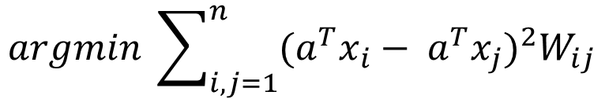

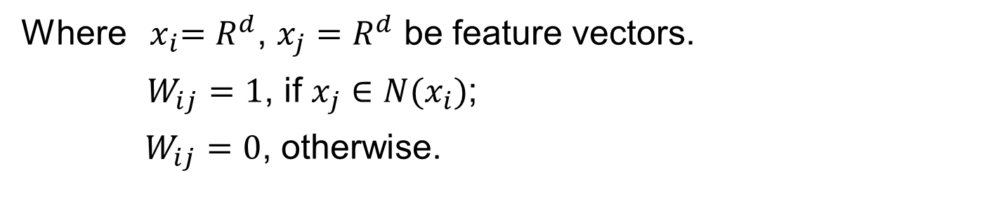

Locality Preserving Subspace Alignment(LPSA)
Locality Preserving Projection(LPP):
$$argmin \sum_{i,j=1}^{n}{{(a^{T}x_{i}− a^{T}x_{j})}^{2}W_{ij}}$$
$$x_{i}$$
$$W_{ij}=1$$
$$x_{j}$$
(6)
$$W_{ik}=0$$
$$x_{k}$$
Where ${ x}_{i}=R^{d}$, $x_{j}=R^{d}$ be feature vectors.
$W_{ij}=1$, if $x_{j}∈N(x_{i})$;
$W_{ij}=0$, otherwise.

Slide 36
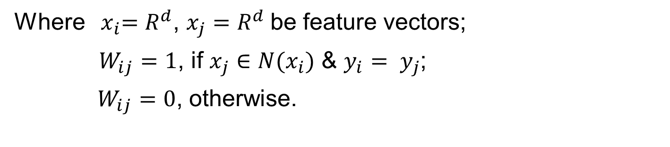
Locality Preserving Subspace Alignment(LPSA)
Supervised Locality Preserving Projection(sLPP):
$$argmin \sum_{i,j=1}^{n}{{(a^{T}x_{i}− a^{T}x_{j})}^{2}W_{ij}}$$
(6)
Where ${ x}_{i}=R^{d}$, $x_{j}=R^{d}$be feature vectors;
$W_{ij}=1$, if $x_{j}∈N(x_{i})$ & $y_{i}= y_{j}$;
$W_{ij}=0$, otherwise.

Slide 37

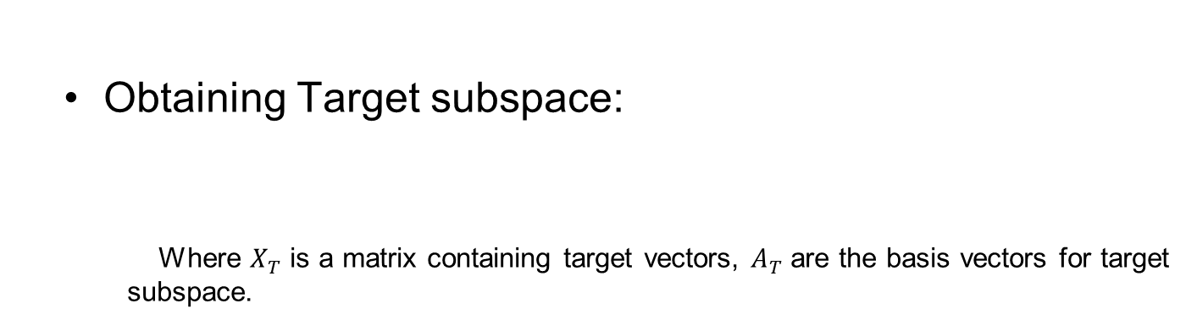

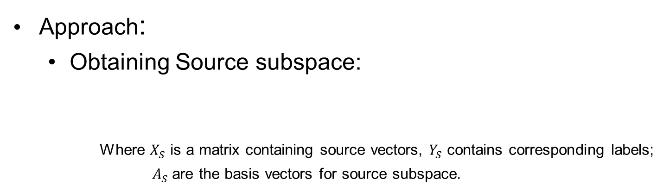
Locality Preserving Subspace Alignment(LPSA)
Approach:
  Obtaining Source subspace:
    Where $X_{S}$ is a matrix containing source vectors, $Y_{S}$ contains corresponding labels;
    $A_{S}$are the basis vectors for source subspace.
$$sLPP(X_{S},Y_{S})→A_{S}$$
  Obtaining Target subspace:
    Where $X_{T}$ is a matrix containing target vectors, $A_{T}$are the basis vectors for target subspace.
$$LPP(X_{T})→A_{T}$$

Slide 38




Locality Preserving Subspace Alignment(LPSA)
Approach:
  Aligning Subspaces
$$M$$
$$A_{S}$$
Target
Subspace
$$A_{T}$$
$${\left\|MA_{S}−A_{T}\right\|}_{F}^{2}+λ{\left\|M\right\|}_{F}^{2}$$
(7)

Slide 39


Approach:
  Projection
    ,
$$Z_{S}←{(MA_{S})}^{T}X_{S}$$
$$Z_{T}←{A_{T}}^{T}X_{T}$$

Slide 40
Datasets
Dataset | Source | No. Images
Printed digits | Rendering digits in 300 different fonts. | 3000
Handwritten digits(HW) | Sampling 300 images per digit MNIST. | 3000

Slide 41
Experimental Results
Source | Target | Method | Accuracy
Handwritten | Printed | No Adaptation | 48.8
Handwritten | Printed | PCA(source) | 55.9
Handwritten | Printed | PCA(target) | 56.5
Handwritten | Printed | PCA(combined) | 56.5
Handwritten | Printed | Fernando et al^{[2]} | 57.0
Handwritten | Printed | LPSA(Ours) | 64.8
^{[2]}Fernando, Basura, et al. "Unsupervised visual domain adaptation using subspace alignment." Computer Vision (ICCV), 2013 IEEE International Conference on. IEEE, 2013.

Slide 42
Experimental Results
Source | Target | Method | Accuracy
Printed | Handwritten | No Adaptation | 70.0
Printed | Handwritten | PCA(source) | 68.1
Printed | Handwritten | PCA(target) | 68.9
Printed | Handwritten | PCA(combined) | 70.2
Printed | Handwritten | Fernando et al^{[2]} | 70.6
Printed | Handwritten | LPSA(Ours) | 73.2
^{[2]}Fernando, Basura, et al. "Unsupervised visual domain adaptation using subspace alignment." Computer Vision (ICCV), 2013 IEEE International Conference on. IEEE, 2013.

Slide 43
Experimental Results
Test Image No Adaptation
DA using LPSA

Slide 44
Overview
Visual Recognition & Retrieval Tasks
Challenges in Visual Recognition & Retrieval
  Dataset Shift
  Large number of categories
Handling Dataset Shift
  Handling Dataset Shift in object recognition by Domain Adaptation
  Handling Dataset Shift in digit classification by Domain Adaptation
  Handling Dataset Shift in word image retrieval by Kernelized Feature Extraction
Handling large number of categories

Slide 45
  3.c. Handling Dataset Shift in word image retrieval by Kernelized Feature Extraction

Slide 46
Style-Content Factorization

Slide 47
Style-Content Factorization
Asymmetric Bilinear Model (Freeman et al. 2000).
Factor 1
Factor 2
Image

Slide 48
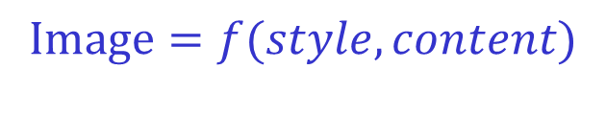
Style-Content Factorization
Asymmetric Bilinear Model (Freeman et al. 2000).
Style
Content
  $$Image=f(style, content)$$
Image

Slide 49
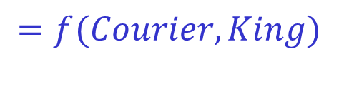
Style-Content Factorization
Asymmetric Bilinear Model (Freeman et al. 2000).
Style
Content
  $$Image=f(style, content)$$
Image
  $$=f(style, content)=f(Courier, French)$$
  $$=f(Courier, King)$$

Slide 50
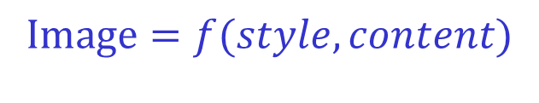
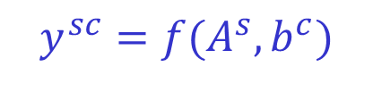
Style-Content Factorization
Asymmetric Bilinear Model (Freeman et al. 2000).
  $$Image=f(style, content)$$
  Notation: refers to style(font), refers to content.
Image
  $$y^{sc}=f(A^{s},b^{c})$$
(8)
Style dependent Basis Vectors
Content Vector

Slide 51
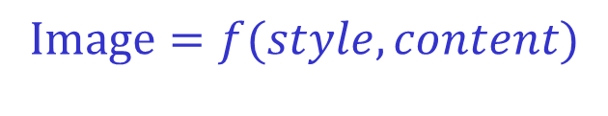

Style-Content Factorization
Asymmetric Bilinear Model (Freeman et al. 2000).
  $$Image=f(style, content)$$
  Notation: refers to style(font), refers to content.
Image
  $$y^{sc}=A^{s }× b^{c}$$
(8)
Style dependent Basis Vectors
Content Vector

Slide 52
Style-Content Factorization
Problems with Asymmetric Bilinear Model
  Needs separate learning for each new style(font).
  Model is too simplistic, overlooks nonlinear interactions.

Slide 53
Style-Content Factorization
Problems with Asymmetric Bilinear Model
  Needs separate learning for each new style.
  Model is too simplistic, overlooks nonlinear relationship.
To tackle these problems, we propose a kernelized version of Asymmetric Bilinear Model.

Slide 54
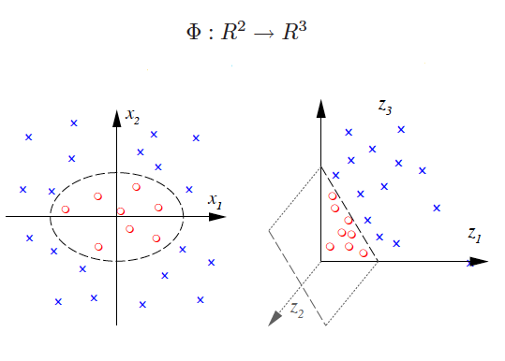
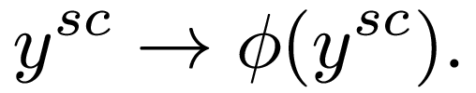


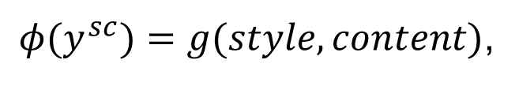
Non-linear Style-Content Factorization
Asymmetric Kernel Bilinear model(AKBM)
(10)
  $φ(y^{sc})=g(style, content)$,
(11)
where

Slide 55

Non-linear Style-Content Factorization
Asymmetric Kernel Bilinear model(AKBM)
(12)
Style Basis
Content vector

Slide 56
Non-linear Style-Content Factorization
Learning the Asymmetric Kernel Bilinear model(AKBM) parameters
(13)
Data fitting term
Regularizer

Slide 57
Non-linear Style-Content Factorization
Learning the Asymmetric Kernel Bilinear model(AKBM) parameters
(13)
  The mapping function is not known.
  Kernel trick comes to rescue.

Slide 58

Non-linear Style-Content Factorization
Learning the Asymmetric Kernel Bilinear model(AKBM) parameters
(13)
Kernel Trick
(14)
  Here is the kernel matrix.

Slide 59
Non-linear Style-Content Factorization
Learning the Asymmetric Kernel Bilinear model(AKBM) parameters
(14)
  Objective is non-convex in and , but convex with respect to any one of them.
  We solve it by alternating between solving the convex problem for keeping constant and vice-versa.

Slide 60


Non-linear Style-Content Factorization
Representing content using AKBM
  For novel query in any style , content is found by minimizing following objective
(15)
(16)

Slide 61
Datasets
Dataset | No. distinct words | No. word images
D1 | 200 | 19472
D2 | 200 | 4923
D3 | 200 | 8463
D4 | 200 | 13557
D5 | 200 | 2868
Dlab | 500 | 5000
D1-D5 consists of word images from 5 different books, varying in font.
Dlab is generated under laboratory settings, consists of 10 widely varying fonts.

Slide 62
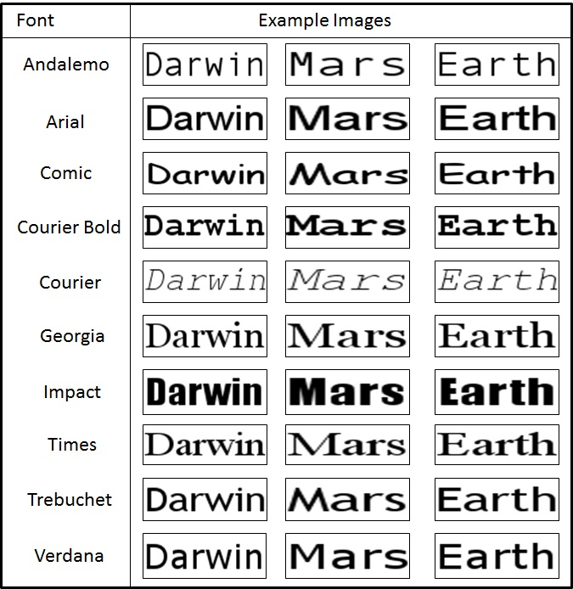
Datasets
Dlab

Slide 63
Experimental Results
 | D1->D2 | D1->D3 | D1->D4 | D2->D1 | D2->D3 | D2->D4
No Transfer | 0.63 | 0.55 | 0.68 | 0.69 | 0.68 | 0.76
ABM(Freeman et al.) | 0.67 | 0.59 | 0.70 | 0.71 | 0.76 | 0.83
AKBM(ours) | 0.88 | 0.72 | 0.84 | 0.85 | 0.83 | 0.91
Asymmetric Kernel Bilinear model(AKBM) refers to our Kernelized style-content factorization.

Slide 64















Query
Retrieved Images(Cross font)
No Transfer
AKBM
No Transfer
AKBM

Slide 65

Experimental Results
Retrieval results on Dlab

Slide 66
Overview
Visual Recognition & Retrieval Tasks
Challenges in Visual Recognition & Retrieval
  Dataset Shift
  Large number of categories
Handling Dataset Shift
  Handling Dataset Shift in object recognition by Domain Adaptation
  Handling Dataset Shift in digit classification by Domain Adaptation
  Handling Dataset Shift in word image retrieval by Kernelized Feature Extraction
Handling large number of categories via Transfer Learning

Slide 67
4. Handling large number of categories via Transfer Learning

Slide 68
Problem Statement
To design a scalable classifier based document image retrieval system.
Around 200K word categories in English language

Slide 69

Proposed Approach
Top few frequent words have most coverage.
A query word can be
  Frequent query : corresponding to the frequent words(higher coverage).
  Rare query : corresponding to the rare
  words(less coverage).

Slide 70

Proposed Approach
  Classifiers are trained for frequent queries & synthesized on-the-fly for rare queries.
  Rare queries consist of characters already present in one or multiple frequent queries.
  To synthesize classifier for a novel rare query, cut and paste relevant portions from existing frequent classifiers.

Slide 71

Proposed Approach
On-the-fly classifier synthesis

Slide 72

Proposed Approach
On-the-fly classifier synthesis

Slide 73
Datasets
Dataset | Source | Type | No. of Images
D1 | 1 book | Clean | 26,555
D2 | 2 books | Clean | 35,730
D3 | 1 book | Noisy | 4373

Slide 74
Experimental Results
Dataset | Source | Type | # Images | # queries | OCR (mAP) | LDA (mAP)
D1 | 1 book | Clean | 26,555 | 100 | 0.97 | 0.98
D2 | 2 books | Clean | 35,730 | 100 | 0.95 | 0.92
D3 | 1 book | Noisy | 4373 | 100 | 0.89 | 0.98
Where mAP is the mean average precision for the 100 queries.

Slide 75
Experimental Results
Dataset | No. of queries | mAP (frequent queries) | mAP (rare queries)
D1 | 100 | 0.99 | 0.90
D2 | 100 | 0.98 | 0.87
D3 | 100 | 1 | 0.82
Where mAP is the mean average precision for the 100 queries.

Slide 76
Conclusion
  Domain Adaptation reduces the mismatch across source & target domains.
  AKBM is more robust to font variations, in comparison to Asymmetric Bilinear Model.
  Transfer learning can be used to design scalable classifier based word image retrieval systems.

Slide 77
Contributions
  PSDL: a joint dictionary learning strategy, suitable for domain adaptation.
  LPSA: a subspace alignment strategy for domain adaptation.
  AKBM: a nonlinear style-content factorization model.
  DQC: a transfer learning strategy for on-the-fly learning of word image classifiers.

Slide 78
Thank You
Related Publications
1. Viresh Ranjan, Gaurav Harit and C.V. Jawahar: Enhancing World Image Retrieval in Presence of Font Variations, International Conference on Pattern Recognition, 2014 (Oral)
2. Viresh Ranjan, Gaurav Harit and C.V. Jawahar: Document Retrieval with Unlimited Vocabulary , IEEE Winter Conference on Applications of Computer Vision(WACV), 2015
3. Viresh Ranjan, Gaurav Harit and C.V. Jawahar: Learning Partially Shared Dictionaries for Domain Adaptation , 12th Asian Conference on Computer Vision (ACCV 2014) (Workshop: FSLCV 2014)
4. Viresh Ranjan, Gaurav Harit and C.V. Jawahar: Domain Adaptation by Aligning Locality Preserving Subspaces, 8th International Conference on Advances in Pattern Recognition(ICAPR 2015)

