Slide 1
Diversity in Image Retrieval: Randomization and Learned Metrics
P Vidyadhar Rao
MS by Research
CVIT, IIIT Hyderabad
201207718

Slide 2
Challenges in Image Retrieval
Optimizing Relevance and Diversity in Retrieval
Randomness
Learning
Algorithmic and Statistical Perspectives
Visual Perspectives
Locality Sensitive Hashing
Distance Metric Learning
Diversity using Random Hash Functions
Diversity using Learned Distance Functions
Experiments and Results
Conclusions

Slide 3

Image Retrieval is Challenging
What is the topic of this image?
What are the right keywords to index this image?
What words would you use to retrieve this image?
Challenges
  meaning of an image is highly individual and subjective
  describing image is cumbersome and labor intensive
  sometimes incomplete

Slide 4
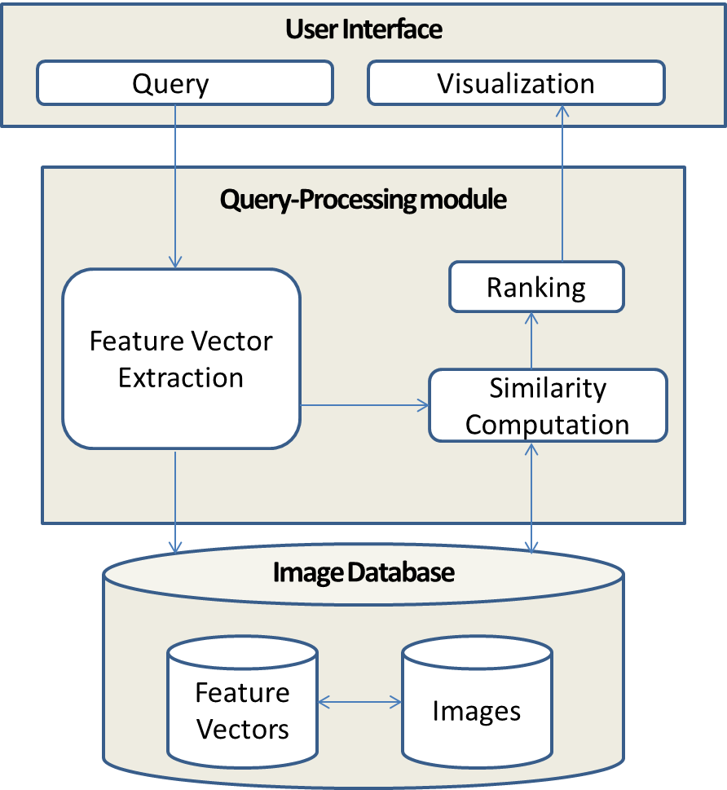
A typical Image Retrieval System
  user provides query
    Usually text or image
  system extracts image features
    texture, color, shape
  returns nearest neighbors
    using suitable similarity measure

Slide 5







Image Retrieval Process
database
images
retrieved images
query image
?
!
similarity
computation
querying
retrieval
START
relevant / irrelevant images
GOAL
[Multimedia Information Retrieval slides by Zoran Steijic, 2002]

Slide 6
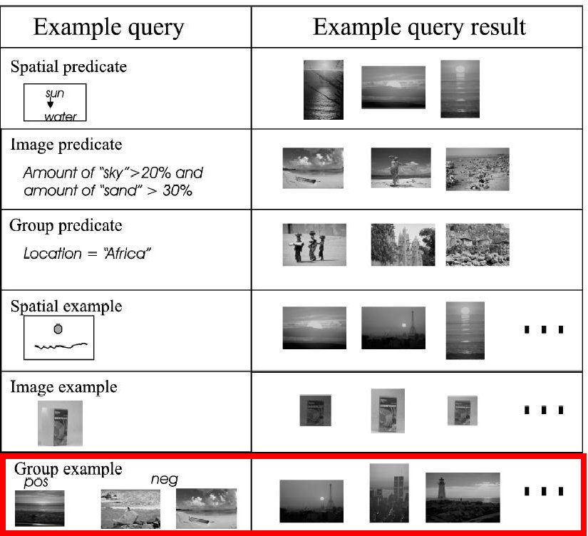
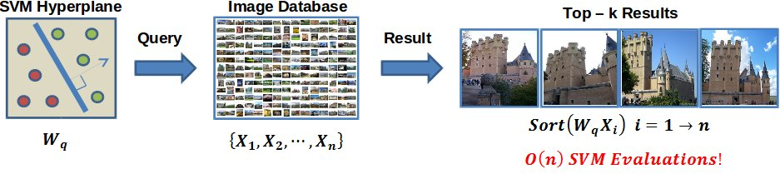
Variety of query mechanisms

Slide 7
Image Representation
Visual content is rich source for image features
  Low level features like color, texture, shape, spatial location etc.
As opposed to high level features or concepts
  Birds, boat, happy, sun-set, water
Semantic Gap
  Gap b/w low-level features and high level user semantics

Slide 8
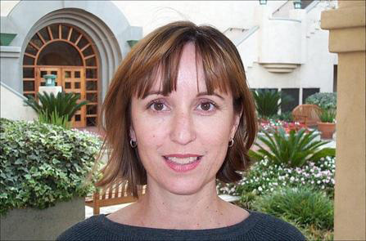
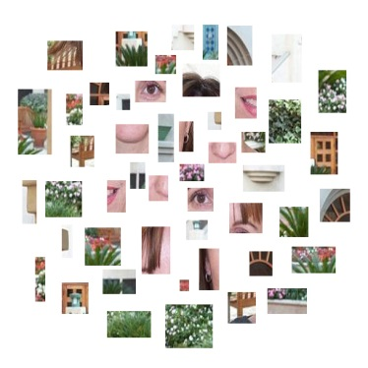

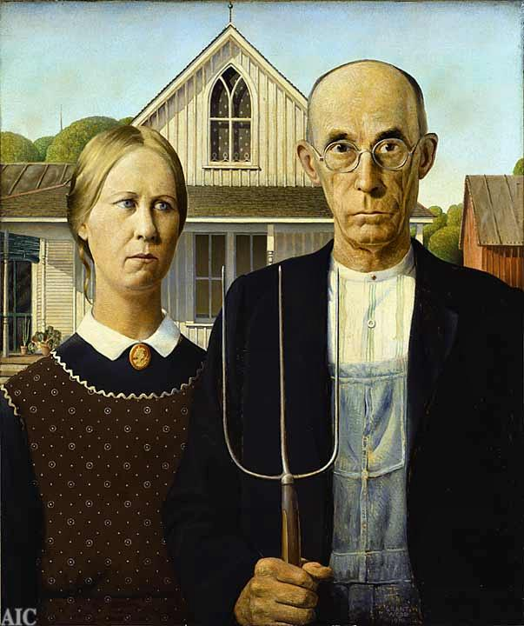
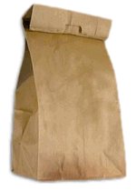













Image Representation
Leverage the classical Information Retrieval methods for Images
Object
Bag of Visual ‘words’
China is forecasting a trade surplus of $90bn (£51bn) to $100bn this year, a threefold increase on 2004's $32bn. The Commerce Ministry said the surplus would be created by a predicted 30% jump in exports to $750bn, compared with a 18% rise in imports to $660bn. The figures are likely to further annoy the US, which has long argued that China's exports are unfairly helped by a deliberately undervalued yuan.
China, trade,
surplus, commerce,
exports, imports, US,
yuan, bank, domestic,
foreign, increase,
trade, value
[Li-Fei-Fei et al Short Course Slides at ICCV 2005]

Slide 9
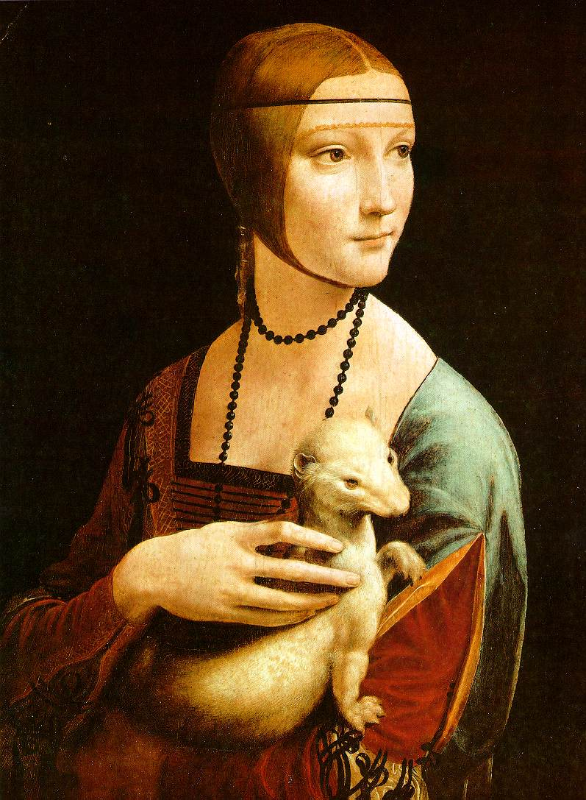
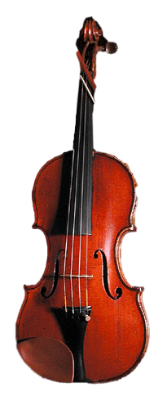
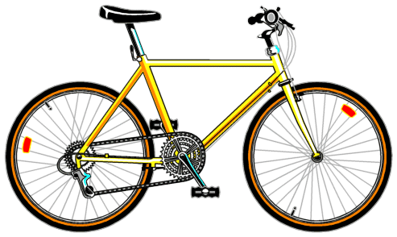
Bag of features: outline
Extract local features from images

Slide 10
Bag of features: outline
Extract local features from images
Learn “visual vocabulary”

Slide 11
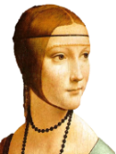

Bag of features: outline
Extract local features from images
Learn “visual vocabulary”
Quantize local features using visual vocabulary
Represent images by frequencies of
“visual words”

Slide 12
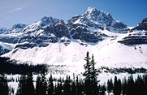
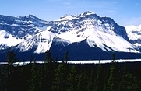
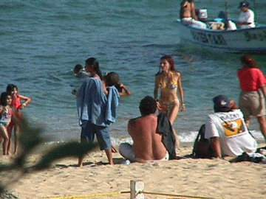
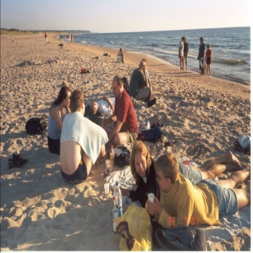
Similarity/Distance Metrics
Retrieval depends on a function that determines the similarity or distance between any two instances.
  Less similar the images, the large the function values
  Euclidean distance is a generic choice.
Feature space is very far from being Euclidean
Visual Relevance
Semantic Relevance
Query image
Similar Image
Query image
Similar Image
[Images from slides by Nikhil Rasiwasia et al, CIVR 2006]

Slide 13
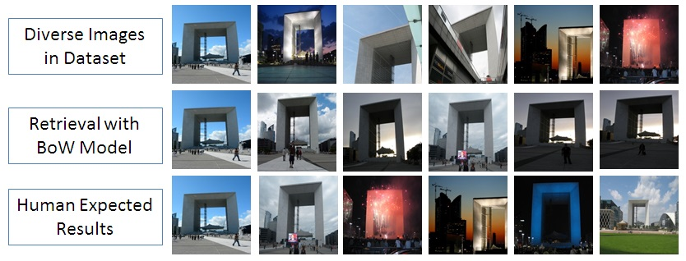
Visual Perspectives
Heterogeneous feature space i.e., diverse in visual content
  Differentiation requires higher order features to be computed
Example: Monument images are subject to geometry and illumination variations
  View point of Camera: position from the which images are captured
  Time of Day: most effected by natural light
  Camera Zoom: intrinsic property of an image

Slide 14
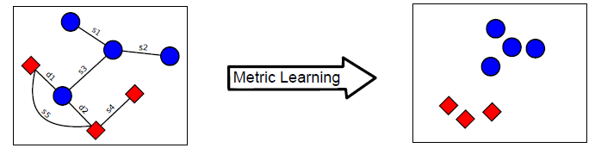
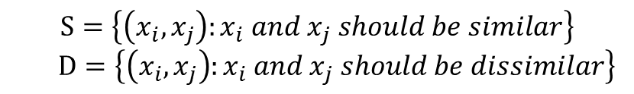

Distance Metric Learning
Semantic information is encoded in the form of pairwise constraints.
Metric can be learned from the constraints to promote desired characteristics
$$S=\left\{\left(x_{i}, x_{j}\right):x_{i} and x_{j} should be similar\right\}$$
$D=\left\{\left(x_{i}, x_{j}\right):x_{i} and x_{j} should be dissimilar\right\}$
$$Dist\left({A, x}_{i},x_{j}\right)={\left(x_{i}−x_{j}\right)}^{T}A\left(x_{i}−x_{j}\right)$$

Slide 15

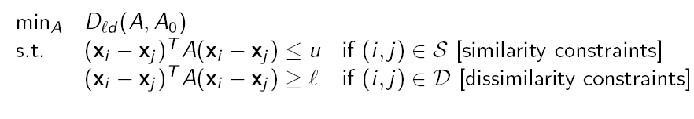
Information Theoretic Metric Learning
ITML Formulation
Advantages
  Simple Efficient Algorithm
  Realized with a linear transformation
  Can be applied to Kernel Space
$$X →Τ=A^{\frac{1}{2}}X$$
[Davis, Kulis, Jain, Sra, and Dhillon, ICML 2007]

Slide 16

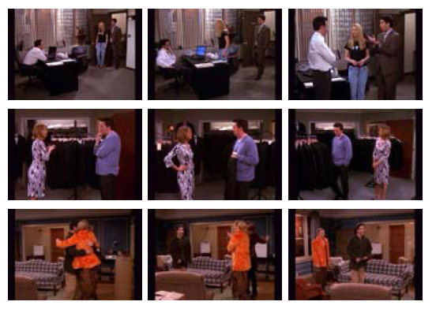
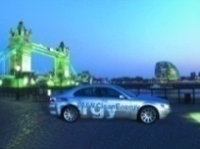
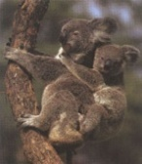
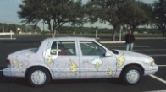

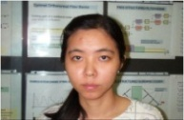
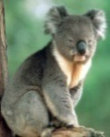
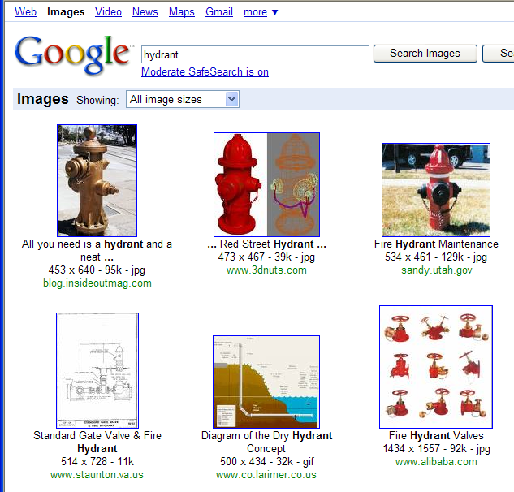

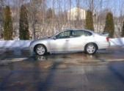
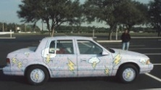

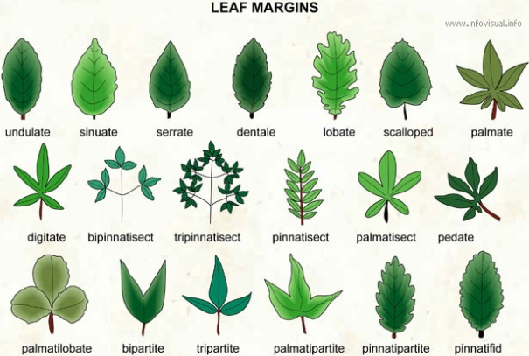





Sources of partially labeled data
Partially labeled image databases
Detected video shots, tracked objects
User feedback
Exploit (dis)/similarity constraints to construct more useful distance functions
Fully labeled image databases
Problem-specific knowledge
[Slides by Jain et al, CVPR 2008]
Notes:
16
16

Slide 17
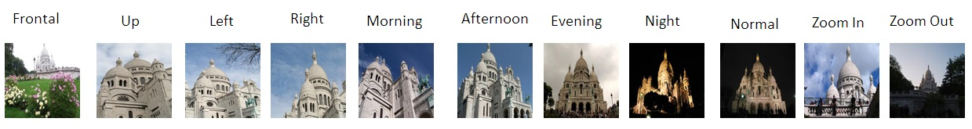
Diversity in Instance based Retrieval
Task
  Retrieve variety of monument images with respect to viewpoint, time of day and camera zoom.
Dataset
  6K images from Paris monument image dataset
  200 images are manually labeled
  Used ITML to learn metrics from 100 pair wise constraints.
Labels for “Sacre Coeur” monument images – [Credits to Ajitesh Gupta ]

Slide 18
Results – Instance based Retrieval
Performance evaluated on 50 queries at Top-5 retrieval
  5% improvements in diversity in the case of time of day and camera zoom
User Preference Study
  Rate the BOVW and ITML methods w.r.t to relevant results.
  210 queries = 14 users X 4 images X 3 criteria.
Method | Accuracy | V-Div | H-V | ToD-Div | H-ToD | Z-Div | H-Z
BoVW | 0.817 | 0.412 | 0.511 | 0.537 | 0.625 | 0.384 | 0.445
ITML | 0.822 | 0.391 | 0.495 | 0.592 | 0.652 | 0.434 | 0.474
Method | BoVW | ITML | TIE
User Preference | 84/210 (40%) | 97/210 (46.19%) | 29/210 (13.81%)

Slide 19
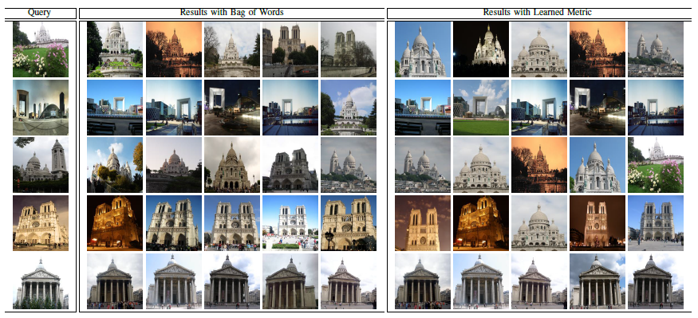
Results – Instance based Retrieval

Slide 20
Diversity is a subjective phenomenon
Topical Diversity
  Product search: e.g., images of a car with different models
Visual Diversity
  People search: e.g., faces of a same person with different ages
Spatial Diversity
  Location search: e.g., photos of a tourist place with different viewpoints
Temporal Diversity
  Video search: e.g., highlights of a player in a game (cricket, badminton etc.)

Slide 21
Need for Diversity in Image Retrieval
Restrictions imposed by fixed-form query
  Ambiguity (lack of clarity) in user requirements
User intent in more complex
  Low-level image features cannot always describe high-level semantic concepts in the user`s mind
Choice of similarity/distance function is rather heuristic
  Semantic notion of similarity is often poorly captured by standard metrics (e.g., Euclidean distance).
Large databases consists redundantly similar images
  Top retrieval results are often dominated by a set of closely related images on some specific topics.

Slide 22
Requirements for image search
Search must be scalable to large databases with fast, accurate and diverse retrieval
Fast
  Indexing mechanisms to efficiently retrieve the images
Scalable
  Require very little memory, enabling their use on standard hardware or even on handheld devices
Accurate
  Relevant images in the results
Diversity
  Large coverage among the retrieved results

Slide 23
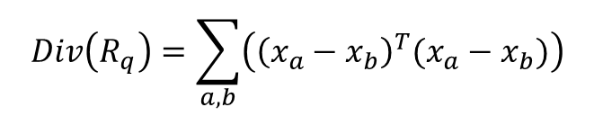

Relevance and Diversity
Relevance: For a given two points, say x and y, dis-similarity is defined as the distance between the two points, i.e.,
Diversity: For a given set of points, diversity is defined as the average pairwise distance between the points of the set, i.e.,
It is not quite clear on how relevance and diversity should be combined!
$$DisSim\left(x,y \right)={\left(x−y\right)}^{T}(x−y)$$
$$Div\left(R_{q}\right)=\sum_{a,b}{\left({\left(x_{a}−x_{b}\right)}^{T}(x_{a}−x_{b})\right)}$$

Slide 24
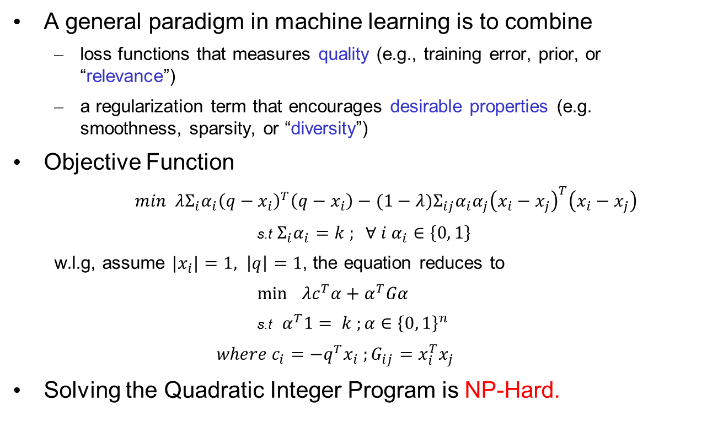
Optimizing Relevance and Diversity
A general paradigm in machine learning is to combine
  loss functions that measures quality (e.g., training error, prior, or “relevance”)
  a regularization term that encourages desirable properties (e.g. smoothness, sparsity, or “diversity”)
Objective Function
  $min{ λΣ_{i}α_{i}\left(q−x_{i}\right)}^{T}\left(q−x_{i}\right)−(1−λ)Σ_{ij}α_{i}α_{j}{\left(x_{i}−x_{j}\right)}^{T}\left(x_{i}−x_{j}\right)$
  s.t $Σ_{i}α_{i}=k ; ∀ i α_{i}∈\left\{0, 1\right\}$
  w.l.g, assume ${|x}_{i}|=1, \left|q\right|=1$, the equation reduces to
  $\min{ }λc^{T}α+α^{T}Gα$
  s.t $α^{T}1= k ;α∈{\left\{0, 1\right\}}^{n}$
  $where c_{i}=−q^{T}x_{i} ;G_{ij}=x_{i}^{T}x_{j}$
Solving the Quadratic Integer Program is NP-Hard.

Slide 25
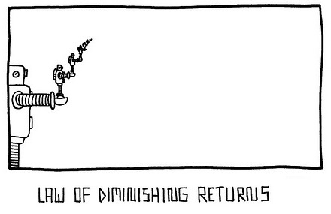
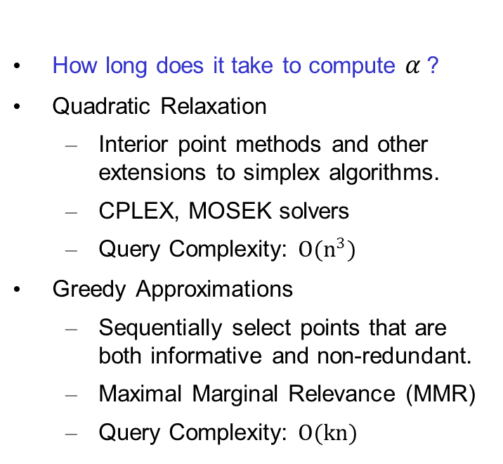
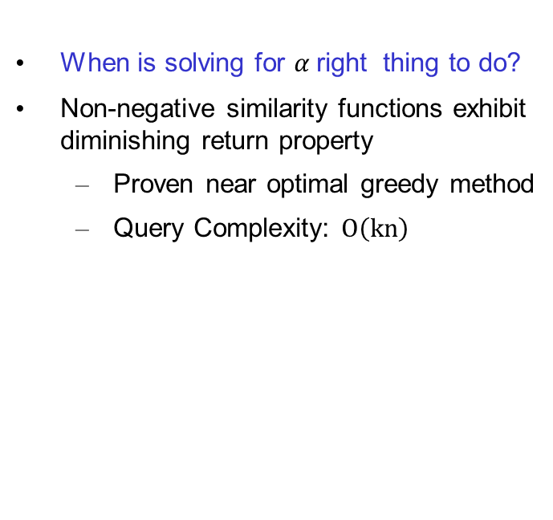
Optimizing Relevance and Diversity
Algorithmic Perspectives
Statistical Perspectives
How long does it take to compute $α$?
Quadratic Relaxation
  Interior point methods and other extensions to simplex algorithms.
  CPLEX, MOSEK solvers
  Query Complexity: $O(n^{3})$
Greedy Approximations
  Sequentially select points that are both informative and non-redundant.
  Maximal Marginal Relevance (MMR)
  Query Complexity: $O(kn)$
When is solving for $α$right thing to do?
Non-negative similarity functions exhibit diminishing return property
  Proven near optimal greedy method
  Query Complexity: $O\left(kn\right)$
[ J.Corbonell et al, SIGIR 1998; J.He et al, NIPS 2012]
Notes:
If we have already shown a lot of relevant results, there should be less added value in showing more relevant results.

Slide 26
Natural forms of diversification
Optimization of set-level relevance objective
  n-call@k metric correlates strongly with diverse retrieval.
  As n -> k, a higher proportion of relevant results are required which discourages diversity.
  When n = 1, encourages diversity since only one relevant result is needed.
  1-call@k in a latent subtopic model of binary relevance shares many features with MMR optimization.
We carry this intuition forward in the nearest neighbor retrieval
  Generalization to arbitrary relevance/similarity functions.
  Guarantee sub-linear time retrieval.
  Trade-offs b/w relevance and diversity can be controlled effectively.
[Wang et al, SIGIR 2010; Sanner et al, CIKM 2011]

Slide 27
Our idea: Randomize don`t optimize
Diverse retrieval “Sole objective”
  Search for the nearest neighbors which also cover large area among themselves
Approximate nearest neighbor retrieval
  Trade off a small hit in accuracy for faster speed of processing
  Efficiency and proven approximation guarantees
Exploit randomness via approximate nearest neighbors that preserves similarity with superior diversity.
In the same way as space and time are valuable resources available to be used judiciously by algorithms, it has been discovered that exploiting randomness as an algorithmic resource inside the algorithm can lead to better algorithms.
[Foundation and Trends in Machine Learning Series, 2010]

Slide 28
Approximate Nearest Neighbors
Tree Based Structure
  Spatial partitions and recursive hyper plane decomposition provide an efficient means to search low-dimensional vector data exactly.
  Kd-trees are not the most efficient solution in theory but widely used in practice.
Hashing
  Dimensionality reduction through random projections while still preserving the similarity between each pair of points.
  Locality-sensitive hashing offers sub-linear time nearest neighbor search by hashing highly similar examples together.
  Strong theoretical guarantees
[Indyk and Motwani 1998, Charikar 2002]

Slide 29
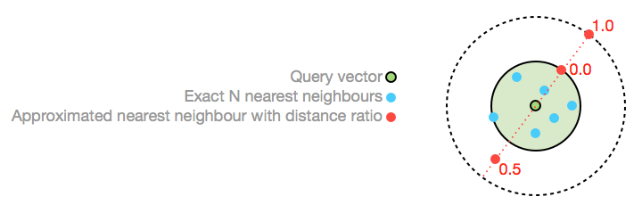


Locality Sensitive Hashing
The basic idea is to project the data into a low-dimensional binary (Hamming) space
  Each data point is mapped to a k-bit vector, called the hash code.
Retrieving distance ratio near neighbors requires query time
  Average distance ration is 0.0, all approximate near neighbors are within the exact neighbor hyper-sphere
  A ratio of 1.0 means the average ANN is 2*R away from the query vector.
$$ε$$
$$\text{O}{(n}^{\frac{1}{1+ε}})$$
[Darter et al, SOCG 2004]

Slide 30
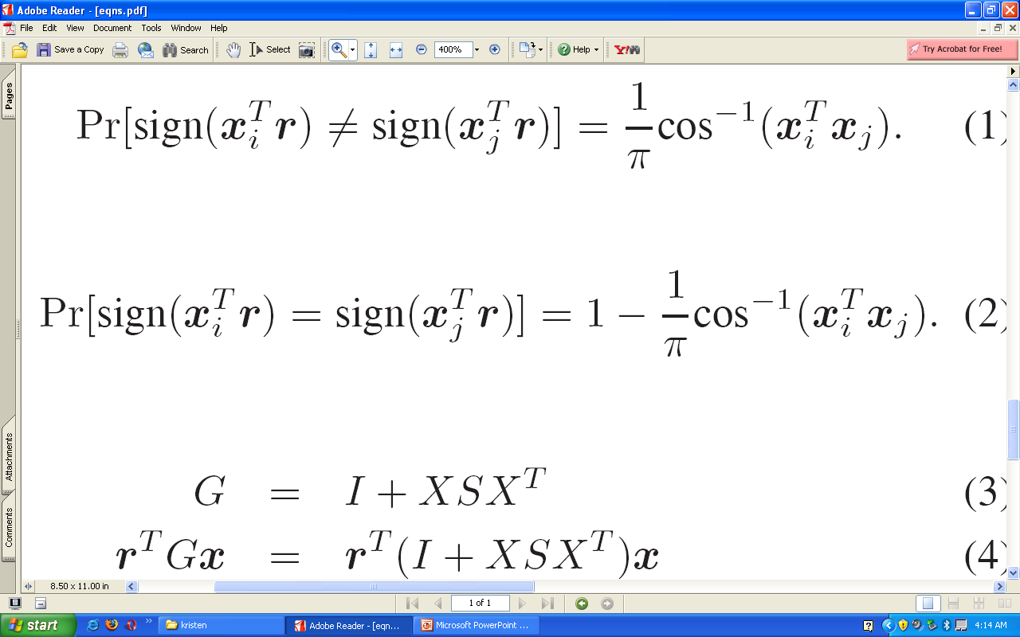


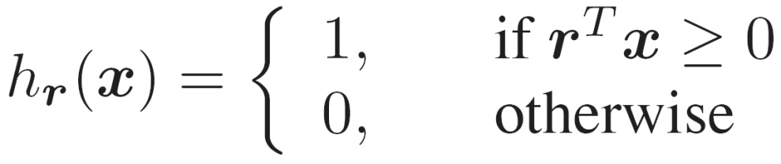

LSH functions for dot products
Probability of random hyper-plane separates two unit vectors depends on the angle between them.
is a hyper-plane separating the space
[Goemans and Williamson 1995, Charikar 2004]

Slide 31
LSH with Random Projections
Take random projections of data
Quantize each projection with few bits
0
101
Feature vector
1
0
1
1
0
[Svetlana et al, Course slides 2009]

Slide 32
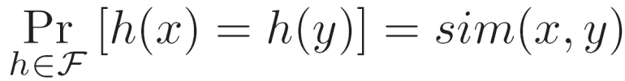
Nearest Neighbor search from hash table
A set of data points
N
Hash function
h
r₁…r_{k}
Search the hash table
for a small set of points
X_{i}
<< N
Hash table
110101
Q
h
r₁…r_{k}
Q
110111
111101
New query
[Kristen Grauman et al, CVPR 2008]
results
Notes:
32

Slide 33
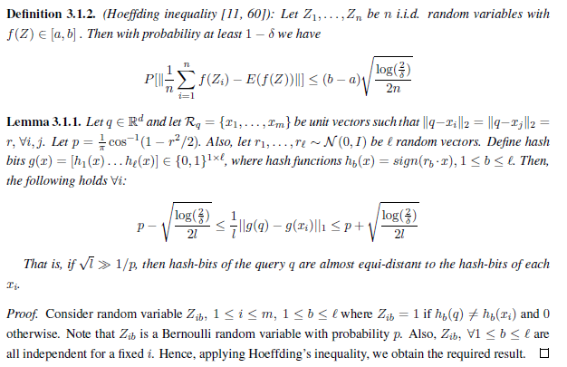
Diversity in Randomized LSH
[Vidyadhar et al, arXiv 2015 – Credits to Prateek Jain]
Notes:
Assuming randomization selection of points from a hash bucket, the probability of selecting any point on the hamming ball is almost the same, i.e., the points selected are nearly uniform at random and are diverse.

Slide 34
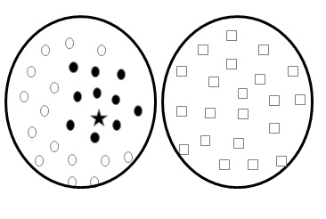
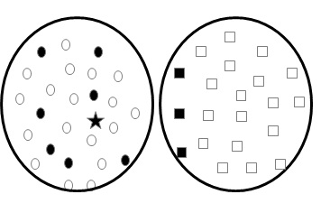
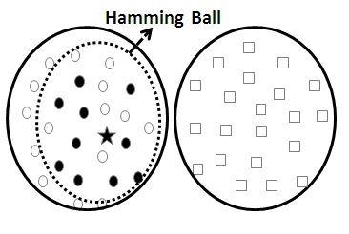
Accurate and Diverse LSH Retrieval
Simple NN Retrieval
(accurate, not diverse)
Greedy MMR Retrieval
(not accurate, diverse)
Randomized LSH
(accurate, diverse)

Slide 35
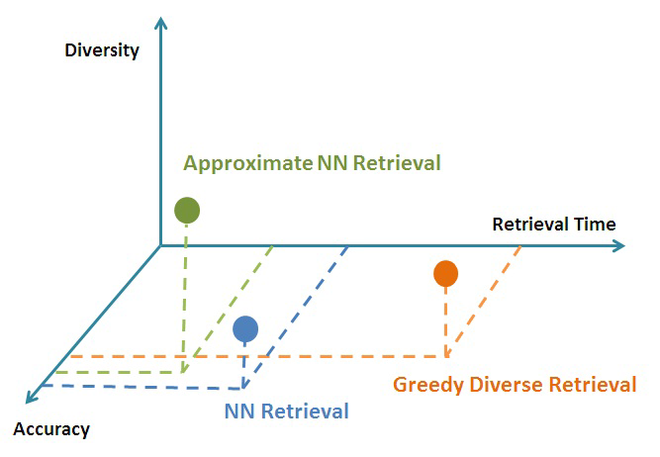



Accuracy, Diversity and Query Time
$$\text{O}{(n}^{\frac{1}{1+ε}})$$
$$\text{O}(kn)$$
$$\text{O}(n)$$

Slide 36
Diversity in Image Category Retrieval
Task
  Retrieve sub-category images for an object category query (classifier).
Dataset
  42K images from ImageNet database with 7 categories: animal, bottle, flower, furniture, geography, music, vehicle. 5 sub-categories for each.
Performance evaluated on 7 categories X 50 random queries
Method | Precision | S-Recall | Diversity | H-Score | Time
NN | 1.00 | 0.60 | 0.53 | 0.66 | 0.621
MMR | 0.92 | 0.73 | 0.68 | 0.77 | 5.168
QP-Rel | 1.00 | 0.74 | 0.69 | 0.81 | 704.9
LSH-Div | 0.97 | 0.79 | 0.76 | 0.84 | 0.112

Slide 37
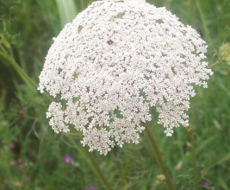
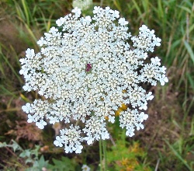
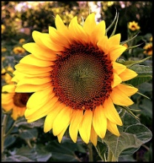
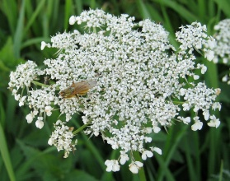
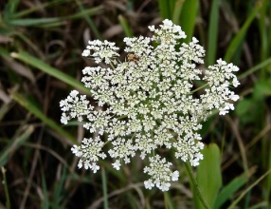















































































Results – Image Category Retrieval
Simple NN Retrieval
Greedy MMR Retrieval
Randomized LSH
Notes:
Add qualitative results

Slide 38
Diversity in Multi-Label Prediction
Task
  Retrieve diverse set of labels for a document query.
Dataset
  LSHTC3 Wikipedia 754K documents with 259K unique labels
Performance evaluated on 10% of the documents.
Method | Precision | Recall | F-Score | Diversity | H-Score | Time
LEML | 0.304 | 0.196 | 0.192 | 0.827 | 0.534 | 137.1
MMR | 0.275 | 0.134 | 0.175 | 0.865 | 0.418 | 458.8
PCA-HASH | 0.265 | 0.096 | 0.121 | 0.872 | 0.669 | 5.9
LSH-Div | 0.144 | 0.088 | 0.083 | 0.825 | 0.437 | 7.2
LSH-SDiv | 0.318 | 0.102 | 0.133 | 0.919 | 0.734 | 5.7
Notes:
4 labels per document

Slide 39


Results – Multi-Label Prediction
Flat classification not efficient for Skewed distribution of labels
A variant of PCA Hash to encourage diversity in the labels
Performance on LSHTC3 dataset with respect to parameter
$$ε$$

Slide 40
Diversity in Image Tag Suggestion
Task
  Predict diverse set of tags for an image query.
Dataset
  2.7M Flickr images with 5,09,234 unique tags.
  Average value of 5.4 tags per image.
Performance evaluated on 314 query images
Method | Prec@1 | Prec@3 | Prec@5 | Diversity | H-Score | Time
VN | 0.057 | 0.054 | 0.053 | 0.910 | 0.100 | 472.1
LSH-Div | 0.048 | 0.037 | 0.034 | 0.911 | 0.065 | 3.0
LSH-SDiv | 0.051 | 0.047 | 0.039 | 0.915 | 0.076 | 4.6

Slide 41






Results – Image Tag Suggestion
Query
Image
Method
Cloud, sky, mountain, blue, water
Flower, red, macro105mm, rose, nature
Light, fire, night, camp, sunset
Race, bike, partial, bicycle accident
Flower, red, macro105mm, pink, garden
Tree, hike, park, house, mountain
VN
Sky, snow, snowboard, winter, italia
Chartact, red, car, canada, grape hyacinth
Adult and juvenil, life, leavalley, restal, kiss
Flower, orangad, macro105mm, red, rose
LSH-Div
---
---
Mountain, travel, sky, cloud, lake adelaid
Flower, red, rose, garden, lea valley
Light, night, firework, flower, concert danzig
Sanfrancisco, bike rack, bike, tour of california
Flower, macro105mm, red, nature, green
LSH-SDiv
Tree, fall, autumn, car

Slide 42
Thesis Contributions
Metrics are convenient proxies for effective representation
  Encode higher order semantics using distance metric learning
  Re-fashion visual feature space to promote diversity in retrieval
Approximate nearest neighbors as proxy to promote relevance and diversity
  Randomize don`t optimize: Theoretical claim that randomized LSH is not biased towards any particular region of the space
Applicability in different retrieval settings
  High level semantics incorporated into the retrieval process.
  Robust at different levels of accuracies – high, medium and low
  Good balance between accuracy, diversity – compact hashing
  Computationally efficient – 100x speedup over baselines

Slide 43
Future Perspectives
Derive guarantees for the proposed approach
Adaptability to different kinds of diversity
  Temporal, Spatial, Topical, Visual
Immediately useful extensions
  Cross-domain retrieval (text and image)
  Knowledge source combination (multi-modalities)
  Image search results navigation on mobile devices
Application to Medical domain
  Lung cancer can stay hidden for over 20 years.
  Visualization of images/reports at different stages of cancer evolution!

Slide 44
Further Reading
Vidyadhar Rao, Prateek Jain and C.V. Jawahar “Diverse Yet Efficient Retrieval using Hash Functions” in arXiv preprint, arXiv:1509.06553, 22nd Sep, 2015.
Vidyadhar Rao, Ajitesh Gupta, Visesh Chari, C.V. Jawahar “Learning Metrics for Diversity in Instance Retrieval” in Proceedings of the 5th National Conference on Computer Vision, Pattern Recognition, Image Processing and Graphics, 16-19 Dec 2015, Patna, India.
Vidyadhar Rao and C.V. Jawahar “Semi-Supervised Clustering by Selecting Informative Constraints” in Proceedings of 5th International Conference on Pattern Recognition and Machines Intelligence, 10-14 Dec. 2013, Kolkata, India.
Acknowledgments: C.V. Jawahar, Prateek Jain, Visesh Chari, Ajitesh Gupta, 14 participants in our human evaluation task.

Slide 45


Tree Based Structure
Kd-tree
  The kd-tree is a binary tree in which every node is a k-dimensional point
(No theoretical guarantee!)They are known to break down in practice for high dimensional data, and cannot provide better than a worst case linear query time guarantee.
  Hierarchical 1-NN
  K-D tree

Slide 46
Our idea: Randomize don`t optimize
Before model induction
  Bootstrap sampling; Feature randomization
During model induction
  Randomized decision trees, Ensemble of randomized trees
After model induction
  Trade off a small hit in accuracy for faster speed of processing
  Efficiency and proven approximation guarantees
Earlier approaches considered approximate nearest neighbor retrieval to be acceptable only for the sake of efficiency.
We argue that one can further exploit approximate NN retrieval to provide impressive trade-offs between accuracy and diversity.
  Inevitable for very large image databases that require real-time responses
Notes:
Use figures to explain each case if possible.

Slide 47



Slide 48




























Slide 49

Outline
Introduction
  Diversity in Image Retrieval
  Thesis Contributions
Related Work
Different Perspectives
  Locality Sensitive Hash Functions
  Information Theoretic Metric Learning
Results
  Image Category Retrieval
  Multi-label Classification
  Image Tag Prediction
  Instance based Image Retrieval
Conclusions and Future work

Slide 50

Example: Many near duplicates in top ranked images for the query “Australian animals”
Notes:
Replace with one of our datasets

Slide 51

Example: User intends for different animals in Australia for the query “Australian animals”
Notes:
Replace with one of our datasets

Slide 52
Accurate and Diverse Retrieval
Simple NN Retrieval
(accurate, not diverse)
Greedy MMR Retrieval
(not accurate, diverse)
Randomized LSH
(accurate, diverse)

