Slide 1
Learning Semantic Interaction Among Indoor Objects
Presented by,
Swagatika Panda
Advisors: Dr. A.H. Abdul Hafez, Prof. C.V. Jawahar
Center for Visual Information Technology, IIIT-Hyderabad , India

Slide 2

What is clutter??

Slide 3
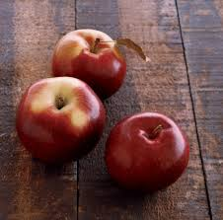
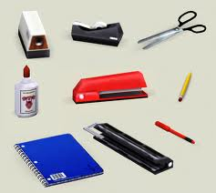
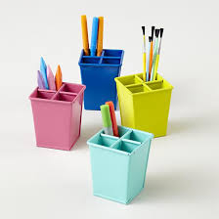
What is clutter??
Extremely cluttered
Spatial Isolation, single plane
Notes:
What exactly is the definition of clutter? It can range from objects places in spatial isolation to extreme amount of clutter. Most of the grasping applications work for objects in spatial isolation. This shows that we have way to go in terms of handling objects in clutter.

Slide 4
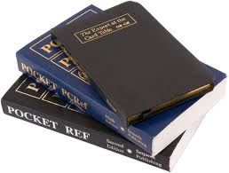
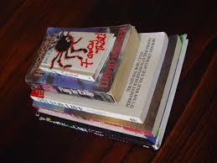
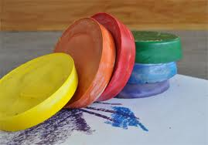
What is clutter??
Extremely cluttered
Spatial Isolation, single plane
Notes:
What exactly is the definition of clutter? It can range from objects places in spatial isolation to extreme amount of clutter. Most of the grasping applications work for objects in spatial isolation. This shows that we have way to go in terms of handling objects in clutter.

Slide 5
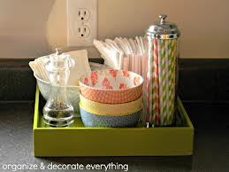

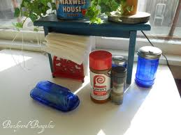
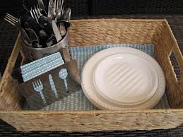
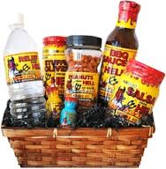
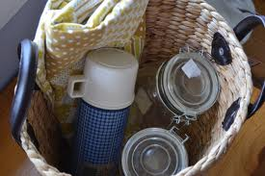

What is clutter??
Extremely cluttered
Spatial Isolation, single plane
Notes:
What exactly is the definition of clutter? It can range from objects places in spatial isolation to extreme amount of clutter. Most of the grasping applications work for objects in spatial isolation. This shows that we have way to go in terms of handling objects in clutter.

Slide 6
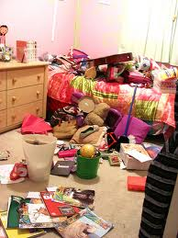

What is clutter??
Extremely cluttered
Spatial Isolation, single plane

Slide 7
What is clutter??
Extremely cluttered
Spatial Isolation, single plane
Grasping applications
Notes:
As we can see, there are different degrees of complexity, Objects of complex shapes and varying sizes, Different types of interaction and Static objects in the background .

Slide 8
What makes our job difficult ??

Slide 9
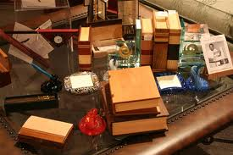
Different degrees of complexity
What makes our job difficult ??

Slide 10
Different degrees of complexity
Objects of complex shapes and varying sizes
What makes our job difficult ??
Notes:
As we can see, there are different degrees of complexity, Objects of complex shapes and varying sizes, Different types of interaction and Static objects in the background .

Slide 11

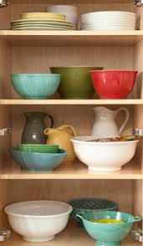
Different degrees of complexity
Objects of complex shapes and varying sizes
What makes our job difficult ??
Different types of interaction
Notes:
As we can see, there are different degrees of complexity, Objects of complex shapes and varying sizes, Different types of interaction and Static objects in the background .

Slide 12
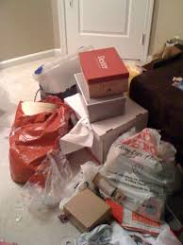
Different degrees of complexity
Objects of complex shapes and varying sizes
What makes our job difficult ??
Static objects in the background
Different types of interaction
Notes:
As we can see, there are different degrees of complexity, Objects of complex shapes and varying sizes, Different types of interaction and Static objects in the background .

Slide 13
How can the robot pick my stuff ??
Notes:
How can the robot pick my stuff from clutter with all these factors present in it?

Slide 14

How can the robot pick my stuff ??
Segment out the object(s)
Notes:
It needs to segment out the object(s),

Slide 15

How can the robot pick my stuff ??
Segment out the object(s)
Use efficient grasping technique
Notes:
Use efficient grasping technique,

Slide 16
How can the robot pick my stuff ??
Segment out the object(s)
Use efficient grasping technique
Infer semantic interaction among objects
Notes:
Infer semantic interaction among objects.

Slide 17

How can the robot pick my stuff ??
Segment out the object(s)
Use efficient grasping technique
Infer semantic interaction among objects
Remove the surrounding objects!

Slide 18
How can the robot pick my stuff ??
Segment out the object(s)
Use efficient grasping technique
Infer semantic interaction among objects
Remove the surrounding objects!
Identify the supported objects …
Remove them without causing damage to the environment.
Notes:
But the objects are no more isolated. We must remove the surrounding objects before removing our object of interest such that there is no damage. For this, we must understand the semantic interaction among objects at different levels.

Slide 19
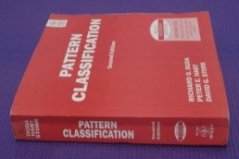


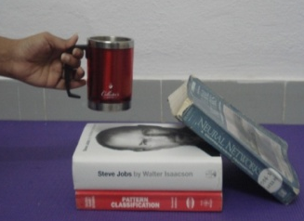
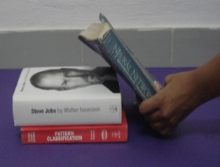
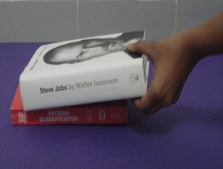
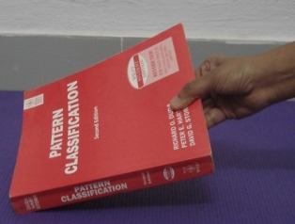
Problem Statement …
Possibility of Damage
Objects are removed in an order
AIM
Automatically find the order (Support Order)using RGBD data.
Notes:
In our work, we Infer support relationship & derive a sequence in which the surrounding objects of our object of interest should be removed while causing minimal damage to the environment, i.e., Learn the Support Order for the object of interest.

Slide 20
Contributions…
Analysis support relationships in different scenarios…
Objects of varying shapes and size.
Noisy background with non-graspable objects present in it.
Clutter with varying level of complexity.
Both direct and indirect physical contact among objects.
Both pair-wise and hierarchical support relations among objects.
Notes:
We analyze spatial relationship or “support relationship” among objects in different levels of
complexity: objects of varying shapes and size, noisy background with non-graspable objects
present in it, clutter with varying level of complexity, both direct and indirect physical contact
among objects, both pairwise support relations and hierarchical support relations among objects.

Slide 21
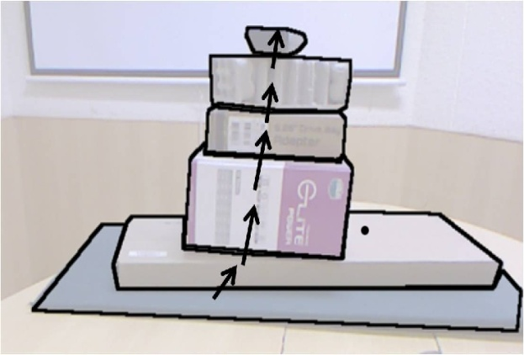
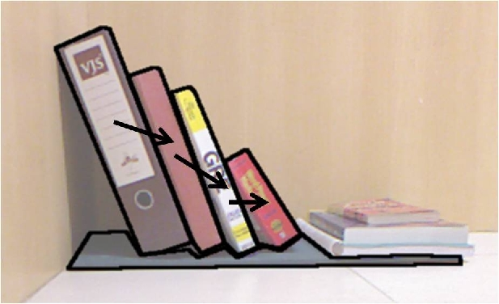
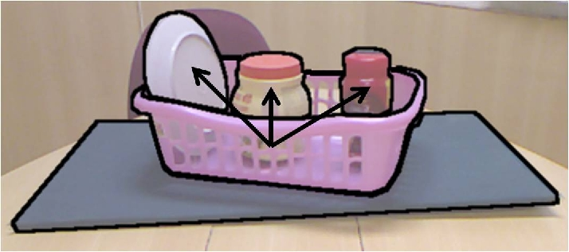
Contributions…
3 types of support relationships …
Support from Below
Support from Side
Containment
Notes:
We infer three types of support relations, “Support from Below”, “Support from Side” and “Containment”.

Slide 22
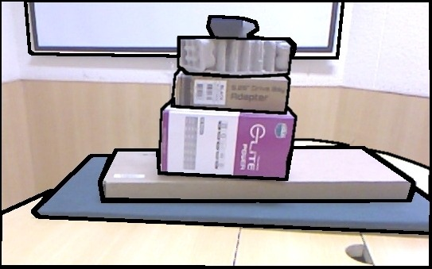
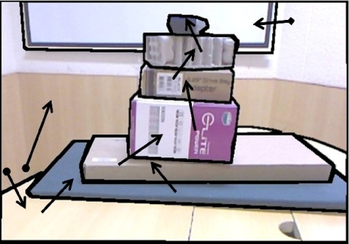
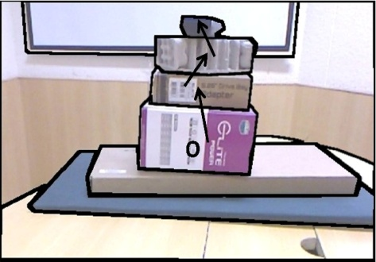
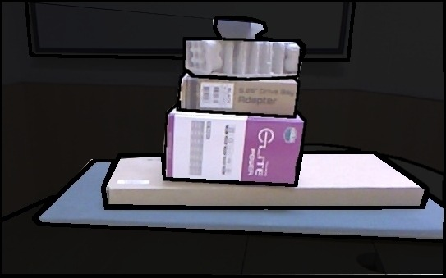
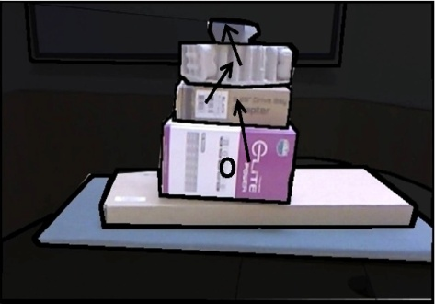
Contributions…
Support inference methods …
Multiple Object Support Inference Method
Input image
Support relations among all regions
Support order prediction
Hierarchical Support Inference Method
Input image
Structure class
inference
Support inference & order prediction
Notes:
We propose two alternative methods “Multiple Object Support Inference” and “Hierarchical Support Inference” for support inference and compare to MAP inference adapted from Silberman et al .

Slide 23
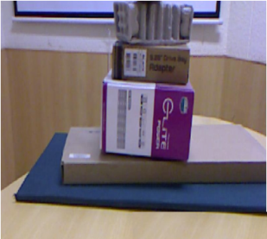


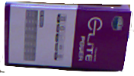
Contributions…
Support Order Prediction …
derive an order in which the surrounding objects of our object of interest should be removed while causing minimal damage to the environment.
1
2
3
Notes:
We propose the idea of “Support Order Prediction” for objects present in clutter. Support Order
is defined as the order or sequence in which surrounding objects need to be removed in order to
grasp the object of interest. We consider different practical constraints in clutter and address them
while predicting support order, in order to avoid damage.

Slide 24
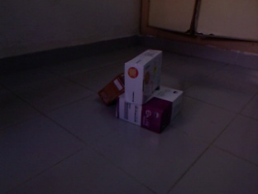
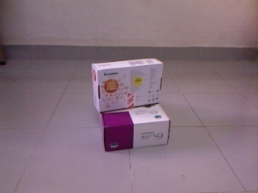
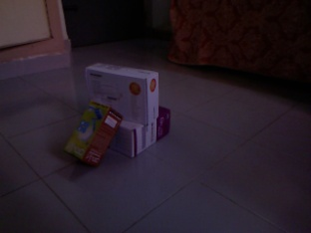
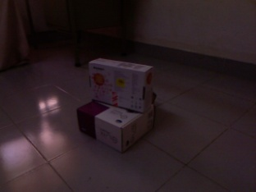
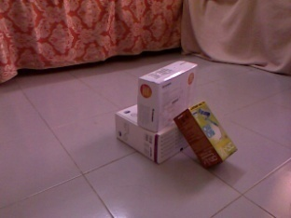
Contributions…
Support order prediction in multiple views …
New object in scene
View2
Clearer view
View3
View1
Object omitted
View5
View4
Notes:
We extend support order prediction to multiple views. The cluttered scene is captured from multiple
views. The regions from different views are mapped together and global support inference
is generated from single views followed by support order prediction.

Slide 25
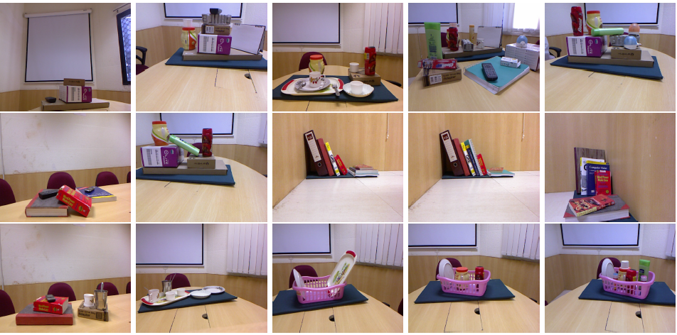
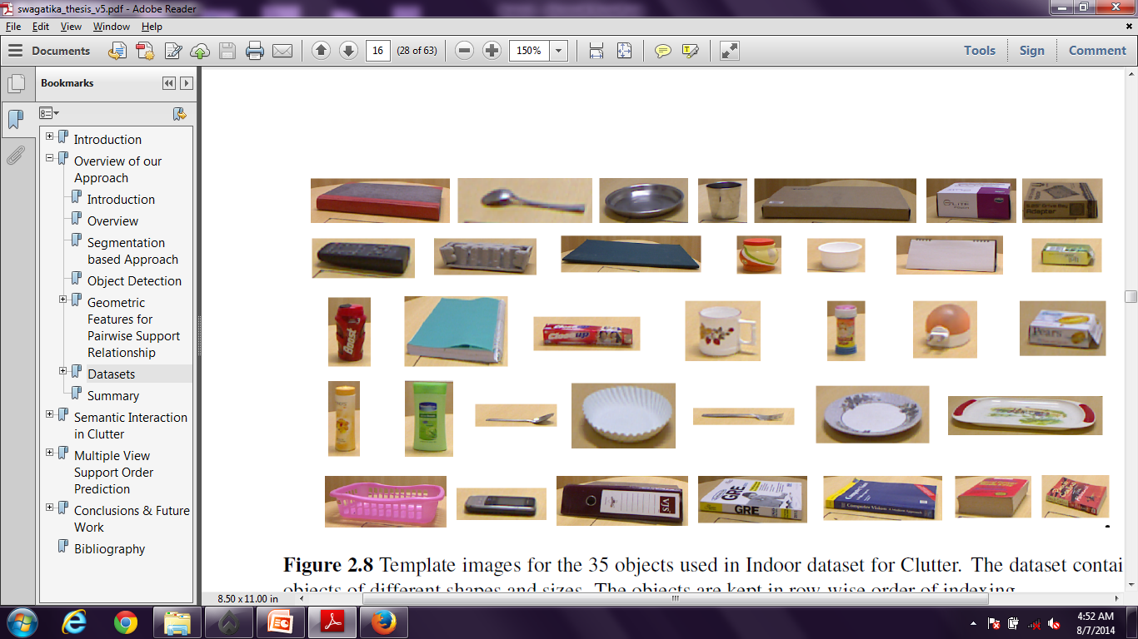
Contributions…
2 RGBD datasets …
Indoor dataset for clutter
50 images
50 cluttered scenes
35 objects
Dataset
Objects
Available @ http://cvit.iiit.ac.in/projects/semantic_interaction_indoor_objects/
Notes:
We have created two RGBD datasets for our experimentation. “Indoor dataset for clutter” contains
50 images of 50 cluttered scenes. “Indoor multiview dataset” contains 67 images of 7 cluttered
scenes. Manual annotation and ground truth generation are also done. For each image/view, its
depthmap and point cloud are collected along with its RGB image using Kinect. We perform our
experimentation in the same datasets. The datasets are also available for public usage.

Slide 26
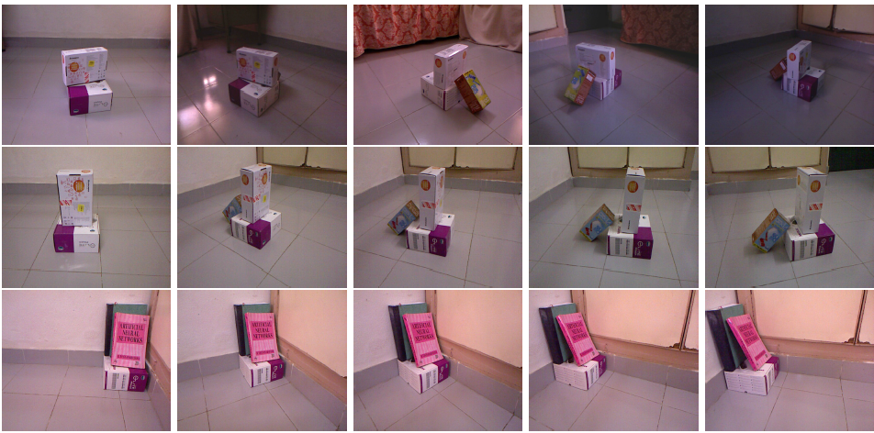
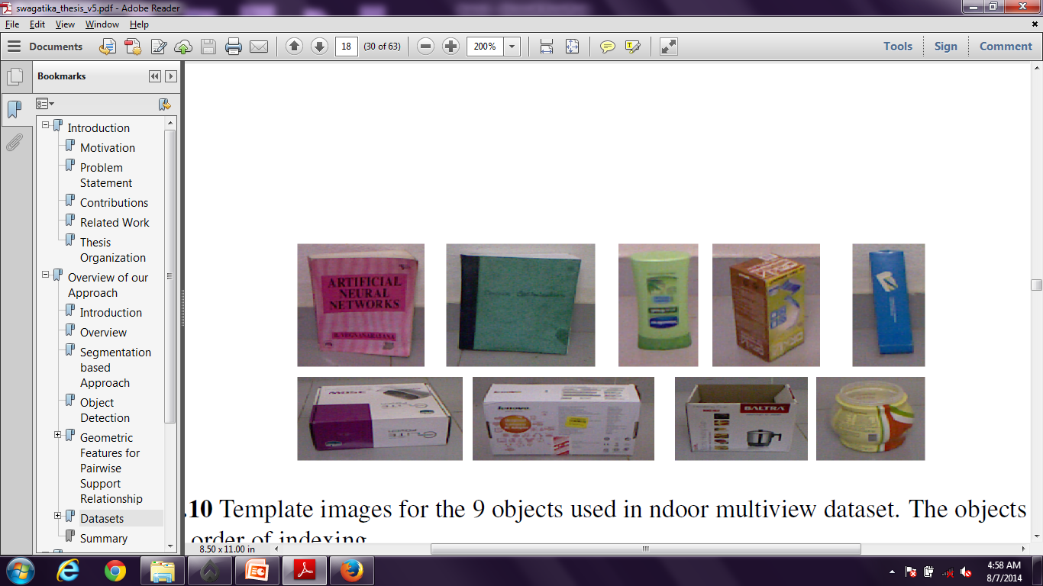
Contributions…
2 RGBD datasets …
Indoor multiview dataset
67 images
7 cluttered scenes
9 objects
Dataset
Objects
Available @ http://cvit.iiit.ac.in/projects/semantic_interaction_indoor_objects/
Notes:
We have created two RGBD datasets for our experimentation. “Indoor dataset for clutter” contains
50 images of 50 cluttered scenes. “Indoor multiview dataset” contains 67 images of 7 cluttered
scenes. Manual annotation and ground truth generation are also done. For each image/view, its
depthmap and point cloud are collected along with its RGB image using Kinect. We perform our
experimentation in the same datasets. The datasets are also available for public usage.

Slide 27


Some of the recent work …
Support by multiple objects
Support in Hierarchy
Semantic interaction
Physical Contact
Clutter in real-world
Noisy background
^{Dogar and Srinivasa, RSS 11}
^{Dogar et al., RSS 12}
Rosman and Ramamoorthy, IJRR 11
^{Sjoo and Jensfelt, IROS 11}
^{Silberman et al., ECCV 12}
Notes:
Some of the significant work in the direction for grasping in clutter is done by Dogar et al and for semantic interaction are done by Rosman et al, Sjoo n Jensfelt and Silberman et al. However, they do not satisfy all of the factors that are semantic interaction, physical contact, clutter in real world, noisy background, support by multiple objects and support in hierarchy. In our work, we try to address all these criteria…

Slide 28
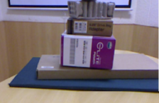
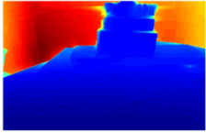
The framework …
RGB Image
Depthmap
Input: RGB Image and Depthmap captured using Kinect.
Notes:
Let us get an idea of the overall framework. RGB and depthmap are captured using Kinect.

Slide 29
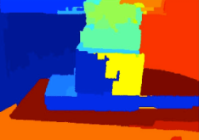
The framework …
RGB Image
Segmentation
Segmented Image
Depthmap
Segmentation: Over-segmentation using Arbelaez et al. (PAMI’11)
Hierarchical segmentation using Hoiem et al. (IJCV’11)
Use 2D and 3D geometric and photometric features.
Boosted decision tree classifier.
Notes:
Both RGB and depth data are used for segmenting an image into regions. The images are first segmented into superpixels using watershed algorithm applied to Pb boundaries
proposed by Arbelaez et al. [8]. A 5-stage hierarchical segmentation method by Hoiem et al. [27] is
used to segment the scene using the superpixels. Both 2D and 3D geometric and photometric features of
the images are used for segmentation [49]. In this approach, a boosted decision tree classifier is trained
to predict the boundary strengths of each image region and regions with boundary strength below a
threshold are iteratively merged to give optimal segments.

Slide 30
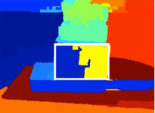
The framework …
RGB Image
Segmentation
Object Detection
Segmented Image
Detected Region
Depthmap
Object of interest
Object Detection: SIFT feature matching.
RANSAC applied to discard outliers.
Matching segmented regions are merged.
For each object multiple templates are stored.
Notes:
. Segmented image is given to object detection module where object of interested is detected using Dense SIFT feature matching followed by RANSAC to discard outliers. If the matched points belong to more than one region, the regions are merged into one region based on adjacency. The template with maximum matching points is chosen as most matching template.

Slide 31

The framework …
RGB Image
Segmentation
Object Detection
Segmented Image
Detected Region
Depthmap
Object of interest
Support Matrix
Support Inference
Tree of Support
Support Inference: Infers support relationships among the regions and stores in a support matrix.
Notes:
This is followed by Support inference in which pairwise support relationship b/w each pair of region is inferred and stored in a support matrix.

Slide 32
The framework …
RGB Image
Segmentation
Object Detection
Segmented Image
Detected Region
Depthmap
Object of interest
1
2
Support order prediction
Support Matrix
Support Inference
Tree of Support
3
Support Order
Support Order Prediction: Support relationship captured in a tree.
Identification of scenarios to avoid damage.
Tree traversal to generate Support Order.
Notes:
This is given as input to support order prediction module which uses the pairwise support information to determine the hierarchical support relationship b/w objects w.r.t the object of interest. And produces the support order.

Slide 33
Support Inference
MAP Inference [Silberman etal., ECCV’12]
Inference methods
Multiple Object Support Inference
Hierarchical Support Inference
Infer supporting region and support type for each region.
Denote hidden supporting region as -1 and floor as 0.
Use geometric features f(i,j)
i : supported region, j: supporting region
Notes:
Support inference module takes in the segmented image and stores pairwise support information in a support matrix. Let us look into support inference method: we apply 3methods: first, MAP inference method by Silberman et al with slight modification and our proposed multiple object support inference method, and then hierarchical support inference method. For each region in the image, supporting region and support type is inferred using a set of support features. We denote them as f(i,j) where the first index is supported region and the 2nd index is a supporting region. A hidden region is denoted by -1 and floor is denoted as 0.

Slide 34
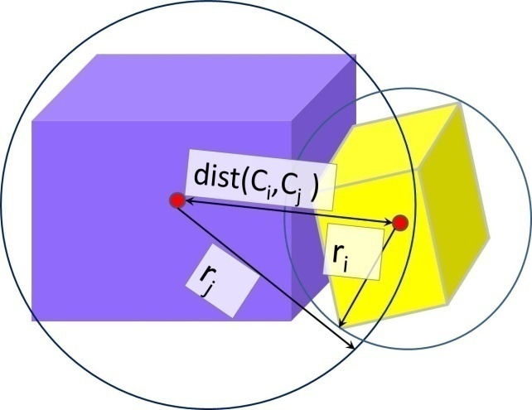
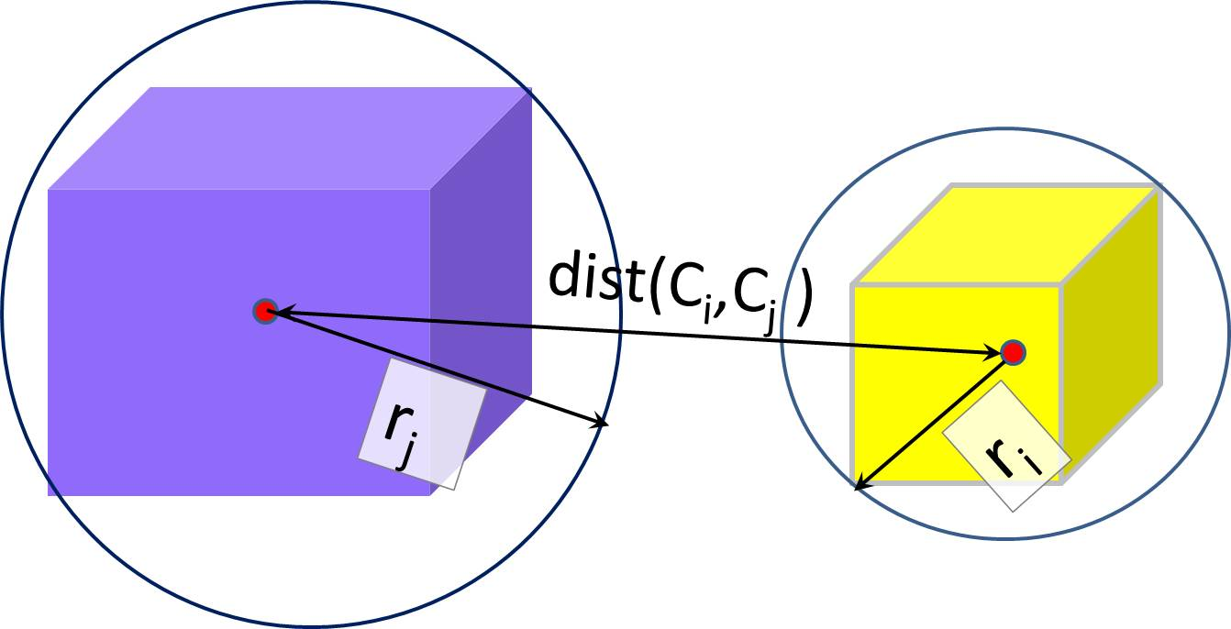
Features…
Close Proximity, f_{p} < 1
Proximity
At distance, f_{p} > 1
Notes:
Let us have a brief overview of the features used for support inference. Proximity b/w two objects measures how close two objects are from each other.

Slide 35
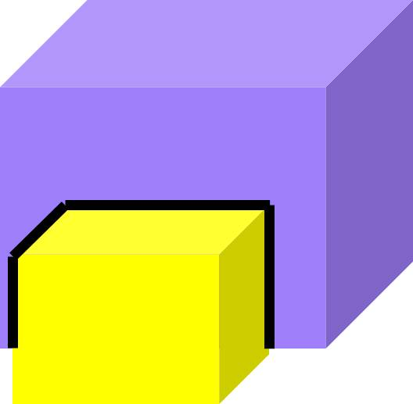
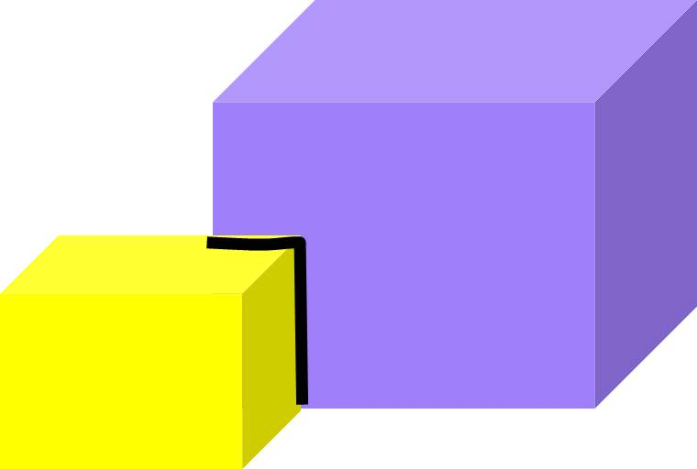
Features…
Significant overlap
Proximity
Boundary Ratio
Less overlap
Notes:
Boundary ratio feature determines the amount of visual overlap b/w object boundaries.

Slide 36
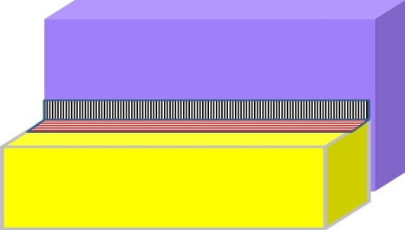
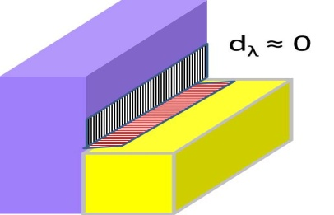
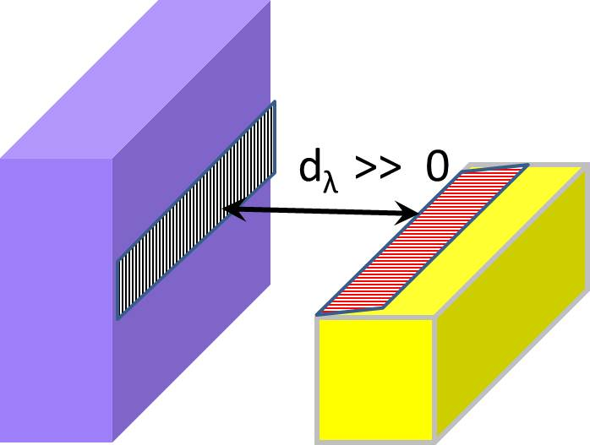
Features…
Visual Occlusion
Proximity
Boundary Ratio
Side view: actual contact
Depth Boundary
Side view: no contact
¹
¹ Mishra et al., “Segmenting simple objects using RGB-D”, ICRA’12
Notes:
Depth boundary feature discriminates actual contact from no contact in case of visual occlusion.

Slide 37


Features…
Containment
Proximity
Boundary Ratio
Depth Boundary
No containment
Containment
Notes:
Containment feature measures if an object is contained inside another or merely lying on top of it.

Slide 38


Features…
Stable object
Proximity
Boundary Ratio
Depth Boundary
Containment
Unstable object
Relative Stability
Notes:
This feature determines the relative stability of one object w.r.t other in terms of -1, +1 and 0.

Slide 39
MAP support inference approach*
where,
S: supporting region
T: support type
M: structure class
^{Limitation:}
does not allow support by multiple objects
not designed for grasping applications
assumption that the supporting region is significantly larger than the supported regions.
* Silberman et al., “Indoor segmentation and support inference from RGBD images”, in ECCV, 2012
Notes:
MAP inference approach proposed by Silberman et al poses the support inference as MAP inference and solves using linear programming. We have modified it by adding a 3rd support type ‘containment’ . However it does not allow support by multiple objects. It is not designed for grasping applications and assumes that the supporting region is significantly larger than the supported regions.

Slide 40
Multiple object support inference approach
Structure class classification* to predict structure class:
Floor, Walls, Furniture, graspable objects
Identify graspable objects to avoid infeasible support relations.
For a region, find Support from below using Proximity fp and Boundary Ratio fbr.
Find containment by using 3D convex hull using containment feature fcnt
Find Support from side by finding regions in contact
(depth boundary, fd) that are not supported from below, but are stable (fstab).
* Silberman et al., “Indoor segmentation and support inference from RGBD images”, in ECCV, 2012
Notes:
In our approach, we explicitly use the geometric features discussed earlier for support inference. At first, the graspable objects are identified from the rest of the environment which may contain walls, floor and furnitures too. A structure classifier is used to classify the four classes.
The graspable objects are identified to avoid infeasible support relations such as a wall being supported by a small box. Proximity features and Boundary Ratio features are used to decide is a region is supported by the regions below it. Out of the regions supporting it from bottom, containment is found by using the containment feature. The regions in contact with the current region that do not provide support from below are checked for depth boundary and relative stability to find if they provide support from side. Thus, using this approach, we allow a region to be supported by multiple other regions.

Slide 41


















Illustration of Hierarchical Support Inference …
O_{in}
O_{out}
Support Matrix
Supported Region | Supporting Region | Support Type
 |  | Below
 |  | Below
 |  | Side
Notes:
For each object, first its supported objects are inferred. And recursively supported objects for each object is found out.

Slide 42


Support Inference
Tree of Support
Structure class Classifier
Graspable objects {O_{i}}
(O_{i} – pa(O_{in}), O_{in})
Support Classifier
{O_{s}}
Object of interest O(O_{in})
O_{in}
Segmented Image
Out
In
Floor, Wall, Furniture
Q
Support Matrix
Support classifier: 3-layer feed-forward neural network classifier
Hierarchical support inference
Given regions (A, B), predict if B supports A.
Support types:
from below/ from side/ containment/none
Notes:
Support classifier is a 3-layer feed-forward neural network classifier . Given regions (A, B), predict if B supports A. It predicts 4 types of support classes: from below/ from side/ containment/none

Slide 43
Support Inference
Tree of Support
Structure class Classifier
Graspable objects {O_{i}}
(O_{i} – pa(O_{in}), O_{in})
Support Classifier
{O_{s}}
Object of interest O(O_{in})
O_{in}
Segmented Image
Out
In
Floor, Wall, Furniture
Q
Support Matrix
Hierarchical Support Inference:
Begin with object of interest O.
Compare each object with other objects except its parents and grand-parents.
Iterate until Q is empty.
#comparisons: O(nlogn)

Slide 44
Beyond pairwise support relations …
4.1
3.1
2.1
2.2
1.1
1.3
1.2
O
Case1 : Support In Hierarchy
Notes:
We need to go beyond pairwise support relationships when objects lie on top of the other. Lets have a look at different scenarios that arise when objects lie in such a fashion. We can see here that the object O supports several other objects in hierarchical fashion, in order to remove it, all other objects must be removed carefully without making other objects fall from the topmost layer to lower layer.

Slide 45
Beyond pairwise support relations …
2.1
2.2
2.3, 3.1
3.2
2.4
2.5
1.1
1.2
O
Case 2 : Simultaneous support in multiple hierarchy
Notes:
An object can support another object in 2 different layers too. The green bottle in the layer can be both consider ed as level 2 and 3. In such cases it will be risky if it is removed before removing the box (2.4). So it is important to remove the object before removing any other object at lower hierarchy.

Slide 46
Beyond pairwise support relations …
1.1
^{2.1}
1.2
1.3
O
^{2.2}
^{2.3}
O
^{1.1}
^{O}
Case 3 : Containment
Notes:
Containment is an important aspect. When we need to pick up any object containing other objects inside it, we do not need to remove the objects contained inside it. So, if we have to pick up the basket, we can directly pick it up w/o removing the bottles and plates inside it. Similarly, for the board, we need to take up the basket and then pick the board.

Slide 47
Support Order Prediction…
O
O₉
O₃
O₅
O₆
O₈
O₁
O₄
O₇
O₈
O₂
O₁
O₄
O₇
O₂
O₅
O₆
O₉
O
O₃
Build Tree of Support
O
O₁
O₂
Root
Supporting Region
SupportedRegion
Notes:
We try consider the above practical cases for support order prediction. In support order prediction, the pairwise relationship given by support inference is converted into a hierarchical one using a tree structure. The tree contains the object of interest on its root. The parent node represents the supporting object and the child node represents supported object. As shown in the figure, we have built a tree of support for every pair of connected object.

Slide 48
Support Order Prediction…
O
O₉
O₃
O₅
O₆
O₈
O₁
O₄
O₇
O₈
O₂
O₁
O₄
O₇
O₂
O₅
O₆
O₉
O
O₃
Build Tree of Support
Prune the redundant edges
Notes:
As discussed in the previous slides, in case of simultaneous support by objects from different layers, the supported object must be removed before removing any of the objects of the higher layers. So the edges connecting to the parent nodes of higher level are pruned.

Slide 49
Support Order Prediction…
O
O₉
O₃
O₅
O₆
O₈
O₁
O₄
O₇
O₈
O₂
O₁
O₄
O₇
O₂
O₅
O₆
O₉
O
O₃
Build Tree of Support
Prune the redundant edges
Skip the contained objects
Notes:
Since we do not need to remove the contained object, we should skip the corr. Nodes while traversing the tree.

Slide 50
Support Order Prediction…
O
O₉
O₃
O₅
O₆
O₈
O₁
O₄
O₇
O₈
O₂
O₁
O₄
O₇
O₂
O₅
O₆
O₉
O
O₃
Build Tree of Support
Prune the redundant edges
Skip the contained objects
Perform Reverse Level Order Tree Traversal
Notes:
Then we perform tree traversal in reverse level order fashion and generate the support order sequence.. the order in which we need to remove the objects so as to grasp our object of interest.

Slide 51
Support Order Prediction…
O
O₉
O₃
O₅
O₆
O₈
O₁
O₄
O₇
O₈
O₂
O₁
O₄
O₇
O₂
O₅
O₆
O₉
O
O₃
Build Tree of Support
Prune the redundant edges
Skip the contained objects
Perform Reverse Level Order Tree Traversal
Support Order: O3 → O9 → O2 → O8 → O7 → O4 → O1 → O

Slide 52












Results on Multiple Object Support Inference and Support Order Prediction
R: 5 10 6 7
M: 5 10 6 7
Support from Below
R: 6 13 12 5 11
M: 6 13 12 5 11
Containment
R: 7
M: 7
Support from Side
R: 1 8
M: 8
Input Images
Rule based Inference
MAP Inference
Support order prediction
Notes:
Let us have a look at some of the images that we have collected. The first image shows horizontal support when both Rule based and MAP inference methods do well. We can see in the 2nd row that the support inference is done in very small closely placed objects. We can also find that the objects in basket are also inferred correctly. However, the difference is found in case of side support. In map inference, the book marked by blue is assumed to be supported by ground and hence the support by the folder marked in red in not inferred, whereas our approach successfully infers the relation.

Slide 53





Demonstration of support by multiple objects
Multiple Object Support Inference
Input Images
MAP Inference
Notes:
This example illustrates the case of simultaneous support by multiple objects. The green bottle is partially supported by two objects. In the 2nd column, we can see that both the objects 12 and 11 are inferred to support the bottle, while MAP inference fails to detect this.

Slide 54
Dependency on Structure class prediction
False Positive
Chair classified as Graspable object
Missed support
Book classified as furniture
Input Image
Multiple Object Support Inference
MAP Inference
Notes:
We noted that the support inference is dependent on structure class prediction. In the top row, we can see that in our approach, the chair in the background is inferred as a graspable object, thus it is counted as an object supported by the book, which is not the case in MAP inference. On the other hand, the book at the top is predicted as a furniture and hence the true support is missed by both the methods.

Slide 55
Accuracy of Multiple Object Support Inference
Region Source | Ground Truth |  | Segmentation
Inference Type | Type Agnostic | Type Aware | Type Agnostic | Type Aware
Multiple Object Support Inference | 66.2 | 56.1 | 35.1 | 32.4
MAP Inference | 65.8 | 48.0 | 32.1 | 30.5
Notes:
In this table, the accuracies of our approach and MAP inference approach is are displayed. Type agnostic accuracy does not consider the support type whereas typer aware approach considers support type. The rule based approach performs better than MAP inference especially in case of type aware method. We can see that the performance is degraded severely when used segmented regions instead of using groundtruth labeled regions thanks to inaccuracies in segmentation algorithms.

Slide 56




Results on Hierarchical Support Inference and Support Order Prediction
Illustration of Support from Below
15 14 13 5 4 3 2 1 16
3 2 1 6 7
Notes:
We can see here support from below and support from side

Slide 57


Results on Hierarchical Support Inference and Support Order Prediction
Illustration of Support from Side
1
2
3 2 1
3
7
3 2 1 7
1
2
3

Slide 58




Results on Hierarchical Support Inference and Support Order Prediction
Illustration of Containment
- 11
- 7
Notes:
In these 2 figures, we can see support ‘containment’

Slide 59
Accuracy of Hierarchical Support Inference
Inference | Structure class Inference |  | Support Class Inference
Type | Training | Testing | Training | Testing
Ground Truth Regions | 100 | 97.02 | 73.42 | 64.72
Segmented Regions | 97.79 | 83.88 | 53.00 | 49.17

Slide 60
Limitations…
Limitations in segmentation
Failure in support inference at some settings
baseline of supporting object invisible,
supporting object is unstable,
entire surface area of supporting object invisible
Notes:
The major limitation of the work is dependency on segmentation. In certain settings support inference fails such as : baseline of supporting object invisible,
supporting object is unstable, entire surface area of supporting object invisible

Slide 61

Multi-view Support Order Prediction…
Hidden object discovered
in another view
Side Support cannot be determined from front view
Containment cannot be detected from frontal view.
Notes:
Some of the previously mentioned limitations can be addressed using multiple views. Such as : hidden object can be discovered , side support that cannot be determined from frontal view can be correctly inferred in another view. Containment cannot be detected from frontal view.

Slide 62
Extension towards multiple views…
New object in scene
View2
Clearer view
View3
View1
Object omitted
View5
View4
Consider multiple views for improved support order prediction
Take views from different angles, at approx 60 degrees.
Combine the Support Order prediction from all views to find optimal prediction.
Notes:
Therefore, we Consider multiple views for improved support order prediction . We Take views from different angles, at approx 60 degrees. Then we combine the Support Order prediction from all views to find optimal prediction.

Slide 63
Framework for Multiple View Support Order Prediction
RGBD data
Object of Interest
Segmented Images
Segmentation
Object Detection
Region Mapping
Updated Segmented Images
Support Order Prediction
Support Inference
Region mapping Table
Support Order
Support Matrix

Slide 64
Region Mapping
(i – 1)^{th} View
i ^{th} View
(i +1)^{th} View
Matching b/w adjacent views
Notes:
Regions of a view are mapped with its previous and next view

Slide 65
Regions →
Region Mapping
1
…
j
…
m
1
…
i
←Views
…
(i – 1)^{th} View
i ^{th} View
(i +1)^{th} View
n
Region mapping table
Matching b/w adjacent views
Notes:
A regionmapping table is initialized . It contains mapped regions from each view

Slide 66

Regions →
Region Mapping
1
…
j
…
m
1
…
i
←Views
…
(i – 1)^{th} View
i ^{th} View
(i +1)^{th} View
n
Region mapping table
Matching b/w adjacent views
Region mapping across 2 views
Object omitted in next view
New object
Mutual match
Notes:
Region mapping b/w 2 views: mutual matches, new objects are discovered and old objeccts get omitted.

Slide 67
Regions →
Region Mapping
1
…
j
…
m
1
…
i
←Views
…
(i – 1)^{th} View
i ^{th} View
(i +1)^{th} View
n
Region mapping table
Matching b/w adjacent views
Regions →
1
…
j
…
m
m + 1
1
…
i
←Views
…
n
Region mapping across 2 views
Object omitted in next view
Update Region mapping table
New column added for new object
New object
Mutual match
Notes:
In case a new object is added, a new column is added to the regionmapping table

Slide 68
Support Inference for N Views
Support inference for each view
Change Support matrices to global annotation using region mapping table
Merge the support matrices into one global support matrix
Remove redundant support relations, note their frequency f0 .
Resolve conflict in support relations w.r.t. support type and loops using f0 .
Use global support matrix for support order prediction.
Notes:
For each view support inference is performed individually. Support matrices are then converted to global annotation using region mapping table. The support matrices are then merged into one global support matrix. Redundant support relations are removed. Conflicts are resolved wrt support type and loops using the frequency of occurrence of each support relation. The global support matrix is used for support order prediction. Support order is then translated to the values in individual views.

Slide 69

Results
Regionmapping
New objects marked with white dot.
Correspondence b/w regions shown
Notes:
Some of the results of regionmapping is shown in this slide. The region correspondences are shown using black arrows. New objects are marked with white dots.

Slide 70










Results
Multi-view Support Order Prediction
Single View
Multiple Views
Hidden Object shown by cross mark
Notes:
Due to multiple view s.o.p, the hidden object in view 1 is noticed and missing support relation in view 2 is inferred.

Slide 71












Results
Multi-view Support Order Prediction
Single View
Multiple Views
Using multiple views, support order that was not accurately inferred using
single view is recovered.

Slide 72
Accuracy of Support Inference using multiple views
Region Source | Ground Truth |  | Segmentation
Inference Type | Type Agnostic | Type Aware | Type Agnostic | Type Aware
Multiple Object Support Inference | 85.0 % | 82.0 % | 65.0 % | 59.4 %
Notes:
The accuracy of support inference on ground truth regions is 85% Type agnostic and 82% type aware. For segmented images, it is 65% type agnostic and 59.4% type aware.

Slide 73
Conclusion
Learned semantic interaction among objects in clutter by support inference and support order prediction
Worked on clutter of indoor objects in different levels of complexity in the environment.
Defined and analyzed three types of support relationships: Support from below, Support from side, and containment.
Proposed “Multiple Object Support Inference” and “Hierarchical Support Inference” along with an adaptation of well-known MAP inference by Silberman et al.
Multi-view Support Order Prediction to handle limitations in single view such as occlusion and incorrect support inference.
Created two RGB datasets “Indoor dataset for clutter” and “Indoor multi-view dataset”.

Slide 74
Future Work
Efficient segmentation algorithm for RGBD data
Use of sophisticated methods for object detection
Real-time implementation
Optimization in finding next best view point
Multi-view object segmentation

Slide 75
Thank You!

