Slide 2
Scalable Primitives for Data Mapping and Movement on the GPU
Suryakant Patidar
skp@research.iiit.ac.in
2006-07-023
Advisor : Prof. P. J. Narayanan
Notes:
Primitive level research with the new architectures of the GPU
Next : GPU/GPGPU/CUDA

Slide 3
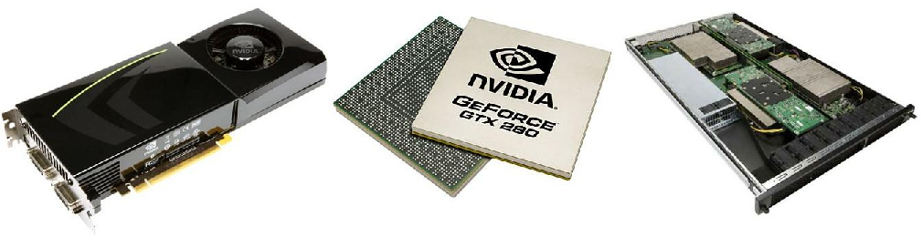
GPU / GPGPU / CUDA
GPU
Graphics Processing Unit
GPGPU
< 2006: General computing on Graphics Processing Unit
> 2006: Graphics computing on General Purpose Unit
CUDA
a hardware architecture
a software architecture
an API to program the GPU
Notes:
Very quickly we will just have some terms being introduced.
Widely used graphics card, invented with the zeal of rendering real time graphics for various purposes but majorly games
Within a decade of GPUs, graphics cards have transformed from non-prog co-processors to deskside SuperComps at just $400
With introduction of GPGPU using the graphics pipeline, now we have high level languages similar to C for programming a 1TeraFlop monster
Next : Split

Slide 4
Split Operation
Split can be defined as performing ::
append(x,List[category(x)])
for each x, List holds elements of same category together
A
B
C
D
E
F
G
H
I
J
K
L
M
N
O
Split Operation
B
G
O
I
C
A
D
K
H
F
N
J
L
M
E
Notes:
Now just before anything we talk about, lets look at a couple of terms.
First the split, which can be easily defined as rearranging data based on its category or bin or key.
Next : Ray tracing

Slide 5
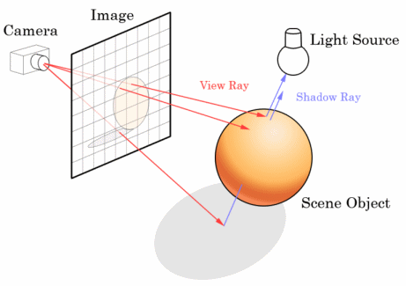
Ray Casting/Tracing
Image © Wikipedia.org
Notes:
Secondly, ray tracing which is a technique for rendering images, just like rasterization/opengl/pipeline
RT is one of the simplest way to render a image, each pixel finding out its intensity. Its like looking at the environment through a fne grid. Rays bring back a color for its own pixel comprising the image
Red lines in the figure show primary rays originating at the eye and tracing the world
The blue lines in the figure show us a type of secondary rays, shadow rays here, which bounce of the environment to bring more information in terms of if the pixel is shadowes or is it a refracting surface or reflecting etc.
So it’s a beautiful simple technique to render images
Rasterization goes triangle by triangle and makes the images, certainly RT goes pixel by pixel for each pixel going triangle by triangle to make the image …. Wats faster ?
Next : iRT is compute intensive … forget abt the change in geometry per frame ..

Slide 6

Image © Wikipedia.org
Notes:
This might have taken days on a regular CPU or for that matter a GPU would have taken hours to generate a single image, let alone real time graphics …
Ray tracing is highly parallel, that we understand, also data structures have been used widely to boost its performance.
In a scenario like that, ppl tend to build the ds once on the CPU and perform real time ray tracing on the GPU,
Lets say wat if my geometry changes or evolves or added or removed with time ,,, wat use is a DS build against a geometry then …
Next : GPU Architecture

Slide 7
Contributions
Fastest Split Primitive on the GPU
Widely used in
Data Structure Building, Database Operations
Improves the state of the art, in performance and scalability by an order.
Ordered Atomic Operations for Parallel Architectures
Fastest Sorting on the GPU
Using the Split Primitive (Scalable Split, Scalable Sort)
Fastest Data Structure building for Ray Tracing
Highly rapid DS construction for million triangle models
50x faster build times compared to state of the art
Million triangle deformable models Raycast at real-time rates
Notes:
So now that we understand split and ray tracing …. And the fact that RC is computationally intensive by the order of primitives compared to Rasterization, data structures are things to look for …
So with just that information, let me say we proposed some fast split, so scalable that we extended it to fastest sorting on the GPU.
Very fast data structure construction for use with deformable models.

Slide 8
GPU Architecture
Thread Execution Control Unit
1
2
M-1
M
Processors, Control Units, Shared Memory and Registers
(on-chip area)
1
2
1
2
1
2
1
2
3
4
3
4
3
4
3
4
5
6
5
6
5
6
5
6
7
8
7
8
7
8
7
8
Special Function Unit
Special Function Unit
Special Function Unit
Special Function Unit
Multi Processors
Shared Memory + Registers
Shared Memory + Registers
Shared Memory + Registers
Shared Memory + Registers
Device Memory (off-chip area)
Notes:
Lets quickly put some pictures in our minds of the GPU,
Latest GPUs can be seen as something above, small processors grouped in sets of 8 ( for now ), called a multiprocessor. An array of such MPs are put together to build a GPU.
Now since they decided to group say 240 processors as 30 MPs and not leave them all alone as 240 independent units, something more can be done ..
Say we provide each of the some memory which all the 8 processors in a MP can use when needed, share, or talk through. 16KB of SM
There is a whole lot of global memory though of the order of a GB which is common to all the units and sits off the chip so to say …
Next : CUDA H/W perspective

Slide 9
CUDA H/W Architecture
SIMD Multi Processor #30
SIMD Multi Processor #2
SIMD Multi Processor #1
Shared Memory (16KB)
Registers
(64KB)
Registers
(64KB)
Registers
(64KB)
Instruction Unit
P₁
P₂
P₈
Texture Cache (8KB)
Constant Cache (8KB)
Device Memory (~1GB)
Notes:
Lets see how much talked about CUDA looks at the GPU from the hardware point of view…
CUDA thinks there are MultiProcessors which have these tiny processors clocked at arnd 1.3 GHz. Now these 8 processors are what we call work in SIMD, i.e., they will all execute the same instruction at a given time, decided by Instruction unit.
Caches come into picture for each of the MPs in terms of Texture and Constant data
Caches, Shared memory, registers sit on the CHIP and thus tend to be very fast for I/O, as against Global memory which can be as much as 400 times slower compared to any of the onchip resources
Next : CUDA S/W perspective …

Slide 10
CUDA S/W Architecture
CPU / Host
GPU / Device
Grid
Kernel 1
Blocks
(0,0)
Blocks
(1,0)
Blocks
(2,0)
Blocks
(0,1)
Blocks
(1,1)
Blocks
(2,1)
Block (1,0)
Grid
Thread
(0,0)
Thread
(1,0)
Thread
(2,0)
Thread
(3,0)
Kernel 2
Blocks
(0,0)
Blocks
(1,0)
Blocks
(2,0)
Thread
(0,1)
Thread
(1,1)
Thread
(2,1)
Thread
(3,1)
Thread
(0,2)
Thread
(1,2)
Thread
(2,2)
Thread
(3,2)
Blocks
(0,1)
Blocks
(1,1)
Blocks
(2,1)
Thread
(0,3)
Thread
(1,3)
Thread
(2,3)
Thread
(3,3)
Notes:
Intersting picture comes up when we finally think about, so wats CUDA s/w, how do we interface…
Kernel here refers to a piece of code the user has which is going to be executed on the GPU. A kernel for parallel programming is a bit diff then cpu code, that is, it understands that multiple instances of the code will be executed and hence the code should inherently understand how it might have to decide what part of computations needs to be done based on some lets say IDs
Thus, a kernel is told be executed as some number of Blocks, so the picture says Kernel 1 needs to be executed for 6 blocks, now each block is defined as some number of threads, just like CPU threads, these threads are the real drivers of the code, i.e. there will be as many instances of ur code/kernel running as there are total number of threads which in this case is 6 x 16 = 96
So there it is, the way parallelization is achieved using CUDA …. Threads/blocks/Kernel
Next : data parallel primitives …

Slide 11
Split / Sort / RayTracing
Split has been addressed by He et al. on the GPU
Independent Memory for each thread to avoid any read/write clashes on a parallel architecture
Max of 64 Bins (Due to inefficient use of limited SM)
Sort
Radix Sort implementation by Harris et al. [CUDPP]
Various Implementations of Bitonic & Merge Sort
Ray Tracing
Zhou et al. ray trace deformable models of up to 170K triangles, by building a kd-Tree on the GPU
Notes:
so now that we understand 3 terms … a very brief idea of wat has already been done
Split as we defined it earlier has been addressed by only one of the groups earlier … whose implementation suffers frm limited 16KB shared memory …. More on this later …
Sorting is a great example of a primitive which had trouble finding a place on the GPU, certainly bitonic sort was considered to be a parallel algo, merge sort was also tried, but the fastest sort on the gpu currently is an implementation of a radix sort, from the CUDPP library … more later
We addressed ray casting at the time when ppl were still using a fixed geomtry data structure built on the CPU and raytracing on the GPU…. Zhou et al. MSR Asia worked on some deformable models of around 170K triangles and performed complete ray tracing on the GPU they gained around 7 fps for that model
Next : Atomic operations

Slide 12
Atomic Operations
An atomic operation is a set of actions that can be combined so that they appear to the rest of the system to be a single operation that succeeds or fails.
Global Memory H/W Atomic Operations
Shared Memory :
Clash Serial – Serialize those which clash
Thread Serial – Serialize all
H/W Atomic [hidden]
Notes:
Ok lets scribble another term for future use quickly, atomic operations can be easily exaplained as operations which are used in case of multiple threads updating a common memory location … if u recall about the semaphores, atomic operations serve exactly the same purppose….
Now in the duration of the work which was done, we went from GPUs which did not support atomic operations at all to support on the global memory and now support on the shared memory too
We do understand there is a cost of such things, which make our task easy ..
Next : Histogram building …

Slide 13
Histogram Building
Notes:
Lets consider a simple example of building histograms on the GPU.
So u are provided with a set of numbers (data) and lets say the categories they belong too ! Just like an image and the value at each pixel. Say we know the range of the data say from 1 to 255
How do we go about building the histogram on the GPU with what we know …
Next : Global Memory Histogras

Slide 14
Global Memory Histogram
Straight forward approach of using atomic operations on the global memory
‘M’ sized array used in global memory to hold the histogram data
Number of Clashes ἀ Number of Active Threads
Highly data dependent, low number of bins tend to perform really bad
Global Memory is high-latency, ~500cc I/O
Notes:
Very clearly we can build a histogram by having the histogram array in the Global memory and using the atomic operations …
Now if we think for a moment, the number of clashes or say addressing the same memory location are in proportion to the number of threads which are active. …..
On that note … if we have 240 processor GPU and sufficient number of threads .. In the worst case they all might be wanting to update the same memory …
What makes it worse is the latency of the Global memory …. Not only more threads clash bt they take a long time to resolve the clash …
Next : Shared Memory Histogram …

Slide 15
Shared Memory Histograms
A copy of the histogram for each Block NOT an Multi-Processor but a Block
Each Block counting its own data
Once all done, we add the sub-histograms to get the final histogram as needed
Notes:
So we had to try our luck with shared memory, before we conclude nething..
Lets say we have a copy of the histogram for each Block, and we do the counting just like earlier within our block …. And finally add the histograms to achieve a final one …
Wat we need is atomic operations just like we had for the global memory … the problem was we didn’t have them then …
Next : Clash Serial …

Slide 16
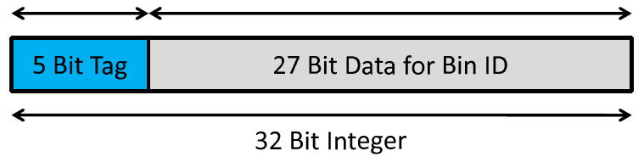
Clash Serial Atomic Operation
Clash Serial Atomic Operations [Shams et al. 2007]
Data is marked with threadID and is repeatedly written to the shared memory unless the write and subsequent read is successful
Works only across threads of a warp (32). For multiple warps, multiple histograms should be used
Notes:
Wat if we had a way to serialize all the clashes and leave alone the ones which are not … ok
First thing to understand is we don’t care about all the threads now !!! We only care about threads clashing within our block, if all the blocks do this, its fine with us …
CUDA Basic Note :: Each block has a unique ID, and each thread within a block too, thus each thread has a unique ID …
So wat we do is, watever data we want to write to the common shared memory, we tag it with our threadid. Great so now I know wat my data is even if it is same as other peoples data becos I put my name on it. STAMPED.
Now wat u do is, if u have to perform the write operation, write to the location, read back and see if the data has ur TAG, if not, whos stopping you write again.
Now in case of clashes what happens is if multiple threads issue a write request, only one of them succeeds, thus u mite have to work so many times as there are number of clashes…. Those without clashes can take off after one write.
There is just a little problem with this approach, the hardware schedules 32 threads at a time, so lets say u have 256 threads in ur block, they wil be scheduled in batches of 32 which is called a warp. The technique tends to work only with 1 warp blocks assuming multiple warps mite get interleaved in scheduling and the writes are corrupted.
Next : Thread Serial …

Slide 17
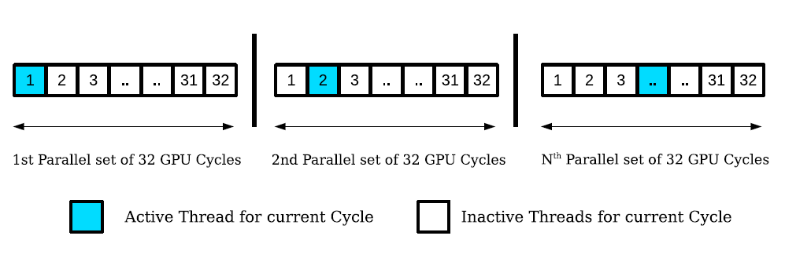
Thread Serial & H/W Atomic
Thread Serial Atomic Operations
Threads of a warp can be completely serialized to achieve atomicity for shared memory writes.
This technique also works only with 32 threads and has a constant overhead, independent of the data distribution
H/W Atomic Operations
GTX200 and above series of Nvidia cards now provide hardware atomic operations on the shared memory
Notes:
Now here is my great invention, what do you do if u don’t have atomic operations on the shared memory,
Well lets have threads lined up, and make them do their write thingy one by one, how cool is that…..killing the whole point of GPUs and parallelization and wat not ….
So say u have 32 threads ( similar to above technique we cant trust it with more than 32) wat u do is
Write a simple for loop of 32 and if ur threadId matches the current loop variable u do the writing … it works perfectly fine, infact we came up with this and then we discovered the previous approach of clash-serial, we were heartbroken … seriously …
And then just when we did all the mind blowing research there comes hardware atomic operations on the shared memory, u know how it works, just like global memroy, use as many threads etc. etc. no problems.
Next : Performance …

Slide 18
Performance Comparison
Clash Serial and Hardware Atomic Operations perform similarly for a range of bins
Due to constant overhead of the Thread Serial atomic operations, constant time is taken
in spite of number of bins (until the occupancy is hampered with 1K bins and higher)
When all the threads of a warp clash on the same bin (last column) thread serial tends to
perform best
Notes:
So with all that talking lets look at how they perform …. So rmr we are building a histogram … say for 16 Million elements and various number of bins. …..
Certainly H/W atomic works perfectly… kicking the thread serial real bad … so does clash serial it was real good appraoch …. Just so to understand 2 variants of h/w atomic with diff number of threads…..
I want u to look at the last column of the graph …. Wats that 1 … k so u are with me till now …. Now that shows … thread serial being so lazy, so predictable, boring it is, took up 7 msec all the time, with 1 bin or 256 bins .. No difference ….
Atomic and clash serial get a real beating when all the threads of the warp clash ….. Lets just keep all this in mind for now …
Next: Ordered AO

Slide 19
Ordered Atomic Operation
An ordered atomic invocation of a concurrent operation ‘O’ on a shared location ‘M’ is equivalent to its serialization within the set ‘S’ of processes that contend for ‘M’ in the order of a given priority value ‘P’
Hardware Atomic – Nondeterministic
Clash Serial Atomic - Nondeterministic
Thread Serial Atomic – Deterministic!!
Notes:
Did I mention that h/w atomic or thread scheduling or block scheduling on the GPUs is top NASA secret … u cant rely on anything like, ok so I will have first 20 blocks do this and then the next 20 will use the output of those etc etc. NO NONE ZIP…… u have no idea wats going on on that chip …
Let me define something to save my MS here this is it…. Lets say I want to have an atomic operation which promises me to perform the operations in a order I tell it to .. That’s Ordered atomic operations… doesn’t exist, we create it, for what, to save the MS, done.
So we clearly see that h/w atomic and clash serial don’t follow our new rule, however the lazy thread serial, does watever u say, u got the for loop in ur hands buddy..
Next : example

Slide 20
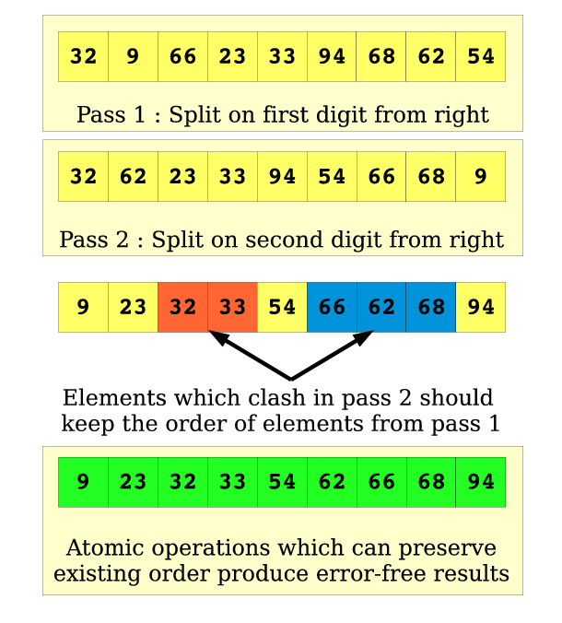
Ordered Atomic Example
Notes:
Ok more lies to cover a lie … now since we have it … lets try to use it … say in a example like … .
Every one knows radix sort rite, so lets radix sort that array based on its digits, so .. We sort all of them on their 1s digt and then on 10s digit …
How kewl is that … we have an application now ..
Next : Split Sequential Algo …

Slide 21
Data Parallel Primitives
New Architecture, New Implementations
GPUs have
Pseudo SIMD structure
Constrained Resources
Shared Memory sizes
Register File Sizes
Cache Sizes
I/O Bandwidths to CPU memory and GPU memory
Primitives ensure efficient usage of the hardware without worrying about the internal details of the hardware
One of the most widely used data parallel primitive library, CUDPP by Harris et al., support operations like scan and sort, implemented efficiently on the GPU
Notes:
So let me just talk abt the phrase “data parallel primitve”
First of all a primitive gives the impression of something old, or something close to the core, need not ever be disturbed, always used as a service letss say
When GPUs unleash so much power using high level languages, anything or everything ppl must have done for CPUs say x86 needs to be ported or reinvented well for the GPUs too …
Can it be different ? Given the architecture of the GPU is different, resources ( for e.g. Caches on the GPU are way smaller than that of CPUs, u buy a CPU with say 2.4GHz and 3MB cache, here the order is in KBs
CUDPP is another thng which will keep popping up in the presentation, consider it as one of the first and most widely used library for the GPU application using CUDA, it provides widely used Scan operation and a sorting technique based on that scan …
Next : related work Split / Sort / RT

Slide 22
Split Sequential Algorithm
I. Count the number of elements falling into each bin
for each element x of list L do
histogram[category(x)]++ [Possible Clashes on a category]
II. Find starting index for each bin (Prefix Sum)
for each category ‘m’ do
startIndex[m] = startIndex[m – 1]+histogram[m-1]
III. Assign each element to the output
for each element x of list L do [Initialize localIndex[x]=0]
itemIndex = localIndex[category(x)]++ [Possible Clashes on a category]
globalIndex = startIndex[category(x)]
outArray[globalIndex+itemIndex] = x
Notes:
Now lets party about our real problems so, we wanted this split thing to work, work fast, and not on just 64 bins but thousands, millions infact say billions …
Rmr split is a technique to rearrange data such that data of same category are together in the final output…..
Wat u do is
Count how many elements belong to each category
Allocated space for each of them just the pointers so I must know category number 3 shud start putting its data from here … and so on …
We use a technique called Scan which adds all the values before itself in an array and gives the output array … tats wat we wanted bingo ..
Next : Parallelize ..

Slide 23
Split Operation in Parallel
In order to parallelize the above split algorithm, we require a clash free method for building histogram on the GPU
Above can be achieved on a parallel machine using one of the following two methods
Personal Histograms for each processors
Atomic Operations on Histogram array(s)
Notes:
Now use this and put the elements of each category in their places .. By doing the above we now know elements of category X will go to subarry something …
Now again in parallel these elements are handled, they must find a unique place to sit and shud not clash with other elements of same category….
Done…. Use 2 histogram thingys and u are assured u will find unique locations … this is split .. Do not forget this
Next : He et al.

Slide 24
Non-Atomic He et al. [SIGMOD 2008]
Each thread uses private memory space for histogram building
32 Threads in a Block, to each its own
16KB SM == 128 Categories = 16KB/(32*4Bytes)
Under utilization of the GPU with low number of threads per MP
Max number of categories = 64
Global Memory Histogram(s) = M * B * T
Notes:
Now wat did I just say their, we can do it without ATOMIC OPERATIONS … I just wasted so much of ur time on that histogram thingy..
Well lets look at a SIGMOD paper which performed split without using atomic ops … how do u do it … easy each thread has its own memory .. No clashing wat so ever ..
So lets say I have 256 threads, and a histogram of 256 bins, how much memory do I need = 64KB :O that’s for 1 block on an MP :P ….
Well u get the idea, clearly the paper conveniently claimed it works for 32 thread blocks and max of 64 bins … go do watever u want to do with it …. I can’t use it … I dreamt of millions and billions …
More over, fine global memory is in ample bt we cant just have M * B * T histograms sitting there …
Next : Split Shared Memory

Slide 25
Split using Shared Atomic
Blocks #0
Blocks #n
Blocks #N
Shared Atomic Operations used to build Block-level histograms
Parallel Prefix Sum used to compute starting index
Split is performed by each block for same set of elements used in Step 1
X₁
Y₁
Z₁
X_{n}
Y_{n}
Z_{n}
X_{N}
Y_{N}
Z_{N}
X₁
X_{n}
X_{N}
Y₁
Y_{n}
Y_{N}
Z₁
Z_{n}
Z_{N}
Local Histograms arranged in Column Major Order
Local Histograms arranged in Column Major Order
A₁
A_{n}
A_{N}
B₁
B_{n}
B_{N}
C₁
C_{n}
C_{N}
Blocks #0
Blocks #n
Blocks #N
A₁
B₁
C₁
A_{n}
B_{n}
C_{n}
A_{N}
B_{N}
Z_{N}
Notes:
Fine even if its going to be slower lets do our histogram thing….
So three step split
Each block makes a histogram
U scan it bringing it out
Then use It to finalize the split .. Simple … works for bins as high as 16KB/4Bytes*NBINS = 4000 !!! That’s it …
Next : Performance comp

Slide 26
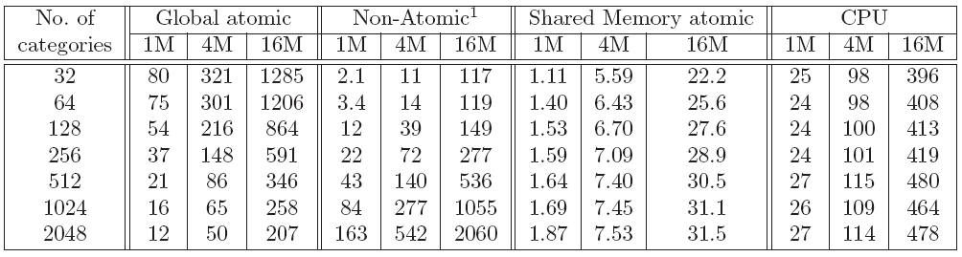
Comparison of Split Methods
Global Atomic does not do well with low number of categories
Non-Atomic can do maximum of 64 categories in one pass (multiple-pass for higher categories)
Shared Atomic performs better than other 2 GPU methods and CPU for a wide range of categories
Shared Memory limits maximum number of bins to 2048 (for power of 2 bins and practical implementation with 16KB shared memory)
¹ He et al.’s approach is extended to perform split on higher number of bins using multiple iterations
Notes:
Lets just compare results finally with all the talk we did ..
Quickly wat u want to know from here is …. Global atomic suffers big time … 32different categories 200 threads attacking there has to clashes …
Non atomic was pushed hard for higher number of bins, multiple iterations
Well so we win … shared memory atomic splits work fastest… 2048 bins done …..
Next : wat about higher bins … Hierarchical .

Slide 27
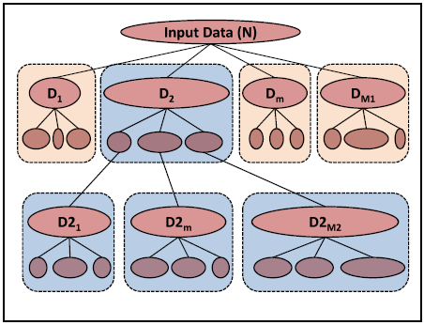
Hierarchical Split
32 bit Bin broken into 4 sub-bins of 8 bits
Bins higher than 2K are broken into sub-bins
Hierarchy of bins is created and split is performed at each level for different sub-bins
Number of splits to be performed grows exponentially
With 2 levels we can split the input to max of 4Million bins
8 bits
8 bits
8 bits
8 bits
1st Pass
2nd Pass
3rd Pass
4th Pass
Notes:
All of u an guess wat one can do for higher number of bins, first of all let me quickly map bins to bits,
Say I have 256 categories that’s like 8 bits …. And 1024 bins are 10 bits. .. So now on we talk about split over some certainl number of bits…
so lets me introduce hierarchical split, well split to most significant 8 bits
Gives u 256 disjoint sets which can be further split …. On their own …. To achieve final split …
Simple math says if u can split to 2K bins in a pass in 2 passes u can go to 4M …. Welll we are into millions now …
Also… grows exponentially …
Next : Still see the Performance COmp

Slide 28
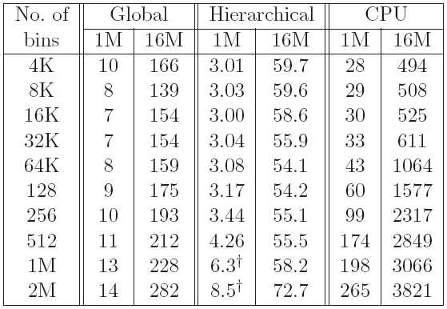
Hierarchical Split : Results
Multi Level Split performed on GTX280. Bins from 4K to 512K are handled with 2 passes and results for 1M and 2M bins for 1M elements are computed using 3 passes for better performance
Notes:
Total proof that Shared Memory split is best … among Global memory and CPU … we cant wait for 64bin approach …
Next : Iterative ??

Slide 29
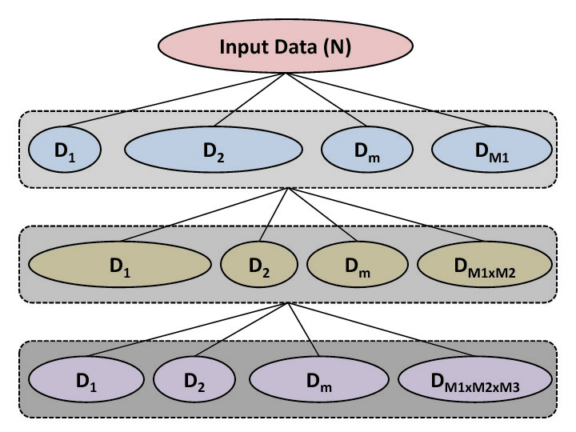
Iterative Split
Using an iterative approach requires constant number of splits at each level
Highly scalable due to its iterative nature and ideal number of bins can be chosen for best performance
Dividing the bins from Right-to-Left requires to preserve the order of elements from previous pass
Complete list of elements is re-arranged at each level
32 bit Bin broken into 4 sub-bins of 8 bits
8 bits
8 bits
8 bits
8 bits
4th Pass
3rd Pass
2nd Pass
1st Pass
Notes:
For pure fun lets consider the bits in reverse order …
Lets split on the least significant bits first say 8 + 8 …..
Then on rest of the 8 bits …. No hierarchy ….
Input given output taken , things are now split on first 8 bits …
Output of 1 given split performed things are now split on next 8 bits …. Great …
Best thing is number of splits to be performed at each level of tree is now
Constant or atleast u can fix it … it wont grow with level …
Did we do anything to ensure that the order of elements from first pass is safe ?
Most of u guessed .. My awesome ordered atomic is going to come into picture soon ….
Next : just one more thing before that … two step scatter …

Slide 30
Two Step Scatter
Block Data
Local Split
Final Copy – Global Scatter
‘Locality of reference’ results in efficient two step scatter
We first scatter the elements assigned to a block locally which results in arrangement of elements with same category close by
Rearrangement of data above results in coalesced writes when Global scatter is performed
Notes:
But before that I will tell u one little thing …
When u write data to the global memory …. Nearby threads writing to closer places help …
If they write to adjacent location is perfect .. They call it coalesced writes ….
The farther the things are written … the slower it mite be …
Without worrying abt it … somehow we were able to break our step number 3 to 2 steps where
We performed efficient scattering …. Making the overall split fast …
More ?
Next : Results SplitBasic()

Slide 31
Split Results : splitBasic()
Low number of bins result in higher shared memory atomic clashes.
High number of bins (512, 1K) do not perform well as the shared memory
256 bins (8 bits) makes a good candidate for iterative application of basic split
Notes:
Well that said .. Lets get to the business. ….
We have split … it works … lets split some stuff ….
Limited shared memory restricts the number of blocks which can run on the MP ….
So wat u c at the end of the graph is becos of running out of shared memory .. The number of blocks which can execute comes down …
Initial peaks are certainly understood as more clashes given the number of different categories are low ..
So 32 warp threads have 16 bins to go to …. Well they might clash .. Atleast clash more often than if we had 256 bins …
So if I give u this graph and ask wat is a good candidate for our basic split ? .. Certainly 256 bins looks gud to me … 8bits … rmr that …
Next : Sort using split algo …

Slide 32
SplitSort : Sort Using Splits
Sort ( inputList[], numBits, startBit )
{
nPasses = numBits / MAX_NUMBITS
If ( nPasses * MAX_NUMBITS < numBits )
nPasses++
firstPass = 1
for i = 1 to nPasses {
if ( numBits >= MAX_NUMBITS)
nBits = MAX_NUMBITS
else
nBits = numBits
startBit = MAX_NUMBITS * (i-1) + startBit
split8 ( inputList, firstPass, nBits, startBit )
numBits = numBits - MAX_NUMBITS
firstPass = 0 [First pass can use non-stable split]
}
}
- Repeated application of split8(), iterative split, is used to sort to high number of bits
Notes:
The worst slide ever … don’t even look at it …
Wat I m conveying here is …. Sort integers == split them on 32 bits ……
How do we do it …. 4 passes of 8 bits so simple …
Much ado abt nothing .. That’s just the ode for it …. How u call split8() for bits higher than 8
Great so just like that I m telling u we can sort .. And u believe me .. Nice folks …
Next : Results …

Slide 33
Split Results : Billions of Bins
Notes:
Ok lets unleas the hell …
We can now sort millions of numbers to upto 64 bits …
By this point, I almost use split an sort interchangeably … they are the same thing
Take away : super scalable and y not …. We have the lazy thread serial thingy which doesn’t care
If we have 10 clashes or 20 or 0 … hence every pass of split is a new morning for it …
Scalable in bits … scalable in number of elements … watelse u want from an algo/implementation ..

Slide 34
Split Results : Key+Index
Split performed on various combination of Key+Value in number of bits (on X-Axis)
Notes:
Noting .. Don’t look there
The point is … lets say I have 256byte data, name or ur long id or something and I have a 32 bit key, given 32 bit key can hold upto 4Billion records … or for safety lets say even 96 bits …
I don’t want to drag my data (256Bytes) in every pass. Every pass of my split rearranges the data completely reading and writing such data is useless … just have an index against ur value and move it all the time ……
Well finally u will have to move the data .. Bt we will come to that later …
So this is split when used with Key+Index ….

Slide 35
Sort Results : 1M to 128M : 32bit to 128bit
Notes:
128 bit sortings … 128M data .. Pushing our algo to limits …. Scales well until the last column or so … that’s when we hit all the 4GB memory on the GPU … so pardon it
Is this even fast .. ?

Slide 36
Sort Results : Comparison I
Notes:
Interestingly when we chked out the literature survey … we found out we are close to the fastest …
Great …fastest sorting .. All proudy ….
We didn’t even want to do it …
Now all that hype abt CUDPP sort … yeah this was the old version …. The second last row was the one which was going to be the next version … we were just marginally better .. And they had published their work while I was watching Sopranos …. So there we are …
CUDPP getting the new fastest sort … ppl are from nvidia …. Had a couple of rounds of ups and downs …
Finally

Slide 37
Sort Results : Comparison II
Notes:
Finally great we have their code … the new CUDPP is out … woot …
So we go from being marginally better to decently 25% better than them …
So that’s how we have the fastest sort today ….
Interesting thing is …. The approaches are similar… they have a Scan based approach .. The prefixsum thingy … and wat we have is lazy thread serial ordered atomic which forces u to work with just 32 threads …. Well we win …
Next : Scatter Large

Slide 38
Efficient Split/Gather - I
Random I/O from global memory is very slow
Locality of Reference within a warp helps
Scatter
Index
8
2
13
0
6
11
9
3
4
12
5
7
1
14
10
t₀
t₁
t₂
t₃
t₄
t₅
t₆
t₇
t₈
t₉
t₁₀
t₁₁
t₁₂
t₁₃
t₁₄
Thread IDs
t₀
t₁
t₂
t₃
t₄
t₅
t₆
t₇
t₈
t₉
t₁₀
t₁₁
t₁₂
t₁₃
t₁₄
Gather
Index
3
12
1
7
8
10
4
11
0
6
14
5
9
2
13
Notes:
So I told something about large values .. Sometimes 256byte data needs to be sorted against 32 bit keys etc……
So we didn’t drag the data in all the passes but a final scatter is wat we need …
As I said moving data in global memory is a pain ….
So such random writes by threads is not advisable … better remove them if u can …
Good thing is ..

Slide 39
Efficient Split/Gather - II
Multi-Element records can be moved efficiently
Key-Value pairs may comprise multi-byte ‘Values’
Multi Element Record
Scatter
Index
5
6
7
8
9
10
11
12
13
14
0
1
2
3
4
t₀
t₁
t₂
t₃
t₄
t₅
t₆
t₇
t₈
t₉
t₁₀
t₁₁
t₁₂
t₁₃
t₁₄
Thread IDs
t₀
t₁
t₂
t₃
t₄
t₅
t₆
t₇
t₈
t₉
t₁₀
t₁₁
t₁₂
t₁₃
t₁₄
Gather
Index
10
11
12
13
14
0
1
2
3
4
5
6
7
8
9
Notes:
The bigger the records the happier I am …
So I have 128 byte records …. That’s like 32 integers …
Great make 32 threads move them from one location to another …
They read adjacent elements they write adjacent elements .. Everyone is happy …

Slide 40
Data Movement Performance
Notes:
Quick numbers on wat I just said .. Just look at 2 values …. 8M last col and 64M first column…
It’s the same amount of data if u c …. 512MB of data….. U can do it 10 times faster if u have bigger records …

Slide 41
Chronologically Speaking
Notes:
So wat just happened was not wat I wanted to do … lets flash back quickly …

Slide 42
July 2007 – July 2008
Can CUDA be used for Raytracing ?
Will it be faster than Rasterization ?
At least close to ? Say 10x slower
Notes:
New CUDA thingy…. Wat do we do with it … we have to …
Looks like threads and stuff … and RT doesn’t need pipeline
Rasterization is the mother of all real time stuff … games ! That’s all …that’s y GPUs are …
So fine lets c …
Next : Target

Slide 43
July 2007 – July 2008
Target
1M Deformable Triangles - 1M Pixels
@ 25fps
Literature survey shows
kdTree on GPU, 200K triangles, 75 msec
For 1M triangles, lets say 375msec == 3fps
Notes:
Wat do u want … I want a million triangle deformable model… blowing dragon or something … rendered at realtime rates using the CUDA thing
Well fine .. Lets c wat DS we can use ….
Wat …. kdTree for RT … something something … 4fps is wat I make my DS at for 1M … when do I render … not possible …
Next : my own DS .. Do simple

Slide 44
July 2007 – July 2008
Simple DS, 3d Grid
Needs fast Split operation
For 1M triangles roughly and say 128x128x32 grid size
Literature Survey shows
Split can only be performed upto 64 bins [SIGMOD 08]
Notes:
I will have my own DS … wat do these ppl know abt GPU …
Wat I want is …. A 3d grid and triangles are placed in it … my rays go to the particular set of gometry and find and intersection … that’s it
Say I divide my Image of 1024x1024 into 128x128 in image space and another 32 slabs in the third direction …
U get the idea that we arrange the data such that each ray does not brute force all the triangles but intersects only with a small set … all is well
Throwing triangles in to voxels is exactly wat we called split …
Well lets have it then …
Literature survey shows … that poor method .. Of 64 bins …. Wat do I do with a 64 bin thing … render a 8x8 pixel image…

Slide 45
Published July 2008
Shared Memory Split proposed
Hierarchical Split, 3 stages, 128 -> 128 -> 32
Ray Casting solved – 1M deformable triangles at 25 fps on 1024x1024 (Nvidia 8800 GTX)
Notes:
Well proposed hierarchical split .. No NOT iterative just yet …. Since hierarchical served my purpose for then ….
3 pass ….
Great we had it … it was very fast to build … decently fast to ray cast .. Just first level ..thats rasterization …
Happy …
Next : faster split …

Slide 46
August – December 2008
Split was tested with numbers like
128x128x32 bins = 512K bins = 19 bits
What if we perform a Split on 32 bits ? Well that’s sorting !!
Hierarchical Split , not fast enough for beyond 3 levels
Notes:
I revisit the ray cast thing and realize that my split is not exactly fast … wat was happening was … for higher number of bins like say 4billions
Hierarchical thing was shooting up the number of splits to be performed …
That’s when we concluded hierarchical is not the way to go all in for sorting kind of thing …
That’s when I even gave the iterative one a thought … u c …

Slide 47
December 2008
Iterative Split proposed
Required Ordered Atomic Operations
H/W atomics did not support any order
Thread Serial Atomic Operations were used to implement the fastest sorting on the GPU
Parallel Work on a similar technique was submitted to a conference [Satish et al.]
32 bit sort
5% faster
Notes:
So now we realize the whole ahhh iterative can be done .. Constant nnumber of splits, ordered atomic showoff great, this is the perfect thing …
Fastest sort ….
Satish et al. aka CUDPP 1.1 paper numbers were very close still we were better … bt just by 5-10% …

Slide 48
March 2009
Improved Split with 2-Step Scatter
20% faster to Satish et al.
Minimum Spanning Tree using SplitLib published to High Performance Graphics
Notes:
We did our 2 step scatter thingy which gained us some more time ….
20% faster …
The best part about the split primitive is .. Lab mates very quickly saw its useful and deviced an algo which used multiple splits to perform MST of a graph and improved their own previous work by 4 times ….
Next : library and finally the fastest …

Slide 49
June 2009
Split Library
Fastest Sort 32,64 and 128 bit numbers
Scaling linearly with #bits #input #cores
CUDPP 1.1 using Satish et al. code released
SplitSort 25% faster for 32 bit Key sizes
No competition for higher number of bits
Notes:
Finally their code is out and now we are arnd 25% faster … it doesn’t matter much but the point is about scan v/s ordered atomic … the war
Their approach is not very scalable and claim 64 bit sorting as future work .. So for now we are unchallenged for 64 bits and 128 bits kind of thing ..

Slide 50
Rasterization v/s Raytracing
Ray Casting as an alternate rendering mode for current Graphics Architecture
CUDA software provides a closer control on underlying GPU hardware
Ray Tracing/Casting does not require graphics pipeline supported on GPUs today
Fragment shaders are already doing ray tracing thus eliminating the need of a rasterizer
Ray Tracing/Casting scales almost linearly with number of cores in case of CPUs and thus maps very well to CUDA hardware with multi processors

Slide 51
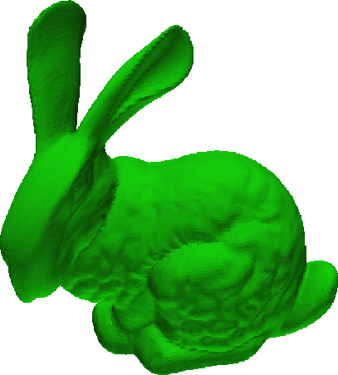
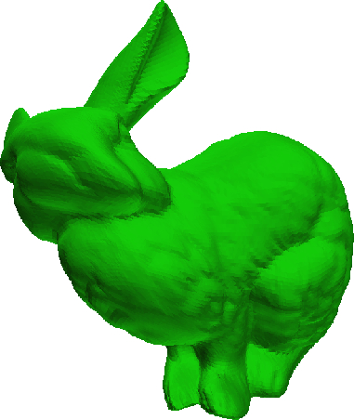


Ray Casting Deformable Models
Rendering technique
Immensely parallel
Historically Slow
Static Environments
Notes:
Anti rasterization ….
Very compute intensive …
Hence for static environments …

Slide 52
Current State of the Art
Current algorithms handle light weight models (~250K triangles) which produce 8-9 fps on Nvidia 8800 GTX
Construction of k-D Tree for a ~170K triangle model takes ~75msec per frame which limits the size of deformable models
We propose a GPU friendly “3-D Image space data structure” which can be built at more than real-time rates for models as heavy as 1Million triangles.
Notes:
Lets not follow the herd and use kdtree as ppl did on CPU …

Slide 53
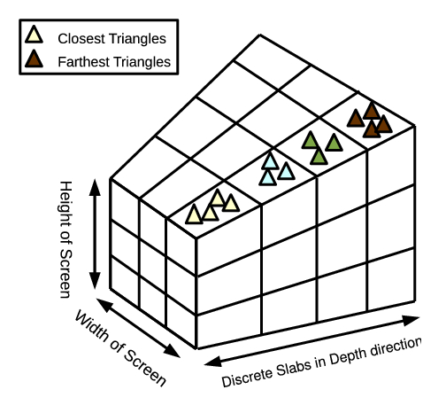
Data Structure for RC/RT
Image space divided into Tiles using regular grid
Frustum is further divided into discrete z-Slabs
Triangles belong to one or more z-Slabs based on their projection and depth
Each triangle is projected onto the screen to list Tiles it belongs to.
Triangle’s projection ‘z’ is used to decide its slab.
It becomes a problem of ‘Split’ in order to ‘Organize triangles per-slab-per-tile’.
Notes:
As I described briefly earlier … lets have a 3d grid in the frustum and put triangles in rite places … split
Project triangles on 2d grid and then depending on their depth assign them a voxel….

Slide 54
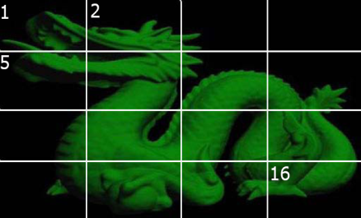
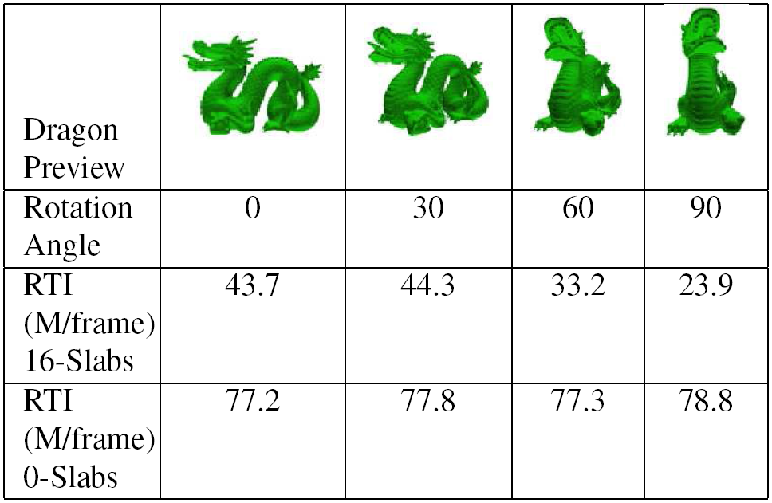
DS Contribution
Tiles Parallelize
Z-Slabs Efficiency
Depth Complexity
Notes:
So we use tiles in the image space to divide them in disjoint sets … take ur geometry take ur rays and go and get me a picture of that part ….
Slabs just help these tiles to finish their job early …
Depth complexity plays a role in how many ray-triangle intersections are performed …

Slide 55
Ray Casting
Each block loads triangle data from its corresponding tile to the SM
Triangle loading shared among threads
A Batch is loaded at a time, starting from closer to farther slabs
A Slab may contain multiple Batches
All thread/pixels intersect with loaded data
Thread stops ray-triangle intersection after finding the closest triangle intersection in a slab
But continues loading data untill all threads find an intersection
A Block stops processing when all threads have found an intersection or at the end of all slabs, producing

Slide 56
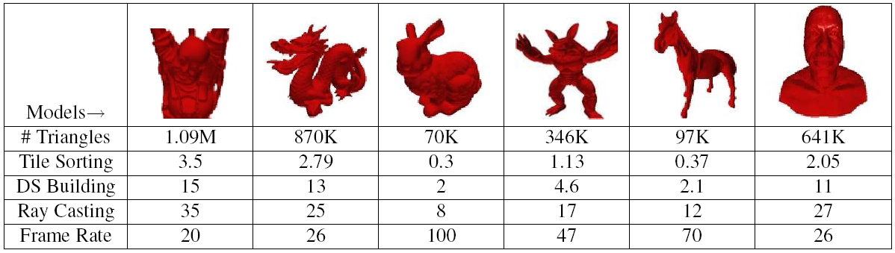







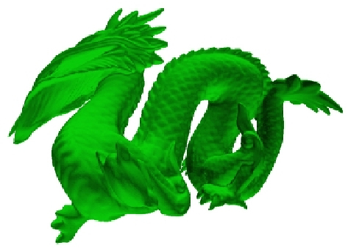

Ray Casting (Results)
Notes:
Well we achieved wat we wanted with a lot to spare ..
Heavy models complete renovation of their data structures … exactly wat I wanted …

Slide 57

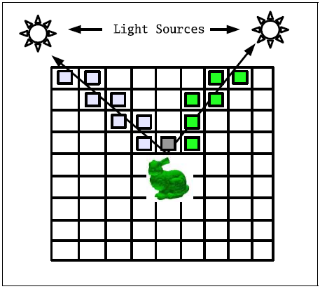
Work - Future Work
Deforming - Stanford Bunny (70K triangles) - Stanford Dragon ( 900K triangles )
Support Secondary Rays with the same Data structure
Notes:
Future …

Slide 58
Conclusion
Proposed Ordered Atomic Operations
Fastest Split
Highly useful primitive
Scalable with #categories, #inputsize, #cores
Fastest Sort
30% faster than the latest sort on the GPU
Scope for improvement with h/w ordered atomic
Ray Tracing Data Structure construction improved by a factor of 50
Notes:
Yes that was the key .. However simple it sounds .. Without it .. Fastest sorting was not possible …

Slide 59
Thank You for Your Time

Slide 60
Questions & Answers

