Slide 1
Improving the Efficiency of SfM and its Applications
Siddharth Choudhary
200601088
siddharth.choudhary@research.iiit.ac.in
Advisor: Prof. P J Narayanan

Slide 2
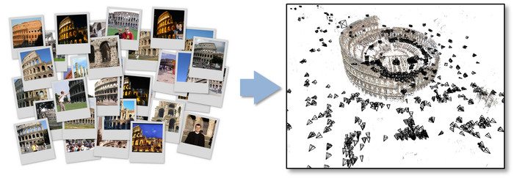
What is SfM?
Structure from Motion (SfM) refers to the process of computing the 3D structure using the motion information available in images or videos captured from different view points

Slide 3
SfM using Community Photo Collections (CPCs)
CPCs have created new opportunities in the area of large scale reconstruction and crowd sourced modeling
Lead to the creation of rich applications like Photosynth which provides virtual and immersive photo-tour of a location
Impressive growth in the area of large scale SfM

Slide 4
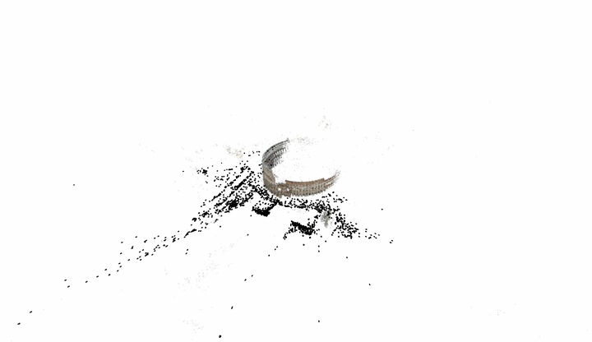
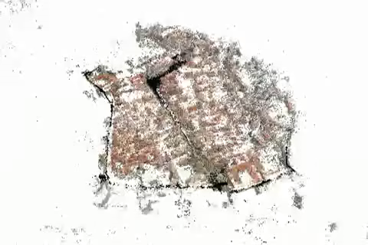
SfM using Community Photo Collections (CPCs)

Slide 5
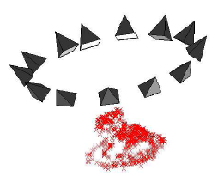
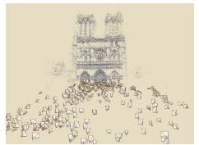
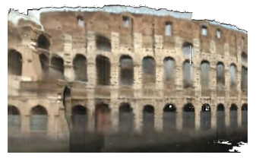
Related Work
Brown and Lowe. Unsupervised 3D Object Recognition and Reconstruction in Unordered Datasets (3DIM 2005)
Snavely et al. : Photo tourism: Exploring photo collections in 3D (SIGGRAPH 2006)
Snavely et al. : Modeling the World from Internet Photo Collection (IJCV 2007)
Agarwal et al. : Building Rome in a Day (ICCV 2009)
Frahm et al.: Building Rome on a Cloudless Day (ECCV 2010)
Crandall et al.: Discrete continuous optimization for large scale structure from motion (CVPR 2011)

Slide 6
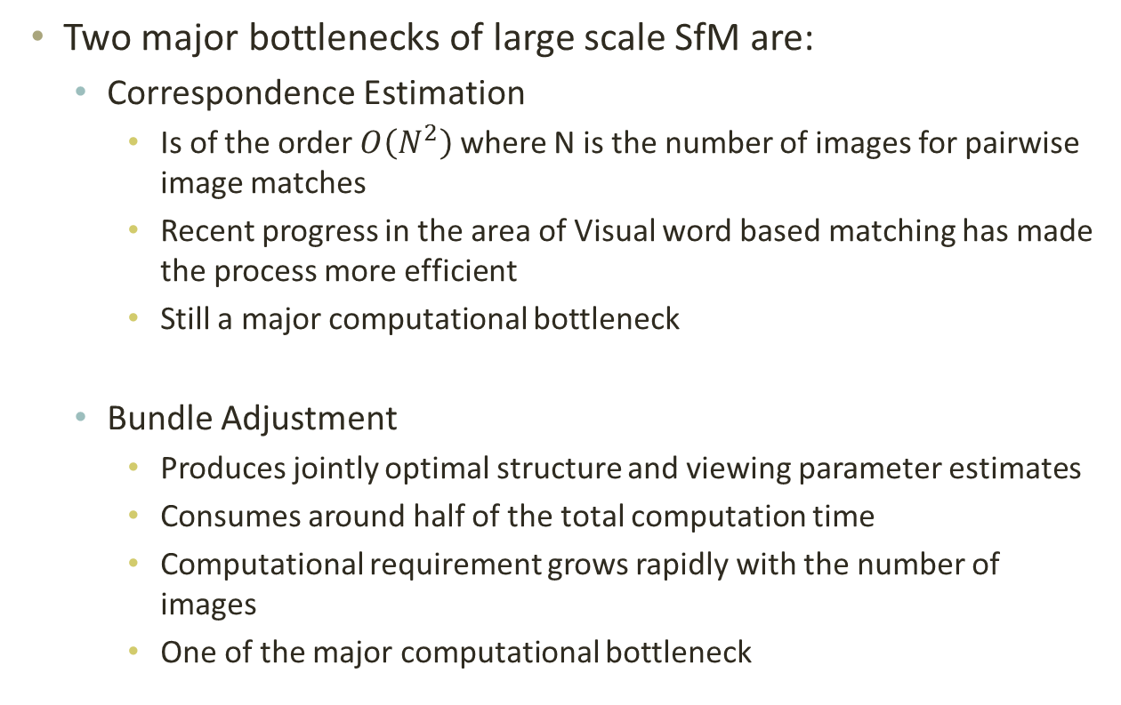
Efficiency of SfM
Two major bottlenecks of large scale SfM are:
  Correspondence Estimation
    Is of the order $O\left(N^{2}\right)$ where N is the number of images for pairwise image matches
    Recent progress in the area of Visual word based matching has made the process more efficient
    Still a major computational bottleneck
  Bundle Adjustment
    Produces jointly optimal structure and viewing parameter estimates
    Consumes around half of the total computation time
    Computational requirement grows rapidly with the number of images
    One of the major computational bottleneck

Slide 7
Contributions of the Thesis
We define a visibility probability and joint visibility formulation defined using the points and cameras in the SfM dataset.
We model the image localization problem using joint visibility probability to estimate camera pose using few 3D-2D correspondences
We introduce the feature triangulation problem and propose an algorithm to estimate the 3D point of a given 2D feature using visibility probability based guided search in the camera space
We develop a practical time implementation of bundle adjustment by exploiting the computing resources of the CPU and the GPU

Slide 8
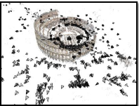
SfM Output
Colosseum Model:
#3d Points: 483,621
#Cameras: 1167
3d point
Point cloud model
Image N
Track of the 3d point
Image 2
Image 1

Slide 9
SfM Output as a Bipartite Graph
X₁
X₂
X₃
Points
X_{n}
…
…
C₁
C₂
C_{m}
Cameras
Each point is seen by multiple cameras and each camera sees multiple points

Slide 10
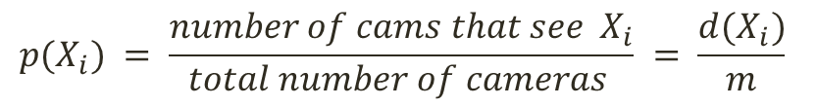
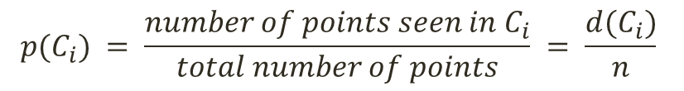
Visibility Probability
X₁
X₂
X₃
Points
X_{n}
…
$$p(X_{i}) = \frac{number of cams that see X_{i}}{total number of cameras } = \frac{d(X_{i})}{m}$$
$$p(C_{i}) = \frac{number of points seen in C_{i}}{total number of points} = \frac{d(C_{i})}{n}$$
…
C₁
C₂
Cameras
C_{m}
Visibility probability of a point/camera is the probability that a given point is seen in a randomly selected view or the probability that a random point is visible in the given camera

Slide 11
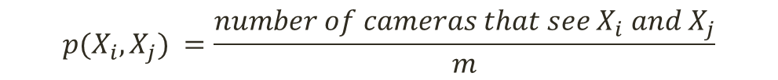
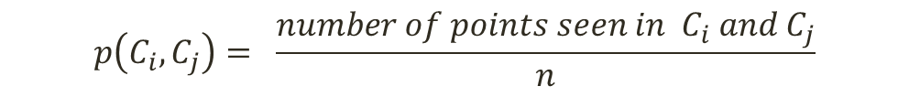
Joint Visibility Probability
$$p(X_{i},X_{j}) =\frac{number of cameras that see X_{i} and X_{j}}{m}$$
The joint visibility probability of two points is defined as the fraction of cameras in which both are visible.
$$p\left(C_{i},C_{j}\right)= \frac{number of points seen in C_{i} and C_{j}}{n}$$
The joint visibility probability of two cameras is defined as the fraction of points visible in both.

Slide 12
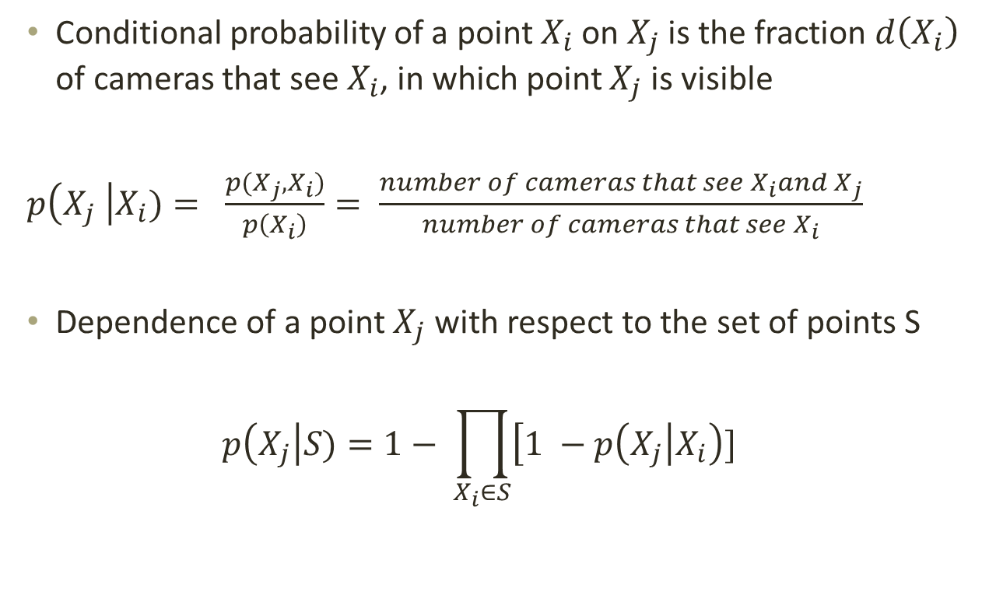
Dependence of a Point
Conditional probability of a point $X_{i}$ on $X_{j}$ is the fraction $d\left(X_{i}\right)$ of cameras that see $X_{i}$, in which point $X_{j}$ is visible
$p\left(X_{j} \right|X_{i})= \frac{p(X_{j}, X_{i})}{p\left(X_{i}\right)}= \frac{number of cameras that see X_{i}and X_{j}}{number of cameras that see X_{i}}$
Dependence of a point $X_{j}$ with respect to the set of points S
$$p\left(X_{j}\right|S)=1− \prod_{X_{i}∈S}{\left[1 −p\left(X_{j}\right|X_{i}\right)}]$$

Slide 13
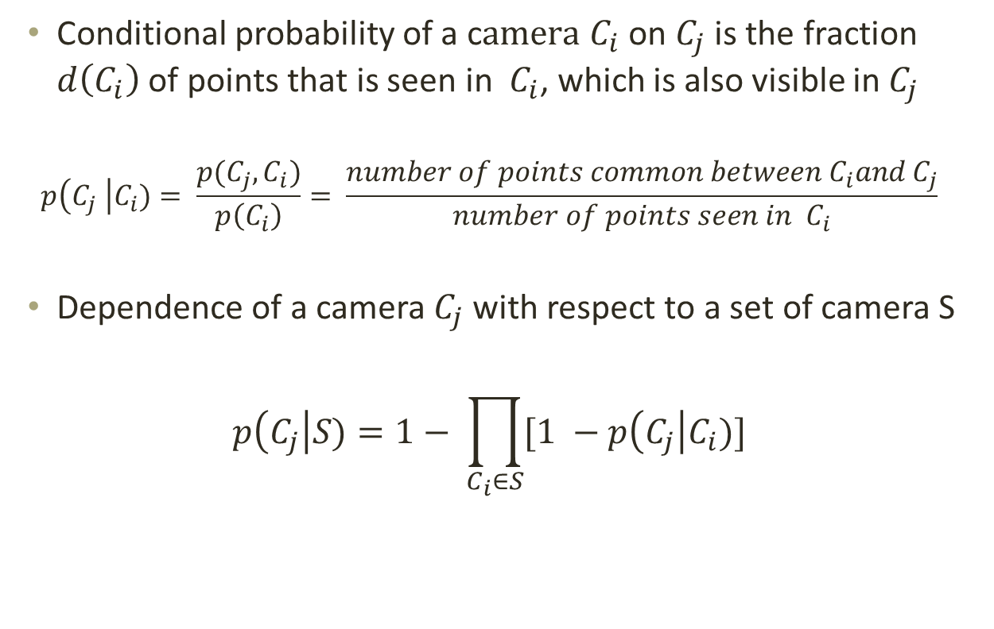
Dependence of a Camera
Conditional probability of a c$amera C_{i}$ on $C_{j}$ is the fraction $d\left(C_{i}\right)$ of points that is seen in $C_{i}$, which is also visible in $C_{j}$
$$p\left(C_{j} \right|C_{i})= \frac{p(C_{j}, C_{i})}{p\left(C_{i}\right)}= \frac{number of points common between C_{i}and C_{j}}{number of points seen in C_{i}}$$
Dependence of a camera $C_{j}$ with respect to a set of camera S
$$p\left(C_{j}\right|S)=1− \prod_{C_{i}∈S}{[1 −p\left(C_{j}\right|C_{i})]}$$

Slide 14
Dual Problems of Image Localization and Feature Triangulation
We model the image localization problem using joint visibility probability to estimate camera pose using few 3D-2D correspondences
We introduce the feature triangulation problem and propose an algorithm to estimate the 3D point of a given 2D feature using visibility probability based guided search in the camera space

Slide 15
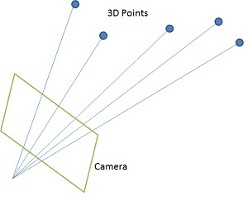
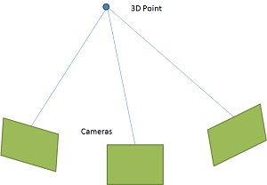
Dual Problems of Image Localization and Feature Triangulation
Image Localization
Feature Triangulation

Slide 16
Contributions of the Thesis
We define a visibility probability and joint visibility formulation defined using the points and cameras in the SfM dataset.
We model the image localization problem using joint visibility probability to estimate camera pose using few 3D-2D correspondences
We introduce the feature triangulation problem and propose and algorithm to estimate the 3D point of a given 2D feature using visibility probability based guided search in the camera space
We develop a practical time implementation of bundle adjustment by exploiting the computing resources of the CPU and the GPU

Slide 17
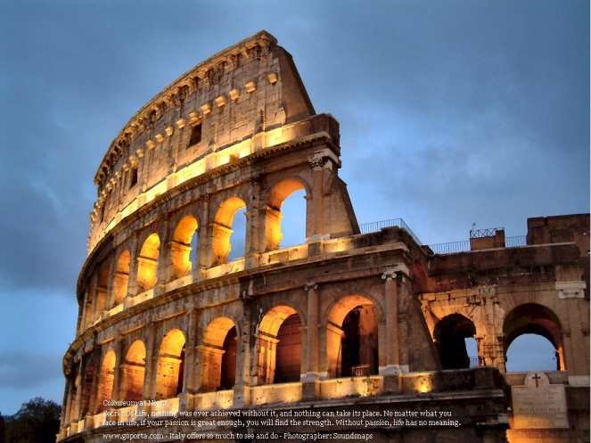
What is Image Localization ?
Input Image

Slide 18
What is Image Localization ?
Input Image
Q. Where am I ?

Slide 19
What is Image Localization ?
Input Image
Q. Where am I ?
Ans: Camera Pose

Slide 20
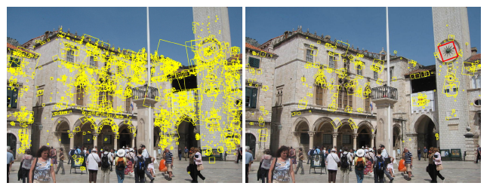
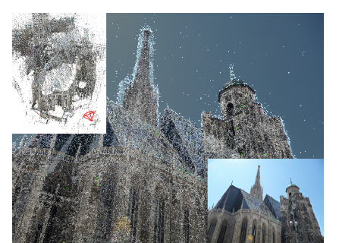
Related Work
Location Recognition using Prioritized feature matching
Yunpeng Li, Noah Snavely and Daniel P Huttenlocher (ECCV 2010)
Fast image based localization using direct 3d-2d matching
Torsten Sattler, Bastian Leibe and Leif Kobbelt (ICCV 2011)

Slide 21
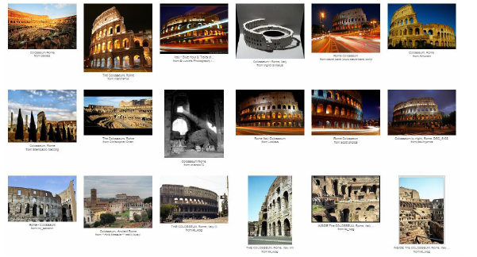
Image Localization Pipeline
Community Photo Collection

Slide 22
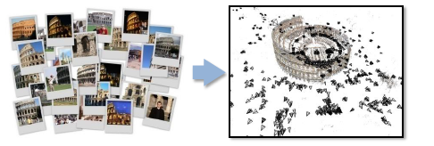
Image Localization Pipeline
Community Photo Collection
Bundler
Point Cloud Model

Slide 23
Image Localization Pipeline
Input to our algorithm:
Community Photo Collection
Bundler
Point Cloud Model

Slide 24
Image Localization Pipeline
Input to our algorithm:
Community Photo Collection
Bundler
Point Cloud Model
Pre-
Computation
Enriched Model

Slide 25
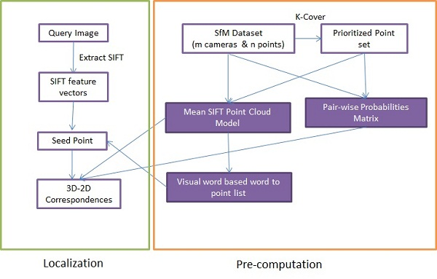
Pre-computation

Slide 26
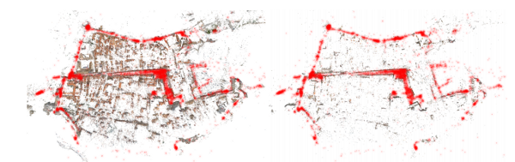
Model Compression using K-Cover
We use approximate K-Cover algorithm to reduce the number of points
K-Cover ensures that the whole model is uniformly covered using minimal number of points
We use only 3-5% of the total number of points

Slide 27
Mean SIFT Point Cloud
3d point
Point cloud model
Image N
Build the feature descriptor of each point
Image 2
Image 1

Slide 28
Visual word based word to point list
Each 3D point is represented using the mean SIFT of its track points
The mean SIFT corresponding to a 3D point is quantized to the nearest visual word using a prebuilt vocabulary tree.
We get a mapping from each 3D point to a visual word
Inverting this list, we get a mapping from each visual word to a set of 3D points.

Slide 29
Enriched Model
Each 3d point has:
  3d coordinate
  Mean of all the projected SIFT points
Visual word based word to point list
Pair-wise Probabilities matrix representing the connection between every pair of 3d points

Slide 30
Image Localization Pipeline (Till Now…)
Input to our algorithm:
Community Photo Collection
Bundler
Point Cloud Model
Pre-
Computation
Enriched Model

Slide 31
Image Localization Pipeline
Input to our algorithm:
Community Photo Collection
Bundler
Point Cloud Model
Pre-
Computation
Enriched Model
Seed Generation
Seed Point

Slide 32
Seed Generation
We adapt 2D-3D approach similar to the work of Sattler et al. to identify a seed point in the query image
Iterate over the SIFT features in the query image and quantize them to the nearest word
Using the word list from the query image and the pre-computed word to point list, we find the set of points corresponding to each query feature
Linear search is performed over the list of 3D points to estimate a potential match
Reverse search is done to confirm a seed point
Sattler et al.: Fast image based localization using direct 3d-2d matching (ICCV 2011)

Slide 33
Image Localization Pipeline (Till Now…)
Input to our algorithm:
Community Photo Collection
Bundler
Point Cloud Model
Pre-
Computation
Enriched Model
Seed
Generation
Seed Point

Slide 34

Image Localization Pipeline
Input to our algorithm:
Community Photo Collection
Bundler
Point Cloud Model
Pre-
Computation
Enriched Model
Seed
Generation
Seed Point
Visibility
Probability
Guided Matching
3d – 2d correspondences

Slide 35
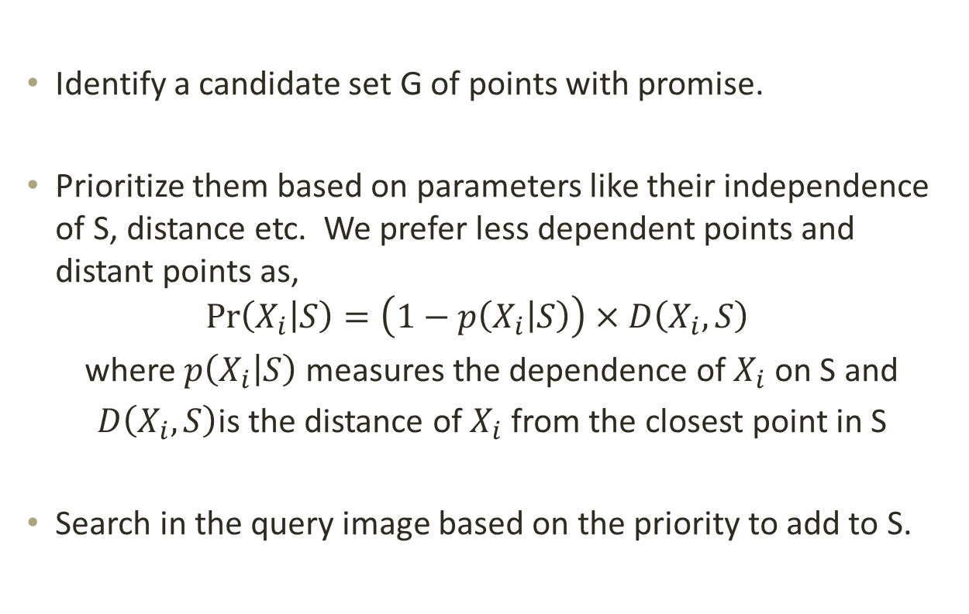
Visibility Probability Guided Matching
Identify a candidate set G of points with promise.
Prioritize them based on parameters like their independence of S, distance etc. We prefer less dependent points and distant points as,
$$\operatorname{Pr}\left(X_{i} | S\right)=\left(1−p\left(X_{i} | S\right)\right)×D\left(X_{i},S\right)$$
where $p\left(X_{i} | S\right)$ measures the dependence of $X_{i}$ on S and
$D\left(X_{i},S\right)$is the distance of $X_{i}$ from the closest point in S
Search in the query image based on the priority to add to S.

Slide 36
Image Localization Pipeline (Till Now…)
Input to our algorithm:
Community Photo Collection
Bundler
Point Cloud Model
Pre-
Computation
Enriched Model
Seed
Generation
Seed Point
Visibility
Probability
Guided Matching
3d – 2d correspondences

Slide 37
Image Localization Pipeline
Input to our algorithm:
Community Photo Collection
Bundler
Point Cloud Model
Pre-
Computation
Enriched Model
Seed
Generation
Seed Point
Visibility
Probability
Guided Matching
DLT
RANSAC
3d – 2d correspondences
Camera Pose

Slide 38
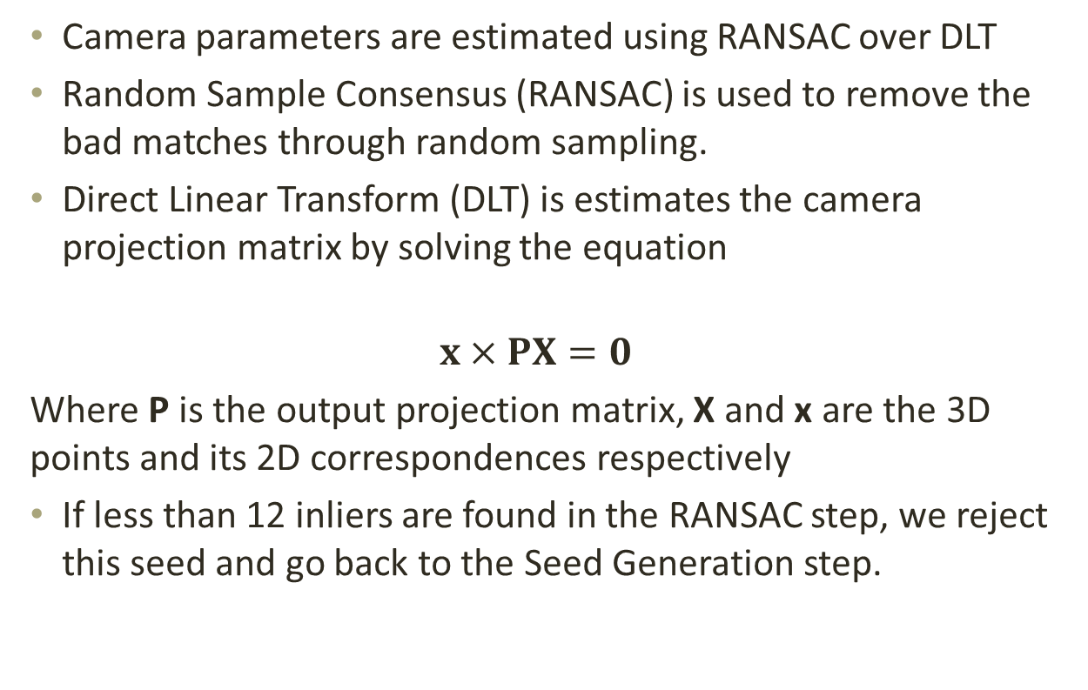
Camera Estimation
Camera parameters are estimated using RANSAC over DLT
Random Sample Consensus (RANSAC) is used to remove the bad matches through random sampling.
Direct Linear Transform (DLT) is estimates the camera projection matrix by solving the equation
$$x×PX=0$$
Where P is the output projection matrix, X and x are the 3D points and its 2D correspondences respectively
If less than 12 inliers are found in the RANSAC step, we reject this seed and go back to the Seed Generation step.

Slide 39
Image Localization Pipeline (Complete)
Input to our algorithm:
Community Photo Collection
Bundler
Point Cloud Model
Pre-
Computation
Enriched Model
Seed
Generation
If Failed
Seed Point
Visibility
Probability
Guided Matching
DLT
RANSAC
3d – 2d correspondences
Camera Pose

Slide 40
Experimental Results :: Registration Performance
Method | Dubrovnik |  |  | Rome |  |  | Vienna
 | #reg. images | #pts searched | Reg. time [s] | #reg. images | #pts searched | Reg. time [s] | #reg. images | #pts searched | Reg. time [s]
Our | 789 | 839.6 | 0.25 | 977 | 3253 | 0.27 | 219 | 972 | 0.40
Sattler et al. | 784 | - | 0.28 | 975 | - | 0.25 | 207 | - | 0.46
Li et al. | 753 | 9756 | 0.73 | 921 | 12963 | 0.91 | 204 | 6245 | 0.55

Slide 41
Experimental Results ::
Localization Accuracy
Method | #Reg. Images | Mean[m] | Median[m] | 1st Quartile [m] | 3rd Quartile [m]
Our Method | 788 | 34.79 | 3.104 | 0.88 | 11.83
Sattler et al. | 784 | 53.9 | 1.4 | 0.4 | 5.9
Li et al. | 753 | 18.3 | 9.3 | 7.5 | 13.4

Slide 42
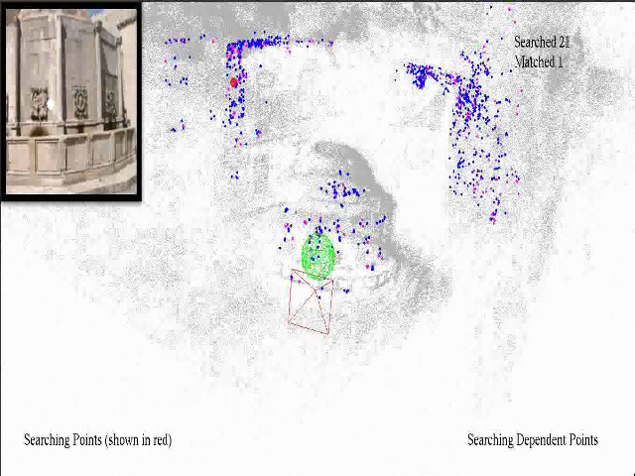
Experimental Results ::
Video

Slide 43
Contributions of the Thesis
We define a visibility probability and joint visibility formulation defined using the points and cameras in the SfM dataset.
We model the image localization problem using joint visibility probability to estimate camera pose using few 3D-2D correspondences
We introduce the feature triangulation problem and propose and algorithm to estimate the 3D point of a given 2D feature using visibility probability based guided search in the camera space
We develop a practical time implementation of bundle adjustment by exploiting the computing resources of the CPU and the GPU

Slide 44
What is Feature Triangulation?
Given a feature point in an image with 2D coordinates and the descriptor, find its 3D coordinates.
Triangulating a 2D feature to a 3D point requires a track of features that matches to the query 2D feature and the corresponding camera poses.
This problem is dual to the image localization problem.

Slide 45
Conventional Algorithm
Feature Triangulation algorithm can be divided into two basic steps:
  Feature Matching: Given a query 2D feature, we have to search the nearby cameras to find the matching 2D features
  Point Estimation: Given a track of 2D features and the corresponding camera poses, a 3D point is estimated such that it minimizes the re-projection error when projected back onto the respective cameras

Slide 46
Our Proposed Algorithm
Our proposed algorithm can be divided into five basic steps:
  Feature Point Selection
  Probability Guided Camera Selection
  Local View Selection Prior
  Two Way Matching
  Point Estimation
  We now explain each one of these in detail

Slide 47
Feature Point Selection
We use feature-point selection to select novel feature-points which are matched to nearby images and reconstruct new 3D points
Features are restricted to lie sufficiently far from the boundary
Alternatively, the user can interactively draw a rectangle to restrict the features inside it
We discard points that are within 4 pixels of the already triangulated feature

Slide 48
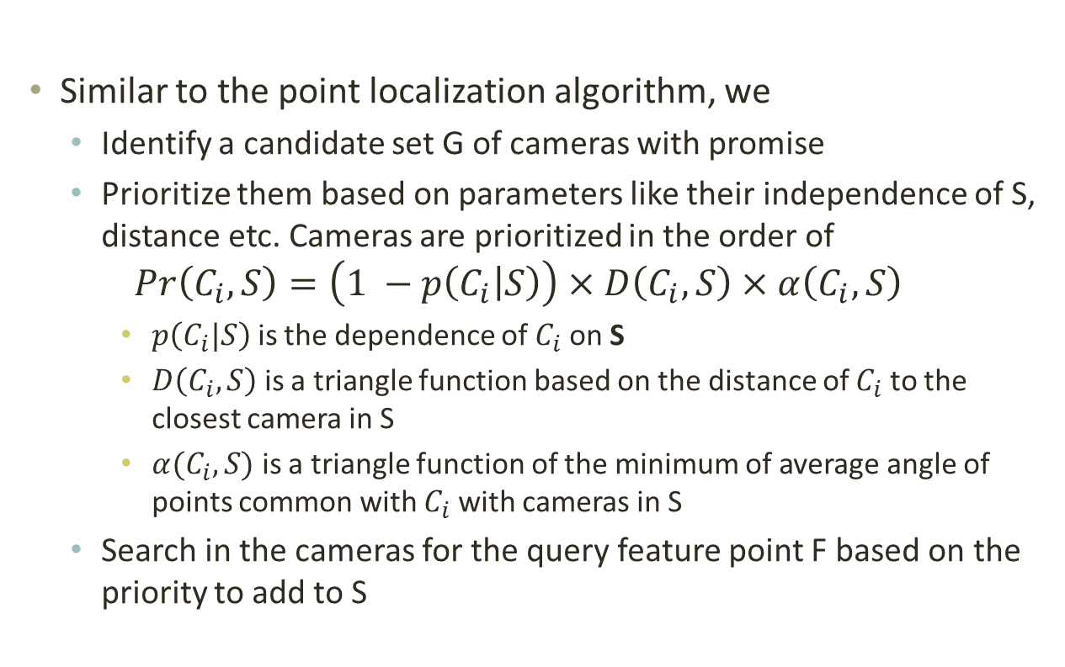
Probability Guided Camera Selection
Similar to the point localization algorithm, we
  Identify a candidate set G of cameras with promise
  Prioritize them based on parameters like their independence of S, distance etc. Cameras are prioritized in the order of
$$Pr\left(C_{i}, S\right)=\left(1 −p\left(C_{i} | S\right)\right)×D\left(C_{i},S\right)×α\left(C_{i},S\right)$$
    $p\left(C_{i}|S\right)$ is the dependence of $C_{i}$ on S
    $D\left(C_{i},S\right)$ is a triangle function based on the distance of $C_{i}$ to the closest camera in S
    $α(C_{i},S)$ is a triangle function of the minimum of average angle of points common with $C_{i}$ with cameras in S
  Search in the cameras for the query feature point F based on the priority to add to S

Slide 49
Local-View Selection Prior
In order to boost the performance of the probability guided camera selection, we multiply the overall camera priority with a local view selection prior
We find 10 already triangulated nearest neighbors of the feature point
The local view prior of a camera is computed as the number of 3D points belonging to 10 nearest neighbors, that is visible in the respective camera

Slide 50
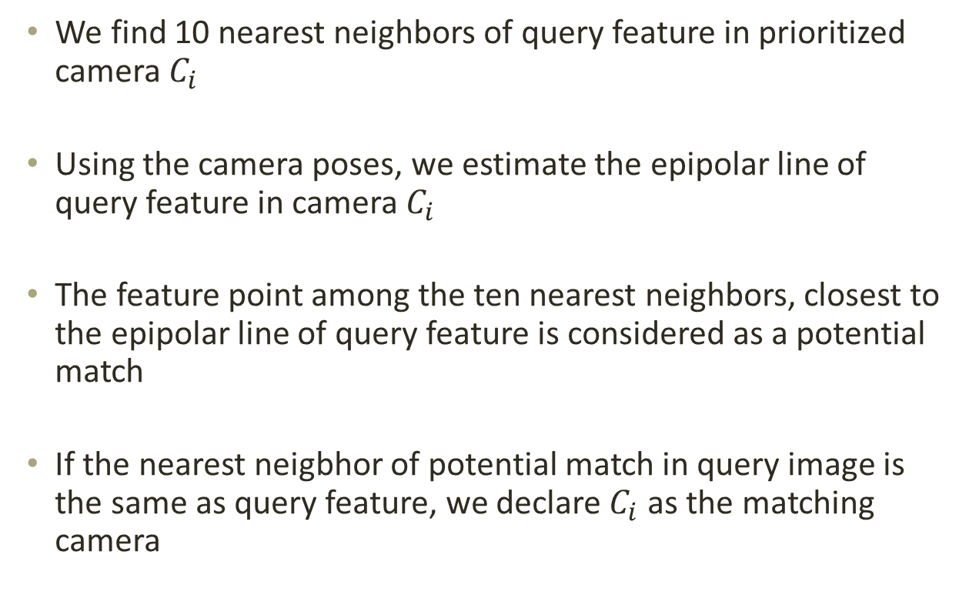
Two – Way Matching
We find 10 nearest neighbors of query feature in prioritized camera $C_{i}$
Using the camera poses, we estimate the epipolar line of query feature in camera $C_{i}$
The feature point among the ten nearest neighbors, closest to the epipolar line of query feature is considered as a potential match
If the nearest neigbhor of potential match in query image is the same as query feature, we declare $C_{i}$ as the matching camera

Slide 51
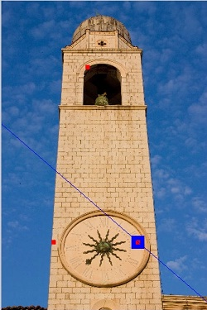
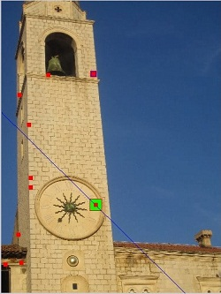
Two – Way Matching

Slide 52
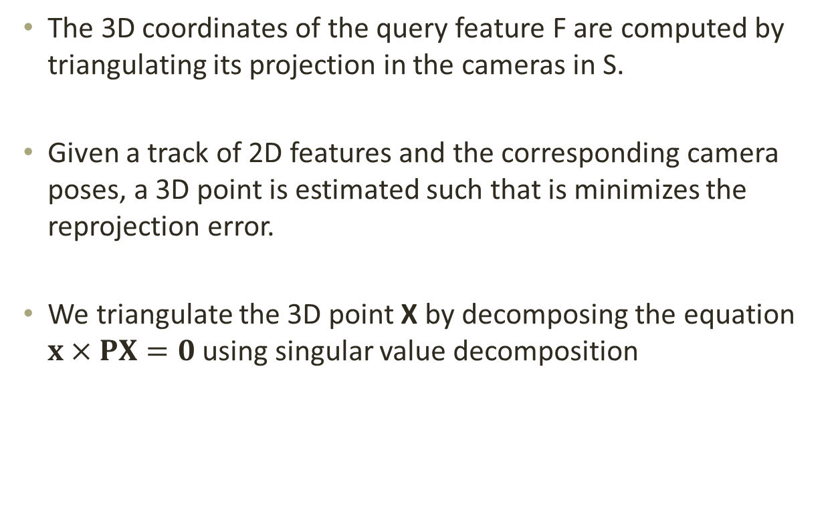
Point Estimation
The 3D coordinates of the query feature F are computed by triangulating its projection in the cameras in S.
Given a track of 2D features and the corresponding camera poses, a 3D point is estimated such that is minimizes the reprojection error.
We triangulate the 3D point X by decomposing the equation $x×PX=0$ using singular value decomposition

Slide 53
Experimental Results :: Triangulation Statistics
Track Length | No. Pts Triangulated | Triangulation Error | Reprojection error | Running time [s]
2 | 8743 | 0.05438 | 0.09498 | 0.44
3 | 2187 | 0.0095 | 1.8092 | 0.59
4 | 1104 | 0.0050 | 2.0842 | 0.49
5 | 791 | 0.0059 | 2.2168 | 0.63
>5 | 5441 | 0.0030 | 2.4178 | 0.33

Slide 54
Experimental Results :: Repetitive Structures
Dataset | Two Way Matching |  |  |  | Ratio Test
 | #Pts added | Tri. error | Reproj. Error | time [s] | #Pts added
9126 Pts | 8830 | 0.0105 | 1.40 | 0.728 | 8950
Image 1 | 669 | - | 1.16 | 0.38 | 14
Image 2 | 686 | - | 1.11 | 0.70 | 60
Image 3 | 120 | - | 1.17 | 0.75 | 4

Slide 55
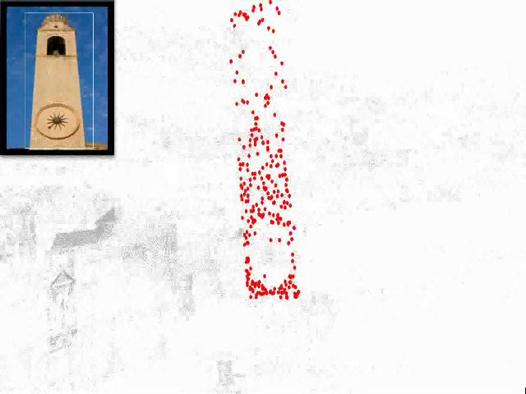
Experimental Results ::
Video

Slide 56
Contributions of the Thesis
We define a visibility probability and joint visibility formulation defined using the points and cameras in the SfM dataset.
We model the image localization problem using joint visibility probability to estimate camera pose using few 3D-2D correspondences
We introduce the feature triangulation problem and propose and algorithm to estimate the 3D point of a given 2D feature using visibility probability based guided search in the camera space
We develop a practical time implementation of bundle adjustment by exploiting the computing resources of the CPU and the GPU

Slide 57
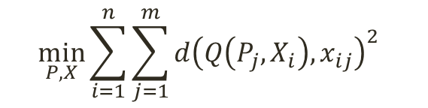
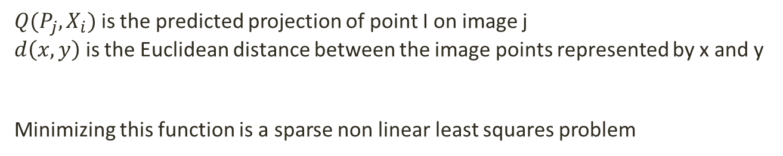
What is Bundle Adjustment ?
Objective Function:
$$\min_{P,X}{\sum_{i=1}^{n}{\sum_{j=1}^{m}{d{\left(Q\left(P_{j},X_{i}\right),x_{ij}\right)}^{2}}} }$$
$Q(P_{j},X_{i})$ is the predicted projection of point I on image j
$d\left(x,y\right)$ is the Euclidean distance between the image points represented by x and y
Minimizing this function is a sparse non linear least squares problem

Slide 58
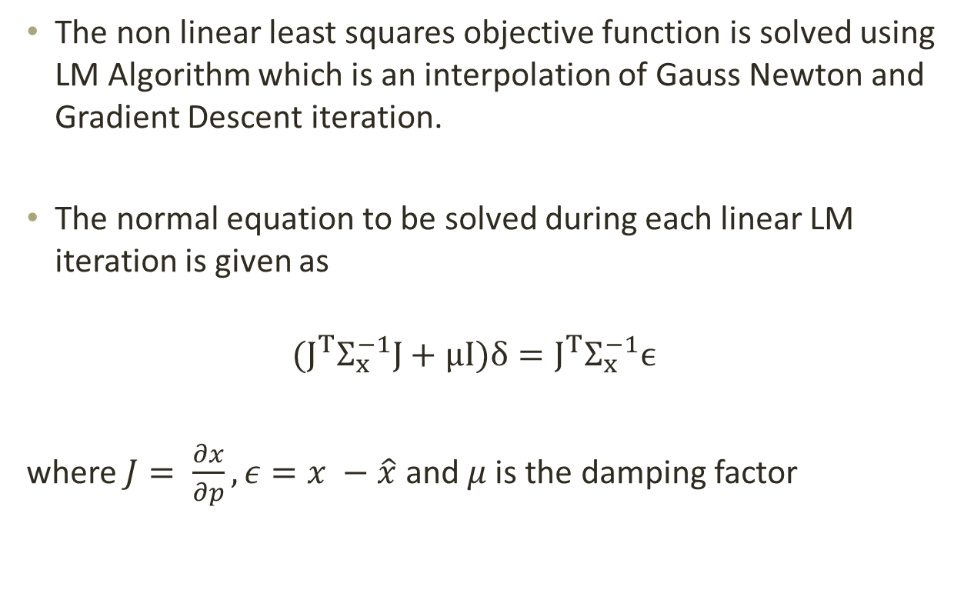
What is Bundle Adjustment ?
The non linear least squares objective function is solved using LM Algorithm which is an interpolation of Gauss Newton and Gradient Descent iteration.
The normal equation to be solved during each linear LM iteration is given as
$${(J}^{T}Σ_{x}^{−1}J+μI)δ=J^{T}Σ_{x}^{−1}ϵ$$
where $J= \frac{∂x}{∂p}, ε=x −\hat{x}$ and $μ$ is the damping factor

Slide 59
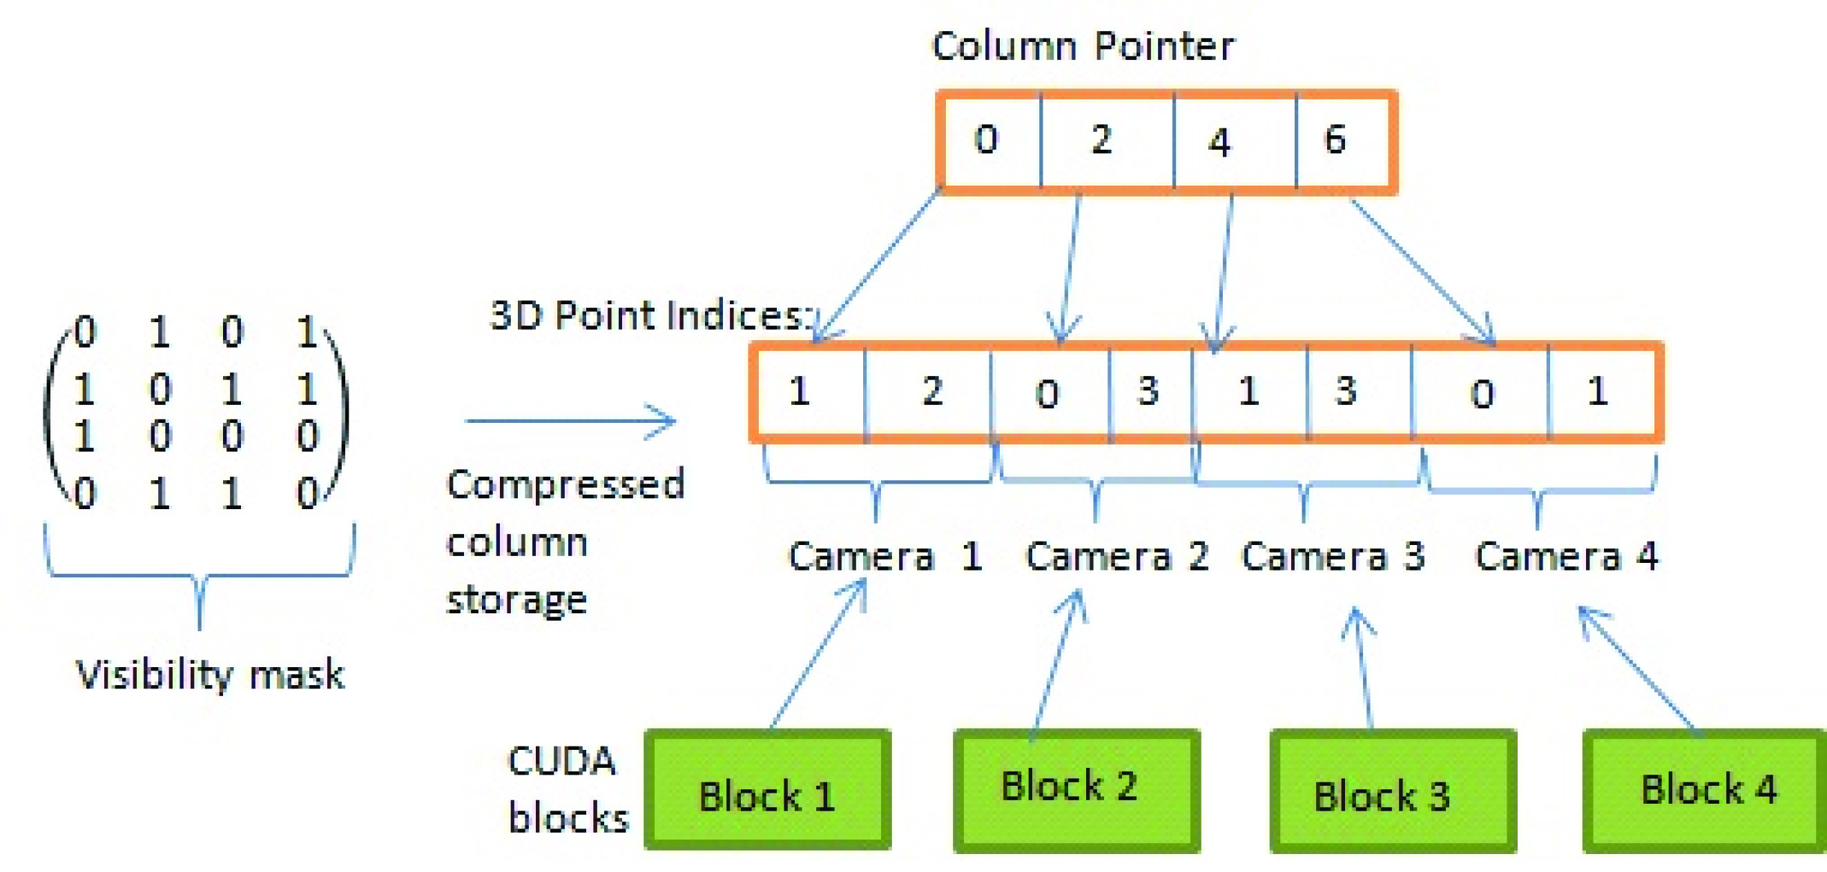
Data Structure for the SBA
Compressed Column Storage of Visibility Mask having 4 Cameras and 4 3D Points. Each CUDA Block processes one set of 3D points.

Slide 60
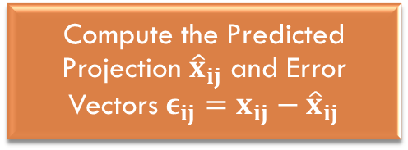
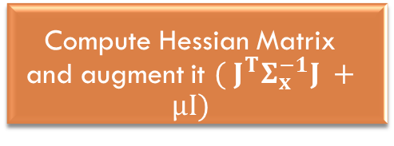

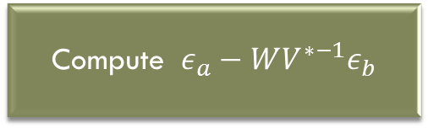
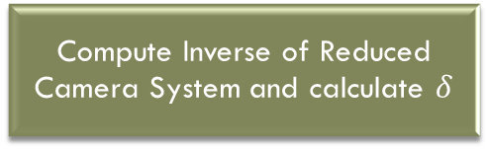
Sparse Bundle Adjustment on the GPU
Compute Jacobian Matrix (J)
Compute L2 Error using Error Vectors
Compute Schur Complement to form Reduced Camera System

Slide 61
Sparse Bundle Adjustment on the GPU
Compute Jacobian Matrix (J)
Compute L2 Error using Error Vectors
GPU
CPU
Compute Schur Complement to form Reduced Camera System

Slide 62
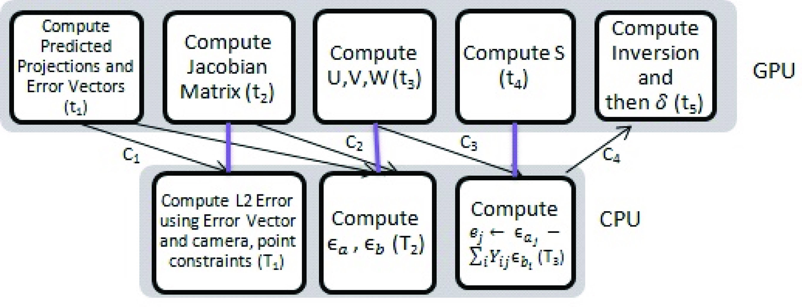
Hybrid Computation
Computation blocks are efficiently scheduled either on CPU or GPU. Arrows show the data dependency between various modules on CPU and GPU. Modules connected through a vertical line are computed in parallel on CPU and GPU

Slide 63
Experimental Results :: Time Interval (488 Cameras)
Timings shown are the time taken by each component either on CPU or GPU including the memory transfer time in one iteration for 488 cameras. Times shown in parenthesis are for the use of S1070 and other for the C2050.

Slide 64
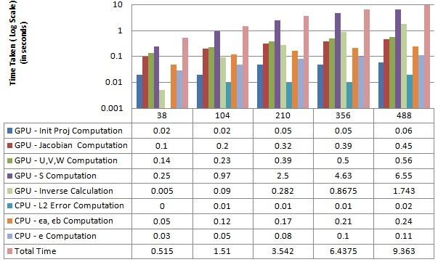
Experimental Results :: Time Split Up
Time(sec) taken for each step in one iteration of Bundle Adjustment on GPU and CPU for various number of cameras. Total time is the time taken by hybrid implementation of BA using CPU and GPU in parallel

Slide 65
Experimental Results :: SpeedUp
Using Tesla S1070
Using Tesla C2050
Time Comparison (one iteration) of Bundle Adjustment Computation on CPU and GPU

Slide 66
Conclusions and Future Work
We presented the visibility probability structure of an SfM dataset and used it to solve the dual problem of image localization and feature triangulation
We introduced a hybrid algorithm using the GPU and the CPU to perform practical time bundle adjustment.
As a possible future direction, we are working on an alternate SfM pipeline using efficient localization, triangulation and fast bundle adjustment.

Slide 67
Thank You siddharth.choudhary@research.iiit.ac.in

Slide 68
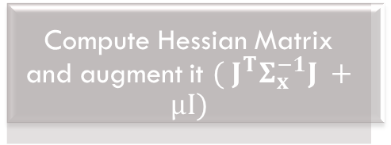

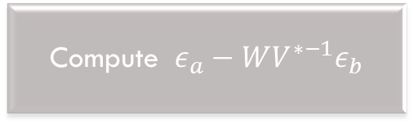
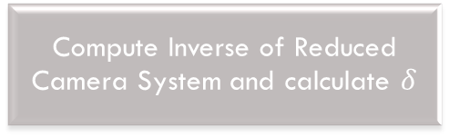
Sparse Bundle Adjustment on the GPU
Compute Jacobian Matrix (J)
Compute L2 Error using Error Vectors
Compute Schur Complement to form Reduced Camera System

Slide 69
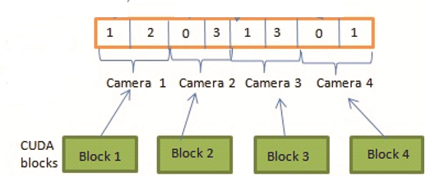
Sparse Bundle Adjustment on the GPU
Computation of the Predicted Projection and Error Vector
  For m cameras, m blocks are launched, with block j computing projections corresponding to camera j.
  The computation is limited by the number of registers available per block and a maximum limit of number of threads per block.

Slide 70
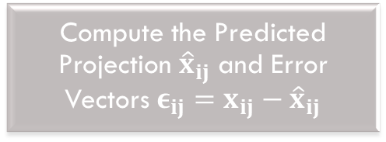
Sparse Bundle Adjustment on the GPU
Compute Jacobian Matrix (J)
Compute L2 Error using Error Vectors
Compute Schur Complement to form Reduced Camera System

Slide 71
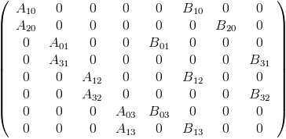



Sparse Bundle Adjustment on the GPU
Computation of the Jacobian Matrix and L2 Error
  The Jacobian Matrix is calculated as $\frac{∂X}{∂P}$, with a grid structure similar to the computation of initial projections.
Compressed Column
Storage
Block j computes the $A_{ij}\& B_{ij}$ submatrices corresponding the jth camera

Slide 72
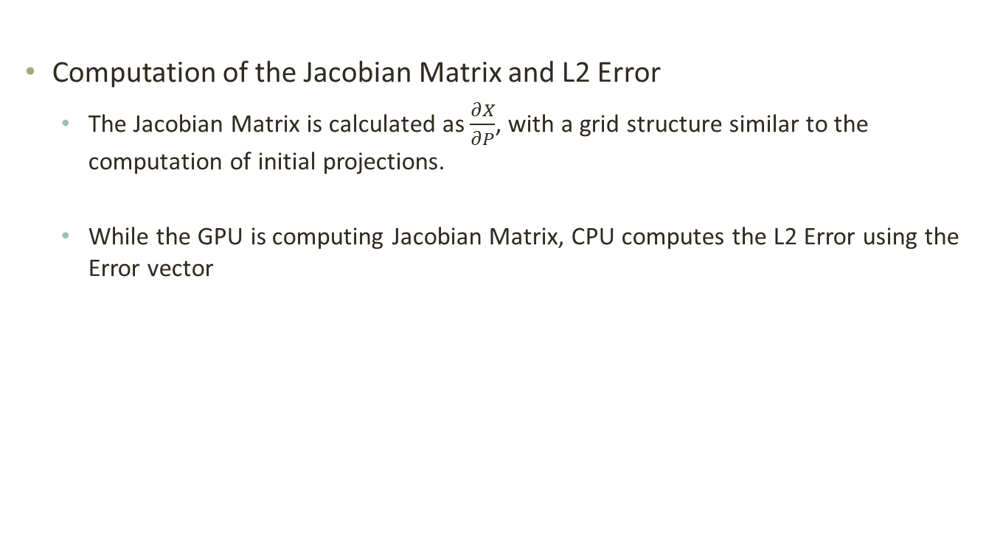
Sparse Bundle Adjustment on the GPU
Computation of the Jacobian Matrix and L2 Error
  The Jacobian Matrix is calculated as $\frac{∂X}{∂P}$, with a grid structure similar to the computation of initial projections.
  While the GPU is computing Jacobian Matrix, CPU computes the L2 Error using the Error vector

Slide 73



Sparse Bundle Adjustment on the GPU
Compute Jacobian Matrix (J)
Compute L2 Error using Error Vectors
Compute Schur Complement to form Reduced Camera System

Slide 74


Sparse Bundle Adjustment on the GPU

Slide 75
Sparse Bundle Adjustment on the GPU
  Computation of U
    The grid structure consists of m blocks with each block processing one Uj where j is the block id
    Summation is done using segmented scan
U

Slide 76
Sparse Bundle Adjustment on the GPU
  Computation of V
    Computation of V is done in a way similar to U, with each block computing Vi for the ith point
U
V

Slide 77
Sparse Bundle Adjustment on the GPU
  Computation of W
    Computation of Ws are independent of each other
    nnz/10 blocks are launched with each block computing 10 Ws
U
W
V

Slide 78

Sparse Bundle Adjustment on the GPU

Slide 79


Sparse Bundle Adjustment on the GPU
Compute Jacobian Matrix (J)
Compute L2 Error using Error Vectors
Compute Schur Complement to form Reduced Camera System

Slide 80

Sparse Bundle Adjustment on the GPU

Slide 81
Sparse Bundle Adjustment on the GPU
Compute Jacobian Matrix (J)
Compute L2 Error using Error Vectors
Compute Schur Complement to form Reduced Camera System

Slide 82

Sparse Bundle Adjustment on the GPU

