Slide 1

Real-time Terrain Rendering and Processing
Shiben Bhattacharjee
200607022 shiben@research.iiit.ac.in
Advisor: Prof. P. J. Narayanan

Slide 2
Why render terrains?
Terrains are a basic need in most graphics application
Geographical information systems
  E.g. Google Earth
Entertainment:
  Computer Games
  Animation Movies
Study of terrains
Notes:
Terrain are thanklessly needed in most graphics applications because everything outdoor is around terrains
Study: e.g. flow of water, agriculture, military tactics, etc.

Slide 3
Chapters
What is terrain rendering?
Real-time Terrain Rendering
Spherical Terrain Rendering
Painterly Rendering of Terrains
Notes:
This thesis presents ideas for terrain rendering for various needs and requirements and splits this presentation in four chapters
I will talk about what is terrain rendering in general and why it is done, why is it necessary and why it became a research topic?
In the next chapter I will talk about a system we created for terrains which fulfills needs of rendering as well as manipulations, like editing the terrain online as well as some simple physics
Next I talk about Spherical terrains. When we map a terrain around a sphere we form a planet, because our planet is not a perfect sphere, there are small irregularities which for us are enourmous. Such a terrain, can be viewed as a planet from astronomical distances and can be zoomed to see its details too.
Finally I am going to talk about artistic rendering of terrains which comes in the research area of non-photo realistic rendering. I will talk a bit about NPR as well

Slide 4
What is terrain rendering?
Notes:
I am so cool :D

Slide 5
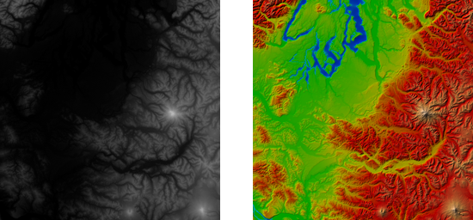
Terrain Data
Notes:
1. Terrain data typically comes in the form of a grid of height maps.
2. This means that it is a 2D array of samples, and each of these samples have a height value.
3. The more heights we have for a region of terrain, we say, we have such a resolution of terrain
e.g. a terrain can have 1 meter distance between its heightmaps or can be even 10 kms distance. E.g. Google earth has 1 to 10 meters resolutions of data.
4. This means the terrain data will look like a grayscale image if treated as a image file. On next to it, you can see a texture map of this data.

Slide 6
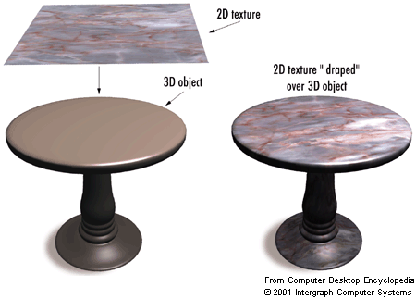
Notes:
A 3D object may not have enough detail which will come up just by lighting conditions.
A technique called texture is used to add detail to geometry
A texture can be anything and of any resolution regardless of what is the geometry is.

Slide 7
Notes:
So this way, triangles are rendered between these samples to form a geometry, and between these triangles texture is put up and thus we are ready with a rigid looking geometry called terrain after a while

Slide 8
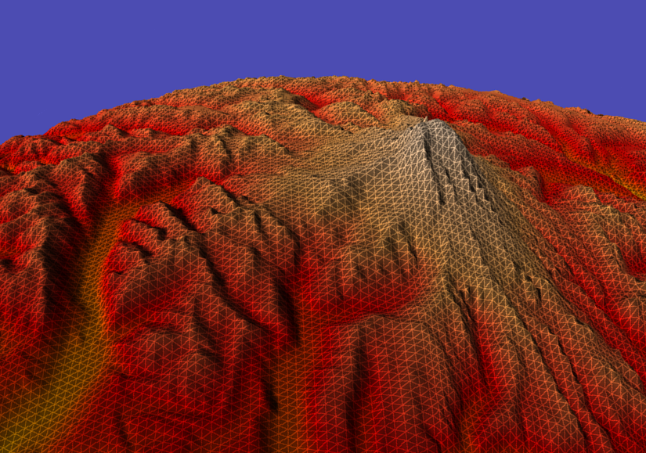
Notes:
So here we don’t see any problem in this screenshot, but this is not real-time. In this particular image, all the samples have been picked up and rendered. We have not harnessed any performance here from the fact that we are not seeing a lot of area of the terrain to the sides, and behind the camera but is still processed and rendered. Another problem is, that in the far regions if you see, there are way too many triangles rendered, which is not required and are redundant.
The number of triangles we render dictates the performance of the system. But more triangles means putting more detail. Its about creating a balance.

Slide 9
Terrain Rendering
Do not render geometry which is not visible
  View Frustum Culling
Control the detail of geometry rendered according to amount of visibility
  Level of Detail scheme
Keep a representation (data structure)
  Memory management
  Fast processing
  Accessibility
Notes:
Simple terms, and then technical term

Slide 10
Theoretically…
Divide the terrain in tiles
Discard tiles not in view
Reduce the detail of tiles farther from camera
Notes:
This is one straight forward way of doing it

Slide 11




Slide 12
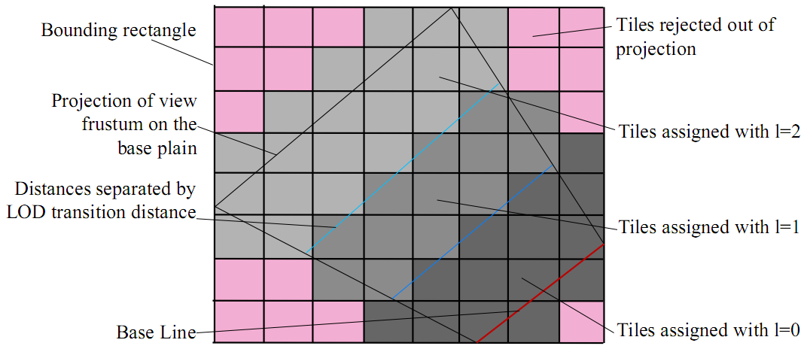

Slide 13
Real-time Terrain Rendering
Notes:
I am so cool :D

Slide 14
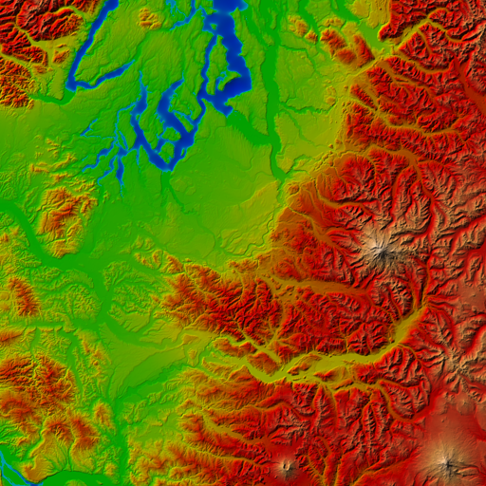
Representation
Array of tilelets
(Rendering by GPU)
Array of tiles
(Rendering by CPU)
Blocks
(Used for caching)
Notes:
Terrain is 2D array of blocks -> basic unit of caching
Block is an array of tiles -> basic unit of rendering for the CPU
Tile is array of tilelets -> basic unit of rendering for GPU
Get 1 image wid animation

Slide 15
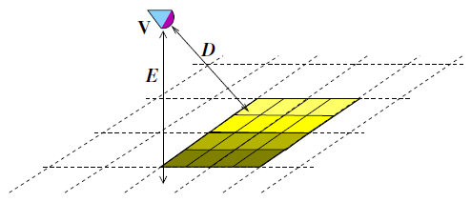
Global LoD System
Merge level
  LoD based on elevation
  Whole GPU cache
  resolution is changed
    Lowered, if camera is going higher
    Increased, if camera is coming to the ground
Distance level
  Tiles’ detail is reduced based on camera distance
Notes:
1 image, merge level and distance level

Slide 16
Terrain Rendering
Divided in two stages
Stage 1: CPU
  View frustum culling (level1)
  Render tiles
Notes:
Get image of array, and a tesselation

Slide 17
Terrain Rendering
Stage 2: GPU
  Tessellate region between vertices
  Access height data for elevation of vertices
  2nd Level of culling
    Only for tiles intersecting
    with view frustum

Slide 18
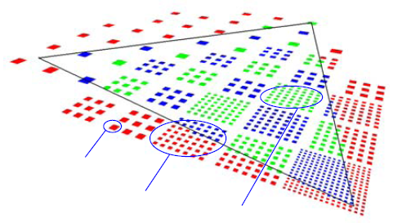
2nd Level of Culling
Test tilelet bounds against screen bounds
If outside, GS doesn’t generate tilelet
CPU load reduced
Distance based lod
Culled tilelet
Tilelets which undergo 2nd level of culling
Tilelets assumed to be inside
Notes:
Lod are not represented specially, data for a specific lod is picked from the GPU cache

Slide 19
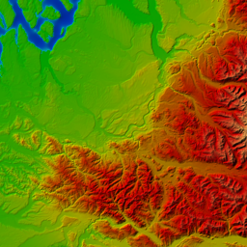
Constant Memory Usage
Camera moving up
Wide view range required
Detail is not necessary
Notes:
3 images, showing horizontal and vertical cache updates

Slide 20
Caching, types of job
Merge 4 blocks into 1
Bring new block from main memory
Notes:
3 images, showing horizontal and vertical cache updates

Slide 21
Caching mechanism
Types of job
  Merge 4 blocks into 1
  Fetch a block from memory
Typical timings (block size = 2MB)
  Merge operation = 0.45 ms
  Update a block = 2.0 ms
Job Queuing

Slide 22
Job Queuing
Cache update is triggered
  Jobs are queued, processed at each frame
  Aiming at 100fps, time left after rendering is used to finish some queued jobs
  If N < 1, we do half a job, next half will be done in next frame
  Over a number of frames, the cache gets updated
N = (10 – T_{r} ) / K
Notes:
Tr is the rendering time (ms), K is a constant, worst case time taken by a type of job
N is number of jobs possible
Speed limit on the camera

Slide 23
Terrain Deformation
Blocks reside in memory as textures
Edited with fragment shader (like GPGPU)
Procedural deformation or mouse based interactions
Cache is edited directly, thus changes are reflected instantly in the rendering
Deforming a block takes 0.25ms

Slide 24
Interactions: Simple Physics
Textures used to keep position and velocities of point objects
A fragment shader pass updates the values according to collision with terrain
Physics uses terrain in cache, behaves according to its deformation

Slide 25
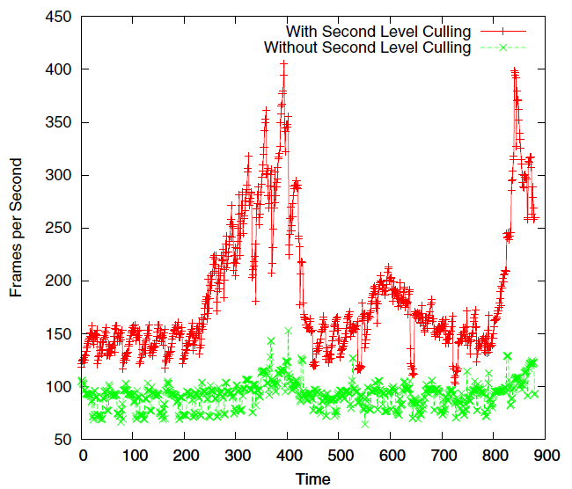
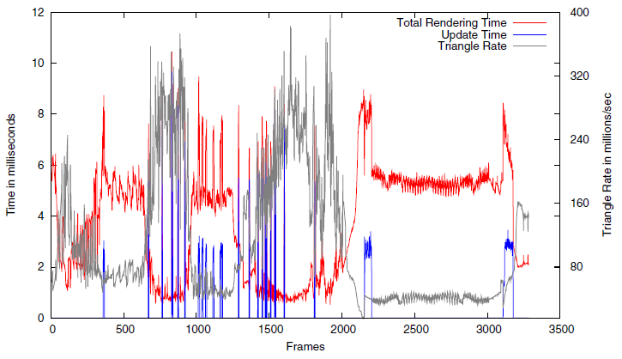
Performance
Rendering and caching performance
Notes:
Performed on a 8800GTX gpu

Slide 26
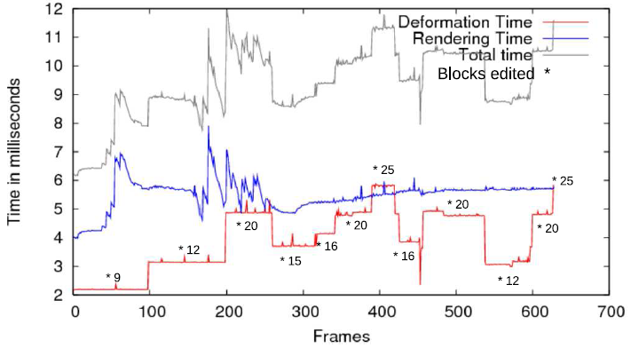
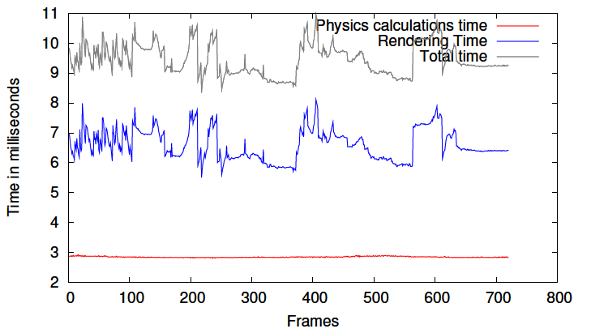
Performance
Deformation and Simple physics
(256K balls)
Notes:
Performed on a 8800GTX gpu

Slide 27
Contributions
Rendering large terrains
Designed to allow
  Interactive editing
  Easy interactions with the terrains
  Constant memory usage
  Tessellation done by Geometry Shader
  Two level culling system
  Cache update adaptive to rendering load
  Editing done on GPU

Slide 28
Future work
Limitations
  Terrain data needs to be in main memory
  Cache update puts speed limit on camera
A CPU cache system similar to our GPU Cache mechanism
Future GPUs will have more bandwidth

Slide 29
Spherical Terrain Rendering
Notes:
I am so cool :D

Slide 30
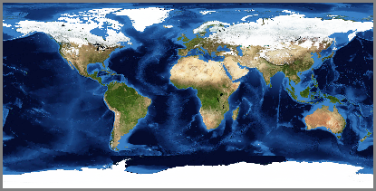
Cartography
Latitude-Longitude system
2D coordinates to refer any point on planet
Map of planet: a 2D image

Slide 31

Terrain Rendering and Cartography
Terrain data available in 2D
Convert 2D samples of data to Polar Coordinates
Render Spherical Structure
Though convenient, has serious problems

Slide 32
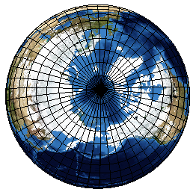
Samples on planet – Not uniform
More samples near polar regions
Fewer samples near equator
Uneven distribution of detail
Poles have singularity
Too many vertices coincide

Slide 33
Redundant Information
Data contains a lot of redundant information
Compare the size of marked regions
Notes:
There are known methods which create bands with lower detail going towards poles for uniformity
However that is discrete. Detail is still uneven within the bands.

Slide 34

Hierarchical Triangular Mesh (HTM)
Start with an octahedron – 8 equilateral base triangles
Recursive subdivision of the triangles
Stop recursion when appropriate detail reached
A. SZALAY, J. GRAY, et al., In MSR-TR-2005-123

Slide 35
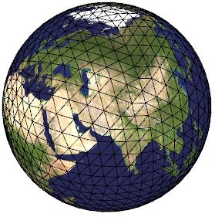
HTM: Regular Sampling of Sphere
Uniform sampling of sphere
No pole singularity
Poles not cluttered
All regions equally sampled

Slide 36
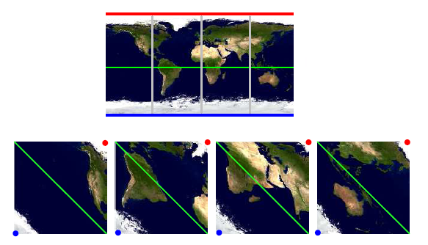
HTM and Terrain Rendering
Transform cartographic data to form 4 images / diamonds
Redundant information removed (saves 50% memory)
Eg.
1024x512
4x (256x256)
Notes:
Please note the red colored north pole, blue colored south pole, and green colored equator in the corresponding images

Slide 37
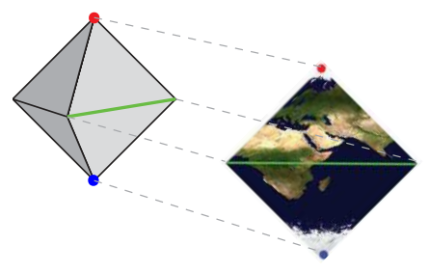
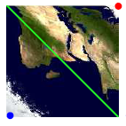
HTM and Terrain Rendering
Each diamond – data for two base triangles
Each sample maps one-to-one to a vertex in the HTM

Slide 38
Geometry Clipmaps
(State-of-the-art Terrain Rendering)
Real-time Terrain Rendering
  High Rendering Throughput
  Constant memory usage
Square geometry clipmaps cannot be used directly
  Equilateral triangles needed
  Data still needed in 2D – friendly with GPUs
Changes needed
F. Losasso and H. Hoppe., SIGGRAPH, 2004
A. Asirvatham and H. Hoppe., GPU Gems 2, 2005

Slide 39


Data is 2D, World Space is not
HTM contains equilateral triangles between samples
A square region in the 2D data = A rhombus in world space
Known terrain rendering techniques use right triangles
New technique needed
Terrains
Triangles
World Space
HTM
2D Data
World Space
Triangles
Notes:
Rhombus will not provide uniform triangle count in all view angles,
Some view angles will get unnecessary detail,
Known Level of details techniques wont make sense, as again at different camera angles, they will fail providing uniformity in view

Slide 40
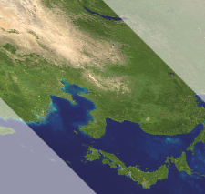
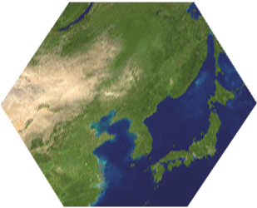
Hexagonal Geometry Clipmaps
Clip two opposite corners of a square region at ½ distance
Form a six sided polygon
This polygon takes shape of a hexagon in world space
Notes:
Once you put 60 degrees angle between these samples, the result is a perfect hexagon

Slide 41


Hexagonal Geometry Clipmaps
Clip all clipmaps: we get a Hexagonal Clipmap Pyramid
Note: Clipmap data remains 2D with ⁷/₁₆ of it unusable
High level
Intermediate level
Low level
Etc.

Slide 42
Hexagonal Geometry Clipmaps
2D data loaded as textures on GPU
Each edge of hexagon is 2^{n}+1 samples
  Clipmap size: 2^{n+1}+1 x 2^{n+1}+1, n>0
Advantages: Inherits properties of Geometry Clipmaps
  Fast rendering & Constant Memory usage
Additional Advantage: More uniform triangle count on the screen at any view angle
Notes:
thus edges of hexagon clipmaps have less varying distance from camera since Hexagon is a closer shape to a circle than a square

Slide 43
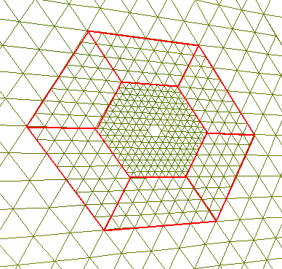
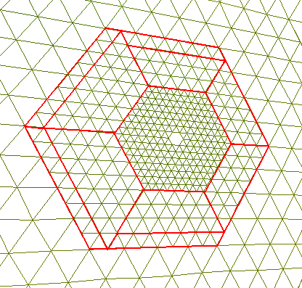
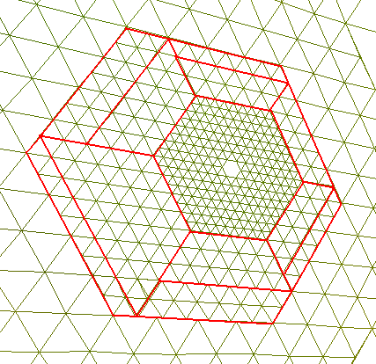
Rendering
Clipmaps of different resolution update with different rate
Hexagonal nest distorted periodically due to this
Hexagonal clipmaps tessellated with Rendering Blocks
Each red quadrilateral uses a rendering block
Notes:
Clipmaps shift with camera movement, because of difference in resolution different clipmaps update with different rate. This distorts the regular hexagonal nest.
A total of 16 rendering blocks are sufficient to fully tessellate (distorted/non-distorted) mesh.
(Rendering block is a array of vertices)
Bounds of rendering blocks sent by CPU
Inner vertices calculated by GPU with spherical interpolation

Slide 44
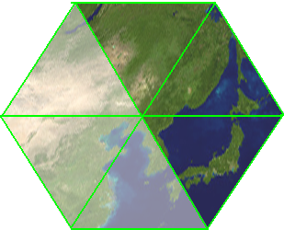
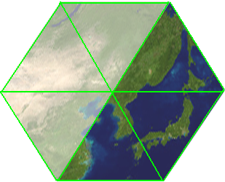
View Frustum Culling
Camera yaw required
Determine which three sides to be shown
  Max fov ~ 120º (use more sides for greater fov)

Slide 45
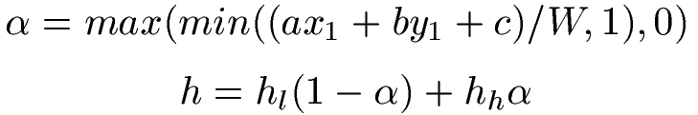
Clipmap update
Hexagonal clipmaps in memory are still 2D
  Update similar to geometry clipmaps
Smooth transition
  Vertices morphed from low detail to high detail (similar to geometry clipmaps)
Notes:
Where α is morphing factor, W is transition distance, (x1,y1) is texture coordinate, hl is elevation at low detail clipmap, hh is elevation at high detail clipmap, ax+by+c=0 is clipmap’s side’s line equation in texture space.
Note that the line equations’ orientation are fixed for sides, the hexagon never changes its orientation since it has to fit for the HTM triangles. Because of that, getting that line equation is not costly

Slide 46
Performance
GPU: 8800 Ultra, Data: Puget Sound
Geometry Clipmaps: Average 650 fps
Our system: Average 2ms per frame (~500 fps)
Notes:
Puget sound data is directly used as one of the diamonds and other diamonds are created by flip-flop transformations
Creating a planet of puget sound data

Slide 47
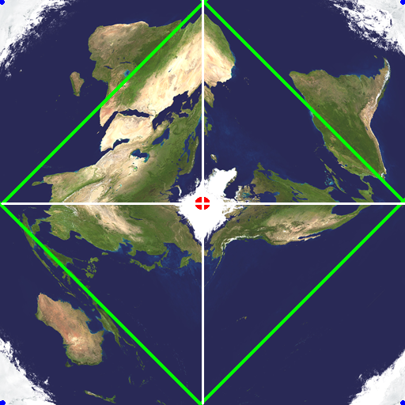
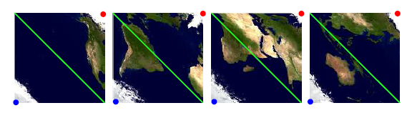
Handling whole planet
Arrange four diamonds in a big-texture
Clipmaps warp at bounds of the big-texture
Special case in rendering: Multiple diamonds in view
Notes:
Note that the big-texture is carrying the whole dataset,
If the dataset is huge, the big-texture may need to be kept as array as blocks

Slide 48

Rendering at borders of diamonds
Rendering is needed for each diamond in view
Rendering blocks going out of bound of diamond culled
Remaining out of bound triangles are buried
Out of bound areas covered by other diamond’s rendering
4 in view
2 in view
1 in view
Notes:
Number of rendering not to be confused by number of passes of pipeline
More than 1 rendering has overhead of few extra triangles
Buried means the elevation is reduced
For each ‘rendering’ of a diamond, the out of bound regions are covered by ‘renderings’ of other diamonds
Buried triangles get hidden by rendering blocks of other diamond in view

Slide 49
Known Issues
Rendering uses only ⁹/₁₆ of data in clipmaps
  Square clipmaps use ¾ of data
Small radius of high detail planet causes precision loss
Inherits limitations of Geometry Clipmaps
  Mesh has uniform detail, does not benefit from local adaptivity
  Terrain is assumed to have bounded spectrum (No salt and pepper samples)
Notes:
Defense of problems of clipmaps: (as defended by Hoppe)
1. the uniform detail clipmaps stay in GPU which instead makes the system fast
2. natural terrains has no salt and pepper features anyway

Slide 50
Painterly Rendering of Terrains
Notes:
I am so cool :D

Slide 51


What is painterly rendering?
Non-photo realistic rendering (NPR)
Convert a photo-realistic image into a artistic hand painted drawing
  Use of brush strokes [Perlin, Hertzmann ‘98]
Notes:
Strokes orientation, size, color etc. decided from the gradient and color information of the original image

Slide 52

For animation
3D space information used for rendering brush strokes [B Meier, 96]
Brush strokes alpha blended, sorted back to front
Notes:
Strokes orientation, size, color etc. decided from the gradient and color information of the original image

Slide 53

For real-time rendering
3D space information used for rendering brush strokes/sprites [Bhattacharjee, Adabala, ICVGIP ‘06]
Brush strokes alpha blended
  Sorting not done
  Depth image used
  to decide visibility
Notes:
Strokes orientation, size, color etc. decided from the gradient and color information of the original image

Slide 54
Terrains
3D space information can be used from terrain data as well
Brush strokes alpha blended
Getting a depth image is heavy
  Terrain have wide view range
  Terrains are heavy object
  Level of detail complexities
Notes:
Because of wide range, the depth image will have low precision for visiblity testing of every stroke
Heavy object, extra pass to get a depth image will be cumbersome… because of this, even sorting these many strokes will be cumbersome
Terrains need level of detail

Slide 55
Motivation
Special kind of models
Existing method will have low performance
Regular grid nature can be used to get depth order of strokes without sorting
A level of detail scheme needed to remove clutter of strokes

Slide 56
Contribution
Real-time Painterly Rendering of Terrains
  Strokes rendered with back to front order without sorting
  Level of detail scheme for strokes
  Use of GPU to render strokes for performance
Notes:
Strokes orientation, size, color etc. decided from the gradient and color information of the original image

Slide 57

Representation
Array of strokes
(Rendering by GPU)
Array of tiles
(Rendering by CPU)
Blocks
(Used for caching)
Notes:
Terrain is 2D array of blocks -> basic unit of caching
Block is an array of tiles -> basic unit of rendering for the CPU
Tile is array of strokes -> basic unit of rendering for GPU
Get 1 image wid animation

Slide 58
Rendering
Divided in two stages
Stage 1: CPU
  View frustum culling
  Render tiles
Notes:
Get image of array, and a tesselation
Same color, no animation

Slide 59
How does an artist does it?
An artist paints on a canvas
  3D information vaguely in the imagination
An artist draws far objects first so that front objects cover them
He/she may be creating 3D environments but strokes individually look flat
Artist may be using different brushes but mostly they remain of the same size
  E.g. Close by objects drawn with detail but farther objects abstracted with 2 or 3 strokes
Notes:
Number of brushes used is short of the scale of the objects size in the scene

Slide 60
Level of Detail
Distance of a tile from the camera decides its level of detail
Tile detail reduced if far from camera
  Less strokes will be rendered
  Alternative strokes are dropped
Strokes pop in and out
  Strokes which are about to disappear are slowly made completely transparent

Slide 61
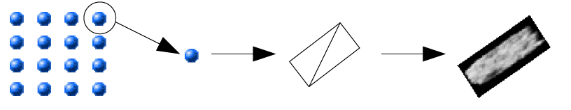
Rendering
Stage 2: GPU
  Convert the incoming vertex into a sprite
  Access height data for position of stroke
  Access slope map for orientation of stroke
  Access texture for color of stroke
  Maintain size, Ignore change due to projection

Slide 62
Back to front stroke ordering
A scan order of regular 2D samples looks sorted from some orientation
camera
camera

Slide 63
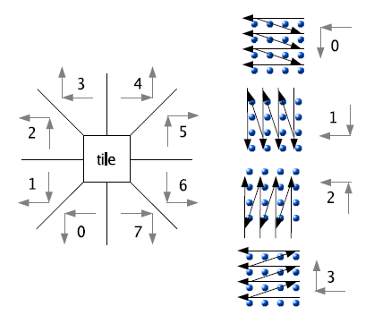
Back to front stroke ordering
A total of 8 such orientations are enough
camera

Slide 64
Back to front stroke ordering
Ordering used for rendering tiles
Ordering used for rendering strokes
No sorting needed
8 Scanning orders stored
Order is chosen depending on camera pan
  That’s only one decision!
No performance affect on rendering
Notes:
No sorting!
No visibility testing with a saved depth image!
Zero performance overhead

Slide 65
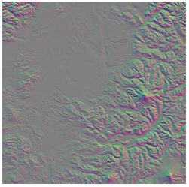
Stroke Orientation
Slope map is a dudv map
Gives the direction of maximum gradient at every point
  Stroke accesses the direction
  Transforms it in camera space
  Orientation of sprite decided

Slide 66
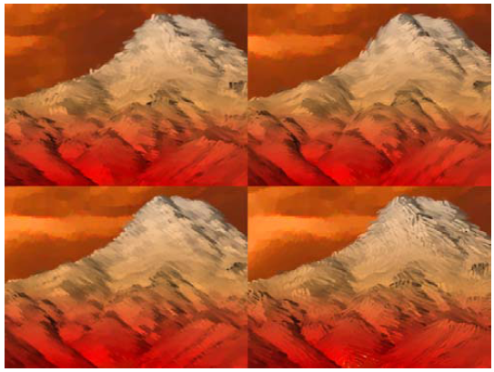
Aesthetics considerations
Using different stroke textures can produce varied painterly styles
Apart from using slope-map for stroke orientation
  normal map can be used
  A constant can be used
  User can create his own texture for stroke’s orientation

Slide 67
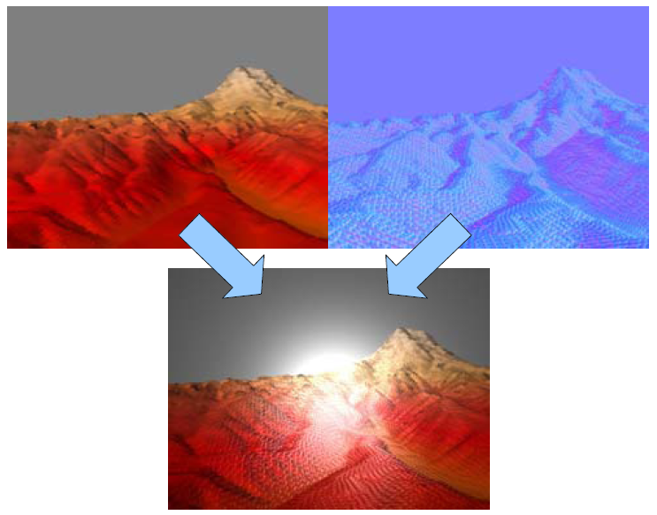
Aesthetics considerations
Shiny oil painting

Slide 68
Performance
Resolution 1024x768
  Performs with 40 million triangles per second
Resolution 1280x1024
  Performs with 35 million triangles per second
Traditional 2 pass algorithm using depth buffer runs nearly at half the performance
Notes:
Performed on a 8800GTX gpu

Slide 69
Conclusion
We present a real-time painterly rendering technique for terrains
Would like to render procedural strokes instead of stroke textures
Use a smooth transition between order shifts

Slide 70
Conclusions
Notes:
I am so cool :D

Slide 71
Conclusions
Aimed to find methods for different needs for handling terrains
Rendering large terrains
  Constant memory usage
  Cache update adaptive to rendering load
  Tessellation done by Geometry Shader
  Two level culling system
  Manipulations on GPU
  Designed for full accessibility
Spherical Terrain Rendering
  Hexagonal Geometry Clipmaps = Geometry Clipmaps + HTM
  New method to sample maps of planet earth
Painterly rendering of terrains
  Strokes rendered with back to front order without sorting
  Level of detail scheme for strokes
  Use of GPU to render strokes for performance

Slide 72
The End
Notes:
I am so cool :D

Slide 73

Thank you

