Slide 1
Detection and Segmentation of Stroke Lesions from Diffusion Weighted MRI of the Brain
Presented by:
Shashank Mujumdar

Slide 2
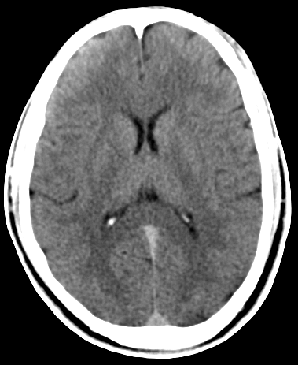
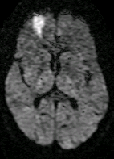
What is Stroke?
Imaging Modalities:
Need:
The accurate location and size of the stroke helps clinicians to classify the stroke sub-type and plan for treatment.
Accurate stroke diagnosis helps in understanding the functional consequences and may predict the eventual outcome.
Hence, early detection and accurate segmentation of ischemic stroke (regardless of size and location) is essential.
Challenges:
Difficult to identify lesions without pre-processing the data.
Data inherently noisy and with low resolution.
Difficult to specify lesion boundaries accurately.
Segmentation of lesions difficult due to low resolution and noisy data.
Window of recovery is small (< 6 hrs).
Stroke is a medical condition caused due to inadequate supply of blood (lack of oxygen) to the brain cells which damages them and may result in their death.
Blood flow may be interrupted due to one of the following:
  (i) A clot in the blood vessel occludes the supply.
  (ii) A blood vessel rupture disturbs the supply.
Stroke caused due to (i) is referred to as ischemic stroke and that due to (ii) is referred to as hemorrhagic stroke.
Ischemic Stroke accounts for around 80% of all strokes!
CT
DWI

Slide 3
Auto-Windowing of Ischemic Stroke Lesions in Brain DWI
Mujumdar et. al. ICMIT, 2013, IIT-KGP, India.

Slide 4
Need for Windowing
DWI acquisition is done using the standard Echo Planar Imaging (EPI) Technique.
EPI induces a trade-off between signal-to-noise ratio (SNR), time of acquisition and resolution of the acquired image.
Since the time of acquisition is significantly less (<1 min), EPI compromises the resolution as well as the SNR of acquired DWI scans.
A linear transform for contrast enhancement is desired which preserves the relative contrast among the tissues.
The wide dynamic range (12-16 bit data) poses a problem for image analysis tasks such as segmentation which operate on lesion contrast since subtle intensity changes may get lost.
A solution is to perform windowing for contrast enhancement of the stroke lesions.

Slide 5
Processing Pipeline
Obtain Candidate Lesions
Obtain Lesion Masks
Generation of CNR Plots
Estimate Window Parameters
Volume Data
Obtain Candidate Lesions
Obtain Lesion Masks
Generate CNR Plots
Obtain Window Parameters

Slide 6
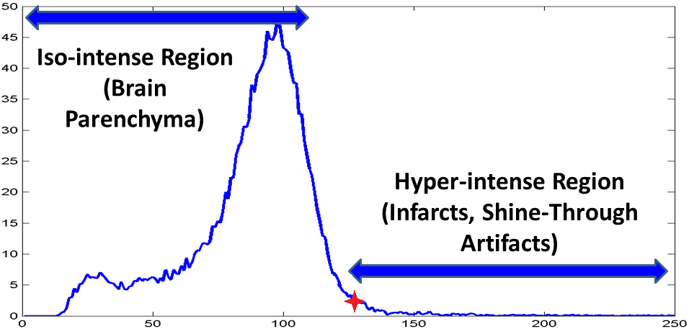
Obtain Candidate Lesions
We start with the following observations
  Stroke volume << brain volume
  Infarct Appears brighter than the brain tissue
Pixels belonging to lesions will give rise to short peaks at the higher end of volume histogram.
The data is thresholded at the knee-point and pixels with intensities greater than the threshold are retained.
A connected component analysis gives the candidate lesions.
Components with size less than 5% of the image dimension are ignored.
Knee-Point

Slide 7
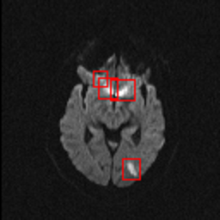
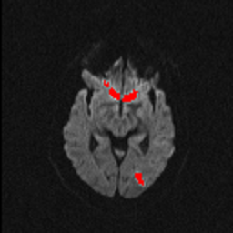
Obtain Lesion Masks
For the given set of candidate lesions the lesion masks are obtained.
A bounding box around the lesion with a 3 pixel margin is considered as the lesion mask.

Slide 8
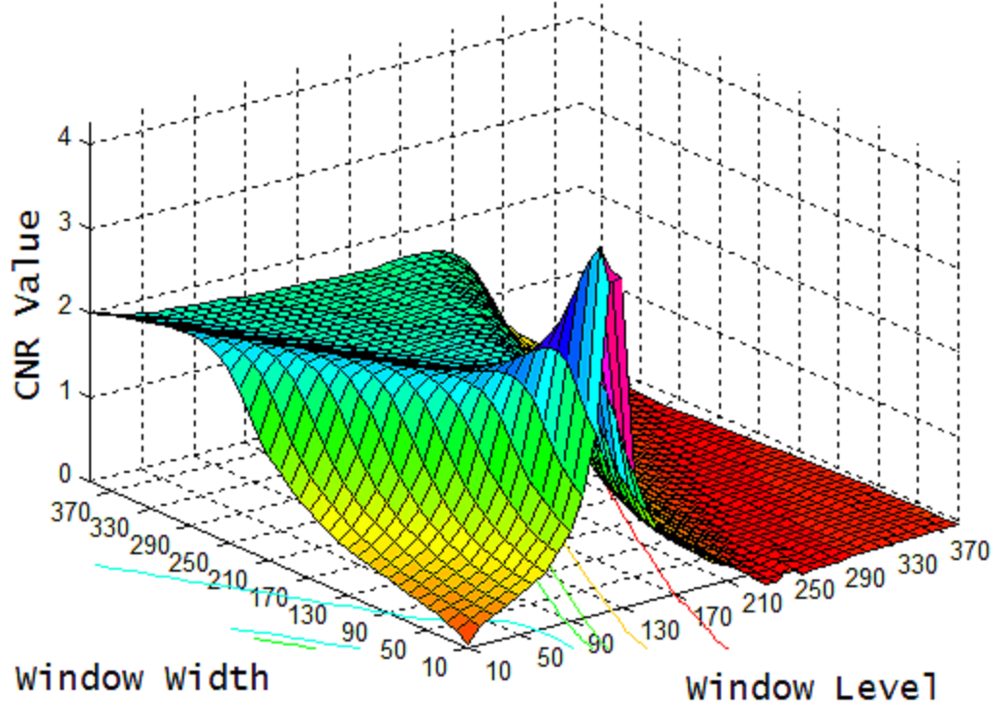

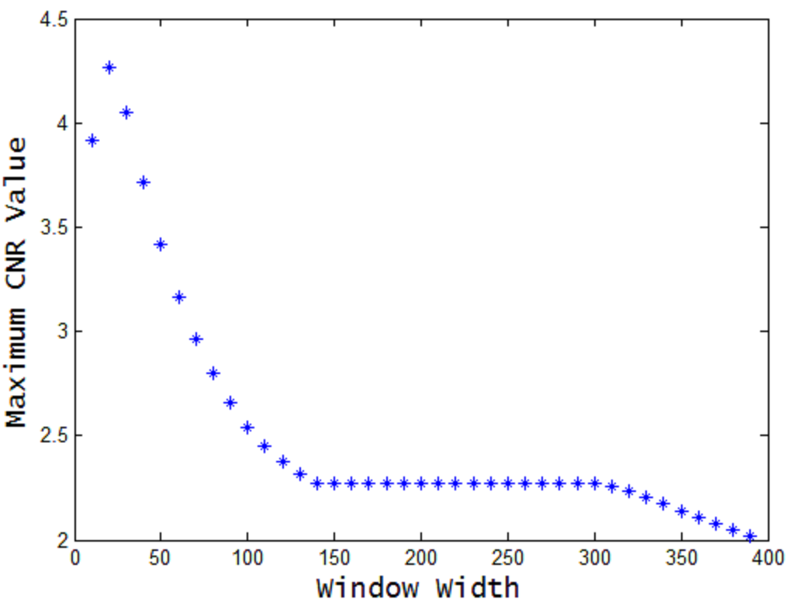

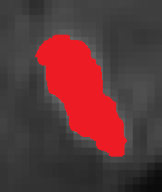

Generate CNR Plot
Two plots are generated for a given volume data
  CNR(l,w)
  max(CNR(w))
Contrast to noise ratio (CNR) is defined as,
  m_{c} = mean of the core
  σ_{c} = std of the core
  m_{b} = mean of the background
  σ_{b} = std of the background
The normal brain tissue in the bounding box is considered as the background. The normal brain tissue is estimated from the ADC maps.

Slide 9
Estimate Window Parameters
The desired optimum level (l_{o}) is found from CNR(l,w) and is taken to be the value of l corresponding to the highest CNR value.
The desired optimum width (w_{o}) is chosen such that the variation in max{CNR(w)} is below a threshold.
The choice of the optimum window level (l_{o}) is intuitive.
The choice of the optimum width (w_{o}) is the width value, above which the contrast of the lesions is not affected significantly.
Notes:
For every window width and window level, the CNR value is computed and plotted to generate the 1st plot.
For every window width, the maximum CNR value is plotted to generate the 2nd plot.
1st plot gives the overall variation of CNR w.r.t. window width and window level.
2nd plot gives variation of max CNR values w.r.t. window width.
CNR will be maximum when core region has highest signal and background region has least signal.
Thus, window level corresponding to mean intensity of core region would give highest CNR value with the window width being close to zero. However, this will suppress the background region which is not desirable. We want to enhance the core region but not by suppressing the background region.
Hence we increase the window width and the maximum CNR value decreases as seen from the 2nd plot. We choose the window width as the one after which the maximum CNR value is not affected much. This trend is observed since after increasing the window width up to a certain point the CNR value falls and remains unchanged because the core region and the background region have similar mean intensities.

Slide 10
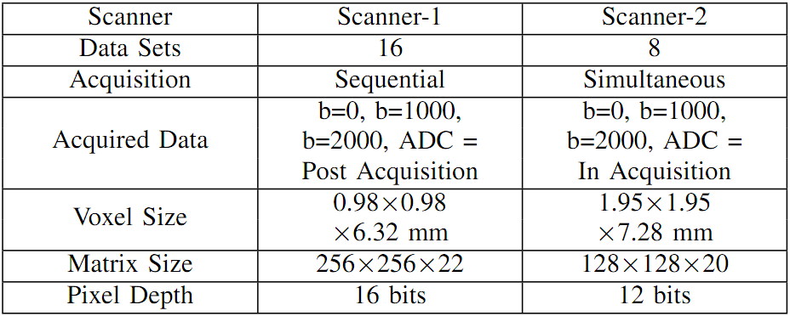
Data description

Slide 11
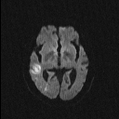
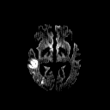
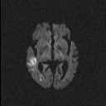
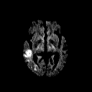
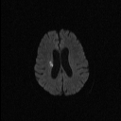
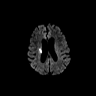
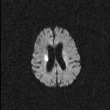
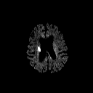
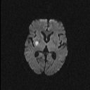
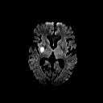
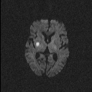

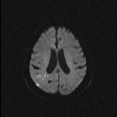
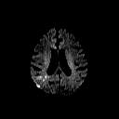
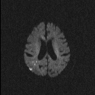

Qualitative Results
Original b1000 Image | Windowed b1000 Image | Original b2000 Image | Windowed b2000 Image
Notes:
- It can be observed that the detectability and the extent of the lesion boundaries is improved as well as the background noise is suppressed in the auto-windowed results which offers much more discrimination between the lesions and the normal brain tissue.

Slide 12
Quantitative Assessment
The assessment aimed at determining the effectiveness of the approach across multiple diffusion weighting (b1000 and b2000).
We report on two different types of assessments
  A mirror region of interest analysis (MRA)
  A contrast improvement ratio analysis (CIR)

Slide 13
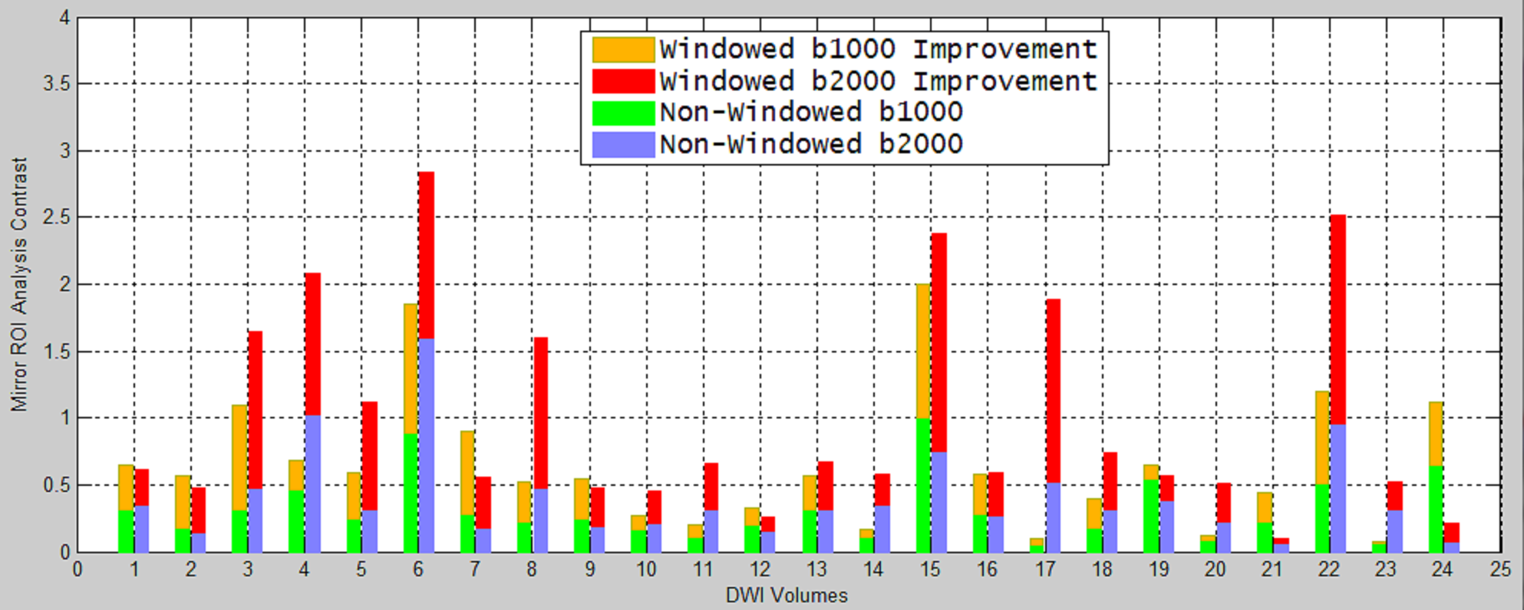
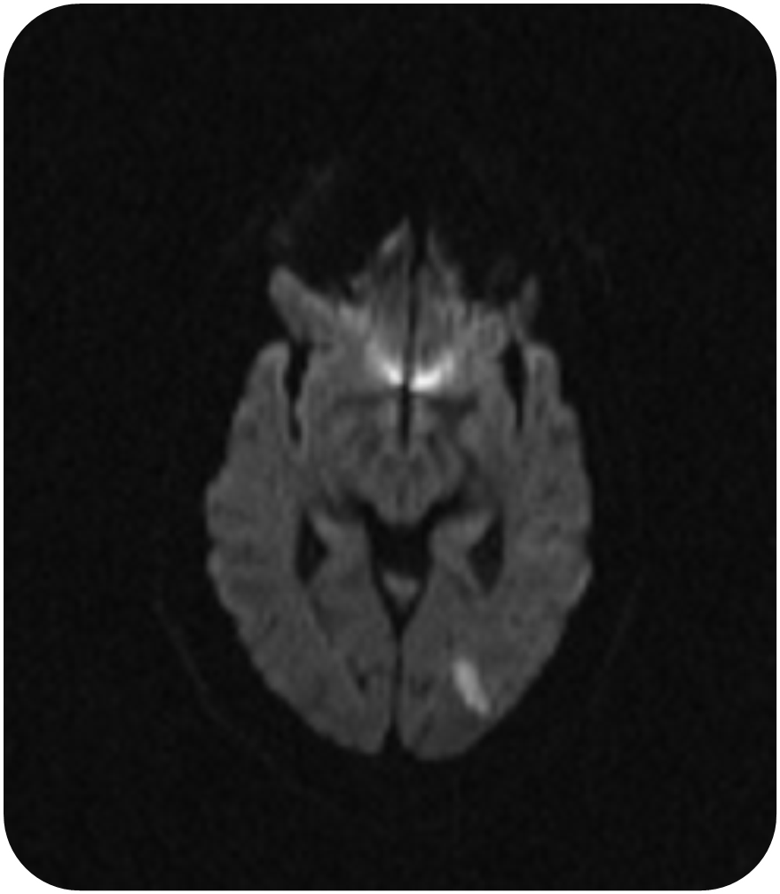
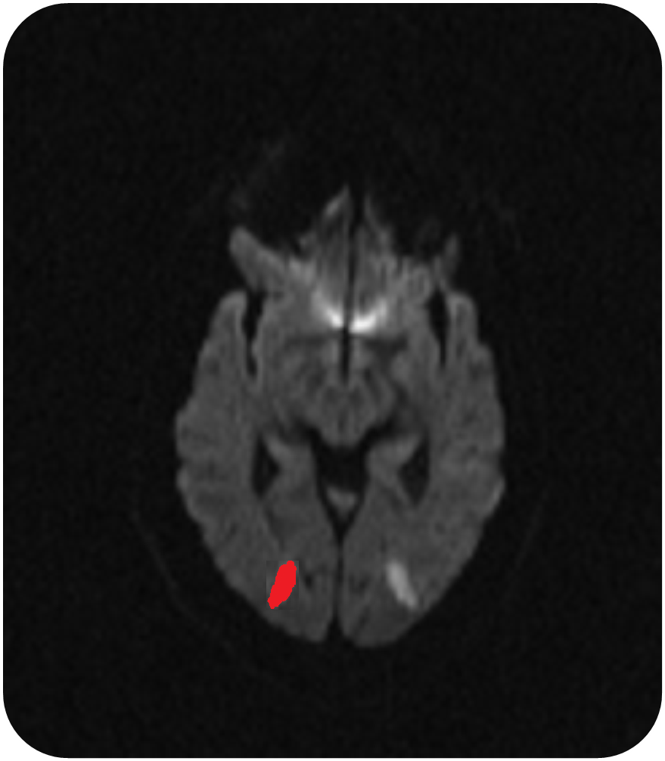
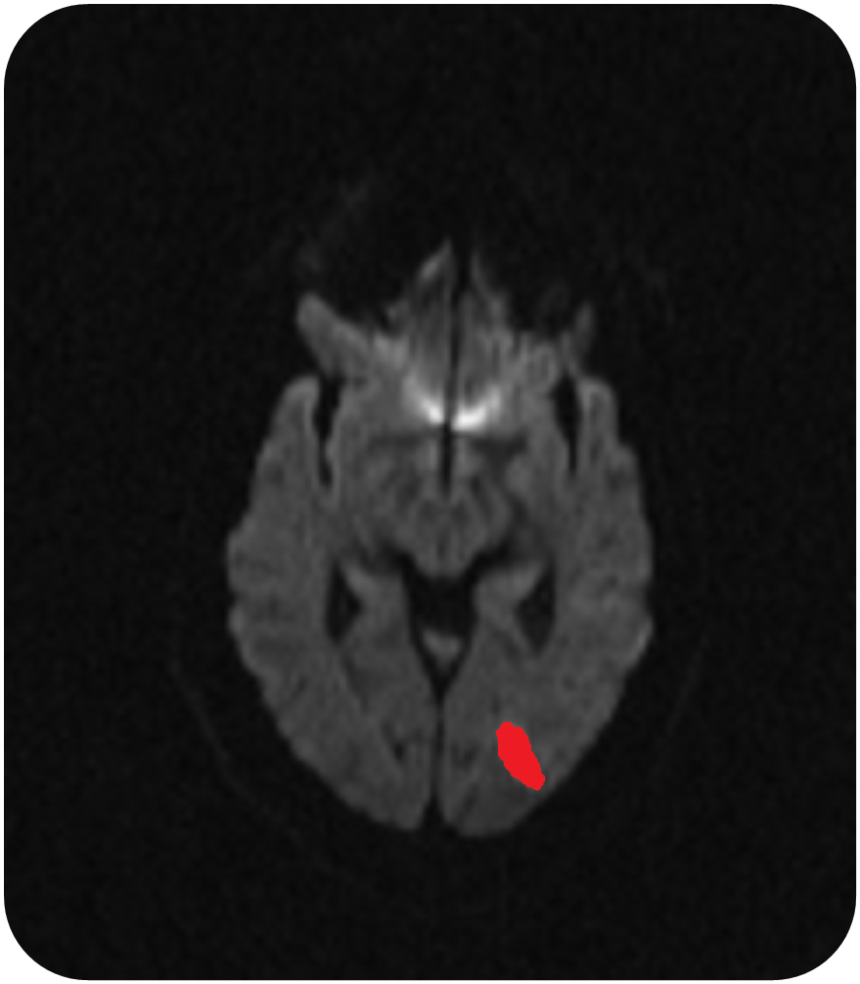
Mirror Region of Interest Analysis
Given a lesion, it was ﬂipped about the mid-line and the corresponding mirror region in the contra-lateral hemisphere was found.
This can also be viewed as a measure of contrast enhancement in a global sense where the improvement in contrast of the lesion is measured against the normal brain tissue globally, represented by the mirrored region.
The improvement in contrast is computed as ,
Notes:
- The CM values are high for both windowed and non-windowed b2000 data in most of the cases. Such a trend is to be expected since b2000 offers higher contrast of the lesions relative to the b1000 data.

Slide 14
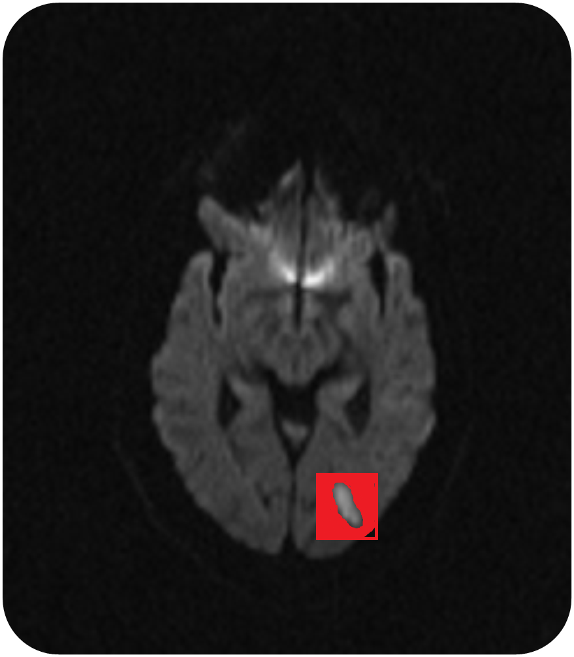
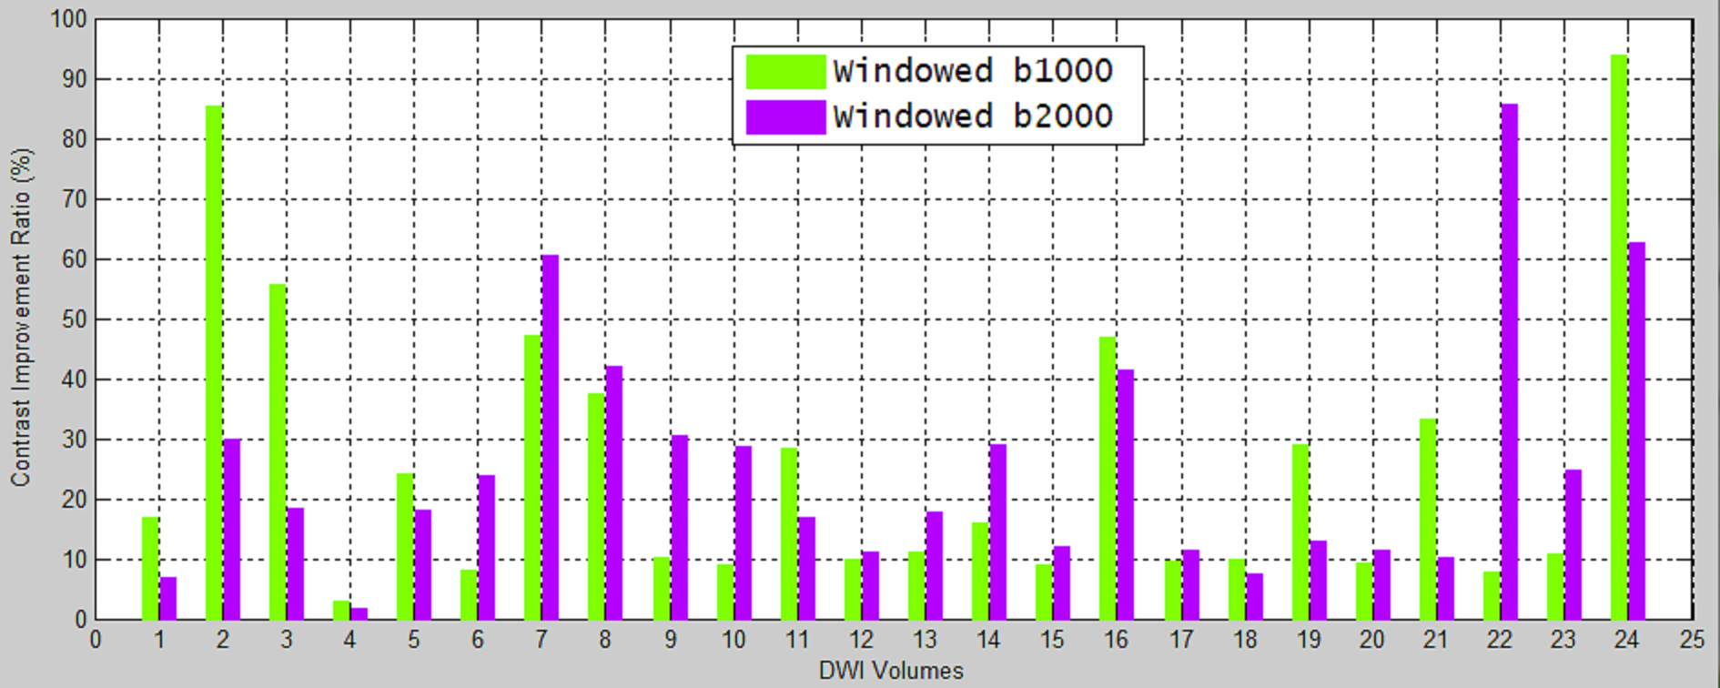
Contrast Improvement Ratio Analysis
Given a lesion, the core and it’s background were found as described earlier.
This can also be viewed as a measure of contrast enhancement in a local sense where the improvement in contrast of the lesion is measured against the normal brain tissue locally, represented by the background region.
The improvement in contrast is computed as ,
Notes:
- There is a minimum improvement of 10% in the CIR values across volumes.
- The size of the lesions has a bearing on the quantitative results. With an increase in lesion size the variation in the intensity within the core region also increases which affects the CIR.

Slide 15
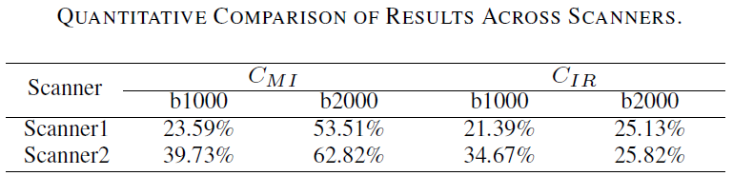
Results
Windowing is more effective to data obtained from scanner-2 relative to scanner-1.
The voxel size, matrix size and the pixel depth of the data obtained from scanner-1 is higher.
Data from scanner-2 has poorer contrast and is noisier relative to data from scanner-1.
Hence the values of C_{IR} and C_{MI} after windowing are more in data from scanner-2 relative to scanner-1.

Slide 16
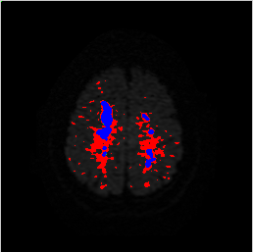
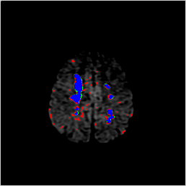
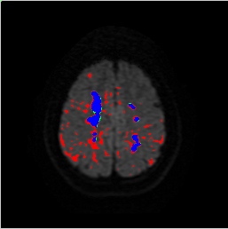
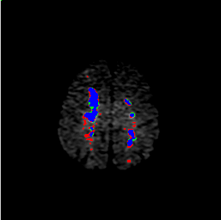
Improvement in Lesion Definition
Improvement in lesion definition is assessed by performing a coarse segmentation task.
The segmentation is performed by simple thresholding at the knee-point as described earlier.
B2000 Windowed
B2000 Original
B1000 Windowed
B1000 Original
The results show that windowing operation helps in
  Reducing false positives.
  Capturing true extent of the lesions.
B2000 Original
B2000 Windowed
B1000 Original
B1000 Windowed
True-Positive False-Positive False-Negative
Notes:
- The results show that windowing helps in a) reducing the FPs significantly and b) capturing the true extent of the lesions.

Slide 17
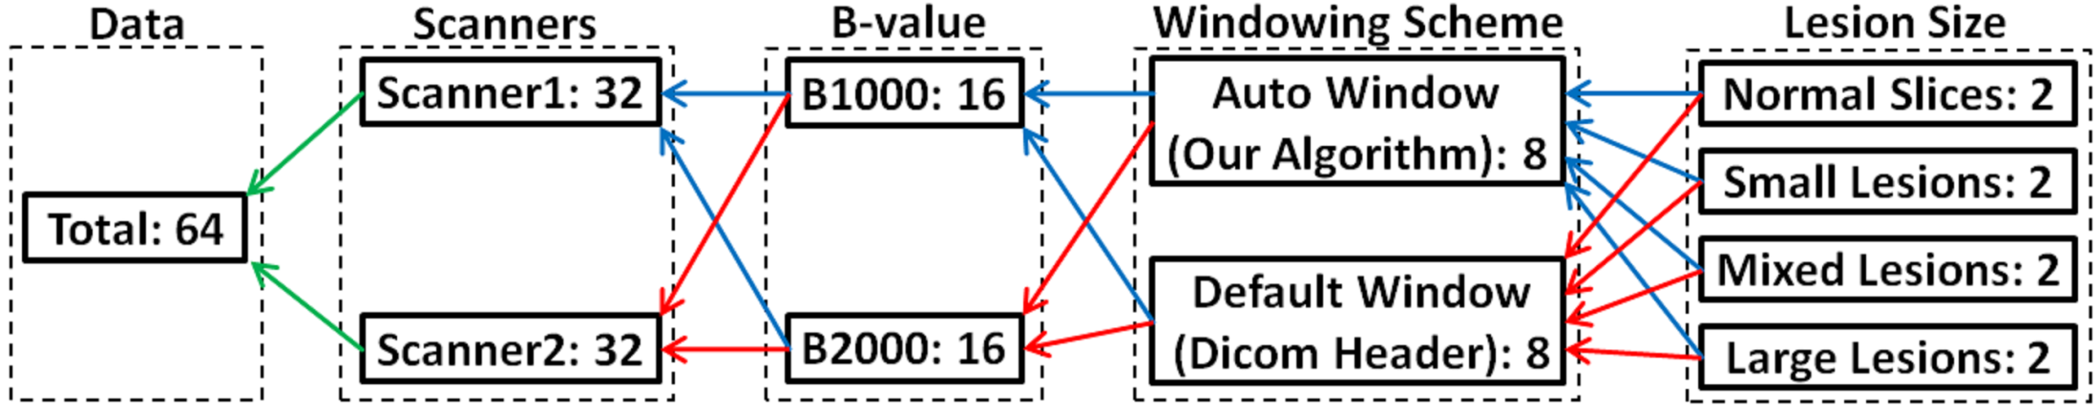
Perception Study
Conducted to validate results from radiologist’s point of view.
Objective
  Note response time in classifying presented DWI slice as normal or abnormal.
  Note number of lesions in the presented DWI slice.
Stimuli
  64 slices consisting of windowed and non-windowed data from two scanners with two b-values consisting of different sized lesions.
Participants
  8 radiologists from CARE hospital, Hyderabad with mean experience of 9.82 ± 9.97 years. (max = 29 years, min = 0.6 years)
Method
  Radiologists were randomly presented with the stimuli and the responses were noted.
Environment
  The experiment was set up in the hospital environment on the monitor regularly used by the radiologists for analysing patient data in order to avoid introducing bias in the obtained results due to different monitor settings (resolution, contrast, brightness settings).

Slide 18
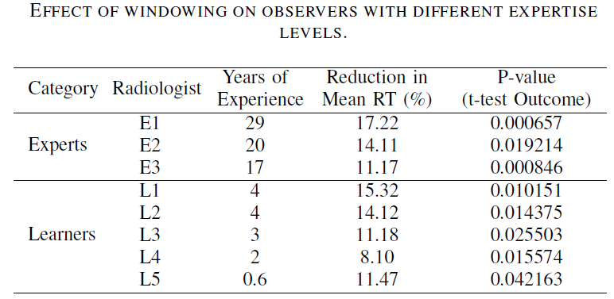
Results of t-Test
Statistical hypothesis testing is done using t-test which calculates the p-value.
p < 0.05 is considered to be statistically significant. (RT = Response Time)
The mean response times were reduced by 14.17% & 12.04% for Experts and Learners respectively.
Notes:
- The statistical hypothesis testing is done using a t-test which quantiﬁes the amount of trust (p-value) to be placed in the sample means based on the difference in the means, the number of observations in the sample sets and the spread of the observations in the sample data sets.
- P-value is deﬁned as the probability of the population means being the same when the given sample data have signiﬁcantly different means. (p < 0.05 is considered to be statistically significant)
- The response times before and after windowing form the two sample data.

Slide 19
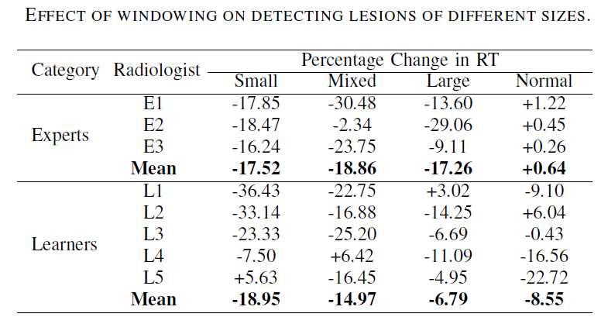
Size-based Analysis
The (-) sign indicates a reduction while a (+) sign indicates an increase.
Windowing helps Learners more with smaller lesions which is crucial from a diagnostic point of view.
Response time (RT) is not affected due to lesion size for Experts.
Experts took marginally more time to analyze normal slices after windowing.

Slide 20
Conclusion
A novel automated windowing technique was presented for diffusion weighted MRI.
The technique was shown to signiﬁcantly improve the contrast of ischemic stroke lesions present in the DWI scan.
The proposed method is effective for different b-valued DWI scans (b1000 and b2000) and robust to data acquired from different scanners with different acquisition processes.
Improvement in the lesion deﬁnition suggests the effectiveness of the approach as pre-processing step for contrast enhancement.
The perception study performed with expert radiologists and detailed analysis of the results indicates the effectiveness of the algorithm for clinical usage from the radiologist’s point of view.

Slide 21
Stroke Detection and Segmentation From Brain DWI Scans With Multiple b-Values.
Mujumdar et. al. ICPR, 2012, Japan.

Slide 22
Related Work
Broad classification of methods
  Manual
    May provide accurate results but are labor intensive and operator dependent.
  Semi-automated
    Rely on operator intervention in tuning the algorithm parameters or to initialize the algorithm.
  Automated
    Generally fail to capture small-sized lesions in the data.
- J.D. Eastwood et al. AJNR, 2003.
- KN Bhanu Prakash et al. CARS, 2008.
- B. Stein et al. MICCAI, 2001.

Slide 23
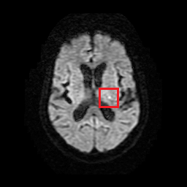
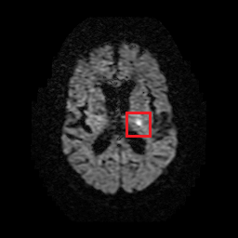
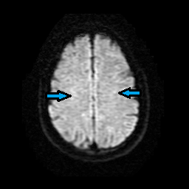
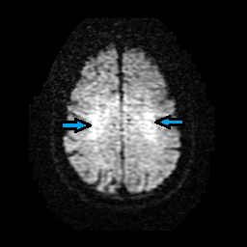


Imaging with High b-Value
b-Value
  Determines the strength and duration of the diffusion gradients (the diffusion sensitivity) during DWI acquisition.
Advantages of high b-value
  The attenuation of the healthy tissue is higher relative to the lesions which gives rise to improved lesion conspicuity.
Disadvantages of high b-value
  The TE increases and thus the SNR of the resulting scan is compromised.
  Accentuated anisotropic effects in regions where white matter tracts are prominent.
B1000
B1000
B2000
B2000
Stroke Lesion
Stroke Lesion
Zoomed Sub-Image
Of Lesion
Zoomed Sub-Image
Of Lesion
- H.J. Kim et al. AJNR, 2005.
- M.C. Delano and Y. Cao, NIC, 2002.

Slide 24
Concept
The b2000 data with high sensitivity for stroke is suitable for ﬁnding candidate locations
  Will have high number of false positive locations (FP) due to anisotropy effects.
The b1000 data (with low anisotropy effects) and the ADC (impervious to shine-through artifacts) are appropriate to help reject the FPs.
Segmentation is performed on the obtained lesion candidates.

Slide 25
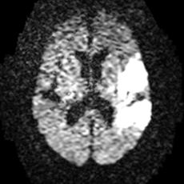
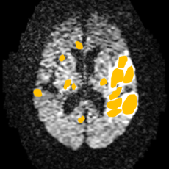
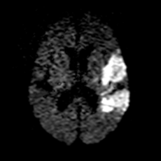
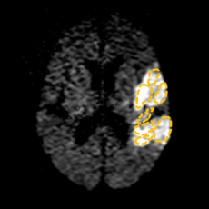

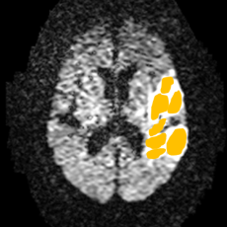
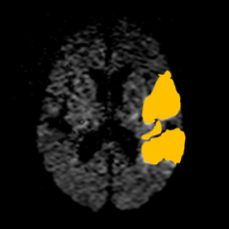
Processing Pipeline
(B)
(C)
DWI Volume
Obtain Lesion Candidates
Obtain
Windowed Result
Level Set Based Segmentation
(A)
(B)
(C)
Type | Data Used
(A) | ADC + B1000 + B2000 Data
(B) | B2000 Data
(C) | ADC + B2000 Data
Obtain Window Parameters
(B)
Candidate Refinement
Obtain Segmentation Results
Stage 1: Lesion Detection
Stage 2: Data Pre-processing
Stage 3: Lesion Segmentation

Slide 26
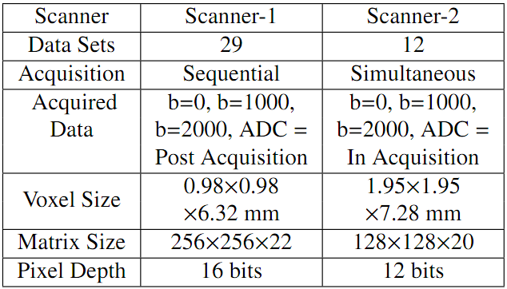
Data Description

Slide 27
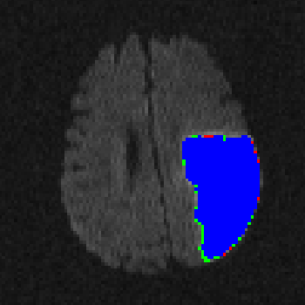
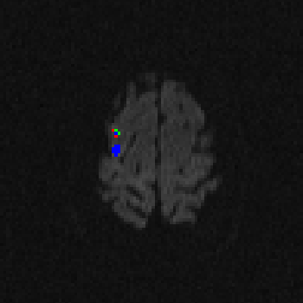













Qualitative Results
True-Positive False-Positive False-Negative

Slide 28

Descriptive Statistics
Our dataset contained 324 large-sized lesions and 286 small-sized lesions.
High median values of SN, SP and DC with corresponding low CV values indicate that the segmentation algorithm is robust to size and shape variations in lesions.
The datasets were acquired from two different scanners with different acquisition protocols and the algorithm appears to be robust to these factors.

Slide 29

Experiments & Analysis of Results
Experiment 1: Effectiveness of the b2000 data in the detection stage.
Detection of smallest early ischemic changes, proven to be better in b2000 over b1000.
To validate this hypothesis for the collected data, the sensitivity vs. speciﬁcity curves were generated for detection of small lesions ( <1% image size) by varying the knee-point.
- H.J. Kim et al. AJNR, 2005.

Slide 30
Experiments & Analysis of Results
Experiment 2: The experiment aimed to study the degree of improvement in the segmentation accuracy (at the boundaries) due to b2000 data.
The segmentation was performed on b1000 and b2000 data separately, for only true lesion locations (found from GT), for all the volumes.
The median DC values for the segmentation results were 0.68 and 0.83 for b1000 and b2000 data respectively.
An improvement of 22.06% in the segmentation accuracy was observed on b2000 data.

Slide 31








Performance Evaluation of Proposed Framework
The performance evaluation aimed at a differential analysis with respect to size of the lesions, comparing the ROC plots between 4 methods
  Method described in *.
  Segmentation on lesion candidates obtained on b1000.
  Segmentation on lesion candidates obtained on b2000.
  Segmentation on lesion candidates obtained utilizing b1000, b2000 & ADC (our method).
Based on the lesion size, the ROC plots were generated for the following cases
  segmentation of small-sized (<1% of image size) lesions.
  segmentation of large-sized (>1% of image size) lesions.
  segmentation of all the lesions in the data.
Small-Sized Lesions
Large-Sized Lesions
All Lesions
Sensitivity values correspond to 95% Specificity.
- KN Bhanu Prakash et al. CARS, 2008.

Slide 32






Qualitative Analysis of Detection and Segmentation Results
Ground Truth
b1000
True-Positive
False-Positive
False-Negative
The accuracy of the segmented results is directly dependent on the accuracy of the detection results.
b2000
Integrated

Slide 33
Conclusions
Novel technique is proposed.
  Utilizes multiple b-values (b1000 & b2000) and the ADC maps.
  Adapts to data acquired from multiple scanners with different acquisition processes.
  Automated.
Experiments and analysis validate the superiority of the method in detection and segmentation.
  Signifies role of b2000 data.
  Superiority over methods utilizing only b1000 data.
Limitation.
  Computationally expensive framework due to additional data processing.
The performance of the system outweighs the computational burden.

Slide 34

Questions?

Slide 35
Thank You

