Slide 1
Ray Tracing Dynamic Scenes on the GPU
Sashidhar Guntury
Centre for Visual Information Technology
IIIT, Hyderabad. India

Slide 2
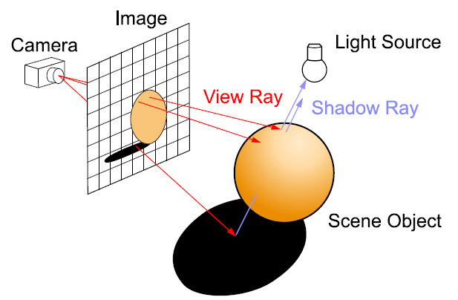
Raytracing?
Raytracing is a technique to synthesize image by simulating light travel in real world
For every pixel, a ray is shot to see if it intersects any geometry in the world
  If it does, what is its color?
Computationally very expensive!
Different from rasterization which determines the geometry visible from camera

Slide 3
Acceleration Datastructures
Process of raytracing can be speeded up using Acceleration data structures
  BVH, Kd-tree, Grids are popular
Exploit the fact that rays in a scene have a fixed direction and move in straight lines
Often groups of rays have same direction which is call coherence
Coherence very important for using the SIMD of multicores to speedup tracing

Slide 4
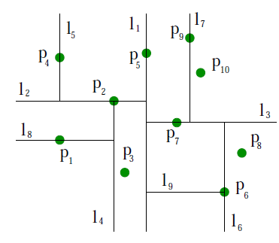
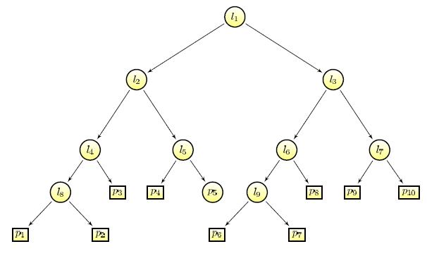
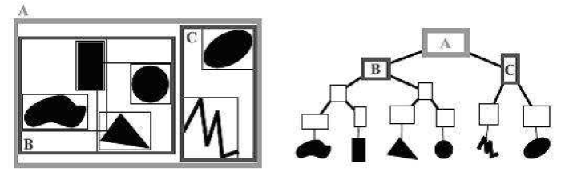
Hierarchical Structures
Kd-tree - Divide the space according to some cost metric
BVH – bounding volumes to encompass geometry
Costly to build on GPU

Slide 5
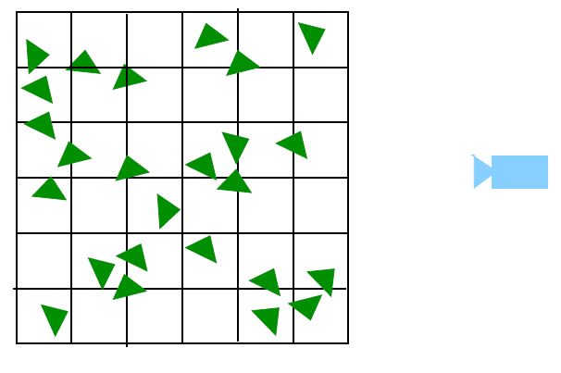
Grids
Very easy to build. Bin triangles in a voxel in world space
Cheap to build on GPU
Not as versatile as BVH or Kd-tree

Slide 6
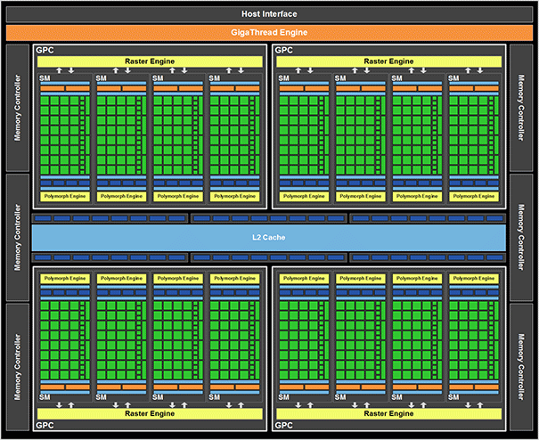
GPU computing model
GPU are fine grained multicore architectures
  To abstract the hardware, tasks are divided into groups and blocks.
  Threads in a block share data among themselves
  Large global memory but slow
  Fast shared memory but confined to a block
  Cache in recent architectures
Threads are scheduled batches of 32 (warp)
Lots of data movement!

Slide 7
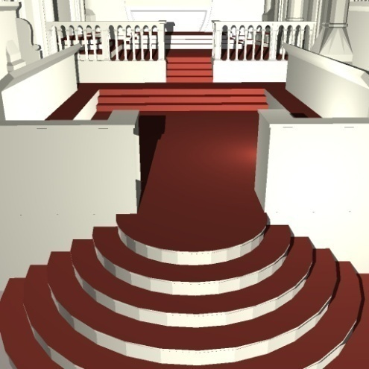
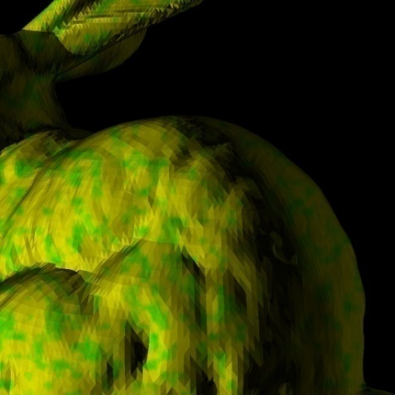
Objective
Interactive ray-tracing using commodity processors
GPUs suitable with high compute power
Render a million triangles to a million pixels at interactive rates
  better grid datastructure
  shadows
  reflection rays
Typical game scene
Notes:
Remove fad.

Slide 8
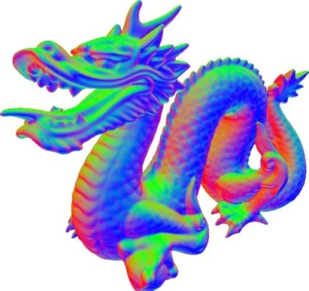
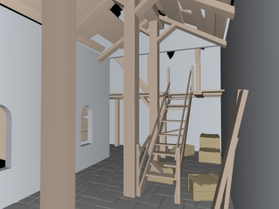
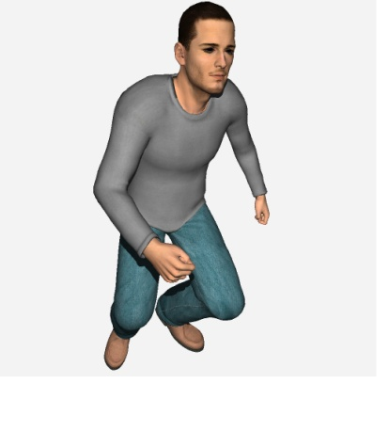
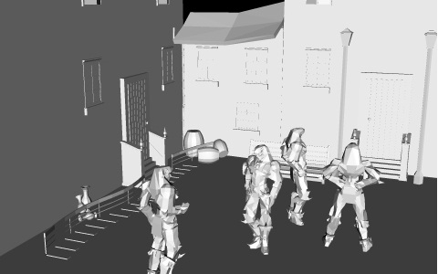
Related Work
Patidar08:primary rays on GPU
  Perspective grids and fast sorting
  20 fps on a 1M model, 100 on 70K
Kalojanov09: improved uniform grid construction
  sort cell-triangle pair list
Wald 06:traversing grid in slice wise manner on multicore CPU
  Great for small SIMD architectures
Hunt 08: building acceleration structure for each light source
  perspective grids
Notes:
Add a small picture for each reference
Perspective grids and fast sorting for Patidar 08
Summary numbers for K 09
W09: On multicore CPUs. Numbers?
Hunt 08: Perspective grids

Slide 9
What do we do?
Achieving acceptable frame rates
  Fast traversal (processing) of rays
    capitalize on the behavior of the rays
    Increase coherence
  Minimize costly data transfers
    bundle rays as packets
Deformable or dynamic scenes
  Fast build time for the acceleration structure
    Perspective grids: cheap and coherent
Notes:
Increase coherence ?

Slide 10
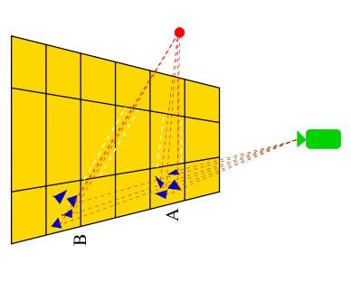
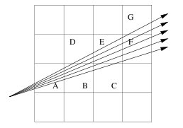
Perspective grids for Primary Rays
Sorting is the key step
Z buffer style early termination
Rays which are spatially similar always remain together
  Share same data and traversal
Keep them together as packets. Cost amortized by bringing triangle data in one go.
Bundle as many rays in a packet, as the GPU has wide SIMD

Slide 11
Ideas from Rasterization
Primary rays need not have all triangle data in the space
Can get rid of substantial geometry by culling back face geometry as the grid is specialized for primary rays
Same philosophy for view frustum culling

Slide 12
Indirect Mapping
Use small tiles and voxels for efficiency
  Sorting is cheap
  Fewer triangles to be considered for intersection
But not too small for the SIMD width
  GPUs have large SIMD width
  Inefficient if ray packet size less than SIMD width
A hybrid solution:
  Sort to small tiles
  Trace multiple such tiles together for coherence

Slide 13
Mapping of Tiles
Sorting Tiles
Rendering Blocks
k x k tiles processed together for tile traversal
K = 2 speeds up traversal
  sort to 256 x 256 tiles and trace to 128 x 128 tiles
Spatially close rays reuse data to allow better performance
  Shared memory partitioned among tiles
  Triangles queried multiple time loaded directly from L1 cache => better performance

Slide 14
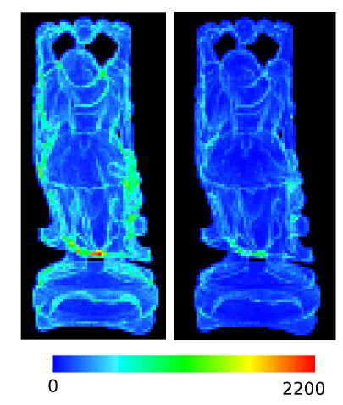
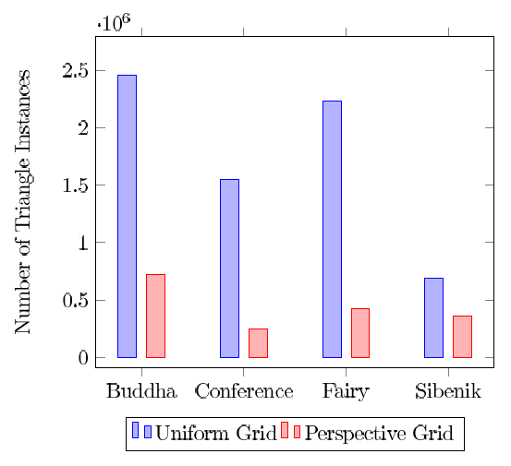
Results
Marked difference with these two simple techniques
Lesser triangles => lesser intersection checks => savings made in tracing step as well

Slide 15
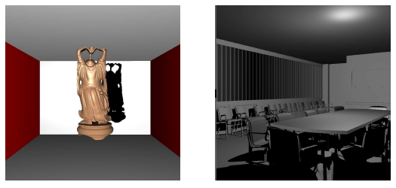
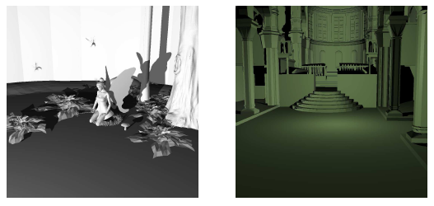
Results

Slide 16
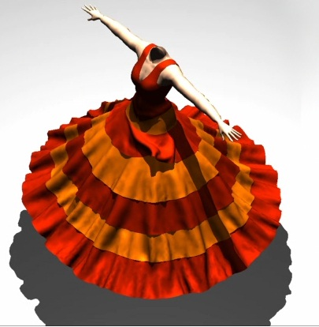

Ray Tracing with Shadows
Lauterbach 09:BVH Construction
  Performance showed for shadows
  14 fps for 92k model (2nd generation hardware)
Hou09: kd-tree construction
  costly to build for large models
  More suitable for static scenes as building is costly
  5.26 fps for 178k model (1st generation hardware)
Hunt 08:build grid for every frame from light point of view.
  On multicores
Notes:
L09: Numbers
H09: numbers?
H08: CPU, numbers?

Slide 17
Properties of Shadow Rays
Exhibit spatial coherence
BVH and Kd-tree take advantage
  Grids don’t use this coherence
Wald et. Al proposed a method to group rays in a frustum and then traverse the voxels in this frustum
  Good for small SIMD. GPU has wide SIMD width
  Problems near silhouttes
  Grid traversal time still large

Slide 18
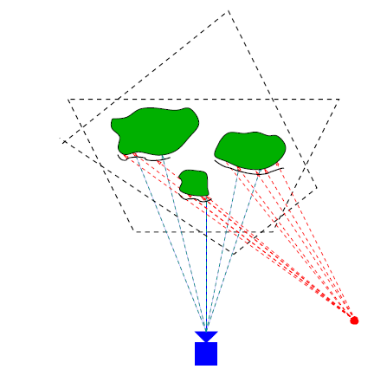
Rebuilding datastructure
Forwarded by Hunt and Mark 2008
  Build grid datastructure from the point of view of every light source
  Very fast compared to BVH or Kd-tree
Specialized datastructure to take advantage of pinpoint coherence of shadow rays

Slide 19
Handling shadow rays?
Seen from primary rays’ grid, shadow rays have arbitrary directions
Building a grid from point of view of light will make shadow rays coherent
Treat like primary rays only
  Get the tile for the ray
  Traverse along the depth direction
  Stop when all rays in the tile are done

Slide 20
Mapping of rays to Tiles
For primary rays, tiles are determined using pixel values
For shadow rays, use intersection
  For every ray, get the intersection point with near plane of the grid
  Get the tile that the point is part of
  Associate ray with this tile

Slide 21
Reordering Rays by Tiles
Shadow rays are indexed according to the pixel ID of the primary rays
Determine the tile each ray falls in
  a ray-tile pair array
  currently sorted by ray ID
Bring all the rays of the same tile together
  Processed together
  Sort on tile ID
Use GPU hardware better with reordering
Reorder Rays
Load Balancing
Traverse Rays
Buid DS

Slide 22
Load Balancing
Distribution of light rays in tiles not uniform
  dependent on light, scene
  some tiles excessively populated
Devote one tile to a CUDA block
  inefficient on GPU due to mismatched loads
Distribute the load into smaller, independent work units
Reorder Rays
Load Balancing
Traverse Rays
Build DS

Slide 23
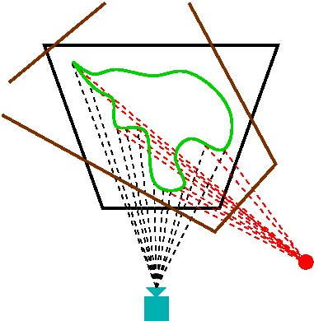
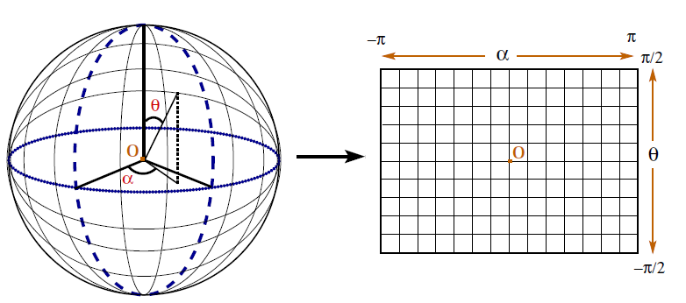
Handling more scenes
What if light in inside the model?
  Typical for architectural models
Define a spherical coordinate system for light
  Build the frustum only for the necessary range
Pole singularity – duplication of triangles along the pole
  Good choice of forward direction

Slide 24
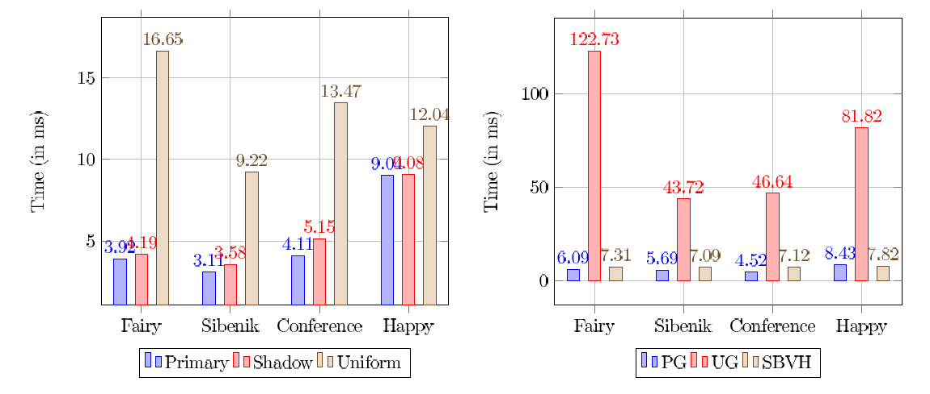
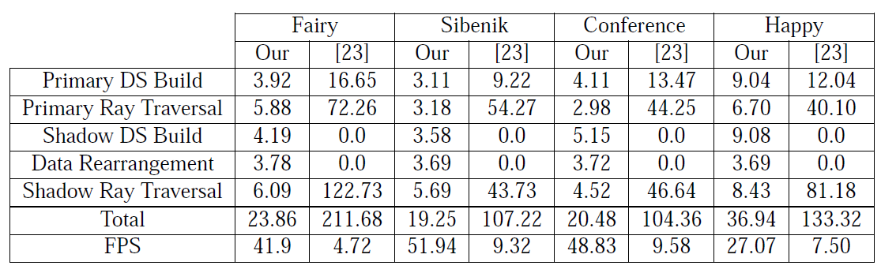
Timings

Slide 25
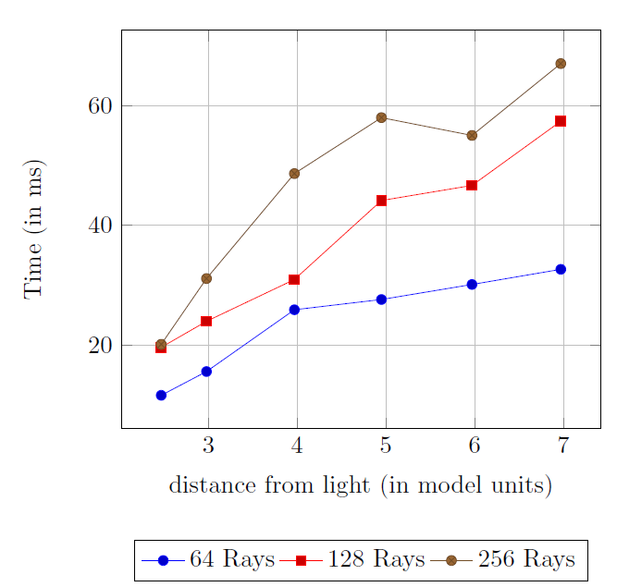
Position of Light
Since the grid is built from the point of view of light, its distance can change things
  More rays get bundled in same tile leading to disparities in population of cells
Load balancing helps us in keeping the number of rays at a threshold level

Slide 26
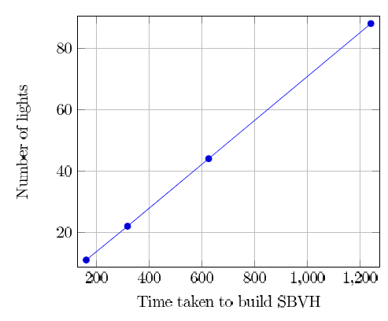
Comparision with SBVH
Almost in line with the performance of SBVH inspite of low grid build time
SBVH build time large and eats into the advantage of faster shadow computation
Number of lights needed so that SBVH performance may be same as Grid

Slide 27
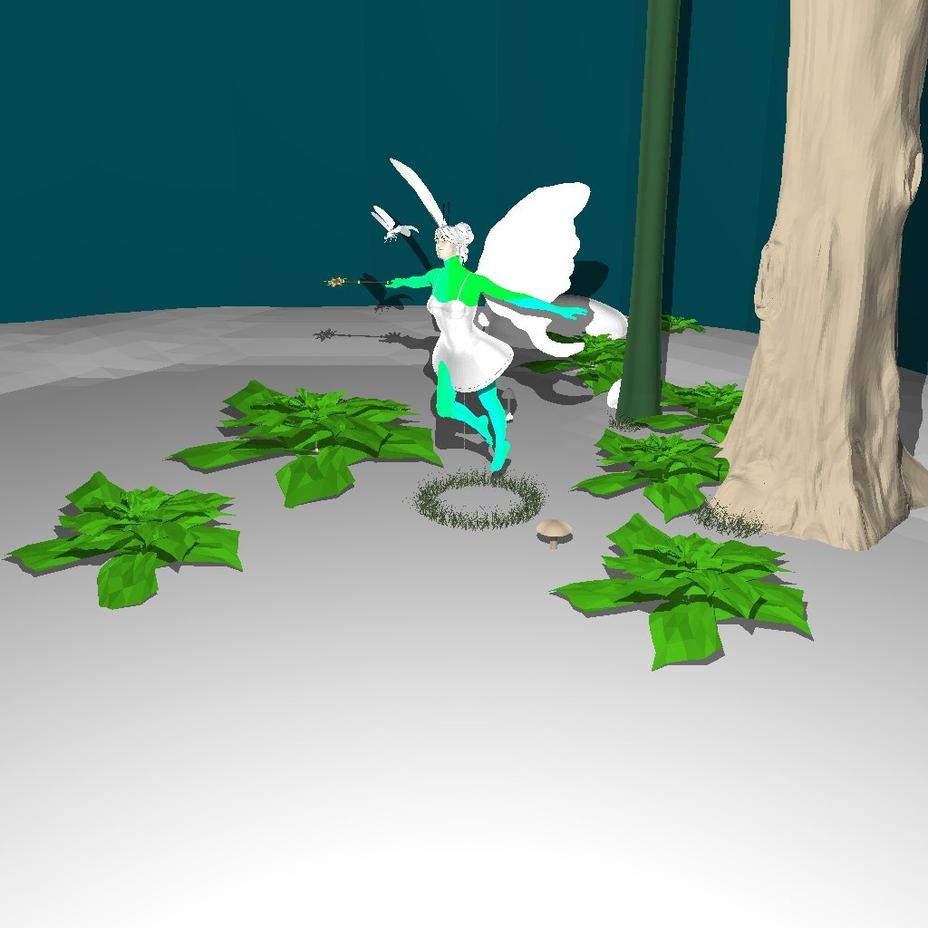
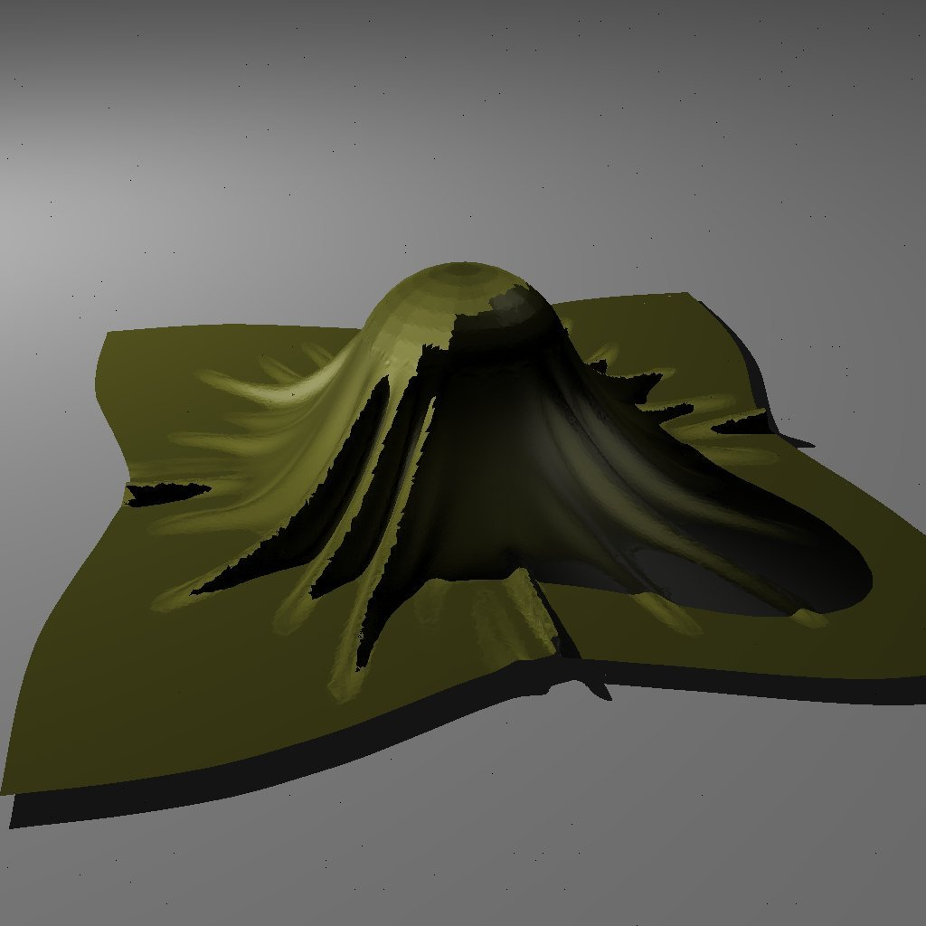
Sample Images

Slide 28
Reflection Rays
Representative of general secondary rays
Much harder to exploit coherence than shadow rays
  Spread in arbitrary directions
  Can not afford to build as many datastructures as the directions
Perspective grid not at all useful
  Fall back on traditional grids, Kalojanov et. al
  No BFC, VFC

Slide 29
Independent Voxel Walk
Find the voxel for the ray (in parallel) and check for intersection.
  Each ray functions independently
  Coherence not set explicitly
    Different voxels => large number of misses in cache
    Trust the accidental coherence of the scene
IVW benefits from cache if multiple rays check in same voxel
  L2 cache fairly large
  Attractive as cache mechanisms evolve

Slide 30
Enforced Coherence
Explicitly make the rays coherent
  Non-trivial
  Time taken can impact the performance
Take rays and make a list of voxels they traverse
Sort them by voxel ID to get all rays in a voxel together
  Ordering lost
  Have to check all voxels. No early termination ☹
  Atomic operation to compute earliest intersection

Slide 31
Results
Three models were used
  Buddha (1.09M tris) :: geometry clumped together
    Finely tesselated => varying normals
  Fairy in Forest (176K tris) :: mostly sparse with dense areas
    Lot of varying normals
  Conference (252K tris) :: well distributed geometry
    Lots of flat surfaces which makes normals aligned and coherent

Slide 32
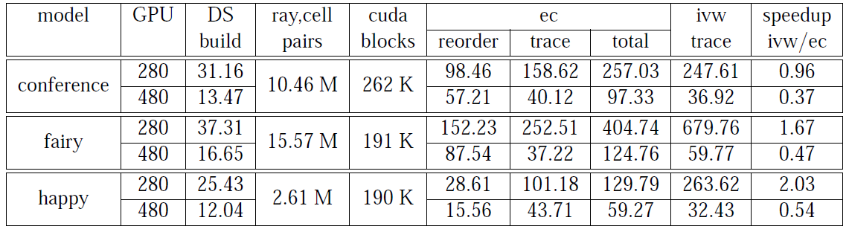
EC slower on GTX 480 as IVW is exploiting cache very well
Times reversed on GTX 280 as it does not have cache and penalizes scenes with arbitrary normals

Slide 33
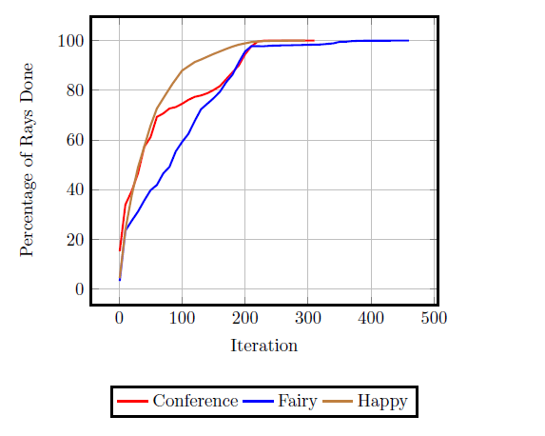
Performance of Buddha
IVW has early exit for rays
Least number of iterations for Buddha (80% done in about 80 iterations)
  Mostly because we are taking self reflection
  All geometry densely packed

Slide 34
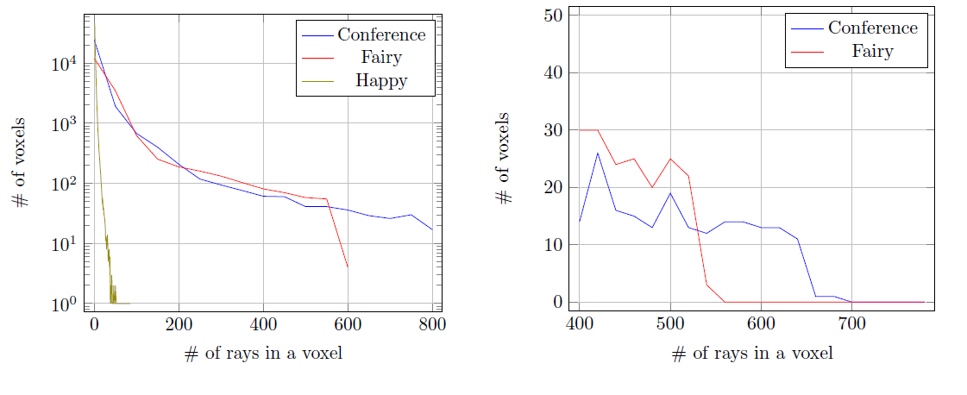
Voxel Concentration
Higher rays in a voxel, more times the same data is used among CUDA blocks => better L2 usage
Conference scene has better voxel concentration

Slide 35
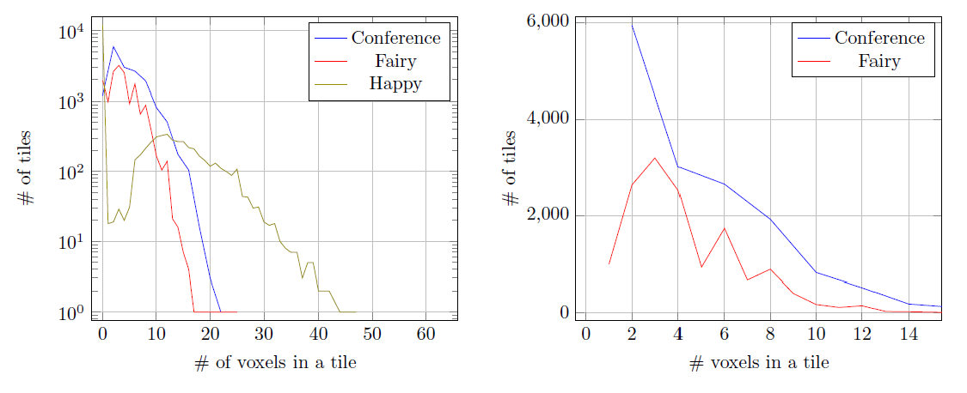
Voxel Divergence
Lesser the voxel divergence, more data is reused in a CUDA block => L1 cache used well!
Conference manages to keep its voxel divergence low for more tiles which leads to better performance

Slide 36
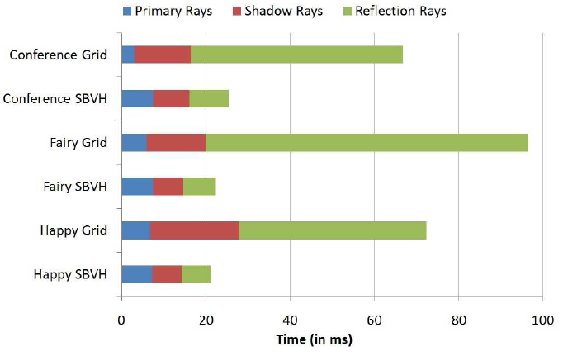
Comparision with SBVH
Grids for reflection rays are largely inefficient
However SBVH construction time really huge and that preprocessing doesn’t show here
Gains can be made in dynamic scene

Slide 37
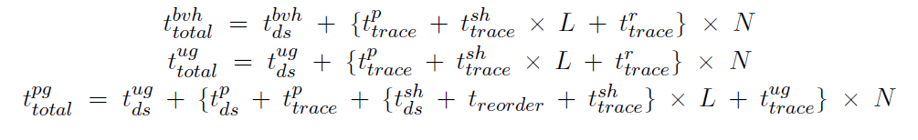
Timings for a pass
SBVH method gains 25 ms for every reflection pass
If GPU SBVH build is 40 times faster than on CPU, it’ll take 35 passes to catch up with grid performance.

Slide 38
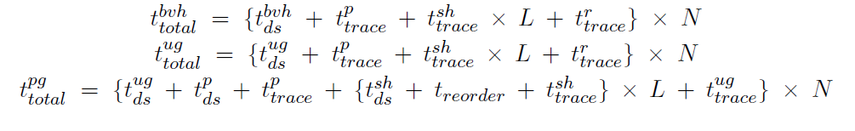
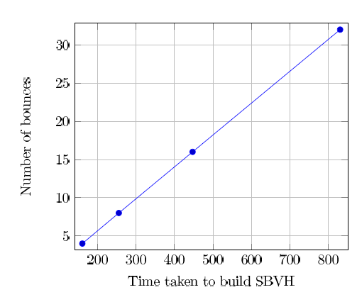
Dynamic scenes
Now SBVH has to be built every frame
SBVH time atleast as much as HBVH (160 ms)

Slide 39
Contributions
Modified datastructure to eliminate triangles that do not contribute to raytracing
Introduced indirect mapping to exploit faster sorting times and the hardware of GPU
Fast shadow tracing by extending perspective grids to shadow rays
Used spherical grid mapping to accommodate lights inside a scene
Load balancing to distribute unevenly spread shadow rays evenly for better processing
Proposed Enforced Coherence (EC) method to gather rays and treat them together
Modified the load balancing scheme of shadow rays to achieve equitable distribution for processing

Slide 40
Conclusions
Coherence is most important on wide SIMD architectures
Grids well suited to dynamic scenes
  Cheap; the datastructure can be built every frame
  Tree structures costly to create
Perspective grids provide coherence for primary rays
  Secondary rays are equally bad as with BVH, Kd-tree
Indirect mapping to match work load to architecture
  Sorting is fast and can reduce triangle intersections
  Match work with SIMD width
Spherical space treats point and spotlights coherently

Slide 41
More Conclusions
Most work done till now looks at raytracing in an isolated fashion
  Moderate or inferior datastructures are easy to build but costly to traverse
  Good traversal needs better datastructures => more time to build them
Our method strikes a good deal with both benchmarks
Use different datastructures for different kinds of rays

Slide 42
Future Work
Grid resolution is not impervious to problems
  128x128x128 resolution for a long thin object…
Extending the method to area light sources
Examining the work in the context of higher level algorithms like gathering and point based color bleeding

Slide 43
Publications
Raytracing Dynamic Scenes with Shadows on GPU
  Sashidhar Guntury and P. J. Narayanan
  Eurographics Symposium on Parallel Graphics and Visualization, 2010 (EG-PGV 2010)
  Norrkoping, Sweden
  (the paper was adjudged best paper in the conference)
Raytracing Dynamic Scenes on GPU
  Sashidhar Guntury and P. J. Narayanan
  IEEE Transactions on Visualization and Computer Graphics

Slide 44
Thank you!

Slide 45
Any Questions?

Slide 46
Reordering Rays by Tiles
Shadow rays are indexed according to the pixel ID of the primary rays
Determine the tile each ray falls in
  a ray-tile pair array
  currently sorted by ray ID
Bring all the rays of the same tile together
  Processed together
  Sort on tile ID
Use GPU hardware better with reordering!
Reorder Rays
Load Balancing
Traverse Rays
Buid DS

Slide 47
Ray ID
…
…
Reorder Rays
Load Balancing
Traverse Rays
Buid DS
11
12
13
14
15
16
17
18
…
…
33
28
28
31
29
28
32
31
sorting
…
…
12
13
16
15
14
18
17
11
…
…
28
28
28
29
31
31
32
33
Tile ID
Notes:
Labels of “ray ID”, “tile ID” and “Sorting”

Slide 48
Load Balancing
Distribution of light rays in tiles not uniform
  dependent on light, scene
  some tiles excessively populated
Devote one tile to a CUDA block
  inefficient on GPU due to mismatched loads
Distribute the load into smaller, independent work units
Reorder Rays
Load Balancing
Traverse Rays
Build DS

Slide 49
Load Balancing
NUMBER OF RAYS
..
..
238
239
240
241
242
243
244
245
246
247
248
249
250
..
..
83
32
38
65
66
95
99
102
84
86
63
51
59
Reorder Rays
Load Balancing
Traverse Rays
Build DS
..
..
28
28
28
29
29
31
31
31
32
33
33
34
34
segmented scan
..
..
1
2
3
1
2
1
2
3
1
1
2
1
2
Black Array: A linear index of each ray
Blue Array: Ray ID; Colored Array: Tile ID
Find the number of rays mapping to each tile using segmented scan
Notes:
Find the number of rays mapping to each tile using segmented scan.

Slide 50
Hard and soft chunks
Rays belonging to same tile form a hard chunk
According to a threshold number rays in a hard chunk are broken into soft chunks
Load is distributed in a equitable fashion

Slide 51
Load Balancing
..
..
83
32
38
65
66
95
99
102
84
86
63
51
59
..
..
1
2
3
1
2
1
2
3
1
1
2
1
2
Reorder Rays
Load Balancing
Traverse Rays
Build DS
thresholding step
..
..
1
2
1
1
2
1
2
1
1
1
2
1
2
get the soft boundaries
..
..
1
0
1
1
0
1
0
1
1
1
0
1
0
Before thresholding: Number of rays belonging to each tile
After thresholding: Number of rays belonging to a CUDA work unit
Notes:
New boundaries for balanced work?

Slide 52
Hard and soft chunks
Rays belonging to same tile form a hard chunk
According to a threshold number rays in a hard chunk are broken into soft chunks
Load is distributed in a equitable fashion

Slide 53
Load Balancing
..
..
238
239
240
241
242
243
244
245
246
247
248
249
250
..
..
Reorder Rays
Load Balancing
Traverse Rays
Build DS
1
0
1
1
0
1
0
1
1
1
0
1
0
stream compaction step
..
..
238
240
241
243
245
246
247
249
TOTAL NUMBER OF BLOCKS
Green Array: Offset of rays belonging to each rendering block/tile
Difference of two consecutive locations: number of rays

Slide 54
Spherical Mapping at Work
Reorder Rays
Load Balancing
Traverse Rays
Build DS
Create a light frustum in alpha-theta space
Measure alpha from forward direction in forward-right plane
Measure alpha from up forward direction in forward-up plane
Pole singularity – duplication of triangles along the pole
  Good choice of forward direction

Slide 55
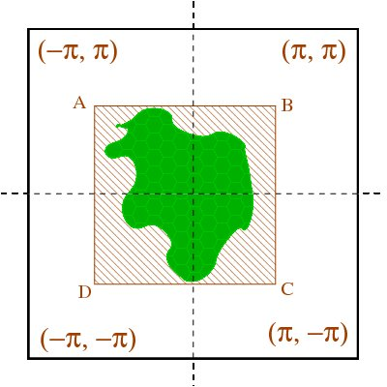
Frustum Clamping
Reorder Rays
Load Balancing
Traverse Rays
Build DS
Get bounding box of angles of all the shadow rays
Include those triangles which fall in the bounding box
  Frustum clamping
User defined Clamp values can implement spotlights
Build a perspective grid with respect to the light source

