Slide 1
Writer Identification and Verification for online Handwriting
Sachin Gupta
(sachin_g@students.iiit.ac.in)
Advisor
Dr. Anoop M. Namboodiri

Slide 2
Handwriting
Graphical representation of thoughts
  Using predefined symbols
  Still used frequently (e.g., note taking)
An acquired skill
  Years of habituation and practice
Complex generation process
  Neuromuscular perceptual-motor task
  Hand contains some 27 bones and 40 muscles
Notes:
We always found ourselves fascinated by different handwriting styles of people. However, we never thought of handwriting as the process.
In technical terms, handwriting is graphical representation of thoughts using some predefined symbols. Handwriting is most common means of communication even with the advent of other fast communication systems such as internet and computers.
Handwriting is acquired through years to practice that become habits. Handwriting involve training of almost 27 bones and 40 muscles over a long period of time. Handwriting is a neuromuscular process as hand muscles are activated by brain.
However, I never thought of handwriting generation as an complex process. Its look so simple to me. After starting working in the field of automatic handwriting analysis for last 3 years, I could understand the complexity of generation process.

Slide 3
Handwriting Identification
Handwritten documents have associated identity
Handwriting Identification
  Study of writership of the documents
  Comparison with reference handwritten documents
Notes:
Complexity of handwriting generation and years of habituation makes handwriting individualistic i.e. unique for each person. So each handwritten document essentially is contains the information about its writer.
In the thesis we will look at those consistent elements of handwriting, called handwriting identification.
In short, Handwriting identification is the process of identying writer of the given document that is carried out using previously captured handwriting from the writers.

Slide 4
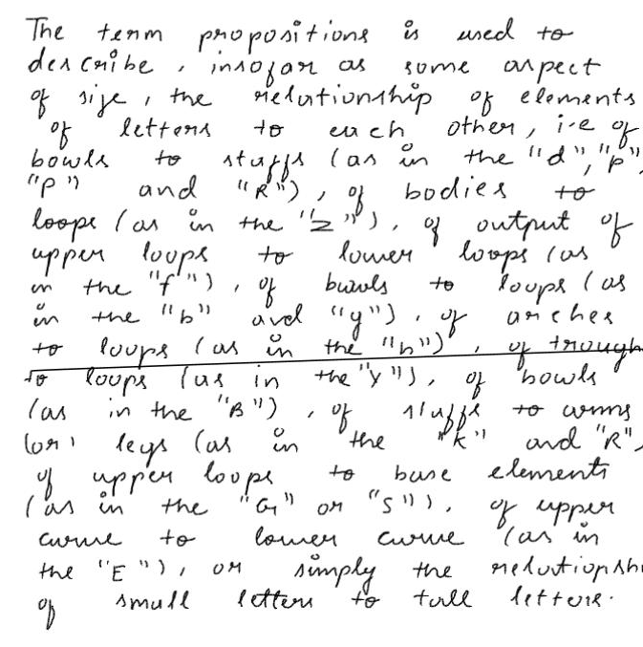
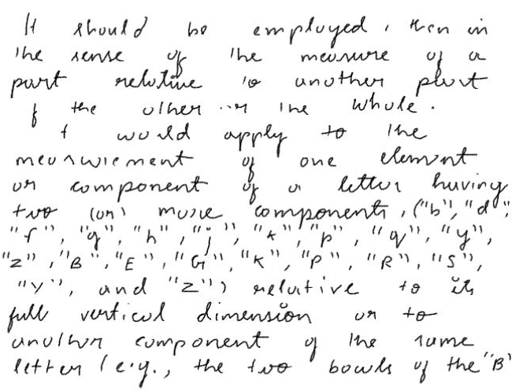
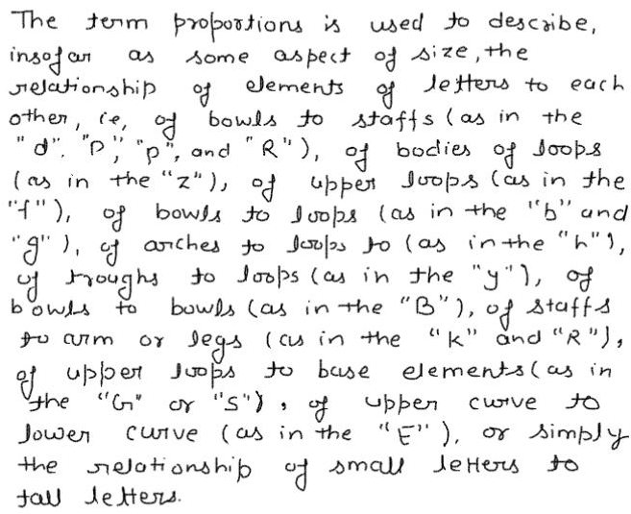
Individuality (example)
X
Y
X
Notes:
As I have mentioned previously, years of habituation makes handwriting of individual consistent. It can be analysed from the diagram also that word “of” is written many times and the writer is quite consistent in his approach.
However, now the question arise whether there are difference across writers. Answer is yes. As it is now visible that same word “of” is written differently by two writers.
We can conclude that handwriting identification is possible due to
Within writer consistency and,
Between writer differences

Slide 5
Recognition Vs Identification
Handwriting Recognition
  To automatically understand the underline text in the document
  Design of automated handwritten document reading systems
  Suppress variation due to writer or handwriting style
Handwriting Identification
  Study to determine the writer of the document
  Enhance the variation due to different handwriting styles
Notes:
We always found ourself confused between two term, that is Handwriting recognition and handwriting identification.
Handwriting recognition is the process to automatically understand the underline text written by any of the writers.
However, identification is the study to determine writer of the given document.
Both terms looks quite similar however, it is quite different. As in case of recognition, the major goal is to suppress the variations due to variuos handwriting styles. Character “A” should be recognizsed as characters “A” inspite It is written by any writer.
However, in case of identification, we try to enhance tha variations due to different handwriting style. We look for discrimination between writers.
So both are opposite facets of coin.

Slide 6
Problem Statement
Writer Identification
  Identify writer of a questioned document
  Given pool of writers
Writer Verification
  Verify whether the claimed identity is right?
  Given: Data based of writers
Forensic Document Analysis
  Verify whether two given documents are written by same person?
Notes:
Seeing the technical perspective, Handwriting Identification process can itself be divided into different categories based on the applications and available information:
Writer Identification, Verification and the problems of forensic document analysis

Slide 7
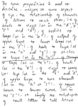

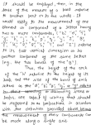
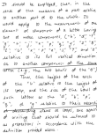
Identification
Who wrote this document?
35
Comparisons
Result
Writer - 3
50
65
Questioned
Document
Reference
Data Base
Matching Score
1: N Matching
Notes:
Writer identification is the process to identify writer of the questioned document from a pool of writers as the reference database. Identification process of termed as is 1:N matching as Questioned document is compared with all the documents in the reference database and return the result based on final matching scores from all documents.

Slide 8
Verification
Mayank: I wrote this document !!!
Reference Data Base
Mayank
Sachin
Amit
Distance
<
Threshold
Yes
Comparator
Questioned
Document
NO
1: 1 Matching
Threshold: decided based on training documents’
Within and Between writer distance distributions
Notes:
In case of verification, Questioned document is associated with claimed identity and questioned document is compared only with the reference document of claimed identity.
Distance between documents is compared with threshold. Threshold is calculated from reference database from within and between distance distributions.

Slide 9



Individuality Features
Sub-character and character level
  Shape and size
  Choice of allograph
Word level
  Connections and character spacing
  Aspect Ratio
Line level
  Slant and slope
  Word spacing
Paragraph and page level
  Indentations and arrangements of text
  Uniformity of margins
W1
W2
W1
W2
Word Level Individuality
Character Level Individuality

Slide 10
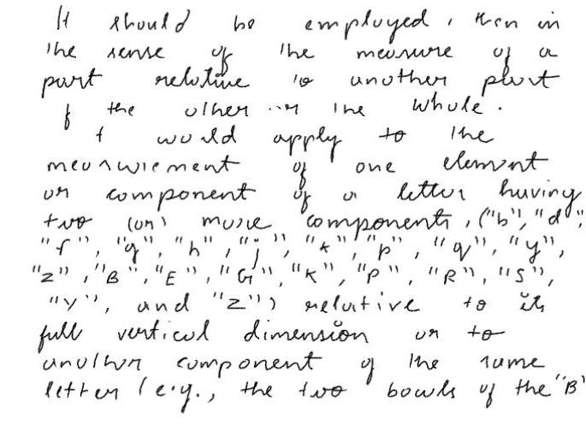
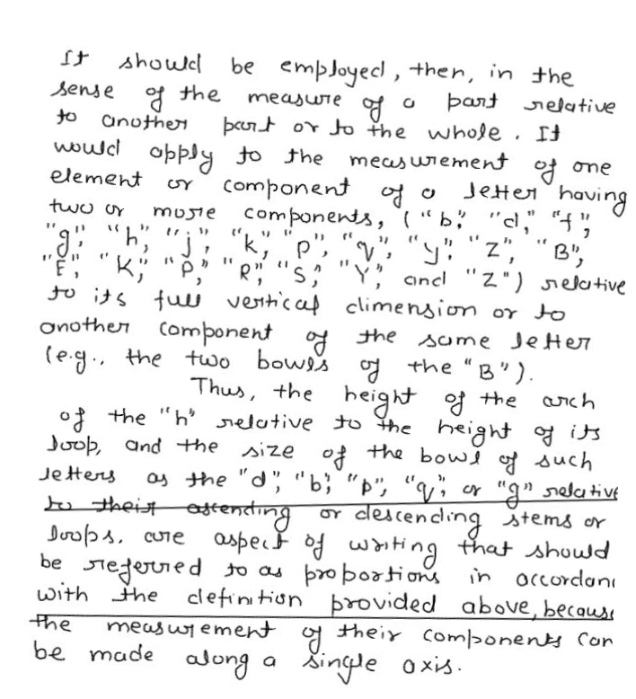
Line and Paragraph Level
Writer-1
Writer-2
Slant and Slope of lines
Parallelism of Lines
Word Spacing – number of words in a line
Uniformity of Margins
Overall Texture

Slide 11
Challenges
High within writer variations
  Due to mood dependent nature of handwriting
  No two piece of handwriting by any individual are same
Low between writer variations
  Handwriting must be readable
  Degree of variations are low
Notes:
Handwriting identification pose different challenges such as
High within writer variations: Handwriting is always affected by mood variation and many other aspects such as pen, paper, environment etc. So handwriting is quite different than other biometrics such as finger prints, face etc where there is no changes as such. Thus creating high within writer variations.
At the same time, writers are essentially writing the same thing and trying to make it readable. This creates low between writer variations.

Slide 12
Online Vs Offline
Offline
  Matrix of integers
  Only shape and size information is available
  Temporal information about how stroke is drawn is lost
Online
  Sequence of X-Y coordinates, Pen up-down events
  Shape and size information is available
  Sequencing of points and strokes is available
Notes:
Before going into more technical details lets look at different aspects of handwriting. Handwritten documents can be captured in two different modes.
Using Scanner and using pen input devices called offline and online

Slide 13
Data collection and Annotation
Major Hurdle
  Sequential process: Devices needed for online handwriting
  People are reluctant to writing
  Standard databases are not available
Online handwriting collection devices are not accurate
Automatic segmentation and annotation
  Research problem
Data collection
  600 pages of data from around 50 writers in various scripts
Notes:
Data collection is major hurdle in case of online handwriting. As special devices are needed to capture handwriting. Thus process become sequential since the number of devices can not be high.
At the same time, people are reluctant to writing as they use more and more computers these days.
Also no standard databases are available with writer information.
Also the quality of devices are not upto the mark. Sometime they capture stroke those are even not present. This wastes lots of collected data.
Even after that annotation of data is the problem. As automatic systems are not available, automatic annotation can not be done. Automatic annotation and segmentation are the research fields itself.

Slide 14
State of the Art
Done by handwriting experts
  Mostly manually
  State of art systems are not available
Using
  Context dependent information such as origin, type and condition of the documents
  Difficult to model mathematically
Notes:
Presently Handwriting identification is usually done manually as no state of art system is presently known to us. During manual identification context dependent information such as origin and type, paper condition can be modeled, that is difficult to model mathematically.

Slide 15
Theme
Identifying consistent features automatically
  To discriminate between writers
Usability of discriminating features
  Preserve discrimination
Notes:
Theme of my thesis work is to identify most consistent features from handwriting of the individual that can be used efficiently to discriminate writers from each other.
At the same time major challenges are in learning this discrimination power effectively. We proposed algorithm for three basic problems in handwriting identification.

Slide 16
Major Contributions
Text-independent writer identification
  Designing codebook of writers
  Automatically identifying and extracting discriminating features
Text-dependent writer verification
  Writer-specific text generation
  Robust to forgery
Forensic document examination
  Repudiation detection in handwritten documents
Notes:
We started working on the problem of Text independent writer identification. We proposed script independent algorithms for identification and extraction of consistent features of individual handwriting style which are further used to identify writers.
In case of text-dependent verification, major hurdle is to identify the text specific to the writers. We design the framework such that writer specific information can be used efficiently to make the system robust to forgery.
In case of forensic document examination, we look forward to problem of repudiation in handwritten documents.

Slide 17
Text-independent writer identification

Slide 18
Text-independent ?
Underline text is not known
  Data is not annotated
  Given: Sequence of strokes and x-y coordinate values
Challenges of text-independent
  Extract consistent curves (features) from documents
  Compare similar features between two documents
  Design codebook of individual writers
Notes:
In case of text independent writer identification, system is not aware of the text being written. That is system doesn’t know individual characters or words. System is just presented with non-annotated sequence of strokes.
The major challenges in case of text independent systems is to identify writer-consistency and then to use this consistency for discrimination.

Slide 19
Consistency…
X
Y
Notes:
As seen from the diagram, we want to extract consistent loops from the documents. However, even after extraction the major problem is that similar loops should be compared with each other to make out differences in the documents This is not the problem when we underline text is known. As we can always compare similar groups for comparison.

Slide 20
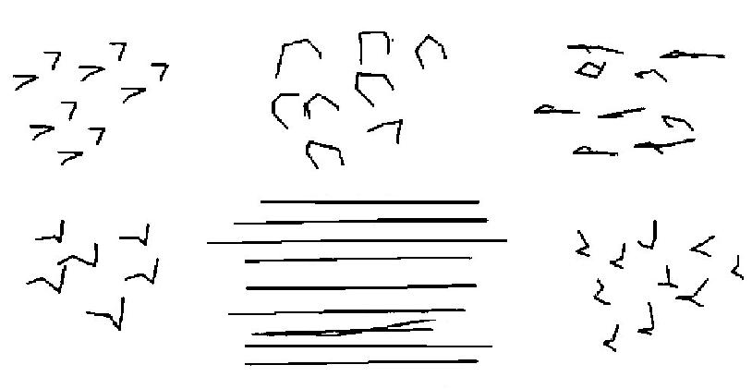
Codebook of a writer
Six different clusters extracted from Devanagari script.

Slide 21
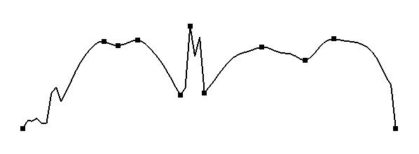
Theoretical background
Handwriting modeling studies
  Strokes is the combination of different forces
  Handwriting curves become consistent due to habituation
Relative velocity points of strokes are constant for same writer (Empirical results)
Stroke from Devanagari Script
Velocity Profile of above stroke
Notes:
Before proceeding into detailed technical details, I would like to introduce some theoritical and empirical findings. According to handwriting modeling papers, handwriting is the combination of forces those are consistent within writer and changes from writer to writer.
Also as we can access velocity information from online handwriting data, we found out that relative velocity of stroke remains the constant, even when absolute velocity is changing.
On the right hand side, stroke and velocity profile is shown. Colored points on the stroke represents the local minimum and maximum velocity points respectively.

Slide 22

Summarized framework
Writer Classification
Cluster into different clusters
NN₁
NN₂
Classifier
Combined Result
NN₃
Soft Classification
…….
Questioned
document
NN_{n}
Classify
Writers

Slide 23
Results
Experimented with
  Roman, Hindi, Cyrillic, Arabic and Hebrew
Training data
  Approx. 300-400 curves for Roman
  Approx. 700-800 curves for others
Test Data
  100 curves for Roman
  200-300 curves for others
  Tables and graphs are on next page…..

Slide 24
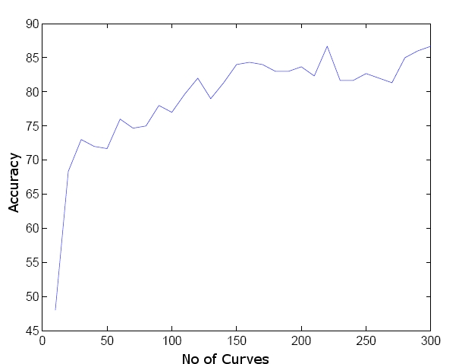
Varying No of Curves
Accuracy with 12 words
Accuracy increases with number of curves.
>85% accuracy reached with 200 curves (10-12 words).

Slide 25
Script Vs Accuracy
~10 writers for all scripts
For Most Scripts Top-2 accuracy is nearly 100% except Chinese
Confusion between pairs of writers

Slide 26
Related work
Paragraph level features
  Image processing
    Grey scale histogram
    Run length coding
    Fractal image compression
  Texture features
    Gabor filter, Wavelet
    Contour-let GGD
    Grey scale covariance matrix
  Online features
    Pen pressure, velocity, azimuth
    Velocity of Bary center
  Codebook generation
    Using directional features
Line level features
  Word spacing
  Lower and Upper profile
  Fractal & wavelet features
  Loops and Blobs
Our approach
  Code book design using
  Sub-character features
  Script independent framework
  Online handwriting data
  Identification with less amount of data
  Automatic Identification of consistent and discriminating features

Slide 27
Result comparison
Schomaker et al[28]
  Combination of directional, texture and image processing features
  Identification: accuracy of 87% with 900 writers
  Verification: Equal error rate of 3%-8%
  Test Data size: 1 page of handwritten data
Our approach[5]
  Using shape based features
  Identification accuracy of ~85% with 15 writers
  Test data size: 12 words (1 line)

Slide 28
Analysis
Shape and size based primitives
  Obtain reasonable accuracy with simple algorithm.
Chinese script
  Most of the strokes are straight line segment
  Inter-stroke relations based features can be used
To increase accuracy
  Robust clustering and classification algorithm
  Fusion with high level like line and paragraph primitive

Slide 29
Text dependent writer Verification

Slide 30
Problem Statement
Text-independent systems
  Large amount of data needed
Text-dependent framework
  Higher Accuracy
  Small amount of data needed
Problems (Text-dependent systems)
  Forgery (due to fixed text known in advance)
  Authentication text not known (usually random text is used)
Notes:
Text-independent system is the most desirable systems however, the applicability of text-independent is still under doubt due to need for large amount of data.
On the other had text-dependent framework are more accurate with limited amount of data available as similar text comparison can be made easily.
However the problem of forgery limits the applicability of the systems. Problem of forgery in these system is due to fixed predefined text that is usually known in advance.
At the same time, in case of text-dependent systems, authentication text is not used. Currently random text is used for the systems.

Slide 31
Signature Vs Text-dependent
Signature and Text-dependent handwriting
    Variations are unlimited, signature need not be readable
    Writer consciously tries to write the same signature
Challenges
    Discrimination between Within and Between writer variation has to be done
    Discriminating distance method have to find out
Notes:
Signature identification is a specific instance of text-dependent systems. However, in case of signature too, variations are high as signature need not be readable. However, words have to be reasonably readable.
Text dependent systems are simpler as compared to independent systems in the term that comparison can be made easily between similar items. However, this is not that easy as its looks. As writers are writing same words essentially so degree of variations are less.
Thus the major challenge in case of text-dependent systems is to search for a feature space such that within and between writer distances are discriminable.

Slide 32
System Specification
Empirical finding
  Discriminating power of primitives vary for individuals
  Primitives: sub-characters, characters, words, etc.
System Specifications
  Writer – specific text
    For higher accuracies
    With limited amount of text
  Varying text across multiple authentication
    Robust to forgery
Notes:
According to Handwriting experts, discriminating power of primitives vary for individuals. Primitives here means essentially subcharacters, characters, or words, parts of handwriting that do posses individualiy information.
Based on this finding, we set system specifications:
First we need to find out discriminating text for the writer, that is the text that can discriminate say me from other writers.
At the same time as fixed text have the problem of forgery, text should also be varied across multiple authentication.
i.e. multiple text for multiple authentication but should be discriminating for writer.

Slide 33
Boosting?
Classifier combination method
  Combines weak classifiers to generate a accurate learning algorithm
  Greedy algorithm
Select weak classifiers on each stage
  based on previously selected classifier
Maintains a distribution of weights over training samples
Notes:
Boosting as we have previously mentioned is a classifier combination method
Boosting have different mechanism of assignment weights to classifiers, and at each stage selects classifiers based on
Previously selected classifiers.

Slide 34
Framework
Verification as 2-class problem
  Positive samples Vs Negative samples
Given
  Set of writers and primitives
  Table of discriminating power
Randomness is included at each stage
  Proportional to the Discriminating power of the classifier
  More Discriminating: more probable to be accepted
Notes:
Verification prob is posed as two class problem of +ve VS –ve samples… all samples from the writer to be verified is +ve and others as –ve.

Slide 35


Text Generation Process
Randomness is included at selection process.
Threshold selected Is biased: accepting the writer
  For lower False Rejection Rates
Bag of Primitives
W1
W2
W3
Fix Threshold and Reject Writers
Select it or not?
W4
W5
W6
List of Writers
Accuracy
Notes:
Consider we have 6 writers in the database and we need to generate text specific to the writer-1
Initially each writer is equally weighted… We select three classifiers one by one…
After each stage we change the weights as shown in the Table…
Now as seen from the figure we can now select writer -1 anr write4 as they are quite discriminating from the writer-1
Now for the next stage we can select another set of classifiers/characters and can again reject some writers based on their
Discrimination…
This way we remain with only one writer i.e. all the writers are quite discriminatig using this text…
Now in order to vary text…. We have introduced randomness.. Each classifier might be reejected at any stage…
Boosting based framework will itself select classifiers based on text selected….

Slide 36
Effect of Boosting
Number of Boosting Stages
Within writer
Distance
Between writer
Distance
X1
Probability
Distance
Notes:
This diagram shown the effect of boosting as number of stages increases…As number of stages increases margin between +ve and –ve samples go increasing…

Slide 37
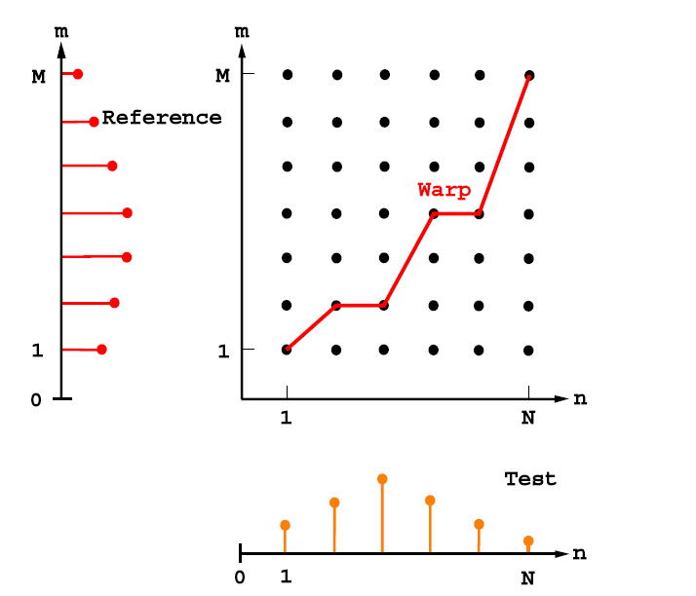
Dynamic Time Warping
Time Series Alignment
Dynamic Programming Approach
Different length feature vectors can be compared
Naïve Alignment Re-sampled series
DTW Alignment

Slide 38
Stroke Comparison
Dynamic Time Warping
  Alignment of stroke done using dynamic programming
Directional features
  Strokes representation: 12 Bins of curvature directions
  Curvature angle: Different between adjacent tangents direction
0
360
1 | 1 | 2 | 3 | 3 | 4 | 3 | 0 | 0 | 0 | 0 | 1

Slide 39
Results
Experimented with English script (20 writers) and Hindi script(10 writers)
DTW and Directional feature extraction methods are used
Each user written about 10-12 words each
  3 fold cross-validation is used

Slide 40
Performance measures
False acceptance rate
  Percentage of user forge user those are accepted
  Should be lower for forensic application
    Security is the major concern
False rejection rates
  Percentage of genuine users those are rejected
  Should be lower for civilian applications
    Usability is the major concern

Slide 41
False Accept Rate
(Directional Feature)

Slide 42
False Reject Rate
(Directional Features)

Slide 43
False Accept Rate
(DTW)

Slide 44
False Reject Rate
(DTW)

Slide 45
Definition
Threshold-1
  Control the range of variations within writers
  Decided based on positive samples
Threshold-2
  Confidence before rejecting other writers (negative samples)
  Lower threshold-2 == Higher confidence

Slide 46
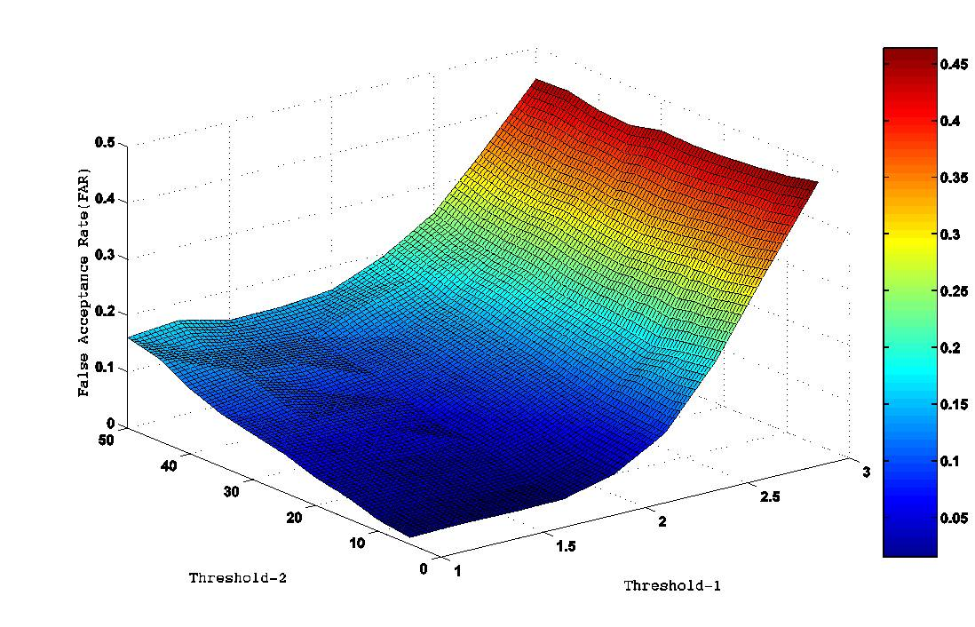
Effect of thresholds..
(DTW and Hindi script)

Slide 47
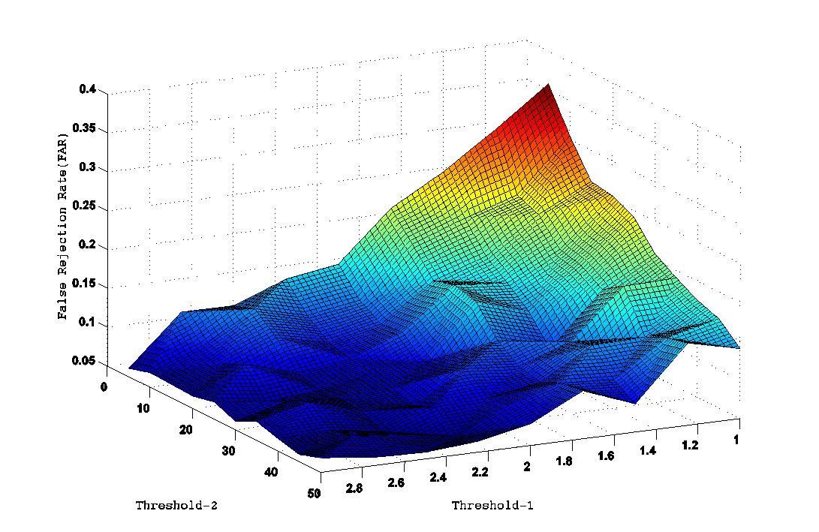
Effect of thresholds..
(DTW and Hindi script)

Slide 48
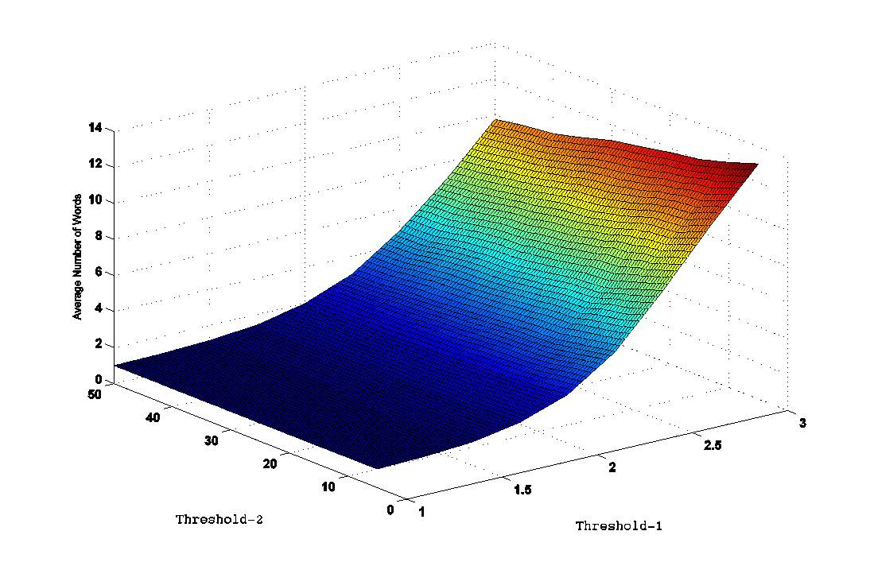
No. of word comparisons..
(DTW & Hindi script)

Slide 49
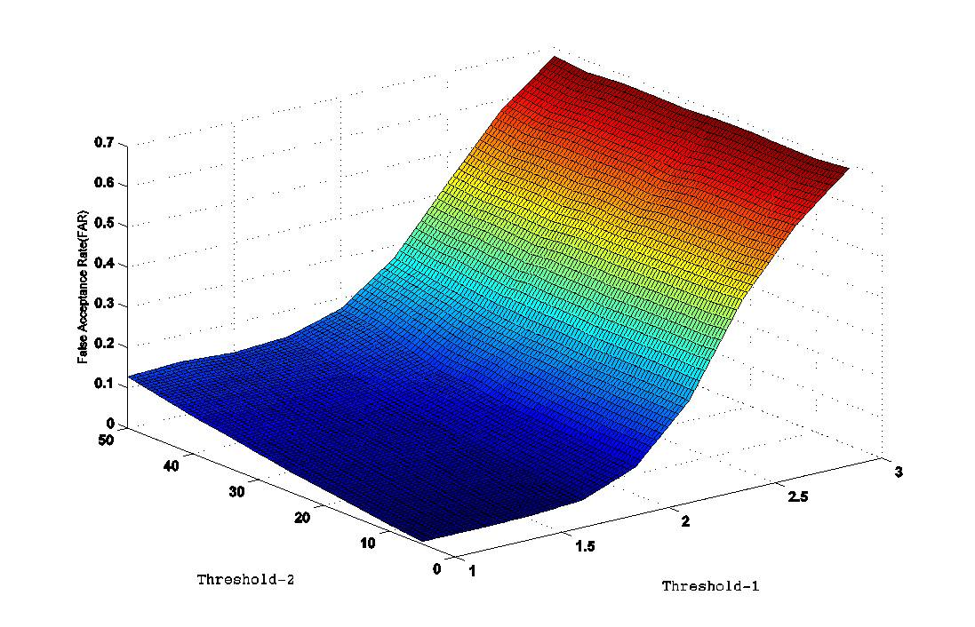
Effect of thresholds..
(Directional feature and Hindi script)

Slide 50
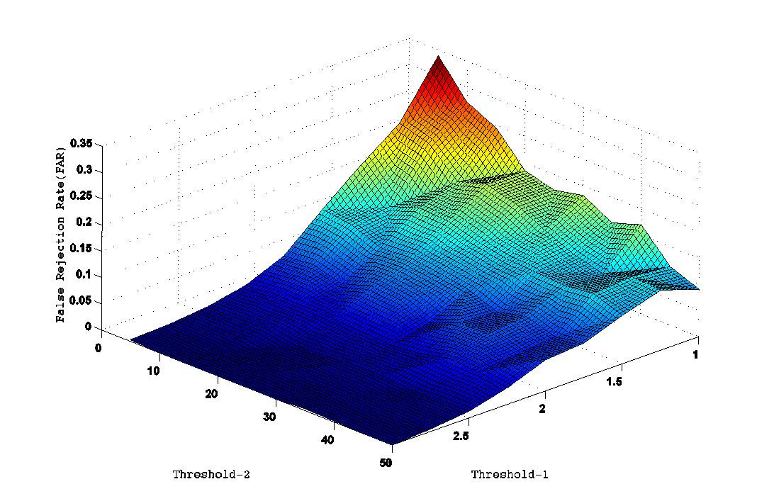
Effect of thresholds..
(Directional feature and Hindi script)

Slide 51
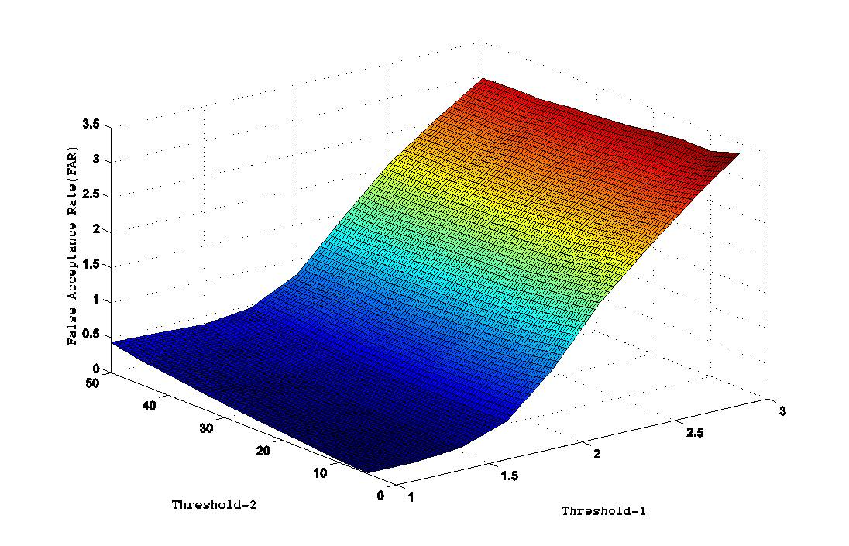
Effect of thresholds..
(Directional features and English script)

Slide 52
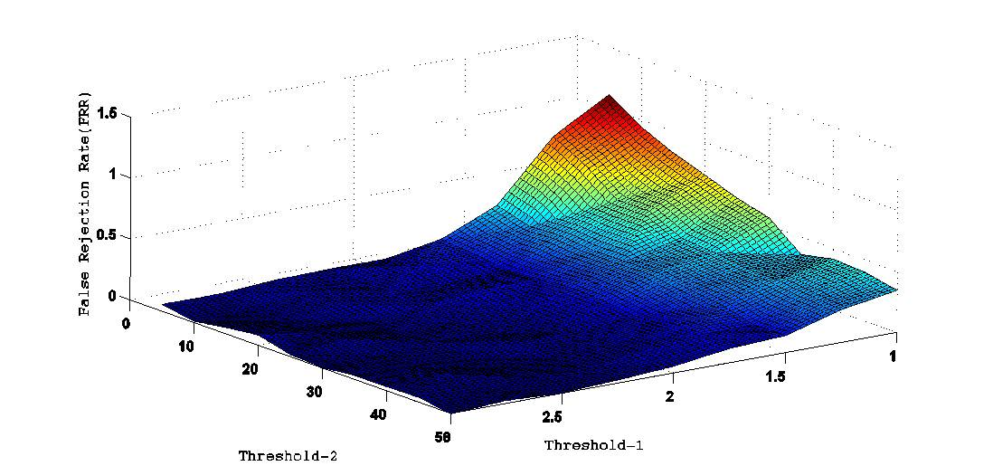
Effect of thresholds..
(Directional features and English script)

Slide 53
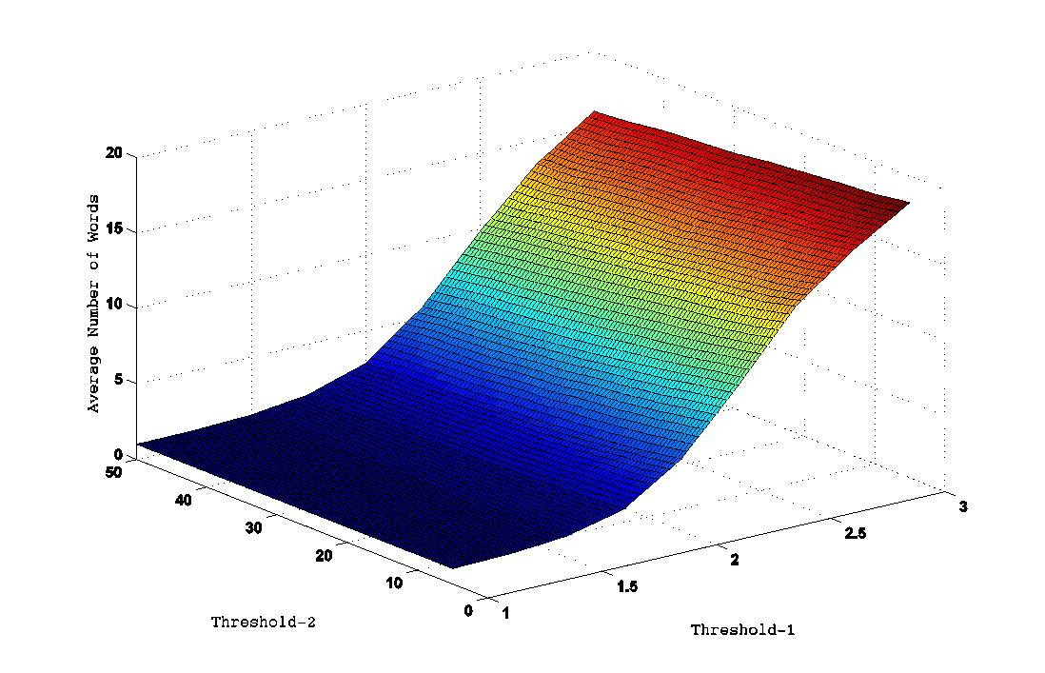
No. of word comparisons..
(Directional & Hindi script)

Slide 54
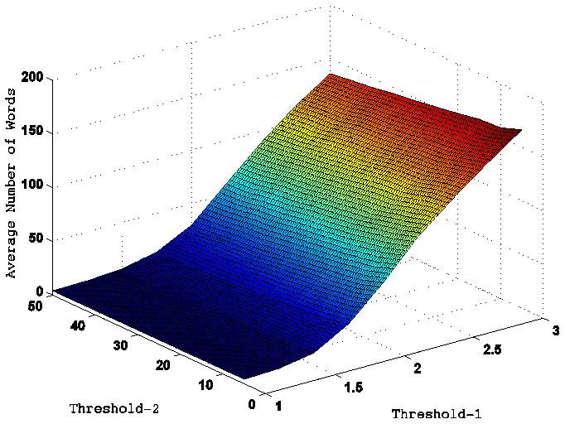
No. of word comparisons..
(Directional & English Script)

Slide 55
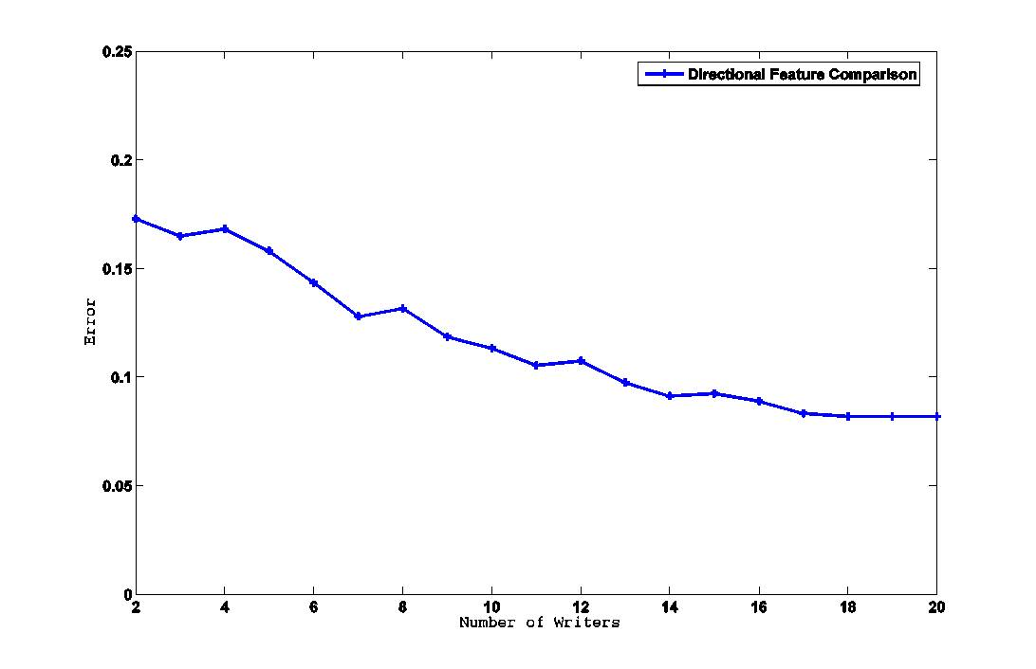
Number of writers Vs Accuracy
(English)

Slide 56
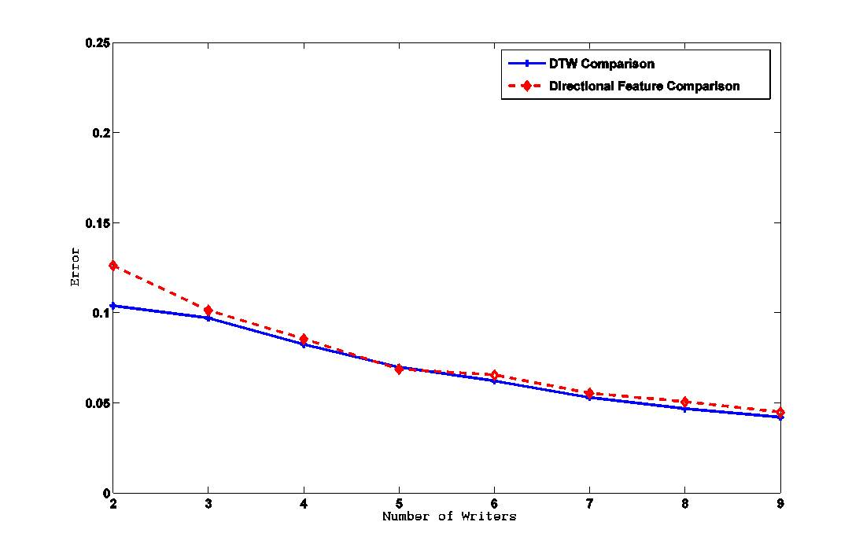
Number of writers Vs Accuracy
(Hindi Script)

Slide 57
Analysis and Summary
Writer-specific text generation framework
Automatic text generation
Automatic threshold generation
Text is Varied
  Robust to forgery

Slide 58
Related work
Features
  Character level
    GSC features
    Structural features
    Directional features
  Word level
    Word model recognition
    Shape curvature
    Shape context
    Morphological features
Feature selection
  Static feature selection
  PCA based discriminating power
Our approach
  Writer-specific text generation
  Boosting based framework
  Text variation
  Higher accuracy with limited amount of data

Slide 59
Comparison
Srihari et al.[17]
  Shape context, Shape curvature, GSC features, WMR features
  Performance: 42%, 22%, 62% and 28% respectively (1000 writers)
  Test data size- 10 words
Our approach
  Directional features
  Performance: 95% (20 writers)
  Test data size: 5 words

Slide 60
Repudiation Detection in Handwriting Documents

Slide 61
Traditional writer identification Vs QDE
Assumption of Natural Handwriting
Biometrics Terms
  Repudiation (Negative Biometrics)
  Forgery (Positive Biometrics)
Quantity and quality of data available
Cost factor involved
  Used as expert witness in legal Verdict

Slide 62
Repudiation
The rejection or renunciation of a duty or obligation (as under a contract)
Merriam-Webster's Dictionary of Law
Handwriting Repudiation
  Deliberately alter his natural handwriting to avoid detection
  To deny involvement in the case

Slide 63
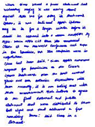
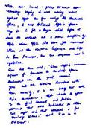
Repudiation
No Database
Written by same writer?
Data
Base
Hypothesis
Testing
Significant
Distance?
Comparator
Calculate
Distance
Same Writer ?
Questioned
Document
Dis
Different Writers ?
Reference
Document
1 : 1 Matching

Slide 64
Verify whether given documents written by same person or different without assuming Natural Handwriting

Slide 65
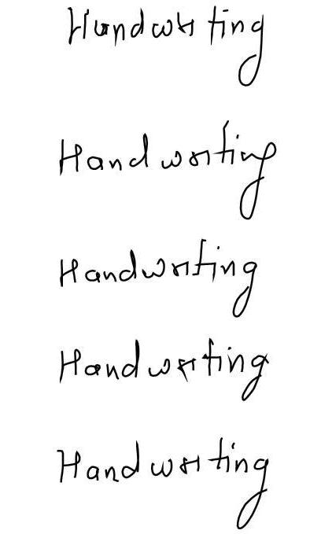
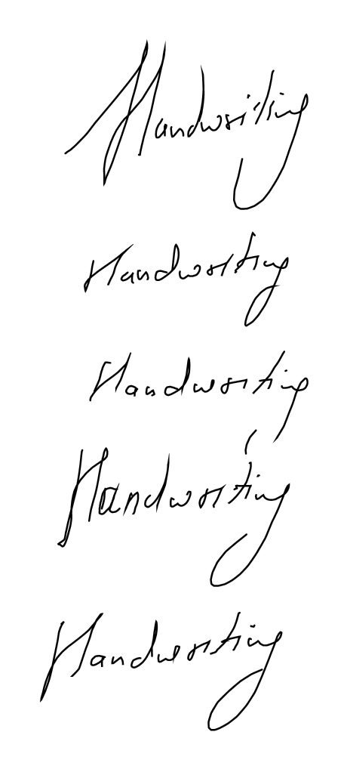
hard problem?
Normal Handwriting
Repudiated Handwriting
Notes:
Show Diagram of Normal and Repudiated words.

Slide 66
Challenges
With in writer variations become high
Between-writer variations become less as compared.
Learning can’t be done as data is not available.

Slide 67
Ray of Hope
One can’t exclude from one’s own writing, those discriminating elements of which he/she is not aware
Maximum and minimum velocity points remain the same in-spite of absolute velocity.
Words have significant overlap at sub-character level.

Slide 68
Framework
Statistically significant score between two documents.
Utilize online information that can be available
No assumptions about distribution of data.
    May lead to erroneous conclusions.

Slide 69
Assumptions
Questioned and reference document either have significant overlap or are same at word level.
Reference document is collected in online mode.

Slide 70
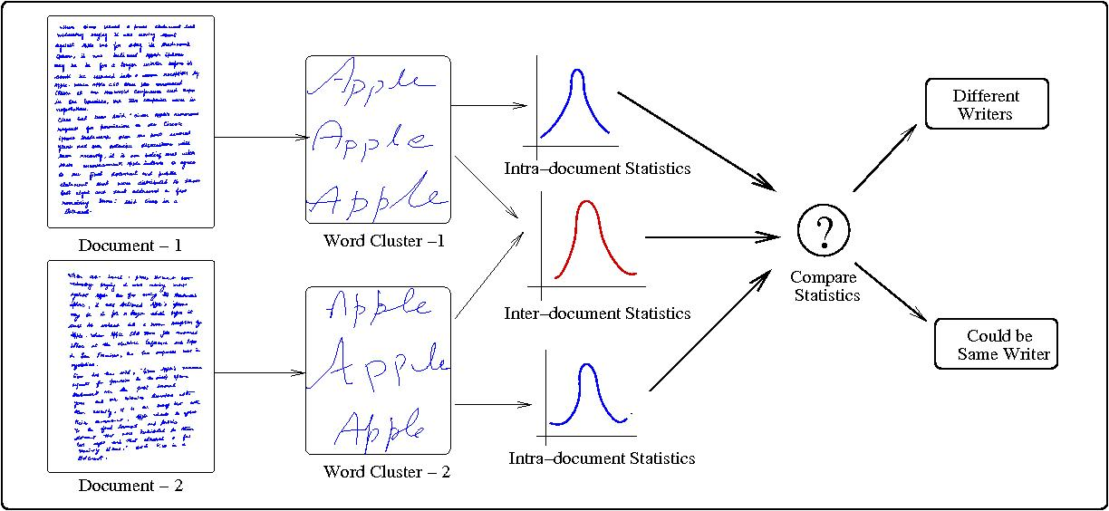
System Framework
Word Segmentation
Hypothesis Testing
Word Comparison

Slide 71
Hypothesis Testing
To calculate significance of distance between two distributions.
According to Neyman Pearson paradigm
  H0 : Documents written by same writer (Null Hypothesis)
  H1 : Document written by different writers (Alternative Hypothesis)
Intra-document word distances and inter-document word distances are two distribution to be compared.
Distributions are compared to find out whether they are generated from same population.

Slide 72
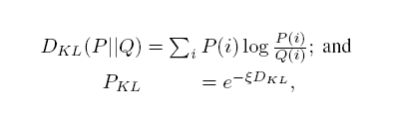



Distribution Comparison
KL divergence test (make assumptions on nature of distribution)
Kolmogorov Smirnov Test (don’t make any assumptions)

Slide 73
Results
Data being collected from 23 different users in English.
Each users 3 pages of normal data and 3 pages of repudiated data is collected.
Preprocessing:
  Words are segmented using semi-automatic toolkit for word segmentation.

Slide 74
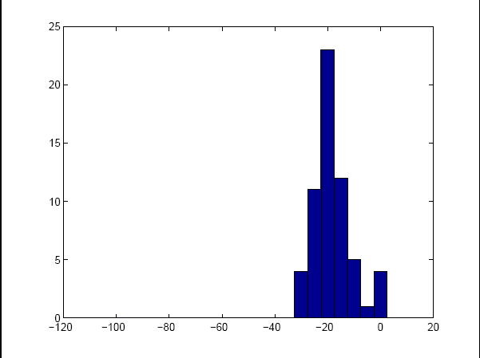
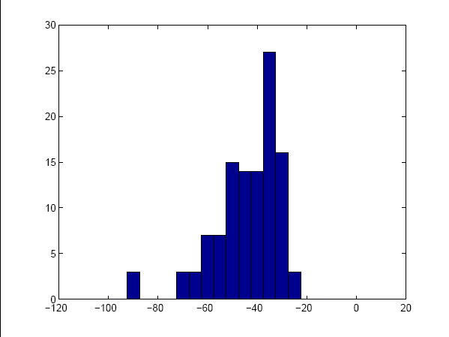
Results
Intra-document distance
Inter-document distance

Slide 75
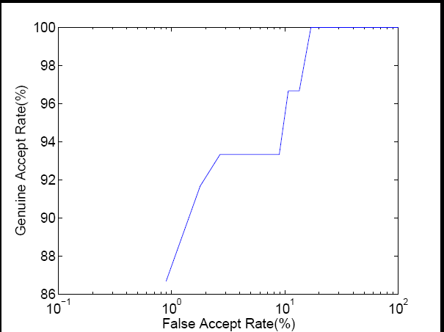
ROC Curve
Genuine Rejection – 82% @ Genuine Acceptance – 100%

Slide 76
Analysis of Results
Semi automatic System
Used as an aid to expert
Null Hypothesis is never accepted without expert intervention.
-1
0
1
Similar
probable
no
conclusion
probably
did not
Different
strong probability
of identification
indications
indications
did not
strong probability
did not
Scale Used by Forensic Experts

Slide 77
Conclusion and Future work
Learning based framework to learn similarity, in-spite of discrimination between documents.
Can we tell whether writer is trying to repudiate.
Framework which can learn more features and can give independent scores on each feature.

Slide 78
Conclusions
Proposed algorithms for automatic identification and extraction of discriminating features for online handwriting
Framework proposed for writer-specific text generation and text variations for text-dependent systems
Introduced the problem of repudiation and proposed a hypothesis testing based framework for the same

Slide 79
Publications
Sachin Gupta and Anoop M. Namboodiri, Repudiation Detection in Handwritten Documents Proc of The 2nd International Conference on Biometrics (ICB'07), PP. 356-365 Seoul, Korea, 27-29 August, 2007.
Anoop M. Namboodiri and Sachin Gupta Text Independent Writer Identification from Online Handwriting , International Workshop on Frontiers in Handwriting Recognition(IWFHR'06), October 23-26, 2006, La Baule, Centre de Congress Atlantia, France.
Sachin Gupta and Anoop M. Namboodiri Text dependent Writer Verification using Boosting, submitted to International Conference on Frontiers in Handwriting Recognition (ICFHR’08), Montreal, Canada
Sachin Gupta and Anoop M. Namboodiri Text dependent Writer Verification, planned in IEEE Transactions on Information Forensics and Security, 2008

Slide 80
Future work
Fusion of online and offline features for higher accuracies
Can we automatically detect person intention to repudiate or forge
  Based on single document
More robust algorithms for feature extraction
  Different than standard feature selection approaches

Slide 81

Thanking You ☺
gupta.sachin25@gmail.com

Slide 82
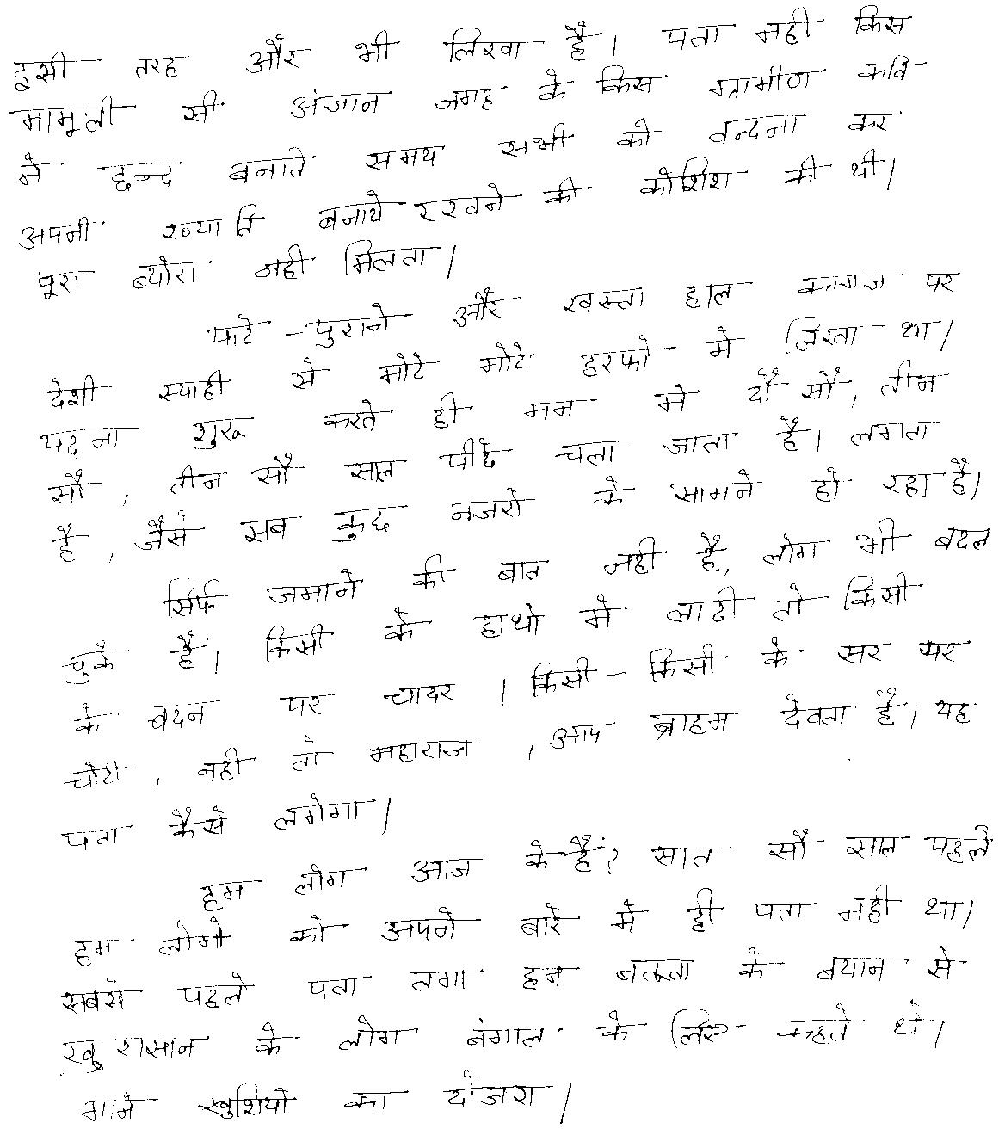
Proposed framework
Critical Points: Minimum and Maximum velocity points.
Shape curve: Curve between any two consecutive minimum velocity points.
Consistent Primitive
  Repeating curves
Extraction
  Unsupervised learning algorithms
Experimental setup
  K-Means
Online Text
Document
1
5
8
Curve Extraction
3
2
Where:
S_{j} be the j^{th} primitive
C_{k} be the k^{th} cluster
W_{i} be the i^{th} Writer
is the discriminability of the k^{th} cluster for the i^{th} writer.
7
6
Representation
4
Representation:
  Incident Angle [1]
  Curvature [2-4]
  Size [5-8]
Characteristic curve
Extraction
Six different clusters extracted
From Devanagari script.
Velocity Profile of above stroke
Writer Identification
Stroke from Devanagari Script

Slide 83
Number of Writers Vs Accuracy
Accuracy
Number of writers
Results for Devanagari Script
Accuracy dependent on the individuality of specific writer

Slide 84
Proposed Framework (example)
Notes:
According to our specification, we proposed a novel framework for writer verification.
We will have text-generation phase, that will generate variable text based on writer ID. Whenever
Writer will try to authenticate, text-generation phase will generate text and ask the writer to write the same.
As seen from the diagram, we have pool of features and Writer ID. System will generate characters based on the ID and ask the user to write.
However now the major problem is to do text-dependent comparison.
As system might not have same set of words available. This is done using text synthesis, that will generate data specific to the user. After that
Text dependent comparisons are done using character segmentations as shown in the figure.

Slide 85
Framework (Authentication)

Slide 86
Writer-specific Text Generation
Given
  A bunch of primitives
  Varying discriminating power for different pairs of writers
Aim
  To select the optimal set of weights for primitives
  To discriminate specific writer from others
Dynamic Feature selection
  Static feature selection achieve single optimum
Notes:
Now the basic question is how to generate text.
Basically we have a large list of primitives say characters, and their discriminating power vary for pair of writers. So we essentially need to find out set of weights for primitives so that writer is well discriminate from others.
This is essentially feature selection framework. Static feature selection achieve optimum set of weights
However our goal is to generate text variation

Slide 87
Writer-specific Text Generation
Text Variation require features
  robust to forgery
Handwriting can have different optimums
  Different combination of handwriting can provide desired results
Notes:
Also in case of handwriting, we can have different set of weights for primitives that can discriminate writer. So we need some method that can search in this space for different set of primtives.
For the purpose we are using a classifier combination method as feature selection i.e. boosting..

Slide 88
Boosting Algorithm
Given
  set of training samples(X) and underline labels(Y)
  Set of weak hypothesis (h)
Initialize weights distribution(D) (over training samples)
Select weak hypothesis h_{j,} such that
m – total number of training samples
t - boosting stage
Notes:
Lets have a quick look at boosting algorithm…
Given a set of labeled training samples for two class problem….
Each training samples are given equal weights…
At each stage boosting select weak classifier based on this set of weights…i.e.
In order to make error of misclassification minimum….

Slide 89
Boosting
Update weights
Where,
Final Hypothesis
-- Weight of the classifier
T– total number of Boosting stages
t - boosting stage
Notes:
After each stages weights of training samples are rearranged… such that
Accurately classifier samples get less weight than non accurate samples.
So that next classifier is selected based on hard samples….
Finally all classifiers are combined with preassigned weightage calculated based on error of classification

Slide 90
Discriminating Power of primitives

Slide 91
Text Generation Process
Calculate Threshold
Select or not?
Writer | Weights
X1 | 0.18 | 0.16 | 0.09
X2 | 0.17 | 0.03 | 0.01
X3 | 0.25 | 0.14 | 0.32
X4 | 0.10 | 0.22 | 0.34
X5 | 0.12 | 0.05 | 0.02
X6 | 0.18 | 0.40 | 0.22
Randomness is included at each stage.
  Each classifier might be rejected
  Based on discriminating power.
Threshold is Biased towards accepting writer
  Writer specific thresholds
Rejection at any stage will also reject claims
Rejected Writer
Writer | Weights
X1 | 0.35 | 0.35 | 0.45
X3 | 0.20 | 0.12 | 0.01
X4 | 0.30 | 0.40 | 0.52
X6 | 0.15 | 0.13 | 0.02
Rejected Writer
Rejected Writer
X4
X4
X4
X3
X6
X5
X6
X1
X1
X1
X2
X3
Probability
Probability
Probability
Writer | Weights
X1 | 0.60 | 0.75 | 0.99
X4 | 0.40 | 0.25 | 0.01
Distance
Distance
Distance
Notes:
Consider we have 6 writers in the database and we need to generate text specific to the writer-1
Initially each writer is equally weighted… We select three classifiers one by one…
After each stage we change the weights as shown in the Table…
Now as seen from the figure we can now select writer -1 anr write4 as they are quite discriminating from the writer-1
Now for the next stage we can select another set of classifiers/characters and can again reject some writers based on their
Discrimination…
This way we remain with only one writer i.e. all the writers are quite discriminatig using this text…
Now in order to vary text…. We have introduced randomness.. Each classifier might be reejected at any stage…
Boosting based framework will itself select classifiers based on text selected….

Slide 92
Why Repudiation is hard problem?
Normal Handwriting
Repudiated Handwriting
I am confused
Normal writer - 1
Normal writer - 2
Repudiated writer - 1
Repudiated writer - 2
Notes:
In this slide we want to convey the message showing feature space in Normal Handwriting and as well as repudiated Handwriting. We want to show that, repudiated words make system nearly unsolvable. We can’t draw a line between two classes. Classes are more merged now. Within Writer Variance has been increased, which in turn effects the Between Variance. Also With the diagram write some lines… Like High Within Variance. Also effects between Variance. Modeling if difficult now as also less data is available in Forensic Documents. So need some specialized method to solve this.
92

Slide 93
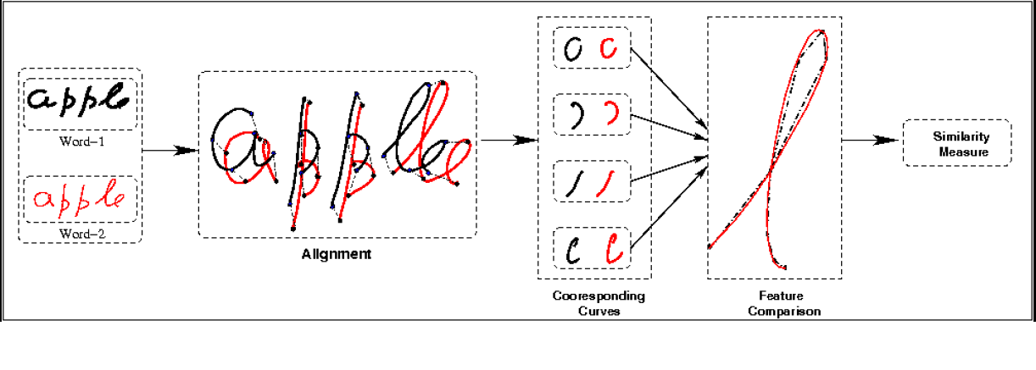
Word Comparison
Sub-character Information
Critical Point Matching
DTW Matching

