Slide 1
Patient-motion analysis in perfusion weighted MRi
Rohit Gautam
200702035
CVIT, IIIT Hyderabad
Guide
Dr. Jayanthi Sivaswamy

Slide 2
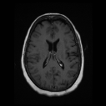
What is Perfusion MRI ?
In the context of MRI, observation of blood flow through an organ is referred to as perfusion.
A bolus of an exogenous paramagnetic contrast agent injected into patient’s blood stream is tracked over time.
Acquired data is 3D time-series.
Volume
1
Before Bolus wash-in
n_{win}
Bolus in transit
n_{wout}
After Bolus wash-out
N
Time-points
Notes:
This is the first question that comes to mind. In the context of MRI, perfusion refers to the observation of blood flow in organ. In perfusion MRI, we inject a bolus of contrast agent into patients blood stream. The injected bolus is then tracked over time. In a typical MRI, a volume is acquired in a single scan. In perfusion MRI, we acquire a series of volumes. The following diagram shows a typical perfusion series. As we can see, a time-series of volumes are acquired. In a perfusion series, two distinct time-points are found. These are the wash-in and the wash-out time-points. Wash-in point is the one when bolus enters the brain region. After sometime, the bolus washes-out of the region. The point when it has washed out is called the wash-out time-point.

Slide 3
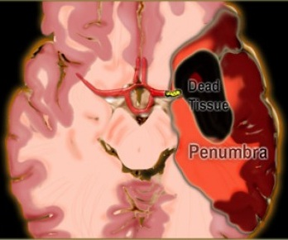
Perfusion MRI in stroke analysis
Stroke: Rapid loss in brain function due to disturbance in blood supply.
Interruption to blood supply (Ischemic)
Blood vessel rupture (Haemorrhagic)
Stroke regions
Core (dead region)
Penumbra (salvageable)
Time-varying data (for brain) is parameterized on voxel-by-voxel basis to obtain perfusion parameters.
These parameters help to profile the blood flow characteristics in different tissues and identify affected regions.
Notes:
Perfusion MRI is one of the methods used in stroke analysis. Stroke is a disease in brain that causes rapid loss in brain functions due to abnormal blood supply to regions inside brain. It can be caused either due to a clot in the blood vessel, or in case there is a rupture in the blood vessel. A stroke consists of regions: the core where the tissues are totally dead. The other region is the surrounding penumbra region which can be recovered through treatment. In perfusion MRI, we obtain a time-varying data for brain. This data is analyzed on a voxel-by-voxel basis to profile the blood flow in different tissues. Precisely, we estimate different perfusion parametric maps using the data and analyze if a particular region is affected.

Slide 4
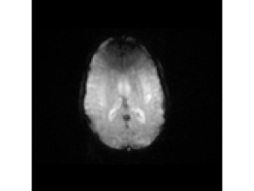
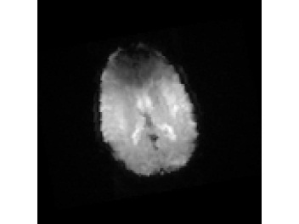
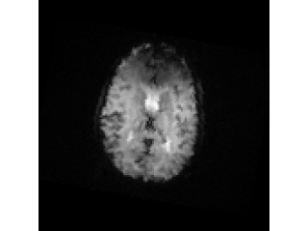
Data corruption due to patient motion
Duration of a perfusion scan lies in range 20~60 minutes.
Difficult for patient to remain still in this period.
Incorrect tracking of voxel across time-points leads to incorrect perfusion parametric maps.
Volume at time t
Volume at time t₁
Volume at time t₂
Notes:
Data corruption is a major problem found in perfusion MRI. The duration of a perfusion scan takes between 20 to 60 minutes depending on the number of volumes scanned. Ideally, the patient should remain still for the entire period but practically, it is impossible for a patient to remain still for that long. Even though a head holder is provided to make sure that the patient remains still, due to claustrophobic nature of MRI scanner and also due to condition of patient, patient motion is observed. In the following figure, we show the data corruption. The location of a voxel has changed due to motion. If we try to estimate the perfusion parameters using such a data, they will be wrong and it will result in a wrong diagnosis. Hence, solving the data corruption problem is the first step in a stroke analysis pipeline.

Slide 5
Variation in perfusion parameters with motion
Perfusion parameters obtained from motion corrupted data vary with degree of motion.
Error in CBV estimation
Error in TTP estimation
TTP: Time to Peak of contrast agent
CBV: Cerebral Blood Volume
Notes:
Here, we show the effect on perfusion parameters with varying degrees of motion. For the purpose of analysis, we added motion to volumes in the time-series. We used a tool perfusion mismatch analyzer (PMA) that can estimate the perfusion parameters for a given time-series. On using PMA tool, it was found that the error in estimation of two important perfusion parameters - time to peek and cerebral blood volume increases with increase in degree of motion. Hence, it becomes important that the perfusion data is correct before it is used for stroke analysis.

Slide 6
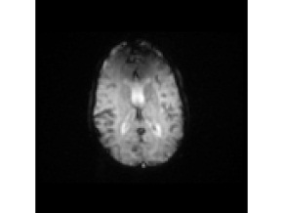
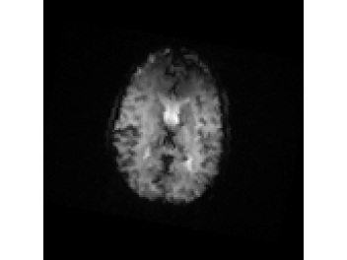
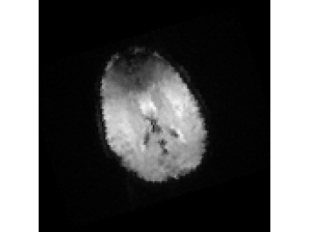
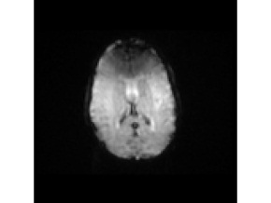

1
Before
bolus
wash-in
Motion
n_{win}
No variation in intensity
Bolus in
transit
Motion
n_{wout}
Non-uniform Variation in intensity
After
bolus
wash-out
Motion
N
No variation in intensity
Notes:
The following figure shows an example of a perfusion series corrupted by patient motion.
These are the volumes scanned before wash-in of bolus. As we can see, these volumes do not show variation in intensity.
When the bolus enters the blood region, a variation in intensity is seen in the volumes that lie in the bolus transit stage.
When the bolus has washed-out, the variation in intensity is not found again.

Slide 7
Problem
Aim
Align the volumes in a perfusion time-series corrupted due to patient motion.
Transformations found in acquired perfusion MR images:
Global transformation due to patient motion.
Local change in image intensity due to injected bolus.
Non-uniform nature of intensity variation due to varying concentration of bolus in brain.
Obstacles
Perfusion MRI is not a common practice in India.
Motion corrupted perfusion data is very difficult to acquire.
Motion is simulated.
Notes:
Thus, our aim is to align the volumes in the perfusion time-series that has been corrupted due to patient motion. It can be seen that the problem is a combination of following three transformations. The first is the global transformation due to patient motion. Second is the local change in intensity ov volumes due to injected bolus and third is the non-uniform nature of intensity variation due to changing concentration of bolus in brain with time. In our study, a major obstacle was acquiring motion corrupted perfusion MRI data. Perfusion MRI is not a common practice in Indian hospitals. Hence, perfusion MR data cannot be acquired easily. To acquire a motion corrupted data becomes even more difficult. Hence, for research purpose, we simulated patient motion on the acquired perfusion MR data.

Slide 8
Strategy for motion correction
Observation
All volumes in the time-series are not affected by motion.
Hence
Find the subset of volumes that are affected by motion.
Align the entire time-series by aligning this subset of volumes only.
Notes:
It was observed that all the volumes in the time-series are not corrupted due to patient motion. Hence, we devised a strategy where we identify the subset of volumes that are corrupted by motion and then align the subset only. The existing approaches align every volume in the time series which proves to be costly.

Slide 9
Proposed three-stage system for motion correction
Notes:
This is the proposed three stage system for motion correction. First, we divide the time-series into distinct sets depending on the status of bolus in brain. Next, in the motion detection stage, we detect the volumes in the time-series that are affected by motion. In the last stage, we perform the alignment of motion corrupted volumes found in stage 2.

Slide 10
Division of perfusion time-series
Notes:
We begin with the first stage – Division of perfusion time-series

Slide 11
Observation
A perfusion time-series cannot be treated as a single unit due to behaviour of contrast agent.
Hence,
The time-series is divided into three sets based on the time-points:
Wash-in time-point of contrast agent
Wash-out time-point of contrast agent
Notes:
A perfusion time-series cannot be viewed as a single unit due to the behaviour of contrast agent. The wash-in and wash-out process causes features to appear and disappear in the time-series.
Hence, we divide the time-series into 3 sets based on the two time-points that are wash in and wash out of contrast agent.

Slide 12
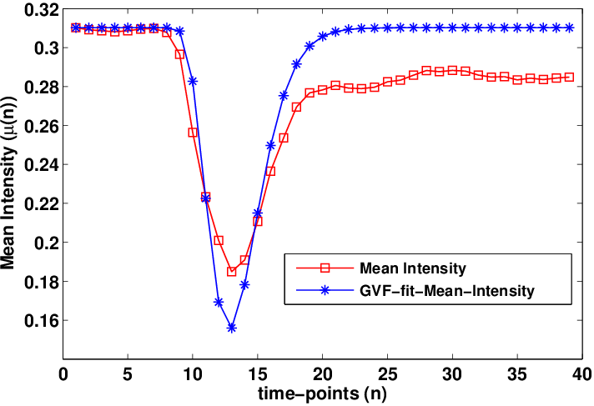
Gamma-variate-function fitting
The signal intensity in perfusion MRI varies proportionally with bolus concentration.
A standard gamma-variate-function (GVF) models the perfusion curves[1].
This GVF is fit on the mean-intensity perfusion curve µ_{a}(n) to estimate GVF-fit mean intensity curve µ_{g}(n).
Using µ_{g}(n), we divide the time-series into 3 sets.
Wash-in
Time point
Wash-out
Time point
Notes:
We use gamma-variate function fitting to divide the time-series.
It is found that the intensity of volumes in time-series varies directly with change in bolus concentration in brain. Hence, an accurate modeling of the bolus concentration provides a correct variation in intensity between volumes.
We use a standard gamma variate function that has been known to model perfusion curves. This modeling takes into account different perfusion parameters.
It is fit on the volume mean intensity perfusion curve to estimate the GVF-fit mean intensity curve.
Using this curve, we identify the wash-in and wash-out time points and divide the series into 3 sets of volumes. Later, we will see that it is also used in the intensity correction.
In the figure, the red plot is the mean intensity plot and the blue plot is GVF fit mean intensity plot. The washin and washout timepoints are the points in the GVF plot where there is a steep change in the mean-intensity. Using these points, the time-series is divided into 3 sets.

Slide 13
Motion Detection
Notes:
After the division of time-series, we move on to the second stage that is motion detection

Slide 14
Motion Detection Scheme
Pre-wash-in
Transit
Post-wash-out
Notes:
The following figure shows the motion detection scheme. Using GVF fitting, we have already divided the time-series into 3 sets. We apply motion detection in each of these sets independently. Since bolus is not present in set 1 and set 3 volumes, motion is detected using block-wise phase correlation method. In set 2, we first apply intensity correction to handle the intensity variation and then perform motion detection

Slide 15

Motion Detection for Set-1 and Set-3
F_{n}
F_{n+1}
Extract Central Slices
Block wise Phase Correlation
U_{n+1}
V_{n+1}
Process is accelerated by down-sampling of central slices.
Notes:
This is the process for motion detection in set 1 and set 3 volumes. Motion is detected between adjacent volumes in the time-series.
We extract central slices in the two volumes and
apply block-wise phase correlation between them to obtain the motion flow maps.
The entire process is sped up by downsampling the slice and choosing block size accordingly.

Slide 16
Motion Detection for Set-2
The injected bolus causes localized non-uniform variation in intensity in the volumes.
To overcome this, intensity correction is applied prior to motion detection on these volumes.
Notes:
The injected bolus causes non-uniform intensity variation in a localized manner. We apply intensity correction to overcome this.

Slide 17
Intensity correction of volumes in set-2
Identify the regions affected by bolus.
Segment the brain into normal and bolus affected regions using fuzzy c-means based clustering.
GVF-fitting based intensity correction of bolus affected regions:
Finally, the intensity corrected volume is obtained.
Notes:
The variation in intensity occurs in those regions that are affected by bolus. Thus, the intensity correction is applied to those regions only. To identify the bolus affected regions, we segment a volume into normal and bolus affected regions using fuzzy c means clustering algorithm. Now, for bolus affected regions, we apply an intensity correction using the earlier estimated GVF mean intensity curve. The normal and intensity corrected bolus regions are combined to create an intensity corrected volume. Using these volumes, we detect motion by block wise phase correlation method as earlier.

Slide 18
Intensity Correction Example
Slice 1
Slice 2
Absolute
Difference
Reduction in absolute intensity difference
Intensity
Correction
Ideally, these should be 0
Slice 1
Intensity Corrected
Slice 2
Absolute
Difference
Notes:
In this example, we show the effect of intensity correction. Two slices that are not corrupted by motion have been taken. The absolute difference in intensity of the two slices is shown. When intensity correction is applied, we see that there is a reduction in the absolute difference in intensity of the two slices. Ideally, the difference should be zero. Thus, after intensity correction, the slice can be used for motion detection.

Slide 19
Motion Characterization
Notes:
After detecting motion, we characterize the degree of motion present in the volumes.

Slide 20
Aim: Categorize the volumes in none, minimal, mild or severe motion category depending on the degree of motion.
Metric used: Peak entropy
The peak entropy (H_{peak}) of the flow fields is found as:
where, H denotes the Shannon entropy of image, H_{n} is the net entropy.
Notes:
Here, our aim is to categorize the volumes into four motion categories depending on the degree of motion corruption. We use peak entropy of the flow maps for this purpose.
First net entropy is found. The net entropy of a volume is the sum of entropies in U and V flow maps. The peak entropy is obtained by taking the maximum value of net entropy in the time-series.

Slide 21
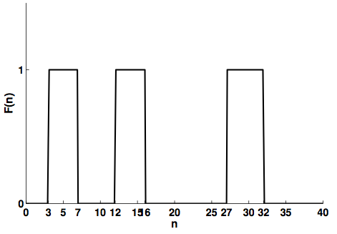
Dataset
Perfusion MRI data was acquired from KIMS hospital.
Known amount of 3D rotations were added to volumes to simulate actual patient behaviour.
Volumes were categorized into four categories – none, minimal, mild and severe.
Step function used to add motion
Motion Category | Angle of rotation (degrees)
None | 0
Minimal motion | [1,5]
Mild motion | [6,10]
Severe motion | [11,15]
Notes:
The dataset that was used in the research was acquired from KIMS hospital. It was actually used in tumour study and was free of motion 3D rotations were added to it to simulate actual patiet behaviour. The step function that was used is shown in the diagram.
The ranges for different motion categories were as shown in the table:

Slide 22
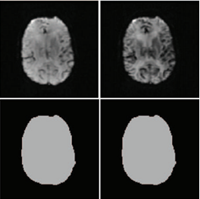
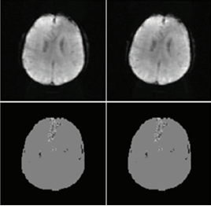
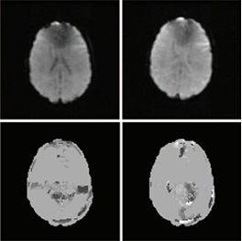
Results - Motion Flow Maps
Slice 1
Slice 2
Slice 1
Slice 2
Slice 1
Slice 2
U_{n}
V_{n}
U_{n}
V_{n}
U_{n}
V_{n}
Bolus present and
no motion
Bolus absent and
minimal motion
Bolus absent and
mild motion
Notes:
In this figure, we show the result of motion detection stage. The first case is where there is no motion present between the volumes but there is intensity variation due to bolus. From the figure, we can see that the obtained flow maps in this case are uniform. The net entropy of these flow maps will be 0.
The second case shows two volumes where motion is present between them but there is no bolus effect. From the figure, we can see that the flow maps are non-uniform. This shows that motion is present between the two slices.
The last case shows slices from two volumes where the degree of motion between them is higer as comapred to the second case. Here also, no bolus is present. As we can see, the flow maps are not only non-uniform but the degree of non-uniformity is higher as compared to the second case. Hence, net entropy can be used to detect the presence of motion between slices.

Slide 23
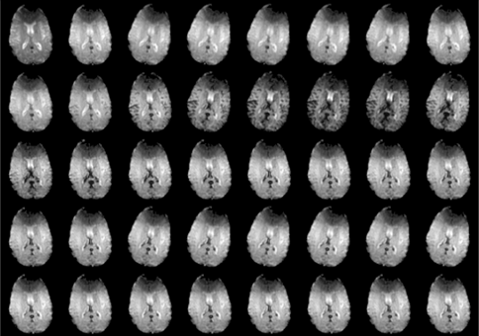
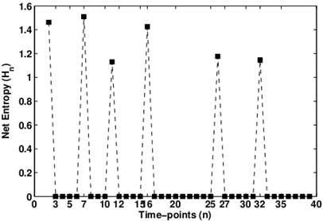
Net Entropy Profile
1
5
8
Zero net entropy even in the presence of bolus.
33
40
Wash-in
time-point
Wash-in
time-point
Notes:
Now we show the net entropy profile for the entire time-series. From the figure, we can see that the value of net-entropy value is 0 for cases where there is no motion even when bolus is present.

Slide 24
Motion Category | Angle of rotation (in degrees) | Peak Entropy (H_{peak}) | Total Entropy in U | Total Entropy in V | Total Entropy
None | 0 | 0.00 | 0.00 | 0.00 | 0.00
Minimal | 1 | 0.00 | 0.00 | 0.00 | 0.00
Minimal | 2 | 0.00 | 0.00 | 0.00 | 0.00
Minimal | 3 | 0.04 | 0.00 | 0.04 | 0.04
Minimal | 4 | 0.08 | 0.00 | 0.23 | 0.23
Minimal | 5 | 0.20 | 0.00 | 0.76 | 0.76
Mild | 6 | 0.25 | 0.00 | 1.29 | 1.29
Mild | 7 | 0.40 | 0.00 | 2.04 | 2.04
Mild | 8 | 0.52 | 0.00 | 2.67 | 2.67
Mild | 9 | 0.61 | 0.00 | 3.25 | 3.25
Mild | 10 | 0.75 | 0.08 | 3.78 | 3.86
Severe | 11 | 1.05 | 0.32 | 4.33 | 4.65
Severe | 12 | 1.15 | 0.48 | 5.14 | 5.62
Severe | 13 | 1.31 | 0.59 | 5.75 | 6.34
Severe | 14 | 1.37 | 0.85 | 6.21 | 7.06
Severe | 15 | 1.51 | 0.97 | 6.88 | 7.85
Such a small motion cannot be detected.
Peak entropy can distinguish between different motion categories.
Entropy values for different motion categories for image size – 32x32 and block size 8x8
Notes:
In this table, we show the entropy values for different degrees of motion. The peak entropy values can be used to distinguish between different categories.
Also, in case where the degree of rotation was below 3 degrees, the method failed to detect motion between slices. Thus it cannot be used in such cases.

Slide 25
Motion Category | None | Minimal | Mild | Severe
Peak Entropy (H_{peak}) | 0 | 0 < H_{peak} <= 0.25 | 0.25 < H_{peak} <= 1 | H_{peak} > 1
Upper and lower bounds of peak entropy values for different motion categories
Notes:
A threshold can be set on the peak entropy for different motion categories. For the case study, the value was 0 for no motion, for minimal motion it was between 0 and 0.25 and for mild motion between 0.25 and 1. After 1, the volumes were classified in to severe category.

Slide 26
Effect of slice resolution and block size
Slice Resolution | Block Size | Mean time per slice pair (sec) | Total time (sec)
128x128 | 32x32 | 0.00 + 3.48 = 3.48 | 132.21
128x128 | 16x16 | 0.00 + 3.99 = 3.99 | 151.69
128x128 | 8x8 | 0.00 + 4.34 = 4.34 | 164.84
64x64 | 16x16 | 0.01 + 0.77 = 0.78 | 29.71
64x64 | 8x8 | 0.01 + 0.97 = 0.98 | 37.38
32x32 | 8x8 | 0.01 + 0.19 = 0.20 | 7.68
Large reduction in computation time
Notes:
In this slide, we see the effect of slice resolution and block size on time taken for motion detection. Initially ,we chose the original slice resolution that is 128x128. The block size chosen was 32x32. To decrease the computation time without, we decreased these two parameters and still we were able to detect the motion present between volumes. We stopped at a reduction factor of 4 when slice resolution was 32x32 and block size 8x8. Using these parameters, we were able to achieve a large refuction in compuation time.

Slide 27
Does Intensity Correction help ?
A non-zero net entropy even in the absence of motion
Notes:
Here we show the importance of intensity correction on set-2 volumes. Without intensity correction, the net-entropy values were non-zero when bolus was present. Thus, the method wrongly treated the change in contrast as motion. After intensity correction, this was solved.

Slide 28
Motion Correction
Notes:
We move on to last stage that is motion correction.

Slide 29
Aim: Align the volumes to a reference volume using 3D image registration.
Image Registration
Process of geometrically alignment of two images of the same object.
where, M is a moving image, F is a fixed image, T is the transformation.
Similarity metrics quantitatively measure how well the images are registered.
Sum of squared difference (SSD): used in same modalities
Notes:
Here our aim is to align the volumes in the time-series. We use 3D image registration for this purpose. Image registration is aligning two images of same object. Basically we try to find the transformation T that will help us align the moving image M to a fixed image F. Different metrics are used to measure the degree of alignment between the two images. In our case, we used sum of squared difference metric.

Slide 30
Findings after consulting a neuroradiologist
Only rigid transformations within specified limits are possible due to patient motion.
Head motion is limited inside MRI scanner:
left to right and vice versa
downwards
Patient motion is transient, i.e. stationary for a set of contiguous time-points followed by irregular motion.
Notes:
After consulting a neuro-radiologist, the patient motion was found to have following characteristics: First, it was found that only rigid transformation due to patient motion are seen in perfusion MRI of brain. Second, the head motion is limited. It can only occur in two directions that from left to right and downwards. Lastly, the motion is transient, that is, the patient does not exhibit motion all the time. He remains still for some time and it is followed by irregular motion.

Slide 31
Proposed strategy for motion correction
Divide the time-series into three sets.
Solve the motion correction problem in each of the three sets (intra-set alignment).
Combine the results in each set to align the complete time-series (inter-set alignment).
Notes:
Here, we propose a divide and conquer strategy for motion correction. The motion correction is done in two-passes which are intra-set alignment followed by inter-set alignment.

Slide 32
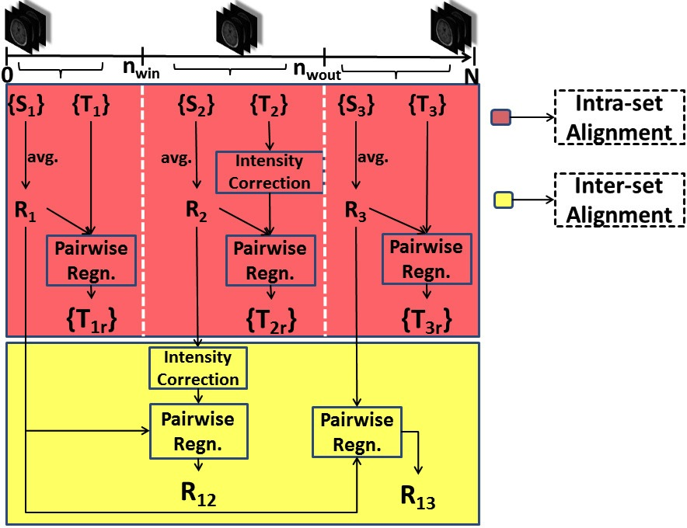
Motion correction framework
Notes:
Here, we show the two pass motion correction framework. The first pass begins with creation of reference volumes for each of the three sets. After that, we align motion corrupted volumes in each set to its reference volume. In the second pass, we align the reference volumes to the global reference volume. Thus, after the end of two passes, we obtain the transformations required to align the complete time-series.

Slide 33
Intra-set alignment of volumes
Create reference volume for each set.
Align volumes in the set-1 and set-3 using 3D registration.
For Set-2 volumes:
Apply intensity correction.
Align volumes using 3D registration.

Slide 34
Creation of reference volumes
Reference volumes (R_{m}) for the three sets are created as:
where, S_{m}(n) is a stationary volume, n₂-n₁+1 is the largest interval of contiguous stationary volumes.
Notes:
The reference volumes for each set are created by using the stationary volumes in that set. In motion detection stage, we were able to detect motion between adjacent volumes. The stationary volumes are the contiguous series of volumes that are not corrupted by motion. The reference volume is the mean of the stationary volumes in that set.

Slide 35
Intra-set alignment of volumes
Align motion corrupted set-1 and set-3 volumes to R₁ and R₂ respectively by 3D registration.
Apply intensity correction on Set-2 volumes:
where, n_{R2} is the time-point of R₂.
Align the intensity corrected volumes to R₂.
Notes:
The volumes in set 1 and set 3 are aligned to their reference volumes using 3D registration. But in set -2 volumes, we have to apply intensity correction before applying motion correction. Here, we use the GVF fit mean intensity variation. After the intensity correction, the volumes are aligned to R2

Slide 36
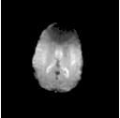
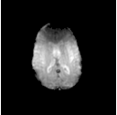
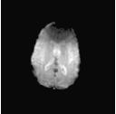
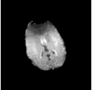
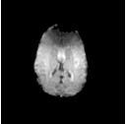

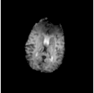
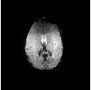
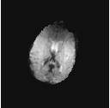
Results
R₁
F₁(i)
F_{1r}(i)
R₃
F₃(j)
F_{3r}(j)
R₂
F₂(k)
F_{2r}(k)
Intra-set alignment of volumes in three sets of time-series. R_{m} denots reference volume of m^{th} set, F_{m}(i) denotes corrupted volume, F_{rm}(i) denotes F_{m}(i) registered to R_{m}.
Notes:
Here, we show the result of intra-set alignment of volumes. The corrupted volumes in each set are aligned to their reference volume. Also note that intensity variation due to bolus in last case does not affect the registration process since we handled the intensity variation before registration.

Slide 37
Transformations estimated:
where, F_{i}(j) denotes j^{th} volume in i^{th} set, F_{ir}(j) denotes F_{i}(j) aligned with R_{i}, T1_{ij} denotes the transformation.
Notes:
Hence, after first pass, we are able to estimate the transformations needed to align motion corrupted volume in a set to its reference volume.

Slide 38
Inter-set Alignment of volumes
R₁ is chosen as the global reference volume R_{final}.
R₃ is aligned to R_{final} using 3D registration.
R₂ is intensity corrected with respect to R_{final}.
where, is the mean-intensity and is GVF-fit mean intensity.
GVF fitting not applicable
before wash-in
Notes:
In second pass, we align the reference volumes. R1 is chosen as the global reference volumes.
Before aligning R2 to Rfinal, we handle the intensity variation again. Please note that in this however, Rfinal is not affected by bolus. Hence, instead of GVF fit mean intensity, we use mean intensity for Rfinal.

Slide 39
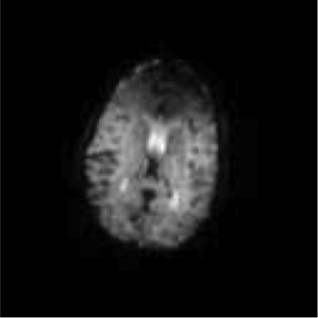
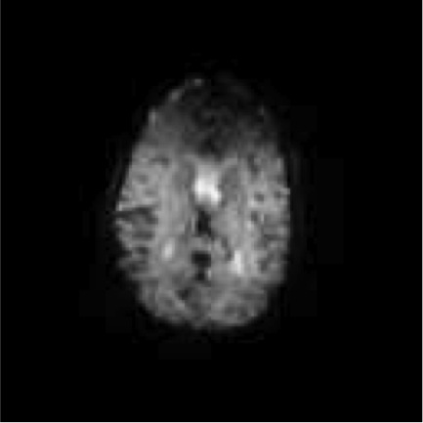
R_{final}
R₃
R_{f3}
R_{final}
R₂
R_{f2}
Inter-set alignment of volumes in the time-series. R_{final} is the global reference
volume, R_{m} is the reference volume of m_{th} set, R_{fm} denots R_{m} registered to R_{final}
Notes:
Here, we show the results of inter-set alignment.

Slide 40
Transformations estimated:
where, R_{if2} denotes R_{i} registered to R_{final}, T2_{fi} denotes the transformation.
Notes:
After inter-ser alignment, we estimate two transformations, one needed to align R3 to Rfinal, other needed to align R2 to Rfinal

Slide 41
Alignment of the time-series
Apply the sequence of transformations:
where, F_{fir}(j) denotes volume F_{i}(j) aligned to R_{final}.
Intra-set
alignment
Inter-set
alignment
Notes:
Now we align the complete time-series through a series of transformations. Since R1 is Rfinal, the volumes in set-1 get aligned to global reference volume in the first – pass itself. For set 2 and set 3 volumes, we apply the transformation estimated during the second pass to align them to Rfinal. Thus, every volume is aligned to Rfinal now which was our aim.

Slide 42
Results
Dice coefficient (DC) value
Measures the degree of overlap between two sets A and B:
A value of 1 indicates perfect alignment.
Rotation in R_{z} (degrees) | Rotation in R_{x} (degrees) | DC before motion correction | DC after motion correction
[0 10] | [-10 10] | 0.88 | 0.93
[0 10] | [-15 15] | 0.86 | 0.92
[0 10] | [-20 20] | 0.87 | 0.93
Notes:
We evaluate the motion correction by finding the dice coefficient of initial and motion corrected time series. As we can see from the table, the DC value increases after motion correction, showing that the volumes in the time-series have been aligned.

Slide 43
Mean intensity plot before and after motion correction
Notes:
Qualitatively, we compare the mean-intensity curve for a manually chosen volume of interest in the initial and motion corrected time-series.
The blue plot which is the plot after motion correction is a typical perfusion MRI curve.

Slide 44
2. Registration error (e_{rms})
where, T_{a}(X) and T_{o}(X) are estimated and applied transformations respectively.
Notes:
We also assess our approach of motion correction using the registration error which is the rms error between the applied and obtained transformations.

Slide 45
Total no. of volumes | No. of corrupt volumes | R_{x} (degrees) | R_{z} (degrees) | Regn. Method | No. of corrupt volumes detected | Regn. Error (e_{rms}) | Time taken (min)
39 | 25 | [0 10] | [-10 10] | MI based | NA | 0.28 | 26.83
 |  |  |  | Our approach | 21 | 0.22 | 13.64
39 | 25 | [0 10] | [-15 15] | MI based | NA | 0.60 | 30.17
 |  |  |  | Our approach | 24 | 0.37 | 17.62
39 | 25 | [0 10] | [-20 20] | MI based | NA | 0.54 | 27.58
 |  |  |  | Our approach | 22 | 0.34 | 14.90
Notes:
Here we show the comparison of our approach with mutual information based registration approach for motion correction. From the table, we can see that the error is less in our approach. Also, the time required in our approach is less as compared to based approach.

Slide 46
Effect of motion detection
We show the time taken by motion correction algorithms:
with and without motion detection
Motion Correction Method | Time taken without using motion detection t_{old} (sec) | Mean Time per volume registration (sec) | Time taken using motion detection t_{new} (sec) | Reduction in time t_{old} – t_{new} (sec) | Percentage Time Reduction (%)
[1] | 640.39 | 16.42 | 397.42 | 242.97 | 37.94
[2] | 636.38 | 16.32 | 395.74 | 240.64 | 37.81
[3] | 1018.20 | 26.11 | 668.78 | 349.42 | 34.32
[1] Kosior et al., JMRI 2007.
[2] Straka et al., JMRI 2010.
[3] Tanner et al., MICCAI 2000.
Notes:
Here, we show the time taken by 3 motion correction algorithms with and without using the proposed motion detection stage in terms of time taken for motion correction. We can see that the time taken is less when a motion detection is used before correction which is as high as 38%

Slide 47
Comparison of motion correction approaches
Motion Correction Method | Time for motion detection (sec) | Time for motion correction (sec) | Total time (sec) | Mean time (sec) | Percentage time reduction (%)
[1] | NA | 640.39 | 640.39 | 16.42 | 57.43
[2] | NA | 636.38 | 636.38 | 16.31 | 57.14
[3] | NA | 1018.20 | 1018.20 | 26.10 | 73.22
Our Approach | 7.68 | 263.59 | 272.97 | 6.99 | -
[1] Kosior et al., JMRI 2007.
[2] Straka et al., JMRI 2010.
[3] Tanner et al., MICCAI 2000.
Notes:
In this table, we compare our approach of motion correction with the same 3 motion correction algorithms. It can be seen that the reduction in mean computation time for motion correction is highly reduced to a maximum of 73%. Thus our approach performs better than these methods.

Slide 48
Conclusion
We proposed a fast and efficient method for motion correction in perfusion MR scans.
We proposed a fast method for detection of motion and characterization.
The system achieves a reduction in mean-computation time for motion correction as high as 73.22%.
The reduction in time was achieved without tradeoff in accuracy.
Notes:
To conclude,

Slide 49
Future Work
Hierarchical automated method for choosing slice resolution and block size.
Alternate methods for motion detection.
Methods independent of central slice based motion detection.
Different motion correction algorithms for different degrees of motion.
Notes:
Central slice detection: DSC MRI is fast. Intra-volume motion is absent. Hence the motion present in the central slice will be same as of the entire volume.

Slide 50
Publications
R. Gautam, J. Sivaswamy and R. Varma. An efficient, bolus-stage based method for motion correction in perfusion weighted MRI. In Proceedings of the 21st International Conference on Pattern Recognition, ICPR, Tsukuba Science City, Japan, 2012.
R. Gautam, J. Sivaswamy and R. Varma. A method for motion detection and categorization in perfusion weighted MRI. In Proceedings of the Eighth Indian Conference on Computer Vision, Graphics and Image Processing, ICVGIP, Mumbai, India, 2012.

Slide 51
Questions ?

Slide 52
Thank you

