Slide 1
Thesis Presentation By Raman Jain (20052021) Towards Efficient Methods for Word Image Retrieval
Notes:
My topic of research is Word Image Retrieval
i.e. Given an word image or text string as input, retrieve all similar word images present in the database.
I have developed two methods which do this task.
One is based on Weighted Euclidean Distance, and the other is based on BLSTM NN

Slide 2

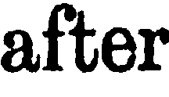
Problem Statement
Aim at learning similarity measures to compare word images.
Similarity?

Slide 3
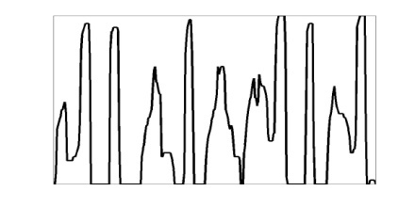
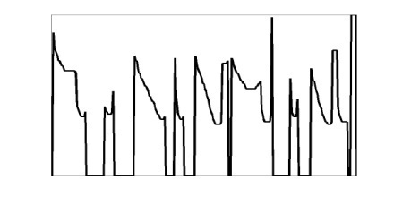

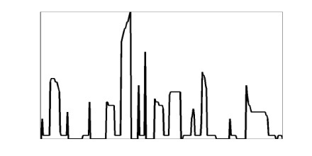

Feature Extraction and Representation
Sliding window is used for feature extraction.
Profile features:
Upper word profile,
Lower word profile,
Projection profile,
Background-to-Ink Transition
Upper profile
Projection profile
Lower profile
Background-ink transition
Notes:
We have used a feature set to represent an image which have already proved success.
Which are these five.
So an image is represented with wx5 length feature vector.

Slide 4
Dataset
Three types of English datasets are used to demonstrate the capabilities of learning schemes.
Calibrated Data (CD) : Generated by rendering the text and passing through a document degradation model.
Real Annotated Data (RD) : Set of words from 4 books(765 pages) with their ground truth.
Un-annotated Data (UD) : Dataset of 5,870,486 words which come out of 61 scanned books without ground truth. Used only for evaluating Precision.
Notes:
These are the datasets for testing our first method

Slide 5
DTW v/s Fixed Length Matching
Performance Measures :
Precision : Measures how well a system discards irrelevant results while retrieving.
Recall : Measures how well a system finds what the user wants.
Average Precision : Measures the area under the precision-recall curve.
Mean of the above measures is computed for multiple queries.
Measure | DTW | Euclidean
mP | 0.653 | 0.598
mR | 0.805 | 0.792
mAP | 0.853 | 0.764
DTW is much slower than Fixed length Matching
Baseline results on comparing DTW and Euclidean on CD dataset.
Notes:
DTW is used for measuring the similarity between two temporal sequences. Here is the result we got using these similarity measures on Calibrated data.
It clearly says DTW is better. But Euclidean is much faster in comparison to DTW. So we thought why don’t we use Euclidean function with weights.
And these weights are different for each query image.

Slide 6
Learning Query Specific Classifier
Given a query word image, retrieve all similar word images. We use a weighted Euclidean distance function for matching word images and retrieving relevant images.
Where w is a weight vector. During retrieval, in each of the iteration t, weight is updated using
Notes:
We used weighted ED, and weights are being learnt from the example and learning algorithm is inspired by relevance feedback learning.
We used close form learning

Slide 7
Dataset | No Learning | QSC with Eq. 1 | QSC with Eq. 2
CD | 0.764 | 0.946 | 0.944
RD | 0.817 | 0.930 | 0.939
Results (mAP) on two dataset with 300 queries.

Slide 8
Learning by extrapolating QSC
Feature descriptor
mapped to d
dimension
query specific
learning in
closed form
disintegration
into sub-word
weight vectors
Mapped to
Constant length
vectors
This pipeline shows how a weight vector is learnt for each sub-word during training.
Already learnt
sub-word(letter)
weight vectors
Projected back to new dimension based on the relative width of each letter
Concatenate and map to a constant length vector
Query text
This pipeline shows how a weight vector is generated by extrapolation for an unseen query which is later used for retrieval.
Notes:
Now but here we have learnt a weight vector for each word but what if the next query is not present in out learning db.
So we needed to have a solution through which we can able to generate a weight vector for an unseen word image.
To do that we learn weight vectors at character level.
So for each character, we are learning a weight vector.
We observed that for a given font, the aspect ratio of each character is almost same.

Slide 9
Extrapolation
Notes:
Here is a graphical representation of the extrapolation technique.

Slide 10
Results
Data set | Measure | DTW | Euclidean | QSC with extrapolation
CD | mAP | 0.853 | 0.764 | 0.902
RD | mAP | 0.778 | 0.817 | 0.923
UD | mP | 0.890 | 0.915 | 0.955
Comparative results of extrapolation on various data.

Slide 11
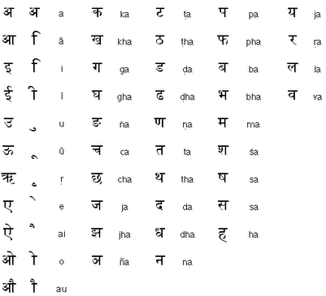
Hindi Script and Word Formation
vowel
consonants
क(c) + ई(v) = की
ka ee kee
त(c) + त(c) = त्त
tha tha ththa
क(c) + द(c) = क्द
ka dha kdha
स(c) + त(c) + र(c) + ई(v) = स्त्री sa tha ra ee sthree
No of characters: 52
No of ligatures : 1000
Notes:
After that we worked on Hindi language historical documents.
The above method will definitely fail as number of different classes are high here and also you can not isolate a character from others.

Slide 12
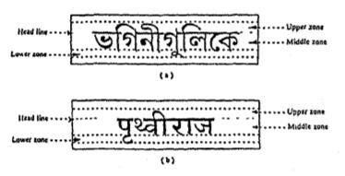
Hindi Recognition and Retrieval
B. B. Chaudhari and U. Pal
OCR for Bangla and Hindi
Satisfactory performance for clean documents
B. B. Chaudhari and U. Pal, An OCR System to Read Two Indian Language Scripts: Bangla and Devnagari (Hindi), ICDAR 1997

Slide 13
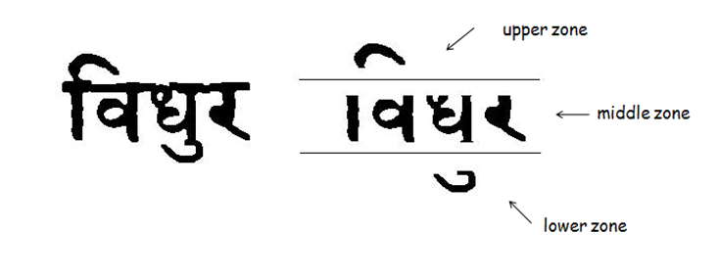
Avoiding Complete Recognition
Most of the modifiers appear either above the shirorekha or below the character.
Shirorekha removal is common.
Recognition of the middle zone is simple.
Number of classes reduced to around 119.

Slide 14
Taking advantage of both..
Recognition
Compact representation
Efficiency in indexing and retrieval
Retrieval
Works with degraded words and complex scripts
No need to segment into characters

Slide 15
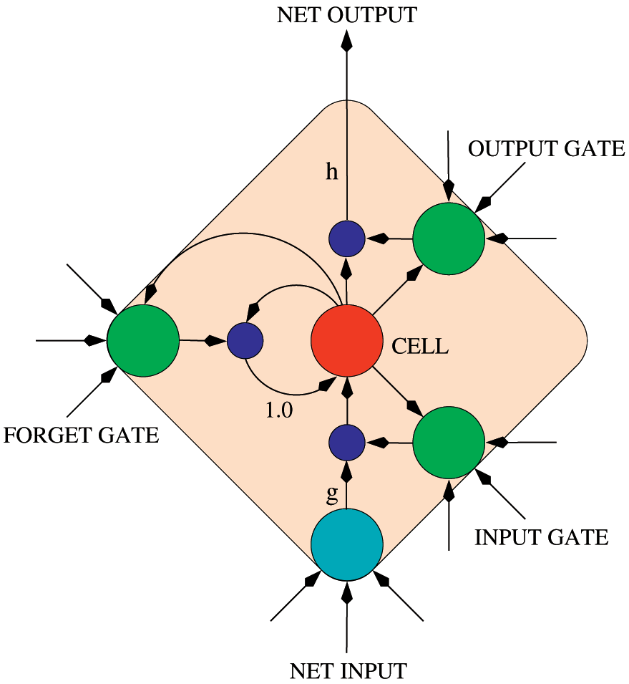
BLSTM Model
Recurrent neural network
Applications in
Handwriting recognition
Speech recognition

Slide 16
BLSTM Model
Smart network unit which can remember a value for an arbitrary length
Contains gates that determine when the input is significant to remember, when it should continue to remember, and when it should get output.
BLSTM – 2 LSTM networks, in which one takes the input from beginning to end and other one from end to the beginning.
We used 30 such nodes and 2 hidden layers

Slide 17

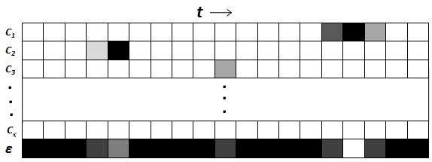
BLSTM Model
Input: Sequence of Feature Vectors
Output Probabilities
K -> number of classes
t -> input sequence index
From training examples, BLSTM learn to map input sequences to output sequences.

Slide 18




Matching and Retrieval
Output of BLSTM is a sequence of characters for each input word image.
Two images are compared with Edit Distance.
word1
word2
zoning
BLSTM output
c1 c2 c3 c4
c1 c2 c3 c4 c2 c5
Edit distance
=2

Slide 19
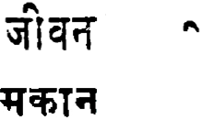

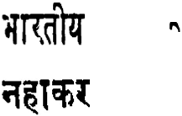

Re-ranking
Used connected component (CC) at upper zone.
Query
Database images
upper
zone
#CC at upper zone
1
query1
1
0
1
query2
1
0

Slide 20
Overall Solution
Query Image
Database images
Zoning
Zoning
Feature Extraction
Feature Extraction
Trained BLSTM NN
Trained BLSTM NN
Output character seq
Output character seq
Edit distance
Re-ranking
Ranked Word Images

Slide 21
Dataset
Book | #Pages | #Lines | #Words
Book1 | 98 | 2463 | 27764
Book2 | 108 | 2590 | 28265
Book1 is used as training and validating
Book2 is used for testing the retrieval performance

Slide 22
Quantitative Results
Method | mP | mAP
Euclidean | 78.23 | 71.82
DTW | 84.64 | 77.39
BLSTM based | 91.73 | 84.77
BLSTM with Re-ranking | 93.26 | 89.02
mP : mean of Precision at 50% recall for 100 queries.
mAP : mean of Average Precision for 100 queries

Slide 23
Quantitative Results
Queries | mP | mAP
In-vocabulary | 95.90 | 91.18
Out-vocabulary | 92.17 | 88.91
Results of BLSTM based method on In-vocabulary and out-vocabulary querites (100 each).

Slide 24
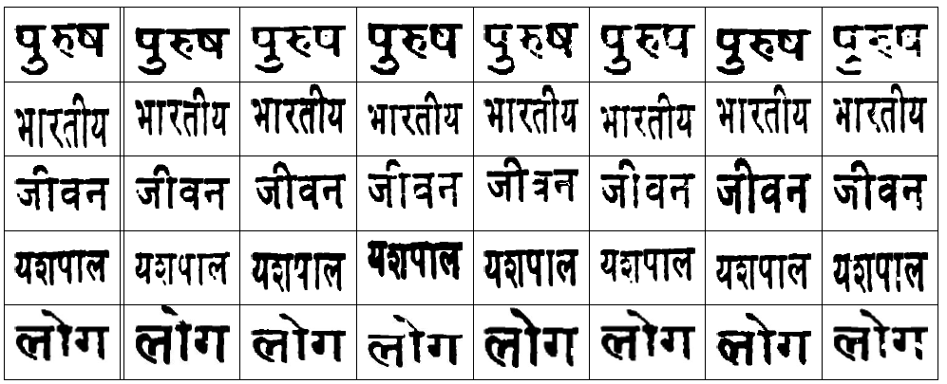
Qualitative Results
Query | Retrieved result

Slide 25
Raman Jain, Volkmar Frinken, C. V. Jawahar, R. Manmatha BLSTM Neural Network based Word Retrieval for Hindi Documents In Proceedings of the IEEE International Conference on Document Analysis and Recognition (ICDAR), Beijing, China, 2011. Raman Jain, C. V. Jawahar Towards More Effective Distance Functions for Word Image Matching In Proceedings of the IAPR Document Analysis System (DAS), Boston, U.S. 2010.
Publications

Slide 26


