Slide 1
Image Based PTM Synthesis For Realistic Rendering of Low Resolution 3D Models
Pradeep Rajiv
200402028
Advisors : Prof M.Anoop Namboodiri, IIIT Hyderabad

Slide 2
Outlines of the presentation
The problem of rendering real world objects and its interpretation.
Its challenges and importance in the realm of Computer Graphics & Computer Vision.
A peek at various tools that help in solving this problem and their limitations.
Our solution to this interesting problem!!

Slide 3

Where does it all start?

Slide 4


All roads lead to Computer Graphics!!

Slide 5


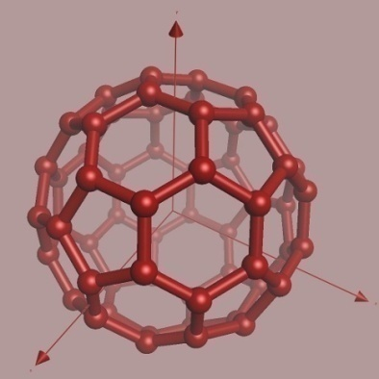
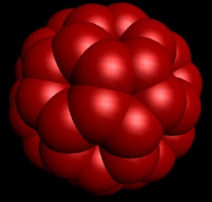
Computer Graphics
Representation and synthesis of visual content.
Mathematical & computational
foundations of image generation
and processing.
3D Representation of geometric
data & rendering of 2D images
.
3D model consists of surface- geometry and surface color/texture information.

Slide 6
What’s the problem that we are solving!!
Problem Statement : Given the shape model, a
small set of views of a large real-world object and its reflectance properties, synthesize a realistic texture model of the object .
Goal: Synthesis of a texture model that looks visually pleasing, similar to its real-world counter part, and also dynamically changes its visual appearance interacting with the light conditions around. Render the model so generated in arbitrary light and view conditions.

Slide 7
Terminology To Explain
Shape Model.
Digital acquisition, modeling & rendering.
Reflectance properties.
Synthesis of texture models.

Slide 8
Shape Models of 3D objects
Mathematical description of the surface geometry.
A set of points p_{i} (x_{i} , y_{i} , z_{i}) over the surface of an objects represent its surface geometry.
The level of surface detail is directly proportional to the number of points.
Representation:
Polygonal mesh models and Dense point models

Slide 9
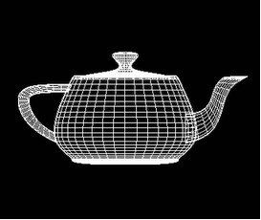
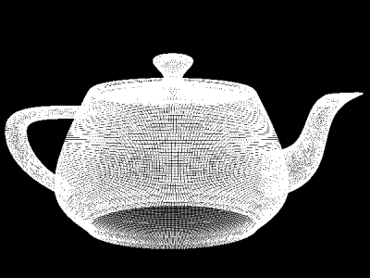
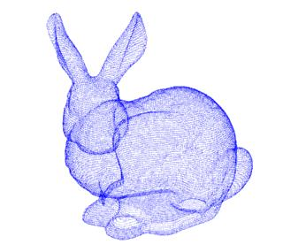
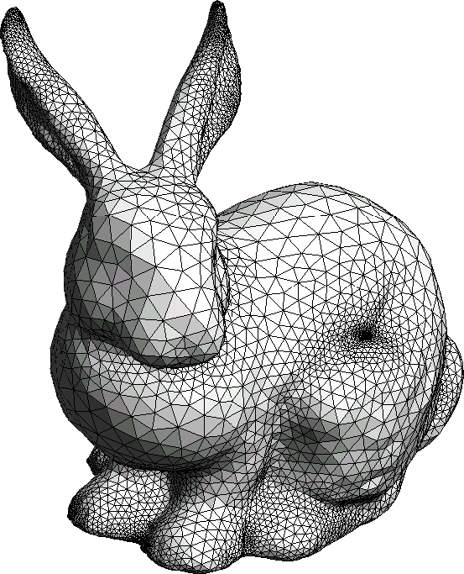
Dense Point Models
Polygonal Mesh Models

Slide 10
Digital acquisition & modeling of an object
Each point (x, y, z) on the surface of an object is assigned color.
Color is usually a RGB vector (r_{i} ,g_{i} ,b_{i} ) or a position ( t_{x} ,t_{y} ) in an Image I.
Color can be functional F_{i} = ( fr_{i} ,fg_{i} ,fb_{i} ) I where I is some color space.

Slide 11
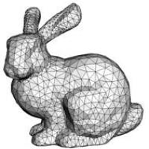

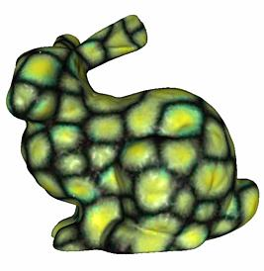
Texture Mapping
Technique to add surface detail to an object by wrapping or projecting
the color information
from an image.
An important criteria and extensively employed in computer graphics

Slide 12
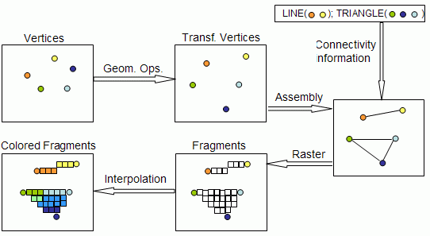
Rendering of Models

Slide 13
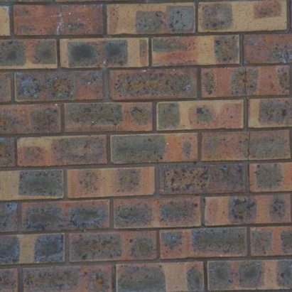
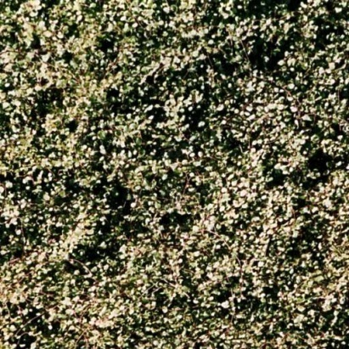
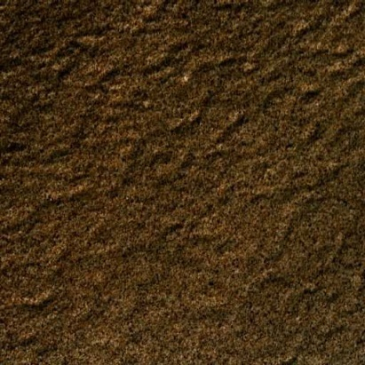
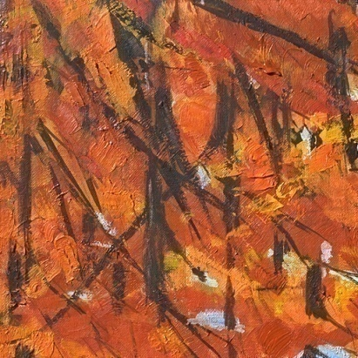
Image Based Modeling and Rendering (IBMR)
Ably capture visual and structural information.
Acquisition of details is easy and has universal applicability.
Rely on a set of images to construct a 3D model, texture it and generate novel views.
Directly generate novel views using multi-view geometry.

Slide 14
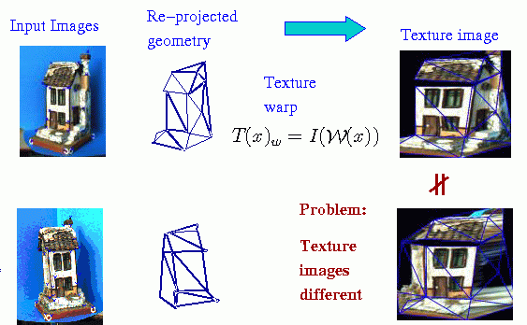
IBMR based View Reconstruction

Slide 15
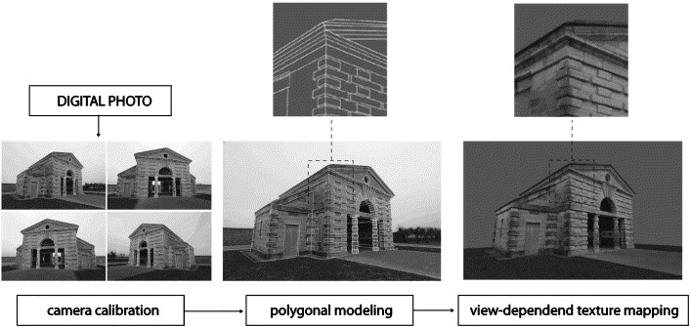

Slide 16
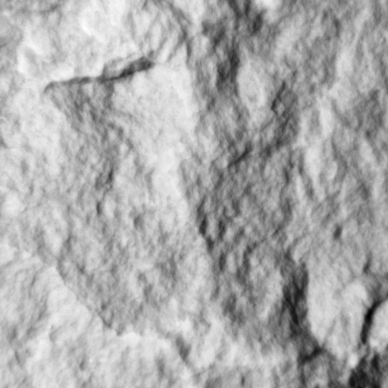
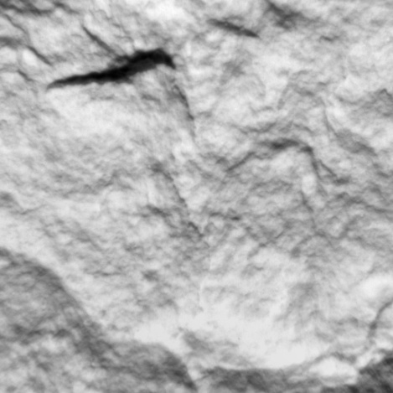
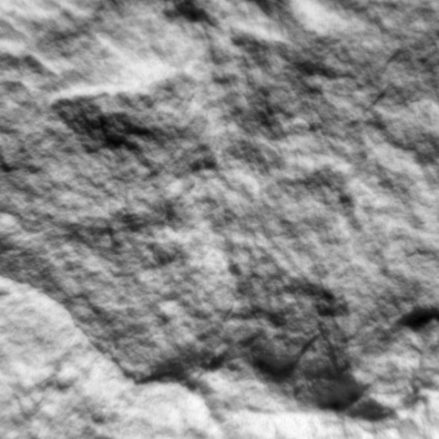
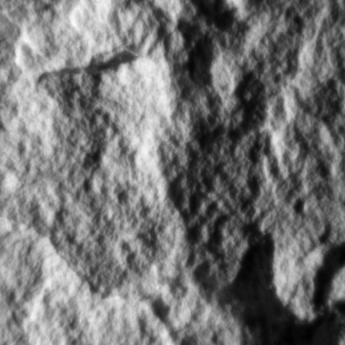
Reflectance Properties of Natural Materials
Visual characteristics arise from varying
1) surface normals 2) reflectance.
Cause shadows, inter-reflections, and specularities,
Change in visual appearance with changing light and viewing conditions.
(a)
(b)
(c)
(d)

Slide 17
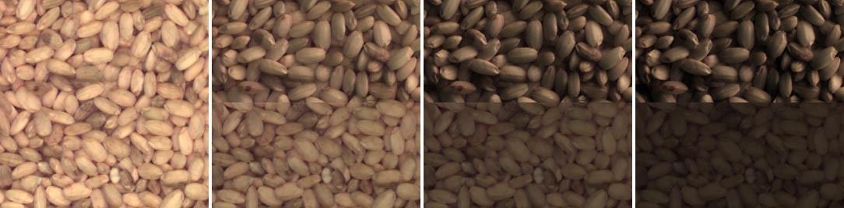
Reflectance Textures
Model reflectance properties of a texture as well as its color information.
Obtained by applying Image-based relighting techniques to model surface reflectance properties.
Reflectance Textures Vs Simple Color Textures

Slide 18
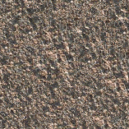
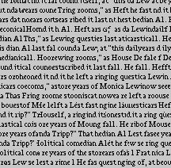
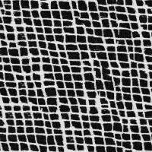

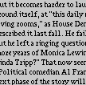
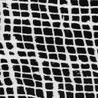
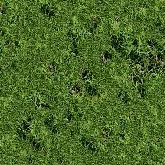
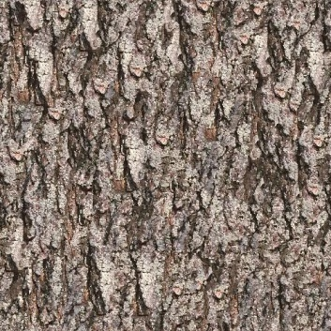

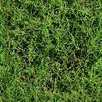
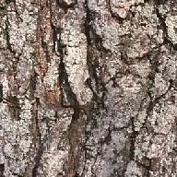

Image based Texture Synthesis

Slide 19
Surface Texture Synthesis
Techniques to synthesize texture directly over the surface of a 3D object.
Praun et al.’s lapped textures (2000).
Turk et al.’s texture synthesis on surfaces (2001).
Wei and Levoy’s texture synthesis over arbitrary manifold surfaces (2001).

Slide 20
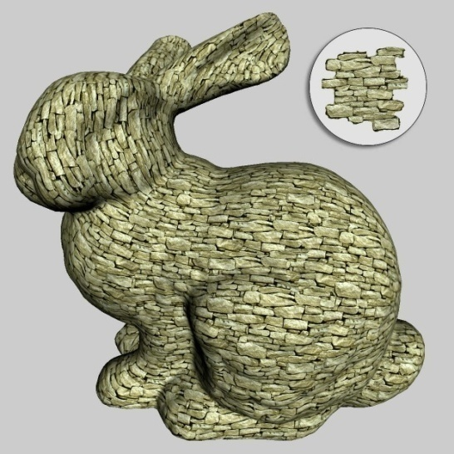
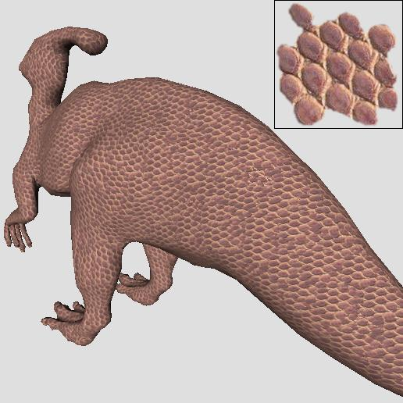
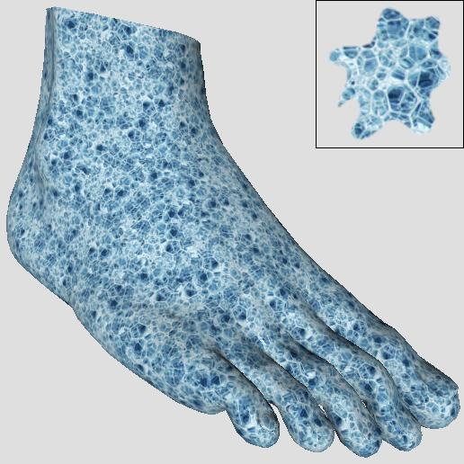
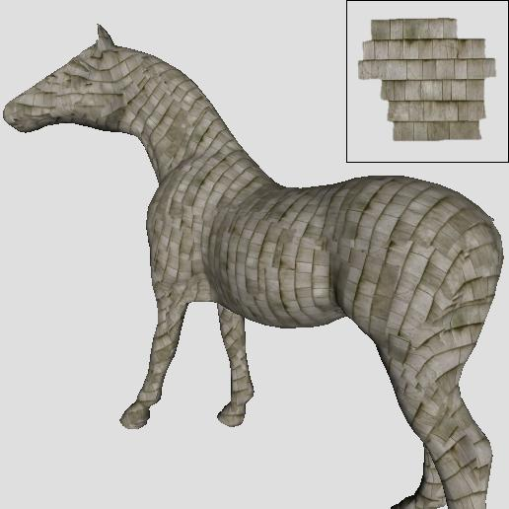

Slide 21
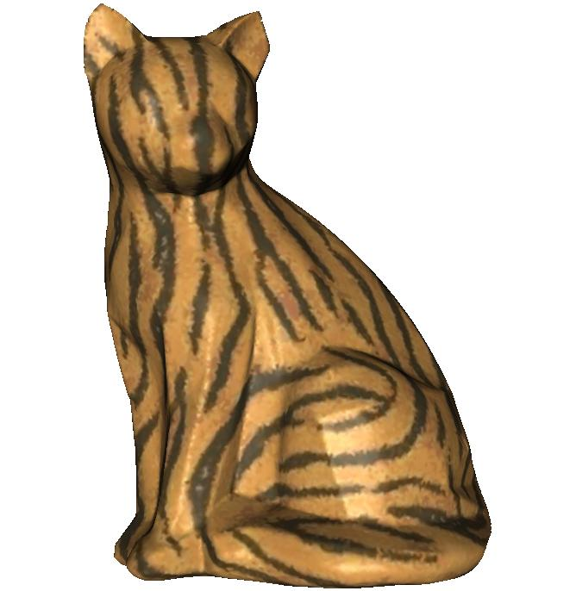
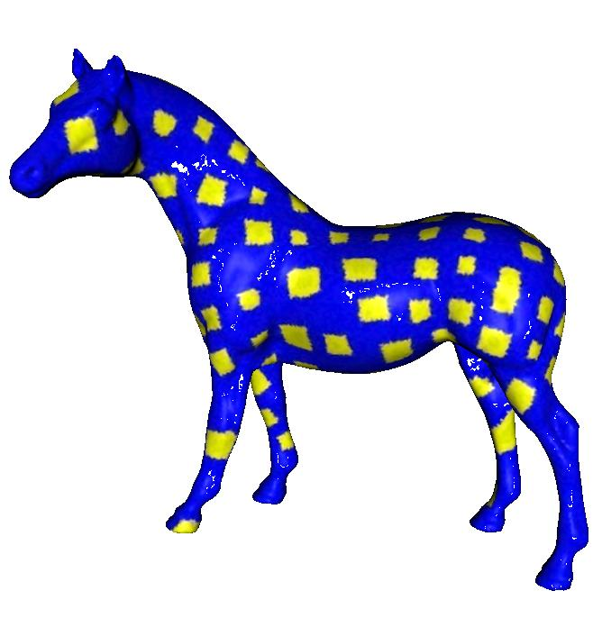


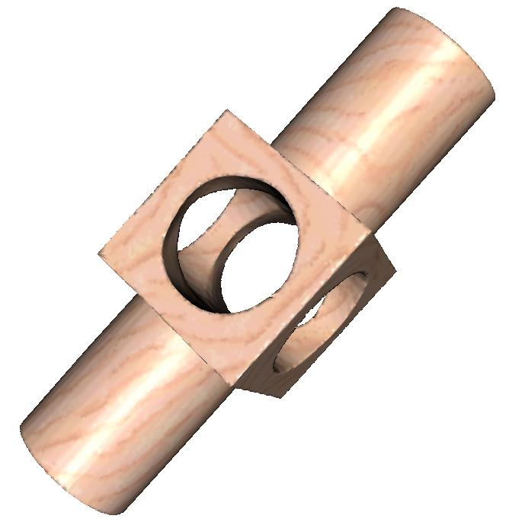
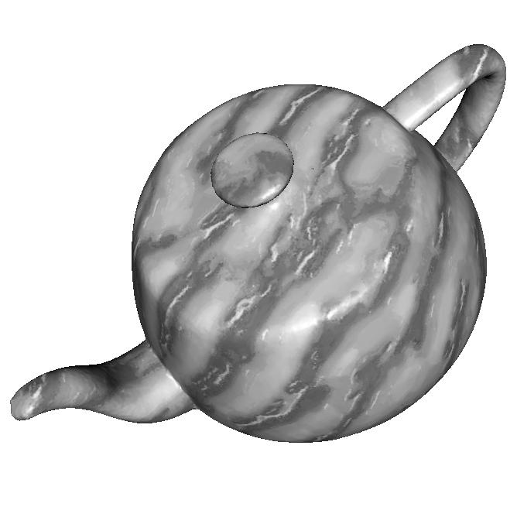



Slide 22
Problem statement Revisited
Given a polygonal mesh model of an large structure, its views under varying light conditions, a sample reflectance texture map of its material, synthesize a reflectance texture model of the object and render it under arbitrary light and view conditions.

Slide 23
Motivation
Realistic rendering of real world objects is an important area of computer graphics.
Prominent usage in movies, games and archival of historical artifacts.
Holds the key for Digital Heritage.

Slide 24
Challenges
Acquisition, rendering of shape & surface details.
High resolution shape modeling. & limited resolution of capture devices at large scales.
Labor intensive assemblage of a single large model.
Time & storage space.
Modeling of Surface light interactions.

Slide 25

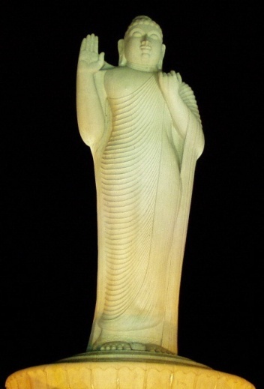
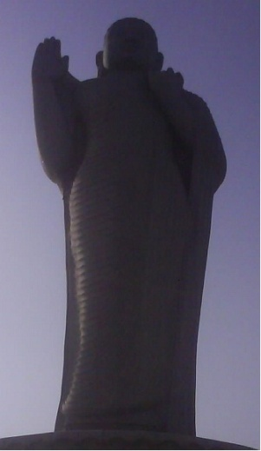
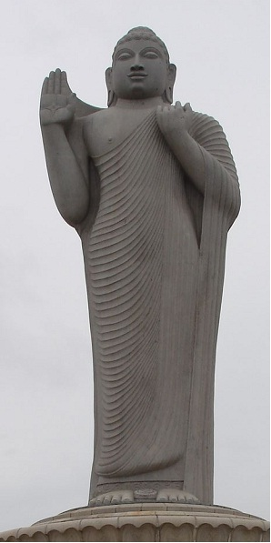


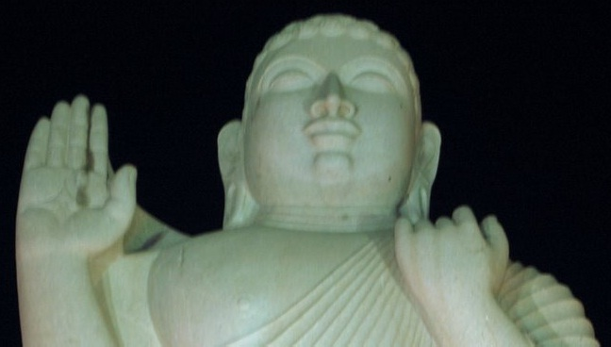


IBMR for Large structures
Sample Material
Zoomed 8X
Zoomed 4X
The Buddha Statue in Hussain Sagar
8 times nearer
4 times nearer
Up-close View

Slide 26

Modeling & Rendering of Large Structures
Detailed Shape and surface acquisition.
Huge shape model and large number of high resolution images.
Point-based modeling and rendering of millions of polygons and billions of points.

Slide 27
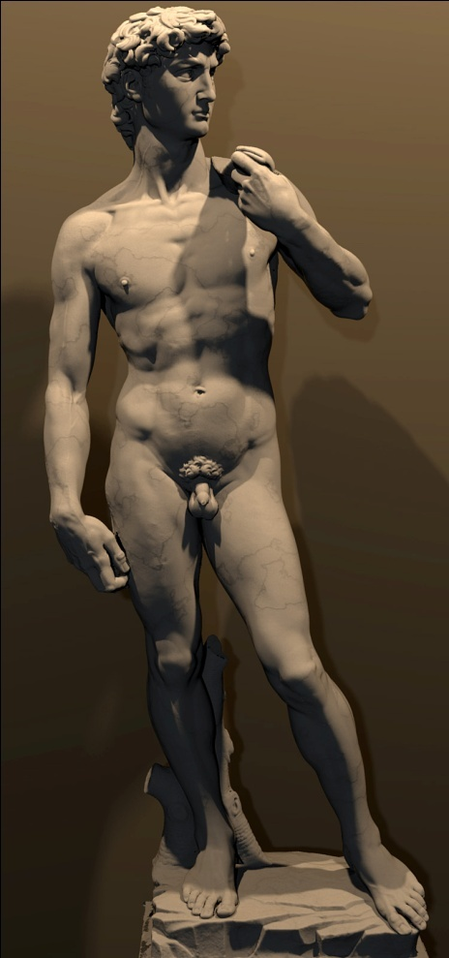
Digital Michelangelo
Built using laser scan technology and light fields.
Contains 4 billion polygons and 7000 images.
Clean up, alignment , merge, and processing was huge & gigantic cost incurring.

Slide 28
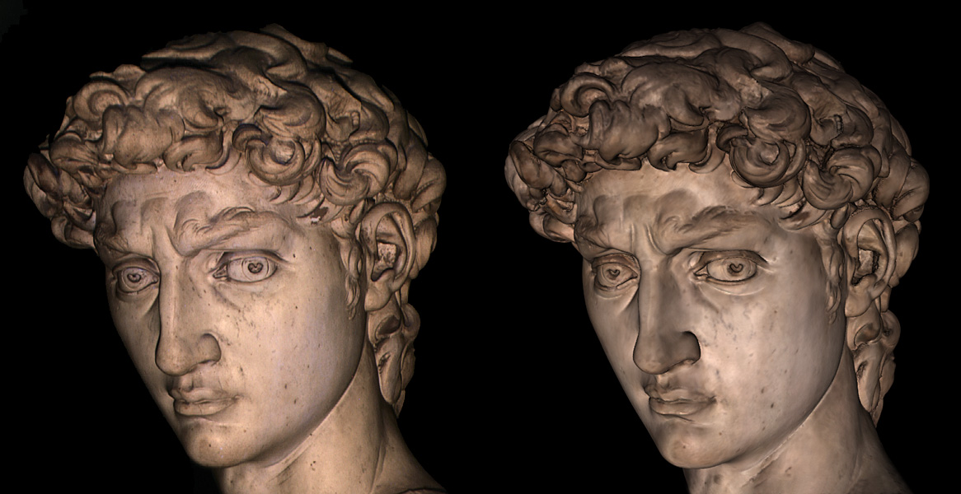
Photograph vs Rendering

Slide 29
Limitations of existing IBMR techniques
Effected by resolution of digital acquisition.
Acquisition at lower resolutions results in coarser surface detail.
High resolution modeling seldom possible in case of large structures.
Cannot model surface reflectance details.

Slide 30
Our Approach to Realistic Modeling of Large Structures

Slide 31
Our Approach
De-coupling of shape and surface detail.
Shape capture in coarser polygonal mesh models.
Relegation of surface details to reflectance textures.
Synthesis of reflectance texture over the mesh model.
Units of synthesis selected from the sample conditional upon the set of object views.
Image based Modeling + Texture synthesis

Slide 32
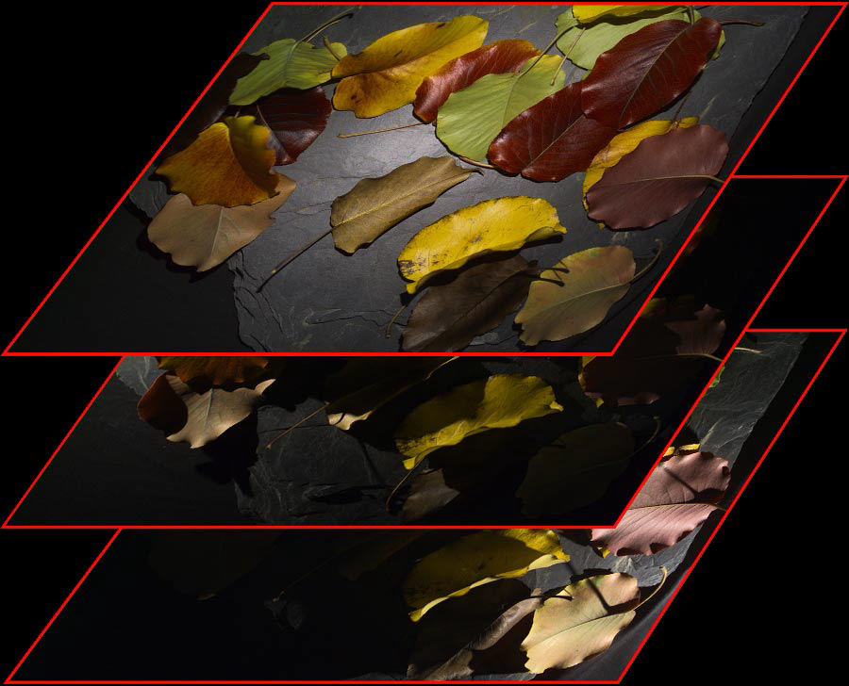
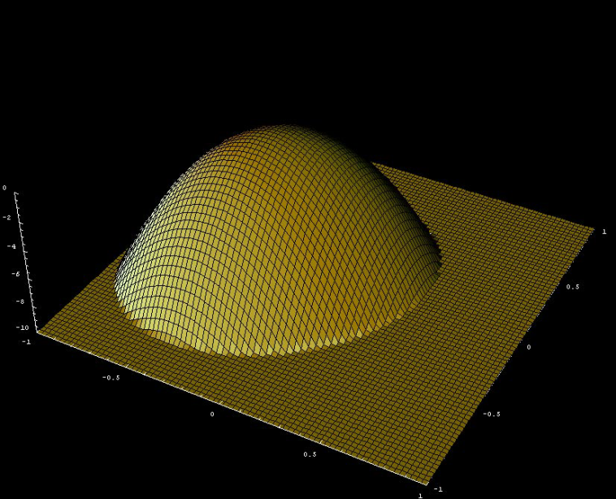
Polynomial Texture Maps(PTM)
(u,v)
l_{v}
l_{u}
Light Direction Space

Slide 33
PTM
Deviced by Malzbendar et al (2002).
Belong to class of Uni-directional Texture Functions
Model the surface luminance at each texel as a
bi-quadratic polynomial function.
Store RGB per pixel and luminance coefficients
(a0 – a5) per texel.
Chromaticity of a pixel (R_{n}, G_{n} , B_{n}) remains constant.

Slide 34
PTM light parametrization
(u,v) - texture co-ordinates
(a₀-a₅) - fitted luminance coefficients
(l_{u} ,l_{v}) – projection of light direction into texture plane.

Slide 35
Fitting PTM to Image Data
Set of images {I_{k}} of the object are obtained under different light conditions {(l_{uk}, l_{vk})}.
The best fit (a₀-a₅) at each pixel(u,v) is computed using SVD so as to fit the pixel data {I_{k} (u,v)}.
The above representation is called LRGB PTM.

Slide 36
PTM Synthesis
Based on patch based texture synthesis.
The texture is viewed as a realization of a homogenous markovian process.
Textural characteristics of a block W are completely determined by its causal neighborhood N_{W} .
Blocks with similar causal neighborhood are copied from the input and pasted.

Slide 37

Pasting blocks with similar causal neighborhood
W
N_{W}

Slide 38
Our METHOD: Image Based PTM SYNTHESIS

Slide 39
Image based PTM synthesis
Generates the reflectance model of an object from its mesh model, sample PTM and a sparse set of views.
Extends the patch based PTM synthesis algorithm to also include the image based constraints.
Selection of synthesis blocks is conditional upon the image set.
Polygonal mesh model
Sample PTM
Image set
Synthesized PTM model

Slide 40
Builds on texture transfer by Efros et al (2001) and 3D texture synthesis by Yacov-Hel-Or et al (2003).
Inputs: A coarser shape model, high resolution sample PTM and a sparse set of views.
Synthesizes a texture that behaves more like its real world counter part in different light conditions.

Slide 41
Synthesis for planar surfaces
Synthesizes reflectance model of a planar surface.
Uses a sample PTM_{in} , a set of views {I_{k}} as constraints and generates reflectance map PTM_{out} .
Takes patches from PTM_{in} as building blocks.
At each step k, a block B_{k} is selected from PTM_{in} and stitched into PTM_{out} with an overlap of width W_{e} .
alpha-blending in the overlapping regions.

Slide 42
Block selection strategy
Raster scan fashion of synthesis.
At each step k, a candidate block B_{k} is selected from PTM_{in} and pasted at the next position (x, y).
The selection of B_{k} is governed by two constraints
Image based constraints
Overlapping constraints

Slide 43
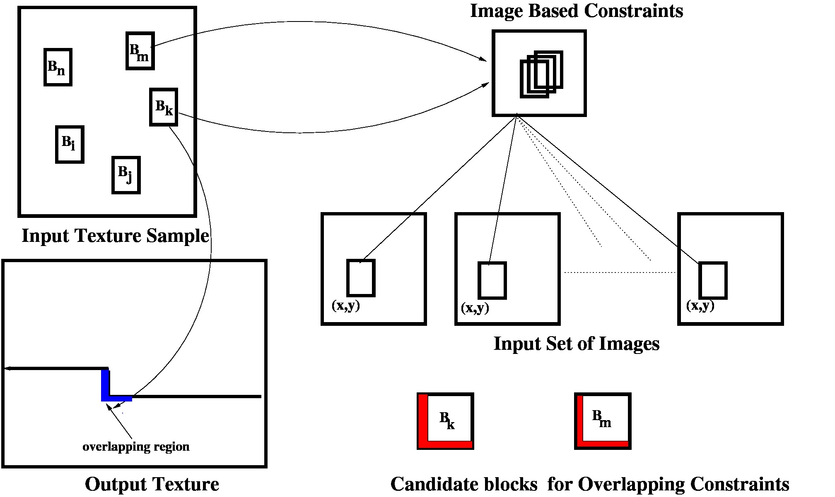

Slide 44
Image based Constraints
Set of images {I_{n}} captured under light positions (l_{un}, l_{vn}) decide the candidate patches.
For the desired PTM block B_{k} , f(B_{k}, (l_{u}, l_{v})) should be similar to the set of image blocks {b(I_{n}, x, y)}.
The blocks {B} ϵ PTM_{in} are ranked according to S.
The blocks {B} are ranked according to score S.

Slide 45
Block Overlap Constraints
Patch B_{k} should agree with its neighbors in PTM_{out} in the overlapping regions.
Blocks selected based on image based constraints are again ranked based on overlapping measure.
L2 norm over the difference of luminance coefficients in the overlapping region is the error measure.
B with minimal error measure is the desired block.

Slide 46
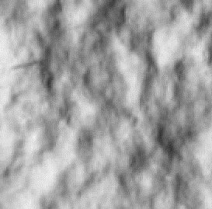
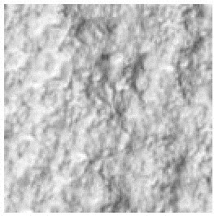
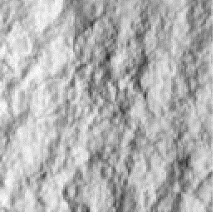
Results: Rough Plaster surface
High resolution sample PTM
PTM model
Object

Slide 47
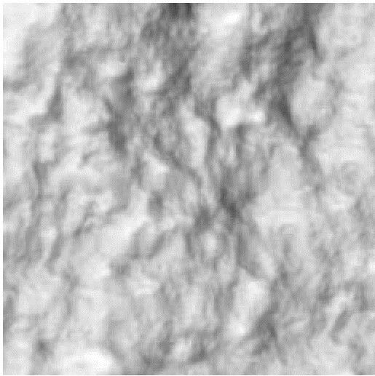

Up-close view
PTM model
Image based Modeling

Slide 48






Sample PTM
Object
PTM model

Slide 49









Object
Our Results
Unconstrained Synthesis

Slide 50
Image constrained PTM synthesis for real world objects
Synthesis reflectance texture models of objects which are 3D in nature.
Quilting blocks are triangles of various shapes, sizes and orientation.
Synthesizes reflectance texture over the triangles of a mesh model.

Slide 51
Input:
Set of images {I_{n}} of the object captured under known light and camera positions {(l_{un}, l_{vn}),C_{n}}.
PTM sample PTM_{in} of the object material.
Output:
Texture model of the object obtained by pasting triangular subsamples taken from PTM_{in} all across the mesh model of the object.

Slide 52
Algorithm
For each triangle T of the mesh model, obtain its mapping t in I_{k} ∈ {I_{n}} in which it is best visible.
Generate the normalized view t_{n} from t, find its best match p in PTM_{in} & extract box B containing p.
Perform Alpha-blending across every edge & update the patches {B_{i}}.
Extract the minimal bounding box b_{i}
Pack all such b_{i} into a number of texture atlases.

Slide 53
Step1: Model to Image mapping
The object is imaged from {(l_{un}, l_{vn}),C_{n}} to obtain {I_{n}}.
Each triangle T is mapped to
I_{k} ∈ {I_{n}} in which it is best visible.
The criteria for visibility is the angle made by normal n of T with the camera vector C.
Obtain the mapping t of T in I_{k} from camera matrix M_{k}
c₃
c₂
n
c₁

Slide 54

Step 2: Re-sampling of Normalized Views
The sides of t_{n} are obtained from those of t
where is the length of side i of t in I_{k}
is the angle between normal n of T &
direction of camera center C .
t_{n} is determined by {l_{in}} and angles A,B,C of T.
t
t_{n}

Slide 55
Search & selection for best PTM patch
The light vector l_{T} of source L w.r.t centroid of T is calculated.
Evaluate PTM_{in} using l_{T} & find a set of patches {t′} similar to t_{n}.
Triangular patch p′ in PTM_{in} corresponds to t′ϵ {t′}.
p ∈ {p′} that best agrees with the patches of already processed neighbors {T_{j}} of T is picked
L
Y
Z
C
l_{T}
T
X
A
B

Slide 56
Overlap constraint & Breadth First Search
1 <= Required number of processed neighbors <= 3
Random processing of triangles weakens overlap constraint & selection strategy.
BFS facilitates orderly processing & region growing mechanism for texture synthesis.
Starts at an arbitrary triangle , then processes its neighbors, their neighbors and so on

Slide 57

Extraction of Bounding boxes
For each triangle T_{i}, a minimal bounding box b_{i} surrounding p_{i} in PTM_{in} is identified.
B_{i} containing b_{i} with an extra texel strip(5 to 10 texels) W_{e} all around are extracted from PTM_{in}.
The extra strip of pixels is used for blending.
b_{i}
B_{i}
p_{i}

Slide 58

Step 3: Alpha-blending of Triangles

Slide 59
Step 4: Building PTM atlas
Minimal bounding boxes {b_{i}} are extracted from {B_{i}} by cutting off the extra strip of texels.
{b_{i}} are then packed in to a number of atlas.
Texture mapping co-ordinates of all T_{i} are updated with respect to the PTM atlases {P_{j}}.

Slide 60
Rendering of the PTM model
For each triangle T of the mesh, its light unit vector (l_{uT}, l_{vT}) is computed.
(l_{uT}, l_{vT}) is used to evaluate its PTM patch p to obtain its corresponding image patch.
Image atlases are resulted from PTM atlases.
Image atlases so obtained are loaded as texture and
the model rendered.

Slide 61



Results
Rough Sphere
Texture model
Another view

Slide 62



Rough Cylinder
Texture model
Another view

Slide 63
Observations
Successful capture and transfer of surface details.
Visual resemblance of the model to the original.
Irregular occurence of specularities.
Slightly accentuated variation in appearance with lighting direction at triangular boundaries.

Slide 64
Contributions
An effective image based texture synthesis technique to synthesize reflectance textures models.
The idea of transferring reflectance texture.
Pros of Our Approach
Easy capture of high resolution images.
Availability of low cost and high resolution cameras.
Cost effective rendering.

Slide 65
Draw Backs
Isotropic nature of materials is not accounted for.
Region growing policy of synthesis doesn’t work for directional surfaces.
Artifacts caused by dis-oriented texture patches of neighboring triangles
Blending doesn’t consider the dimensions of scale and orientation.

