Slide 1
Representation of Ballistic Strokes of Handwriting for Recognition and Verification
Prabhu Teja S
Advisor
Anoop M. Namboodiri

Slide 2
Thesis overview
Introduction
Motivation
Handwriting Recognition
Signature Verification
Summary and Conclusion
Notes:
1. Presentation in five sections.
2. Introduction to where the core idea comes from.

Slide 3
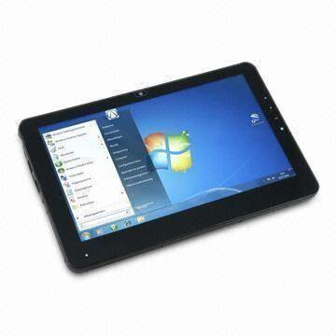
Handwriting
Natural/acceptable way of recording information
Multitude of applications with new interfaces
Data conversion– manual transcription is not practical
Need for efficient methods for handwriting recognition.
Speech & handwriting - two modalities specifically for recognition.
Pen computing:
Pointing input
Handwriting recognition
Direct manipulation
Gesture recognition
Notes:
Handwriting has been form of communication for several millenia now.
There are several new applications that have various different forms of input interfaces, and one of the major forms is pen-based.
Sellen and harper– myth of paperless office. paper will always have a place because it affords different uses than screens
In literature, 4 major appls of pen-computing have been identified (Read the four points)
In this thesis the major focus is on handwriting recognition
Because hw and speech are the only two modalities that explicitly for recognition.

Slide 4
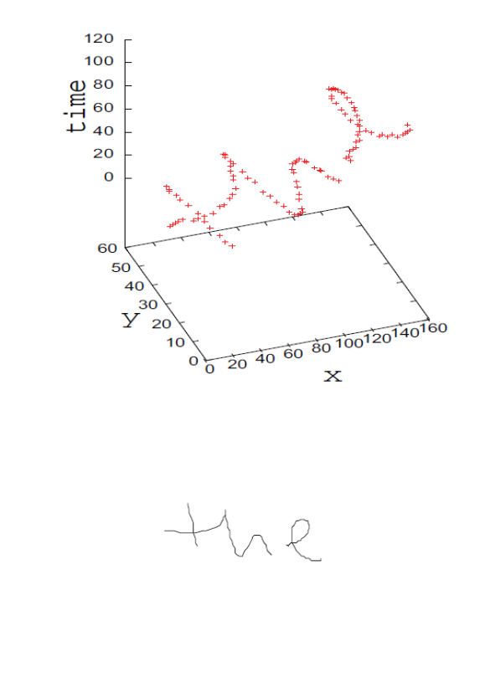
Data acquisition paradigms
Two kinds
Offline – Final image of writing eg: paper scan
Online – Stores the temporal order of writing
Online – {(x_{i},y_{i})}_{i=1}^{N}
Has information about pen-ups and pen-downs
Special digitizing devices required
Top figure: Online data. Bottom figure: Only offline data
Notes:
Before jumping in to the technical details, two types of data acquisition.
offline- just has the final output of what has been written.
Online- also stores the temporal order ie., it also stores the order in which those coordinates have been written
Because of this, it has information about when the pen was removed from the interface and when it was put back down.
This requires special digitizing devices. Most of modern phones and tablets have the capacity to do so.
Some special digitizing devices, also have pressure, pen angle and other attributes.

Slide 5
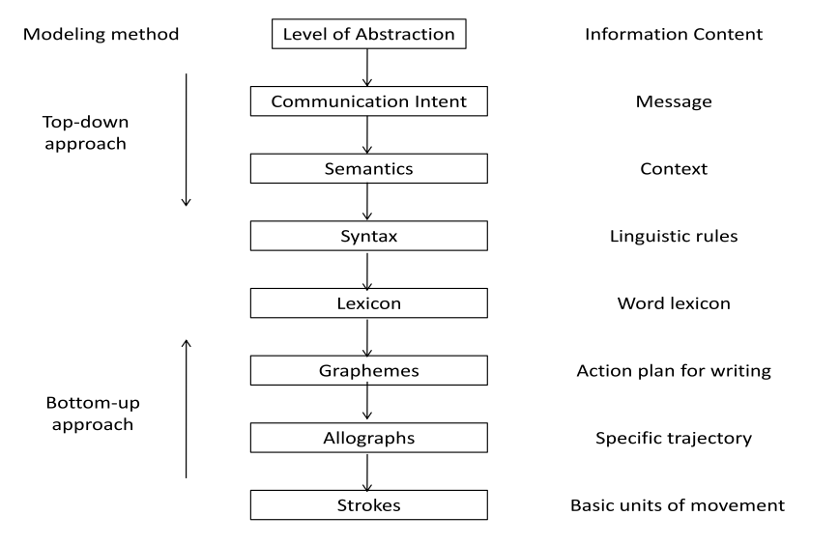
Handwriting Generation
Notes:
How is handwriting generated?
The intention to write is transfered to a semantic level, which is further transformed into
words (lexical and syntactical level). The individual letters (graphemes) are transformed into shapes
(allographs) based on writer characteristics and contextual information. Below this level, the allographs
are transformed into basic movements called strokes

Slide 6
Generation models
Categorization of models:
Bottom-up approaches: mimic the lower level characteristics of handwriting like velocity, acceleration and primitive shapes
Top-down models: focus on psychological aspects like motor learning, movement memory, planning and sequencing
Focus in this thesis on bottom-up approaches.

Slide 7
Stroke and Trace
Trace - Set of points from a pen-down to pen-up.
Notes:
Trace is the set of all points, that the digitizer records from the pen-down to the pen-up.
Here the word ‘the’, has 3 traces. One for the vertical line of t, one for the joint – and h and one for e.

Slide 8
Stroke
Fundamental unit of hand movements while writing.
“A mark made by movement in one direction of pencil or hand”
Primarily characterized by asymmetric bell shaped speed profile.
Points corresponding to consecutive local minima in speed.
Notes:
Stroke is the fundamental unit of human hand movement. It is, in simple terms, defined as a mark made by movement of pen in one direction.
Looking at the speed profile, it looks like an asymmetric gaussian.
Take the example of ‘3’ shown. It has 4 strokes and it shows up at four minima in the speed profile.

Slide 9
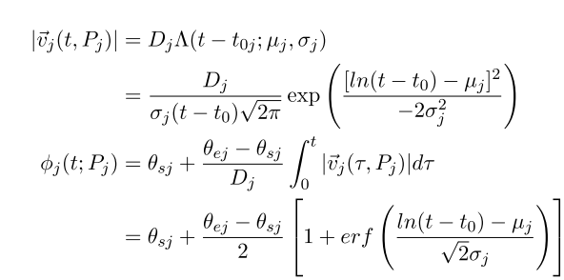
Lognormal theory of generation
Output speed of neuromuscular system action is of the shape of a lognormal curve scaled by command parameter (D) and shifted in time by the time of command (t₀)
Notes:
Based on the previous definition of stroke, a theory of handwriting generation has been defined called lognormal theory.
It says that output speed of neuromuscular system is a lognormal curve with a scaling factor, also called command factor.
Each stroke is a pivoting movement of the wrist, which makes it semi-circular or an arc of a circle.
Each stroke is a result of several neuromuscular systems, where such systems have been mathematically shown to be hierarchically connected, which is the reason for lognormal equation.

Slide 10
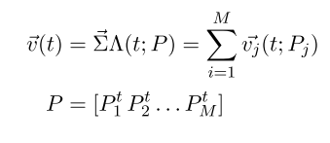
Lognormal theory
A complex handwriting has several such systems.
The total synergy of coupling of several such systems is a vectorial summation of the velocities of the individual systems.
Notes:
Now that how one stroke has been defined, complex handwriting, say a signature, has several such strokes.
The total, output or the synergy, is the vectorial summation of the velocities of the individual systems.

Slide 11
Thesis overview
Introduction
Motivation
Handwriting Recognition
Signature Verification
Summary and Conclusion

Slide 12
Motivation
Standard Pattern Recognition problem.
Common and effective ways of representing handwriting -- resampling techniques (equi-spaced, equi-time, random) or some local representations in terms of change of angles between subsequent samples
Abundance of literature on plausible theories of handwriting generation.
This thesis is a step towards using the production characteristics of handwriting towards recognition and verification tasks.
Notes:
Given the background regarding generation process, I’ll know motivate the work presented in this thesis.
Computer processing of HW fits in to the paradigm of a pattern recognition problem. It has a feature extractor and a classifier.
Common handwriting representations are based on simple resampling and local properties of the points.
I only talked about one generation model, but there are several mathematical models that try to model handwriting and do explain several of invariant properties.
Given that there are lots of various models of handwriting representation, can we use the information contained in the model for representation?
A more basic question, can that information be used at all for building systems?
This thesis is a step in that direction. It uses these for handwriting recognition and signature verification, which I’ll talk about.

Slide 13
Thesis overview
Introduction
Motivation
Handwriting Recognition
Signature Verification
Summary and Conclusion

Slide 14
Prior art
Methods
Statistical
Implicit
Markov models
Rule based
Prototype methods
Notes:
Most of the previous methods in handwriting recognition can be broadly classified into statistical and rule-based methods.
Statistical methods describe by a few features describing some characteristics of the writing.
Statistical methods can be classified into Implicit, Markv based and prototype methods.
Implicit methods are generally neural network based– TDNN, SOMs etc. These need lots of data.
Markov models are based on HMMs. Predominantly been applied to Latin scripts, but havent achieved practical accuracies. The method being proposed is also falling under this, which I’ll talk about in the coming few slides.
In prototype methods, recognition is done by distance based matching with a subset of training set called the prototype set. The test sample is labeled as belonging to the class of most similar prototype.

Slide 15
Representation of characters
Ideal representation: Compact, Fixed length, Discriminative
Has to strike a balance between on-line and off-line representations
Most successful representations are simple constant length resampling. eg: Time, Distance etc.
No method to recognize characters based on the most basic unit of handwriting, which is the ballistic stroke
Notes:
1. Ideal representation for characters, like it is to be for images or videos, should be compact, discriminative enough and hopefully of fixed length.
2. It has to strike the balance between online and offline representations.
3. Reiterating my statements about current commonly used representations, most of them are based on resample and local characteristics
4. And there are no methods that recognize handwriting based on the most basic unit ie., ballistic stroke.

Slide 16


Segmentation into strokes
Individually model x(t), y(t)
Curvature of trajectory given x(t) & y(t)
Two-thirds power law: Empirical power law stating an inverse non-linear relationship between the tangential hand speed and the curvature of its trajectory
Segment strokes at curvature maxima rather than at velocity minima
Noise immunity is better
Notes:
If I can parameterize individual components x and y of handwriting, in terms of an independent paramter, say time t, the curvature is given by that formula
There is an emperical law that states that there is a non-linear inverse relation between speed and curvature of its trajectory.
So instead of speed minima, we can say that curvature maxima can be used to segment complex handwriting into strokes.
The argument is that this method is more immune to noise, the theoritical argument is provided in my paper and thesis.

Slide 17
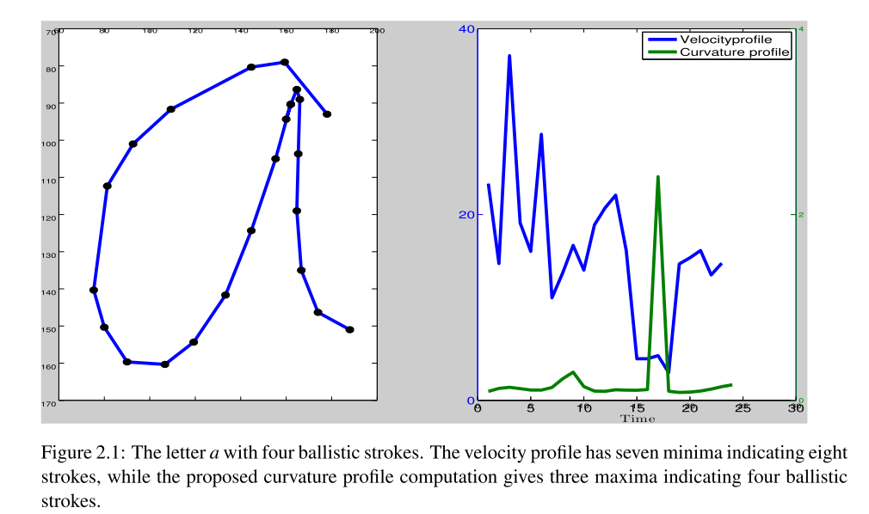
Handwriting data of poor quality

Slide 18
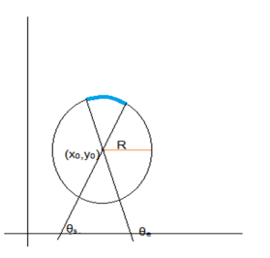
Representation of strokes
A ballistic stroke, spatially, is a pivotal movement of the hand along the arc of a circle
Parameters that characterize a stroke (r,x₀,y₀,θ_{s},θ_{e})
x₀, y₀ are very sensitive to minor variations in the shape of stroke
Use x_{µ}, y_{µ} instead
r → (0, 1) by sigmoid function
Notes:
Inspired from the lognormal theory, each stroke can be represented has an arc of a circle.
Which means that we need the radius and center of the circle and starting and ending angles of the arc wrt some reference.
We’ve found in our experments that instead of taking center of circle, which is a fit to points, using mean points has better robutness
Also, in the case of a straight line, the radius of the fit is theoritically inf. In practice a very large number. We constrain that by applying a hyperbolic tangent or a sigmoid.
This brings it to the range of (0,1)

Slide 19
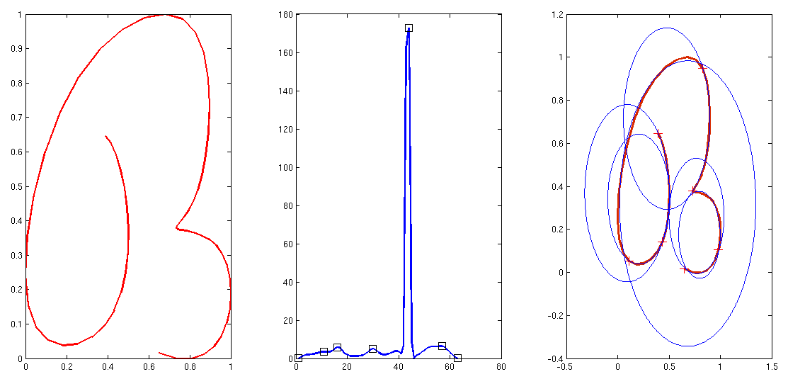
Character example
Curvature profile and maxima shown
Circles fit between points of maxima
Notes:
This image shows a character in malayalam, and its curvature profile, and its circle fits.
Each character can have varying number of strokes
But we would like a constant dimensional feature representation, which in its basic idea is bag-of-words.

Slide 20
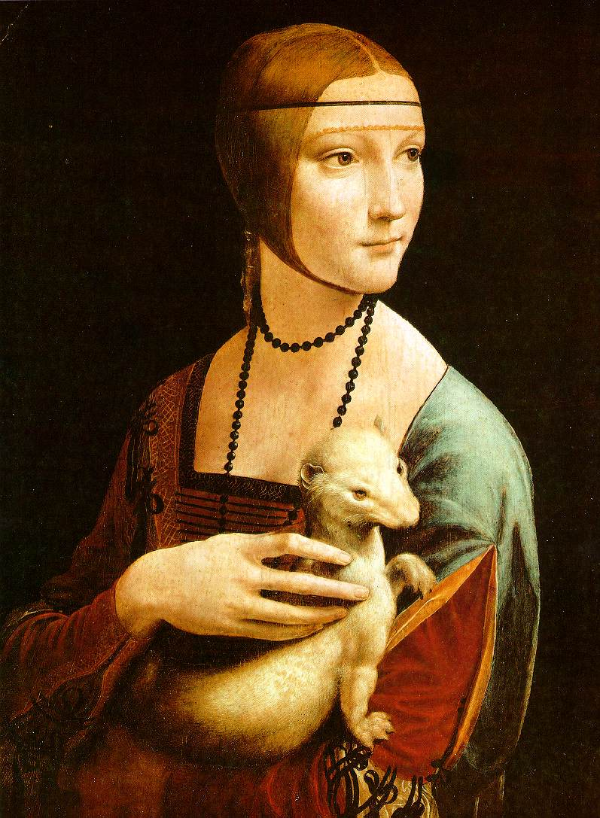
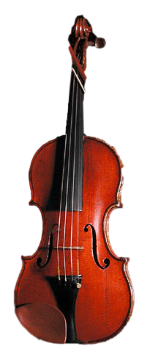
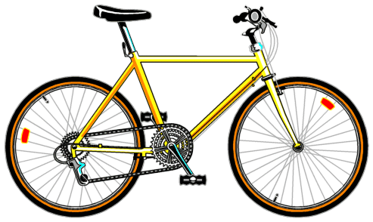
Bag of words: outline for vision applications
Extract features
Notes:
Bag of words has been used extensively in computer vision literature
The following are the steps in BoW for vision.
For each image, extract somepoints that are important.
Describe them with some feature.

Slide 21
Bag of features: outline
Extract features
Learn “visual vocabulary”
Pool all features from train set
Notes:
1. Pool all such features from the training set.

Slide 22
Bag of features: outline
Extract features
Learn “visual vocabulary”
Pool all features from train set
Quantize features using visual vocabulary
Notes:
Quantize that space using any quantization method say k-means, or clustering trees
And store the centroids.

Slide 23
Bag of features: outline
Extract features
Learn “visual vocabulary”
Quantize features using visual vocabulary
Represent images by frequencies of “visual words”
Notes:
When a new image comes, extract the same features at some important points
Assign each of those to the closest learnt centroids.
Find the histogram of the assignments to those centroids.
That is the representations using BOW

Slide 24
Representation of characters
Compute the 5-D representation of each ballistic stroke in training data
Vector quantization of 5-D representation by k-means
Bag-of-words representation using these centroids.
Instead of histogram, use only indicator function
Classifier used is SVM.
Notes:
In this case, extract the 5-D representation.
Use K-means to get the centroids and BoW using these centroids
We use only an indicator function, instead of natural numbers.
And finally use SVM to classify them.

Slide 25
Dataset description
Malayalam dataset:
Malayalam script has 13 vowels, 36 consonants, and 5 half consonants
Several symbols for multiple consonant combinations
Malayalam dataset contains 106 different traces or classes to be identified
Actual data was collected as a set of words that were chosen to cover all the trace classes and the set of words were written by over 100 writers
8966 traces in our final dataset.
The data was collected using Genius G-Note 7000 digital ink pad

Slide 26
Dataset description
UJI Penchars:
A lower case character subset of publicly available UJIPenchars2
The classification task is of 26 classes.
Each class on an average has 120 samples
Total number of samples used is about 3116
Data from capacitive device:
Handwriting dataset collected from Google Nexus 7 tablet and a Samsung Galaxy SII mobile phone.
26 lower case English alphabets, with each of the participants writing each character at-least 10 times.
Total number of characters in the database is 1380, giving an average of 53 samples per class.

Slide 27
Results
 | Equidistant Sampling | Curvature Weighted Sampling | ED +CS | Bag of Strokes | ED+CS+BoS
Malayalam | 84.40 | 81.75 | 85.76 | 94.55 | 97.75
UJIPenchars | 82.51 | 76.05 | 86.70 | 95.8 | 96.5
Touch-Screen | 95 | 94.5 | 95.58 | 93.9 | 96.2
BASE LINE
Notes:
Looking at the results, setting the baseline as equidistant resampling.
We see that BoS is promising.

Slide 28
Results
On Noisy data: Comparable to resampling
Improvement over velocity based stroke segmentation, which gives an accuracy of 91.9% on the same dataset (compared to 93.9%) .
Information in the representation complements resampling based methods and the combined accuracy is even higher.

Slide 29
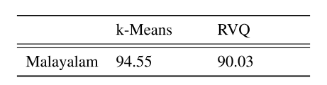
Importance of Words learnt
Use of Random Vectors opposed to Standard k-means clustering.
Notes:
Instead of using learned centroids, if we use random vectors, there is drop in accuracy of the recogntion.
Which means that there are some shapes more important than others in recognition.

Slide 30
Cross-lingual recognition
Ballistic strokes are expected to stay invariant across languages
Can we represent characters of a language using the ‘words’ learned for another language? How effective will this representation be?
Cluster centers learned for Malayalam to represent and recognize the characters in the UJI-Penchars (English)
Achieved nearly same accuracy (95% instead of 95.8%)
Suggests that the representation can be made language independent if learned from a sufficiently large dataset.
Notes:
End of the section on handwriting recognition. Any questions?

Slide 31
Thesis overview
Introduction
Motivation
Handwriting Recognition
Signature Verification
Summary and Conclusion

Slide 32
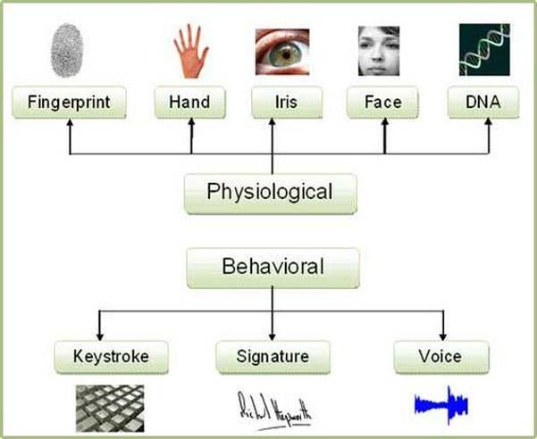
Biometrics
Refers to automatic recognition of individuals based on physiological or behavioral traits.
Notes:
Biometrics refers to automatic recognition of individuals based on physiological or behavioral traits.
There are two types of biometrics, based on the source of the information.
Physiological and behavioral

Slide 33


Biometric systems’ modes
Biometrics systems in two modes
Identification - Whose biometric is it?
Verification - Is this person I’s biometric sample?
Signature biometrics operate in Verification mode.
Notes:
Any biometric system operates in two modes.
identification– whose biometric is this? Take the query example, and call it that person’s whose sample in the database is the closest.
Verification – is this, a person’s biometric? There is an identity claim made to the system. So compare only with the samples of that person in the database
Signature biometrics are generally considered weaker compares to physiological biometrics and hence used in verification mode.

Slide 34

Verification
Person J - signed this
Reference Data Base
I
J
K
Distance
<
Threshold
Yes
Comparison
Query
Signature
NO
Representation and metric.
Should define appropriate similarity metric S(X_{Q},X_{I}) or Distance
Signature representation is same as character.
Notes:
In case of verification, Questioned signature is associated with claimed identity and it is compared only with the reference signature of claimed identity.
Distance between signatures is compared with threshold. Threshold is calculated from reference database from within and between class distance distributions.
Thus this requires a representation and a metric for comparison. The representation is kept same as the character

Slide 35
System performance
System’s decision
Genuine Acceptance Rate
I
not I
False Rejection Rate
True Pos
False Neg
I
Actual Identity
not I
False Pos
False Acceptance Rate
Equal Error Rate = FAR = FRR

Slide 36

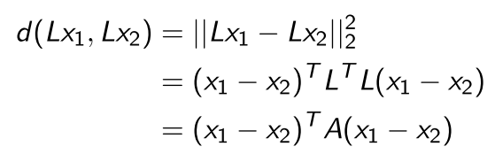
Metric learning
Mahalanobis distance : where A is a p.s.d matrix
Problem of metric learning is to find A based on some criterion
If L is a linear transformation applied to the space of x₁ & x₂ then the Euclidean distance between them is
Notes:
goal is to learn from examples a similarity function that measures how similar or dissimilar two objects are.

Slide 37



Metric learning contd
SVM has the distinct advantage of having good generalization performance
Output of trained SVM, C_{i} is of the form where
By concatenating all such ^{k}C₂ vectors, we get the projection matrix V.
The final metric matrix is computed as
Notes:
1. SVMs have theoritical guarantees of generalization performance and hence prefered.
2. Consider a multiclass classification problem. Say it’s a one vs one formulation. Then ‘read second point’
3. Since, it’s a ‘k’ class problem, kc2 separating planes are available. Concatenating these, we get the projection matrix.
4. Final metric, as from the previous slide, is defined VV transpose.

Slide 38
The sign of C_{i}(x) is the class of x. Thus the distance between two samples is the correlation of the class labels of the two.
Not all ^{k}C₂ are required to get good performance.
Easy to learn metric. Easy to modify to accommodate newer users.
Notes:
For an intuition of why this works,
Sign of each projection, gives the class of that sample. So distance between two points is the correlation of the class labels of the two.
We’ve found that not all exhaustive pairs are required for good performance.
Metric is very easy to learn. And its very easy to add one user to the database. Because you just have to add a few columns to the projection matrix,

Slide 39
Dataset
Publicly available SVC-2004 set
Signatures by 40 users each providing 20 repetitions of their signatures
Data was digitized with a WACOM Intuos tablet
Along with the 20 genuine signatures, 20 skilled forgeries were also collected from 4 contributors.

Slide 40
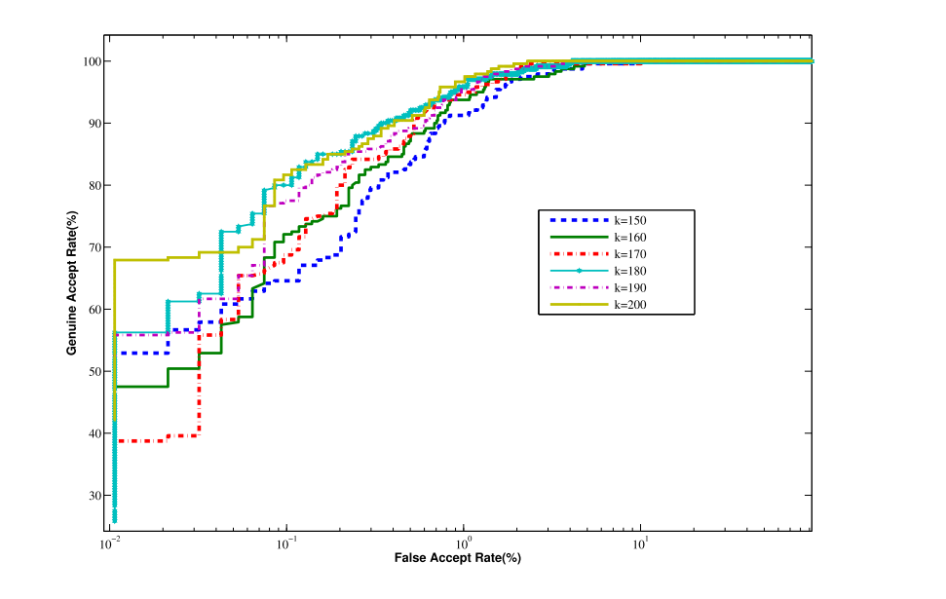
Results
ROC for Random Forgeries
Notes:
This shows the ROC curve for Random forgeries.
Its clear that the method works well for random forgeries. The equal error rate is about 1.4%.

Slide 41
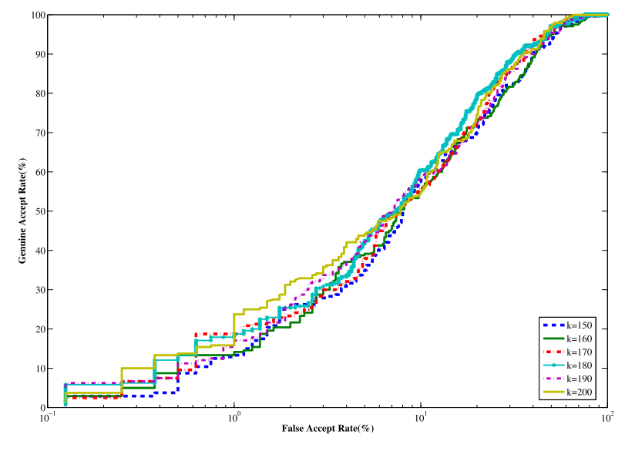
Results
ROC for Skilled Forgeries
Notes:
For skilled forgeries, the ROC is a bit more skewed. The EER is about 22%.

Slide 42
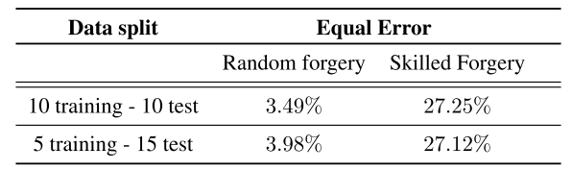
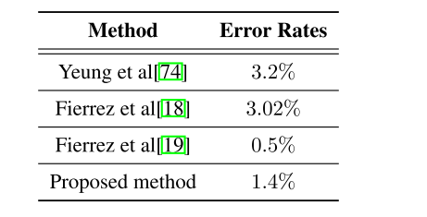
Changes in EER for various test-train splits
Comparison with other methods

Slide 43
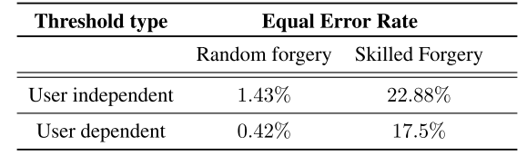
Number of classes used to construct Metric
% of SVs removed | EER on Random Forgeries | EER on Skilled Forgeries
25% | 1.34% | 22.88%
Very little change from having all (<0.1%)
User-specific thresholds

Slide 44
Thesis overview
Introduction
Motivation
Handwriting Recognition
Signature Verification
Summary and Conclusion

Slide 45
Conclusions
Proposed a method of representing handwriting in terms of its constituent ballistic strokes, based on Bag-of-words.
Proposed a curvature based segmentation method, as opposed to the traditional velocity minima based segmentation, and showed that this method of segmentation is more robust to noise.
Proposed a similarity metric based on metric learning for signature biometrics.

Slide 46
Thank you!

