Slide 1
Classification, Detection and Segmentation of Deformable Animals in Images
Omkar M. Parkhi
200807012
Advisers:
Prof. C.V. Jawahar Prof. A. P.Zisserman
3rd August 2011

Slide 2
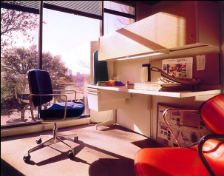
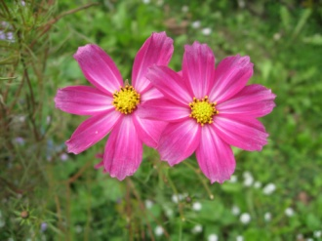
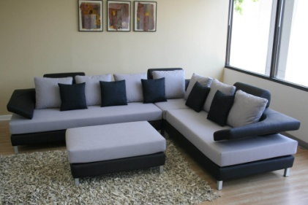
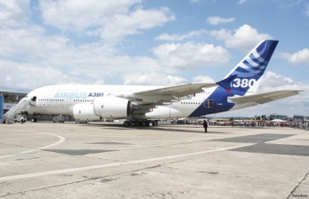
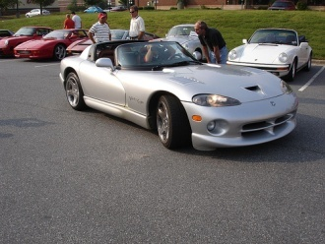
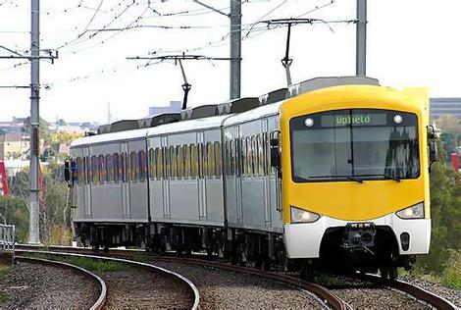
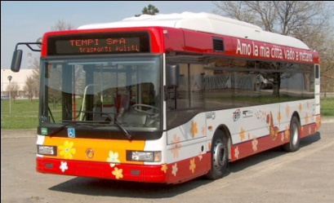
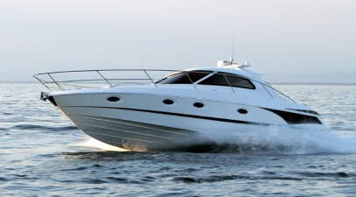
Object Category Recognition
Popular in the community since long time.
Several datasets such as Pascal VOC, Caltech, Imagenet have
have been introduced.
People have been working on categories such as Flowers, Cars
person etc.
In this work we work with animal categories: cats and Dogs

Slide 3
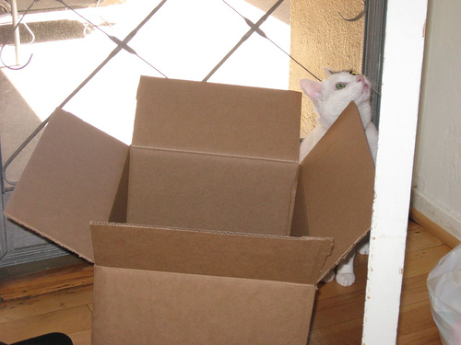
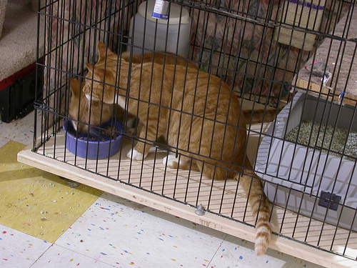
Why Cats and Dogs?
Tough to detect in images
Pascal VOC 2010 detection challenge
Category | AP%
Aero plane | 58.4
Bicycle | 55.3
Bus | 55.5
Cat | 47.7
Dog | 37.2

Slide 4
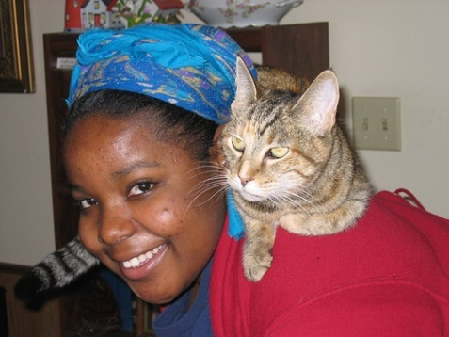
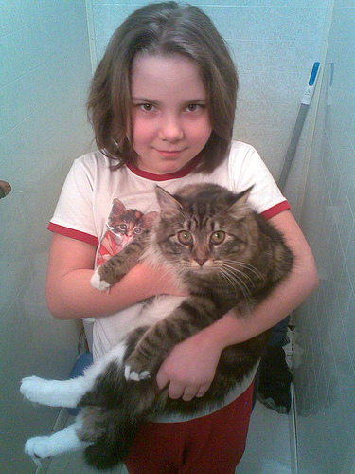
Why Cats and Dogs?
Popular pet animals - always found in images
and videos besides humans
Google images have about 260 million cat and
168 million dog images indexed.
About 65% of United States household
have pets.
38 million households have cats
46 million households have dogs
This popularity provides an opportunity to
collect large amount of data for machine
learning.

Slide 5



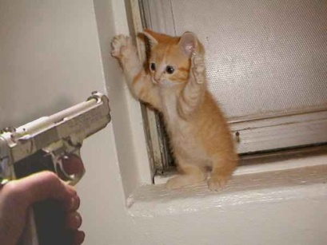
Why Cats and Dogs?
Social networks exists for people having these
pets.
Petfinder.com a pet adoption website has
3 milion images of cats and dogs.
Fun to work with..!

Slide 6
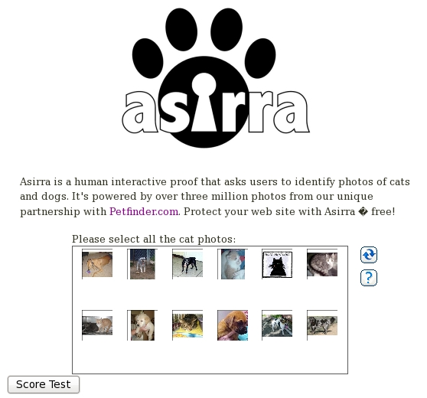
Why Cats and Dogs?
Difficulty in automatic classification of cats and dogs images was exploited to build a security system for web services.

Slide 7
Contributions of this work
Introducing IIIT-Oxford PET Dataset
Collection of extensively annotated image
Extension of Part Based models
achieving state of the art results.
Breaking MSR Assira challenge
Achieving 30% improvement over previous best.
Fine Grained classification
of cat and dog breeds

Slide 8
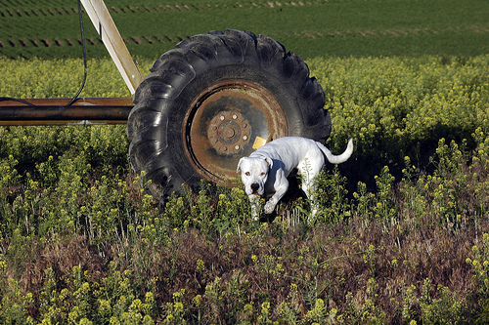
Object Recognition Tasks (Classification)
Is there a dog in this image?

Slide 9
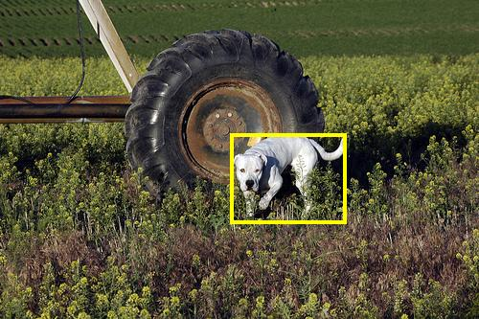
Object Recognition Tasks (Detection)
If yes, where is the dog?

Slide 10
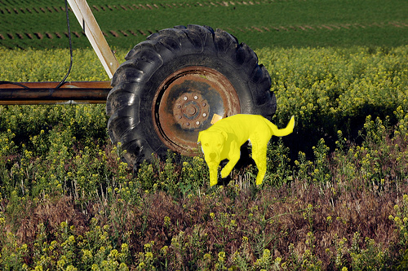
Object Recognition Tasks (Segmentation)
Which pixels exactly?

Slide 11
Object Recognition Tasks (Sub Categorization)
American Bulldog
What breed?

Slide 12
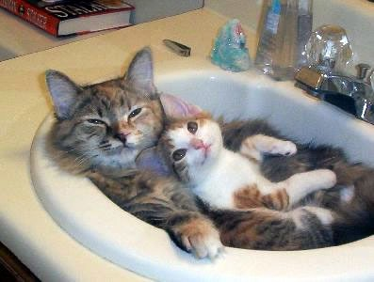
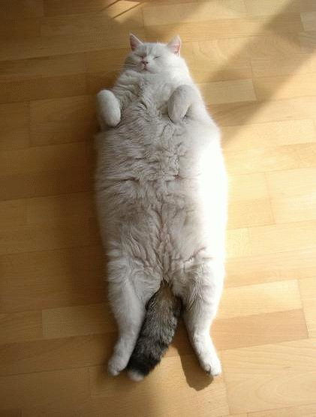

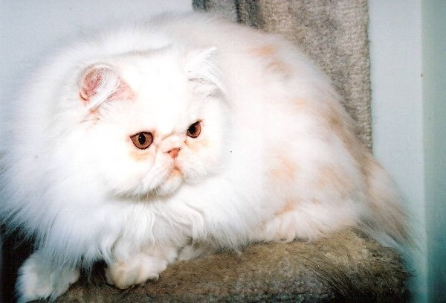
Challenges: Deformations
Objects appearing in different shapes and sizes
Body parts not always visible
Hard to model the shape of the object.

Slide 13
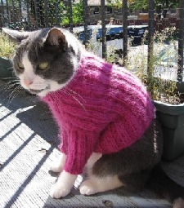
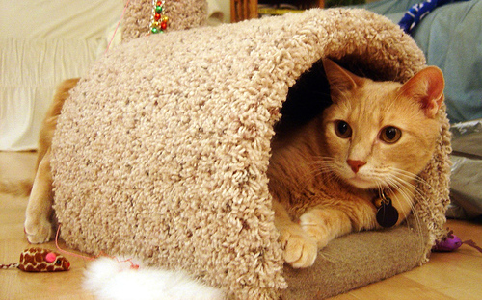
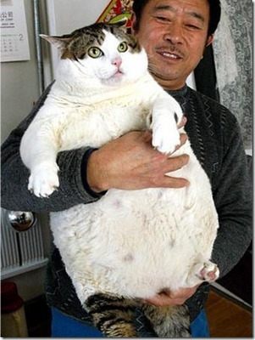
Challenges: Occlusion
Some portion of the body is covered by other objects
Hard to fit a shape model
Hard to get information from pixels.

Slide 14
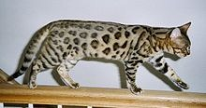
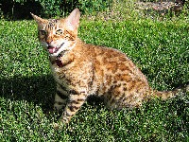
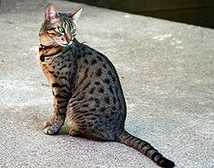
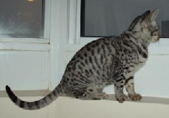
Challenges: Inter Class Similarities & Intra Class Variations
Bengal
Bengal
Egyptian Mau
Occicat
Different breeds looking similar
Variations in the same breed
Mix breed pets
Similarities between cats and dogs

Slide 15
The IIIT-OXFORD PET Dataset
Collection of images belonging to 37
different categories of cats and dogs.
7,349 extensively annotated images.
Each image annotated with
Breed label
Bounding box around head
Pixel level foreground/Background
annotation

Slide 16




Dataset Creation collection
Collected images from different sources on the internet.
(2000/3000 per category)
Catster.com , Dogster.com
Flickr!, Google Image Search
Wikipedia
Cat Fancier’s Association, American Kennel Club

Slide 17
Dataset Creation Filtering
Filtering of images.
Removed near duplicates.
Filtered bad images (poor quality/ lighting /
Occluded)
Removed mixed breed images.
Resulted in upto 200 image per category

Slide 18
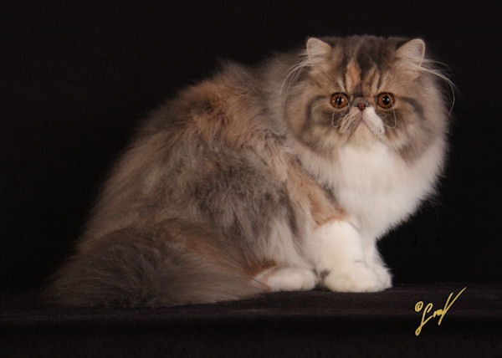


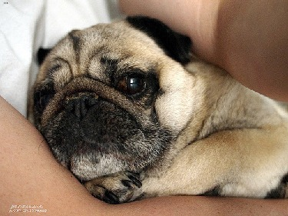
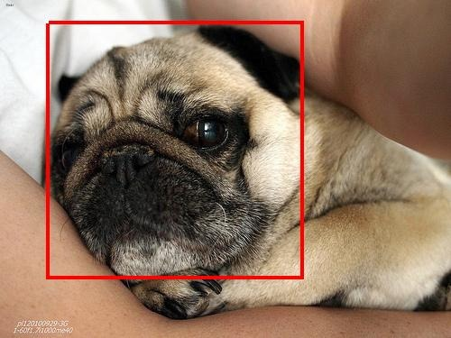
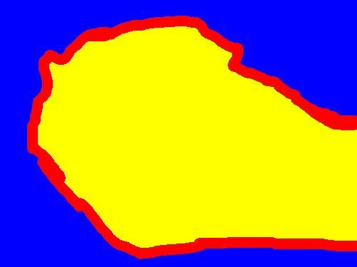
Dataset Annotations
Persian
Pug
Annotations as per PASCAL VOC Annotation Guidelines.
XML format annotations for breed and bounding boxes.
Trimap for pixel level annotations.

Slide 19
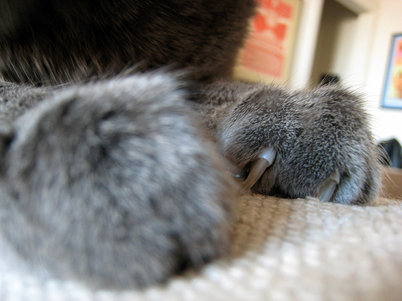
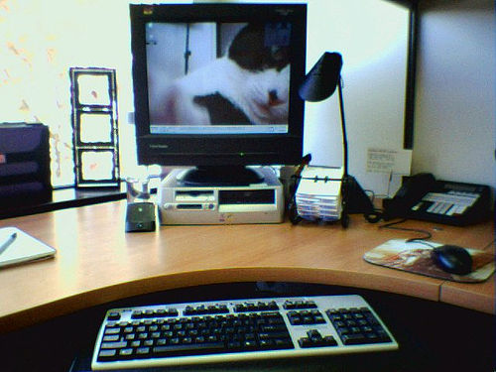
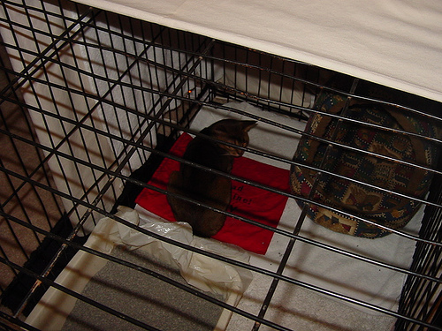
Dataset Annotation Difficulties
Is this a cat or a dog?
How to mark the head?
How to tackle occlusions?

Slide 20
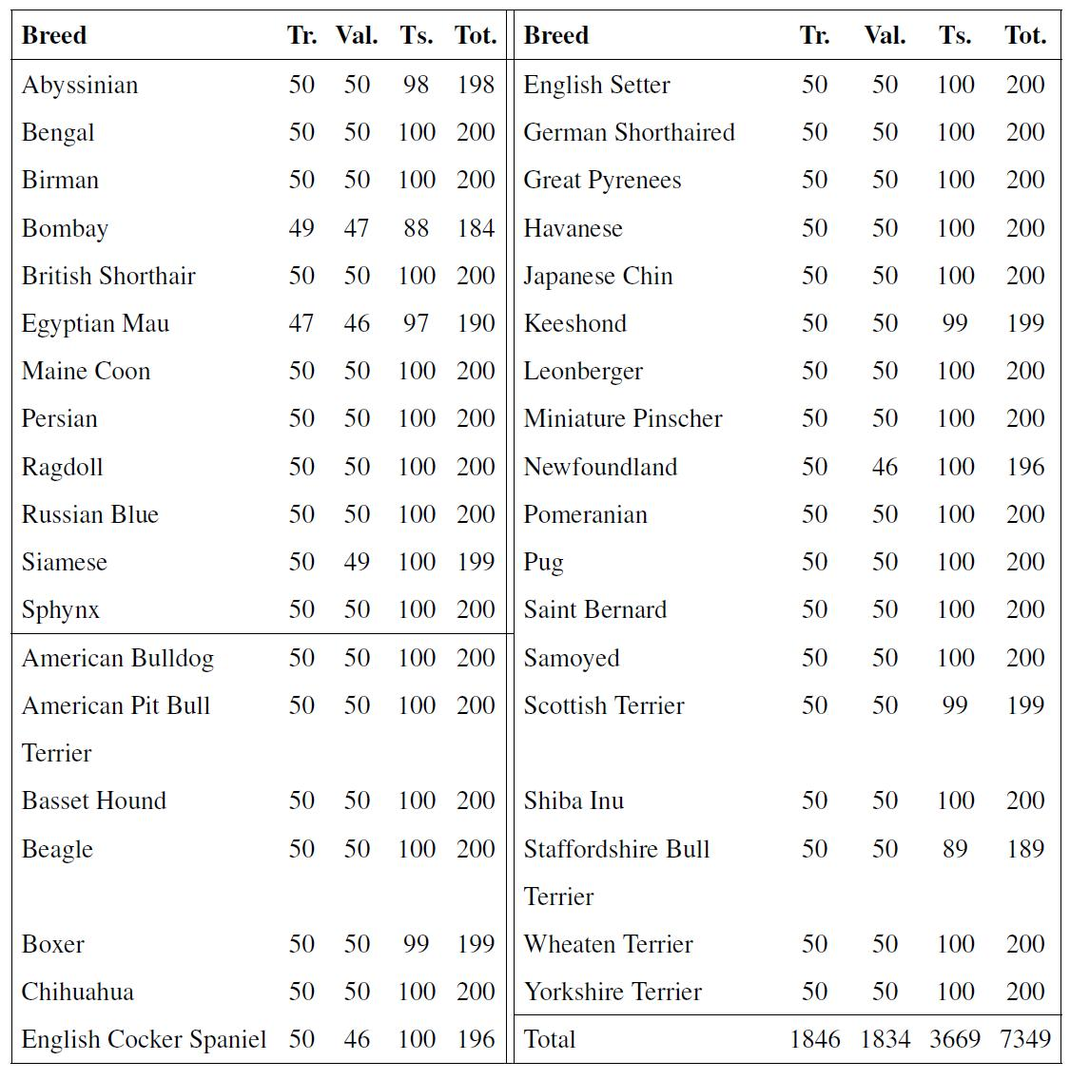
Dataset Creation Statistics

Slide 21
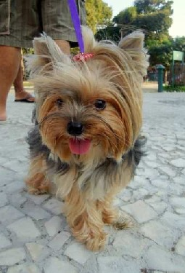
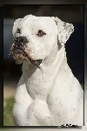


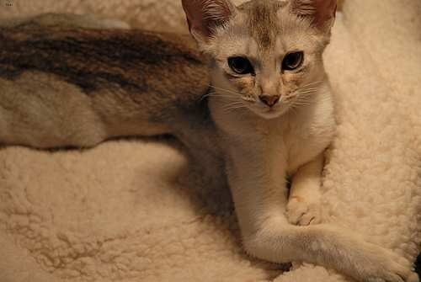
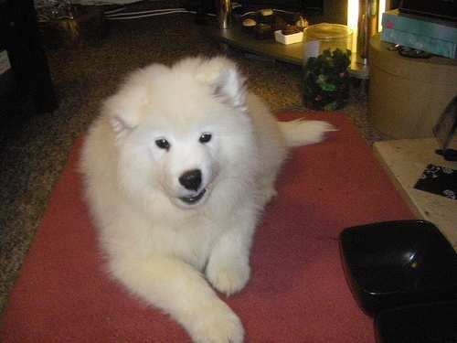
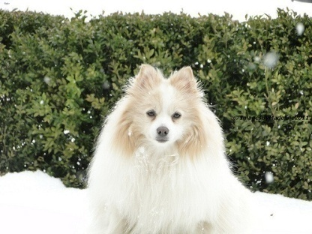
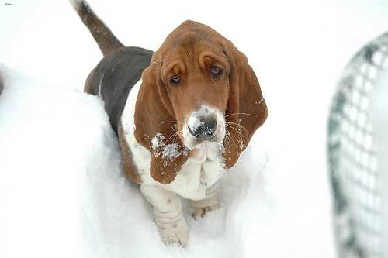
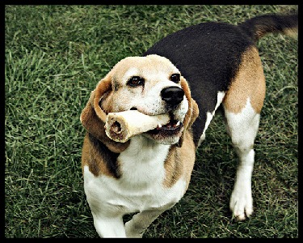
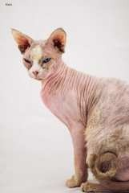
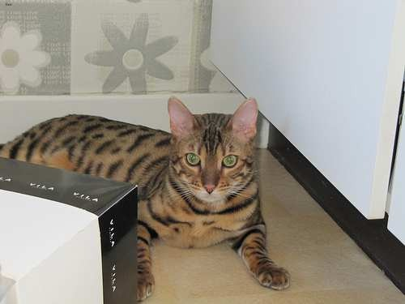
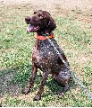
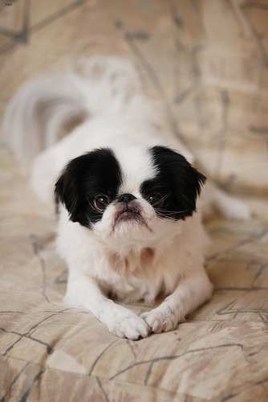
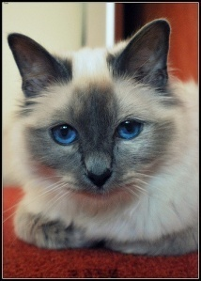

Dataset Examples

Slide 22
Dataset Evaluation protocols
Classification:
Average Precision computed as area under the Precision
Recall curve is used to evaluate performance.
Detection:
Average Precision computed as area under the Precision
Recall curve is used to evaluate performance. Detections
overlapping 50% with groundtruth are considered true
positives.
Segmentation:
Ratio of intersection over union of ground truth with output
segmentation is used to evaluate the performance.

Slide 23
Object Detection: State of the Art
“Object Detection with Discriminatively
Trained Part Based Models.”
P. Felzenszwalb, R. Girshick, D. McAllester and D. Ramanan. In PAMI 2010
System represents objects using mixtures of deformable part
models.
System consists of combination of
Strong low-level features based on histograms of oriented gradients (HOG).
Efficient matching algorithms for deformable part-based models (pictorial structures).
Discriminative learning with latent variables (latent SVM).
Winner of PASCAL VOC 2007
Lifetime achievement award in PASCAL VOC 2010.

Slide 24
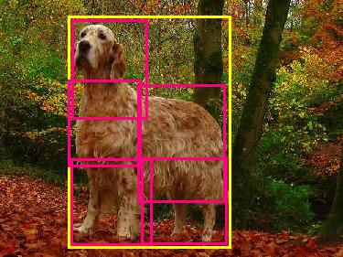
Extending Deformable Parts Model for Animal Detection
Head
Object
Torso
Legs
Legs
Representing objects by collection of parts

Slide 25
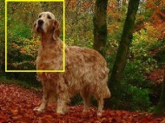
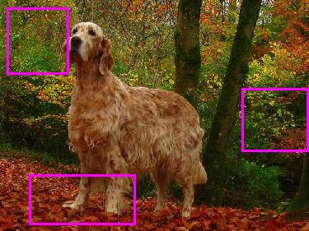


Object Detection: State of the Art
Searching for object
(Root Filter)
Searching for parts
(Double Resolution)
Best Location for root filters and parts

Slide 26
Object Detection: State of the Art
Good overall performance but fails on animal categories.
Outperformed by Bag of Words based detectors on animal categories.
Can this method be improved to get the state of the art results?

Slide 27


Distinctive Parts Model
Model head of the animal
How good does it work?
Method | AP | Max. Recall
HoG | 0.45 | 0.52
HoG+LBP | 0.49 | 0.58
HoG+LBP (less strict) | 0.61 | 0.79

Slide 28

Distinctive Parts Model
With head detected what can I do further?
Method | AP | Max. Recall
FGMR Model | 0.28 | 0.55
Regression | 0.31 | 0.56
Can anything better be done?

Slide 29


Distinctive Parts Model
Is it possible to take any clues from detected head and segment the whole object?

Slide 30

Interactive Segmentation GrabCut
Introduced by Rother et al. in ICCV 2009
Iteratively minimizes Graph Cut energy function
Energy
Data Term
Pair wise Term
Data terms are taken as posterior probabilities from a GMM.
GMMs are updated after every iteration.

Slide 31


Segmenting the object Selecting Seeds
Some foreground and background pixel (seeds) need to be
specified for GMM initialization.
Rectangle from the head region is taken as foreground seed.
Boundary pixels are used as background seeds.
Background is added while some foreground is missing

Slide 32


Segmenting the object Berkeley Edges
Introduced in 2002, Berkeley Edge Detector provides edge response
by considering context from the images.
Response of the edge detector used to model pair wise terms.
Cut is enforced at place where there is high edge response.

Slide 33



Segmenting the object Posterior Probabilities
GMMs often un capable of modeling color variations.
Foreground and Background color histograms computed on
training images.
Posteriors are computed using these histograms.
Global posteriors are mixed with image specific ones to achieve
better modeling.
Before
After

Slide 34

Distinctive Parts Model (Results)
Method | AP
FGMR Model | 0.28
Basic GrabCut | 0.37
Adding Global Posteriors | 0.41
Adding Berkeley Edges | 0.46
Re ranking the detections | 0.48
State of the Art in VOC 2010 | 0.47
Distinctive part model improves AP by 20% over
original method.
Results comparable to state of the art method are
obtained.
Still lot of scope to improve results further.

Slide 35
















Distinctive Parts Model(Results)

Slide 36









Distinctive Parts Model(Failure Cases)

Slide 37








Classification Tasks
Can a computer classify and label these images?
Can we break Asirra Test?

Slide 38









Classification Tasks Species Classification
Given an image, classify it as a cat or a dog.
Dog
Cat
?

Slide 39












Classification Tasks Breed Classification
Given an image, classify it according to its breed.
Bombay
Chihuahua
?
Beagle

Slide 40




Classification Tasks Appearance Feature
Scale Invariant Feature Transform (SIFT) Features
Bag of Words Histogram
Spatial layout based on head detection and segmentation
Single feature vector formed by concatenating several
BoW histograms.

Slide 41

Classification Tasks Shape Feature
Output of part based model used to form shape feature.
Head detection scores concatenated to form a feature
vector.
Dog Head Model
Cat Head Model
0.85 , -0.54

Slide 42
Classification Tasks Classifiers
Support Vector Machine (SVM) Classifiers used
Appearance feature represented by a Chi-2 kernel
Appearance feature represented by a Linear kernel
Final kernel formed by addition of two kernels.
Hierarchical and flat approaches used for breed
classification

Slide 43
Classification Tasks Results
Method | Accuracy
Species Classification | 95.80%
Breed Classification (Cat) | 69.23%
Breed Classification (Dog) | 62.09%
Breed Classification (Combined – Hierarchical) | 60.74%
Breed Classification (Combined - Flat) | 62.76%

Slide 44

Classification Tasks Results
Confusion Matrix for breed classification

Slide 45

Cracking Assira
“ASIRRA” is a security challenge which
protects websites from bot attacks.
Developed by Microsoft Research.
All cat images from 12 images shown
need to be selected.
Classifier with accuracy can break
the system with accuracy of
25,000 test images are made available

Slide 46
Cracking Asirra
Shape + Appearance model classification
accuracy of 93%
Results in system breakup probability of 42%
Improvement of over 30% over previous best 9.2% (82%)
System can be broken once every 3rd attempt as
compared to every 10th attempt previously.

Slide 47
Future Work
Improving segmentations using super pixels.
Using multiple segmentations to locate the object
Improving head detection results using better
features.
Finding improved models for subcategory
classification.
Improving the dataset, adding more images and
categories.

Slide 48
Thank You!
Any Questions?

