Slide 1
Improving image quality of synthetically zoomed tomographic image
-Neha Dixit

Slide 2
Presentation layout
Tomography basics/background
Problem statement and challenges faced
Existing approaches
Proposed approach
Results
Conclusion
Future work

Slide 3
Tomographic image reconstruction
Tomography is a non-invasive imaging technique which helps to visualize the internal structures of an object
Cross-sectional images of body or an object are generated from sinogram data (radon transform).
Tomographic imaging modalities includes CT ,MRI, nuclear-medicine (SPECT and PET).

Slide 4
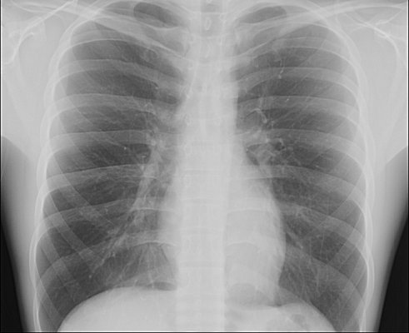
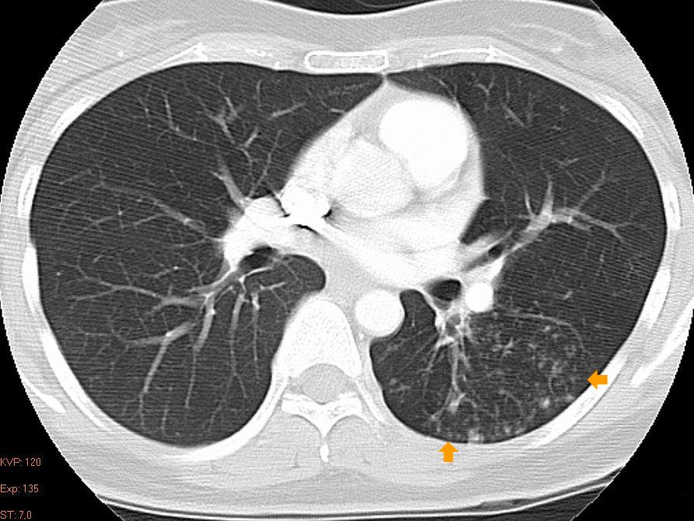
X ray image
Source : Dicts.info
CT image
Source:Radiology picture of the day
Notes:
Why tomography was introduced and how it is different from X-ray

Slide 5
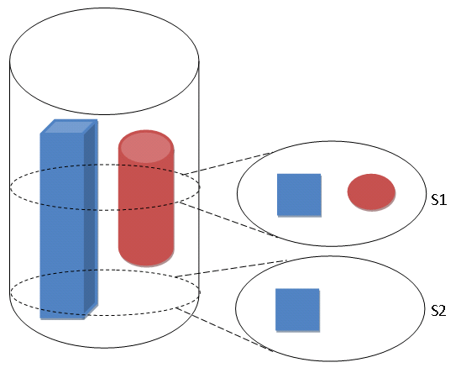
Concept of tomography

Slide 6
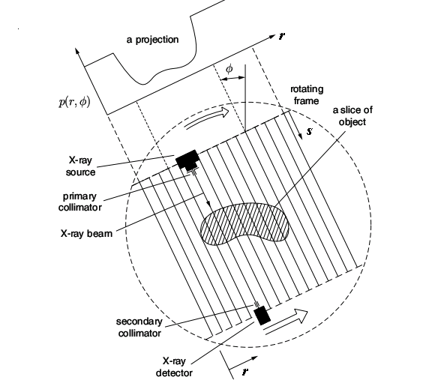
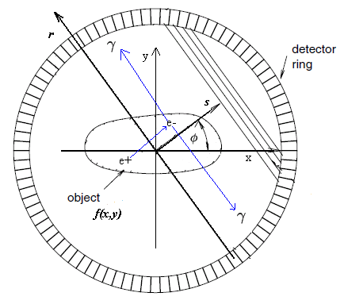
Data Acquisition
CT scanner
PET scanner
Source: Jiri and Jan,
Medical image processing, reconstruction,
and restoration, concepts and methods.
Notes:
Data acquisition in CT and PET will mention here that we will concentrate only on these two .

Slide 7
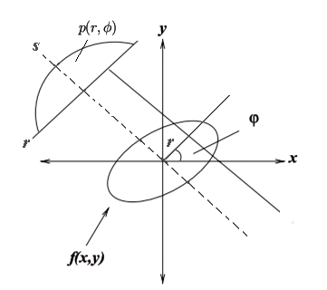
Radon Transform
The Radon Transform (RT) is an integral transform whose inverse is used to reconstruct images
f(x,y) : a function defined on Cartesian coordinates (x,y)
p(r,φ): 1-D sinogram of f(x,y) defined over rotated (r,s) coordinate system

Slide 8
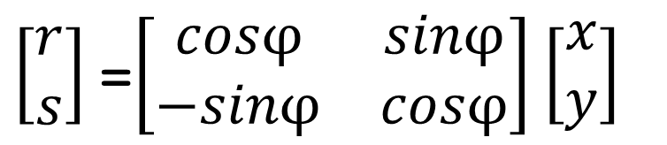
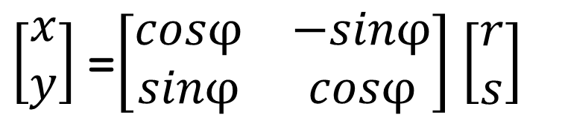
Relationship between coordinates
$\left[\begin{matrix}r \\ s\end{matrix}\right]$ =$\left[\begin{matrix}cosφ & sinφ \\ −sinφ & cosφ\end{matrix}\right]$ $\left[\begin{matrix}x \\ y\end{matrix}\right]$
$\left[\begin{matrix}x \\ y\end{matrix}\right]$ =$\left[\begin{matrix}cosφ & −sinφ \\ sinφ & cosφ\end{matrix}\right]$ $\left[\begin{matrix}r \\ s\end{matrix}\right]$

Slide 9
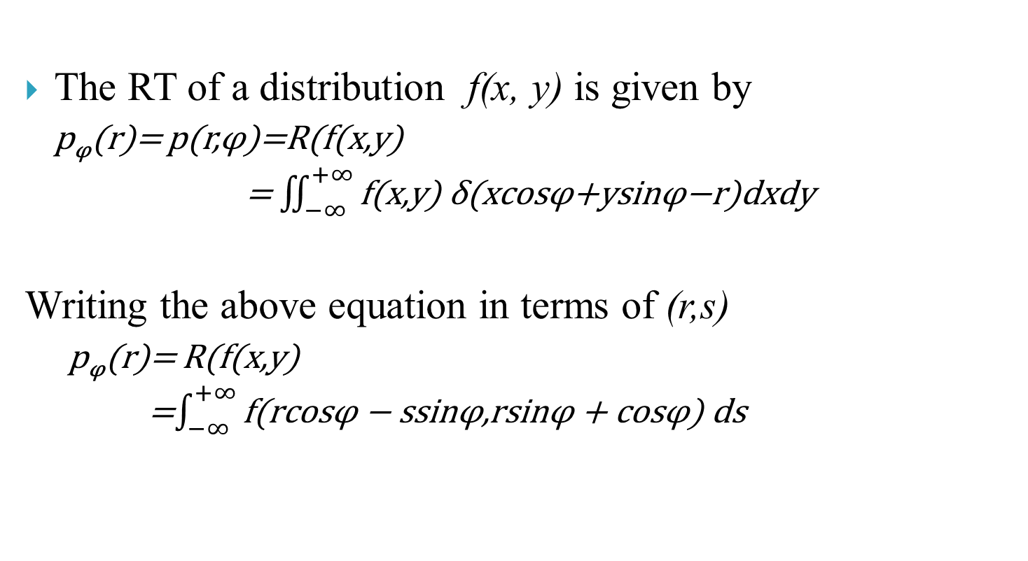
Radon transform…..
The RT of a distribution f(x, y) is given by
p_{φ}(r)= p(r,φ)=R(f(x,y)
= $\iint_{−∞}^{+∞}{\text{f}\text{(}\text{x}\text{,}\text{y}\text{) }\text{δ}\text{(}\text{xcos}\text{φ}\text{+}\text{ysin}\text{φ}\text{−}\text{r}\text{)}\text{dxdy} }$
Writing the above equation in terms of (r,s)
p_{φ}(r)= R(f(x,y)
=$\int_{−∞}^{+∞}{\text{f}\text{(}\text{rcos}\text{φ}\text{ − }\text{ssin}\text{φ}\text{,}\text{rsin}\text{φ} \text{+ }\text{cos}\text{φ}\text{) }\text{ds}}$

Slide 10
An Object and its Radon Transform
RT is nothing but the sinogram p(r,φ) of size 180x180

Slide 11
Image Reconstruction
Given the Radon Transform of an object to reconstruct the cross-section image one of the following methods can be used:
Back projection
Filtered back projection
Iterative reconstruction

Slide 12
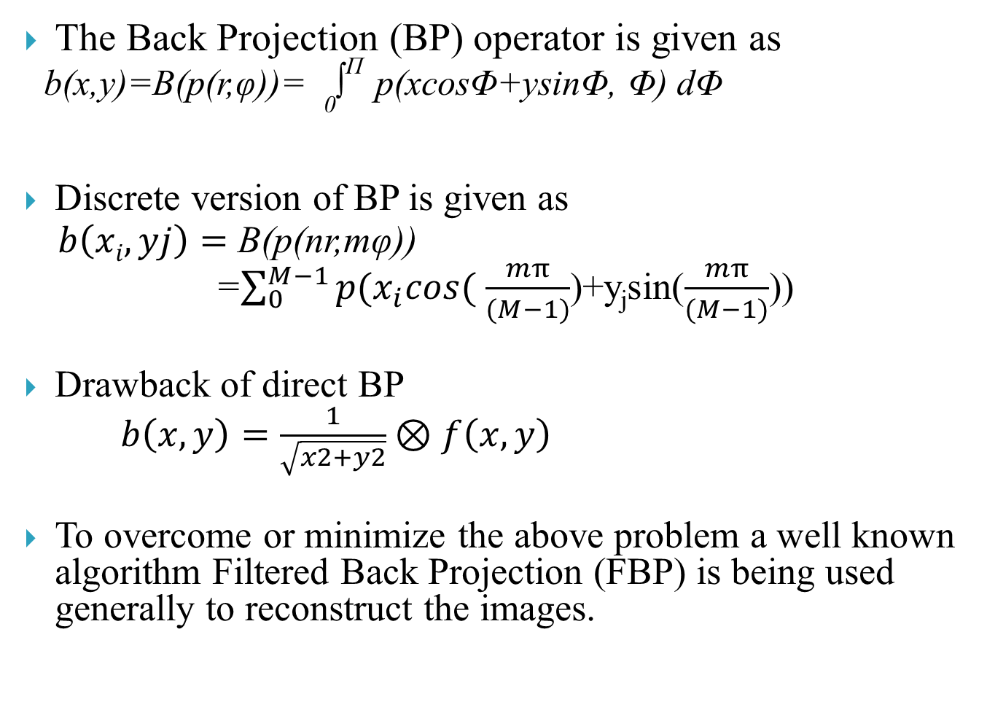
Back Projection
The Back Projection (BP) operator is given as
b(x,y)=B(p(r,φ))= ₀∫^{Π} p(xcosΦ+ysinΦ, Φ) dΦ
Discrete version of BP is given as
$b\left(xi,yj\right)=$ B(p(nr,mφ))
=$\sum_{0}^{M−1}{p(x_{i}cos(}$ $\frac{mπ}{(M−1)}$)+y_{j}sin($\frac{mπ}{(M−1)}$))
Drawback of direct BP
$b\left(x,y\right)=\frac{1}{\sqrt{x2+y2}}⊗f\left(x,y\right)$
To overcome or minimize the above problem a well known algorithm Filtered Back Projection (FBP) is being used generally to reconstruct the images.

Slide 13
Filtered Back Projection
Take 1-D Fourier transform of the sinogram data p(r,φ) for every view angle . Let this be denoted as P _{φ}(ω).
Since convolution is equivalent to multiplication in Fourier domain, so 1-D Fourier transform is multiplied with 1-D ramp (|ω\) filter function to nullify the effect of PSF.
The filtered sinogram which is in the frequency domain is then transformed back to spatial domain by taking the 1-D inverse Fourier transform.
The final image is generated by backprojecting the processed sinogram.

Slide 14
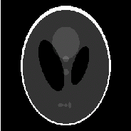
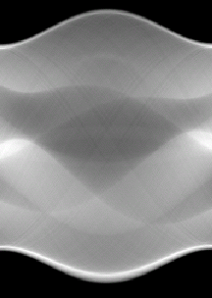
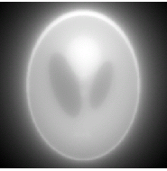
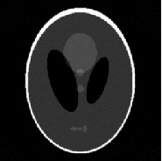
Radon Transform
Back projection
(a)
(b)
(c)
1-D Fourier Transform
of sinogram
(a) Shep-logan Phantom, (b) Sinogram , (c)Reconstructed image after simple back projection, (d) ramp filter, (e) Image reconstructed using FBP
Back projection
Inverse Fourier
Transform of
filtered sinogram
Cut of frequency
Cut of
frequency
(d)
(e)
Filtered Back Projection
Filtered Back Projection

Slide 15
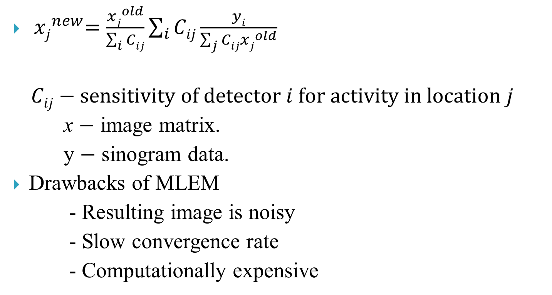
Iterative Reconstruction
${ xj}_{}^{new}=\frac{{xj}_{}^{old}}{\sum_{i}{Cij}}\sum_{i}{Cij}\frac{yi}{\sum_{j}{Cij}{xj}_{}^{old}}$
$$Cij−sensitivity of detector i for activity in location j$$
x $−$ image matrix.
y $−$ sinogram data.
Drawbacks of MLEM
- Resulting image is noisy
- Slow convergence rate
- Computationally expensive

Slide 16
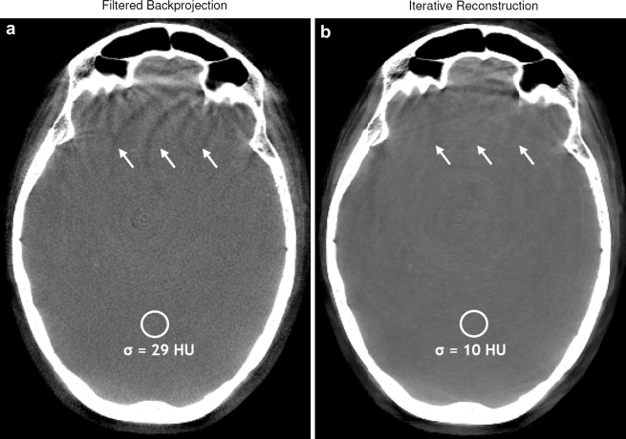
Why Iterative Reconstruction
Source : Iterativereconstruction methods in X-ray CT
Marcel Beister, Daniel Kolditz, Willi A. Kalender

Slide 17
Motivation
Improving resolution of tomographic images has been an active area of research in the past few years.
Nuclear imaging modalities such as PET and SPECT produce images of poor resolution (typically 128x128).
Higher resolution images are often required
to view details
for multimodal registration
Problem Statement
Generating higher resolution tomographic images of good quality from given scanner (sinogram) data

Slide 18
Existing methods for improving resolution
Direct upsampling using a suitable kernel.
Computationally inexpensive but image quality is compromised
Super resolution techniques :
(i) projection data is obtained after applying sub-pixel shifts and rotation to the object [Kennedy et al TMI 2006]
Impacts dosage, scan time and data integrity
Not feasible to implement with a patient
(ii) reconstruction by union of low resolution images on shifted lattices (denoted as USL) [Chang et al Med. Phys. 2008]

Slide 19
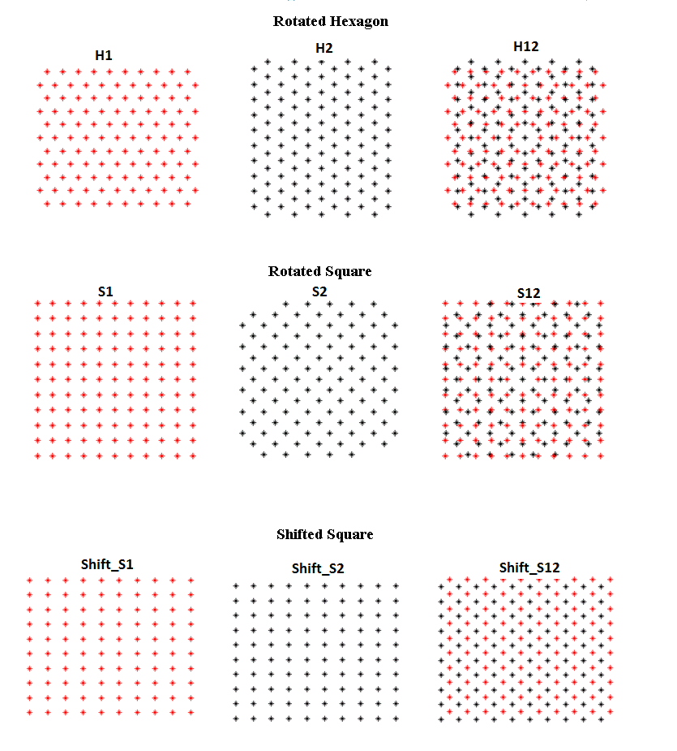
Union of Shifted Lattices (USL)

Slide 20
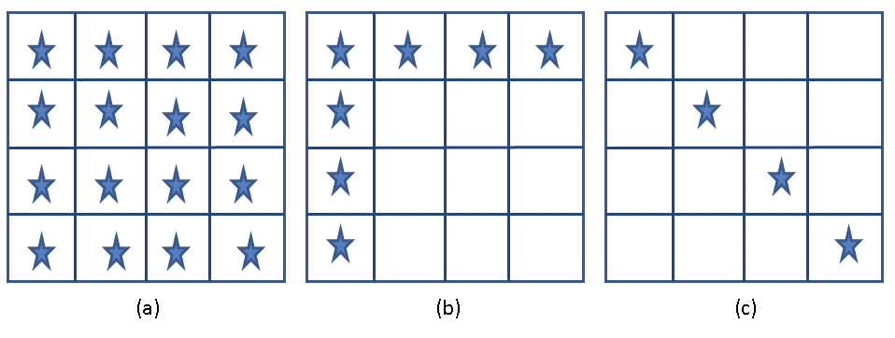
Required low resolution images (marked by stars) required for deriving an up- sampled (by 4) image using USL :
16 with SR algorithm [Chang et al Med. Phys. 2008]
7 with ISR-1 algorithm [Chang et al Med. Phys. 2009]
4 with ISR-2 algorithm [Chang et al Med. Phys. 2009]

Slide 21
Proposed Solutions
An alternative lattice: In this approach, we use samples defined on single hexagonal lattice for generating upsampled images.
Multiple lattices: Here, an up-sampled image is generated using a super resolution technique by combining low resolution images which are defined on two rotated lattices (denotes as URL).
Both hexagonal and square lattices were considered

Slide 22
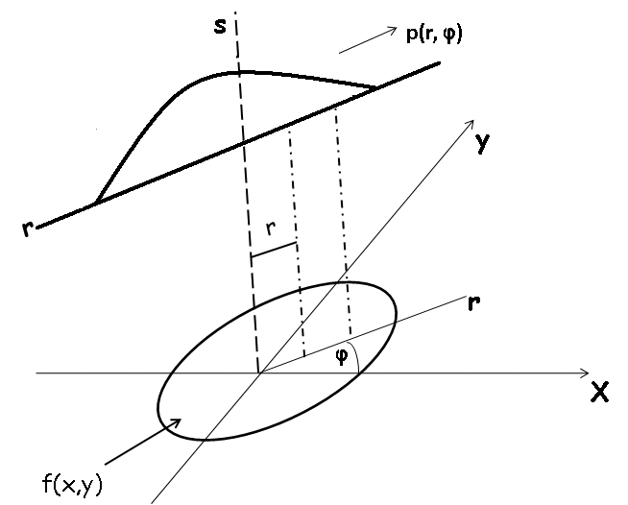
Radon transform for Hex Lattice
The Radon Transform (RT) is an integral transform whose inverse is used to reconstruct images
f(x,y) : a function defined on hexagonal coordinates (x,y)
p(r,φ): 1-D sinogram of f(x,y) defined over rotated (r,s) coordinate system

Slide 23
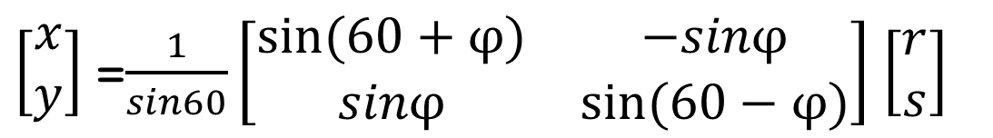
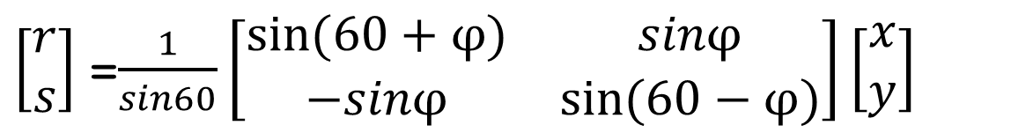
Relationship between coordinates
$\left[\begin{matrix}r \\ s\end{matrix}\right]$ =$\frac{1}{sin60}\left[\begin{matrix}sin⁡(60+φ) & sinφ \\ −sinφ & sin(60−φ)\end{matrix}\right]\left[\begin{matrix}x \\ y\end{matrix}\right]$
$\left[\begin{matrix}x \\ y\end{matrix}\right]$ =$\frac{1}{sin60}\left[\begin{matrix}sin⁡(60+φ) & −sinφ \\ sinφ & sin⁡(60−φ)\end{matrix}\right]$ $\left[\begin{matrix}r \\ s\end{matrix}\right]$

Slide 24
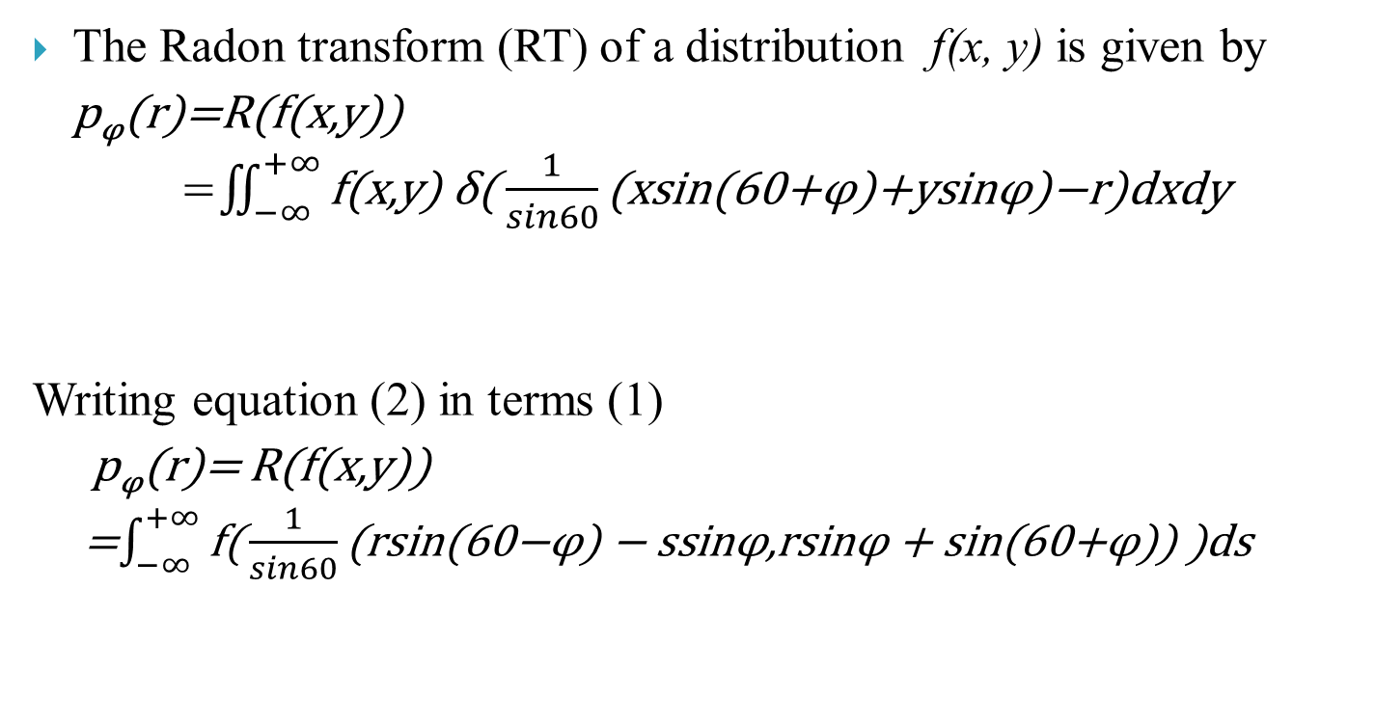
Radon transform for Hex Lattice
The Radon transform (RT) of a distribution f(x, y) is given by
p_{φ}(r)=R(f(x,y))
=$\iint_{−∞}^{+∞}{\text{f}\text{(}\text{x}\text{,}\text{y}\text{) }\text{δ}\text{(}\frac{1}{sin60}\text{(}\text{x}\text{sin}\text{(}\text{60}\text{+}\text{φ}\text{)}\text{+}\text{ysin}\text{φ}\text{)}\text{−}\text{r}\text{)}\text{dxdy} }$
Writing equation (2) in terms (1)
p_{φ}(r)= R(f(x,y))
=$\int_{−∞}^{+∞}{\text{f}\text{(}\frac{1}{sin60}\text{(}\text{r}\text{sin}\text{(}\text{60}\text{−}\text{φ}\text{)}\text{ − }\text{ssin}\text{φ}\text{,}\text{rsin}\text{φ} \text{+ }\text{sin}\text{(}\text{60}\text{+}\text{φ}\text{)}\text{) }\text{)}\text{ds}}$

Slide 25
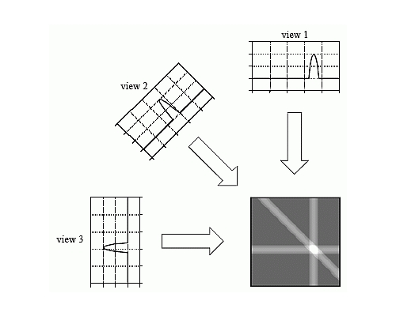
2D Tomographic Reconstruction Using Filtered Back Projection
Object
(continuous)
Sinogram
(n* Φ)
DFT(1D)
Filtering
Inverse DFT
(1D)
Back Projection
(on discrete lattice)
Reconstructed Image

Slide 26
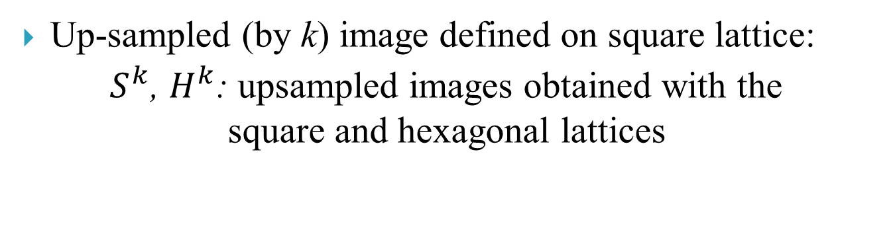
Implementation details
Filtered back projection on square lattice
Bicubic interpolation
S^{K}
Projection data
(sinogram) (n*Φ)
Filtered back projection on hexagonal lattice
Non-linear splines
H^{K}
Up-sampling (by k) pipeline
Up-sampled (by k) image defined on square lattice:
$S_{}^{k}$, $H_{}^{k}$: upsampled images obtained with the square and hexagonal lattices

Slide 27
Super Resolution (Multiple lattice)
Notes:
How shall I approach this slide? The description is too big.

Slide 28
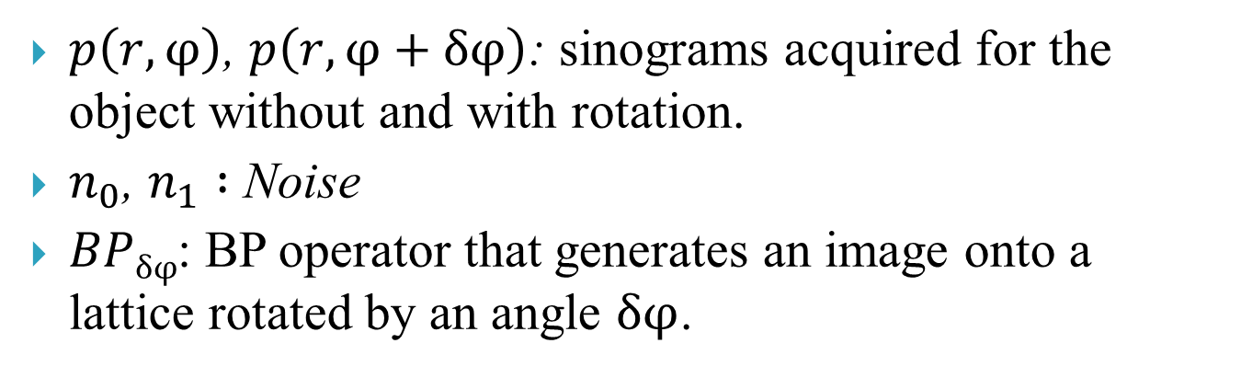
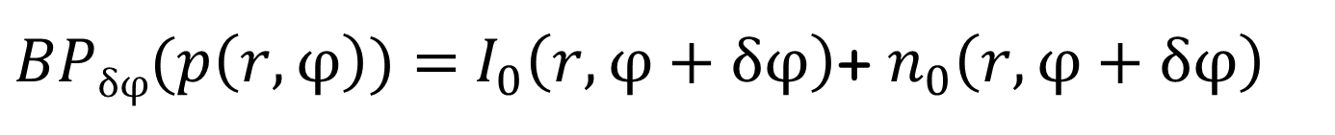
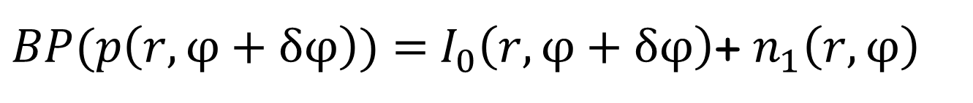
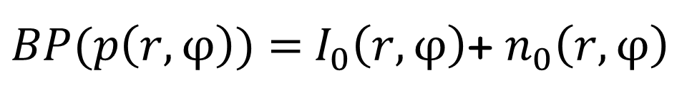
Super resolution ….
$BP(p\left(r,φ\right))=$ $I_{0}\left(r,φ\right)$+ $n_{0}\left(r,φ\right)$
$BP(p\left(r,φ+δφ\right))=$ $I_{0}\left(r,φ+δφ\right)$+ $n_{1}\left(r,φ\right)$
$BPδφ(p\left(r,φ\right))=$ $I_{0}\left(r,φ+δφ\right)$+ $n_{0}\left(r,φ+δφ\right)$
$p\left(r,φ\right)$, $p\left(r,φ+δφ\right)$: sinograms acquired for the object without and with rotation.
$n_{0}$, $n_{1} :$ Noise
$BPδφ$: BP operator that generates an image onto a lattice rotated by an angle $δφ$.
Notes:
Shall I include fourier domain equations also.

Slide 29
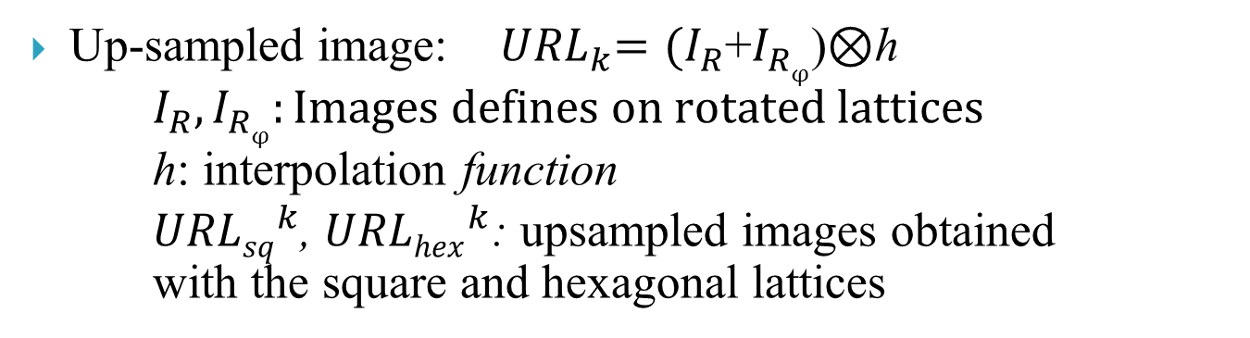
Implementation details
Filtered back projection on
lattice 1
Combination of samples for up-sampling by k
Projection data
(sinogram) (n*Φ)
URL^{k}
Filtered back projection on lattice 2
Pipeline for generating URL images, lattice 2 is a rotated version of lattice 1
Up-sampled image:${ URL}_{k}=(I_{R}$+$I_{Rφ}$)⊗h
$I_{R},I_{Rφ}:Images defines on rotated lattices$
h: interpolation function
${URLsq}_{}^{k}$, ${URLhex}_{}^{k}$: upsampled images obtained with the square and hexagonal lattices

Slide 30
Implementation details …..
Up-sampled SR image
Ref1:
USL^{k}
Projection data
(sinogram) (n*Φ)
Filter back projection on to shifted square lattice
Image with origin at (0,0)
Up-sampled image (bicubic interpolation)
Ref2:
S^{k}
Pipeline for Generating reference images for validation of results
Reference images for Assessment of proposed method
Direct upsampled images S^{k}₍ref1): The input sinogram was filtered and back projected onto a square lattice using the FBP algorithm. This was next up-sampled using bi-cubic interpolation to obtain image S^{k.}
Union of shifted lattices USL^{k} (ref2): The FBP algorithm was used to generate sub-pixel shifted images defined on square lattices. [J.A.Fessler, image reconstruction toolbox],[Vandewalle , Super resolution toolbox ]

Slide 31
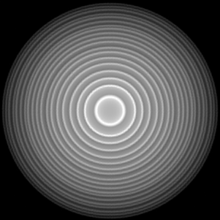
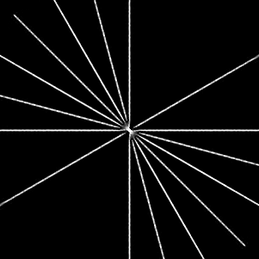
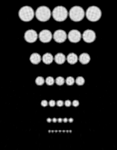
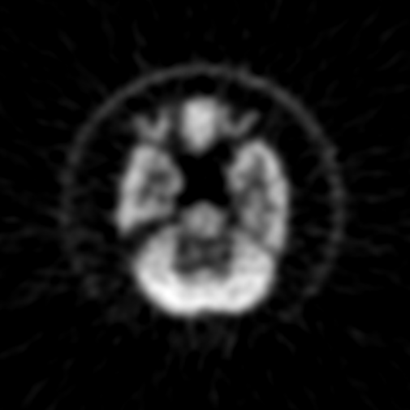
Phantoms
Concentric rings
Size:151x180
Lines
Size:121x180
Dots
Size:101x180
Hoffman brain
Size:396x315x91
NEMA
Size:293x280

Slide 32
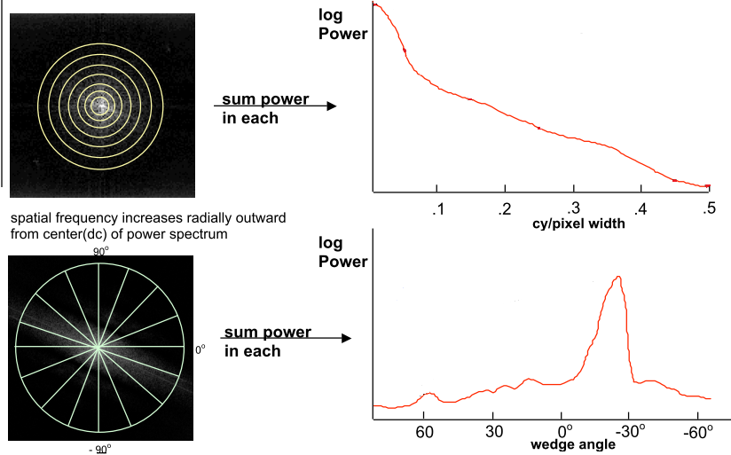
Quality Metric
Energy Distribution plots:
Energy Distribution plots in radial and
angular (wedge) directions [Bill,IQM toolbox]

Slide 33
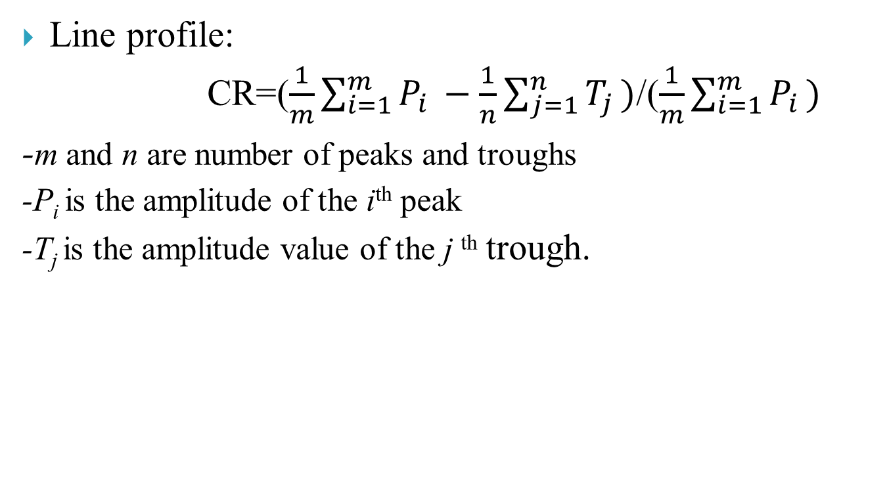
Quality Metric ……
Line profile:
CR=($\frac{1}{m}\sum_{i=1}^{m}{P_{i }}−\frac{1}{n}\sum_{j=1}^{n}{T_{j })}$/($\frac{1}{m}\sum_{i=1}^{m}{P_{i })}$
-m and n are number of peaks and troughs
-P_{i} is the amplitude of the i^{th} peak
-T_{j} is the amplitude value of the j ^{th} trough.
Line profiles of the 1st row for Dots.

Slide 34
Upsampled ROI(by 4) of Concentric Rings
S⁴
H⁴
USL⁴
URL⁴_{sq}‏
URL⁴_{hex}‏

Slide 35
Spectra of upsampled concentric rings
S⁴
H⁴
USL⁴
URL⁴_{sq}‏
URL⁴_{hex}‏

Slide 36
Wedge Plot -Concentric rings

Slide 37
Radial Plot –Concentric rings

Slide 38
Upsampled ROI(by4)- Line
S⁴
H⁴
USL⁴
URL⁴_{sq}‏
URL⁴_{hex}‏

Slide 39
Upsampled ROI(by4)-Dots
S⁴
H⁴
USL⁴
URL⁴_{sq}‏
URL⁴_{hex}‏

Slide 40
Intensity Profile of the penultimate line
 | S⁴ | H⁴ | USL⁴ | URL⁴_{sq} | URL⁴_{hex}
Contrast ratio | 0.5406 | 0.5262 | 0.5645 | 0.5717 | 0.5581

Slide 41
Intensity Profile of the last line
 | S⁴ | H⁴ | USL⁴ | URL⁴_{sq} | URL⁴_{hex}
Contrast ratio | 0.6086 | 0.5874 | 0.6516 | 0.6638 | 0.6534

Slide 42
Upsampled ROI(by4)-Dots(OSEM)
S⁶
USL⁶
URL⁶_{sq}‏
 | S⁴ | USL⁴ | URL⁴_{sq}
Contrast ratio | 0.6964 | 0.7761 | 0.7627

Slide 43
Intensity Profile of the last line

Slide 44
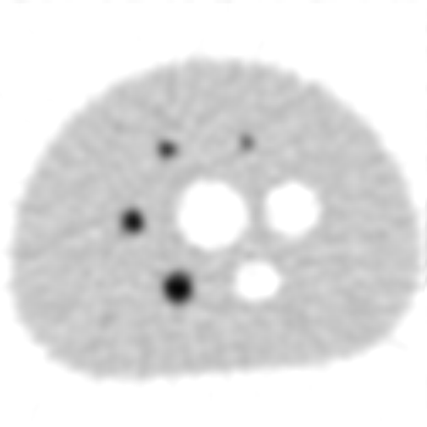




Nema- Upsampling factor 4
S⁴
H⁴
USL⁴
URL⁴_{sq}‏
URL⁴_{hex}‏

Slide 45
Spectra of NEMA
S⁴
H⁴
USL⁴
URL⁴_{sq}‏
URL⁴_{hex}‏

Slide 46
Line profiles of the smallest sphere
-NEMA phantom

Slide 47
Radial Energy Plot –NEMA phantom

Slide 48

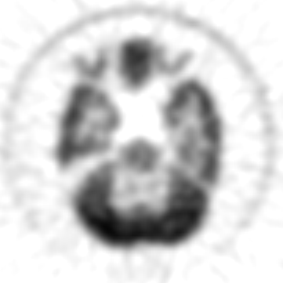

Hoffman Brain Phantom (upsampling factor 4)
URL⁴_{hex}‏
S⁴
USL⁴

Slide 49
Hoffman Brain Phantom: Spectra
S⁴
USL⁴
URL⁴_{hex}‏

Slide 50
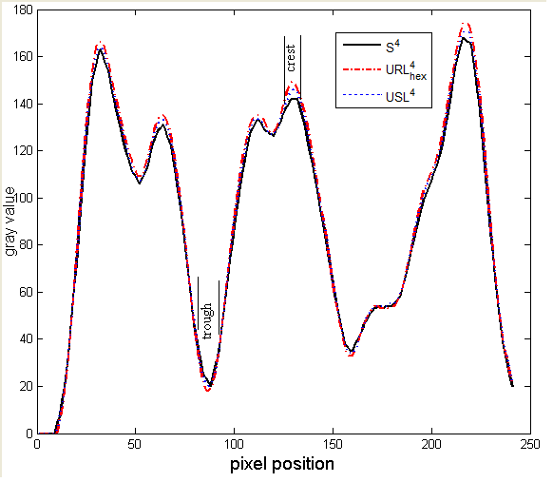
Line profile
Selected Line
Images | Difference in gray values of trough region |  |  |  |  |  |  |  |  |  |  | Avg
URL-S | -2 | -2 | -3 | -2 | -4 | -5 | -3 | -1 | -2 | -3 | -1 | -2.5
USL-S | -1 | -1 | -2 | 0 | -2 | -2 | -1 | +1 | 0 | -2 | -1 | 1.0
Images | Difference in gray values of crest region |  |  |  |  |  |  |  |  |  |  | Avg
URL-S | +5 | +7 | +7 | +7 | +7 | +6 | +4 | +5 | +5 | +5 | +5 | 5.7
USL-S | +2 | +3 | +3 | +3 | +4 | +4 | +3 | +3 | +3 | +3 | +2 | 3.0

Slide 51
Hoffman Phantom: slice 19
Noise spectra of the ROI
ROI
S²
USL²
URL²_{hex}‏
ROI : taken from the 19th slice of the Hoffman phantom
- used for computing noise spectra

Slide 52
Summary
Problem addressed: Generating higher resolution tomographic images of good quality from given scanner (sinogram) data
Proposed Solutions:
Use a Hexagonal lattice for reconstruction
Use a combination of rotated lattices (hex or square) for reconstruction

Slide 53
Conclusion
Single Lattice:
From the results it is evident that Hexagonal and Square lattices yield upsampled images that are of similar quality.
However, use of Hexagonal lattice incurs lesser computation cost, better representation of signal, additional equi-distance neighbor and better representation of curved structures.

Slide 54
Conclusion ...
Multiple Lattice:
Images generated by URL scheme are of better quality when compared with direct upsampling method as well as of comparable quality to the image obtained by ISR-2 algorithm [Chang et al Med. Phys. 2009]
URL saves storage space and computational cost.
For example for generating K times upsampled image, K² shifted images are needed. ISR-1 and ISR-2 require 2*(k-1) and K images respectively. Our proposed method requires 2 images for any upsampling (k=2…6)factor.

Slide 55
Future Work
Explore different interpolation kernels: hex splines etc.
Explore design of adaptive kernel.
Multiple lattices: Optimal rotational angle could be computed theoretically.
Explore GPU platform for further speedup.

Slide 56
Reference:
[1] J. A. Kennedy, O. Israel, A. Frenkel, R. Bar-Shalom, and H. Azhari,
“Super resolution in PET imaging”, TMI 25(2), 2006.
[2] G. Chang, T. Pan, J. Clark Jr., O.R. Mawlawi, “Comparison between two
super resolution implementations in PET imaging” Med. Phys, 2009.
[3] G Chang, T Pan, J Clark, Jr, O.R. Mawlawi, “Optimization of super-
resolution processing using incomplete image sets” Med. Phys, 2008.
[4] P.Vandewalle, K. Krichane, P. Zbinden, Super resolution toolbox
(http://lcavwww.epfl.ch/software)
[5] J.A.Fessler, image reconstruction toolbox
(http://www.eecs.umich.edu/fessler/code)
[6] N.B. Nill and B.H. Bouzas, "Objective Image Quality Measure Derived
from Digital Image Power Spectra”, Optical Engineering, vol.31, 1992

Slide 57
Publication
N. Dixit, N. V. K. Medathati and J. Sivaswamy, "Synthetic Zooming of Tomographic Images by Combination of Lattices", Nuclear Science Symposium Medical Imaging Conference, Orlando, 2009.
N. Dixit and J. Sivaswamy, "Novel Approach to Generate Up-sampled Tomographic Images using Combination of Rotated Hexagonal Lattices ", National Conference on Communication, Chennai, 2010.

Slide 58
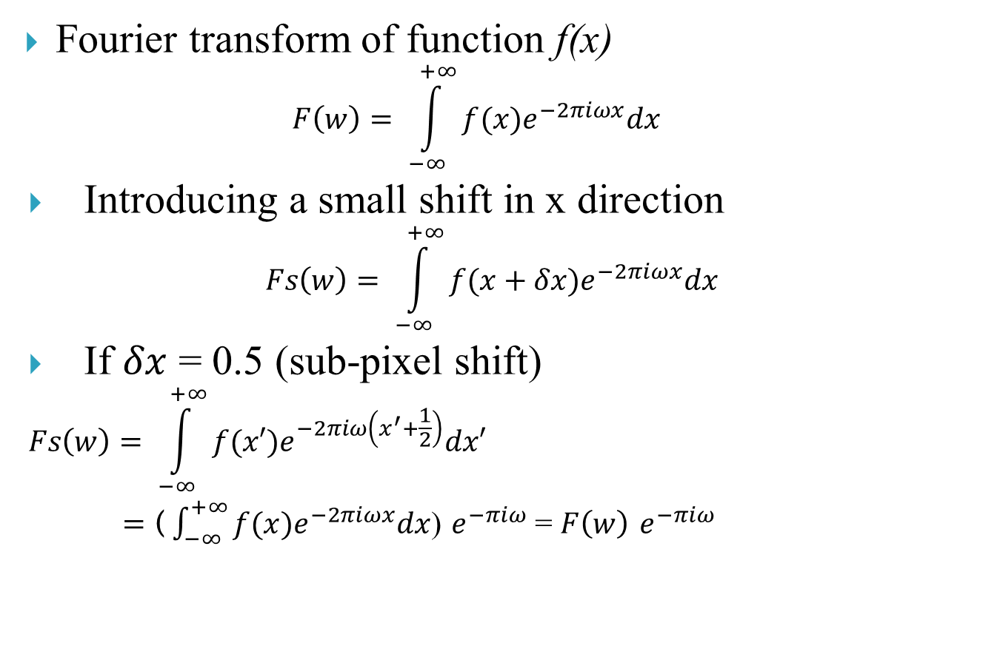
Super resolution concept
Fourier transform of function f(x)
$$F\left(w\right)= \int_{−∞}^{+∞}{f(x)e^{−2πiωx}dx}$$
Introducing a small shift in x direction
$$Fs\left(w\right)= \int_{−∞}^{+∞}{f(x+δx)e^{−2πiωx}dx}$$
If $δx$ = 0.5 (sub-pixel shift)
$$Fs\left(w\right)= \int_{−∞}^{+∞}{f(x′)e^{−2πiω\left(x^{′}+\frac{1}{2}\right)}dx′}$$
$=$ ($\int_{−∞}^{+∞}{f(x)e^{−2πiωx}dx}$) $e^{−πiω}$ = $F\left(w\right)$ $e^{−πiω}$

Slide 59
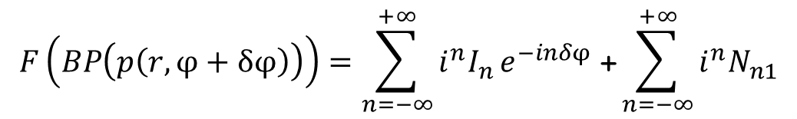
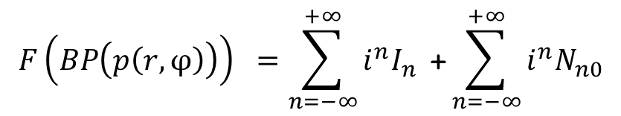
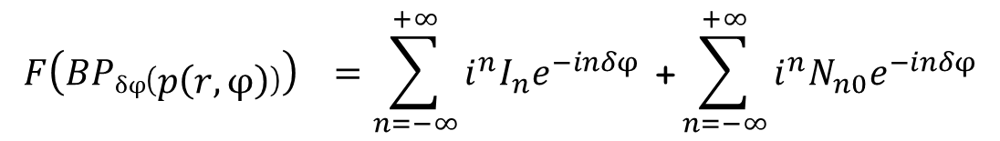
Super resolution: Hex lattice
$$F\left(BP\left(p\left(r,φ\right)\right)\right) =\sum_{n=−∞}^{+∞}{{i_{}^{n}I}_{n}}\text{ +}\sum_{n=−∞}^{+∞}{{i_{}^{n}N}_{n0}}$$
$$F\left(BP\left(p\left(r,φ+δφ\right)\right)\right)=\sum_{n=−∞}^{+∞}{{i_{}^{n}I}_{n}}e^{−inδφ}\text{ +}\sum_{n=−∞}^{+∞}{{i_{}^{n}N}_{n1}}$$
$$F\left(BPδφ\left(p\left(r,φ\right)\right)\right) =\sum_{n=−∞}^{+∞}{{i_{}^{n}I}_{n}e^{−inδφ}} \text{+}\sum_{n=−∞}^{+∞}{{i_{}^{n}N}_{n0}e^{−inδφ}}$$

Slide 60
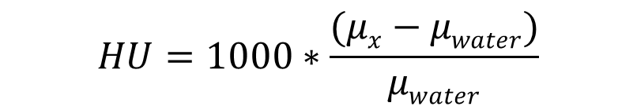
Hounsfield Table
Substance | HU
Air | −1000
Lung | −700
Soft Tissue | −300 to -100
Fat | −84
Water | 0
CSF | 15
Blood | +30 to +45
Muscle | +40
Bone | +700 to +3000 (dense bone)
$$HU=1000∗\frac{(μx−μwater)}{μwater}$$

