Slide 1


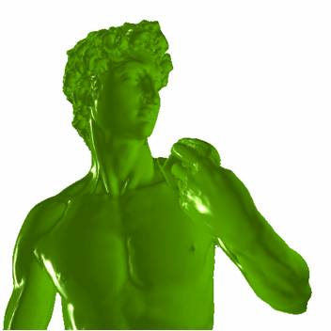
High Quality Rendering of Large Point-based Surfaces
Naveen Kumar Bolla (naveenb@research.iiiit.ac.in)
Guide: P. J. Narayanan, CVIT, IIIT Hyderabad.

Slide 2
Outline
Background and Motivation
Algebraic splat Representation
Splats Rendering
Metaballs Rendering

Slide 3
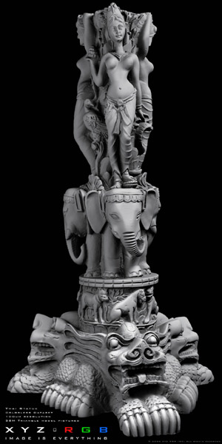
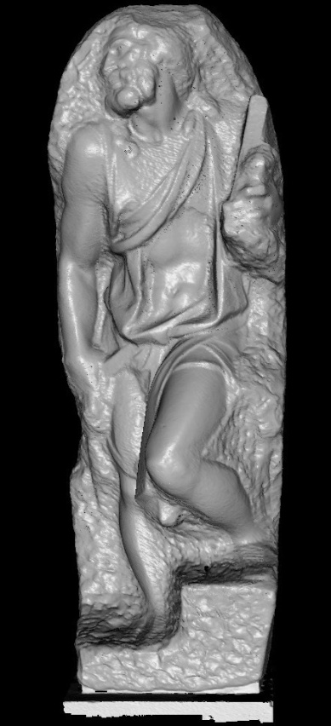
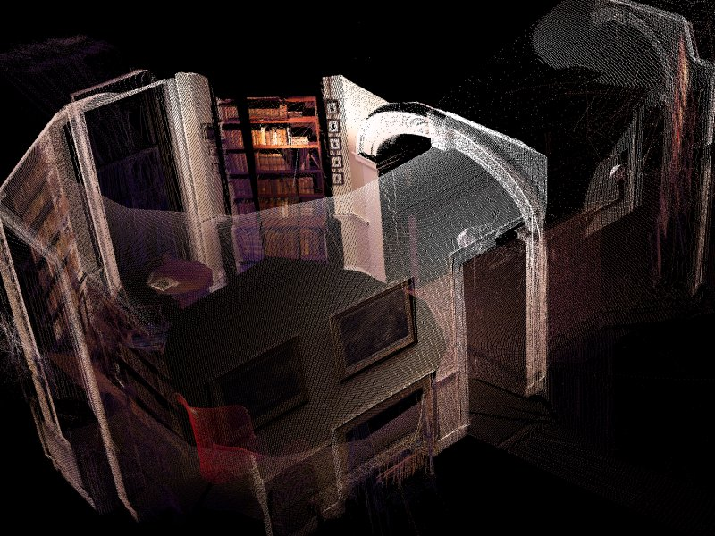
Motivation
UVA Monticello: 20 Million points
XYZRGB Thai Statue:
69 Million Points
Stanford St. Mathew:
400 Million points
So large that it is difficult to maintain the dataset
(let alone the data-structure) in working memory.

Slide 4
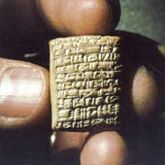
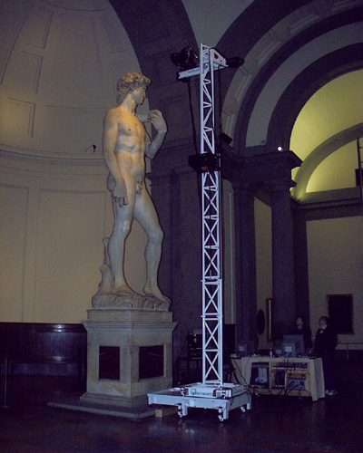
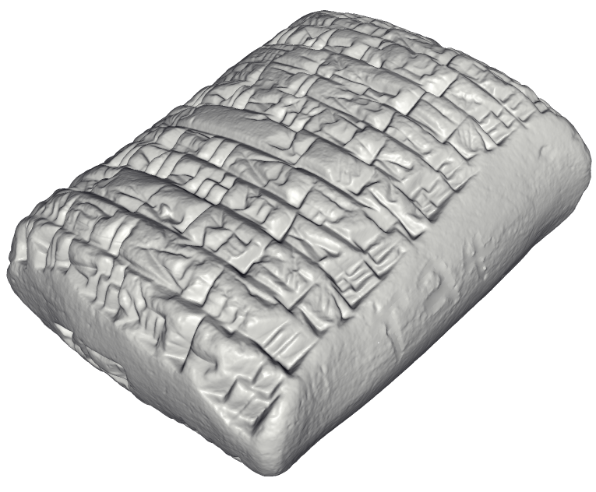
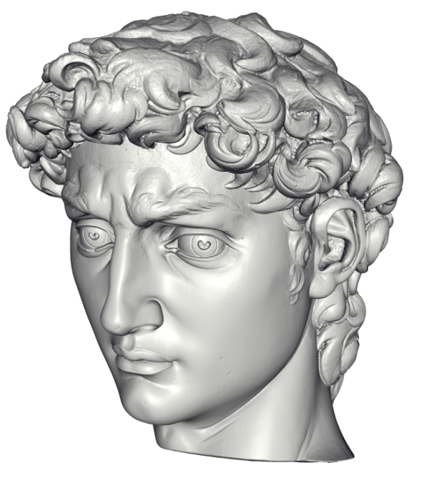
Motivation
http://www.jhu.edu/digitalhammurabi/
http://graphics.stanford.edu/projects/mich/
Archaeology
Cultural heritage
Reverse engineering
Films
Virtual environments
Medical imaging
Game content

Slide 5
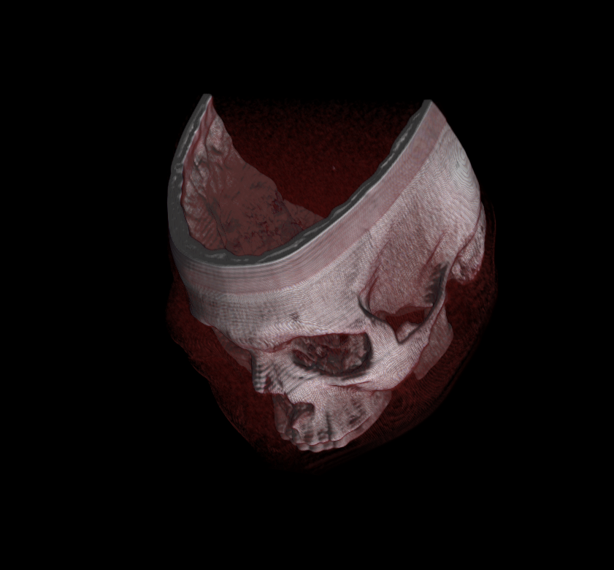
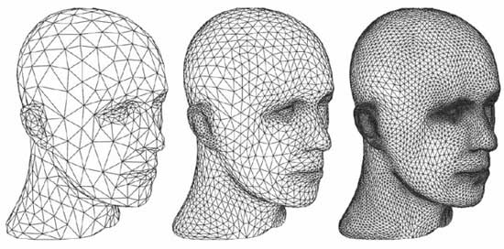
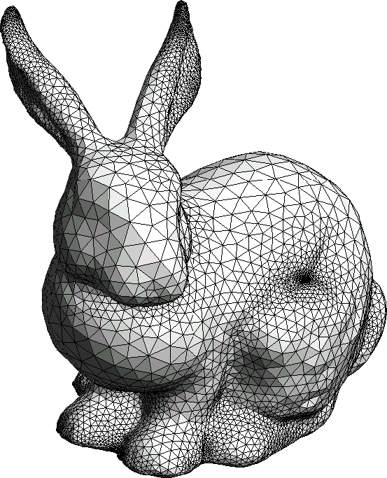
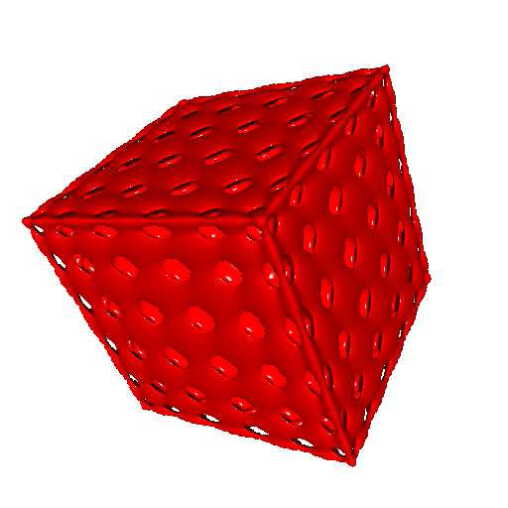
Geometry Representation
Polygonal Geometry
Volume data
Subdivision Surfaces
Parametric and Implicit Surfaces
Procedural Geometry and CSG

Slide 6
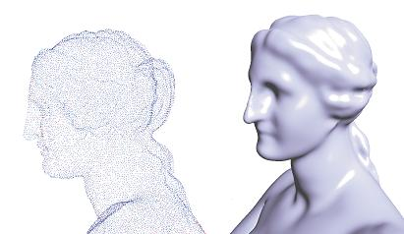
Point based graphics
Points as rendering primitive.
Points when rendered directly, holes are visible
Points need interpolation or extrapolation scheme.
Left: Direct rendering of points. Right: Rendering using point set surfaces.
Notes:
Add references for splats, surfels etc

Slide 7
Splats
Circular disks or Splats are the most popular extrapolation scheme.
Splats approximate the surface linearly in the small neighborhood.
Disadvantages
  Large number of linear primitives are needed.
  Low rendering speeds
  Shading is not independent of object sampling
Point based representation should be
  As small as possible
  Convey the shape well.

Slide 8
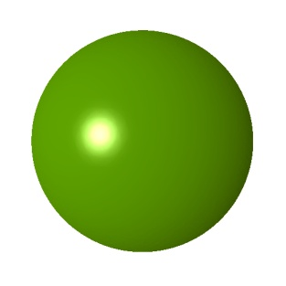
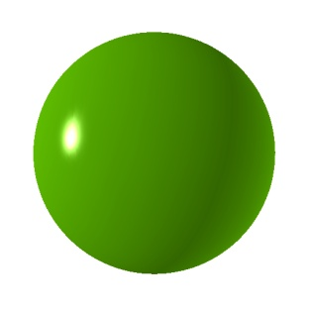
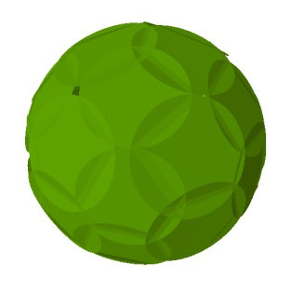

Non Linear Splats
Extrapolation scheme should convey shape
  With few number of primitives.
Idea: Non-Linear surface elements.
Non-linear splats preserves the shape.
Linear (3K)
Linear (52)
Qudratic (3K)
Qudratic (52)
Algebraic Splats

Slide 9
Contribution :: Algebraic Splats
A compact and lightweight representation of points
A multi-resolution structure with continuous LOD
Ray-tracing Algebraic splats on the GPU
Adaptive Anti-aliased Rendering

Slide 10
Related Work

Slide 11
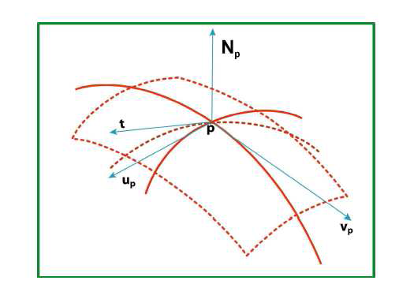
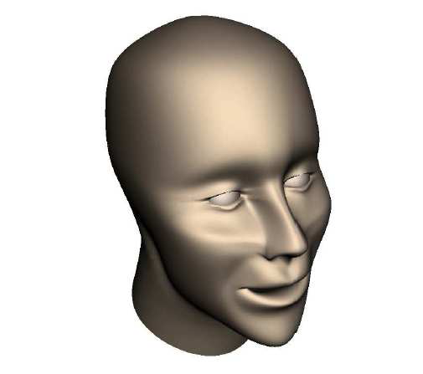
Differential Points [Kalaiah and Varshney 2003]
Local differential properties
Normal-mapped Rectangles are primitives
2X speed up and 75% less disk space
Our method saves more than 90% of disk space and 10X faster

Slide 12
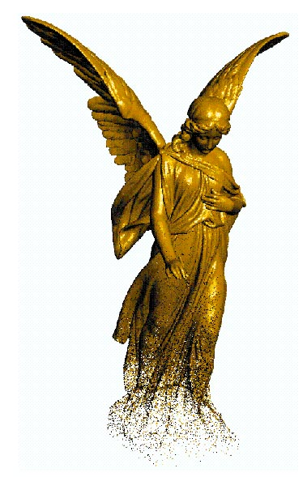
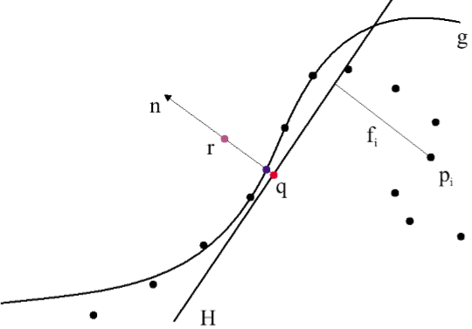
Point Set Surfaces
Moving Least Squares [Levin et. al. ]
  Fit a plane in the local neighborhood.
    Plane defines the local coordinate system
  Fit a polynomial implicit function to define the surface in local neighborhood.
Point set surfaces [Alexa et. al. 2001]
  Moving least squares based approach
  Methods to resample surface
  Rendering primitives are points or splats

Slide 13
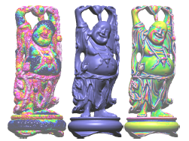
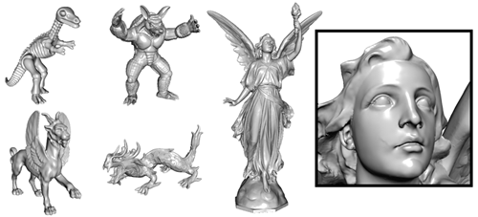
SLIM
Spare-Low degree Implicit (SLIM) surfaces [Ohtake et. al. ]
  Based on Multi-level partition of Unity (MPU)
  Fits low degree polynomials to the point sets.
  Sensitive to noise.
A GPU based rendering algorithm for SLIM is proposed in 2007.
A slim based approximation of Stanford Buddha. Ohtake et. al. 2005.

Slide 14
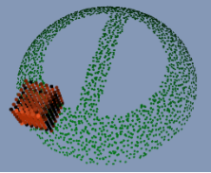
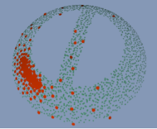
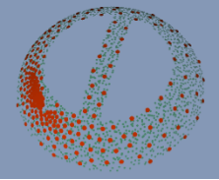
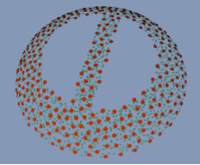
Locally Optimal Projection
Locally Optimal Projection (LOP) by Lipman et. al. in SIGGRAPH 2007.
    A method to refine the noisy data.
    It can projects arbitrary point set onto a input cloud.
We used above method to generate point based models of any given size.

Slide 15
Outline
Background and Motivation
Algebraic splat Representation
Splats Rendering
Metaballs Rendering

Slide 16
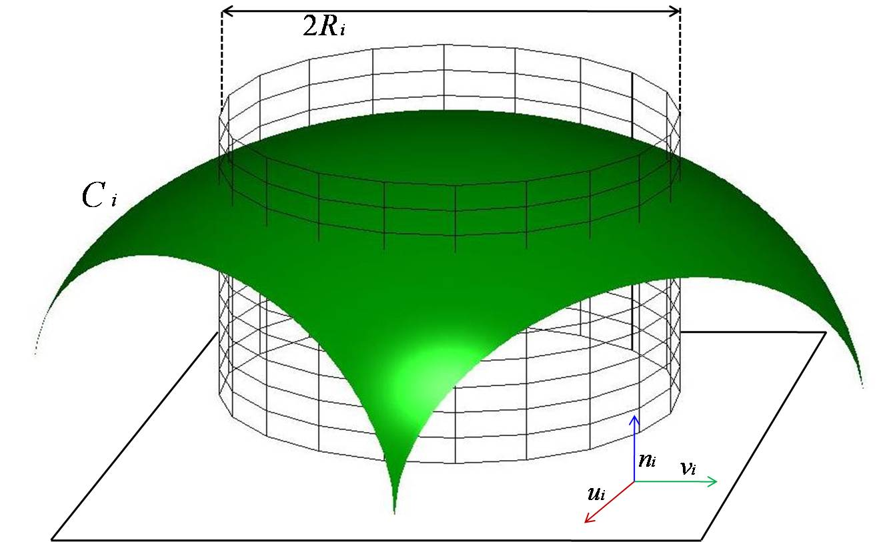
Algebraic splats
A locally restricted Moving Least Square surface
    Polynomial functions in the local neighborhood.
    Semi-Implicit in local neighborhood.

Slide 17
Radius of Restriction
Density dependent
Local feature size is computed as
  Find k-nearest neighbors of
  is the mean distance of k-nearest neighbors.
Local feature size
  Is used during weighting scheme for MLS.
  Controls smoothness of model.
  Captures the density of point set.

Slide 18
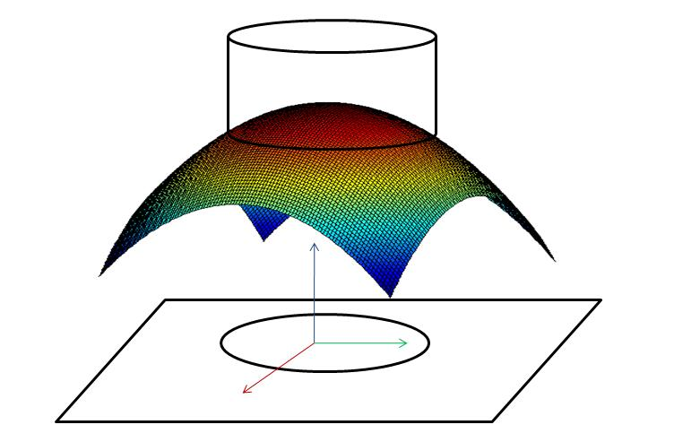
Generation of Algebraic Splat
Compute local feature size for each point
Compute MLS approximation of point
Represent algebraic splat as

Slide 19
Sub Sampling
Point set should be decimated.
Appropriate positions for splats need to be selected.
Point set can be decimated based on
  Overall quality-based decimation.
  Decimation based on size of point set.
Notes:
Now, we need to decimate the point set by selecting appropriate splats for representing the model. We proposed two methods for this. One is overall quality based and other is based on number of splats

Slide 20
Quality based decimation
For a given point
  Remove all points which are at less than cut-off distance
  Add to new set.
  Continue until all points are either selected or discarded.
New set is the required sub-sampled set.
Cut-off distance
  : specifies the quality of model.

Slide 21
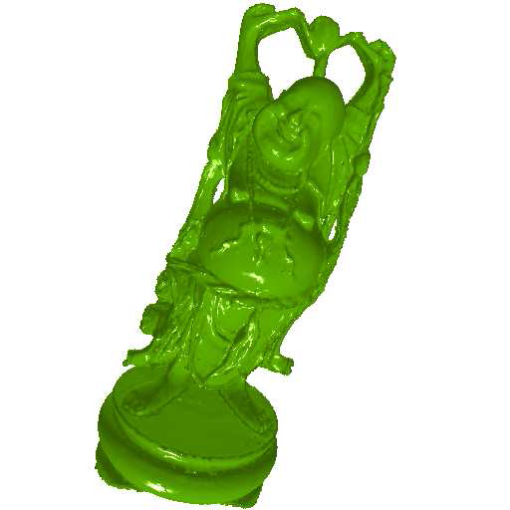

Result :: Quality-based Decimation
Dragon
42K Algebraic Splats (9.6%)
Happy Buddha
24K Algebraic Splats (4.4% )

Slide 22
Fixed-size point set generation
Based on LOP method.
Algorithm:
    Select M random points (L) from a given point set (P).
    Apply LOP operator between L and P to obtain D
    D is regularly distributed into the shape of P.
    Generate algebraic splats for all points in D using D U P.

Slide 23
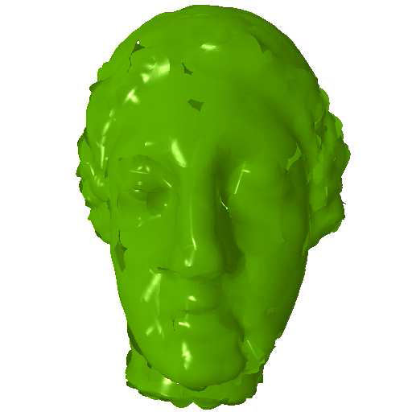
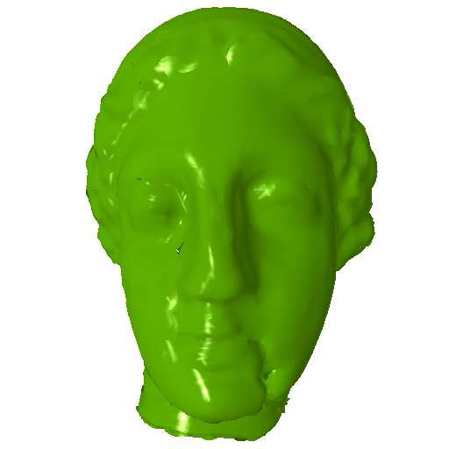
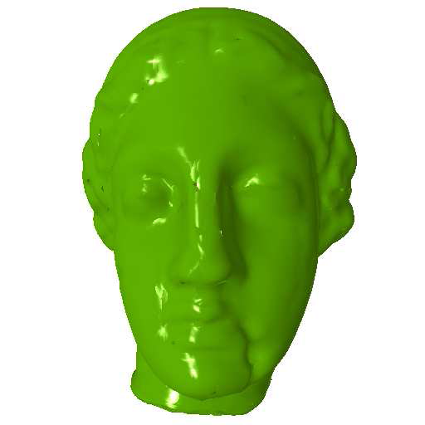
Result :: Fixed-Point Decimation
IGEA
1%, 2% and 10% of points

Slide 24
Error
Error of approximation at point in the original point cloud is due to combined error of the near by overlapping splats.

Slide 25
Multi-resolution
Point clouds are easily amenable to Level of detail approaches.
To enable continuous level of detail rendering.
The data set is divided into various sets.
Computed in two stages

Slide 26
Multi-resolution :: First stage
User specifies Maximum (Q_{M}) and Minimum (Q_{m}) Quality for multi-resolution representation
Algebraic splat representations P_{M} and P_{m} are computed for quality levels Q_{M} and Q_{m}
A difference set P_{d} is computed as P_{M} - P_{m}
Notes:
Now the points in P_d should be added to P

Slide 27
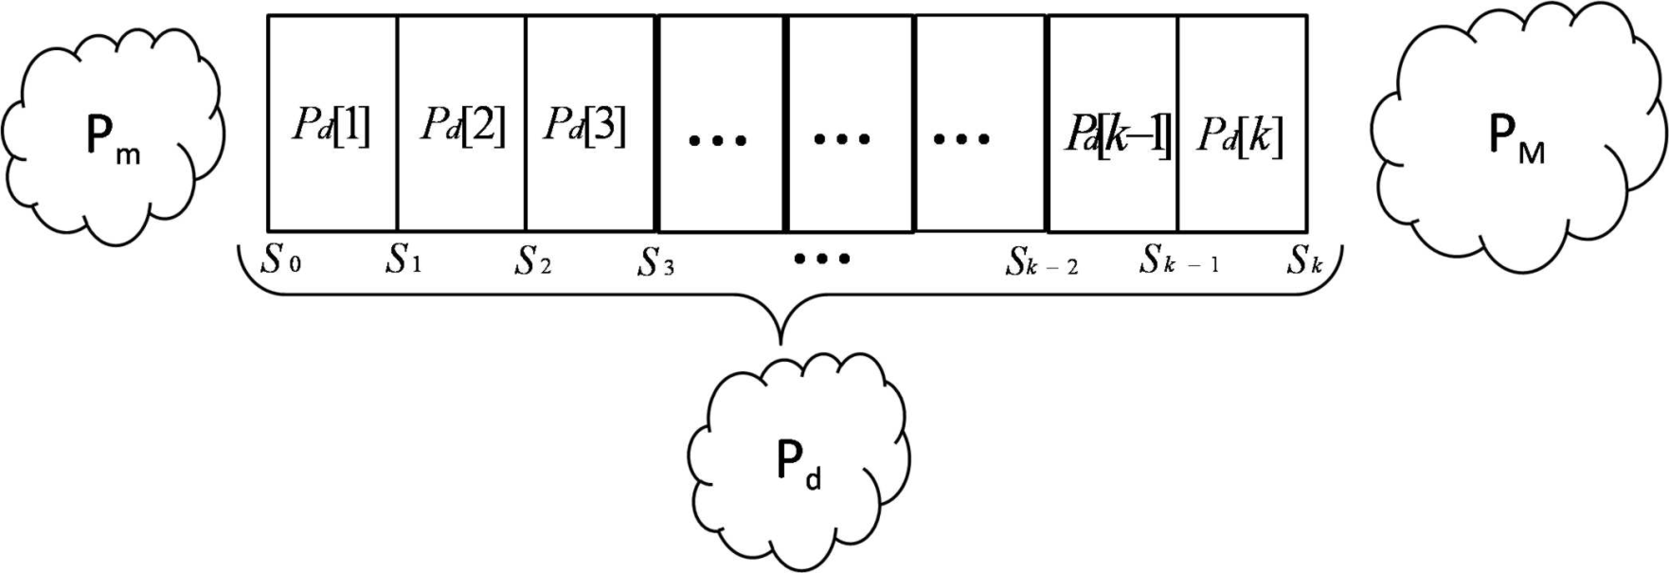
Multi-resolution :: Stage 2
The kth partition of difference set P_{d}[k] is

Slide 28
Continuous Level of Detail
Octree is built over multi-resolution representation.
The data in each leaf nodes is sorted in the order of partitions defined.
LOD is defined for at each leaf node of Octree.
For a i^{th} leaf node at LOD level l^{th}

Slide 29
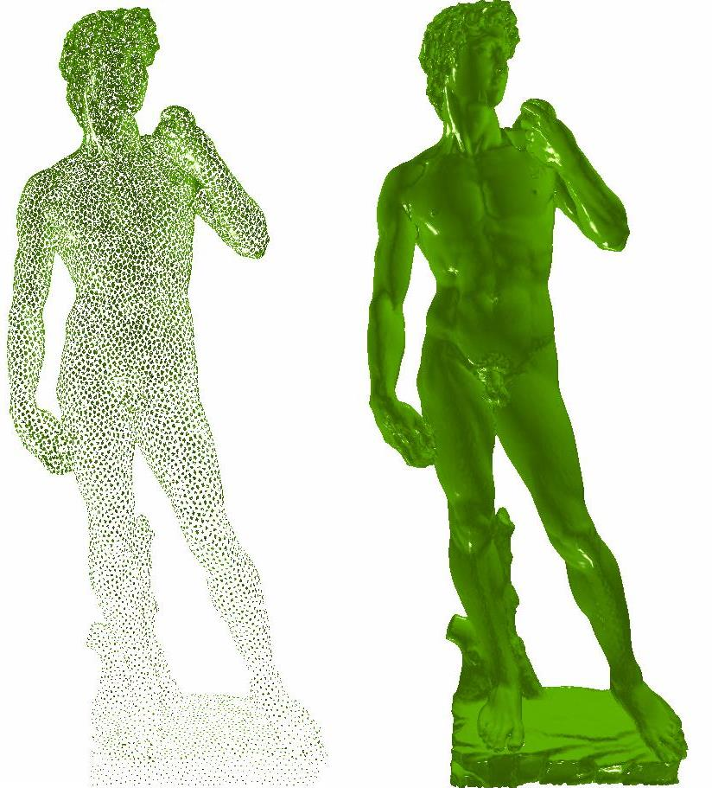
David :: Multi-resolution Rendering
For Camera at top

Slide 30
Outline
Background and Motivation
Algebraic splat Representation
Splats Rendering
Metaballs Rendernig

Slide 31
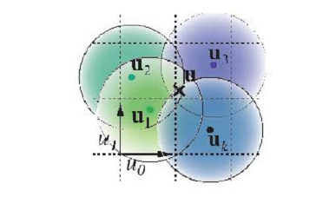
Rendering Algebraic splats
A GPU based ray-casting of splats.
Overlapping and non-conforming splats
  Blending is needed depth and normal space
    Smooth rendering
2-pass rendering algorithm
  Visibility pass
  Blending pass

Slide 32

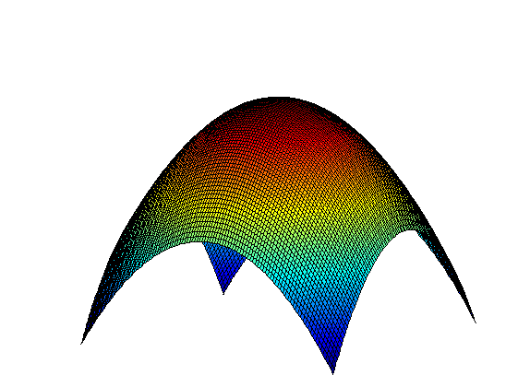
Rendering Algebraic Splats
camera
screen
Notes:
Change matlab graph to some thing real splat

Slide 33
Rendering a single splat
A screen space bounding box is computed for a splat.
Rays are generated only inside this bounding box.
Ray-surface intersection is computed to get point in surface.
The normal is computed as gradient of surface.

Slide 34
2-pass algorithm
Visibility pass
  Nearest depth is accumulated in a depth buffer
  Depth buffer is shifted away by
Blending pass
  Colors and depths of points with in from nearest points are blended.
  The output of color buffer
  Gaussian weighting.
Rendering pass
  The color buffer is normalized and copied to output color buffer.

Slide 35
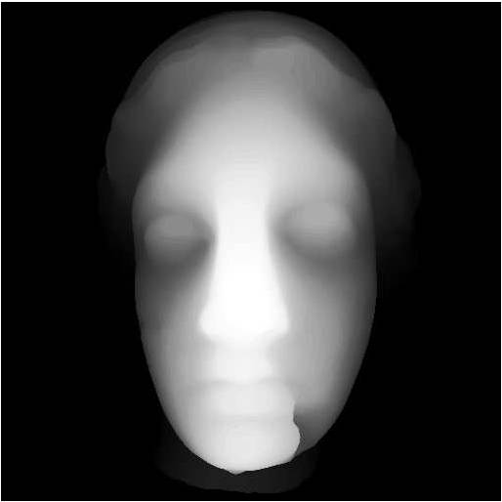
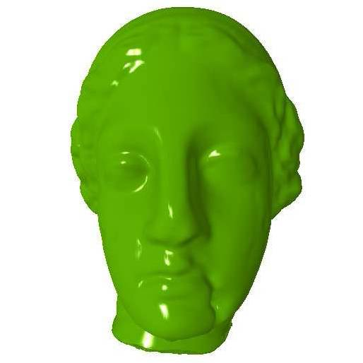
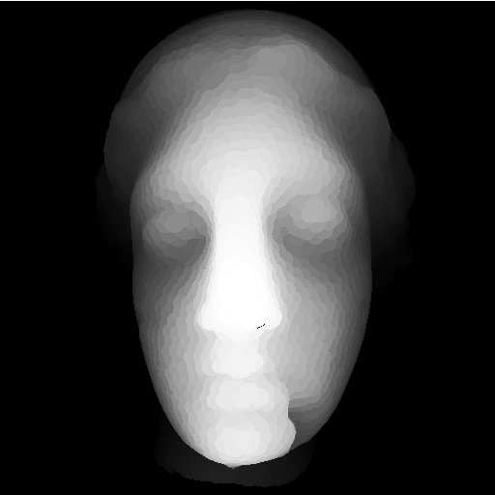
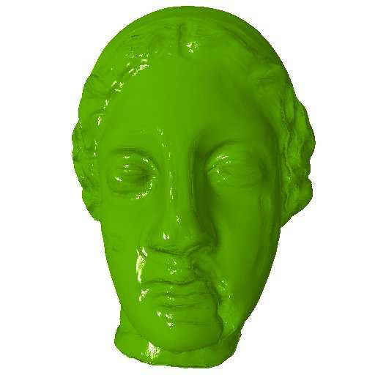
Results :: Blending

Slide 36
Ray-splat Intersection
Splats are
Transform to ray parameter space,
  Rays is defined as
      is camera center in local coordinate system
      is direction of ray
Solve
  The smallest positive root inside disc is desired root.
  Ray-splat intersection

Slide 37
Finding Roots
Analytical Methods are used to find the roots.
  Only possible up 4th order surfaces.
Quadratics and cubic are solved using methods published by Jim Blinn.
Quartic equations are solved using Ferrari’s Method.

Slide 38
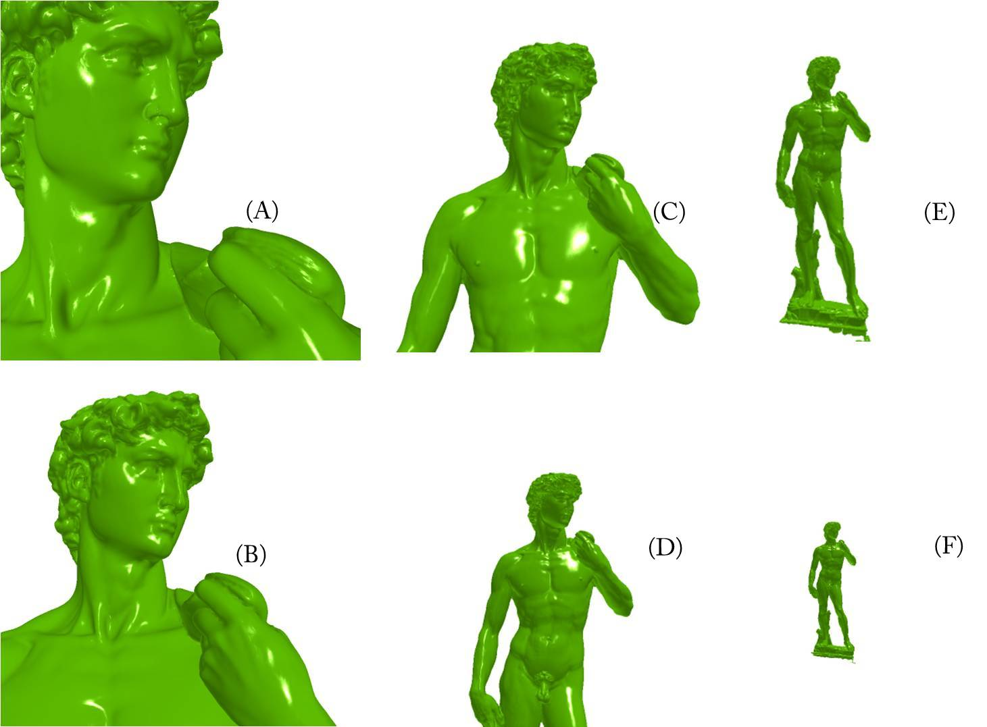
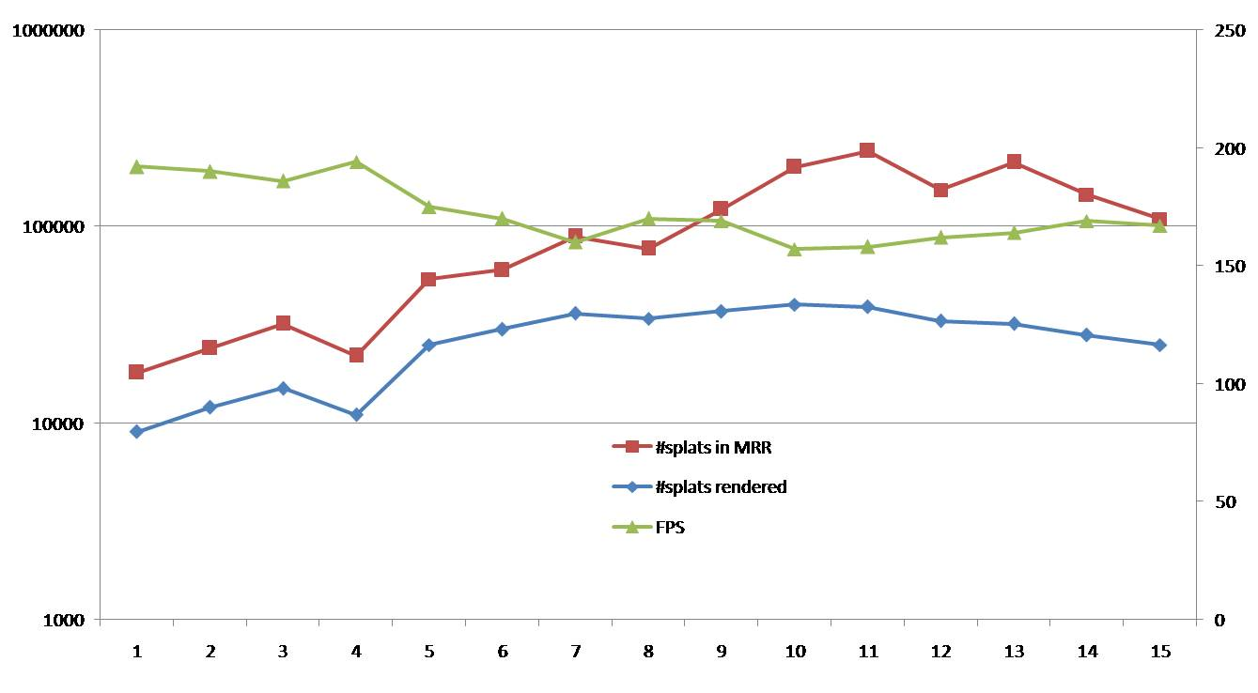
David :: Multi-resolution Rendering
David Multi Resolution :: From camera point of view
Rendering Speed Graph
Camera is at top.

Slide 39


Outline
Algebraic splat Representation
Multi-resolution Representation
High-Quality Rendering

Slide 40
Adaptive Anti-aliasing
Full screen anti-aliasing results in very slow speed
  4 times slower for 2x anti-aliasing
Only silhouette pixels need anti-aliasing
The silhouette pixels are detected by computing the derivative of the algebraic splats.
  At silhouette the magnitude of the derivative is very small.

Slide 41
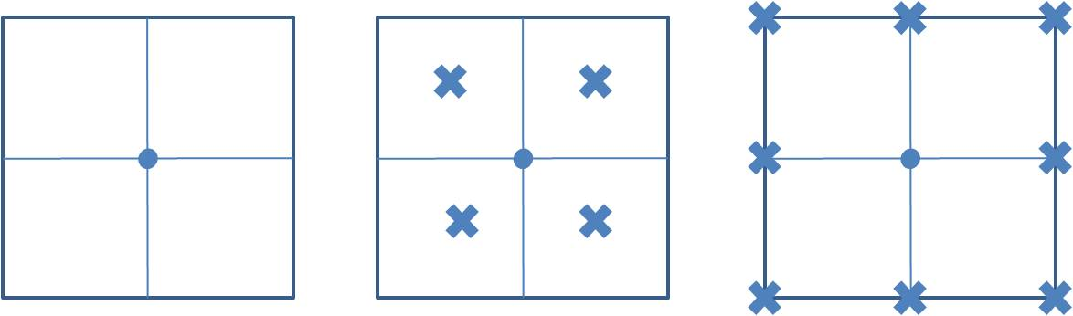
Adaptive Anti-aliasing
The fragments marked for anti-aliasing is super sampled
The below picture shows the normal pixel, 2x super sampled and 3x super sampled pixels.

Slide 42
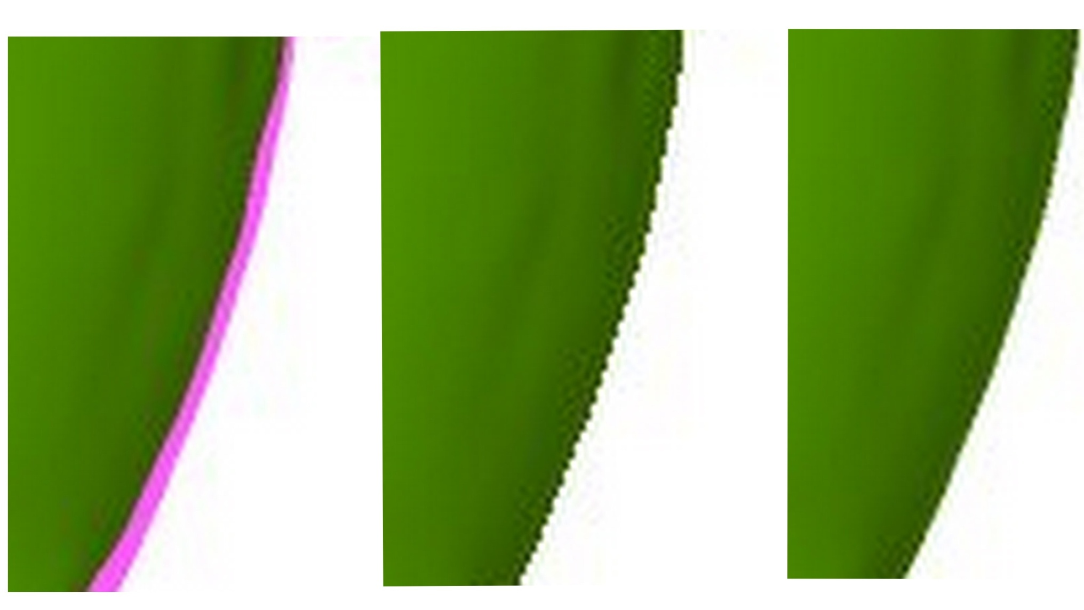
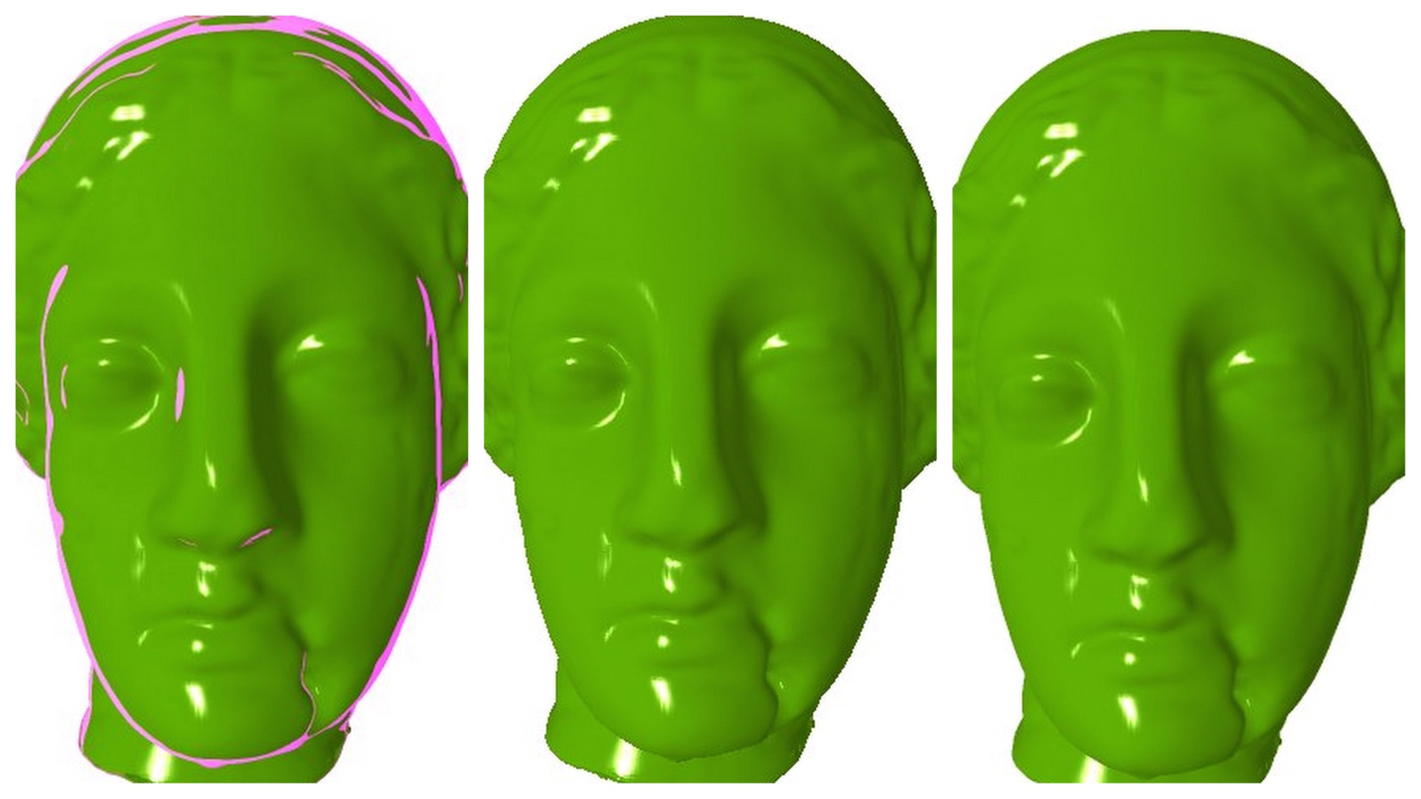
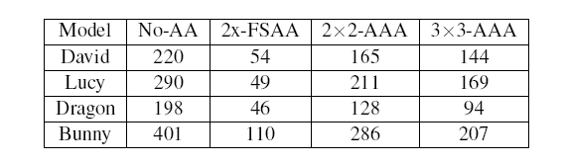
Igea :: Adaptive Anti-aliased
Performance of AAA

Slide 43
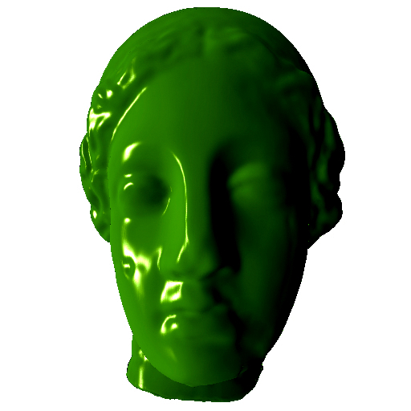
Shadow mapping
We used shadow mapping technique for generation of shadows
Igea at 95 fps with shadows and
anti-aliasing

Slide 44
Outline
Background and Motivation
Algebraic splat Representation
Splats Rendering
Results

Slide 45
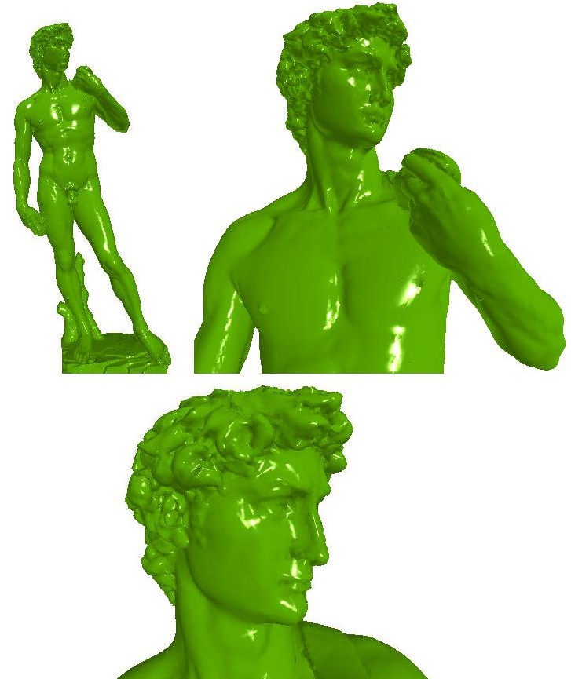
Results
We tested our scheme on models with points ranging from 32K to 3.6M points.
Model: David
Points: 3.6M
Algebraic splats: 30K ( 0.8 % )
Speed: 226 fps
SLIM Splats: 126K
Speed: 7 fps

Slide 46
Algebraic splats Vs SLIM
MODEL | #Splats | Algebraic splats(FPS) |  |  | SLIM(FPS)
 |  | GTX280 | 8800GTX | 7900GTX | 7900 GTX
Lucy | 130K | 92 | 49 | 11 | 7
Armadillo | 24K | 168 | 94 | 39 | 23
Dino | 6K | 306 | 180 | 87 | 44
David | 932K | 18 | 10 | 4 | 3
David | 126K | 108 | 69 | 14 | 7
All the fps numbers are rounded off to nearest integer.

Slide 47
Speed
Model | Quadratic (FPS) | Cubic (FPS)
Dragon | 198 | 119
Igea | 221 | 148
Buddha | 240 | 159
Dino | 393 | 206
David | 226 | 135
Bone | 270 | 158
Armadillo | 350 | 186
Lucy | 290 | 143
All the fps reported are taken on nVidia GTX280

Slide 48
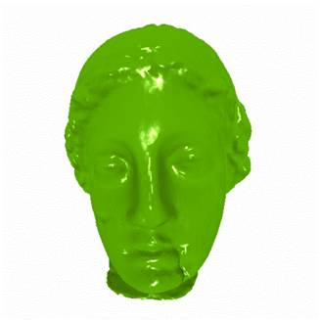

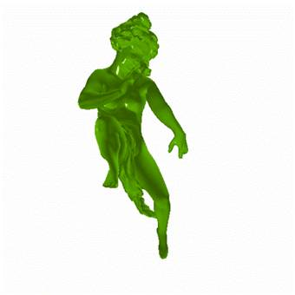





Rendering using Algebraic splats
4%, 198 fps
3.6%, 221fps
2.7%, 240fps
4%, 393fps
0.8%, 226 fps
3.9%, 270fps
2.8%, 350fps
3.5%, 290fps

Slide 49
Video

Slide 50


Algebraic splats
The Primitives are Quadratic or Cubic Splats
The surface is estimated based on Moving Least Squares
Need only 5-10 % of points for most models.
Continuous Level of detail representation
Adaptive Anti-aliasing
Primitive : Quadratic Splats
Speed : 42K at 180 FPS on GTX280
Primitive : Cubic Splats or Patches
Speed: 42K at 180 FPS on GTX280

Slide 51
Outline
Background and Motivation
Algebraic splat Representation
Splats Rendering
Metaballs Rendering

Slide 52
Metaballs Rendering
Metaballs (or blobs) are attributed points
Used to represent fluids molecular structure
Each point in associated with a scalar force fields

Slide 53


Metaball
For N = 2
density
0
Distance from center
iso surface
Threshold, T

Slide 54
Related work
Ray casting of algebraic surface [Loop and Blinn 2006]
  Not scalable
Point-based visualization of metaballs [van Kooten et al. 2007]
  Misses small particles
Ray Casting for a Large Number of Metaballs [Yoshihiro et. al. 2008]
  Screen space ray casting
Fitted-BVH for rendering Metaballs [Gourmel et. al. 2010]
  CPU Data structure building and does not scale beyond 100K metaballs

Slide 55
Our Method Overview
Data Structure
  A grid in perspective space.
  Fast building and high coherence for ray casting
  Adapted [Patidar et. al. 2008] and [Kalojanov et. al 2009]
Ray-surface intersection
  Modified Adaptive-marching points algorithm [Jagmohan et. al. 2009]
  March along the ray and Search for root in each cell.

Slide 56

Perspective Grids
Top View
Image Space View
Data Structure: (voxelID, metaballID) and a Histogram

Slide 57
GPU Data Structure Building
For each metaball in parallel
  Project into perspective space.
  Count of number of tiles in XY and slabs in Z overlapped
  Record the total number of slabs occupied by each metaball in global memory
Scan the array to get the total number of entries in DS
6
8
12
6
18
20
14
15
30
1
2
10
4
8
18
6
14
26
32
50
70
84
99
129
130
132
142
146
154
172

Slide 58
Data Structure
For each metaball in parallel
  Project into perspective space
  For all the voxels overlapped by metaball
    Write (voxelId, ballID) pair to global memory
Sort the (voxelId, blobId) list with voxelID as the key.
1
1
2
2
2
3
3
4
4
4
5
5
5
6
7
2
3
4
5
6
1
2
4
1
3
7
4
5
2
5

Slide 59

Coherent Ray-casting
For each voxel from front to back
  If voxel is not empty
    Load metaballs into shared memory
    March along the ray to find ray-surface intersection.
      Bracket the interval
      if there is such interval
        Find the exact root using binary search.

Slide 60

Data Structure
The data structure building is fast.
Build each frame.

Slide 61

Results

Slide 62

Scattered Data :: Synthetic

Slide 63
Conclusion
Explored various higher-order surface representations
Presented a compact representation for point based models using non-linear surface elements
Adaptive anti-aliased rendering
Fast rendering of large number of metaballs

Slide 64

THANK YOU
Notes:
Thanks you all. Questions ?

