Slide 1
Word Recognition of Indic Scripts
Naveen TS
CVIT
IIIT Hyderabad
Notes:
10/29/11
1

Slide 2
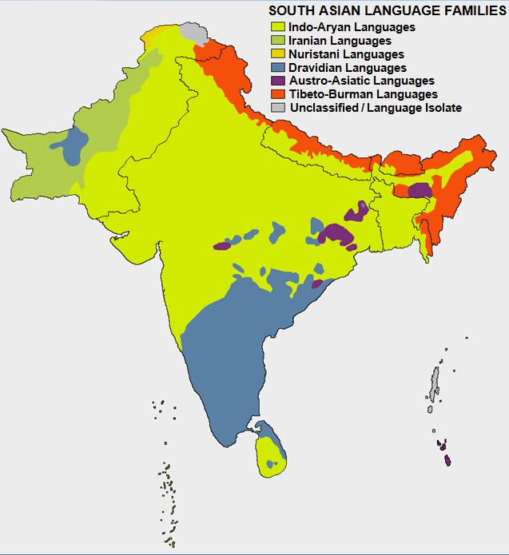
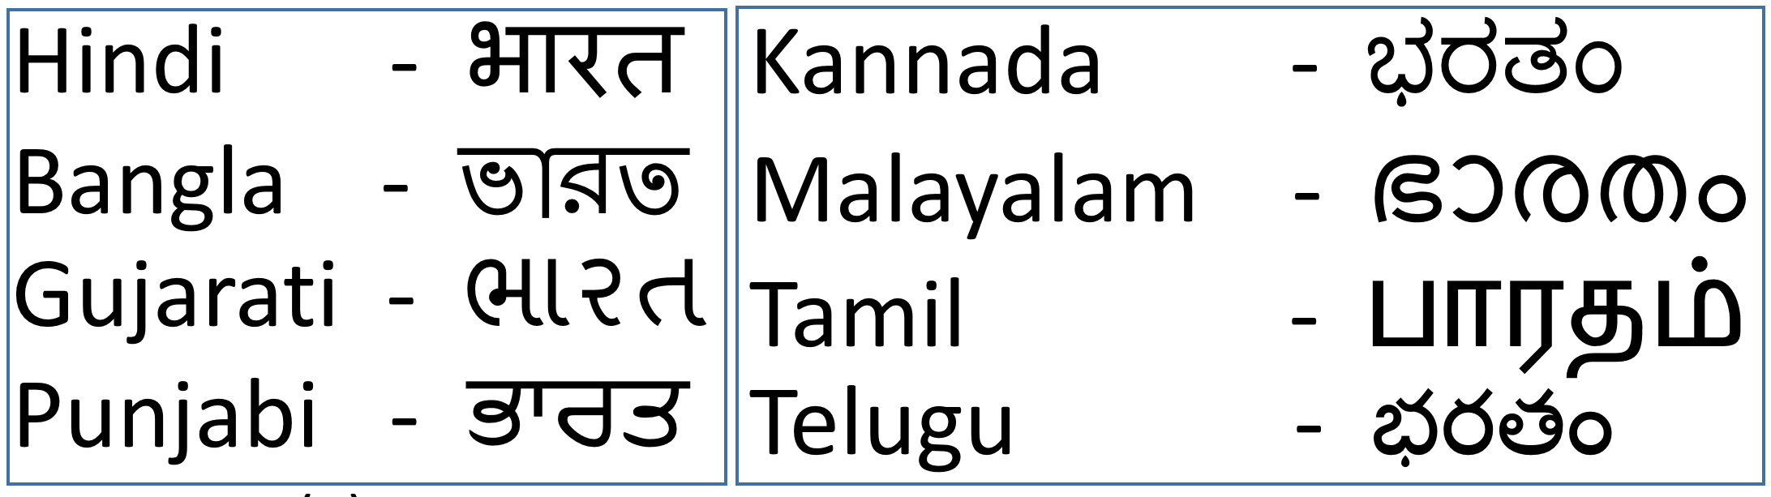
Introduction
22 official languages.
100+ languages.
Language specific number system.
Two major groups
  Indo – Aryan
  Dravidian

Slide 3
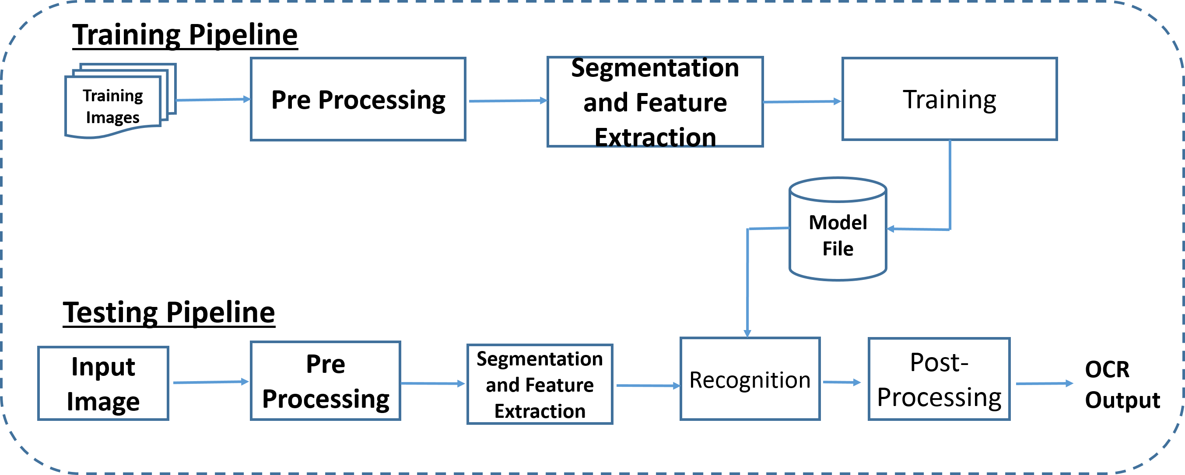
Optical Character Recognition

Slide 4
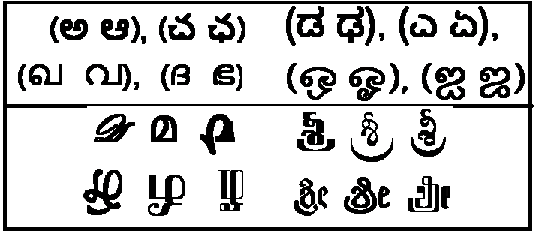
OCR Challenges
Challenges due to text editors
  Different editors renders same symbol in different ways.
Multiple fonts
Poor/cheap printing technology
  Can cause degradations like Cuts/Merges
Scanning quality

Slide 5
IL Script Complexity
Script complexity
  Matras, similar looking characters
  Samyuktakshar
  UNICODE re-ordering

Slide 6
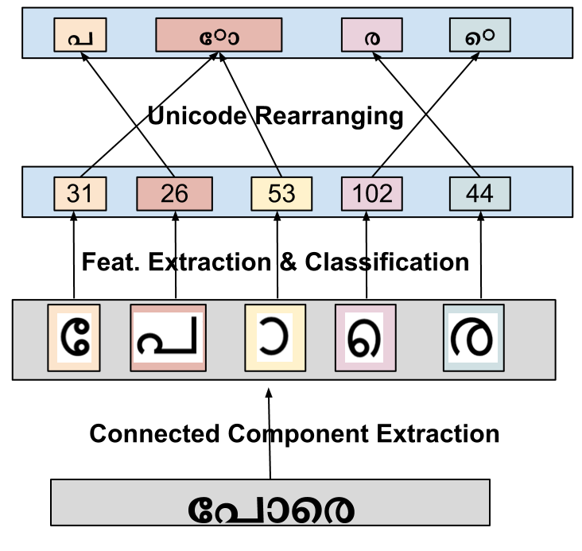
Unicode re-ordering
Final Output

Slide 7
OCR Development challenges
Word -> Symbol segmentation
Presence of cuts/merges
Development of a strong classifier
Efficient post-processor
Porting of technology for development of OCR for a new language.

Slide 8
Motivation for this Thesis
Avoiding the tough word->symbol segmentation
Automatic learning of latent symbol -> UNICODE conversion
Common architecture for multiple languages
Post-processor development challenges for highly inflectional languages.

Slide 9
OCR Development

Slide 10
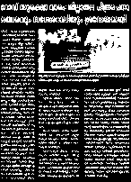
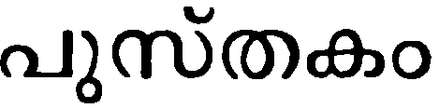


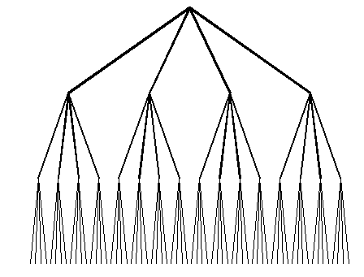
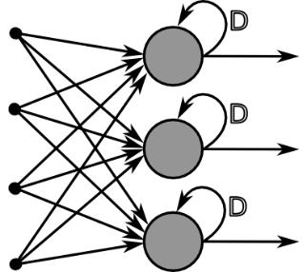
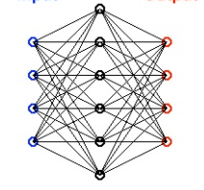
Recognition Architecture
Large # Output Classes
Huge training size
Degradation impact minimal
Small # Output Classes
Moderate training size
Degradation impact serious
Word Recognizer
Symbol Recognizer

Slide 11
Limitation of Char recognition System
10.2.57.116
Difficult to obtain annotated training samples
  Extracting symbols from words is tough.
Inability to utilize all available training data
  Extremely difficult to extract all symbols from 5000 pages and annotate them.
Classifier output(Char) -> Required output(Word) conversion.
Issues due to degradations (Cuts/Merges) etc.

Slide 12


Holistic Recognition
Word Annotation
Word Text
Word Image
Word Recognition System
Evaluation
Final Output
To Evaluation System

Slide 13

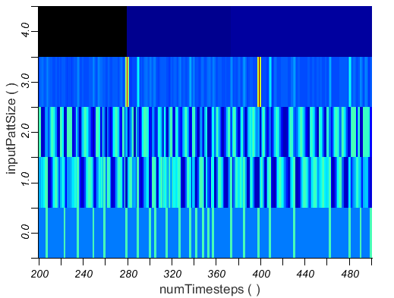
BLSTM Workflow
Word Output
Output layer
CTC
CTC
LSTM Cell
…
…
backward pass
Hidden layers
Hidden layers
…
…
forward pass
Input layer
t
t+1
…
Input
sequence
Features

Slide 14
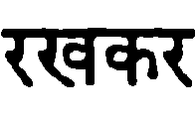



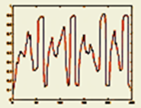
Importance of Context
Small Context
Larger Context
For a given feature, BLSTM takes into account forward as well as backward context.

Slide 15
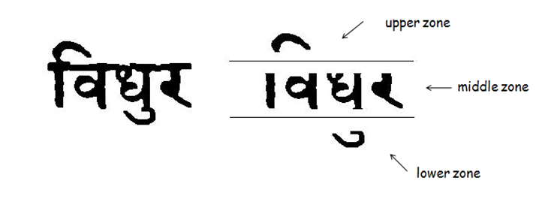




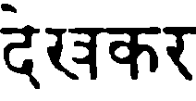
BLSTM for Devanagari
Motivation
  No Zoning
  Word Recognition
  Handle large # classes
Naveen Sankaran and C V Jawahar. “Recognition of Printed Devanagari Text Using BLSTM Neural Network” International Conference on Pattern Recognition(ICPR), 2012.

Slide 16
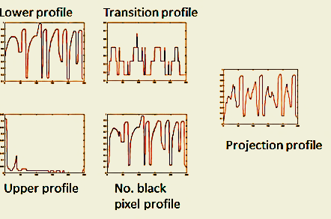
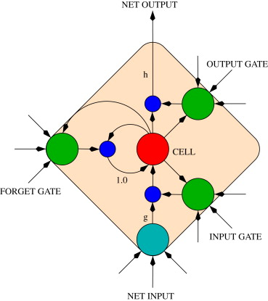
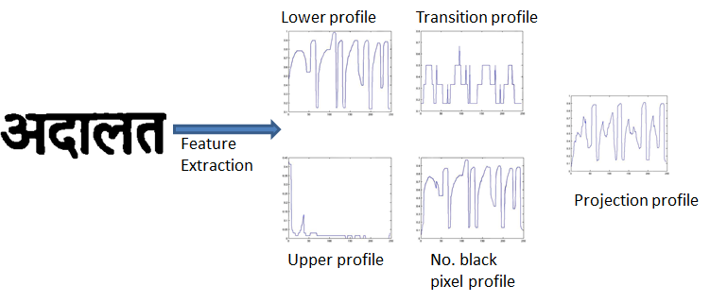
BLSTM for Devanagari
Feature Extraction
BLSTM Network
Output
Class Labels
Class Label to
Unicode conversion
_{Input Image}
35, 64, 55, 105
अदालत

Slide 17
BLSTM Results
Trained on 90K words and tested on 67K words.
Obtained more than 20% improvement in Word Error Rate.
 | Char. Error Rate |  | Word Error Rate
Devanagari | OCR[1] | Ours | OCR[1] | Ours
Good | 7.63 | 5.65 | 17.88 | 8.62
Poor | 20.11 | 15.13 | 43.15 | 22.15
1. D. Arya, et al., @ ICDAR MOCR Workshop, 2011.
Experiences of Integration and Performance Testing of Multilingual OCR for Printed Indian Scripts

Slide 18
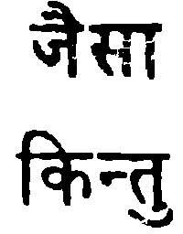
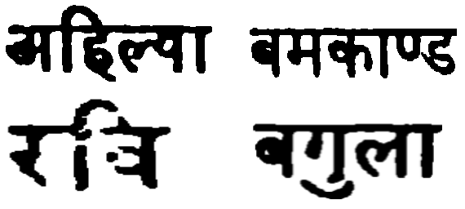
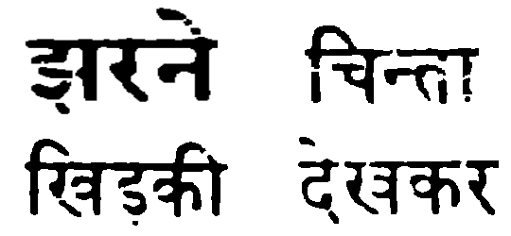
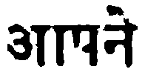
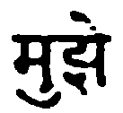
Qualitative Results

Slide 19
Limitations
Symbol to UNICODE conversion rules are required to generate final output.
Huge training time of about 2 weeks.

Slide 20
Recognition as Transcription
Network learns how to “Transcribe” input features to output labels.
Target labels are UNICODE
No Symbol-> UNICODE output mapping
Easily scalable to other languages

Slide 21
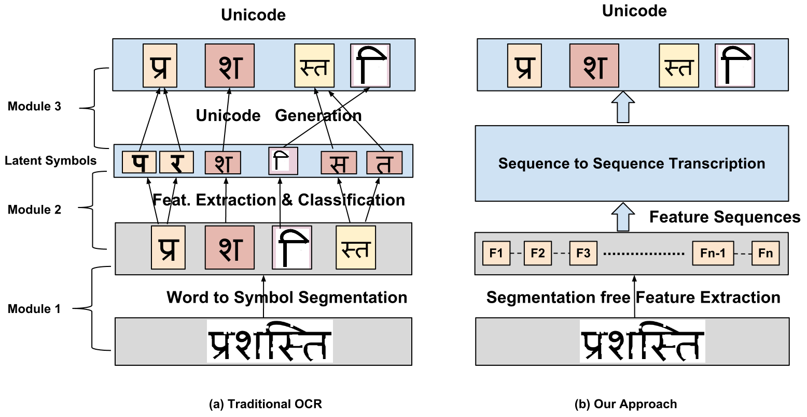
Recognition Vs Transcription

Slide 22
Challenges
Segmentation free training and testing
UNICODE (akshara) training and UNICODE (akshara) testing
Practical Issues:
  Learning with memory: (symbol ordering in Unicode)
  Large output label space
  Scalability to large data set
  Efficiency in testing

Slide 23
Training time
Training time increases when
  # Output classes increases
  # Features decreases
  # Training data increases

Slide 24
Training at Unicode level
UNICODE training largely reduces the number of classes.
UNICODE training can reduce the time taken
Language | # Unicode | # Symbols
Malayalam | 163 | 215
Tamil | 143 | 212
Telugu | 138 | 359
Kannada | 156 | 352

Slide 25
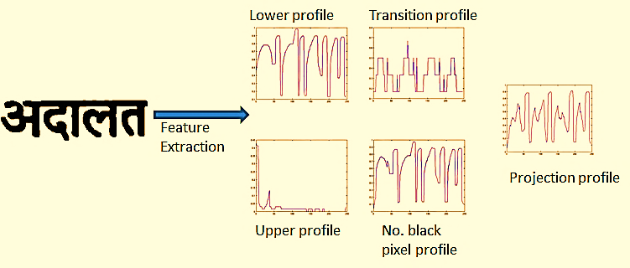
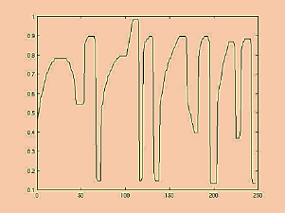
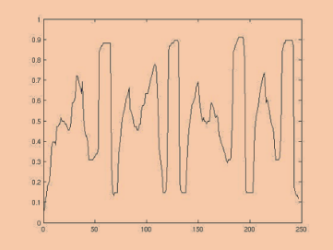
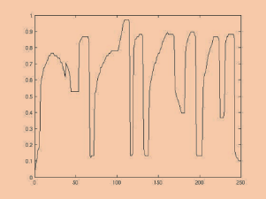
Features
Each word split horizontally into two parts
7 features extracted from top and bottom half
Sliding window of size 5pixel used.
Binary Features Grey Features
Mean
Std. Deviation
Variance

Slide 26
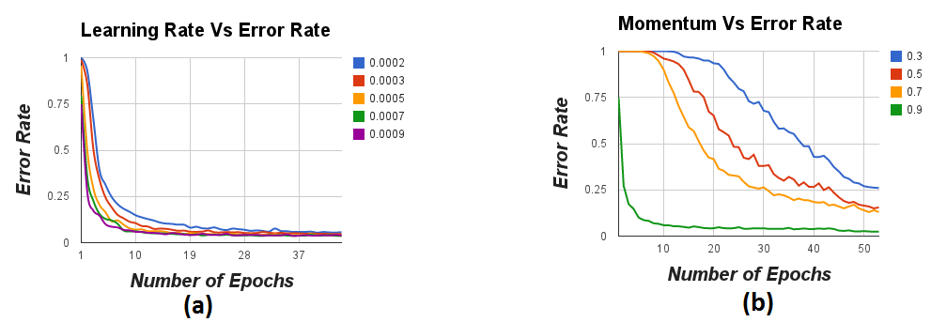
Network Configuration
Learning rate of 0.0009
Momentum 0.9
Number of hidden layers = 1
Number of nodes in hidden layer = 100

Slide 27
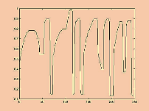
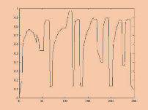
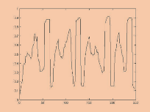
Final Network Architecture
CTC LAYER
अदालत
.
.
.
.
.
.
Input layer
Hidden Layer
Output Layer
UNICODE Output
Input t=0

Slide 28
Evaluation & Results

Slide 29
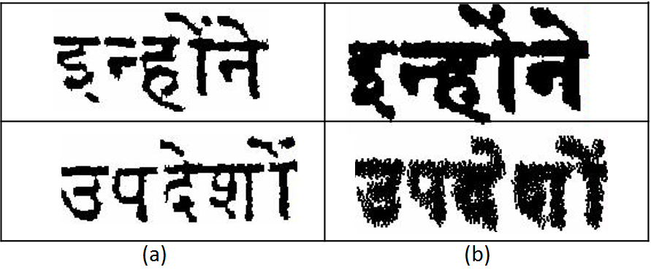
Dataset
Annotated Multi-lingual Dataset (AMD)
Annotated DLI dataset (ADD)
  1000 Hindi pages from DLI
Language | No. of Books | No. of Pages
Hindi | 33 | 5000
Malayalam | 31 | 5000
Tamil | 23 | 5000
Kannada | 27 | 5000
Telugu | 28 | 5000
Gurumukhi | 32 | 5000
Bangla | 12 | 1700
AMD ADD

Slide 30
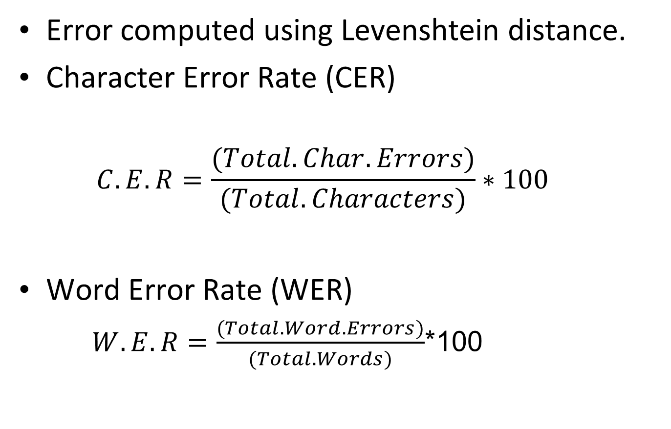
Evaluation Measure

Slide 31
Quantitative Results
Language | Character Error Rate(CER) |  |  | Word Error Rate(WER)
 | Our Method | Char OCR[1] | Tesseract[2] | Our Method | Char OCR[1] | Tesseract[2]
Hindi | 6.38 | 12.0 | 20.52 | 25.39 | 38.61 | 34.44
Malayalam | 2.75 | 5.16 | 46.71 | 10.11 | 23.72 | 94.62
Tamil | 6.89 | 13.38 | 41.05 | 26.49 | 42.22 | 92.37
Telugu | 5.68 | 24.26 | 39.48 | 16.27 | 71.34 | 76.15
Kannada | 6.41 | 16.13 | - | 23.83 | 48.63 | -
Bangla | 6.71 | 5.24 | 53.02 | 21.68 | 24.19 | 84.86
Gurumukhi | 5.21 | 5.58 | - | 13.65 | 25.72 | -
1. D. Arya, et al., @ ICDAR MOCR Workshop, 2011.
Experiences of Integration and Performance Testing of Multilingual OCR for Printed Indian Scripts
2. https://code.google.com/p/tesseract-ocr/

Slide 32
Qualitative Results

Slide 33
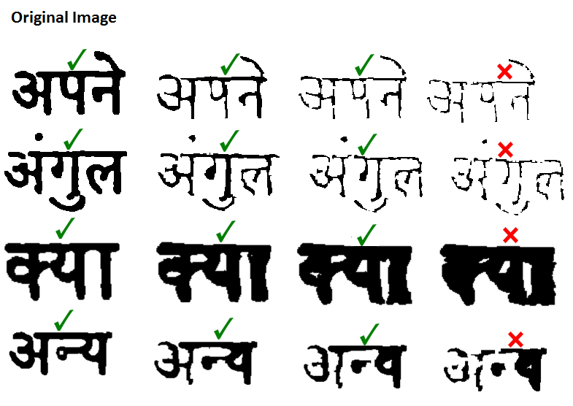
Performance with Degradation
Added Synthetic degradation to words and evaluated them.
Degradation Level 1
Degradation Level 2
Degradation Level 3

Slide 34
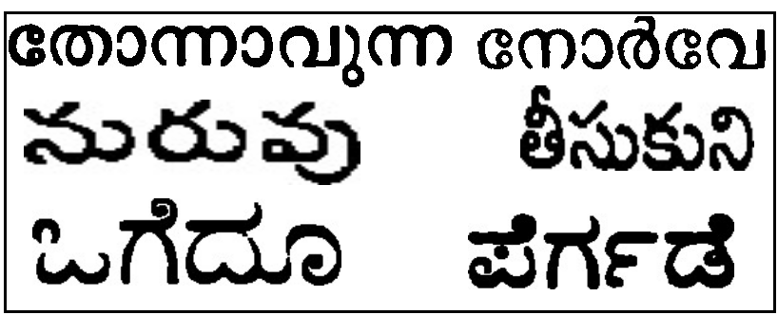
Qualitative Results
Unicode Rearranging

Slide 35
Error Detection for Indian Languages

Slide 36
Error Detection : Why is it hard?
Highly Inflectional
UNICODE Vs Akshara
Words can be joined to from another valid new word.

Slide 37
Development Challenges
Availability of large corpus
Percentage of unique words
Language | Total Words | Unique Words | Average Word Length
Hindi | 4,626,594 | 296,656 (6.42%) | 3.71
Malayalam | 3,057,972 | 912,109 (29.83%) | 7.02
Kannada | 2,766,191 | 654,799 (23.67%) | 6.45
Tamil | 3,763,587 | 775,182 (20.60%) | 6.41
Telugu | 4,365,122 | 1,117,972 (25.62%) | 6.36
English | 5,031,284 | 247,873 (4.93%) | 4.66

Slide 38
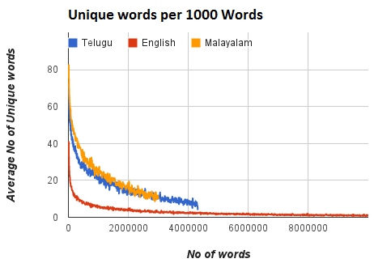
Development Challenges
# Unique words in Indian Languages

Slide 39
Development Challenges
Word Coverage
Corpus % | Malayalam | Tamil | Kannada | Telugu | Hindi | English
10 | 71 | 95 | 53 | 103 | 7 | 8
20 | 491 | 479 | 347 | 556 | 23 | 38
30 | 1969 | 1541 | 1273 | 2023 | 58 | 100
40 | 6061 | 4037 | 3593 | 5748 | 159 | 223
50 | 16,555 | 9680 | 8974 | 14,912 | 392 | 449
60 | 43,279 | 22,641 | 21,599 | 38,314 | 963 | 988
70 | 114,121 | 54,373 | 53,868 | 101,110 | 2395 | 2573
80 | 300,515 | 140,164 | 144,424 | 271,474 | 6616 | 8711

Slide 40
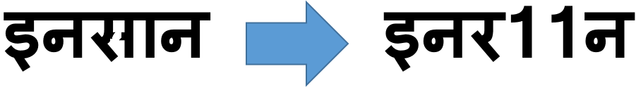
Error Models for IL OCR
Two type of errors generated by OCR
  Non-Word error
    Presence of impossible symbols between words.
    Caused due to recognition issues, Symbol -> UNICODE mapping issues etc.

Slide 41
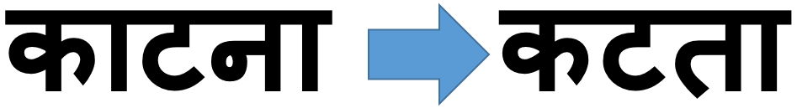
Error Models for IL OCR
Two type of errors generated by OCR
  Real-Word error
    Caused when one valid symbol is recognized as another valid symbol.
    Mainly caused due to confusion among symbols

Slide 42
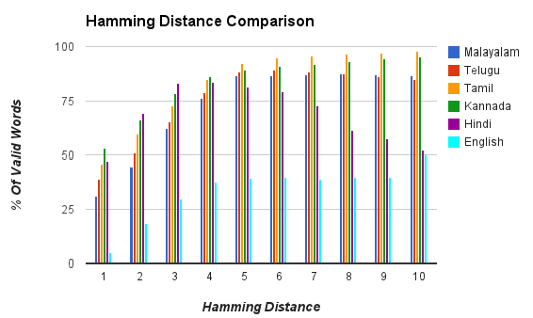
Error Models for IL OCR
Percentage of words which gets converted to another word for a give Hamming distance.

Slide 43
Error Detection Methods
Using Dictionary
  Create a dictionary based on most frequently occurring words.
  Valid words are those which are present .
  Accuracy depends on dictionary coverage.
Using akshara nGram
  Generate symbol (akshara) nGram based dictionary.
  Every word is converted to its associated nGrams.
  Dictionary generated using these nGrams.
  A word is valid if all nGrams are present in dictionary.
Word and akshara dictionary combination
  First check if word is present in dictionary.
  If not, check in the nGram dictionary.
Detection through learning
  Use linear classification methods to classify a word as valid or invalid.
  nGram probabilities are chosen as features.
  Used SVM based binary classifier to train.
  This model was used to predict if a word was valid or not.

Slide 44
Error Detection Methods
Word and akshara dictionary combination
  First check if word is present in dictionary.
  If not, check in the nGram dictionary.
Detection through learning
  Use linear classification methods to classify a word as valid or invalid.
  nGram probabilities are chosen as features.
  Used SVM based binary classifier to train.
  This model was used to predict if a word was valid or not.

Slide 45
Evaluation Matrix
  True Positive (TP) : Our model detect a word as Invalid and annotation seconds it
  False Positive(FP) : Our model detect a word as Invalid but is actually a valid word
  True Negative (FN) : Our model detects a word as Valid but is actually invalid word
  False Negative (TN) : Our model detects a word as Valid and annotation seconds it
  Precision, Recall and F-Score

Slide 46
Dataset
British National Corpus for English and CIIL corpus for Indian Languages.
Used OCR output from Arya et.al (J-MOCR, ICDAR 2011) for experiments.
Took 50% wrong OCR outputs to train SVM with negative samples.
Malayalam dictionary size of 670K words and Telugu dictionary size of 700K

Slide 47
Results
Method | Malayalam |  |  |  | Telugu
 | TP | FP | TN | FN | TP | FP | TN | FN
Word Dictionary | 72.36 | 22.88 | 77.12 | 27.63 | 94.32 | 92.13 | 7.87 | 5.67
nGram Dictionary | 72.85 | 22.17 | 77.83 | 27.15 | 62.12 | 6.37 | 93.63 | 37.88
Word Dict. + nGram | 67.97 | 14.95 | 85.04 | 32.02 | 65.01 | 2.2 | 97.8 | 34.99
Word Dictionary + SVM | 62.87 | 9.73 | 90.27 | 37.13 | 68.48 | 3.24 | 96.76 | 31.52
Table showing TP,FP,TN and FN values for Malayalam and Telugu
Method | Malayalam |  |  | Telugu
 | Precision | Recall | F-Score | Precision | Recall | F-Score
Word Dictionary | 0.52 | 0.72 | 0.60 | 0.51 | 0.94 | 0.68
nGram Dictionary | 0.53 | 0.73 | 0.61 | 0.91 | 0.62 | 0.73
Word Dict. + nGram | 0.61 | 0.68 | 0.74 | 0.94 | 0.64 | 0.76
Word Dictionary + SVM | 0.69 | 0.63 | 0.76 | 0.95 | 0.67 | 0.78
Table showing Precision, Recall and F-Score values for Malayalam and Telugu

Slide 48
Conclusion
A generic OCR framework for multiple Indic Scripts.
Recognition as Transcription.
Holistic recognition with UNICODE output.
High accuracy without any post-processing.
Understanding challenges in developing post-processor for Indic Scripts.
Error detection using machine learning.

Slide 49
Thank You !!!!

