Slide 1
Techniques for Organization and Visualization of Community Photo Collections
Kumar Srijan
Faculty Advisor : Dr. C.V. Jawahar

Slide 2
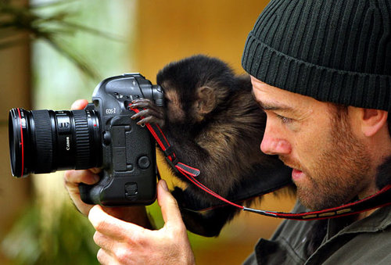

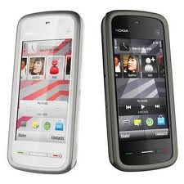
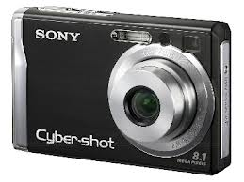




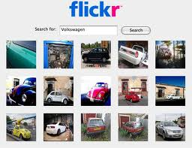

Community Photo Collections
Anyone can take photographs!
Sharing photographs is easy!
Searching for photographs is easy!

Slide 3
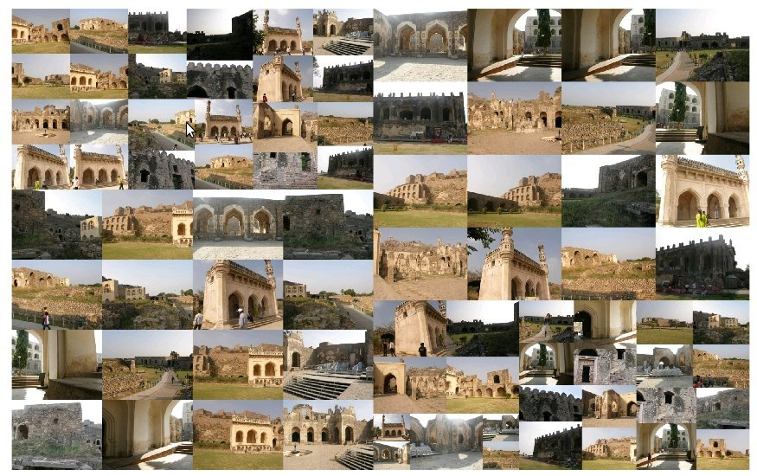
Community Photo Collections
Golkonda Fort (Google Images + Flickr)
> 50 K images

Slide 4
Photo Tourism
Noah Snavely, Steven M. Seitz, Richard Szeliski
Photo tourism: Exploring photo collections in 3D
Photosynth

Slide 5
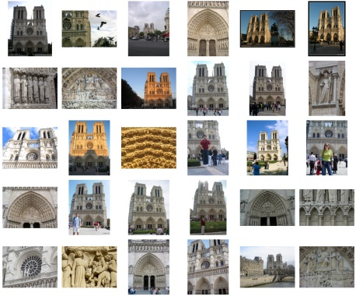
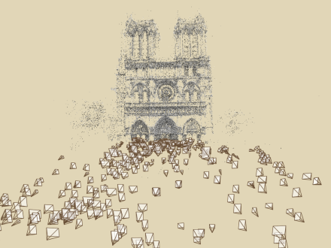
Photo Tourism
Input Images
Computing Correspondences
Pairwise
Feature Matching
Match Refinement
Feature Extraction
Track Creation
Incremental SfM
Seeding
Add new images and triangulate new points
Bundle adjust
Full Scene Reconstruction
Notes:
So phototourism takes as input an unordered set of images. First, it tries to find consistent point matches between these images. For this, it extracts robust features from all these images. These keypoints are then matched between all the pairs of images. Then for each pair, the matches are refined by estimating a Fundamental matrix and checking which feature matches are consistent with it. Next these matches are chained across the images and all the consistent chains are saved as tracks.
The next stage takes these tracks as input to reconstruct the geometry by doing SfM for a large set of images.
This reconstruction is seeded by a 2 frame reconstruction involving 2 carefully selected images such that they see a good number of points in common, they have a wide enough baseline and they have sufficient parallax. Next more images are added into the reconstruction iteratively in small batches. Each iteration proceeds by estimating the position and orientation of the new cameras and the position of the point visible to them using the direct linear transform. This is followed by a refinement of these estimates using a non linear optimization involving a large number of parameters using a procedure known as the bundle adjustment. This refinement is O(N^3) in the number of images in the worst case.

Slide 6
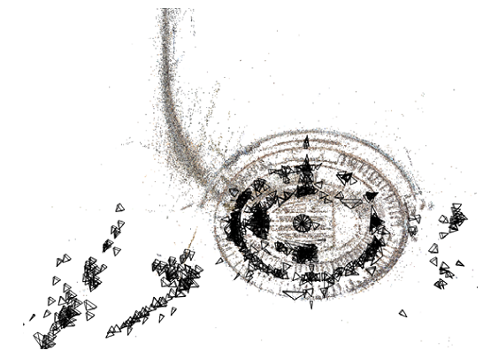
Bottlenecks and Issues
Quadratic Image Matching cost
Global scene reconstruction
O(N⁴) in the worst case
Sensitivity to the choice of the initial pair
Cascading of errors
Notes:
The Full scene reconstruction is done by using a seed and grow technique starting from a 2 frame reconstruction.
For this, it requires selecting a good initial pair of images.
If a wrong choice is made, the reconstruction can get severely affected.
After the 2 frame reconstruction, rest of the images are then added iteratively in small batches by estimating their pose using the Direct Linear Transform procedure.
And later, the pose of the all the cameras and positions of the scene points are jointly refined by doing a global non linear optimizations referred to as bundle adjustment.
During this, if the pose one of the cameras is incorrectly estimated, then all the subsequent cameras seeing points in common with that camera will have errors in their pose estimation. This leads to cascading of errors and wrong estimation of large sections of the scene. Bundle adjustment is O(N^3) in the number of images. So doing the SfM on the whole set becomes O(N^4) in the number of images and it is again very expensive.
The high time complexity of pairwise matching and SfM make it hard for the system to scale to very large sets of images.
The motivation of our work is to try and address these two bottlenecks.

Slide 7
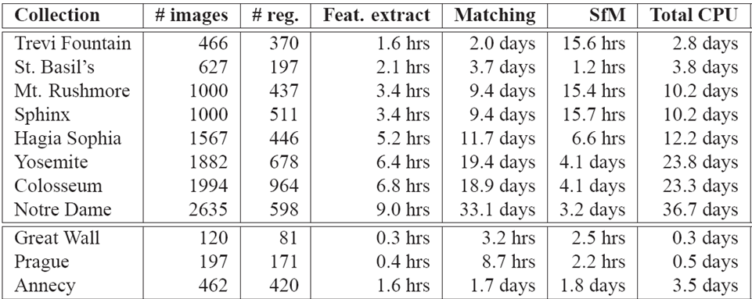
Bottlenecks and Issues
Timing Breakdown
Full Scene Reconstruction for Trafalgar Square with 8000 images took > 50 days

Slide 8
Motivation
CPCs are unstructured collections
Different resolutions, viewpoint , lighting conditions…
Very limited number of images match
Contribution 1 : Matching
Exhaustive pairwise matching w/o quadratic cost
Contribution 2 : Visualization
Framework for bypassing the issues faced with Incremental Sfm.

Slide 9
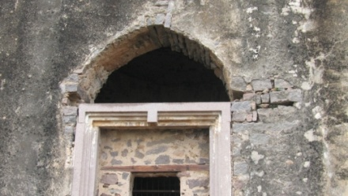
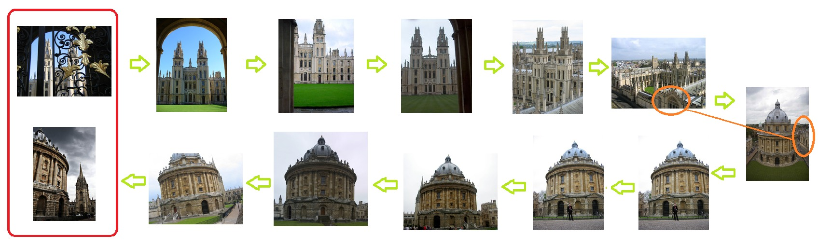
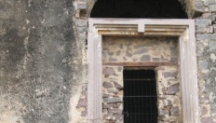
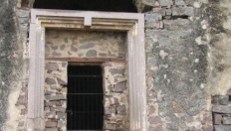
Image Matching Problem
Compute Image Match Graph
Images →Nodes
Image Match →Edges
Queries:
Connected components
Shortest path

Slide 10
Discovering Matching Images
Object Retrieval with Large Vocabularies and Fast Spatial Matching – Philbin et al.
Image Retrieval
1. Indexing Image Database
Quantization : Image Features → Visual Words(VW)
Inverted Index : over VWs
2. Querying Image Database
Filtering → Shortlist of Top Scoring matches
Verification → of shortlist
O(N) time for a single querying

Slide 11
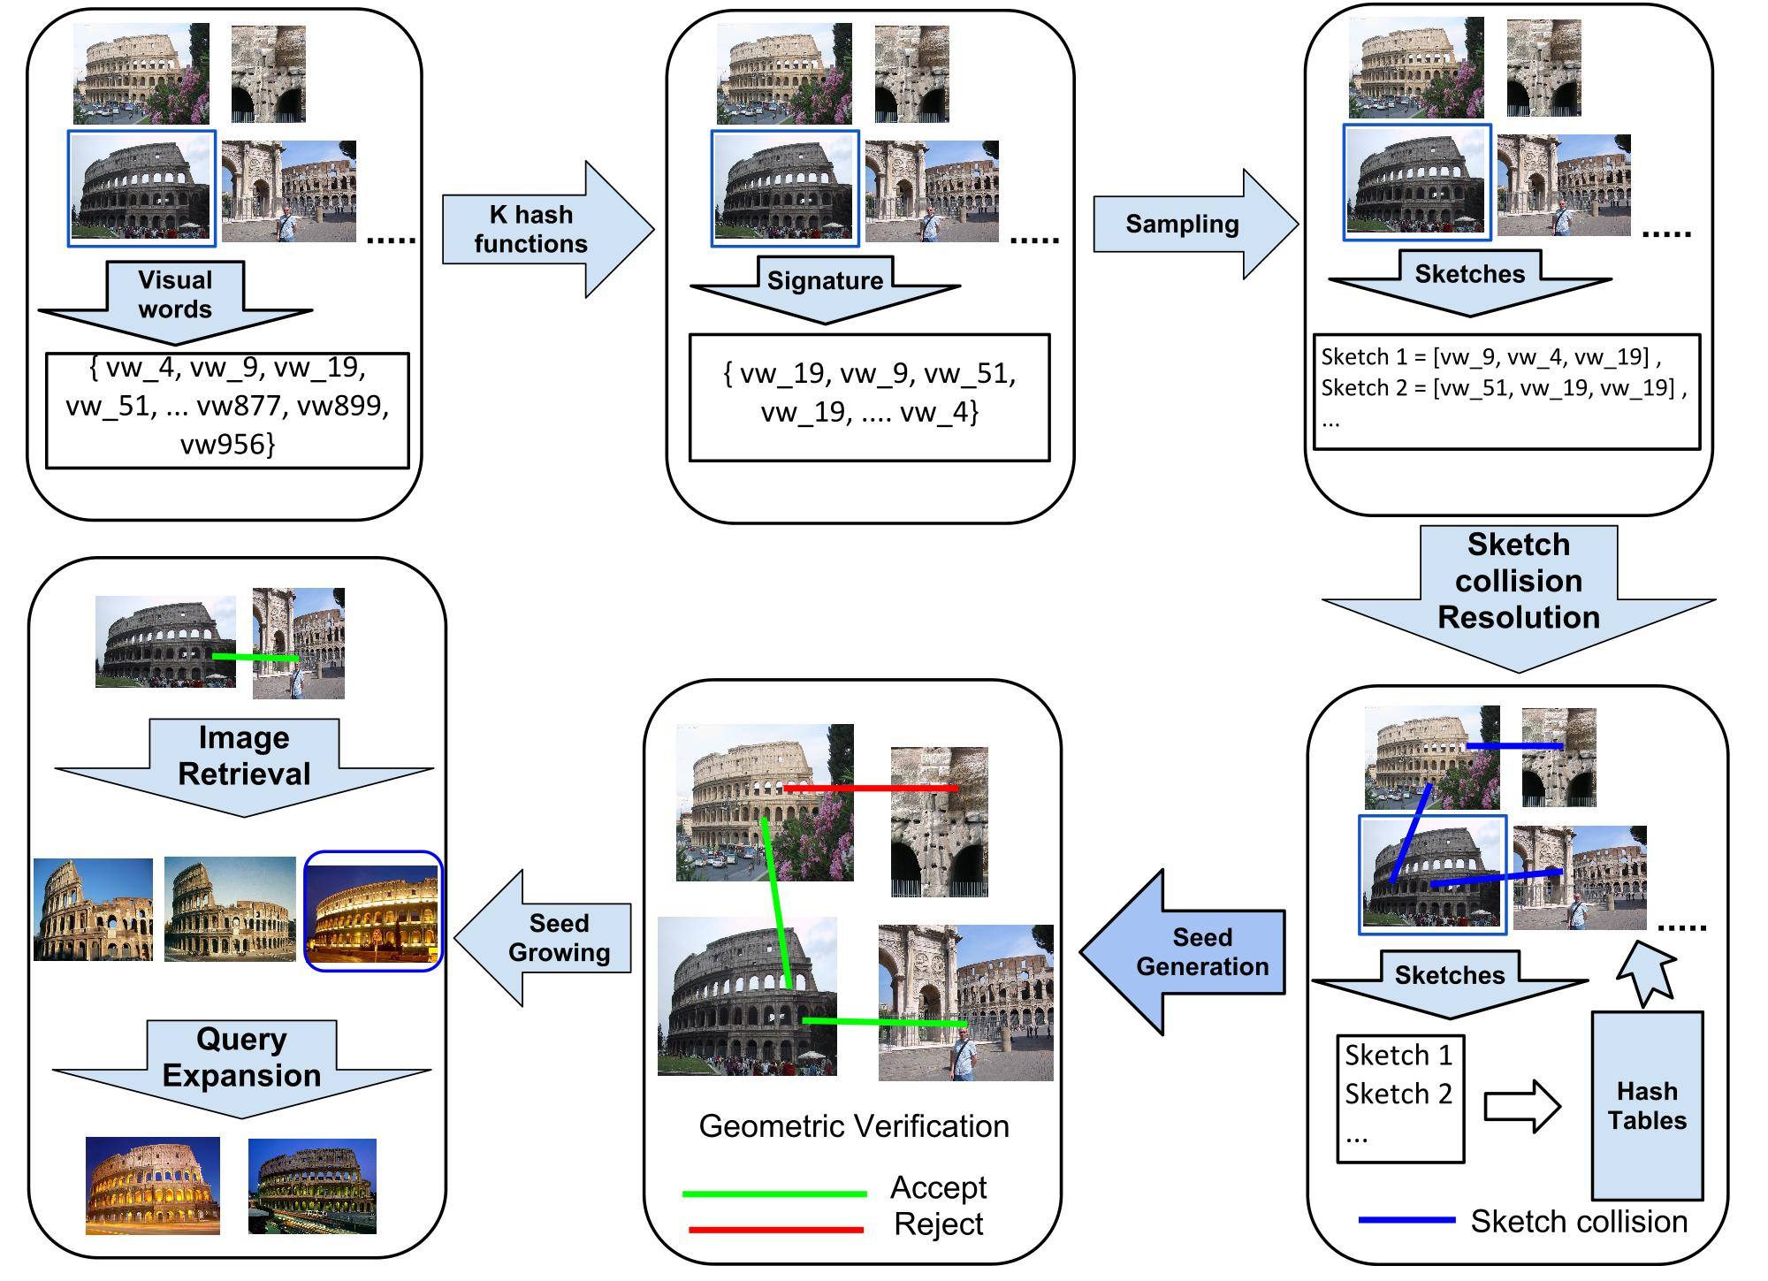
Discovering Matching Images
Large Scale Discovery of Spatially Related Images - Chum, O. and Matas. J

Slide 12
Our Solution : Overview
Exhaustive Pairwise Matching
Query each image in turn
Goal : O(1) per query
Addressing Exhaustiveness
Verify all potential matches : No shortlists
Verification doable from Index retrievals
Our Main Result : Indexing geometry allows both!

Slide 13
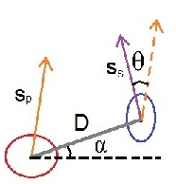
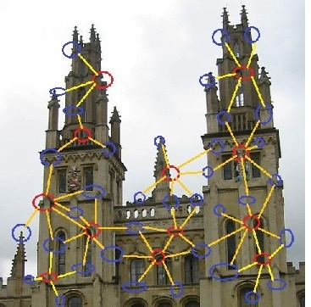
Indexing Geometry
High Order Features
Combine nearby features
Primary with Secondary Features
Encode Affine Invariants
Relative Orientation and Scale
Normalized distance
Baseline orientation
HOF is a Tuple
<VWp,VWs,g1,g2,g3,g4>
Huge Feature Space

Slide 14
Constant Time Queries using HOFs
Regular Inverted Index
Posting lists grow with Database size O(N)
HOF => Huge Feature Space ( > 10¹² )
Reproject with Hash Functions!
Range α Database size
Constant sized posting lists
Result : Constant time queries

Slide 15
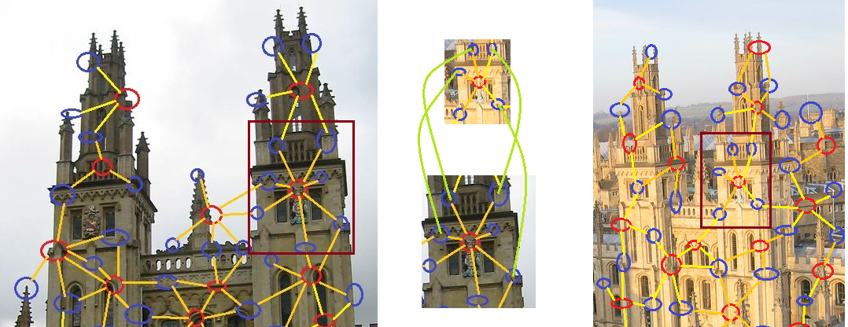
Spatial Verification
Computable from index retrievals
For a query primary feature
Search all secondary features in database images
Pass if R features are found.

Slide 16
Solution : Summary
Extract HoF in the N database images
Select Reprojection size as CN
Initialize an Index of size CN
Indexing
Key : Hash value of HoF
Value : Image Id
Query : Each image in turn
Record matches in adjacency list
Result : Image Match Graph

Slide 17
Results
UK benchmark
2550 categories x 4 = 10400 images
73.2 % recall
Large Scale Discovery of Spatially Related Images (Min Hash based solution)
49.6 % recall

Slide 18
Results
 | Oxford 5K | Oxford 105K | Oxford 105K
#HOF | 78 Mn | 1480 Mn | 1480 Mn
Index Size | 2^25 | 2^29 | 2^30
Feature Extraction Time | 27 min | 8 hours | 8 hours
Query Time per Image | 0.024 sec | 0.085 sec | 0.061 sec
Query Time | 2 min | 2.5 hours | 1.8 hours
Clusters Found | 317 | 2147 | 2147
Images Registered | 1375 | 7198 | 7198

Slide 19
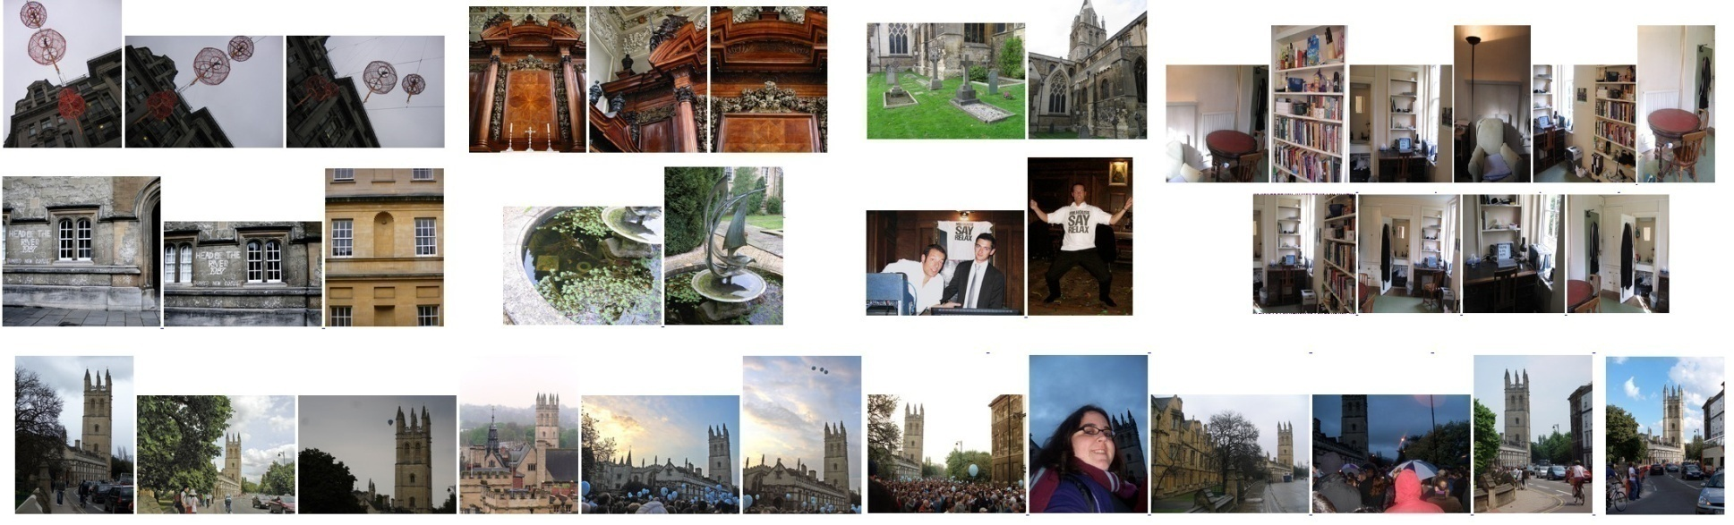

Results
Small Clusters
Errors

Slide 20
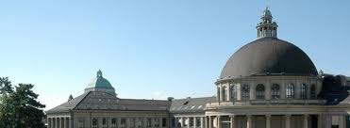
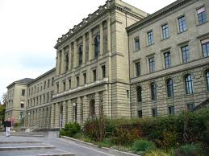
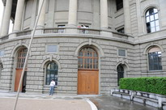
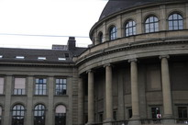
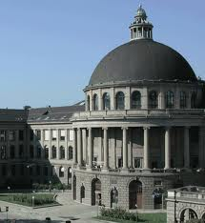
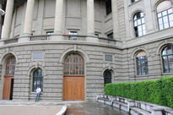
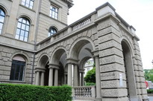
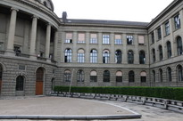
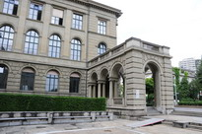
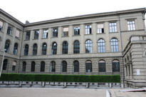
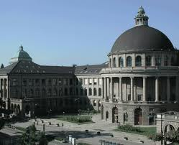
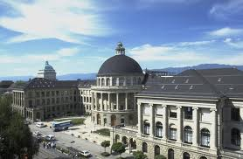
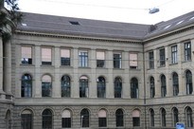
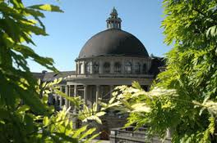
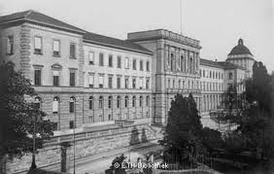
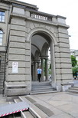
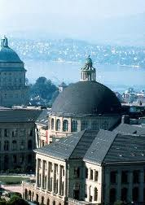
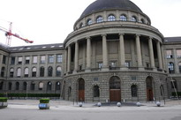
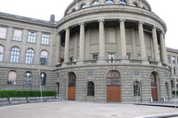
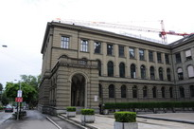
Visualizing CPCs
Notes:
The increasing popularity of digital photography/ and online photo-sharing sites such as Flickr/ is creating large and visually interesting photo collections of landmarks and popular destinations around the world. /
[ These collections are visually interesting/ as they capture the site from various viewpoints and under different lighting conditions. ]
Unfortunately, these image collections are completely unordered.
/Browsing through such huge collections would be very difficult in the absence of cues that tell about the relationships amongst these images.
Moreover, these image collections keep on growing by the day and hence organizing such a dynamic and incrementing collection creates complications of its own.

Slide 21
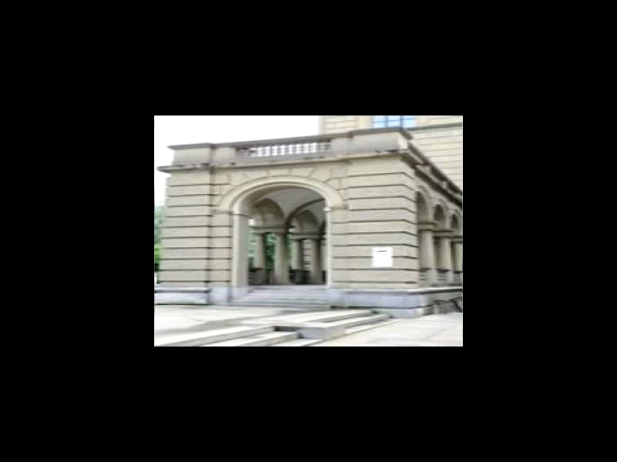
Problem Statement
Efficiently browse and keep Incorporating incoming stream of images
Notes:
Keeping this in mind, Our work is concerned with the following two problems:
How can we efficiently organize and browse through these huge images collections in an intuitive way?
The Second problem we address is “how to incorporate new images into the framework as they become available ?”
Here’s how the same collection can be explored in our interface while experiencing the rich relationships that exist amongst the images:

Slide 22
Our Solution : Overview
Observation : In a walkthrough, users primarily see nearby overlapping images.
Advantages:
Robustness to errors in incremental SfM module
Worst case linear running time
Scalable
Incremental
Independent Partial Scene Reconstructions
instead of
Global Scene Reconstruction
Notes:
Now I’ll explain our approach to organizing these large and growing image collection. Please note that in a walkthrough, users primarily observe near by overlapping images because they convey the most about the local geometry around the image. Hence, we propose creating Independent Partial Scene Reconstructions, containing an image and its overlapping images, instead of a Global Full Scene Reconstruction. This framework provides certain distinct advantages over the previous system:
We avoid sensitivity to the choice of an initial pair as one wrong choice of initial pair in one of the reconstructions will not affect the correctness of other partial reconstructions. For a similar reason we are also able avoid the cascading and compounding of errors leading to misestimating of large sections of the scene. Our framework puts a limit on the number of images involved in a partial reconstruction and thereby putting a bound on the time taken in creating a partial reconstruction. This makes our system linear in the number of images and thereby allowing it to scale to large datasets.
The use of partial reconstructions also makes it easy for our system to handle new images as they become available.
One drawback of this approach is that is restricts the possible number of images to which a user can transition from a given image, to only its immediate neighbors, as we shall see this is compensated by reduction in the time complexity.

Slide 23
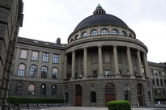

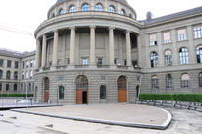
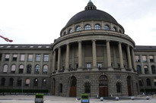
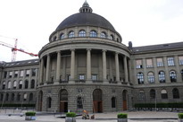
Partial Reconstructions
Compute Matches
Refine Matches
Compute partial Reconstructions
Match
Image
Correct Match
Incorrect Match
Standard SfM
Notes:
Now I’ll give an overview of how these partial reconstructions are constructed:
It involves 3 steps:
We start by finding for each image a set of top ‘n’ similar images in a scalable and efficient manner. For this, we use Bag of visual words representation of images which converts an image into a histogram of visual words present in the image. [So, the problem of matching of images becomes a problem of matching histograms.] We create inverted indexes which map visual words to images containing them and thus speed up the process of histogram matching. This also makes matching linear in the number of images. Alternatively, one can use a pre-trained vocabulary tree Generated from a large number of images obtained from the internet and made available by Fraundorfer.
The second step involves refining these matches as the previous step does not take into account the position of the features in the image and thus, may generate spurious matches. For this, we estimate the Epipolar geometry of every match by obtaining a RANSAC based Fundamental Matrix estimation. We accept a match based on the number of inliers the estimated fundamental matrix has.
In the final step, we do a scene reconstruction corresponding to each image and its verified neighbors.
We use Bundler, created by Noah Snavely, as the SfM pipeline for obtaining these partial reconstructions. [During this computation, some of the images may fail to register due to the lack of sufficient number of feature matches with the current reconstruction.]

Slide 24
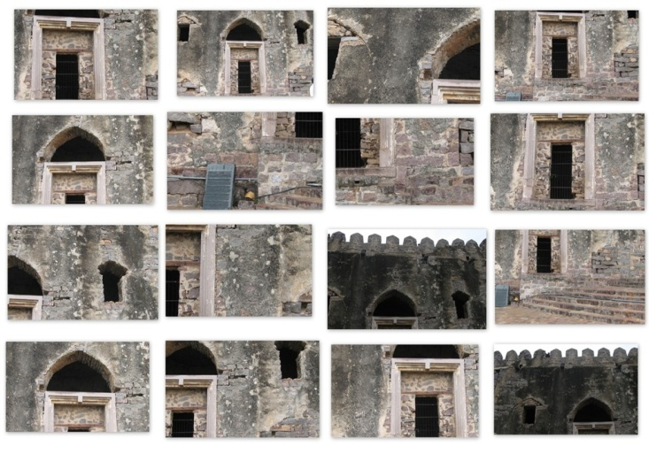
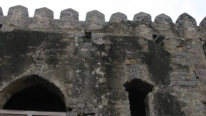

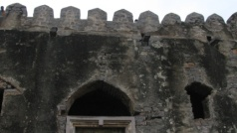
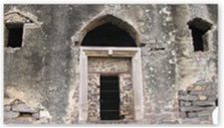
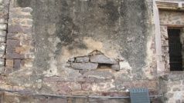

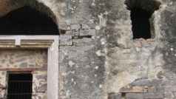
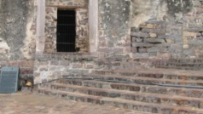










User interface and navigation
Sample image
Input images
Verified neighbors
Visualization Interface
Partial reconstruction
Notes:
Our visualization interface allows browsing through the partial reconstructions created from the given input images in a interactive 3D virtual environment. We start with the partial reconstruction corresponding to one of the images, say I. Next, we align the virtual camera with the camera corresponding to image I and project image I on a planar approximation of the points visible to the camera. Similarly, we display the other images in the partial reconstruction as wireframes of their respective projections. Upon clicking a wireframe, we make a smooth transition from the current image to the new image. And at the end of the transition we move to the partial reconstruction corresponding to the new image and align the virtual camera to the camera corresponding to the new image. Therefore, the user is explores the scene by moving from one partial reconstruction to another while getting cues about the relationships that exist between an image and its overlapping images.

Slide 25

Incremental insertion
Geometric Verification
Match
Compute Partial Scene Reconstruction
New Image
Improve Connectivity
Notes:
Our system makes it very easy to incorporate a new image into a existing reconstruction. For this we determine the top n matches of the new image by comparing the histogram representation of the new image to that of the existing images. Next we verify these matches by computing their epipolar geometry.
Then the new image along with it verified matches is sent to Bundler for a creating partial scene reconstruction corresponding to the new image. Thus, we potentially add a new partial reconstruction for every image that is inserted into the system. In the end we improve the connectivity of the visualization graph by making it undirected as explained earlier.

Slide 26


























Dataset
Golconda Fort, Hyderabad
Fort Dataset
5989 images
Notes:
We have tested our system on a large image collection of nearly 6000 images of Golkonda Fort at Hyderabad. These images capture the fort in various illumination conditions and from several viewpoints.

Slide 27

Results
Notes:
We created a few subsets of various sizes from this dataset. Our system scales to large datasets of up to 6k images in nearly 5 days of CPU computation time.

Slide 28

Results
Notes:
This graph compares the time taken by our system to compute all the partial reconstructions with time taken by Bundler in doing a SfM to provide a Full scene reconstruction for datasets of various sizes. We see that the speed up provided by our system increases as with the number of images as our system takes nearly linear time in the number of images.

Slide 29

Results
Courtyard Dataset with 687 images
Initialized with 200 images
Added 487 image one by one
Largest CC of 674 images.
Notes:
In a experiment with an image collection of 687 images of a courtyard of the Fort collected over different times of the day, we initialized with 200 images and incrementally added the 487. The final image connectivity graph had 674 images. This following walkthrough was created from the same.

Slide 30
Conclusions
Image Matching : HOFs gives a larger feature space which can be reprojected to obtain sparse posting lists making Exhaustive Pairwise Matching feasible.
CPCs Visualization : Partial scene reconstructions can effectively be used to navigate through large collections of images.
Bypasses issues faced by standard Sfm.

Slide 31
Thank you!
QUESTIONS ?!
Take Home Message : 2 ideas
For information retrieval using a inverted index, combining features gives a larger feature space which can be reprojected to control the average lengths of posting lists, and thus the query time.
For a very complex algorithm O(N > 2), it may sometimes be meaningful to fragment the dataset into O(N) groups, each of finite size, there by reducing the overall complexity to O(N).

Slide 32
Thank You!
Questions
Notes:
Thank you very much for your kind attention.

Slide 33
Backup Slides
Notes:
Thank you very much for your kind attention.

Slide 34

Photo Tourism
Annotation Transfer

Slide 35


Matching images
Correspondence computation
Match Verification
RANSAC based epipolar geometry estimation
Expensive

Slide 36

Establishing Correspondences
SIFT features : D. Lowe
Scale Invariant Feature Transform
Key points
Detection
Description : 128D
Correspondence
Key points with Similar descriptors
Alternatives : SURF, Brisk..

Slide 37

Image Retrieval
Feature Quantization
Visual Words
A B C D E F G
B
C
A
F
D
E
G

Slide 38

Image Retrieval
Feature Quantization
Visual Words
Inverted Indexing
Query visual Word (E)
Visual Word | Image Ids
A | 0, 1, 3, 4, 7
B | 0, 1, 2, 5, 8, 9
C | 1, 3, 6, 8
D | 1, 2, 4, 6, 8
E | 2, 4, 6, 9
F | 3, 4, 6, 8, 9
...

Slide 39

Image Retrieval
Feature Quantization
Visual Words
Inverted Indexing
Geometric verification
Epipolar Geometry

Slide 40
Bloom Filters
Bloom Filter
Set Membership
Bit array(m)
Hash Functions(k)
Elements(n)
Insert(A)
0
0
0
H1
0
0
A
H2
0
H3
0
0
0
0
0
0

Slide 41
Bloom Filters
Bloom Filter
Set Membership
Bit array(m)
Hash Functions(k)
Elements(n)
Insert(A)
0
1
0
H1
0
0
A
H2
0
H3
0
0
1
1
0
0

Slide 42
Bloom Filters
Bloom Filter
Set Membership
Bit array(m)
Hash Functions(k)
Elements(n)
Insert(A)
Insert(B)
0
1
0
H1
0
1
B
H2
0
H3
0
0
1
1
1
0

Slide 43
Bloom Filters
Bloom Filter
Set Membership
Bit array(m)
Hash Functions(k)
Elements(n)
Insert(A)
Insert(B)
Query(C)
Not present
Set = {A,B}
0
1
0
H1
0
1
C
H2
0
H3
0
0
1
1
1
0

Slide 44
Bloom Filters
Bloom Filter
Set Membership
Bit array(m)
Hash Functions(k)
Elements(n)
Insert(A)
Insert(B)
Query(C)
Not present
Query(D)
False positive
Set = {A,B}
0
1
0
H1
0
1
D
H2
0
H3
0
0
1
1
1
0

Slide 45
Global vs. Partial
Global : Allows transition to any image
Partial : Allows transition to a limited number of overlapping images
A -> B implies B -> A
A
A
B
B
Notes:
Till now we have been considering all the match graphs as directed even when each of the match was commutative. This was done to ensure that only a finite number of images are involved in every partial scene reconstruction. But we can use this commutativity of the matches during the visualization to improve connectivity. For this, we note that, an edge from A to B in the visualization graph essentially means that it is possible to make a transition from Image A to Image B in a partial reconstruction corresponding to image A, denoted by P(A). If an edge from B to A is not present then we can still show a transition from B to A in P(B) by using P(A) as a proxy partial reconstruction. For this we align the virtual camera at Image B in P(A) and make a transition from B to A. Thus, our final connectivity graph used for navigation is undirected.

