Slide 1
Multimodal Semantic Indexing for Image Retrieval
P . L . Chandrika
Advisors: Dr. C. V. Jawahar
Centre for Visual Information Technology, IIIT- Hyderabad
Notes:
1
1

Slide 2






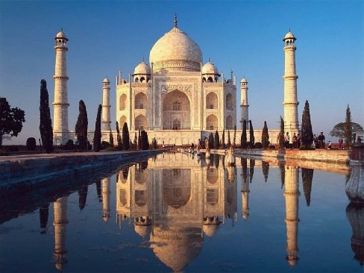









Problem Setting
Love
Rose
Flower
Petals
Gift
Red
Bud
Semantics Not Captured
Green
Words
*J Sivic & Zisserman,2003; Nister & Henrik,2006; Philbin,Sivic,Zisserman et la,2008;
Notes:
People ran into the same problem with the growth of the web but web search proved to be a viable solution to this problem.
These web search engines offer image search features also but these images are not indexed by their content
<click>
For example given an jpeg of rose these search engines look for text terms within the surrounding text and associate them to the image.
But because image content is subjective and tags and text are noisy and cannot scale, these search engines don’t perform well.
Content based image retrieval is a viable alternative to the image retrieval problem. In recent years, the bag of visual words model has enabled image retrieval to scale beyond a few thousand images. <click>
Most of the traditional Image retrieval methods use either low level visual features or embedded
text for representation and indexing.

Slide 3
Contribution
Latent Semantic Indexing(LSI) is extended to Multi-modal LSI.
pLSA (probabilistic Latent Semantic Analysis) is extended to Multi-modal pLSA.
Extending Bipartite Graph Model to Tripartite Graph Model.
A graph partitioning algorithm is reﬁned for retrieving relevant images from a tripartite graph model.
Verification on data sets and comparisons.
Notes:
Latent Semantic Indexing(LSI) is extended to Multi-modal LSI, with a tensorial representation
and Higher Order SVD.
pLSA is extended to Multi-modal pLSA by combining multiple modes into a single context,
and then using EM algorithm to ﬁt the model parameters.
A Tripartite Graph based representation of images.
A graph partitioning algorithm is reﬁned for retrieving relevant images from a tripartite graph
model.

Slide 4
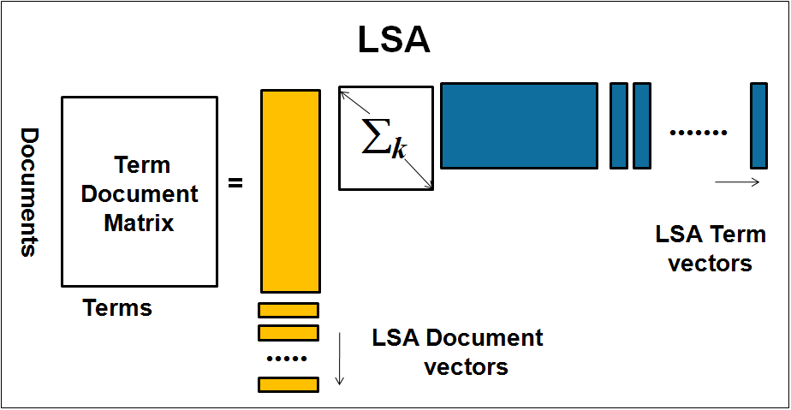
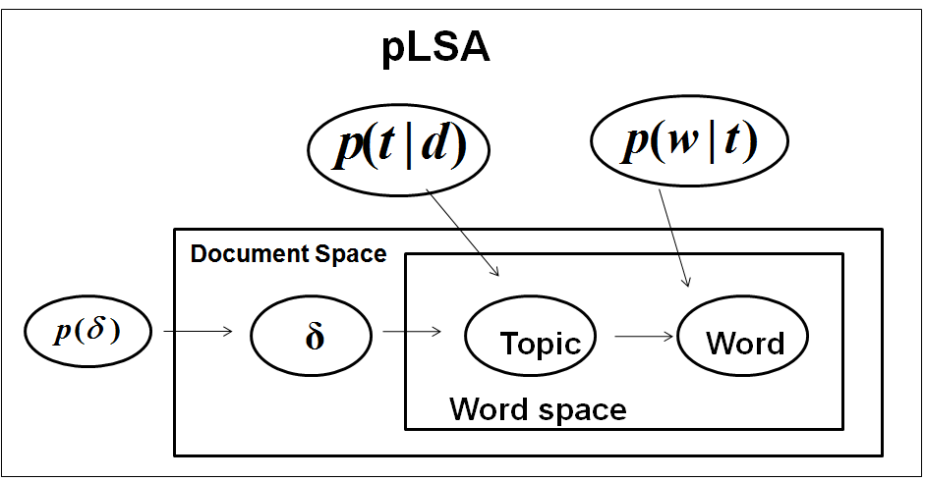
Background
In Latent semantic Indexing, the term document matrix is decomposed using singular value decomposition.
In Probabilistic Latent Semantic Indexing, P(d), P(z|d),
P(w|z) are computed used EM algorithm.
Notes:
Latent − “hidden”
Semantics − “meaning”
Finds the “hidden meaning” of terms based on their occurrences in documents.
Maps terms and documents to a “latent semantic space”
Synonymous terms look more similar in latent space.
The term-document matrix(N) is decomposed into three matrices by Singular Value Decomposition(SVD).
The diagonal matrix(∑) is a non-negative diagonal elements called Singular values(eigen values).
The U and V are orthogonal matrices(left eigen vectors and right eigen vector respectively).
The top k eigen values form the decomposed matrices are selected to form a reduced matrix(N_{k}).

Slide 5




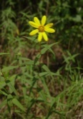

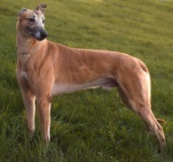
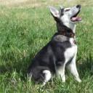

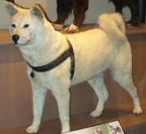







Semantic Indexing
Animal
Whippet
GSD
doberman
Whippet
daffodil
d
w
GSD
tulip
doberman
P(w|d)
rose
daffodil
LSI, pLSA, LDA
Flower
tulip
rose
* Hoffman 1999; Blei, Ng & Jordan, 2004; R. Lienhart and M. Slaney,2007
Notes:
In semantic indexing methods like LSI, pLSA, LDA, IpLSA the term document matrix is analyzed to discover latent topics which could cluster the relevant images together. Semantic indexing in this sense can be seen as unsupervised clustering of terms and documents. These semantic indexing techniques usually have high space complexity and are very inefficient.
These semantic indexing schemes form a significant bottleneck in the bag of words system when dealing with dynamic image databases <click> for example.

Slide 6
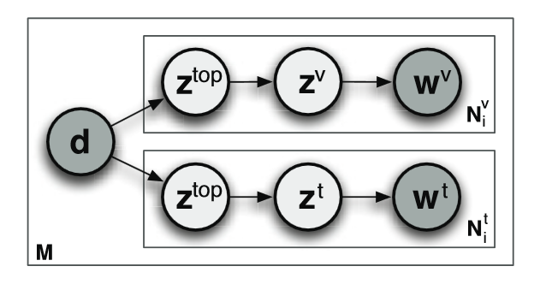
Literature
LSI.
pLSA.
Incremental pLSA.
Multilayer multimodal pLSA.
High space complexity due to large matrix operations.
Slow, resource intensive offline processing.
*H. Wu, Y. Wang, and X. Cheng, “Incremental probabilistic latent semantic analysis for automatic
question recommendation,” in AMC on RSRS, 2008.
*R. Lienhart and M. Slaney., “Plsa on large scale image databases,” in ECCV, 2006.
*R. Lienhart, S. Romberg, and E. H¨orster, “Multilayer plsa for multimodal image retrieval,” in CIVR, 2009.
Notes:
with two separate leaf-pLSAs, and a single top level pLSA node merging the two leaf-pLSAs. Here,
they apply pLSA to each mode, i.e., visual features and textual words separately, and then concatenate
the derived topic vectors of each mode to learn another pLSA on top of that.

Slide 7
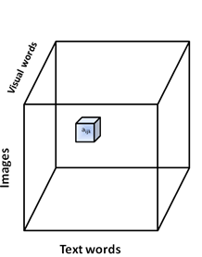
Multimodal LSI
Most of the current image representations either solely on visual features or on surrounding text.
Tensor
We represent the multi-modal data using 3rd order tensor.
Vector: order-1 tensor
Order-3 tensor
Matrix: order-2 tensor

Slide 8
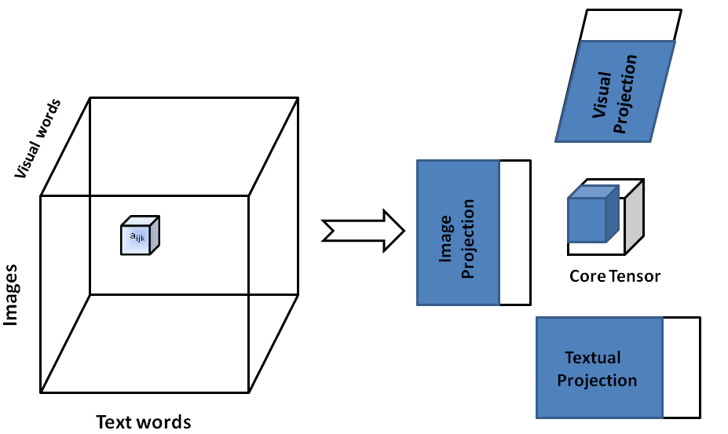
MultiModal LSI
Higher Order SVD is used to capture the latent semantics.
Finds correlated within the same mode and across different modes.
HOSVD extension of SVD and represented as

Slide 9
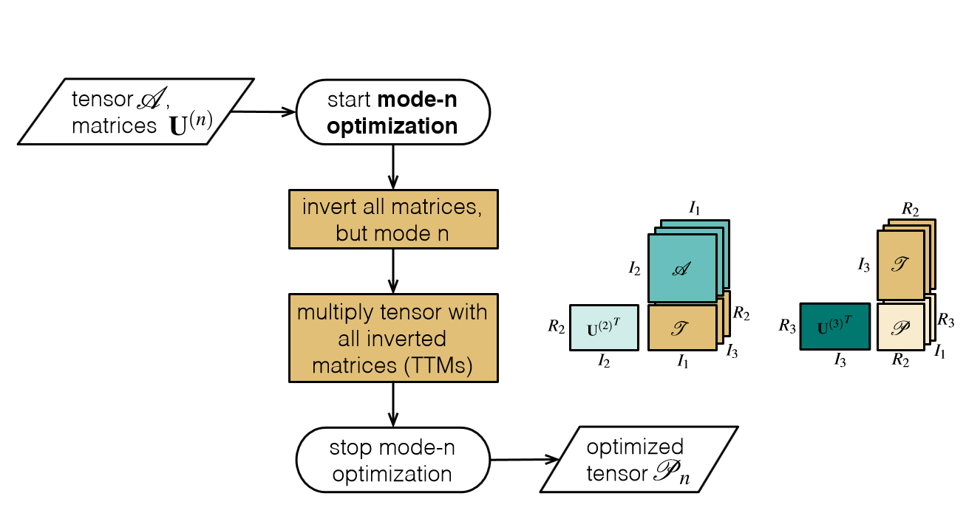
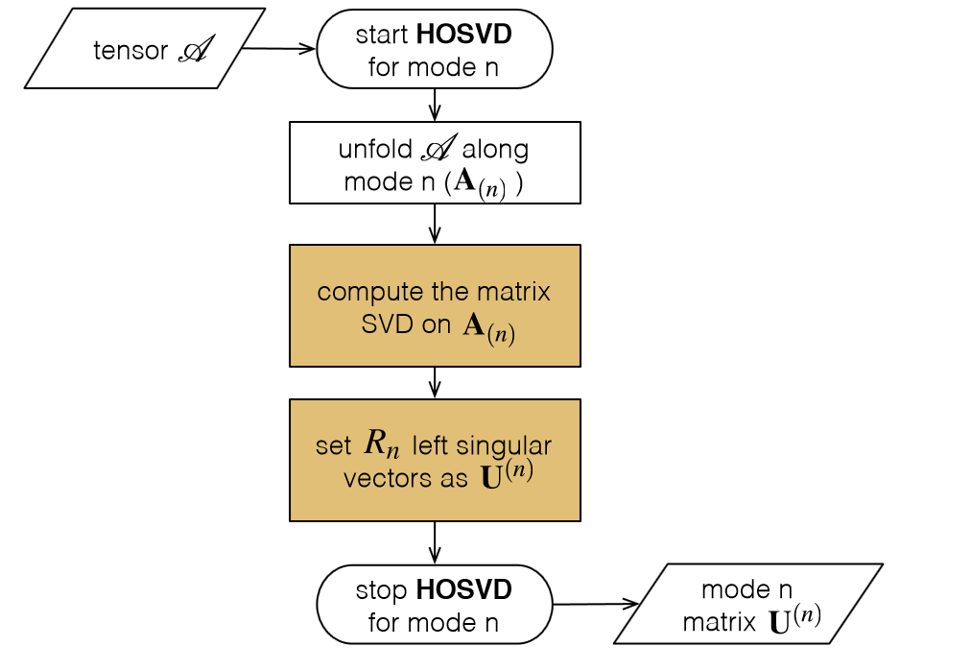
HOSVD Algorithm

Slide 10
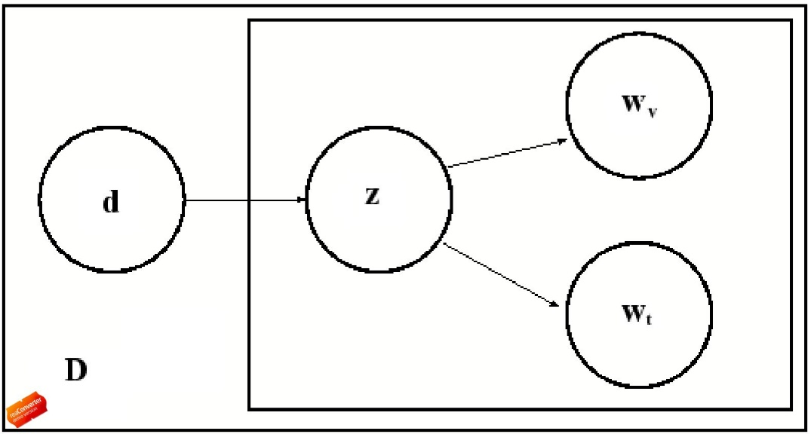
Multimodal PLSA
An unobserved latent variable z is associated with the text words w ^{t} ,visual words w^{v} and the documents d.
The join probability for text words, images and visual words is
Assumption:
Thus,
Notes:
We assume that the pair of random variables (w^{v} ,w^{t}) are conditionally independent given the respective image or document d. Thus,

Slide 11
Multimodal PLSA
The joint probabilistic model for the above generative model is given by the following:
Here we capture the patterns between images, text words and visual words by using EM algorithm to determine the hidden layers connecting them.

Slide 12
Multimodal PLSA
E-Step:
M-Step:
Notes:
E-Step
Expectation step where expectation of the likelihood function is calculated with the current parameter values
M-Step
Update the parameters with the calculated posterior probabilities
Find the parameters that maximizes the likelihood function

Slide 13

Bipartite Graph Model
w1
w1 w3 w2
w5
w2
w1 w3 w2
w5
w3
TF
words
w1 w3 w2
w5
Documents
w4
IDF
w1 w3 w2
w5
w5
w1 w3 w2
w5
w6
Notes:
The bipartite graph model is a bipartite graph constructed from terms and documents. For example consider these documents and the words within them. Now, the bipartite graph is constructed by connecting terms and documents in which they occur by edges. The important thing about BGM is that <click>the edges are weighted by TF or term frequency which indicates how relevant a term is to a document and vice-versa. All the terms/words are also associated with their respective IDF or inverse document frequency values.

Slide 14

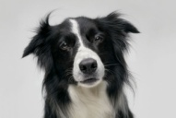
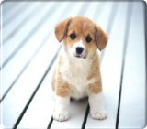


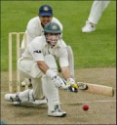
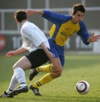

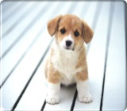
BGM
Query Image
Cash Flow
w1
w2
w3
w4
w5
w6
w7
w8
Results :
*Suman karthik, chandrika pulla & C.V. Jawahar, "Incremental On-line semantic Indexing for Image Retrieval in Dynamic. Databases“, Workshop on Semantic Learning and Applications, CVPR, 2008
Notes:
Naïve retrieval retrieves images from a standard inverted index, where words point to documents in which they occur <click> for a query in naïve retrieval the relevant words are taken and all documents occuring in the inverted index w.r.t relevant nodes are retrieved. In case of BGM however <click> cashflow is used to retrieve relevant images, you can see during cashflow how the amount of cash depreciates over distance traveled on the graph.
14

Slide 15
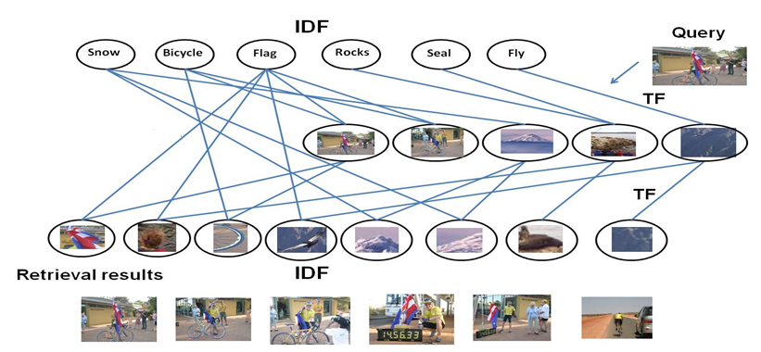
Tripartite Graph Model
Tensor represented as a Tripartite graph of text words, visual words and images.
Notes:
For retrieval, we start from the query image, and traverse to the neighboring nodes (visual as well as text words).
An initial relevance score (R) at the query node gets distributed to all the neighboring nodes, according to the TF values.
Then these word-nodes, propagate this relevance score back to the connected documents. This is done based on IDF values.
The relevance score is propagated between the text and visual words based on the edge weights connecting them.
Thus in one iteration, the relevance score gets distributed over multiple documents. The entire process is repeated multiple times.

Slide 16
Tripartite Graph Model
The edge weights between text words with visual word are computed as:
Learning edge weights to improve performance.
Sum-of-squares error and log loss.
L-BFGS for fast convergence and local minima
* Wen-tan, Yih, “Learning term-weighting functions for similarity measures,” in EMNLP, 2009.
Notes:
However, the weights of edges which relate the text words with visual words can not be directly assigned. These edges are weighed as:
Yvi for each visual word and document
Yti for each test word and document.
Output learned yvio, ytio.

Slide 17
Offline Indexing
Bipartite graph model as a special case of TGM.
Reduce the computational time for retrieval.
Similarity Matrix for graphs G_{a} and G_{b}
A special case is G_{a} = G_{b} =G′.
A and B are adjacency matrixes for G_{a} and G_{b}

Slide 18
Datasets
University of Washington(UW)
1109 images.
manually annotated key words.
Multi-label Image
139 urban scene images.
Overlapping labels: Buildings, Flora, People and Sky.
Manually created ground truth data for 50 images.
IAPR TC12
20,000 images of natural scenes(sports and actions, landscapes, cites etc) .
291 vocabulary size and 17,825 images for training.
1,980 images for testing.
Corel
5000 images.
4500 for training and 500 for testing.
260 unique words.
Holiday dataset
1491 images
500 categories

Slide 19
Experimental Settings
Pre-processing
Sift feature extraction.
Quantization using k-means.
Performance measures :
The mean Average precision(mAP).
Time taken for semantic indexing.
Memory space used for semantic indexing.

Slide 20
BGM vs pLSA,IpLSA
Model | mAP | Time | Space
Probabilistic LSI | 0.642 | 547s | 3267Mb
Incremental PLSA | 0.567 | 56s | 3356Mb
BGM | 0.594 | 42s | 57Mb
* On Holiday dataset

Slide 21
BGA vs pLSA,IpLSA
pLSA
Cannot scale for large databases.
Cannot update incrementally.
Latent topic initialization difficult
Space complexity high
IpLSA
Cannot scale for large databases.
Cannot update new latent topics.
Latent topic initialization difficult
Space complexity high
BGM+Cashflow
Efficient
Low space com plexity

Slide 22
Results
Datasets | Visual-based | Tag-based | Pseudo single mode | MMLSI
UW | 0.46 | 0.55 | 0.55 | 0.63
Multilabel | 0.33 | 0.42 | 0.39 | 0.49
IAPR | 0.42 | 0.46 | 0.43 | 0.55
Corel | 0.25 | 0.46 | 0.47 | 0.53
LSI vs MMLSI
Datasets | Visual-based | Tag-based | Pseudo single mode | mm-pLSA | Our MM-pLSA
UW | 0.60 | 0.57 | 0.59 | 0.68 | 0.70
Multilabel | 0.36 | 0.41 | 0.36 | 0.50 | 0.51
IAPR | 0.43 | 0.47 | 0.44 | 0.56 | 0.59
Corel | 0.33 | 0.47 | 0.48 | 0.59 | 0.59
pLSA vs MMpLSA

Slide 23
TGM vs MMLSI,MMpLSA,mm-pLSA
MMLSI and MMpLSA
Cannot scale for large databases.
Cannot update incrementally.
Latent topic initialization difficult
Space complexity high
TGM+Cashflow
Efficient
Low space complexity
mm-pLSA
Merge dictionaries with different modes.
No intraction between different modes.
Datasets | MMLSI | MMpLSA | mm-pLSA | TGM-TFIDF | TGM-learning
UW | 0.63 | 0.70 | 0.68 | 0.64 | 0.67
Multilabel | 0.49 | 0.51 | 0.50 | 0.49 | 0.50
IAPR | 0.55 | 0.59 | 0.56 | 0.56 | 0.59
Corel | 0.33 | 0.39 | 0.37 | 0.35 | 0.38

Slide 24
TGM vs MMLSI,MMpLSA,mm-pLSA
TGM
Takes few milliseconds for semantic indexing.
Low space complexity
Model | mAP | Time | space
MMLSI | 0.63 | 1897s | 4856Mb
MMpLSA | 0.70 | 983s | 4267Mb
mm-pLSA | 0.68 | 1123s | 3812Mb
TGM | 0.67 | 55s | 168Mb

Slide 25
Conclusion
MMLSI and MMpLSA
Outperforms single mode and existing multimodal.
LSI, pLSA and multimodal techniques proposed.
Memory and computational intensive.
TGM
Fast and effective retrieval.
Scalable.
Computationally light intensive.
Less resource intensive.

Slide 26
Future work
Learning approach to determine the size of the concept space.
Various methods can be explored to determine the weights in TGM.
Extending the algorithms designed for Video Retrieval .

Slide 27
Related Publications
Suman Karthik, Chandrika Pulla, C.V.Jawahar, "Incremental On-line semantic Indexing for Image Retrieval in Dynamic. Databases" 4th International Workshop on Semantic Learning and Applications, CVPR, 2008.
Chandrika pulla, C.V.Jawahar,“Multi Modal Semantic Indexing for Image Retrieval”,In Proceedings of Conference on Image and Video Retrieval(CIVR), 2010.
Chandrika pulla, Suman Karthik, C.V.Jawahar,“Effective Semantic Indexing for Image Retrieval”, In Proceedings of International Conference on Pattern Recognition(ICPR), 2010.
Chandrika pulla, C.V.Jawahar,“Tripartite Graph Models for Multi Modal Image Retrieval”, In Proceedings of British Machine Vision Conference(BMVC), 2010.

Slide 28
Thank you

