Slide 1
A Framework for Community Detection from Social Media
Chandrashekar V
Centre for Visual Information Technology
IIIT-Hyderabad
Advisers:
Prof. C. V. Jawahar, Dr. Shailesh Kumar

Slide 2
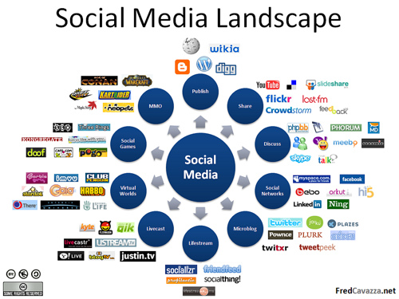
Motivation

Slide 3
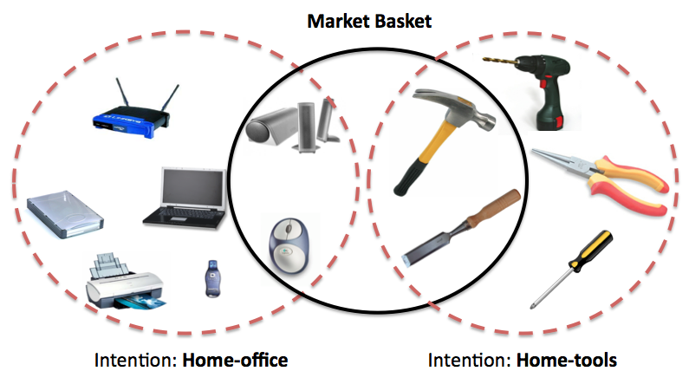
Problem Statement

Slide 4
Challenges
Scalability: billions of nodes & edges
Heterogeneity: multiple types of edges & nodes
Evolution: current network under consideration is static
Evaluation: Lack of reliable ground truth
Privacy: Lot of valuable information not available

Slide 5
Outline
Social Media Network
Communities
CoocMiner: Discovering Tag Communities
Compacting Large & Loose Communities
Image Annotation in Presence of Noisy Labels
Conclusions

Slide 6
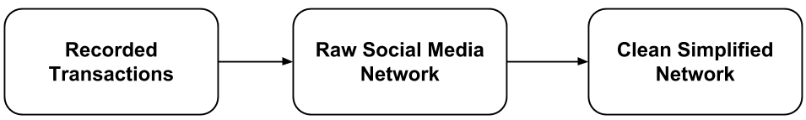
Social Media Network
Vertices of Social Media Network
Users
Content Items (blog posts, photos, videos)
Meta-data Items (topic categories, tags)
Relations/Interactions among them as edges
Simple
Weighted
Directed
Multi-way (connecting > 2 entities)
Social Media Network Creation

Slide 7
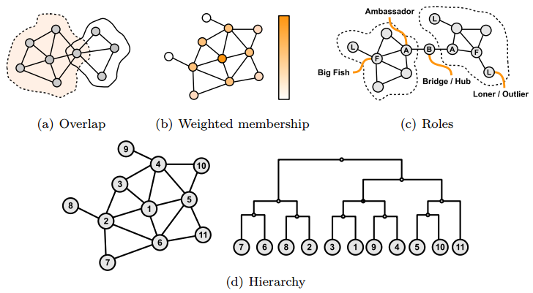
Communities
No unique definition.
network comprising of entities with a common element of interest like topic, place, event.
Community Structure & Attributes

Slide 8
Community Detection Methods
Key to community detection algorithm is definition of community-ness
Definitions of community-ness:
Internal Community Scores: No. of edges, edge density, avg. degree, intensity
External Community Scores: Expansion, Cut Ratio, betweenness centrality[3]
Internal + External Scores: Conductance[1], Normalized Cut[1]
Network Model: Modularity[2]
Popular Methods
Clique Percolation Method (CPM)[4]: identifies & percolates k-cliques
Modularity Maximization Methods[5,6]
Label Propagation Methods[7,8]
Local Objective Maximization Approaches[9,10]
Community Affiliation Network Models[11]

Slide 9
CoocMiner: Discovering Tag Communities

Slide 10
Community Detection in Tagsets
Tagset Data
Flickr
YouTube
AdWords
IMDB
Scientific Publications
Key Challenges
Noisy Tag-sets
Weighted Graphs
Overlapping Communities

Slide 11
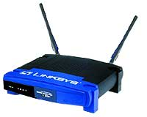
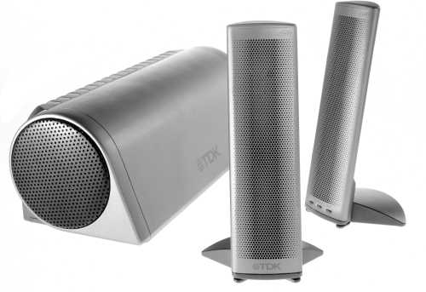




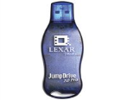
Entity-set Data - a “Crazy Haystack” !
Few buy complete “logical” itemset in same basket
Already have other products
Buy them from another retailer
Buy them at a different time
Got them as gifts
…
It’s a Projections of latent customer intentions

Slide 12
It gets even Crazier!
It’s a Mixture of Projections of latent intentions

Slide 13
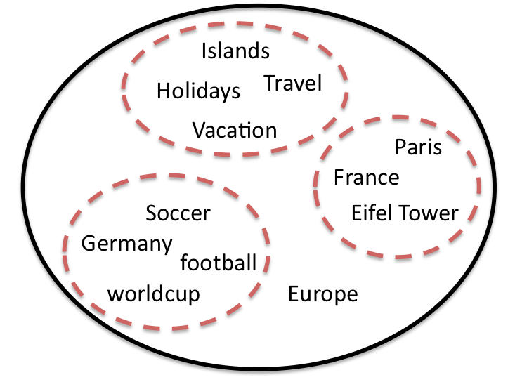
Tagsets – a “Crazy Haystack” !
Mixture of Projections of latent Concepts

Slide 14





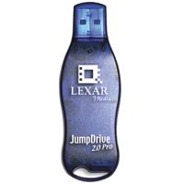

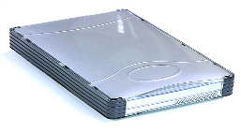


Frequent Item-Set Mining
CANDIDATE
ITEM-SETS
Size = 3
FREQUENT
ITEM-SETS
Size = 1
CANDIDATE
ITEM-SETS
Size = 2
FREQUENT
ITEM-SETS
Size = 2
FREQUENT
ITEM-SETS
Size = 3

Slide 15
CoocMiner
A scalable, unsupervised, hierarchical framework that
Analyzes pair-wise relationships among entities
Co-occurring in various contexts
To build a Co-occurrence Graph(s) in which
It discovers coherent higher order structures

Slide 16
Co-occurrence Analysis
Context – Nature of Co-occurrence
E.g. resource-based, session-based, user-consumed etc.
Co-occurrence – Definition of Co-occurrence
E.g. Co-occurrence, Marginal & Total counts
Consistency – Strength of Co-occurrence
E.g. Point-wise Mutual Information

Slide 17
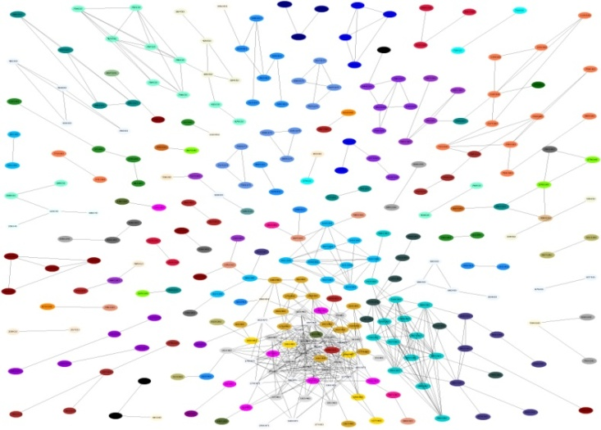
“Co-Purchase” Consistency Graph
a
b
Logical Itemsets = Cliques in the
Co-Purchase Graph
Consistency: Strength
A
B
A
B
Low
High

Slide 18
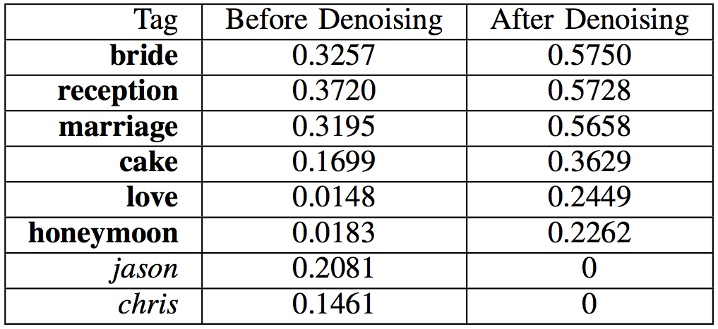
Denoising – for better graphs
Co-occurrence of Tags with tag “wedding”
Tag
Before Denoising
After Denoising

Slide 19

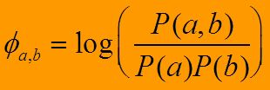
Creating Robust Co-oc Graph
umbrella
umbrella
rain
rain
thunder
thunder
coffee
chocolate
coffee
chocolate
cake
cake
umbrella
rain
thunder
chocolate
coffee
cake

Slide 20
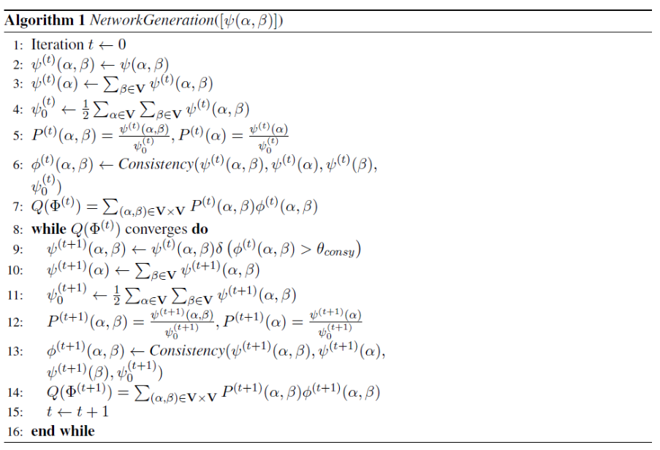
Network Generation

Slide 21
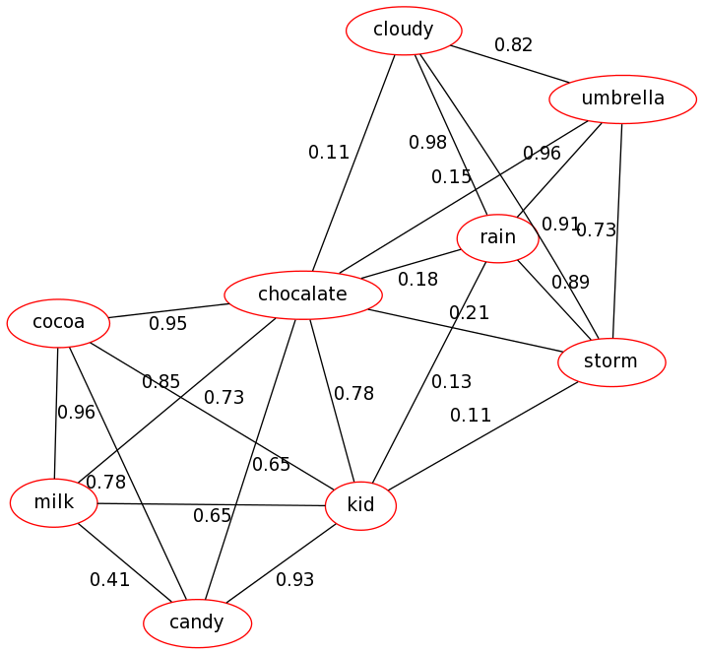


Local Node Centrality (LNC)
A node is central to a community if it is strongly connected to other central nodes in the community.
Localization
Eigenvector
Unnormalization
Coherence: A community is coherent if each of its nodes belongs with all other nodes in the community

Slide 22
Dataset | Communities with LNC scores of entities
IMDB | Courtroom:0.92, lawyer, trail, judge, perjury, lawsuit, false-accusation:0.53
IMDB | Africa:1.0, lion, elephant, safari, jungle, chimpanzee, rescue:0.36
IMDB | Hospital:0.98, doctor, nurse, wheelchair, ambulance, car-accident:0.43
Flickr | Wimbeldon:1.02, lawn, tennis, net, court, watching, players: 0.81
Flickr | Airplane:0.85, plane, aircraft, flight, aviation, flying, fly:0.72
Flickr | Singer:0.84, singing, musician, guitar, band, drums, music:0.72

Slide 23
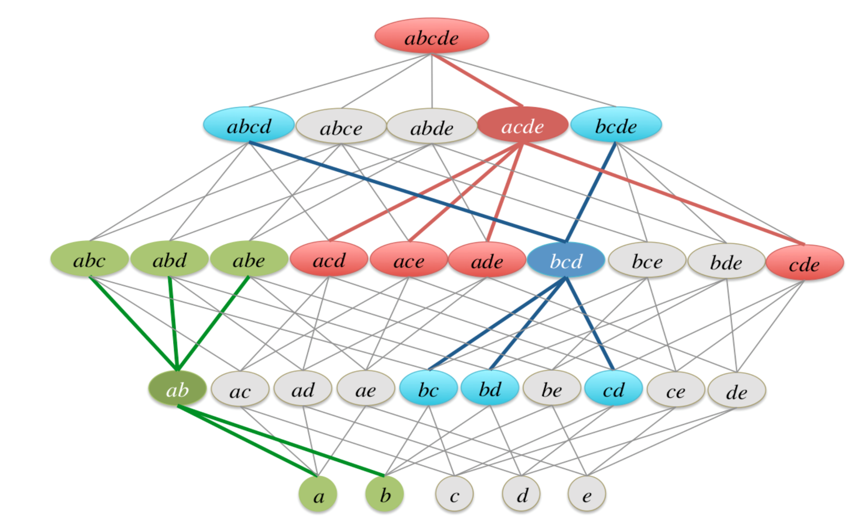
Soft Maximal Cliques (SMC)
Up Neighbor
Up Neighbor
Down Neighbors
Soft Maximal Clique
Coherence of a Soft Maximal Clique is higher than the coherence of all of its Up as well as Down neighbors

Slide 24
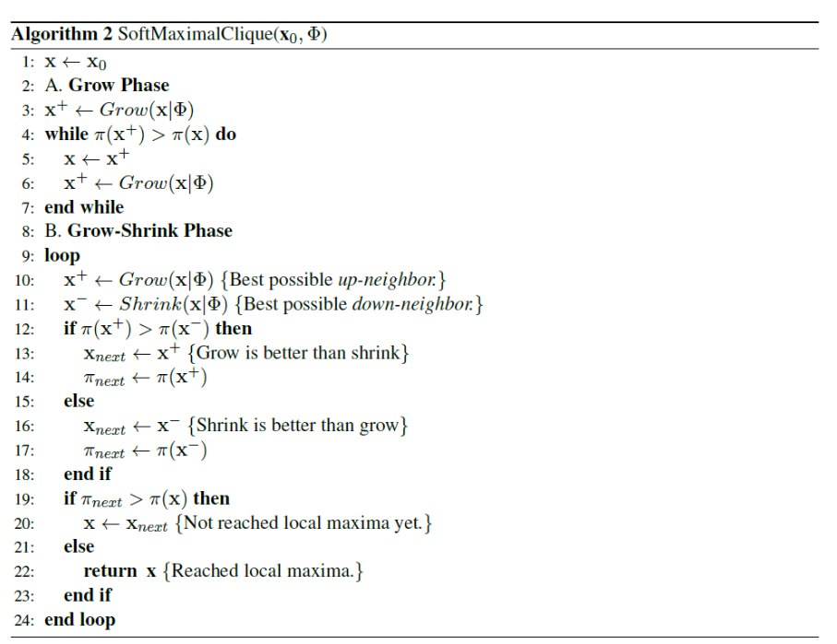
SMC Algorithm

Slide 25
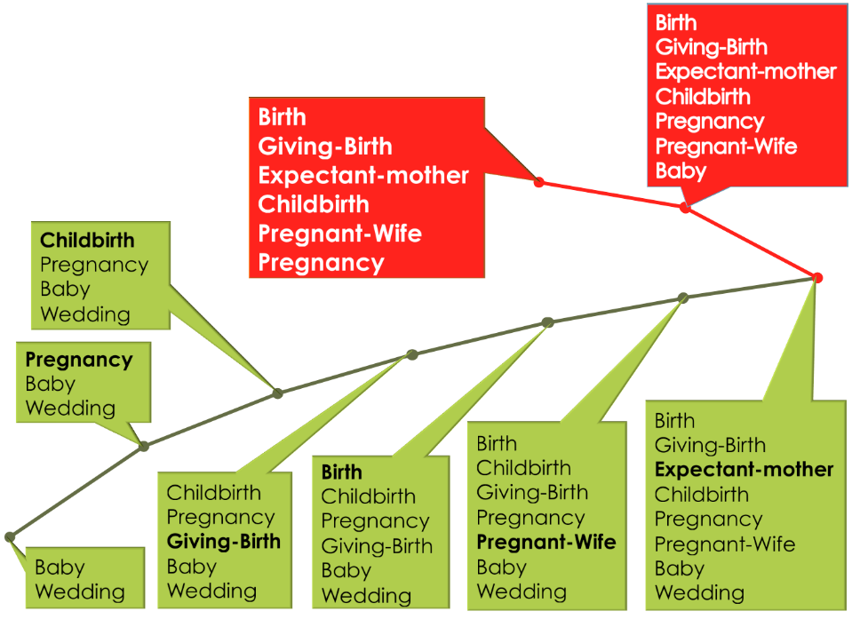
Discovering SMCs

Slide 26
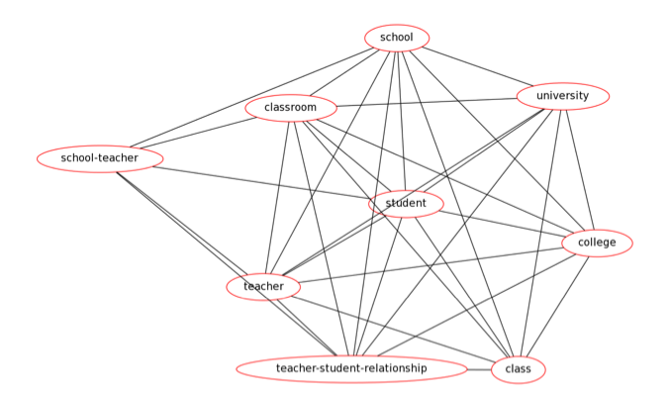
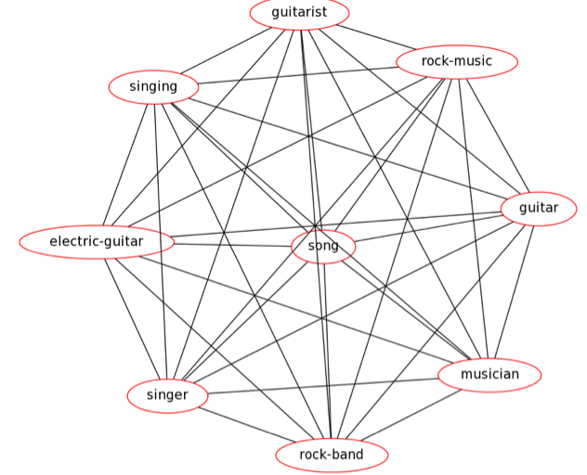
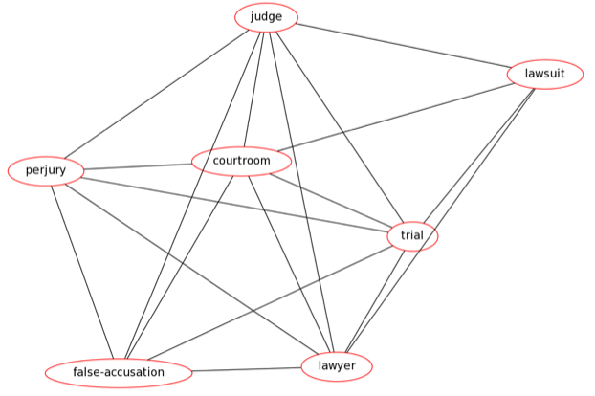
Discovered SMC Communities
school
classroom
university
school-teacher
student
college
teacher
teacher-student-relationship
guitarist
rock-music
judge
singing
lawsuit
guitar
courtroom
electric-guitar
song
perjury
trial
musician
singer
false-persecution
lawyer
rock-band

Slide 27
More Discovered SMCs
mountaineering, countryside, walking, climbing, backpacking, peak, hiking
empirestatebuilding, statueofliberty, bigapple, broadway, timessquare, centralpark, newyorkcity
lieutenant, sergeant, colonel, military-officer, captain, u.s.-army, military, soldier, army
Marvel Comics, DC Comics, Superhero, Comic book, Spider-Man, Fictional character, Superman, X-Men, Batman, Marvel Universe
linux, debian, ubuntu, unix, opensource, os, software, freeware, microsoft, windows, mac, computer
css, webdesign, html, webdev, design, web, xhtml, javascript, ajax, php, mysql

Slide 28
Experimental Evaluation
Datasets
Bibsonomy – tags for 40K bookmarks & publications.
Flickr – collection of 2 million social-tagged images randomly collected.
IMDB – Keywords associated with about 300K movies.
Medline – containing references & abstracts on about 14 million life sciences & biomedical topics. Mesh terms associated with topics as entities.
Wikipedia – wiki pages as entities and out-links of page used for creating entity-set of page. Around 1.8 millions wiki pages used for dataset.
Evaluation Metrics
Coherence
Overlapping Modularity[12]
Community-based Entity Prediction
Comparative Community Detection Methods
Weighted Clique Percolation Method (WCPM)[13]
BIGCLAM[11]

Slide 29
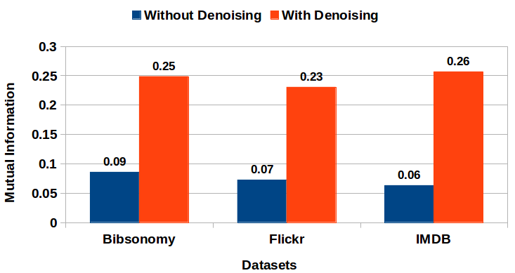
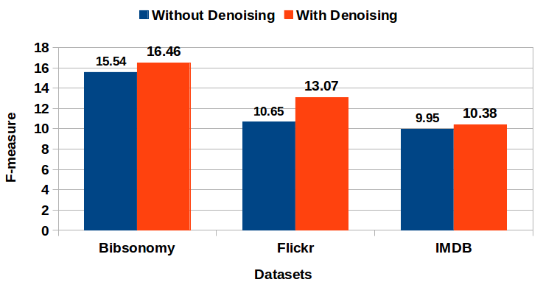
Effect of Denoising in Network Generation Phase
In Bibsonomy & IMDB, there is about 4-5% increase in F-measure, whereas for user-colloborative network Flickr, there is exceptionally high increase of 22.72%.
Denoising doesn’t deteriorate the performance of framework, rather tries to improve its effectiveness wherever possible.

Slide 30
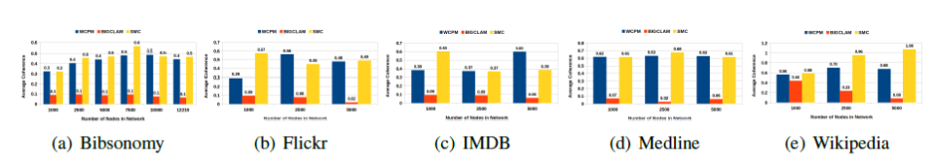
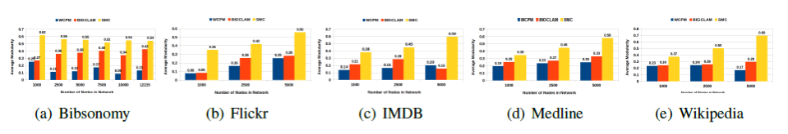
Structural Properties of Communities
Coherence of Communities Discovered
Modularity of Communities Discovered
-SMC –BIGCLAM -WCPM

Slide 31
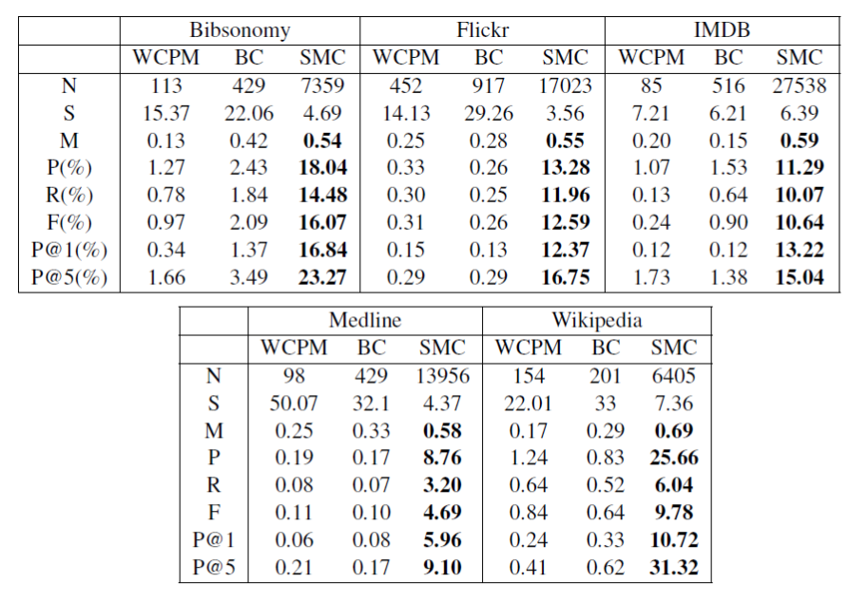
Community-based Entity Recommendation

Slide 32
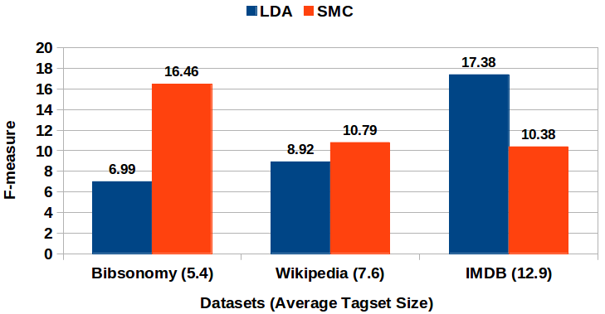
Comparison with LDA
LDA[14] would not be right choice for semantic concept modeling in tagging systems, where avg. length of entity-set (document) is low & the entity frequencies in entity-sets is either 0 or 1.

Slide 33
Compacting Large and Loose Communities

Slide 34
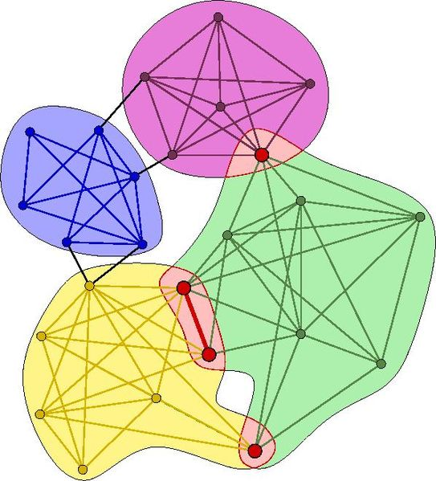
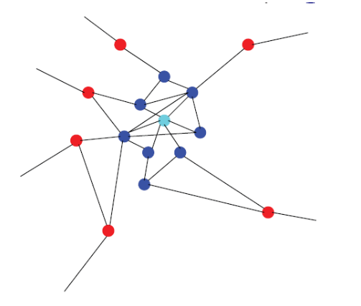
Traditional Community Detection Methods
Maximal Cliques
Clique Percolation Method (CPM)[4,13]
Local Fitness Maximization (LFM)[9]

Slide 35
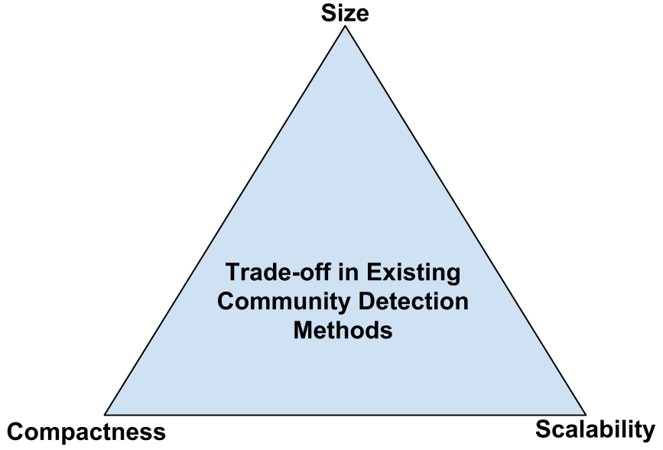
Motivation
Oversized communities contain unnecessary noise, while undersized communities might not generalize concept well.
Finding large number of compact communities like maximal cliques is an NP-hard problem.

Slide 36
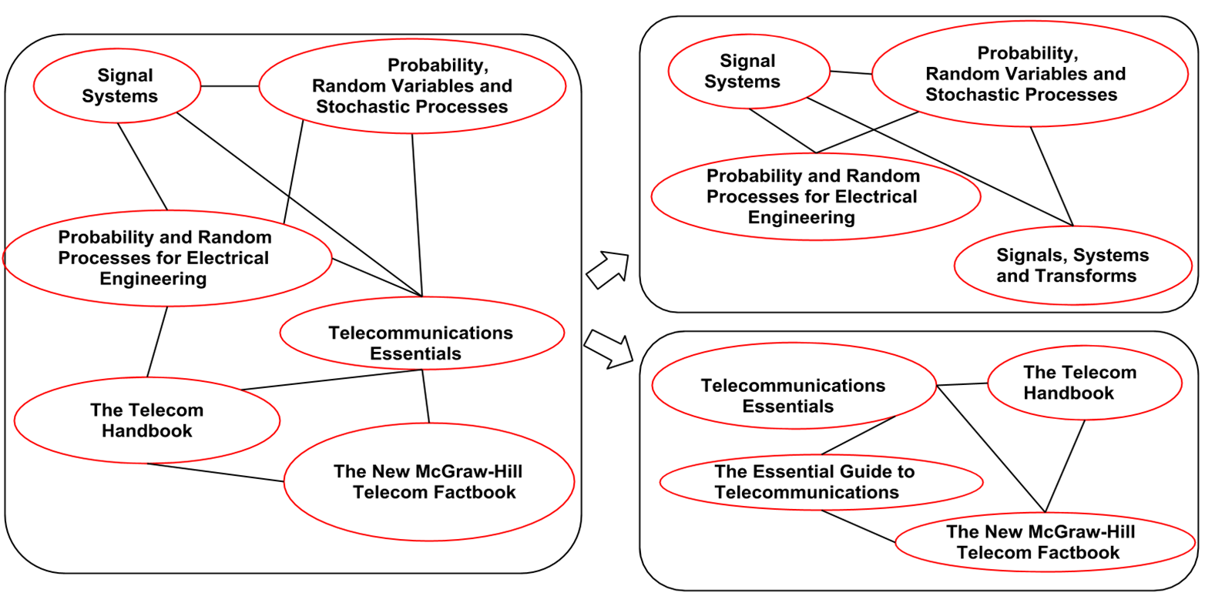
Goal
To find a way to identify loose communities discovered by any method & refine them into compact communities in a systematic fashion.

Slide 37
Important Notions & Definitions
Local Node Centrality (LNC)
Coherence of community
Neighborhood of Community

Slide 38
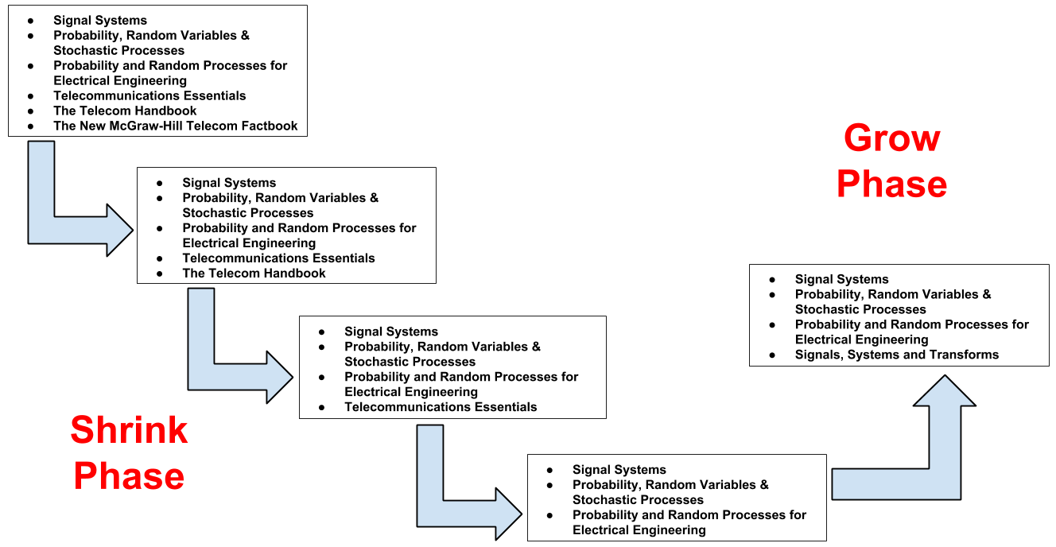
Loose Community Partition (LCP)

Slide 39
Datasets & Evaluation
Datasets
Amazon Product Network
Flickr Tag Network
Evaluation
Overlapping Modularity[12]
Community-based Product/Tag Recommendation

Slide 40
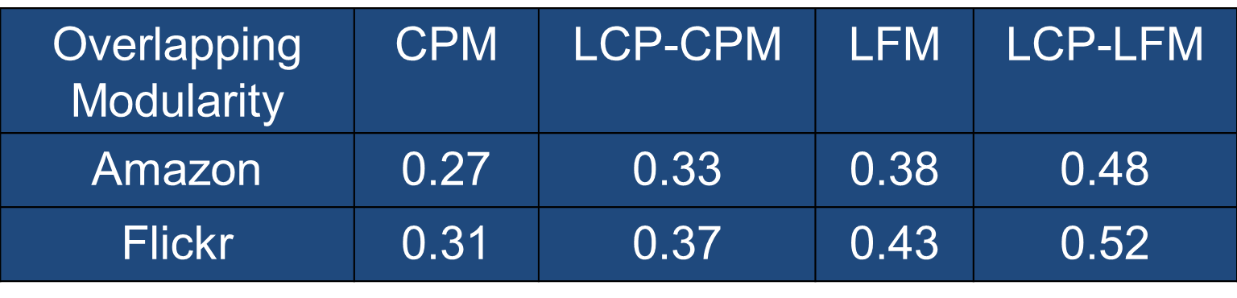
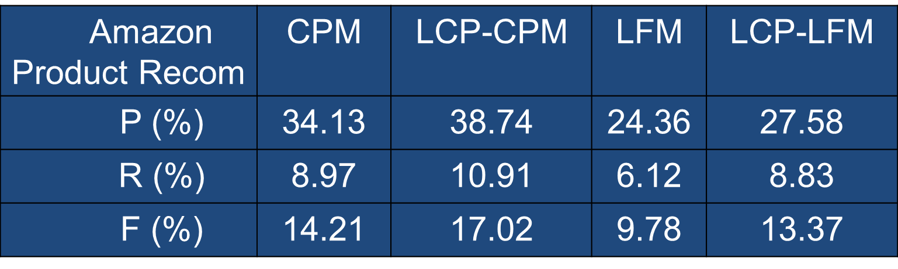
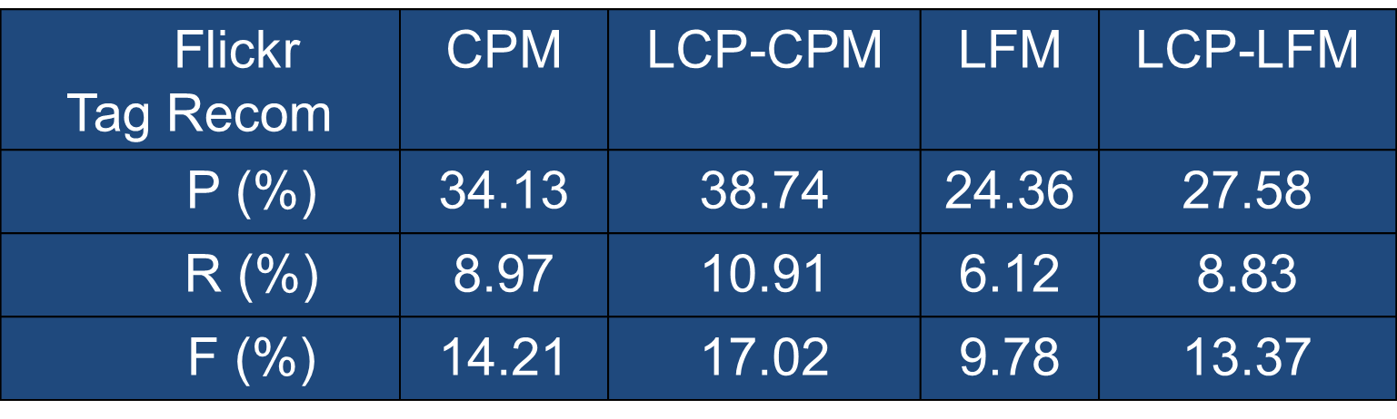
Results

Slide 41
Image Annotation in Presence of Noisy Labels

Slide 42
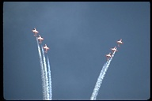
Annotation
Given an image, come-up with some textual information that describes its “semantics”.
What do we “see” in the image ?
Sky, Plane, Smoke , …

Slide 43
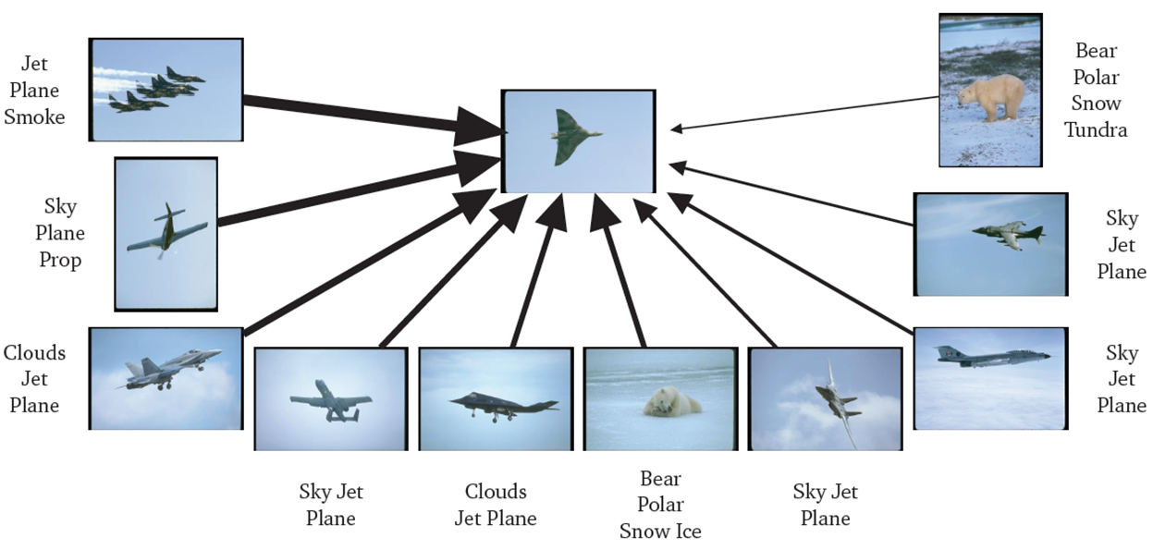
Nearest Neighbor Model
Propagate labels from similar images
Similar images share common labels
Image from Matthieu Guillaumin “Exploiting Multimodal Data for Image Understanding”, PhD Thesis.

Slide 44
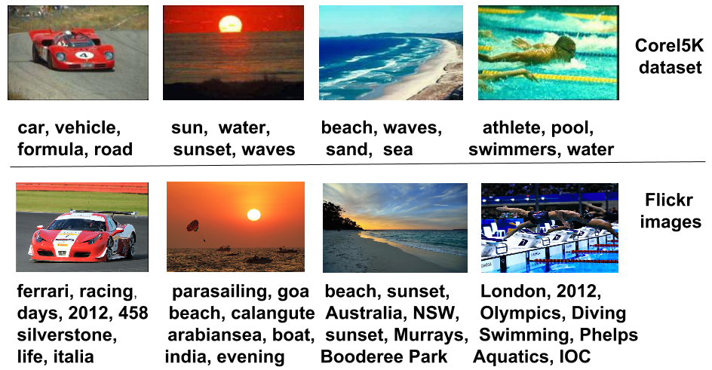
Noisy Labels

Slide 45
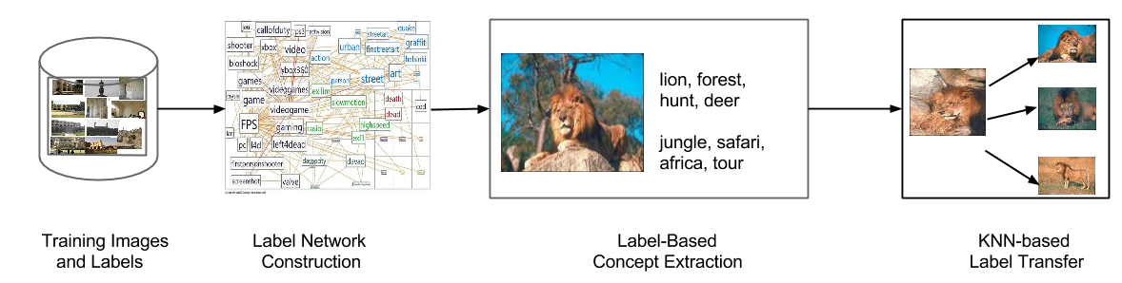
Concept-based Image Annotation

Slide 46
Concept-based Image Annotation
Label Network Construction
Noise Removal
Label-based Concept Extraction
Label Transfer for Annotation

Slide 47
Label Transfer for Annotation
Given a test image, find top K-visually similar training images.
Labels associated with concepts of nearest training images are ranked.
Ranking done based on visual similarity, concept strength & label strength.
L top-ranked unique labels are assigned to the test image.

Slide 48
Experiments
Datasets:
Corel-5K (5000 images, 374 labels)
ESP (22000 images, 269 labels)
Modulated experiments by regulating the degree of noise adding to training data.
Features: SIFT, color histograms, GIST
Evaluation: F₁-score
Comparison with JEC[15]

Slide 49
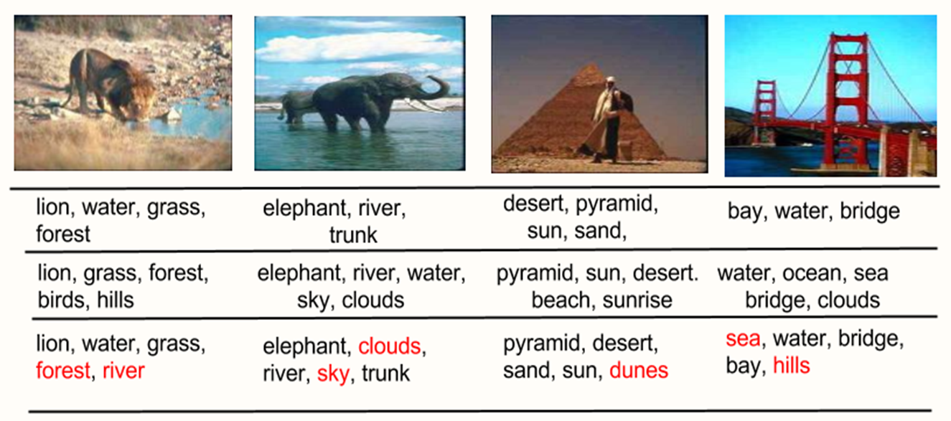
Qualitative Results on Corel-5K

Slide 50
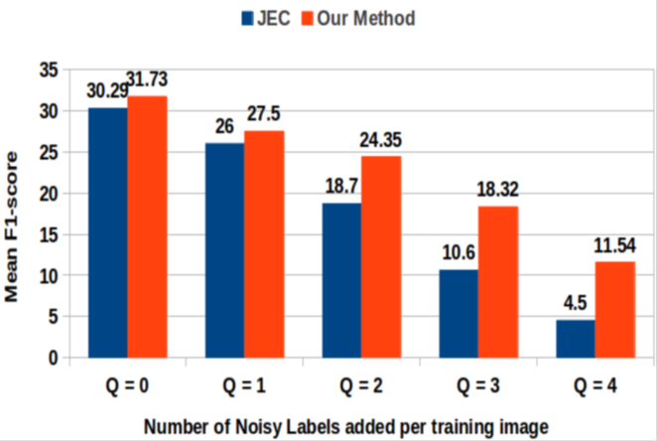
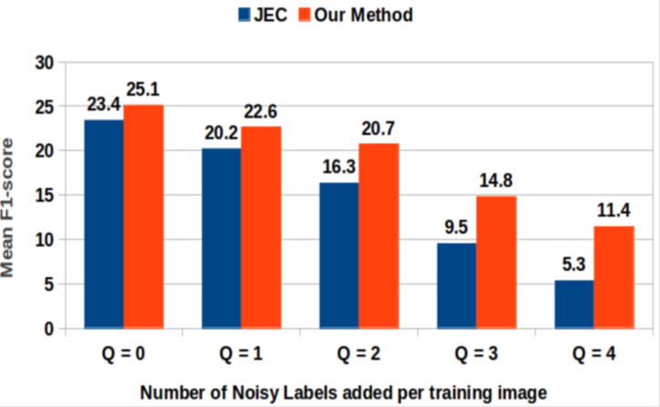
Quantitative Results
Corel-5K
ESP-Games
As degree of noise is increased, there is about 150% increase in F₁-score.

Slide 51
Conclusions
Presented CoocMiner, an end-to-end framework for discovering communities from raw social media data.
Introduced an algorithm for identifying large and loose communities discovered by any community detection method & partition them into compact and meaningful communities.
Proposed a novel knowledge-based approach for image annotation that exploits semantic label concepts, derived based on collective knowledge embedded in label co-occurrence based consistency network.

Slide 52
Related Publications
Logical Itemset Mining, Workshop Proceedings of ICDM 2012.
Compacting Large and Loose Communities, ACPR 2013.
Image Annotation in Presence of Noisy Labels, PReMI 2013.

Slide 53
References
J.Shi and J.Malik. Normalized cuts and image segmentation. IEEE PAMI 2000.
M.E. Newman. Modularity and community structure in networks. PNAS 2006.
M. Girvan and M.E.J. Newman. Community structure in social and biological networks. PNAS 2002.
G. Palla et.al. Uncovering the overlapping community structure of complex networks in nature and society. Nature 2005.
Clauset et.al. Finding community structure in very large networks. Physical Review 2004.
Duch et.al. Community detection in complex networks using extremal optimization. Physical Review 2005.
Raghavan et.al. Near linear time algorithm to detect community structures in large-scale networks. Physical Review 2007.
Xie et.al. Uncovering overlapping communities in social networks via a speaker-listener interaction dynamic process. ICDMW 2011.
Lancichinetti et.al. Detecting the overlapping and hierarchical community structure in complex networks. New Journal of Physics 2009
Lancichinetti et.al. Finding statistically significant communities in networks. PLoS ONE 2011.
Yang et.al. Overlapping community detection at scale: a nonnegative matrix factorization approach WSDM 2013.

Slide 54
References
12. Nicosia et.al. Extending the definition of modularity to directed graphs with overlapping communities. Journal of Stat. Mech. 2009.
13. Farkas et.al. Weighted network modules. New Journal of Physics. 2007
Blei et.al. Latent Dirichlet Allocation. JMLR 2003.
Makadia et.al. Baselines for image annotation. IJCV 2010.

Slide 55
Thank You
Questions ?

