Slide 1
Cascaded Filtering For Biometric Identification Using Random Projection
Atif Iqbal

Slide 2
Thesis Overview
Introduction
Motivation
Previous Works
Cascaded Filtering for Palmprints
Cascaded Filtering for Fingerprints
Summary and Conclusion

Slide 3
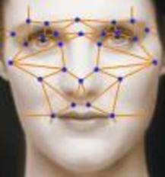
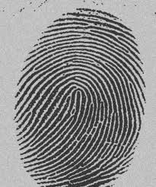
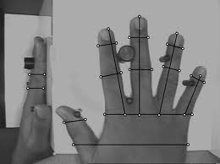
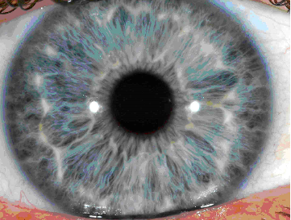
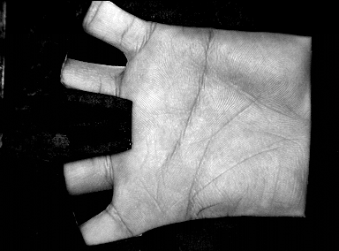
What is Biometrics?
“Uniquely recognizing a person based on their physiological or behavioral characteristics”
Behavioral Biometric: Typing Rhythm, Gait and Voice
Advantages:
User convenience, Non-repudiation, Wide range of applications (data protection, transaction and web security)
Used by many government to keep a track on its people

Slide 4
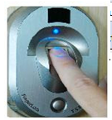
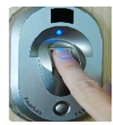
Biometric Authentication System
Enrollment
Feature
Extraction
Template
Generation
Template Database
Verification
User Information
Feature
Extraction
Template
Matching
Yes
No

Slide 5
Biometric Authentication System
Enrollment
Feature
Extraction
Template
Generation
Template Database
Identification
Feature
Extraction
Template
Matching
Yes
No

Slide 6
What if the size of the database is too large??

Slide 7
Thesis Overview
Introduction
Motivation
Previous Works
Cascaded Filtering for Palmprints
Cascaded Filtering for Fingerprints
Summary and Conclusion

Slide 8
Scale of the Matching Problem
Large Database (1.25 billion in case of UID project).
Identification: obtained template is matched with each template stored.
If one matching takes around 1 millisecond, a single enrollment will take more than 300 hrs.
With 1000 processors, it will take over 20,000 years to enroll every Indian.
Unacceptable

Slide 9
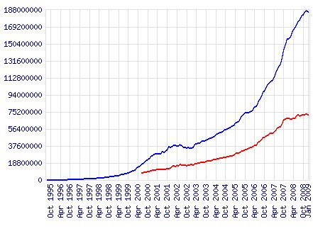

Large Scale Search Problems
Application in web search
Match every search query against 1 trillion web pages
Text search is fast
Indexing improves the speed of data retrieval.

Slide 10
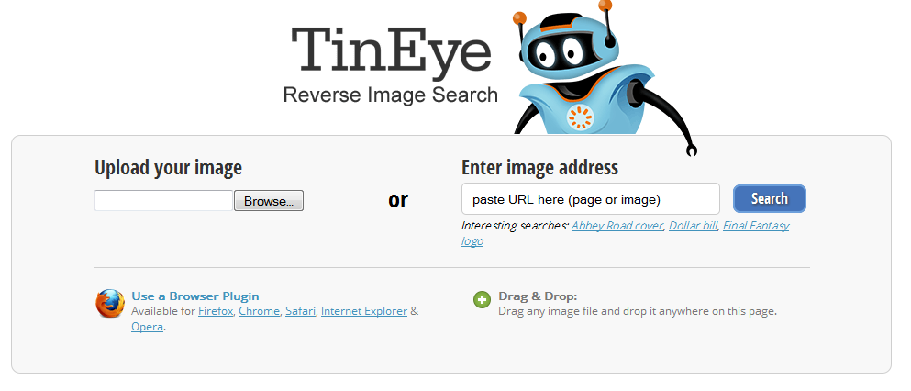
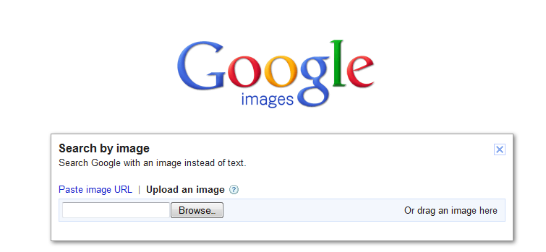
CBIR
Google Image search
Tineye

Slide 11
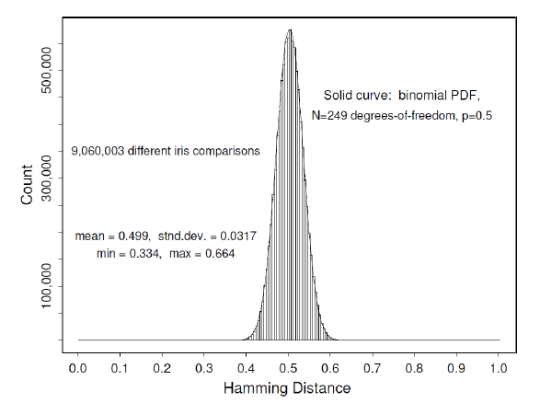
Biometric Indexing: A Special Case
High Inter-Class Variation
Low Intra-Class Variation
Low variation in inter-class distances

Slide 12
Indexing of Biometric data
Indexing is difficult in biometrics
Features extracted have high dimensions
Do not have natural sorting order.
Acquired image can be of poor quality.
Use of different sensors.

Slide 13
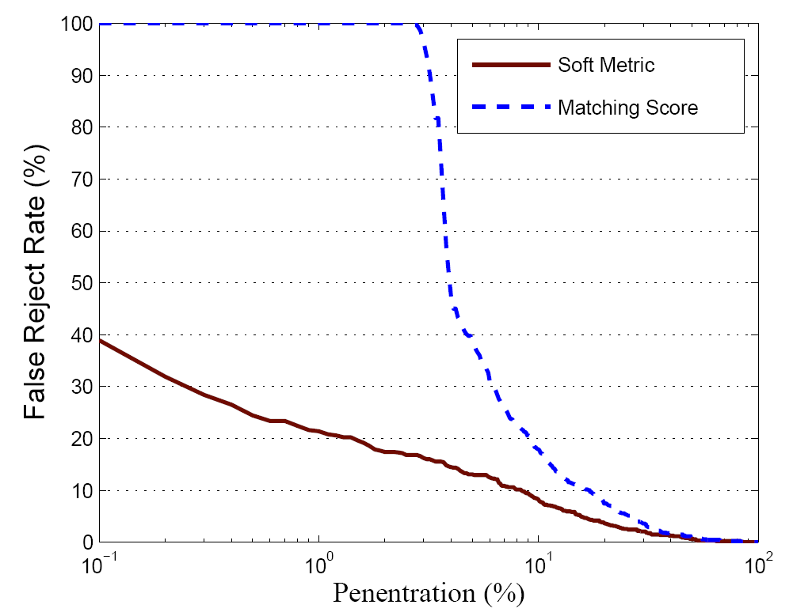
Iris have Bad Indexability
False Non-Identification Rate (FNIR) vs Penetration (%) (CASIA Iris)

Slide 14
Random projections
Distance preserving nature of random projections.
Useful in variety of applications: dimensional reduction, density estimation, data clustering, nearest neighbor search, document classification etc.
Derive low dimensional feature vectors.
Computationally less expensive.
Similarity of data vectors is preserved.
Organizing textual documents.

Slide 15
Thesis Overview
Introduction
Motivation
Previous Works
Cascaded Filtering for Palmprints
Cascaded Filtering for Fingerprints
Summary and Conclusion

Slide 16
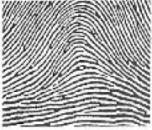
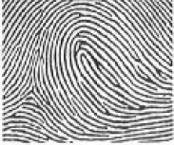
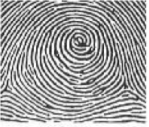
Indexing in biometrics
First indexing in biometrics 1902 by Edward Henry for fingerprint.
Arch (~5%) Loop(~60%) Whorl(~35%)
Indexing using KD-Trees
Pyramid indexing a database is pruned to 8.86% of original size with 0% FNIR.
In Mehrotra et al(2009) the IRIS datasets were pruned to 35% with an FNIR of 2.6%.
Arun Ross et al. in 2011 used Minutia quadruplets for fingerprint indexing.

Slide 17
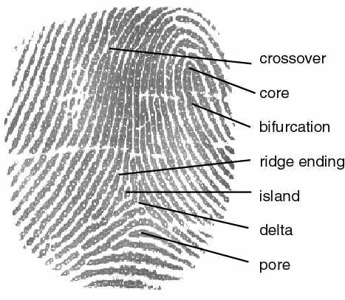
Fingerprints Details

Slide 18
Fingerprints
Fingerprint is one of the strongest biometric trait
Old and reliable method.
Everyone is known to have unique, immutable fingerprints.
Identification: minutia and pattern matching
Indexing started in 1902
Edward Henry divided the fingerprint into 9 classes.

Slide 19
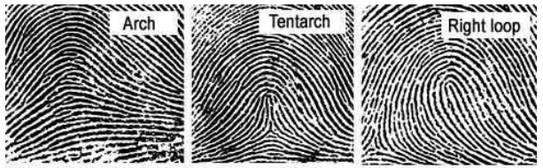
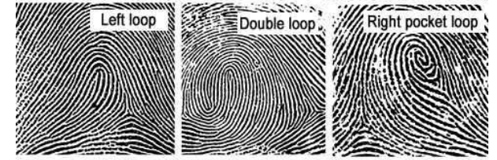
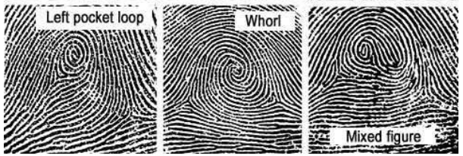
Fingerprint Classification
Started in 1900 by Bengal Police officer.

Slide 20
Fingerprint Classification
Initially classified in 9 different classes.
No. of classes were reduced to 5 with AFIS
Fingerprints are not equally distributed
Whorls : ~30-35%
Arch: ~5%
Loops: ~65%

Slide 21
Fingerprint Indexing
Detection of core and delta points.
Alignment of fingerprints.
Problem: Some of the captured fingerprints may not have core and delta points.
Wont work if the size of the data base is very large
Time: if indexing takes a lots of time it will be useless for large scale implementation.

Slide 22
Thesis Overview
Introduction
Motivation
Previous Works
Cascaded Filtering for Palmprints
Cascaded Filtering for Fingerprints
Summary and Conclusion

Slide 23
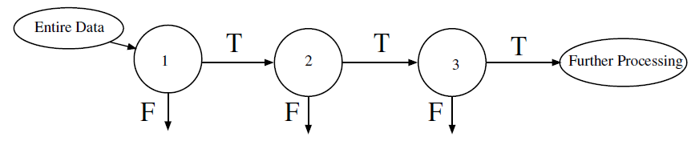
Cascaded Filtering

Slide 24
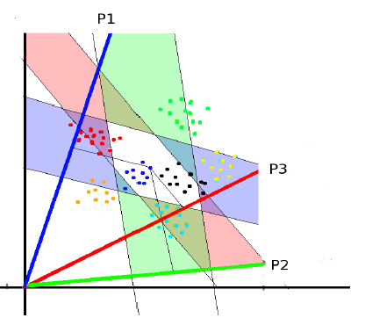
Filtering with projections

Slide 25
Selection of Random Lines
Samples in space is normalized
Projections lines were selected based on its capacity to filter out the imposter samples.
We put the projections with high scores on top.
For palmprints, size of the window is fixed.
For fingerprints the size of the window is calculated along with the scores of projections during training phase.

Slide 26
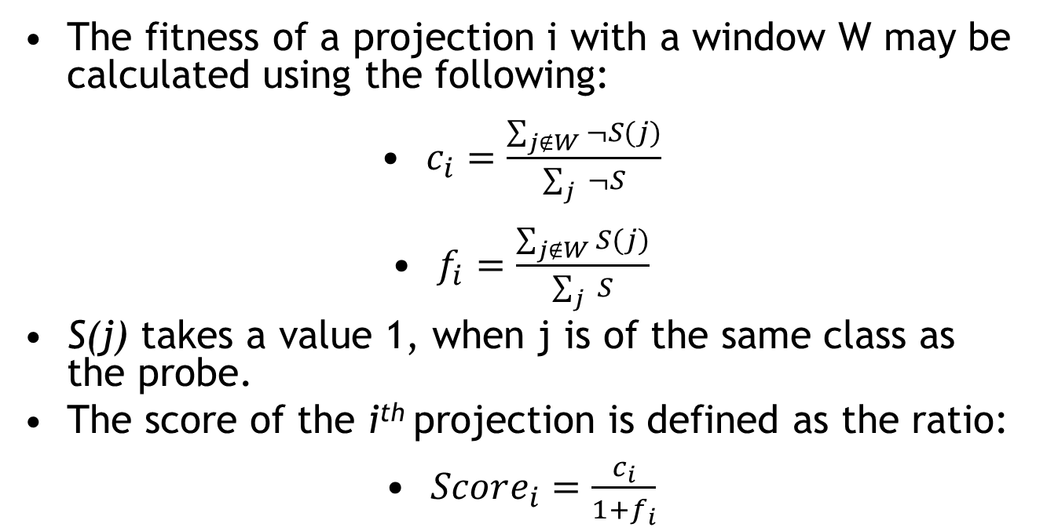
Sorting of the projections
The fitness of a projection i with a window W may be calculated using the following:
$c_{i}=\frac{\sum_{j∉W}{¬S(j)}}{\sum_{j}{ ¬S}}$
$f_{i}=\frac{\sum_{j∉W}{S(j)}}{\sum_{j}{ S}}$
S(j) takes a value 1, when j is of the same class as the probe.
The score of the i^{th} projection is defined as the ratio:
$Score_{i}=\frac{c_{i}}{1+f_{i}}$

Slide 27
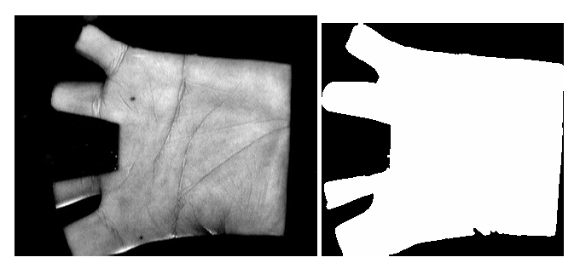
Feature Extraction

Slide 28
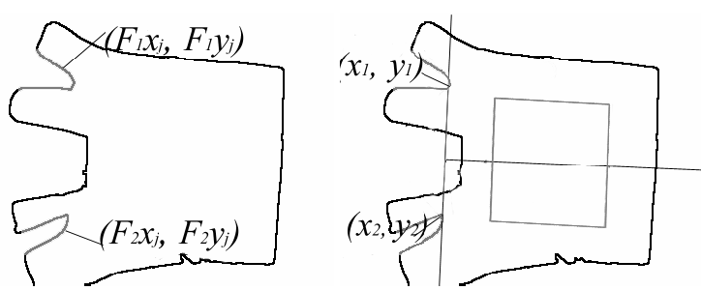
Feature Extraction

Slide 29
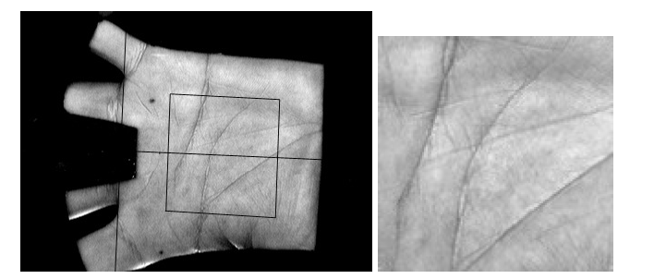


Feature Extraction

Slide 30
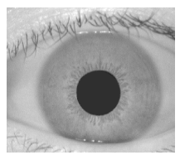
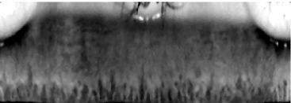

Features for the Iris

Slide 31

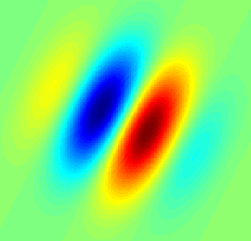
Gabor Filter
Image Source : wikipedia

Slide 32
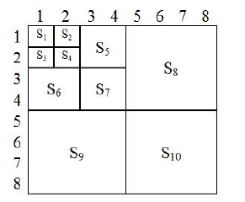
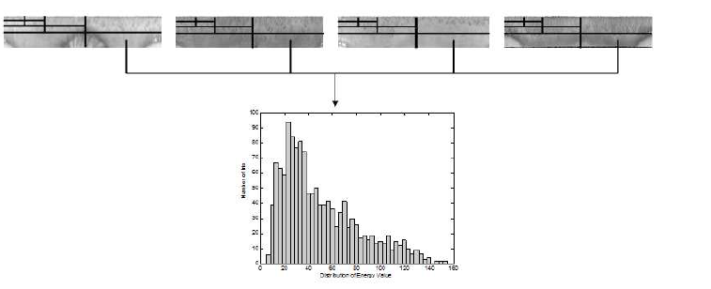
Additional Features
Image source: Mehrotra et al.

Slide 33
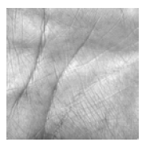
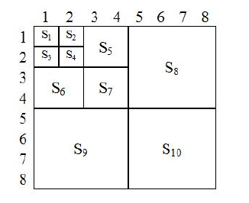
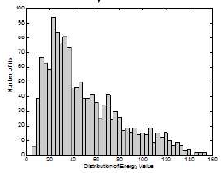
Feature Representation
Gabor response Mehrotra et al[2009]

Slide 34
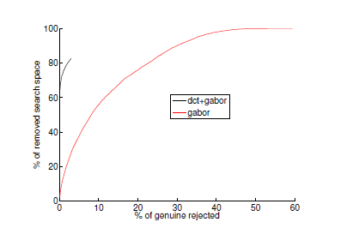
Effect of Additional Features

Slide 35
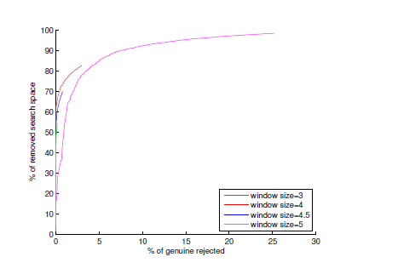
Effect of the Size of Window

Slide 36
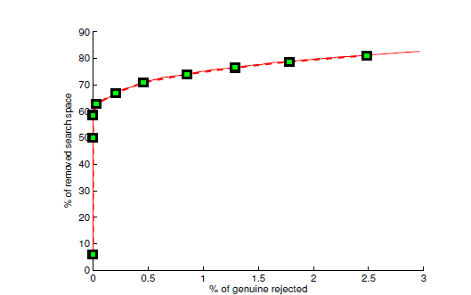
Pruning
Data pruned after each set of 50 projections, starting with 1. The improvement in pruning reduces as the number of projections increase

Slide 37
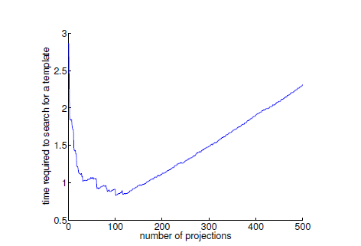
Time Analysis
It takes 2.86 seconds for explicit comparison of a template against all samples, whereas it takes 0.84 seconds after using filtering pipeline of 104 random projections.

Slide 38
Thesis Overview
Introduction
Motivation
Previous Works
Cascaded Filtering for Palmprints
Cascaded Filtering for Fingerprints
Summary and Conclusion

Slide 39
Minutia
Degradation types – ridges are not continuous, parallel ridges are not well separated, cuts/creases/bruises

Slide 40
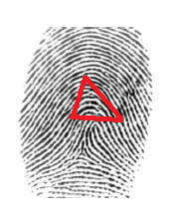
Feature Extraction
The feature should be fixed in length for all the samples.
Minutia Triplets and Quadruplets is used as features
Smaller Angles
α₁
α₂
Largest Side

Slide 41
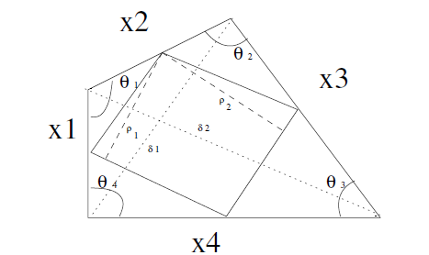
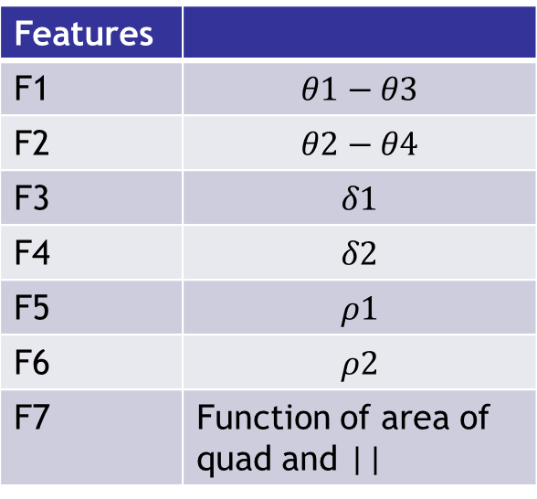
Minutia Quadruplets
Features
F1 | $$θ1−θ3$$
F2 | $$θ2−θ4$$
F3 | $$δ1$$
F4 | $$δ2$$
F5 | $$ρ1$$
F6 | $$ρ2$$
F7 | Function of area of quad and ||
K Means is used to find 50 cluster center
50 Features extracted from triplets and quadruplets and joined together.

Slide 42
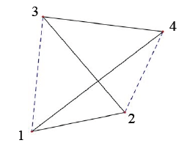
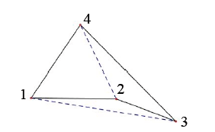
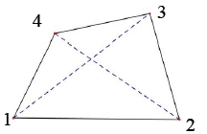
Types of Quadrilaterals
Convex Quadrilateral
Concave Quadrilateral
Reflex Quadrilateral

Slide 43
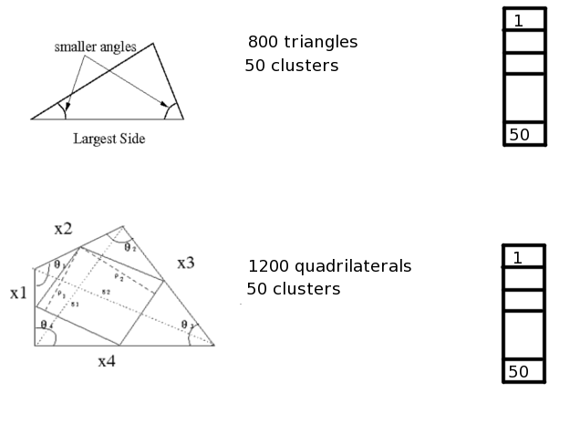
Cluster Formation
50 features from triangle
Combined together
50 features from quadrilaterals

Slide 44
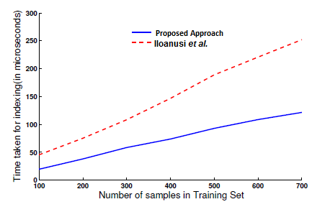
Time Analysis

Slide 45
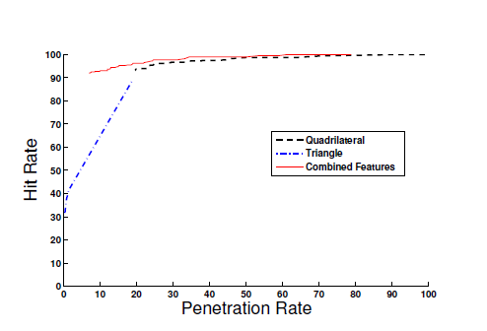
Effect of the combination of features

Slide 46
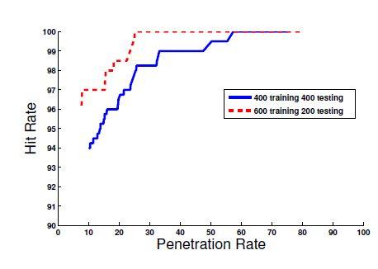
Effect of the size of training set
Method | Penetration Rate (99% Hit rate) | Time taken in microseconds
Iloanusi et al. | 20% | 147
Proposed Approach | 26% | 74

Slide 47
Thesis Overview
Introduction
Motivation
Previous Works
Cascaded Filtering for Palmprints
Cascaded Filtering for Fingerprints
Summary and Conclusion

Slide 48
Summary
Search space reduced by 63% and search time by 3 times on PolyU Datasets.
Search space reduced by 74% and search time by almost 2 times on FVC 2002.
Can add more features without time overhead.
The approach is flexible using different feature vectors.
Cost for inserting new data is minimal.
Allows a high degree of parallelization.
Possibility of creating more complex filtration with formally characterized fitness function.

Slide 49
Publications
Cascaded Filtering for Biometric Identification Using Random Projections, National Conference on Communication, January, 2011
Cascaded Filtering for Fingerprint Identification Using Random Projections, Computer Vision and Pattern Recognition Workshop, June, 2012

Slide 50
Questions?

