Slide 1
Minutiae Local Structures for Fingerprint Matching and Indexing
Akhil Vij
Anoop Namboodiri

Slide 2
Overview
Introduction
Major Challenges
Motivation
Local Structures for Indexing
Local Structures for Matching
Summary and Conclusion

Slide 3
Introduction
Biometrics – General Overview

Slide 4
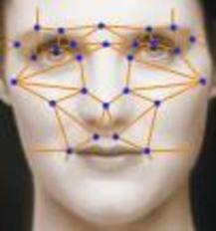
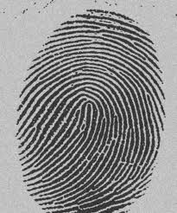
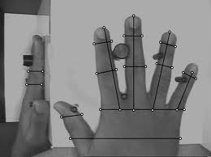
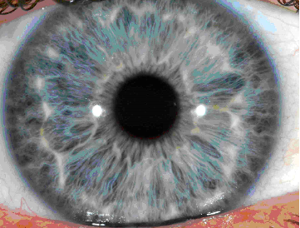
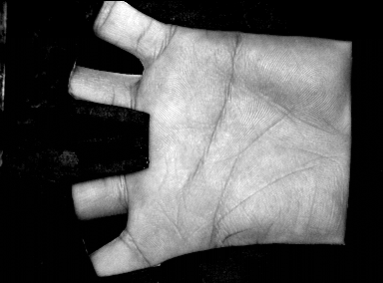
What is Biometrics?
“Uniquely recognizing a person based on their physiological or behavioral characteristics”
Behavioral Biometric: Typing Rhythm, Gait and Voice
Advantages:
User convenience, Security and Uniqueness, Wide range of applications (data protection, transaction and web security)
Used by many government to keep a track on its people

Slide 5
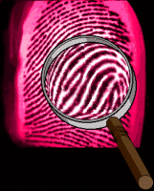
Fingerprints
Fingerprint is one of the strongest biometric trait
Old and reliable method.
Everyone is known to have unique, immutable fingerprints.
Popular because of ease of capture, distinctiveness and persistence over time, as well as the low cost and maturity of sensors and algorithms.

Slide 6
Fingerprints Details
Fingerprints are fully formed at about seven months of fetus development and finger ridge patterns do not change for an individual except due to accidents such as bruises and cuts.
Fingerprints contain two levels of detail/information – local minutia information (attributes: type, (x,y) location, orientation) and global ridge/structure information.

Slide 7
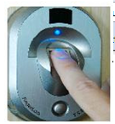
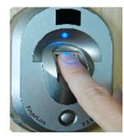
Biometric Authentication System in Verification Mode
Enrollment
Feature
Extraction
Template
Generation
Template Database
Verification
User Information (1vs1)
Feature
Extraction
Template
Matching
Yes
No

Slide 8
Biometric Authentication System in Identification Mode
Enrollment
Feature
Extraction
Template
Generation
Template Database
Identification
1 vs N
Feature
Extraction
Template
Matching
Yes
No

Slide 9
Accuracy of Fingerprint Verification Systems
False Match Rate (FMR): In this case, the system mistakes two fingerprints coming from different individuals to be a match. FMR is defined as the probability that an imposter score exceeds the threshold t.
False Non Match Rate (FNMR): In this case, the system mistakes two different impressions of the same finger to be non-matching. FNMR is defined as the probability that an genuine score falls below the threshold t.
Imposter Scores generally should be very low and genuine scores should be on the higher side. A good verification algorithm separates out these two classes.

Slide 10
Accuracy of Fingerprint Verification Systems

Slide 11
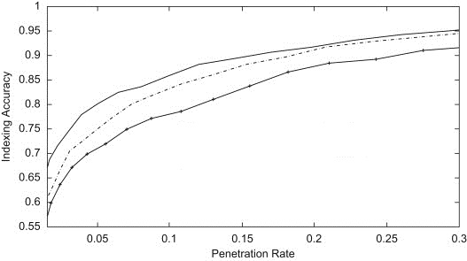
Accuracy of Fingerprint Identification Systems
Correct Index Power (to measure performance)
Penetration Rate (to evaluate retrieval efficiency)

Slide 12
Overview
Introduction
Major Challenges
Motivation
Local Structures for Indexing
Local Structures for Matching
Summary and Conclusion

Slide 13
Major Challenges – Fingerprint Identification
Identification of Fingerprints over a large database is still an open problem.
Features extracted have high dimensions.
Acquired image can be of poor quality.
Different impressions of the same finger can look quite different because of global transformations, noise, uneven pressure and other skin conditions.
Use of different sensors.

Slide 14
Major Challenges – Fingerprint Matching
Global Transformations
Partial Overlap
Non-linear Distortions
Uneven Pressure and other skin conditions
All above factors lead to large variability in different impressions of the same finger.

Slide 15
Overview
Introduction
Major Challenges
Motivation
Local Structures for Indexing
Local Structures for Matching
Summary and Conclusion

Slide 16
Motivation
Need for more accurate minutiae-only indexing and matching algorithms
Need for algorithms that are robust to missing or spurious minutiae points
Need for new fixed length fingerprint representation
Need representation suitable for template protection schemes

Slide 17
Overview
Introduction
Major Challenges
Motivation
Local Structures for Indexing
Local Structures for Matching
Summary and Conclusion

Slide 18
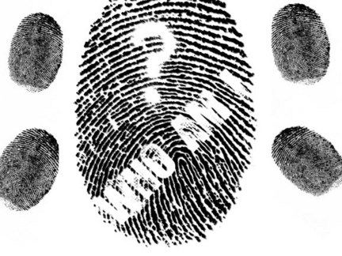
Fingerprint Identification
Problem Statement
Given a fingerprint database and a query obtained in the presence of translation, rotation, scale, shear etc. does the query resemble any of the fingerprints in the database?
Possible Solutions
Do one-to-one explicit verification for each fingerprint in the database.
Fingerprint Classification.
Fingerprint Indexing.

Slide 19
Explicit One-to-One matching with entire Database
This is not feasible as this can lead to very large number of matches in case of large databases (1.25 billion in case of the UID project).
If one matching takes around 1 millisecond, identifying a single query will take more than 300 hours. This is not what we need.
We need efficient filtering techniques to narrow down the portion of the database to be searched.

Slide 20
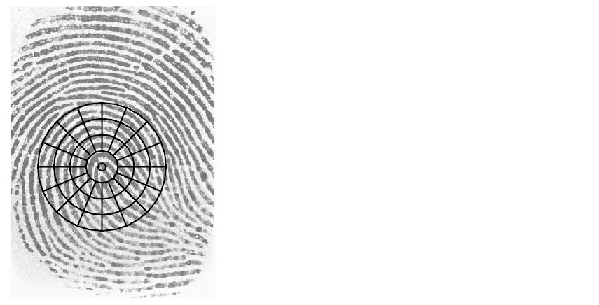
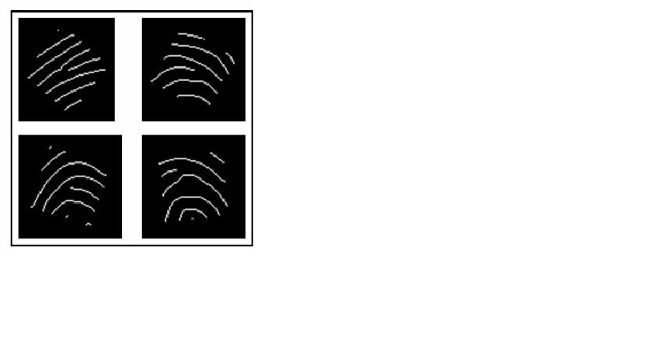
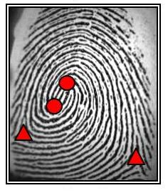
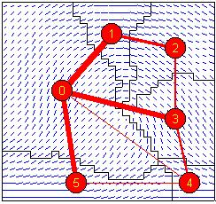
Fingerprint Classification
Fingerprint classification refers to the problem of assigning a fingerprint to a class in a consistent and reliable way.
Fingerprint classification is generally based on global features, such as global ridge structure and singular points like core and delta. Once the query has been assigned a class, the matching is done only with samples of the same class. Proposed approaches :
Fingercode
Global ridge pattern
Singular Points
Graph Theory

Slide 21
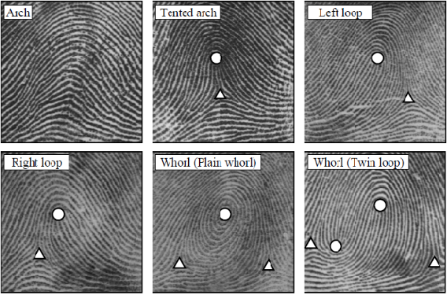
Problems with Fingerprint Classification
Uneven distribution of fingerprints in different classes .
Number of classes are less.
Ambiguity in case of poor quality fingerprints
3.7%
2.9%
33.8%
31.7%
18%
9.9%

Slide 22
Fingerprint Indexing
The goal of the third approach, called indexing, is to find a mapping that maps similar fingerprints to close points in a high-dimensional space.
Retrieval is performed by matching the query fingerprint with those in the database whose vectors are close to query vector.
Usually , local features such as minutiae locations , minutiae triplets have been proposed for indexing purposes. But appearance and disappearance of minutiae points is a problem with these methods. We try to address this problem in our work.
Ignored Fingerprints
Query Fingerprint
Retrieved Fingerprints

Slide 23
Feature Representation Used
The atomic unit of our representation is a fixed-length descriptor for a minutia that captures its distinctive neighborhood pattern in an affine-invariant fashion.
This distinctive representation of the neighborhood of each minutiae allows us to compare two minutiae points and determine their similarity irrespective of the global alignment.
In our work, we try to ensure affine-invariance of the minutiae neighborhood and explore the effectiveness of affine-invariant features for the purpose of indexing.

Slide 24
Feature Representation Used

Slide 25
Calculation of the Descriptor
ρ₁₁ ρ₁₂ ρ₁₃ ….. Ρ_{1m}
ρ₂₁ ρ₂₂ ρ₂₃ ….. ρ_{2m}
ρ₃₁ ρ₃₂ ρ₃₃ ….. ρ_{3m}
………………….
………………….
ρ_{k1} ρ_{k2} ρ_{k3} ….. ρ_{km}
E
This m-length descriptor describes the local arrangement of these m-points around the minutia.
Since there are k=^{n}C_{m} such m-point combinations, we get the following descriptor matrix for a single minutia point.
D
A
Similarly we do m such clockwise rotations to calculate the m-length descriptor ρ₁ ρ₂ ρ₃ …… ρ_{m}
Now, with 4 points marked as A, B, C, D we calculate the invariant ρ₁.
Then , we find its n nearest minutiae points.
Then, we select a subset of m points.
Initially, we have the minutia point surrounded by its neighbors.
B
A
Now we perform a clockwise rotation of points A,B, C and D and calculate the invariant ρ₂.
C
D
C
B

Slide 26
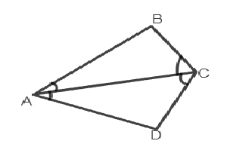
Calculation of the Descriptor
Area(∆ABC)/Area(∆ACD)
Ratio of largest sides = AB/AD
Ratio of median angles=∠ ACB/∠ACD
Ratio of minimum angles=∠ BAC/∠DAC

Slide 27
Calculation of the Descriptor
To calculate the fixed length descriptor for a minutia p :
We first calculate the nearest n neighbors of p.
Then we enumerate over all combinations of m points out of these n points.
For each such combination, we arrange the m points in clockwise order.
Then with 4 points denoted as A, B, C and D, we calculate the following affine invariant features :
Ratio of Areas of ∆ABC and ∆ACD (denoted by φ).
Ratio of Lengths of Largest side of ∆ABC and ∆ACD (denoted by λ).
Ratio of median and minimum angles of ∆ABC and ∆ACD (denoted by α₁ and α₂).
- These features are combined to get one final value which describes the local arrangement of these m points around the minutia p.

Slide 28
Enrolling a Fingerprint
ρ₁ρ₂ρ₃ρ₄ρ₅
ρ₂ρ₃ρ₄ρ₅ρ₁
ρ₃ρ₄ρ₅ρ₁ρ₂
ρ₄ρ₅ρ₁ρ₂ρ₃
ρ₅ρ₄ρ₃ρ₂ρ₁
FP id, Minutia id, vector
m=5
FP id, Minutia id, vector
A
FP id, Minutia id, vector
D
B
C
FP id, Minutia id, vector
FP id, Minutia id, vector
n=7
Notes:
Number of entries per minutia = m*m*(nCm) = 150 in our experiments with m=5 and n=6. This is so because each local arrangement of length m is stored as m*m numbers (with all the cyclic permutations taken care of). Since, there are (nCm) number of arrangements, hence the above number of entries in the hash table.

Slide 29
Querying the Index
m=5
A
ρ₁ρ₂ρ₃ρ₄ρ₅
FP id 2, Min. id p5, ρ₁ρ₂ρ₃ρ₄ρ₅
D
B
C
Increase the vote for fingerprint with ID 2
n=7

Slide 30
Database Details
Most of the experiments were done on the four FVC 2002 databases (db[1-4]) and two FVC 2004 databases(db[1-2]).
Each database contains 800 fingerprints from 100 users (8 impressions per finger).
For indexing experiments, the first 4 impressions were used to build the hash table while the remaining 4 were used as probes.
For matching experiments, a total of 14,000 genuine matches (2800 per database) and 24,750 imposter matches (4950 per database) were done.

Slide 31
Identification Results – Accuracy & Retrieval Efficiency

Slide 32
Identification Results – Time Gain

Slide 33
Identification Results – Scaling of Algorithm with increase in database size

Slide 34
Comparison
Graph showing the comparison with the quadruplet method proposed by Ross et . al

Slide 35
Overview
Introduction
Major Challenges
Motivation
Local Structures for Indexing
Local Structures for Matching
Summary and Conclusion

Slide 36
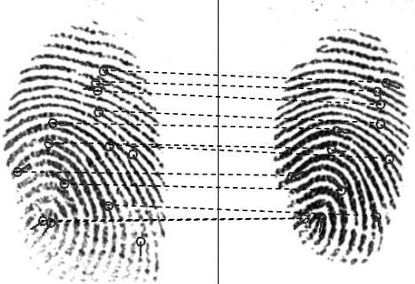
Fingerprint Verification
Problem Statement
Given two fingerprints, in the presence of Global distortions, partial overlap and non-linear distortions, we need to return either a degree of similarity or a binary decision (matched/non-matched)
Possible Solutions
Correlation Based Matching
Ridge-Based Global Fingerprint Matching
Minutia-Based Local Fingerprint Matching

Slide 37
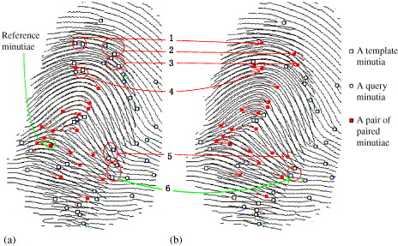
Correlation-Based Fingerprint Matching
These techniques work by superimposing the two fingerprint images and computing the correlation between the corresponding pixels for different alignments.
These techniques cannot handle local non-linear distortions and also pixel correlations have to be computed for exponential number of alignments making matching very expensive.

Slide 38
Global Ridge-Based Fingerprint Matching
These techniques use global features such as singular points, orientation flow around core points, average ridge-line frequency, directional field and geometric attributes of ridge lines.
Most of these algorithms are computationally demanding and lack robustness with respect to non-linear distortions.
Also, most of these features are not present in the standard ISO minutiae template and have to computed separately from images.

Slide 39
Feature Representation Used

Slide 40
Calculation of the Descriptor
To calculate the fixed length descriptor for a minutia X :
We first calculate the nearest n neighbors of X.
We arrange the n points in clockwise order.
With 2 points denoted as A and B, we calculate the following affine invariant features for the triplet {A,X,B} :
Relative Distances – Distance of points A,B with respect to central minutia point X.
Relative Orientation – Orientations of points A,B with respect to central minutia point X.
Ratio of Angles of ∆AXB
- These features are combined to get one final value which describes the contribution of this minutiae triplets {A,X,B}.

Slide 41
Feature Representation used
Features Used :
Ratio of lengths of sides
Ratio of relative angles
Ratio of relative orientations

Slide 42
Learning Minutiae Neighborhoods

Slide 43
Learning Minutiae Neighborhoods

Slide 44
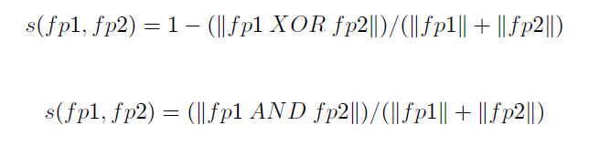
Similarity Measure b/w two Fingerprints
Given two binary vectors fp1 and fp2, representing the two fingerprints, a formula based on simple bitwise operations on the two vectors will give a measure of number of similar neighborhoods present in them.
Simple and fast bit-oriented coding can now be used as a measure for fingerprint similarity.

Slide 45
Database Details
Most of the experiments were done on the four FVC 2002 databases (db[1-4]) and two FVC 2004 databases(db[1-2]).
Each database contains 800 fingerprints from 100 users (8 impressions per finger).
For indexing experiments, the first 4 impressions were used to build the hash table while the remaining 4 were used as probes.
For matching experiments, a total of 14,000 genuine matches (2800 per database) and 24,750 imposter matches (4950 per database) were done.

Slide 46
Verification Results – Accuracy

Slide 47
Verification Results – Accuracy

Slide 48
Verification Results – Accuracy and number of clusters

Slide 49
Comparison with similar Fixed length Representations

Slide 50
Verification Results – Class distributions for FVC 2004 Databases

Slide 51
Verification Results – Class distributions for FVC 2002 Databases

Slide 52
Publications
Fingerprint Indexing Based on Local Arrangements of Minutiae Neighborhoods, Computer Vision and Pattern Recognition Workshop, June, 2012
Learning Minutiae Neighborhoods : A new Binary Representation for Matching Fingerprints (to be submitted) in upcoming International Conference on Pattern Recognition, ICPR 2014

Slide 53
Questions ??

