Slide 1
Mining Characteristic Patterns from Visual Data
Abhinav Goel
Roll No. 200702001
Email: abhinavgoel@students.iiit.ac.in
abhinav.goel02@gmail.com
CVIT, IIIT Hyderabad

Slide 2



















Photo Albums on the Internet

Slide 3
Photo Albums on the Internet
27,800 photos uploaded to Instagram
will produce 510,000 likes
208,300 photos uploaded to Facebook
What good is it to us?
Readily Available
Treasure trove of useful information
Are we properly equipped?

Slide 4
Challenges
Uncertainty in Feature Representations
Mining methods operate on concrete data
Image processing yields large dimensional features
Unsupervised
No prior knowledge
Object appearance and location is not known
Extension to fuzzy/noisy image features
Scalability and Efficiency
Large search space

Slide 5
Focus
Bridge the gap between Computer vision and Data mining
How do we model features in a way which is suitable for mining?
How do we mine in a way that only relevant results are obtained?
How do we adapt existing data mining methods to mine from large image datasets in a manner which is both (a) Scalable, and (b) Fast?

Slide 6
Focus
Mining interesting patterns from visual data
Mining prominent persons from photo albums
Inferring social relationships from video surveillance feeds
Mining discriminative feature configurations to improve classification, retrieval and detection performances
Mining object categories
Mining current trends in lifestyle, fashion from images an video.
In this thesis, we attempt to solve a few of the above mentioned problems…

Slide 7
Focus
Photo albums uploaded to social networking sites such as Facebook
Small image collections
Pictures of friends, family members
Photo albums uploaded to photo sharing sites such as Flickr
Medium sized image collections
Pictures of events, places visited
Collections of environment images such as Google Street View
Large sized image collections

Slide 8
Background

Slide 9
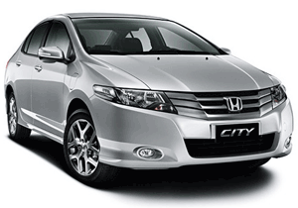
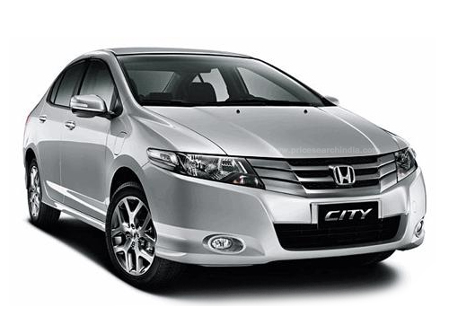
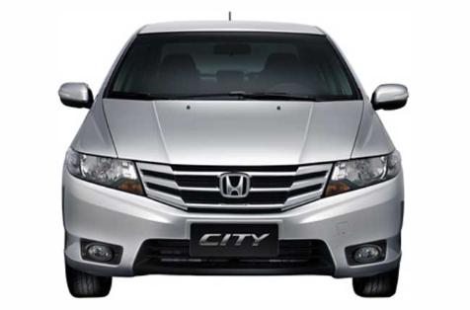
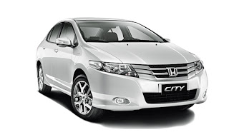
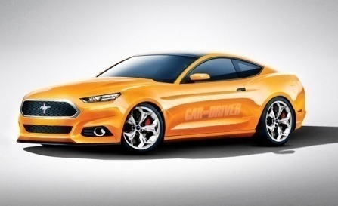
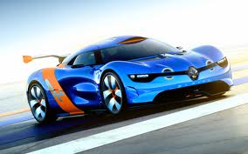
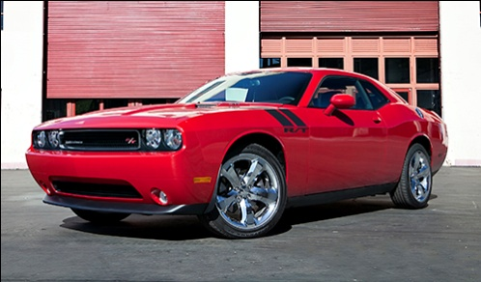
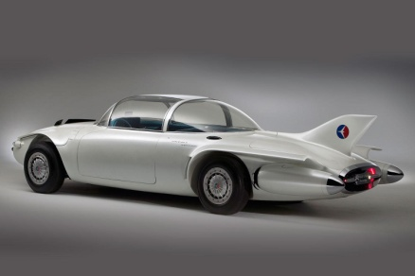
Instances vs Categories
Notes:
Instance retrieval is finding the particular instances of the query, for example retrieve all the occurrences of this particular car.
Category retrieval on the other hand is retrieving variants of the query, for example retrieve all the cars (different makes, different colors, etc).

Slide 10
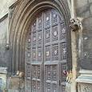
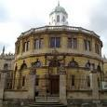
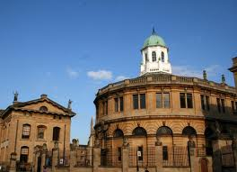
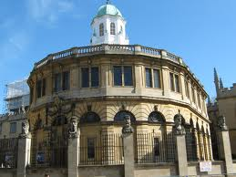
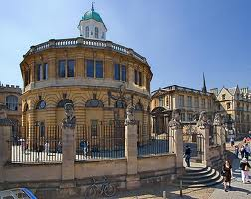
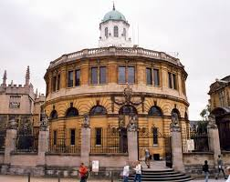


Instances vs Categories
Sheldonian Theatre, Oxford
Various Oxford Buildings

Slide 11
Instances vs Categories
Query for word “Submarine” and retrieve the word “Submarine” … (instance)
Exact string matching; Easy to compute.
Amenable to indexing
Efficient and “Accurate”
Query for word “Submarine” and get results for “Ferry”, “Ship”, “Boat” … Vehicles that move in water
Hard to obtain and index
Handcode with prior knowledge
Use retrieved data and learn relationships.

Slide 12
Instance Retrieval
Accurate results:
Large size of visual vocabulary allows for matching of identical objects
Geometric verification ensures spatial consistency between matched objects
Very Fast:
Inverted Indexing: Fast indexing and searching
Notes:
Results obtained in instance retrieval are typically very accurate, and obtained much faster due to the relatively easy nature of the problem. The main reasons for the high accuracy of the instance retrieval are :
1. Large size of visual vocabulary allows for matching of identical objects
2. Geometric verification ensures spatial consistency between matched objects
Instance retrieval is very fast because
Inverted Indexing: Fast indexing and searching
The high accuracy and high speed make instance retrieval scalable for big datasets.

Slide 13
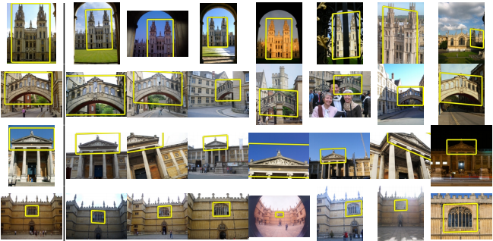
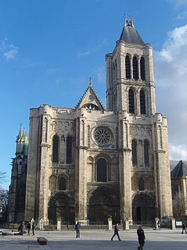
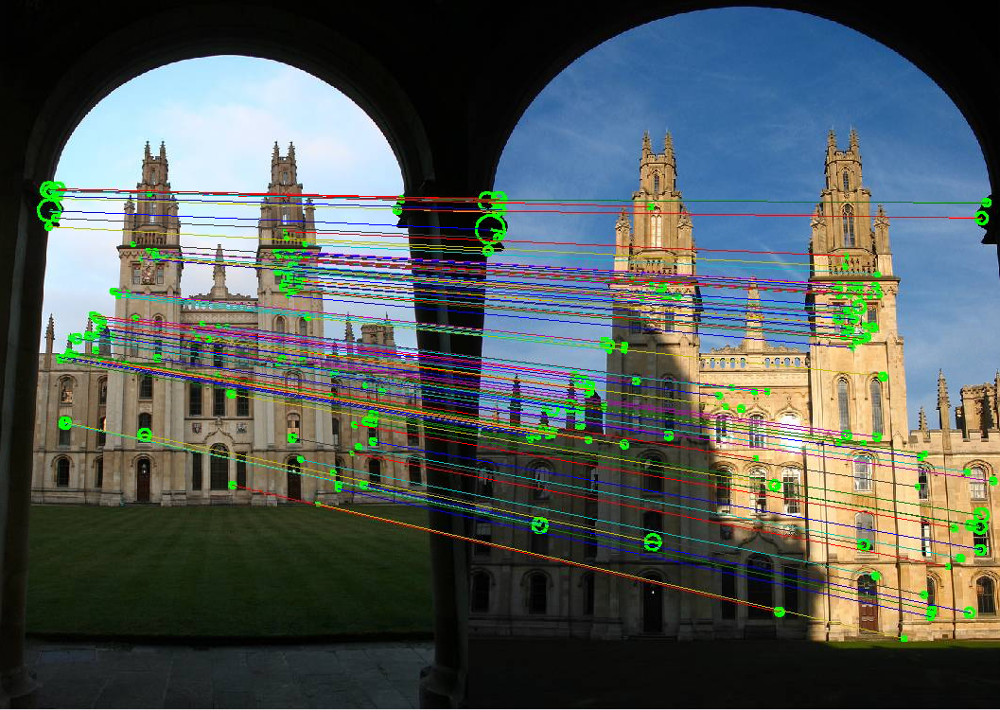
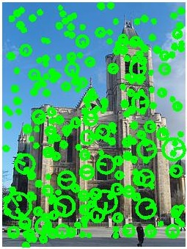
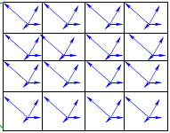
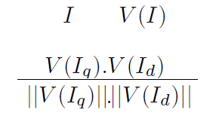
Instance Retrieval Pipeline
Query
BoW representation
Spatial Verification
Retrieval
Image
Interest point Detection
Eg. SIFT
Notes:
Given a query image marked by the user, the goal is to achieve all instances (of the same object) which are present in the image database.
The popular approach to solving this problem employs the Bag-of-Words method. SIFT descriptors, are computed at interest points in the image. The visual codebook used to assign word ids is obtained by clustering a random subset of feature descriptors, using K-means clustering. A visual word identiﬁer is assigned to each feature descriptor, similar descriptors being assigned the same word id. Using large vocabulary sizes (1 million visual words) has shown to give superior performance for retrieving instances.
A standard tf-idf weighting scheme is used to down-weight the contribution of commonly occurring (and hence not very descriptive) visual words across the database. Each image I in the database is represented as a vector V (I) of
visual word occurrences. The similarity between the query image I(q) and a database image I(d) is defined as the cosine similarity of the two vectors
The inverted file technique is used to store the database images. A rank list of the database images is obtained by comparing every database image against the query. Since the database is already indexed, this step can be done in the order of milliseconds.
Geometric Veriﬁcation is used as a post processing step to incorporate spatial information into an otherwise order- less Bag-of-Words (BoW) method. The standard method is to use one of the several variants of the RANSAC algorithm to generate multiple fundamental matrices from randomly sampled subsets of a given set of point correspondences. Based on the number of consistent “inliers“, one of the several generated hypotheses is selected. The geometric veriﬁcation step is computationally expensive, thereby limiting its application to only the top few retrieved results.

Slide 14
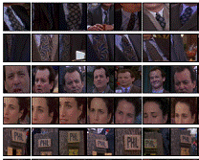
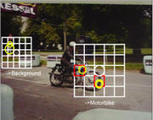
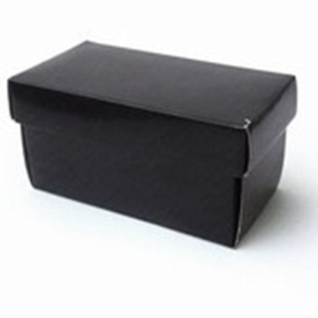
Literature Survey
Josef Sivic and Andrew Zisserman,
Video Data Mining Using Configurations of Viewpoint Invariant Regions, CVPR 2004
Till Quack, Vittorio Ferrari and Luc Van Gool, Efficient Mining of Frequent and Distinctive Feature Configurations, ICCV 2007
Frequent Itemset Mining

Slide 15
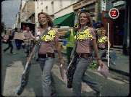
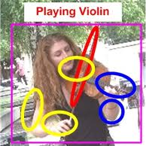
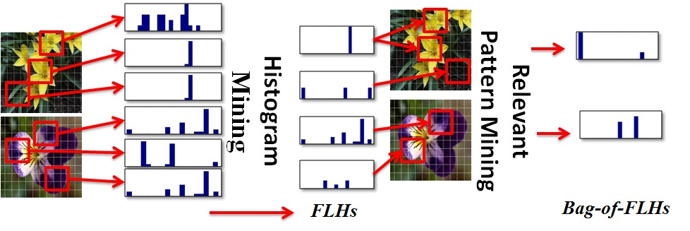
Literature Survey
Video Mining with Frequent Itemset Configurations. CIVR 2006
Grouplet, Yao et. al (201)
Efficient use of Frequent Itemset Mining for image classification, Fernando et. al (2012)
Notes:
There have been many attempts in the past at adapting well-established data-mining techniques for unsupervised mining in images. Quack et al mine clusters containing similar image content from geo-tagged imagery obtained from Flickr. The mined clusters are then classiﬁed into objects/events, and text labels, obtained from Wikipedia articles, are associated with each cluster. Sets of discriminative patches, termed as Grouplets, were mined for modeling the interactions between humans and objects.

Slide 16
Outline
Motivation
Challenges
Focus
Literature Survey
Mining Prominent Persons from Photo Albums
Motivation
Face detection and representation
Prominent Person Mining
Experiments and Results
Mining Characteristic Features for Architectural Style Categories
Motivation
Dataset of European Monuments
Pairs of Visual Words for Image Categorization
Discovering Semantic Patterns
Leveraging Instance Retrieval for Efficient Category Mining
Motivation
Efficient Category Retrieval
Efficient Category Mining
Experiments and Results
Related Publications

Slide 17
Prominent Person Mining in Photo Albums
Presented at NCVPRIPG, Hubli, Karnataka, 2011

Slide 18
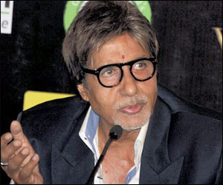

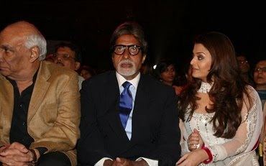
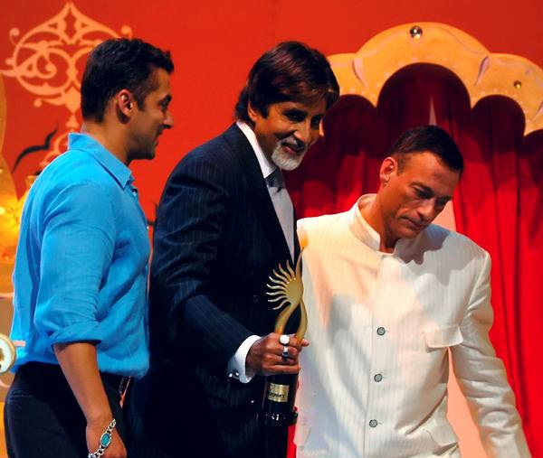

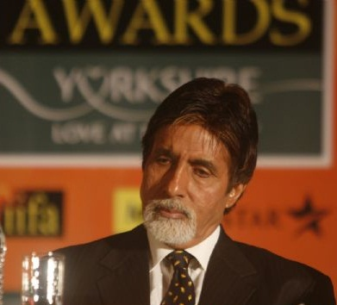
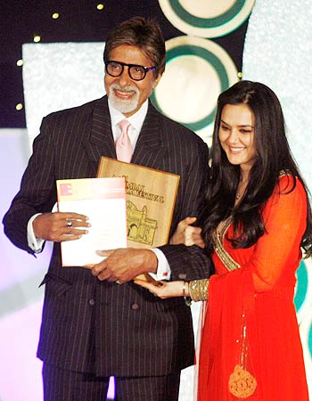
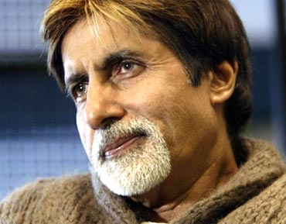
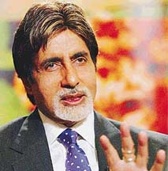


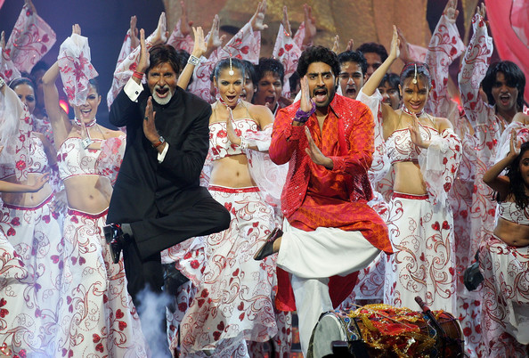
A prominent person
Is often the center of
attraction in photos
Often occupies a
large area in photos
Occurs frequently in
a given photo album

Slide 19
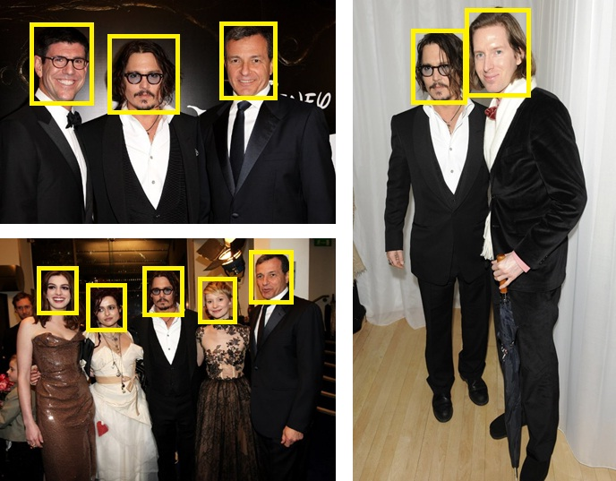
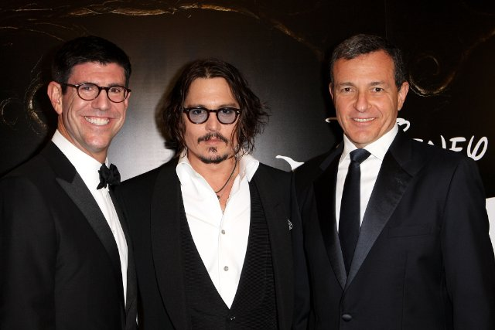
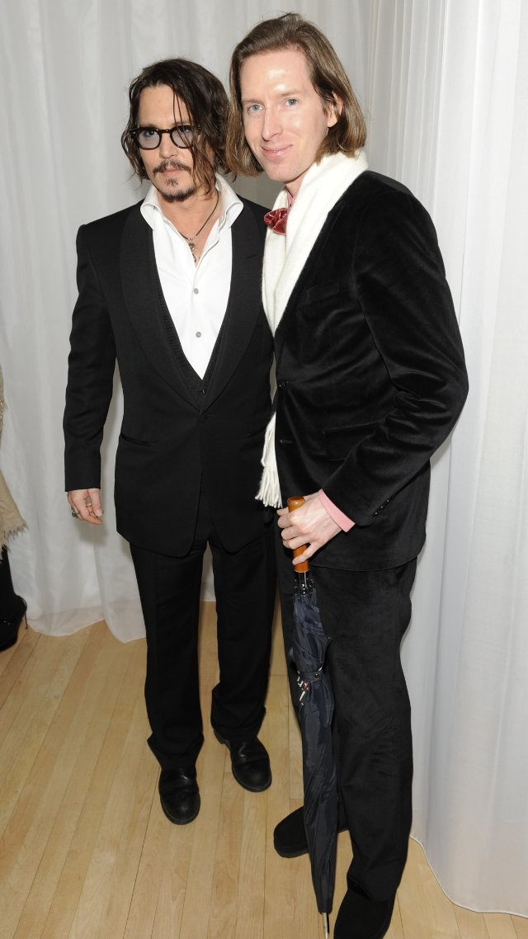
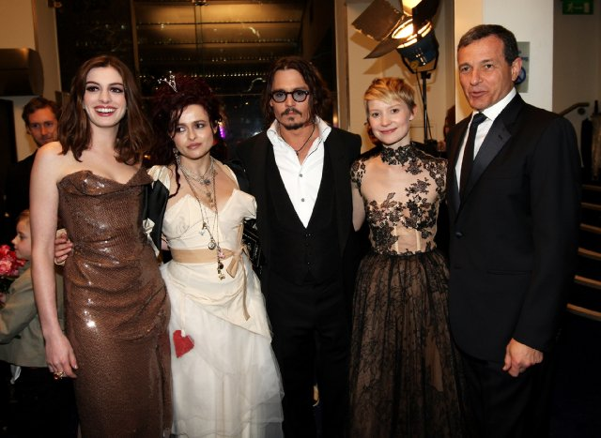
Face Detection

Slide 20


















Face Representation
Mean Face Image
Original Images
Eigen faces
$$\{w1, w2…wk\}$$

Slide 21






Frequent Itemset Mining
Transaction
Items
T1
Bread
Jelly
Peanut Butter
T2
Bread
Peanut Butter
T3
Bread
Milk
Peanut Butter
T4
Beer
Bread
T5
Beer
Milk
min_supp = 0.6
Support(Bread) = $\frac{4}{5}$ = 0.8
$≥$ min_supp
Support(Peanut Butter) = $\frac{3}{5}$ = 0.6
$≥$ min_supp
Support(Bread, Peanut Butter) = $\frac{3}{5}$ = 0.6
$≥$ min_supp

Slide 22



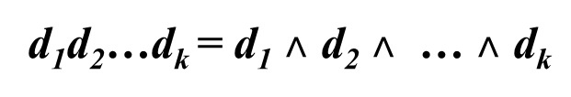
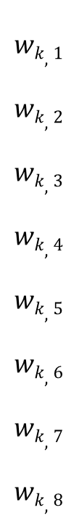
Prominent Person Mining
Face Database
Ith dimension
$$wk,1$$
$$wk,2$$
$$wk,3$$
$$wk,4$$
$$wk,5$$
$$wk,6$$
$$wk,7$$
$$wk,8$$
Most Prominent Person in Ith dimension
d_{i} = 11110000
Agglomerative Hierarchical Clustering
Most Prominent Person in K dimensions
d₁d₂…d_{k} = d₁ $˄$ d₂ $˄$ … $˄$ d_{k}

Slide 23
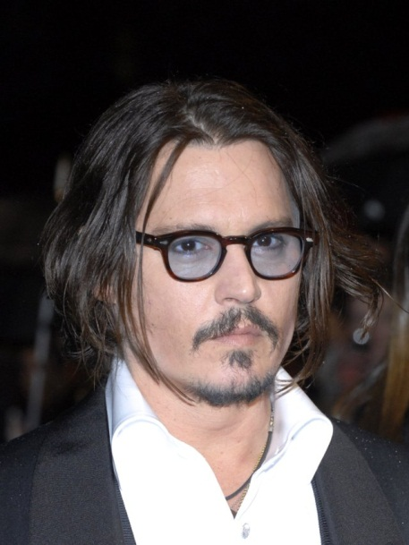
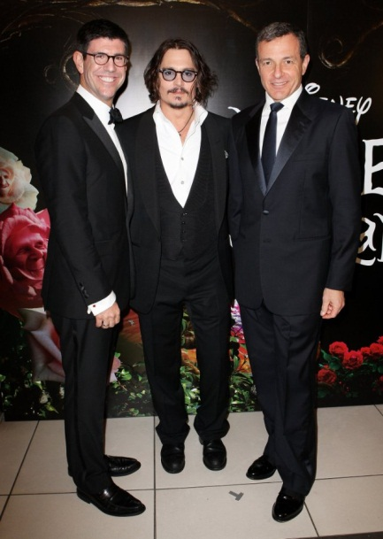
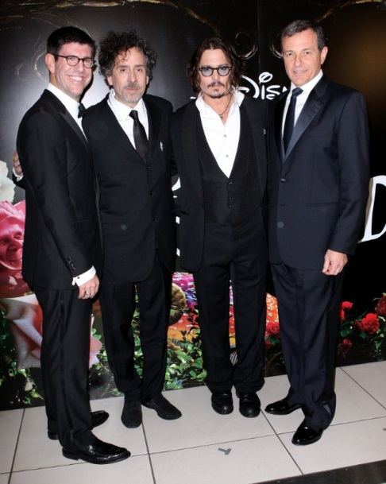

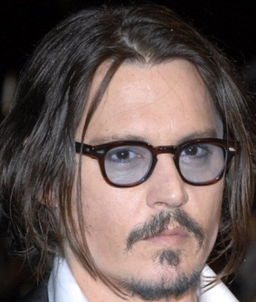
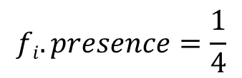


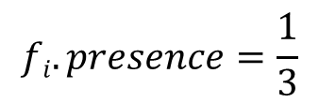



Semi-Supervision
$$w\left(fi\right) = fi.presence + fi.ratio − fi.deviation$$
$$w^{′}=\frac{w}{2}$$
$$x$$
SIZE (
)
$$fi. ratio=$$
$$fi.deviation=\frac{x}{w′}$$
SIZE (
)
$$fi.presence=1$$
$$fi.presence=\frac{1}{3}$$
$$fi.presence=\frac{1}{4}$$

Slide 24
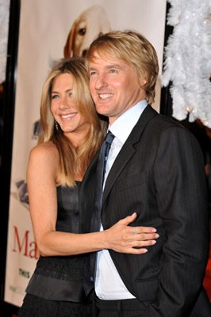
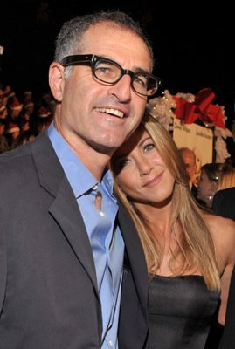
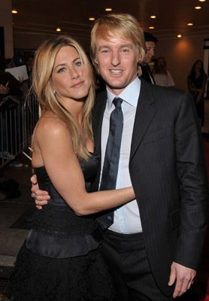
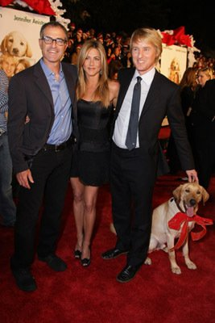





























Datasets Used
ORL
LFW
IMDB
Facebook
# Images
400
>1500
1780
947
# Subjects
40
143
25
26
# Photo Albums
100
91
100
40
Characteristics
Dark
Non
-
uniform
High quality
Low quality
homogenous
background,
images, Large
images, Large
background,
Variation in
groups of
groups of
Upright
frontal
face pose
people
people
position

Slide 25


















Experiments – ORL Face dataset
Most Prominent Person(~8-10)
Other Persons(~1-4)
# Photo Albums | 100
# Prominent Persons Mined | 100
# Correct Prominent Persons Mined | 90
Accuracy | 90 %
Sample Test Album

Slide 26
















Experiments – LFW Dataset
Most Prominent Person (~8-10 images)
# Photo Albums | 92
# Prominent Persons Mined | 92
# Correct Prominent Persons Mined | 70
Accuracy | 76 %
Other Persons (~1-4 images)
Sample Test Album

Slide 27







Experiments – IMDB dataset
# Photo Albums | 100
# Prominent Persons Mined | 100
# Correct Prominent Persons Mined | 91
Accuracy | 91 %
Most Prominent Person
Test Album – Actor: Nicholas Cage, Movie: Matchstick Men

Slide 28











IMDB Dataset - Results

Slide 29







Experiments – Facebook dataset
# Photo Albums | 40
# Prominent Persons Mined | 40
# Correct Prominent Persons Mined | 24
Accuracy | 60 %
Most Prominent Person

Slide 30






Facebook Dataset - Results

Slide 31
From Instances to Categories…
Mining instances
High visual similarity across photos
Mining categories
Identifying characteristics which are representative of an object category
Being able to model these characteristics in a way which is consistent across all members of the category
Buildings
Instances of the same building
Categories of buildings (similar architectural styles)

Slide 32






Slide 33






Slide 34
Mining Characteristic Features for Architectural Style Categories
Presented at ICVGIP 2012, Bombay, India.

Slide 35











Instance Retrieval
Oxford Buildings, Philbin et. al (2007)
Smooth Object Retrieval,
Arandjelović and Zisserman (2011)
Video Google, Sivic et. al (2003)

Slide 36














Category Retrieval
CATEGORY Retrieval : Hampi Temples
QUERY IMAGE
INSTANCE Retrieval : Vittala Temple Entrance Images

Slide 37




Category Retrieval
CATEGORY Retrieval : Hampi Temples
QUERY IMAGE
Same architectural style
Different sites
CATEGORY Retrieval :
Vijaynagara Empire

Slide 38













Architectural Styles
Mughal
Domes
Dravidian
Pyramid
British
Twin
Minarets
Classification
Query Image
Retrieved Images
Retrieval
Mining

Slide 39


Classification Pipeline
Original Image
SIFT Features at Interest Points
HOG Blocks (3x3) at Interest Points
Histogram Representation

Slide 40




















Classification Pipeline
St. Elisabeth’s Church
Sagrada Familia
Casa
Batllo
Casa
Mila
Casa Lleo Morera
Training Set
Testing Set
Art Noveau Architecture

Slide 41



Dataset of European Monuments
Art Noveau
Baroque
Gothic
Renaissance
Romanesque

Slide 42
Bag of Words Method
Feature | K | Accuracy (in %)
Shape Context [Belongie et. al, 2000] | 1000 | 27.91
Geometric Blur 1 [Berg et. al, 2005] | 4000 | 35.93
Geometric Blur 2 | 4000 | 36.07
HoG [Dalal and Triggs, 2005] | 4000 | 32.90
 | 1000 | 35.60
DoG + SIFT [Lowe et. al, 2004] | 4000 | 31.31
PHOW | 4000 | 46.74
Spatial Pyramid + SIFT [Lazebnik et. al, 2006] | 84000 | 42.25
Dense SIFT | 4000 | 46.22
Character Recognition in Natural Images, Manik Varma, 2009

Slide 43


Mining Pairs of Visual Words
Visual Phrases

Slide 44

Mining Pairs of Visual Words
 | V_{i}
V_{k1} | 0
V_{k2} | 4
V_{k3} | 3
V_{k4} | 1
V_{k5} | 0
V_{k6} | 2
 | V_{i}
V_{k1} | 2
V_{k2} | 6
V_{k3} | 5
V_{k4} | 1
V_{k5} | 2
V_{k6} | 2
k₁
k₃
k₂
k₃
i
k₅
k₅
k₂
k₁

Slide 45

Mining Pairs of Visual words
$$dij=|HC\left(i,j\right)−\frac{1}{NC−1}\sum_{C=1,C≠c}^{NC}{HC(i,j)}$$
Top P visual word pairs
P-length extended histogram
K X K pair histogram

Slide 46





Results
Image Categorization
Method | Length of Histogram | Accuracy (in %)
Word Mining | 1000 | 32.64
SVM | 4000 | 46.22
SVM+Word Mining | 5000 | 48.25
Image Retrieval
Query
Results

Slide 47




Comparison
 | Gothic | Korean | Georgian | Islamic | Avg
Visual Pattern | 93 | 76 | 79 | 77 | 81.25
Dense SIFT | 97.27 | 97.50 | 100 | 87.64 | 95.60
Word Mining | 98.18 | 99.38 | 98.57 | 97.50 | 98.40
Visual Pattern, Chu et. al, ICMR (2012)

Slide 48
Discovering Semantic Patterns

Slide 49








Seed Generation
Candidate Seeds

Slide 50
















Mining Characteristic Features
Query Image
Retrieved Results

Slide 51

Refining
Spatial Verification
Affine transformation
Generate hypotheses from single pair of correspondences
Allow for large re-projection errors
LBP Refinement
Represent each image as histogram of LBP features
$$Rank=RankSIFT+RankLBP$$

Slide 52













Results: Gothic Architecture
http://en.wikipedia.org/wiki/Rose_window

Slide 53





Results: Gothic Architecture
http://en.wikipedia.org/
wiki/Gothic_architecture

Slide 54














Results: Renaissance Architecture
http://en.wikipedia.org/wiki/Renaissance_architecture

Slide 55




Results: Baroque Architecture
http://en.wikipedia.org/wiki/
Baroque_architecture

Slide 56
Leveraging Instance Retrieval for Efficient Category Mining
Presented at CVPR Workshop, Portland, Oregon, 2013
Notes:
Good Afternoon everyone. My name is Mayank Juneja. I am from Centre for Visual Information and Technology, IIIT Hyderabad. I am here to present our work “Efficient Category Mining by Leveraging Instance Retrieval”. This is a joint work with Abhinav Goel and Prof. C. V. Jawahar.

Slide 57
Can Instance Retrieval be used for Category Retrieval?
Notes:
Instance Retrieval is fast,
Recently, “Leveraging Category-Level Labels For Instance-Level Image Retrieval” Gordo et al.[13] touched on an important issue
in instance retrieval - instance retrieval returns, among the
top ranked images, results which are visually similar, but
not always semantically consistent with the query. To overcome
this issue, they incorporate information from category
level labels while searching for instances. We pose a question
in the reverse direction - Can instance retrieval be used
to benefit retrieval of object categories?

Slide 58





Category Retrieval
Car model
Exemplar SVM
Malisiewicz et. al (2011)
DPM
Felzenswalb et. al (2010)
Notes:
Category retrieval has been approached as a learning-based classification problem. Some recent methods are the DPM’s and Exemplar SVM’s. They are slow because of the complex SVM learning methods.
Since the location and spatial extent of the object
is unknown in the test set, such methods involve an exhaustive evaluation
of all possible windows, at multiple spatial scales.
This process is computationally expensive.
Moreover, Exemplar SVM require separate SVM for each of the image. Because of the huge time complexity, These methods are not scalable to big datasets.

Slide 59

Category Retrieval
Instances
Near Instances
Classes
Notes:
The two extremes that we have talked about are instances (same object) and the category retrieval (retrieve example from same class). There is an intermediatory set of classes, which we call as Near Instance categories. The images in the near instance categories have less intra-class variation and can be treated more like instances rather than a class.

Slide 60

Category Retrieval
Modifications in the Instance Retrieval:
Reduce the vocabulary size.
1 million to 10k
HoG Post-processing
Notes:
To perform the category retrieval for near classes, we make a couple of changes in the standard Instance Retrieval pipeline.
First is to reduce the vocabulary size. The typical vocabulary size used in category retrieval/
classification is 4000. Thus, visual words are better
able to capture the variation across categories. On the
other hand, in instance retrieval we are interested in exact
matches, hence using a much larger vocabulary size (1 million
visual words). We choose a vocabulary size of 10,000
visual words, which is more suitable for representing “near
instance“ categories.
Next change we propose is a HoG-based post processing method to improve the quality of retrieved results. HoG feature descriptors are obtained for the query as well as retrieved images. The retrieved images are re-sized to the size of the query image, ensuring consistency in the dimensions of HoG vector representations. The descriptors for each image are concatenated into a 1-dimensional vector. The Euclidean distance (d) between the HoG vector representations of the query sample and that of the retrieved images is computed. Two retrieved images are compared as
If the eucledian distance between retrieved Image I1 and Query sample is less than that of I2, I1 is reranked above I2.
Based on the results of our experiments, we are able to divide the object categories into three sets. Images in each of the three sets exhibit different properties, based on which we infer how easy/tough it is to retrieve from them.
Near instance categories: Using an Instance Retrieval based method accompanied by a HoG-based post processing step gives much better performance, both in terms of precision at 10 as well as average precision, than an exemplar SVM based method, as well as the standard instance retrieval pipeline.
Neutral categories: From observing the images belonging to these classes, we inferred that even though there is some similarity in visual appearance across images, it is not sufﬁcient for instance retrieval to work. This observation is supplemented by the similar retrieval performance obtained by our method as well as 1-Exemplar SVM for these categories.
Tough categories: Images of objects in these classes exhibit high intra-class variance, due to which standard cat- egory retrieval methods such as SVM often outperform our method of retrieving near-instances.

Slide 61
Experiments – Caltech 101
SIFT descriptors computed at interest points
Vocabulary (10k words) learnt using 100k randomly sampled SIFT descriptors.
Random 5 images from each class picked as query images.
Notes:
We test our method on the Caltech 101 dataset [9]. SIFT
descriptors are computed for each image in the database
at interest points obtained using a Difference of Gaussian
(DoG) detector. A random subset of 100,000 SIFT descriptors
obtained from the database images is used to create a
vocabulary. The vocabulary size is chosen to be considerable
large (10,000). This ensures that only significantly
similar features are captured by each visual word. 5 images
are randomly selected from each class to create the set of
query images.

Slide 62
Results Caltech-101
 | Mean Precision at 10
Class | IR | IR + HoG | 1E-SVM
Accordion | 0.60 | 0.82 | 0.51
Windsor Chair | 0.62 | 0.68 | 0.48
Chair | 0.11 | 0.10 | 0.12
Watch | 0.11 | 0.12 | 0.11
Schooner | 0.11 | 0.12 | 0.22
Electric Guitar | 0.11 | 0.10 | 0.15
IR: Instance Retrieval
HoG: Histogram of Oriented Gradients
1E-SVM: Exemplar SVM
Notes:
We report the results as Mean precision at 10, which is The precision obtained for the top 10 retrieved samples. The average over 5 randomly chosen queries is reported for each category.
We compare against multiple baselines. In the first baseline, we use the simple instance retrieval pipeline (without spatial verification) to retrieve object categories. As a second baseline, we train a
linear SVM classifier for each query exemplar. HoG descriptor of the query exemplar is used as a positive training
instance. Thousand negative exemplars are obtained from 10 random samples from each class, except the class of positive exemplar. Each image I in the database is scored as max scoring window, out of all possible windows in I.
Based on the results of our experiments, we are able to divide the object categories into three sets. Images in each of the three sets exhibit different properties, based on which we infer how easy/tough it is to retrieve from them.
Near instance categories (Green): Using an Instance Retrieval based method accompanied by a HoG-based post processing step gives much better performance than an exemplar SVM based method, as well as the standard instance retrieval pipeline.
Neutral categories (Yellow): From observing the images belonging to these classes, we inferred that even though there is some similarity in visual appearance across images, it is not sufficient for instance retrieval to work. This observation is supplemented by the similar retrieval performance obtained by our method as well as 1-Exemplar SVM for these categories.
Tough categories (Red): Images of objects in these classes exhibit high intra-class variance, due to which standard category retrieval methods such as SVM often outperform our method of retrieving near-instances.

Slide 63



Results Caltech-101
Airplane
Motorbikes
Dollar Bill

Slide 64


Results Caltech-101
Starfish
Windsor Chair

Slide 65
Unsupervised Category Mining in Large Datasets
Notes:
Motivated by the concept of “near instances” category, we try to do unsupervised mining of “near instance” object categories in large datasets. Mining object
categories in these unannotated datasets is an important and useful step to extract meaningful information and applications like labelling.

Slide 66

Google Street View Images
Doersch et. al., Siggraph 2012
Notes:
In this work, we focus on the dataset of Google Street View Images. The dataset consist of images for 12 cities.
As you can see from the example images, there are some interesting near instance categories like windows, doors, lamp posts, road signs which can help semantic information from these unannotated images. Our goal is to mine these categories from such large datasets automotically without any supervision.
// We downloaded 25,278 images
from Google Street View, the dimensions of each image being
936 537 pixels. This gives us 38 22 = 836 patches
per image, when the starting patch size is 2525 pixels. A
starting set of 100 seed images was used for the purpose of
discovery.

Slide 67
Challenges
Clustering based methods
Not discriminative
Large dimensional features
Discriminative Classifier based methods
Millions of windows to be searched – Slow
Leverage Instance retrieval to solve Category retrieval
Inverted index for fast searching
Spatial verification for efficient matching
Retrieval in the order of milliseconds

Slide 68
Mining: Our approach
Start with small-size patches (candidate patches).
Query each patch in the candidate set.
Reject uninteresting patches and grow the remaining patches to bigger size patches.
Repeat the steps at multiple levels.
Notes:
I will give you a brief overview of our mining approach. We start with a set of small-size patches that we call as candidate patches. Then, we query each patch from the candidate set to find the similar patches using the modified IR pipeline. After we get the retrieved similar patches, the uninteresting patches are rejected and the remaining patches are grown in size. We progressively query patches at increasing
spatial scales, all the while rejecting uninteresting patches
at every step. As a result, we are able to quickly discover
a set of semantically meaningful near-instance object categories.

Slide 69
Mining Pipeline
Image
1
W
1
2
3
4
Q
H
Notes:
Now, I will explain the method in details. The given image is ﬁrst divided into square patches of ﬁxed size of 25 × 25 pixels. This starting set of patches constitutes the initial candidate set L0. Each candidate patch is queried and based on the results returned, a score is assigned to it which signiﬁes the goodness of the candidate patch. The goodness of a candidate patch tells us the score of that patch belonging to a larger, semantically meaningful and frequently occurring near-instance category.
Each patch in the candidate set is represented using a histogram of visual words. This patch is now used as a query to retrieve visually similar patches across the image database. The top few retrieved patches are re-ranked using a spatial veriﬁcation step. We ﬁt an afﬁne transformation with 3 degrees of freedom (dof) between the query and retrieved patches. To accommodate matches on near-instance categories, we allow large-re-projection errors

Slide 70

Mining Pipeline
Issues with retrieving instances for small patches
Very few number of matches in spatial verification
Large number of false positives
$$GScore\left(Q\right)= {\left(\frac{\sum_{i=1}^{N}{d(HoGp, HoGi)}}{N.A}\right)}^{−1}$$
Notes:
The retrieved list of patches is characterized by many false positives. This is mainly due to (a) using a reasonably large vocabulary size for matching object categories (not instances), and (b) small size of the query patch, which results in very small number of matches from spatial veriﬁcation. We propose a good- ness score to measure the quality of the retrieved patches obtained in the cluster. The Goodness Score of a patch is computed as the sum of the Euclidean distance between the query patch and each retrieved patch, normalized by the number of patches retrieved and the area of the query patch. The patches are re- sized to the size of the query before the HoG descriptors are computed, to ensure consistency in dimension across HoG vector representations. A larger value of N enforces a much stricter goodness constraint on each patch, at the cost of increased computation in calculating the distances between the HoG vector representations. Normalizing by the area enables fair comparison between the scores assigned to patches of varying sizes.

Slide 71
Mining Pipeline
1
W
Support = 3/9 >= minsupp
Q
C_{k}
H
Notes:
At the kth level of grouping, we select (2k + 1) × (2k + 1) square patches, where the size of each patch is 25 × 25 pixels. The support of this new patch of increased size is computed. Regions with support value greater than a minimum threshold minimum support value are used to create the candidate set Lk+1 for the next level of evaluation.
Alternate methods:
A simple solution for growing the patch can be to select 8- connected neighboring patches of the current patch. A fundamental problem with this is that some parts of the new patch might be uninteresting, and may not have any semantic association with the object which, if present, we are trying to discover. Another method of selecting useful patches is non-maximum suppression (in terms of Goodness Score), where a larger image region around each local maximum is selected.

Slide 72







Mining Pipeline
$$C_{k+1}= \left\{x | x∈Ck and supp\left(x\right)> minsup\right\}$$
C_{n}
…
C_{k}
…
C₁

Slide 73


Mining Pipeline
Retrieve top 100 results for each query region
Post-processing step to push away false positives:-
$$Rank= \max_{}{(RankSIFT, RankHoG)}$$
Notes:
After multiple levels of reﬁning, we are left with few, reasonably large sized patches. Similar to the method of patch evaluation, these reasonably large patches are used to query from the database. We retrieve the top 100 results for each query region. A HoG based post-processing step is employed to reﬁne the clusters of near-instance object categories. The ﬁnal rank of a retrieved patch is computed as the maximum of the ranks obtained by distance comparison of SIFT and HoG feature descriptors. Our HoG-based re-ranking method suppresses false positives by pushing them away from the query, while retaining true positives in the top results. This method of pushing away false positives retains the ranking information obtained by SIFT matching, which is important for retrieval of near-instance object categories.

Slide 74

Near-Instance Retrieval Results
Text Signs
Notes:
We perform mining upto 3 levels. The top 20 results were retrieved for each patch up to the penultimate mining level. Top 100 results were obtained for visualization at the last level. From the set of 100 seed images, we discovered several different concepts (at multiple levels), which fall into the category of near-instance objects. The type of object category discovered varies with the level at which we are mining. For example, “House Signs“ and “Street Lamps“ were discovered on the second level of mining, where the patch size is relatively low. As we move higher, the type of near-instance object categories discovered are those which cover a larger spatial extent, such as “Windows“ and “Text Banners“.

Slide 75

Near-Instance Retrieval Results
Grills

Slide 76

Near-Instance Retrieval Results
Street Lamps

Slide 77

Near-Instance Retrieval Results
Windows

Slide 78

Computational Complexity
Exemplar SVM Training:
$$O(\max\left(n, d\right)\min\left(n,d\right)2)$$
Mining/Retrieval:
$$O\left(E x \left|D\right| x H x W\right)$$
E exemplar SVMs
D database images of dimensions HxW
Notes:
Mining/Retrieval of Object Categories using Exemplar SVM comprises of two stages - training and testing. Train- ing a linear SVM involves maximizing the margin between the single positive exemplar and millions of negative exem- plars. For both primal and dual optimization, the complex- ity is O(max(n,d)min(n,d)2) (O. Chapelle. Training a support vector machine in the primal. Neural Comput., 2007), where n is the number of training instances (1 Positive + Many Negatives), and d is the dimension of representation of an exemplar. Both re- trieval as well as mining are unsupervised methods, and re- quire no time for training, as opposed to an SVM classiﬁer. SVM testing scales linearly with the number of positive in- stances (but not the negatives), since a separate classiﬁer is learnt for each positive exemplar. For an image (of dimen- sion H × W), applying a classiﬁer (at say S spatial scales) takes O(H × W) computation (since S << H × W). We can evaluate all E Exemplar-SVMs over |D| database im- ages in O(E × |D| × H × W).

Slide 79
Quantitative Evaluation: Exemplar SVM vs Mining
Instance Based Solution | Time (in s) | Exemplar SVM | Time (in min)
Similarity Search | 0.012 | Training | 22.66
Geometric Verification | 0.411 | Testing | 26.66
HoG Reranking | 0.070
Total (in mins) | 0.0082 |  | 49.32
Notes:
For Quantitative evaluation, we compare with Exemplar-SVM method. A linear SVM is learnt for a single positive exemplar, and all possible windows from database images (other than query image) as the negative exemplars. We perform 10 iterations of retraining, and 5 iterations of mining hard negatives in each iteration of re-training. 100 hard negatives are mined in each iteration (of re-training) and added to the negative set. The PEGA- SOS SVM solver in the VLFeat library is used for training. The bias multiplier is set to 100, and the regularization parameter λ = 100/N, where N is the number of training samples. For training, the classiﬁer is run on a subset of 200 database images, at 4 spatial scales. We also perform retrieval on this subset using the same positive exemplar, followed by the HoG post-processing method

Slide 80
Contribution
Tackle some of the questions posed when adapting existing mining methods to computer vision
Scalability, Robustness, Uncertainty in feature representation
Leverage mining to
solve instance retrieval and category retrieval problems, and
Improve category mining borrowing strengths of instance retrieval
Introduce a new dataset of European monuments categorized by architectural style

Slide 81
Contribution
Dataset available at:
Thesis available at:
CVIT Pages
http://cvit.iiit.ac.in/Papers/Abhinav-AreBuildings-ICVGIP12/

Slide 82
Related Publications
Whose Album is this? (Oral)
Abhinav Goel & C.V. Jawahar
National Conference on Computer Vision, Pattern Recognition, Image Processing and Computer Graphics, Hubli, 2011
Are Buildings Only Instances: Explorations in Architectural Style Categories (Oral)
Abhinav Goel, Mayank Juneja & C.V. Jawahar
Indian Conference on Vision, Graphics and Image Processing, Mumbai, 2012
Efficient Category Mining by Leveraging Instance Retrieval
Abhinav Goel, Mayank Juneja & C.V. Jawahar
Big Data Computer Vision Workshop, USA, 2013

Slide 83
Thank You.

