Slide 1
Text Recognition and Retrieval in Natural Scene Images
Udit Roy
CVIT, IIIT Hyderabad
Advisor: C. V. Jawahar
Co-advisor: Karteek Alahari, Inria

Slide 2
Overview
Introduction
Text Detection
Cropped Word Recognition & Retrieval
End-to-End Frameworks
Summary

Slide 3
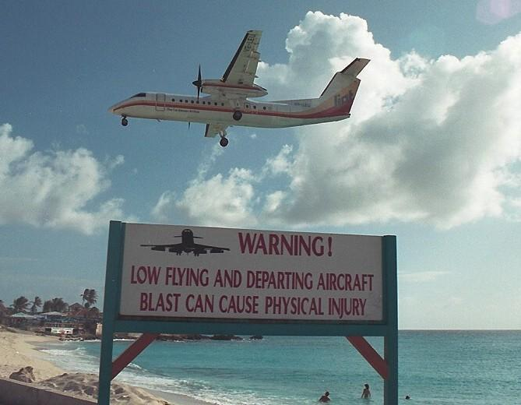
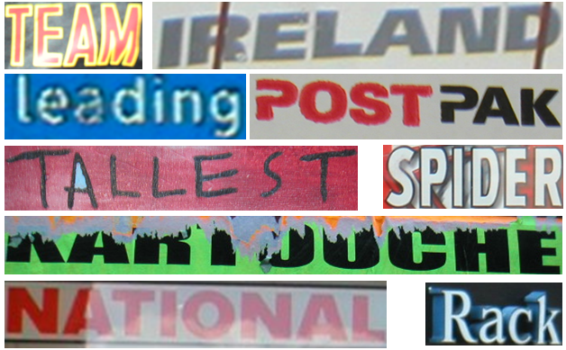
Introduction | What is Scene Text?
Text in natural scene images
Objective: Locate and convert text into machine readable data
Applications: OCRs, Content Tagging, Navigation, etc.

Slide 4
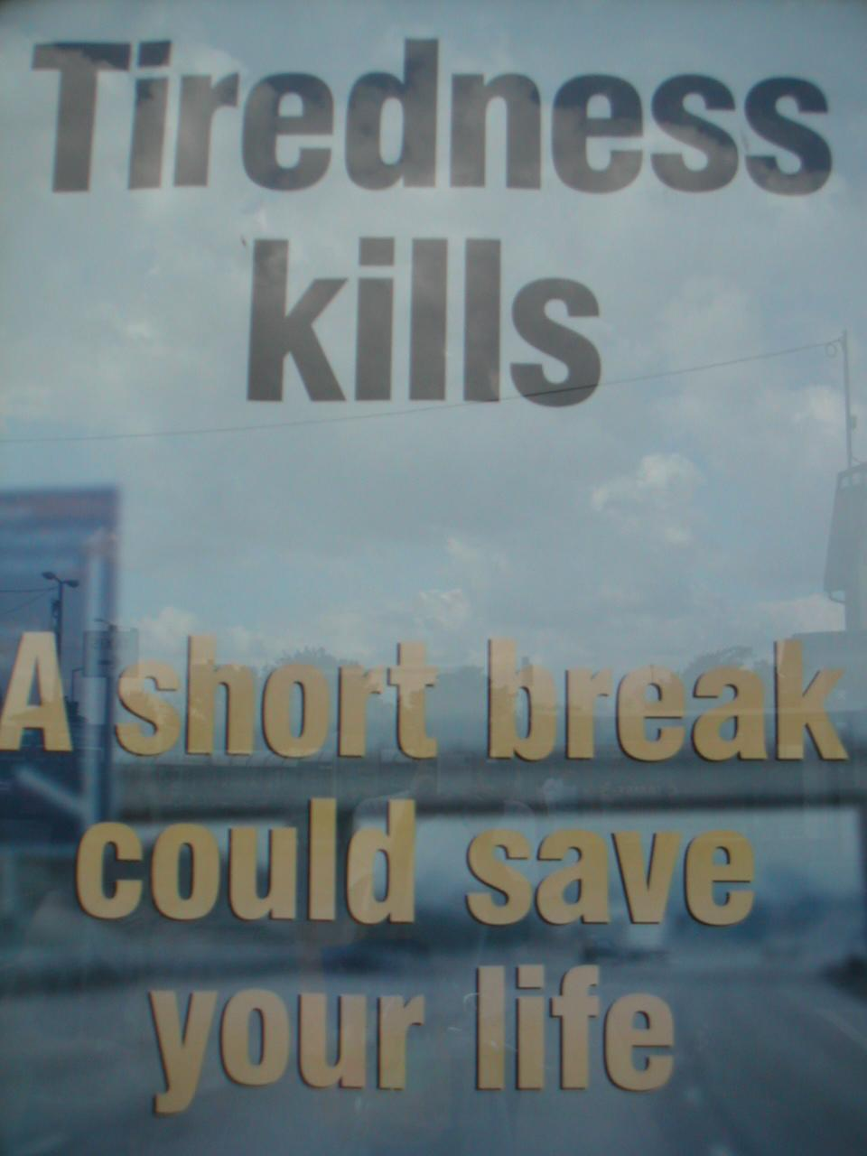
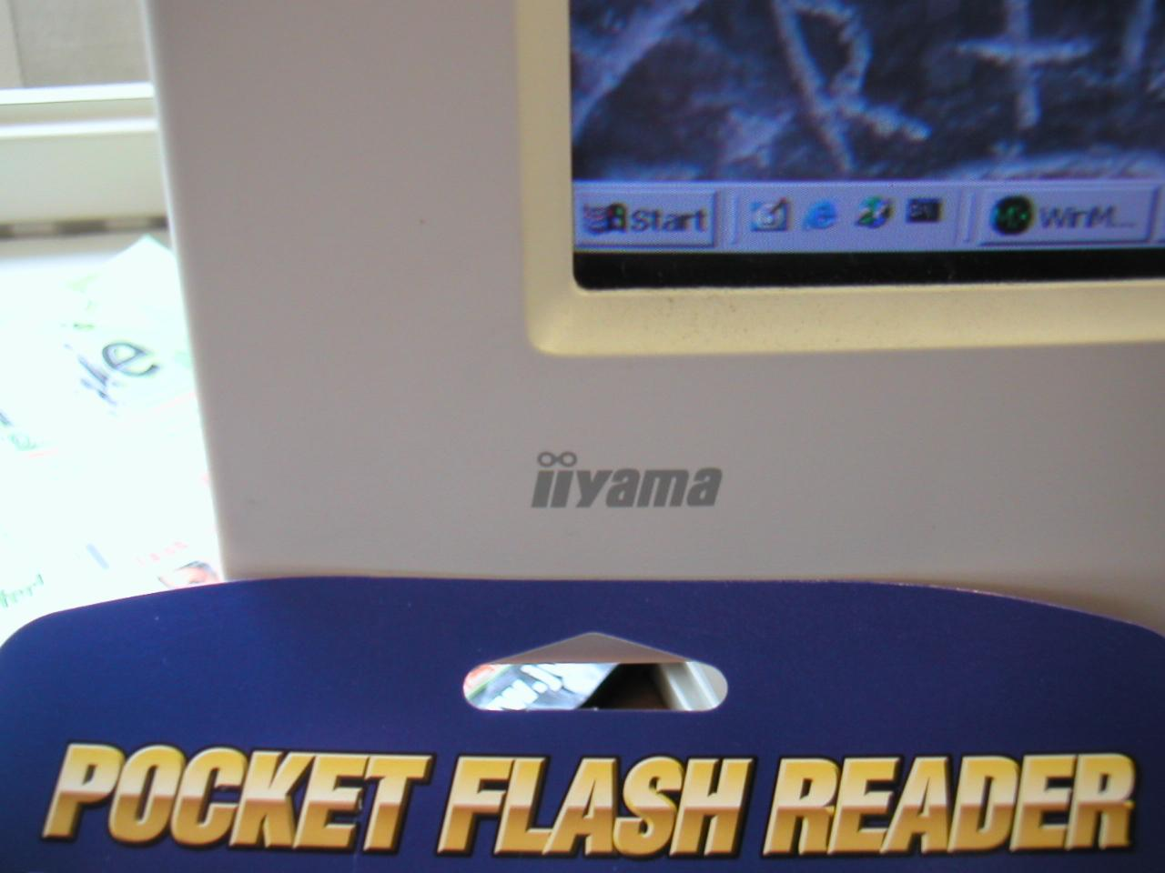
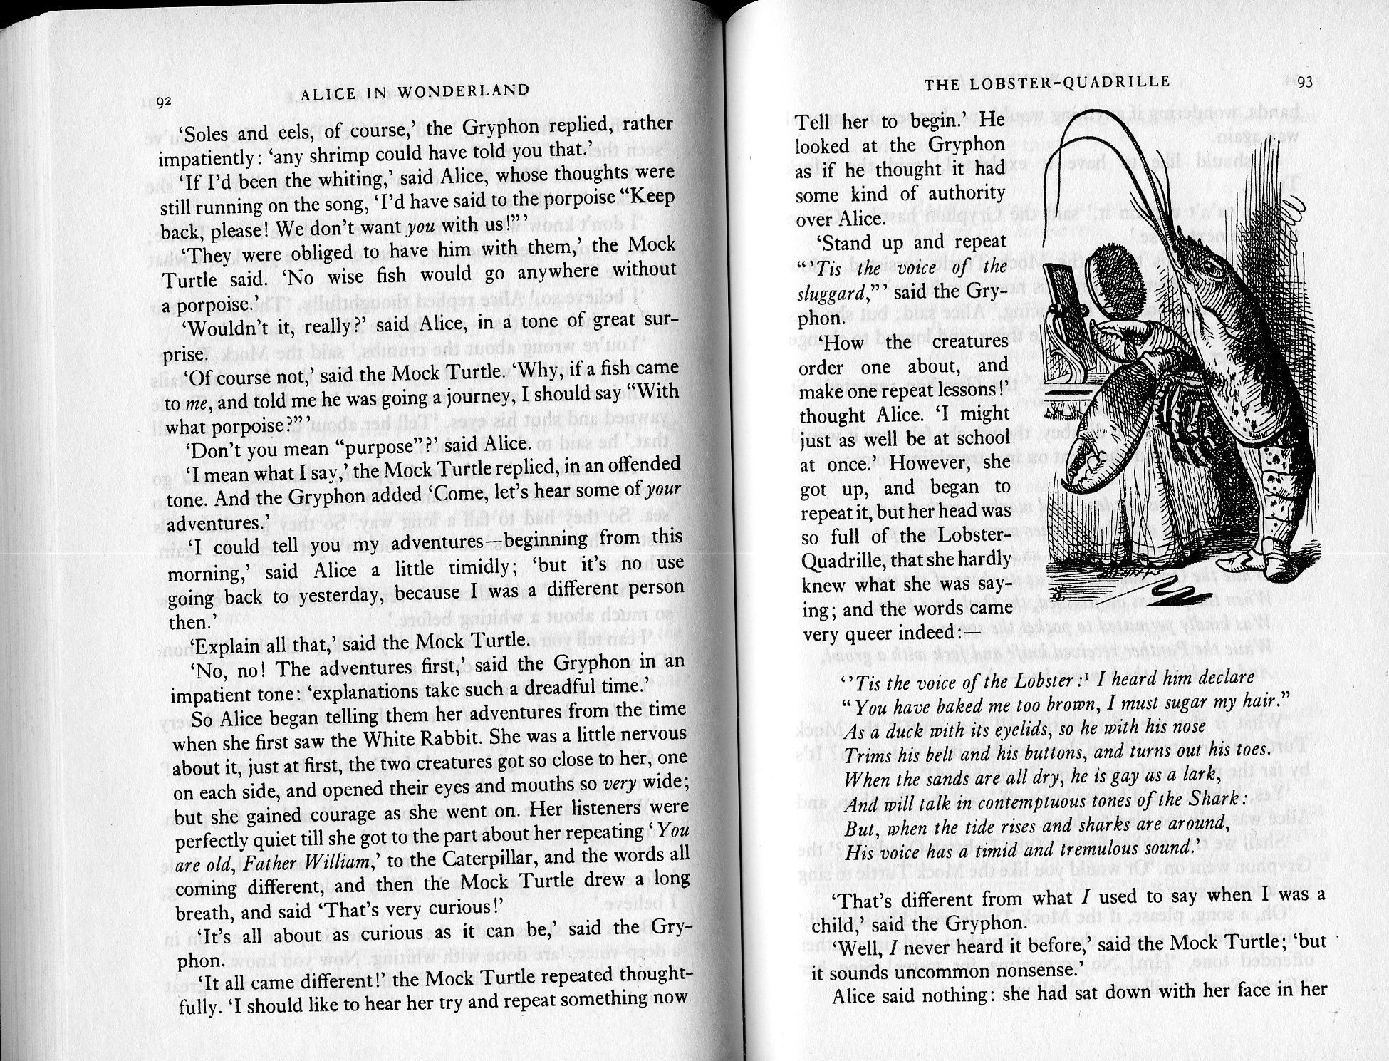
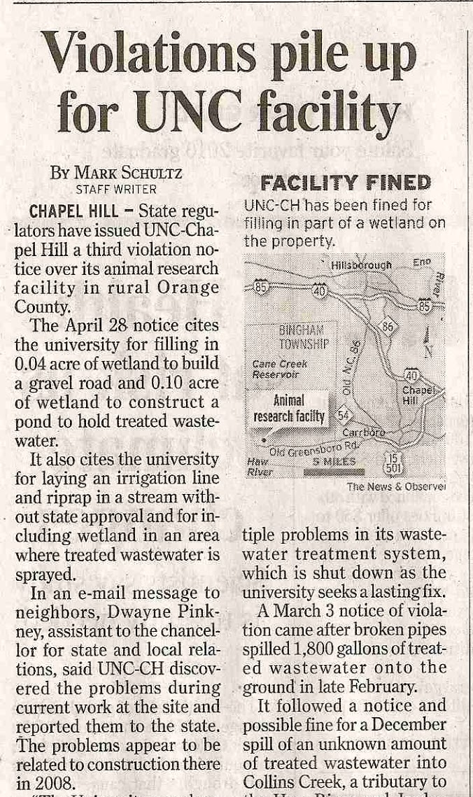
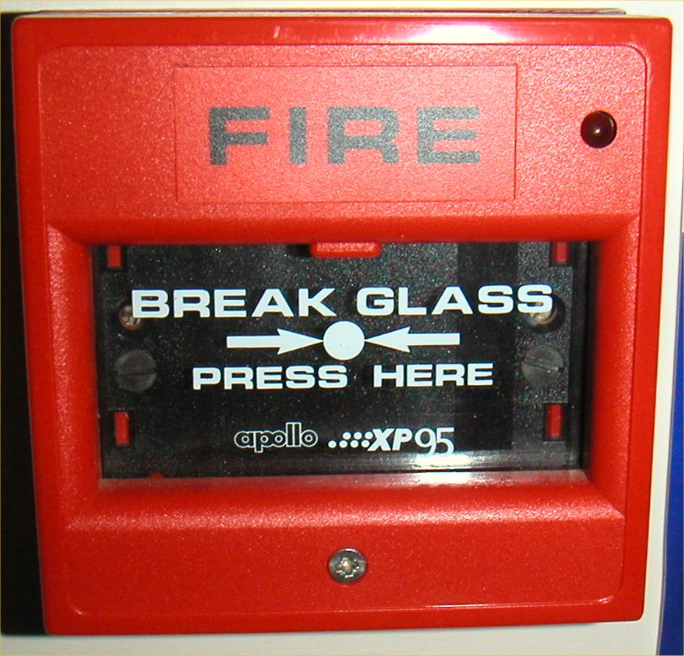
Introduction | Scene Text vs. Printed Text
Variations in font styles, color and sizes
Different quantities of text
Standard layouts in printed content
Scene Text: sign boards, logos, book covers, etc.
Printed Text: Scanned books, newspapers, historical documents, etc.

Slide 5

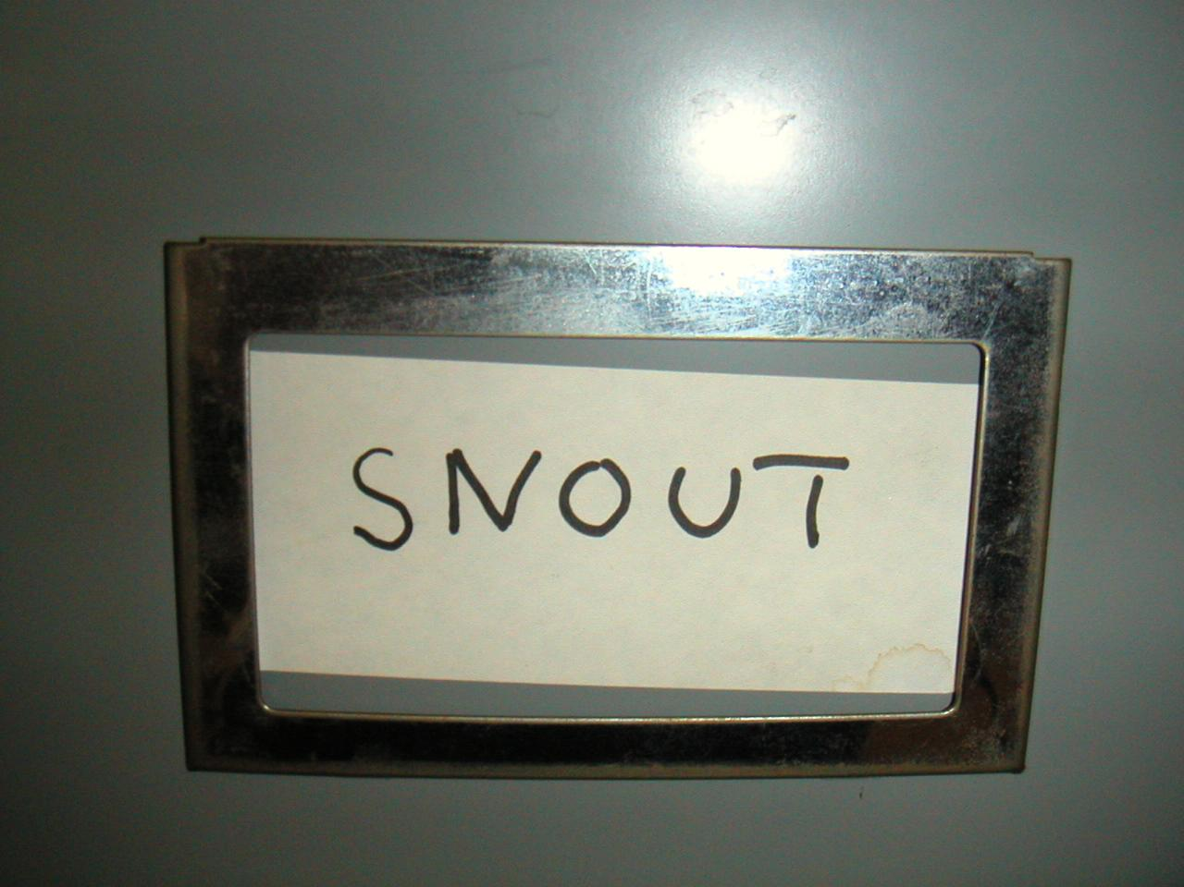
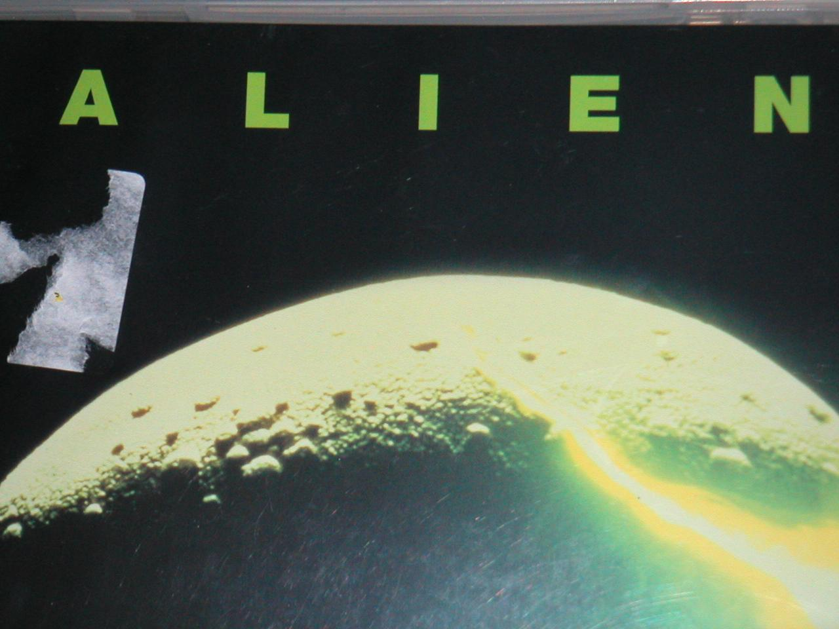
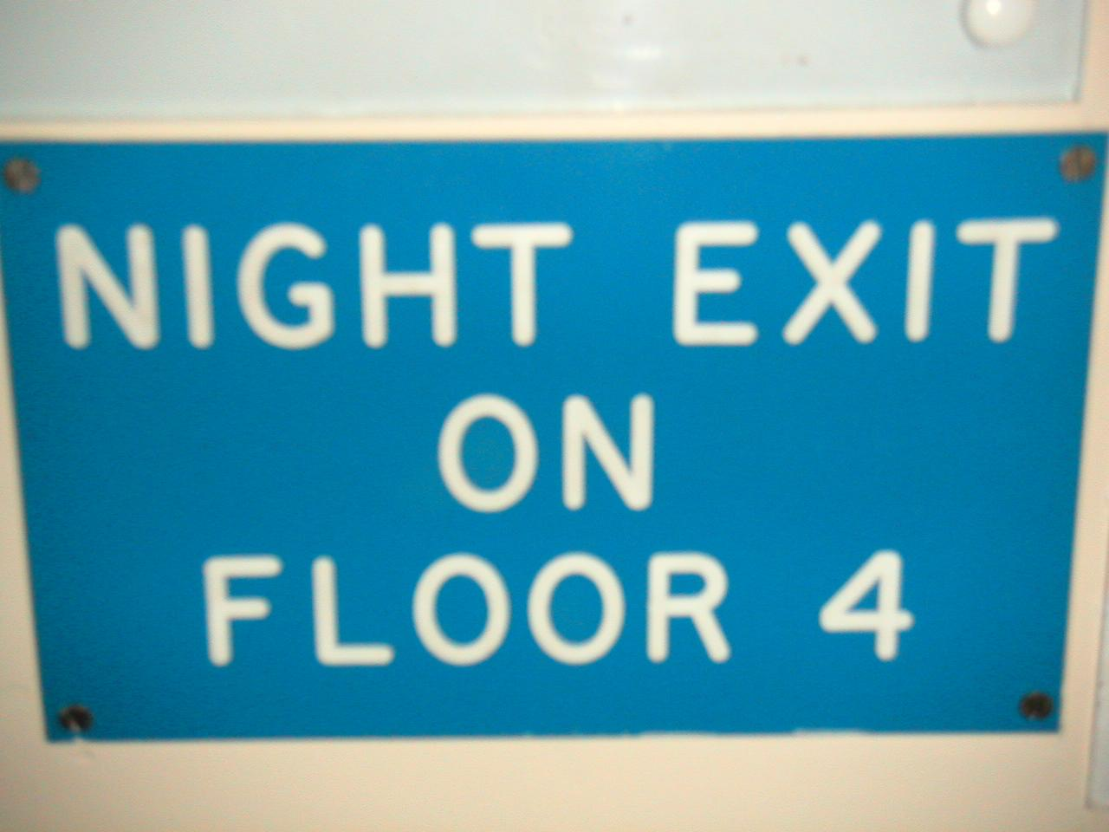
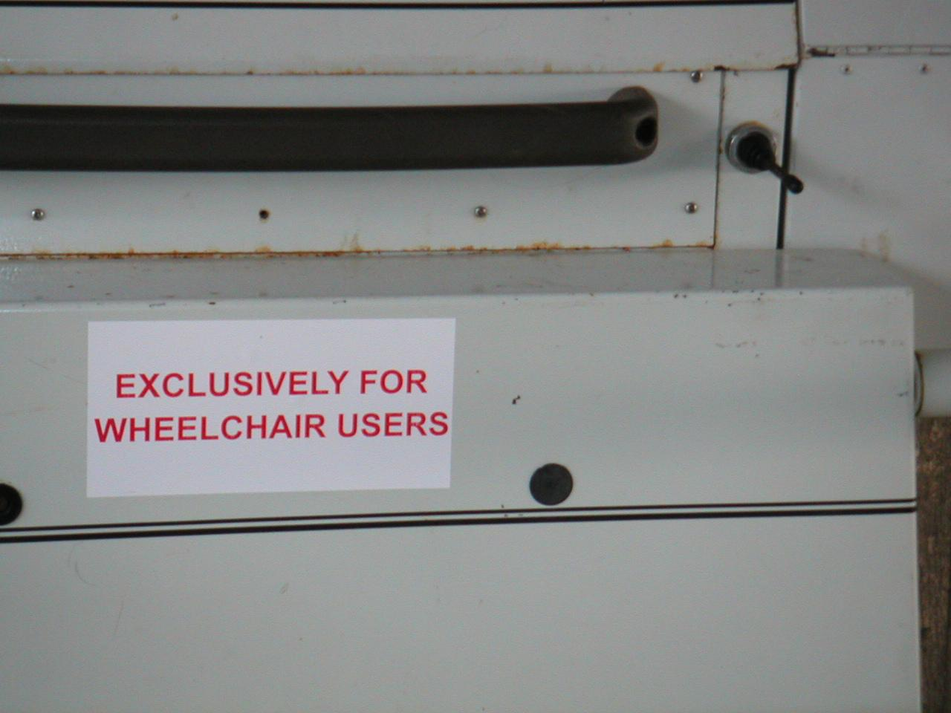

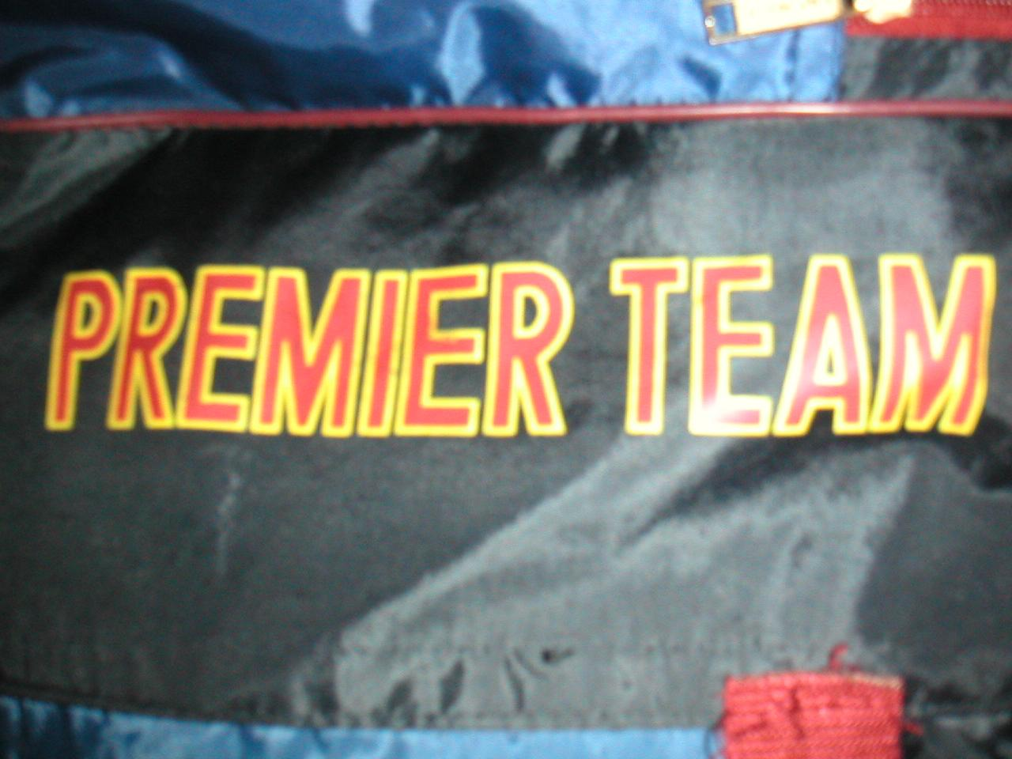
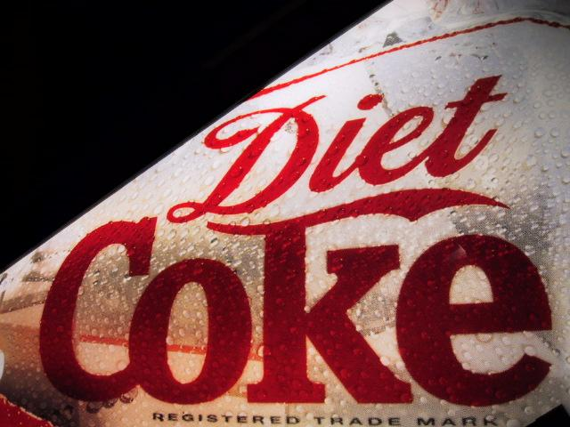
Introduction | Variations
Size
Color
Spacing
Style
Background

Slide 6
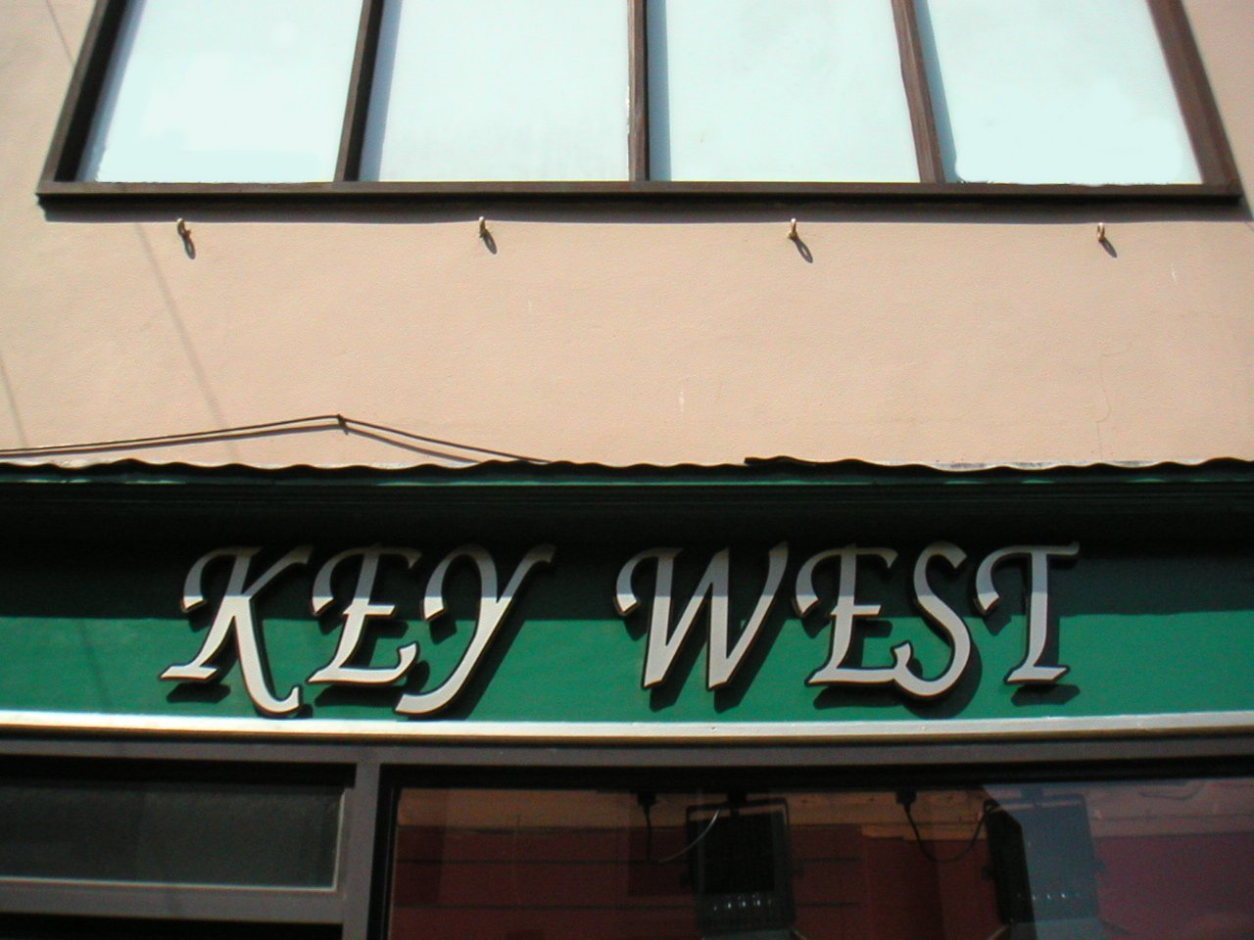
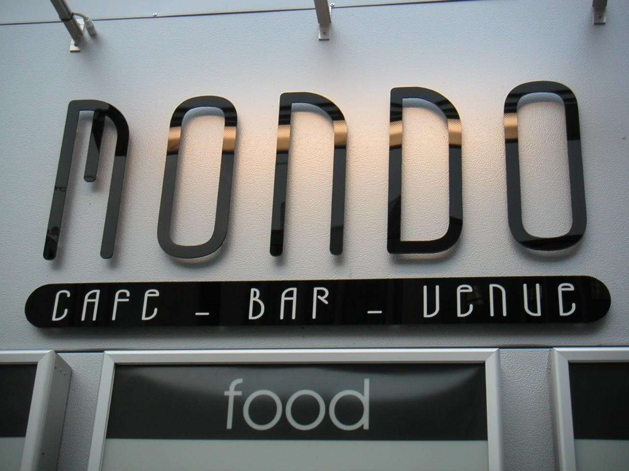
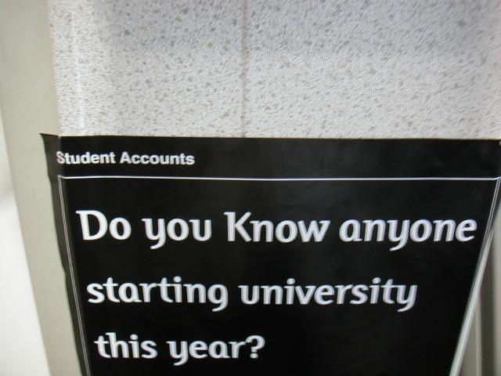

Introduction | End-to-End Framework
Detection
Recognition
WEST
lexicon free
via bounding boxes
+
WEST
Images
lexicon
via segmentation
lexicon based

Slide 7
Overview
Introduction
Text Detection
Generic Pipeline
Proposed Method
Evaluation
Text Recognition
End-to-End Frameworks
Summary

Slide 8
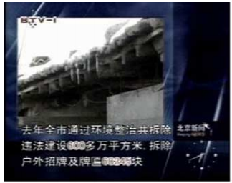
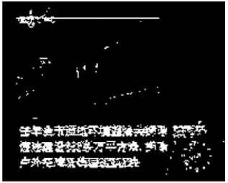
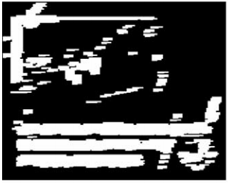

Text Detection | Generic Pipeline
Image
Classical Approach
Segmentation
Generate text probability map
Image Processing
Detection
Group high probability regions into candidate lines
Morphological Operations
Verification
Classify candidate lines as text or non-text
Heuristics
Text Locations
Ye et al. [IVC ‘05]

Slide 9
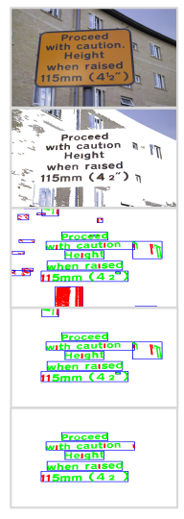
Text Detection | Generic Pipeline
Image
Current Approach
Segmentation
Generate text probability map
Connected Components
Detection
Group high intensity regions into candidate lines
Similarity based grouping
Verification
Classify candidate lines as text or non-text
Classifiers
Text Locations
ICDAR 2013 RRC Winner
TexStar by Yin et al. [SIGIR ‘13]

Slide 10
Text Detection | Drawbacks
Character classification is script specific
Gestalt law of proximity - n-gram level information can be utilized
Character classification error introduced early in the pipeline
Our Approach
group regions into overlapping clusters
(via hierarchical clustering)
↓
classify clusters as a unit
(text/non-text classifier + region proposals)

Slide 11
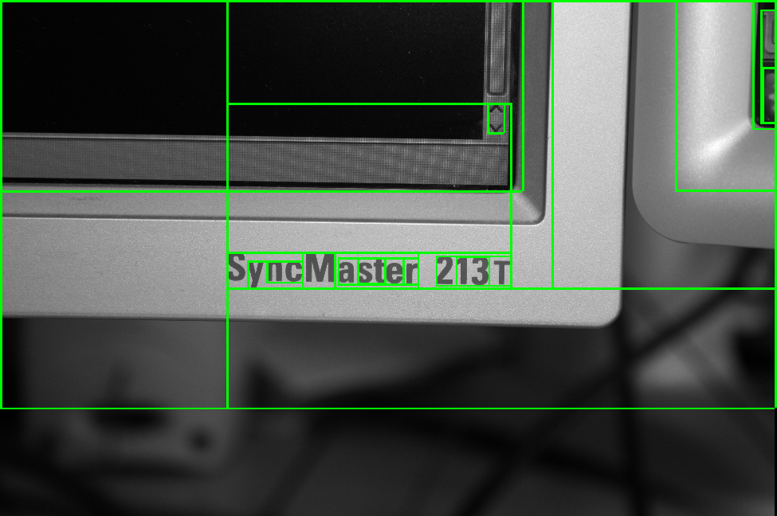
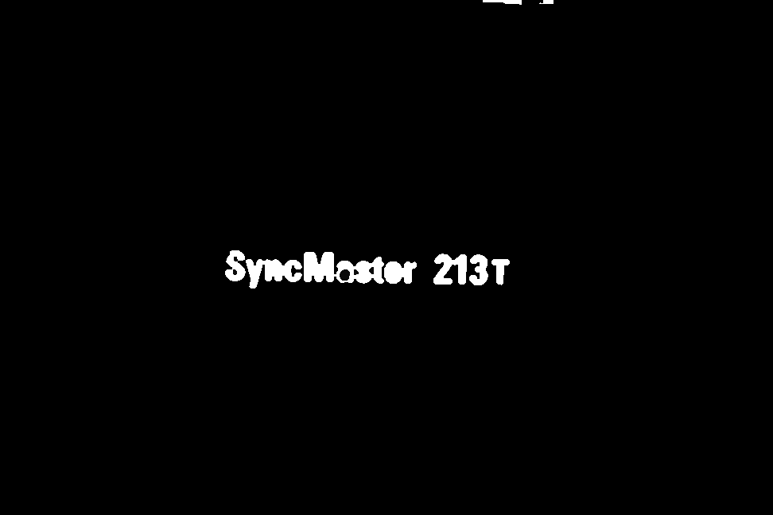
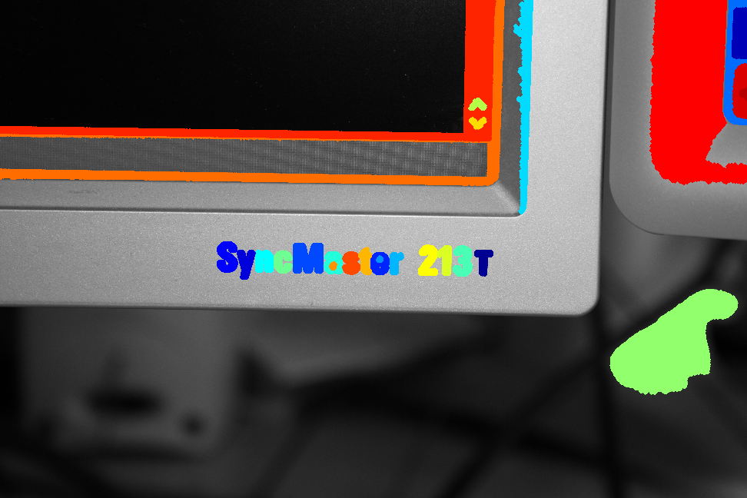
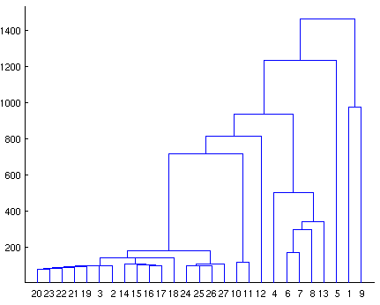
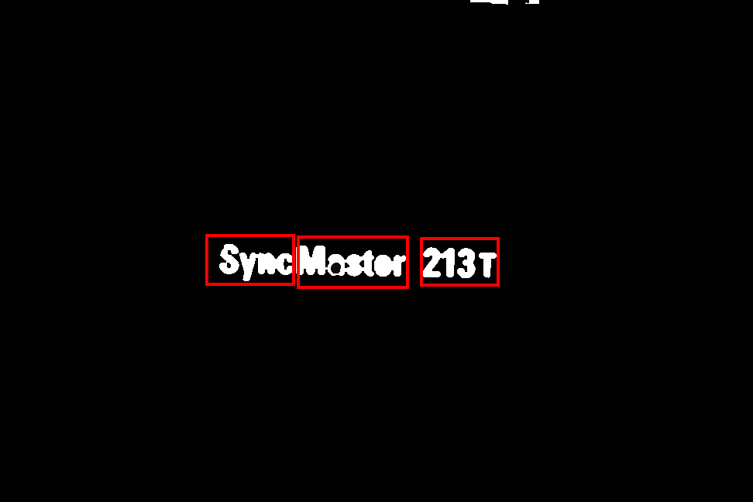
Text Detection | via Hierarchical Clustering
Scene Image
MSERs
Hierarchical Clustering
Text/Non-text
Classifier
Text Segmented Image
OCR
Single Linkage Clustering (SLC)

Slide 12
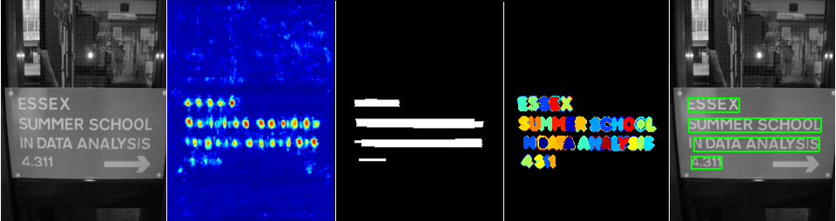
Text Detection | Region Proposals
Multiple scales
Text/Non-text CNN classifier
Score maps
Text grouping
Scene Image
Text proposals
(bounding boxes)
Score map
Formation of text lines/words

Slide 13
Text Detection | Fusion
Text clusters
Scene Image
Detection via Hierarchical Clustering
Fusion
Improved Text Segmented Image
Region Proposals
proposed bounding boxes
Fusion: Retain clusters with high overlap with proposed bounding boxes

Slide 14
Text Detection | Evaluation
Dataset | Images | Language | Text Orientation | Ground Truth Type
ICDAR 2003 | 250 | English | Horizontal | Boxes + Segmentation
ICDAR 2013 | 236 | English | Horizontal | Boxes
MRRC | 167 | English + Kannada | Any | Boxes + Segmentation
Boxes: IoU overlap [ICDAR 2003]
Segmentation: Pixel level [ICDAR 2003]
Proposals: IoU overlap, Regions per Image

Slide 15
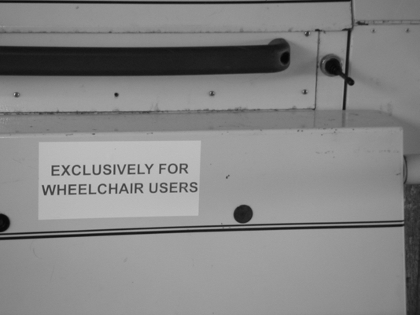
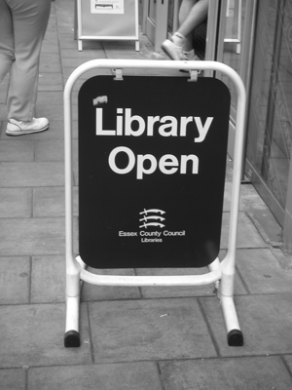
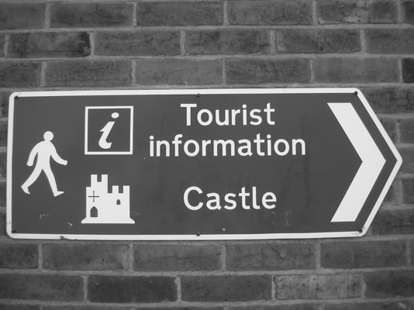
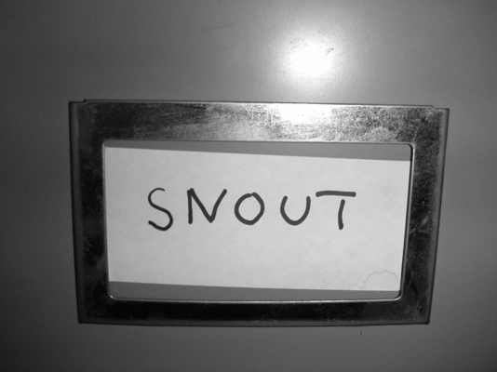
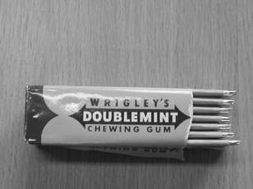





Text Detection | Qualitative Results

Slide 16
Text Detection | Quantitative Results
Detection via Segmentation | MRRC |  |  | ICDAR 2003 |  |  | Runtime (sec.)
 | R | P | F | R | P | F
Gomez et al. [arXiv ‘14] | 60 | 67 | 63 | 59 | 58 | 58 | 3
Milyaev et al. [ICDAR ‘13] | 82 | 20 | 32 | 74 | 31 | 43 | 7
SLC + adaboost | 60 | 78 | 69 | 53 | 66 | 59 | 10
Fusion | - | - | - | 46 | 83 | 60 | 11
Performance comparison with existing pixel-wise segmentation methods

Slide 17
Text Detection | Quantitative Results
Region Proposals | ICDAR 2003 |  |  | ICDAR 2013
 | Recall | R/I | Time | Recall | R/I | Time
Endres et al. [PAMI’ 14] | 66 | 1417 | 1216 | 64 | 1510 | 1300
Alexe et al. [PAMI ‘12] | 58 | 1000 | 9 | 56 | 1000 | 10
Uijlings et al. [IJCV ‘13] | 79 | 4168 | 13 | 72 | 4053 | 15
Zitnick et al. [ECCV ‘14] | 84 | 6270 | 3 | 79 | 6409 | 7
CNN based | 75 | 1658 | 10 | 72 | 1400 | 11
Comparison with generic object region proposal methods on scene text datasets

Slide 18
Overview
Introduction
Text Detection
Cropped Word Recognition & Retrieval
Lexicon based Recognition
Our Approach
Evaluation
End-to-End Frameworks
Summary

Slide 19



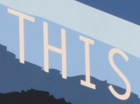

Scene Text Recognition | Goal
Word Recognition
Text-to-Image Retrieval
Query: BRADY
Lexicon
Lexicon
Lexicon
Lexicon
TIMES
Some Applications
Recognizing grocery items
Retrieving books by titles

Slide 20
Scene Text Recognition | Lexicon based
Wang K et al. [ICCV ‘11], Shi et al. [CVPR ‘13], Wang T et al. [ICPR ‘12], Mishra et al. [CVPR ‘12]
Potential character locations detected using binarization or sliding window
Drawbacks
Difficult to obtain true character windows
Does not perform well with large lexicons (words in thousands)
Approximation errors in inference
Inference on graphs to recognize text
T
H
1
S
THAT THIS TREE
….
THIS
Lexicons used to correct recognition

Slide 21
Scene Text Recognition | Our Approach
Focus on large lexicon based recognition
Multiple candidate words generation
Inferring multiple solutions
Iterative lexicon reduction

Slide 22
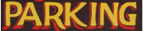
Scene Text Recognition | Our Approach
N Multiple Solutions
M Candidate Words
+
Unary Potentials
{HRKING, HRK1NG, BPKING, BPKIMG, BRKING}
{PARKIMG, PAPKING, PARKING, PARAING, BARKING}
…
{PARKM, PARKN, PAPKM, IARKN, PARKN}
CRF Inference
Multiple Candidate Word Module
Pairwise Potentials
NxM solutions
Reduced Lexicon
Pairwise Update
Lexicon Reduction
Initial Lexicon
Strengthen pairwise terms by reducing lexicon size using multiple solutions

Slide 23
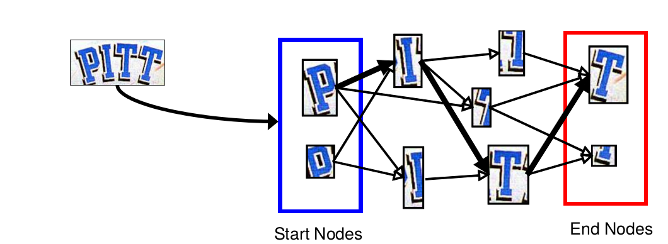
Scene Text Recognition | Candidate Words
Obtaining potential character locations with a high recall is desired
Multiple binarization techniques to generate several candidate words

Slide 24

Scene Text Recognition | CRF Framework
(nodes)
(edges)
Unary Potential → computed from SVM confidence score
Pairwise Potential → computed from bi-gram probabilities from characters pairs in the lexicon

Slide 25

Scene Text Recognition | Diverse Solutions
𝚫 = dot product similarity
Diversity constraint
Batra et al. [ECCV 2012]

Slide 26

Scene Text Recognition | MAP vs. Diverse
Word Image | MAP | Diverse solutions (ranked)
 | PITA | PASP | ENEP | PITT | AWAP
 | AUM | NIM | COM | MUA | PLL
 | MINSTER | MINSHER | GRINNER | MINISTR | MONSTER
 | BRKE | BNKE | BIKE | BAKE | BOKE
 | TOLS | TARS | THIS | TOHE | TALP

Slide 27
Scene Text Recognition | Strategy
Recognition
Retrieval
1000+
1000+
1
Lexicon Reduction
Lexicon Reduction
Yes
10
5
AED > 𝛉
Inference Engine
Influenced by variation in lexicon
Grid search on validation set
Text
Query
Retrieve and rank images with query in reduced lexicon
Recognized Text

Slide 28
Scene Text Recognition | Lexicon Reduction
Group Edit Distance → re-rank lexicon using the minimum edit distance for each of the lexicon words. For example,
Multiple Solutions | Lexicon →
 | STARS | THIS | TAP | ...
TARS | 1 | 2 | 2 | ...
TOLS | 3 | 2 | 3 | ...
THIS | 3 | 0 | 3 | ...
GED | 1 | 0 | 2 | ...
Rank | 2 | 1 | 3 | ....

Slide 29

Scene Text Recognition | Lexicon Reduction
Word Image | Iteration 1 | Iteration 2 | Iteration 3 | Iteration 4
 | FGAIEESHER | FGAIERSHER | KINGFISHER | KINGFISHER
 | NHAI | AHAI | AHAI | THAT
 | MAITOTA | MAITOTA | MACTOTH | MAMMOTH
 | THTL | THEL | THEL | THIS

Slide 30
Scene Text Recognition | Datasets
Dataset | Training Images | Testing Images | Lexicons
IIIT 5K-Word | 3000 | 2000 | Small - 50 Medium - 1000 Large - 0.5 mil
ICDAR 2003 | - | 890 | Small - 50 Medium - 1000* Large - 0.5 mil
SVT | - | 647 | Small - 50 Medium - 1000* Large - 0.5 mil
* wordnet ontology

Slide 31
Scene Text Recognition | Quantitative Results
Method | IIIT 5K-word |  |  | ICDAR 03 | SVT
 | Large | Medium | Small | Small | Small
non-CRF based
Wang et al. [ICCV ‘11] | - | - | - | 76 | 57
Bissacco et al. [ICCV ‘13] | - | - | - | 82.8 | 90.3
Alsharif et al. [arXiv ‘13] | - | - | - | 93.1 | 74.3
Goel et al. [ICDAR ‘13] | - | - | - | 89.6 | 77.2
Rodriguez et al. [BMVC ‘13] | - | 57.4 | 76.1 | - | -
CRF based
Shi et al. [CVPR ‘13] | - | - | - | 87.4 | 73.5
Novikova et al. [ECCV ‘12] | - | - | - | 82.8 | 72.9
Mishra et al. [CVPR ‘12] | - | - | - | 81.7 | 73.2
Mishra et al. [BMVC ‘12] | 28 | 55.5 | 68.2 | 80.2 | 73.5
Our Method | 42.7 | 62.9 | 71.6 | 85.5 | 76.4
Recognition performance comparison between various CRF and non-CRF methods

Slide 32
Scene Text Recognition | Quantitative Results
K | ICDAR 03 |  | ICDAR 11 |  | ICDAR 13 |  | IIIT 5K-word |  | SVT
 | M | L | M | L | M | L | M | L | M | L
 | Non Diverse
1 | 78.9 | 61.5 | 69.9 | 51.1 | 70.5 | 51 | 58 | 40.9 | 66.4 | 48.3
3 | 79.1 | 63.9 | 69.8 | 51.4 | 70.5 | 51.2 | 58.3 | 40.9 | 66.6 | 48.9
5 | 79.2 | 63.6 | 69.9 | 51.2 | 70.5 | 51.2 | 57.8 | 40 | 66.7 | 48.8
 | Diverse
1 | 77 | 62.7 | 68.2 | 52.3 | 69.4 | 52.6 | 57.7 | 38.9 | 67.2 | 51.4
3 | 78.3 | 66.9 | 70.3 | 57.2 | 70.6 | 57.1 | 62.2 | 43.9 | 67.2 | 51.4
5 | 80.0 | 66.5 | 70 | 58.1 | 72.1 | 59.0 | 62.9 | 45.3 | 67.3 | 51.4
Recognition performance while varying the type and number of multiple solutions (K)
M - Medium
L - Large

Slide 33




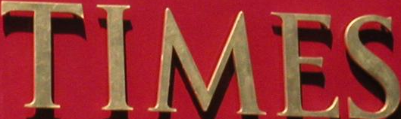

Scene Text Recognition | Correct Retrievals
Query | Retrieved Image | Partial Reduction with Diversity
BRADY |  | MY, BRADY, ANY, A, RODE
SPACE |  | HOT, SPACE, LACEY, SALE, SPA
HAHM |  | BUENA, HANDA, HAHM, PIPE, HAM
DAILY |  | PEARL, MOUNTS, DAILY, NIKE, DO
TIMES |  | TIME, TIMES, WINE, MED, THE
THREE |  | THE, THREE, THERE, USED, HERE

Slide 34




Scene Text Recognition | Failure Cases
Query | Retrieved Image | Partial Reduction with Diversity
CLEAR |  | CLEAR
HOME |  | HOME, 900AM, 9080, 90, TOM
BAR |  | BAR
FOR |  | AND, ARTS, FOR, INN, FARM
311 |  | 311
JOIN |  | ONE, JOIN, OUT, OUR, FOUR
No label in reduced lexicon
Incorrect ranking

Slide 35
Scene Text Recognition | Retrieval Results
Method | IIIT 5K-word |  |  | ICDAR 03
 | Large | Medium | Small | Small
Without diversity
Full Reduction | 27.5 | 51.9 | 65.0 | 81.7
Partial Reduction | 35.1 | 35.6 | 60.7 | 76.9
With diversity
Full Reduction | 23.1 | 52.0 | 65.0 | 78.9
Partial Reduction | 42.1 | 59.0 | 66.5 | 79.5
Top-1 precision results

Slide 36
Overview
Introduction
Text Detection
Cropped Word Recognition & Retrieval
End-to-End Frameworks
Two pipelines
Evaluation
Summary

Slide 37
End-to-End Frameworks | Two Pipelines
Text Detection + OCR Pipeline
Lexicon free
Pixel level text detection
Word level grouping by OCR
Segmented
Image
Detection via Hierarchical Clustering
Tesseract
Regions
+
Text
Image
Region Proposals + CRF Pipeline
Lexicon based
Text detection for word level candidates
Word level grouping induced by lexicons
Lexicon
Region
Proposals
Multiscale Detection via CNN Classifier
CRF based Recognition
Regions
+
Text
Image

Slide 38
End-to-End Pipelines | Quantitative Results
Method | Recall | Precision | F measure
Neumann et al. [CVPR ‘12] | 37.2 | 37.1 | 36.5
Wang et al. [ICCV ‘11] | 30 | 54 | 38
Neumann et al. [DAS ‘13] | 39.4 | 37.8 | 38.6
OCR based
Gomez et al. [ACCVW ‘14] | 32.4 | 52.9 | 40.2
Text Detection + OCR | 32 | 59.0 | 41.5
Lexicon free end to end framework performance on ICDAR 2011 dataset

Slide 39
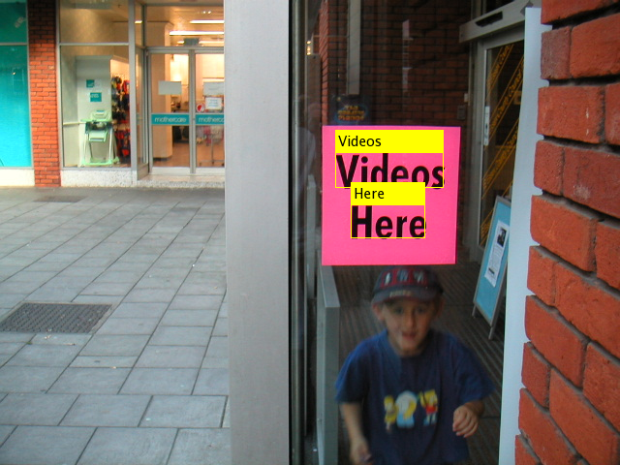
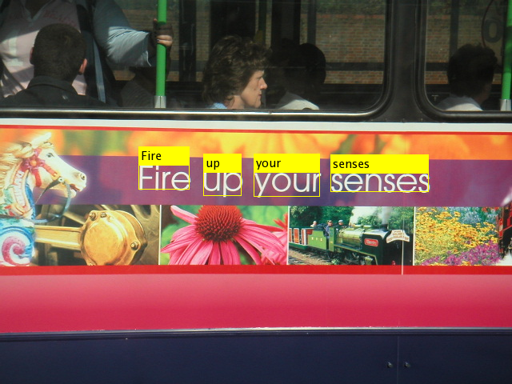
End-to-End Pipelines | Qualitative Results
Successful qualitative results for the Text Detection + OCR method

Slide 40
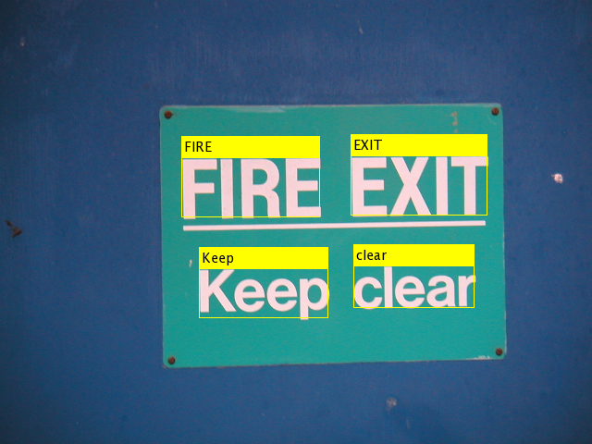
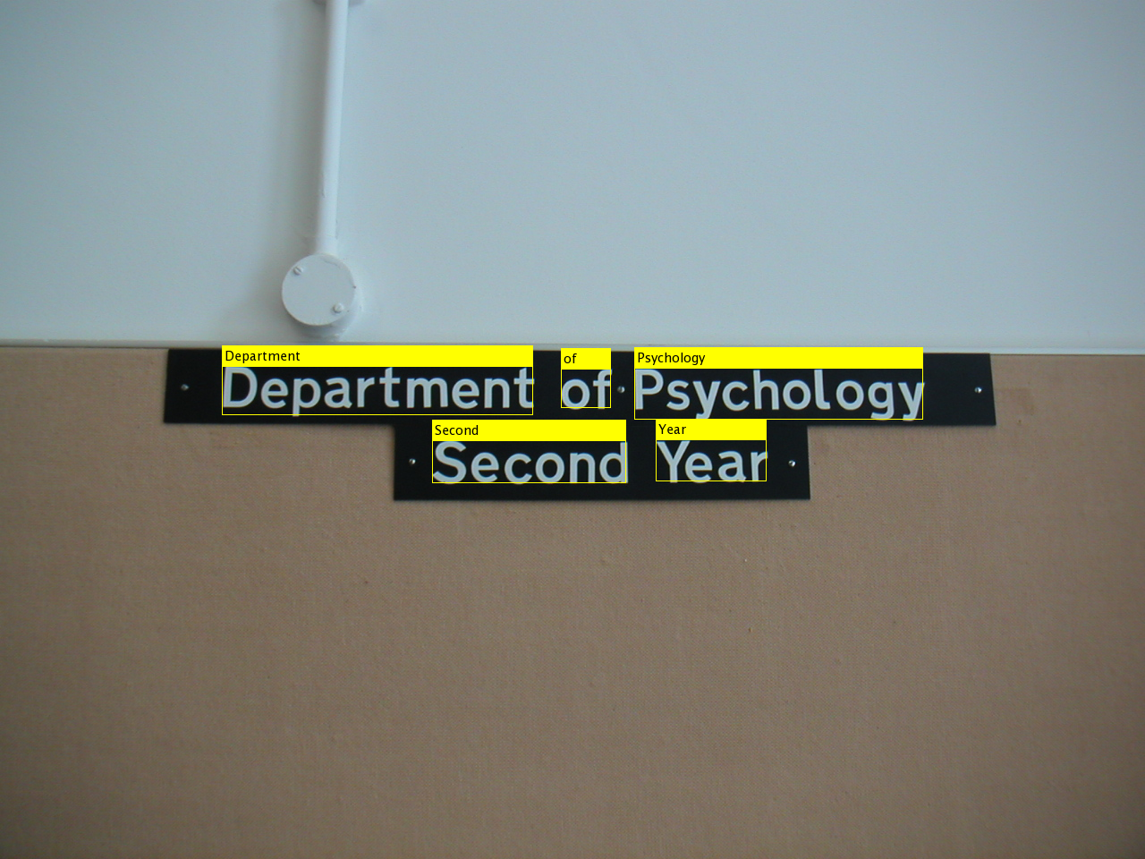
End-to-End Pipelines | Qualitative Results
Successful qualitative results for the Text Detection + OCR method

Slide 41
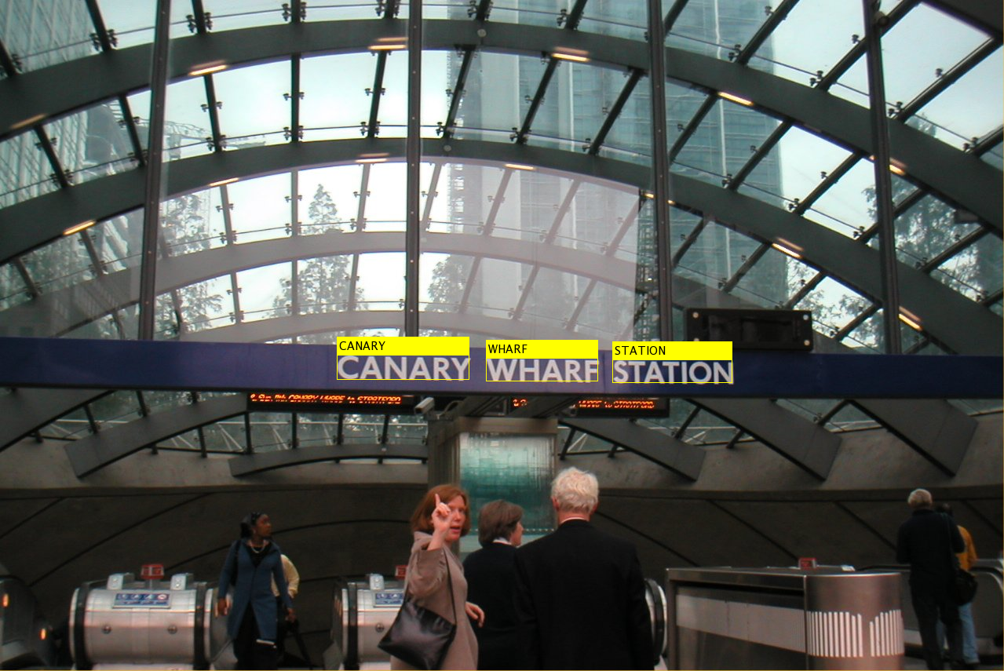
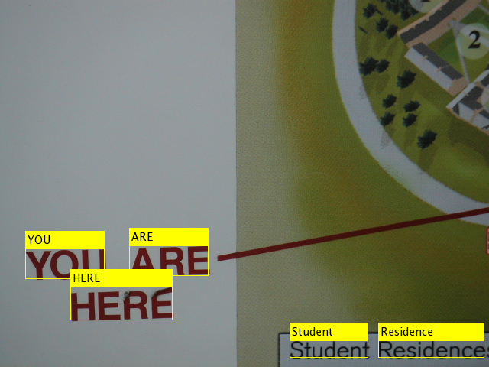
End-to-End Pipelines | Qualitative Results
Successful qualitative results for the Text Detection + OCR method

Slide 42
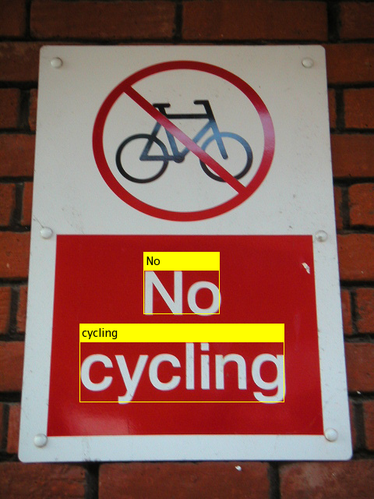
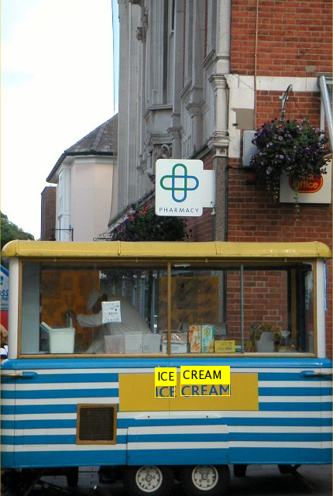
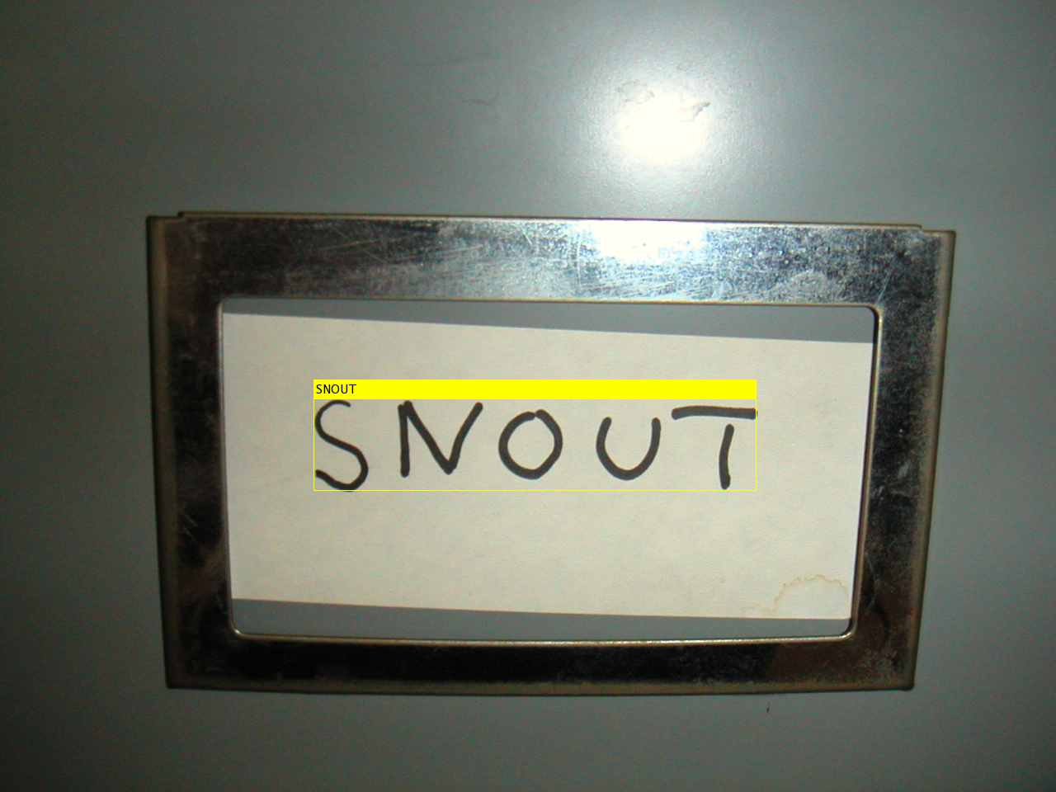
End-to-End Pipelines | Qualitative Results
Successful qualitative results for the Text Detection + OCR method

Slide 43
End-to-End Pipelines | Quantitative Results
Method | Small | Full
Wang et al. [ICCV ‘11] | 68 | 51
Alsharif et al. [arXiv ‘13] | 77 | 70
Jaderberg et al. [ECCV ‘14] | 80 | 75
Jaderberg et al. [ICCV ‘14] | 90 | 86
Region Proposals + CRF | 53 | 50
Lexicon based end to end framework Recall on ICDAR 2003 dataset

Slide 44
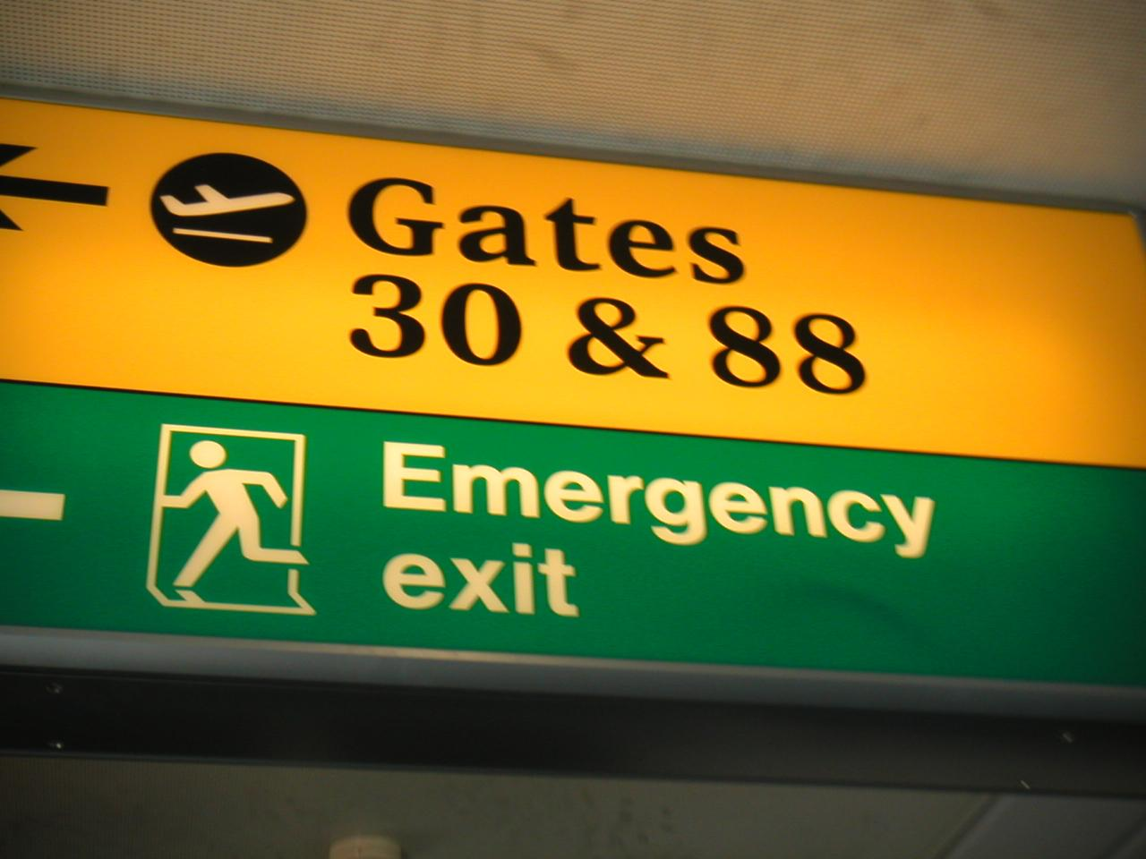

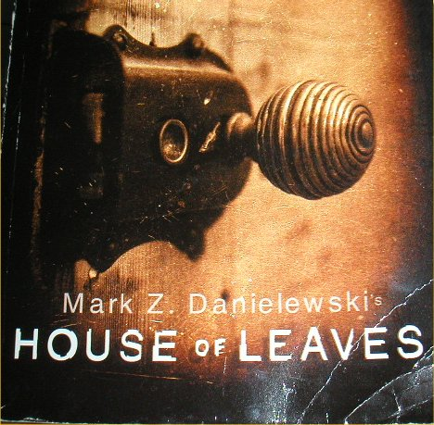
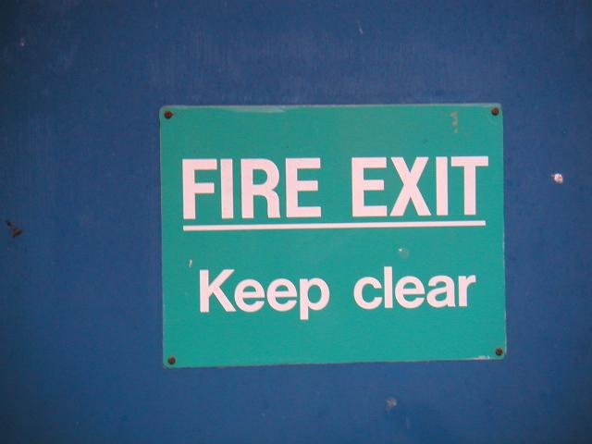
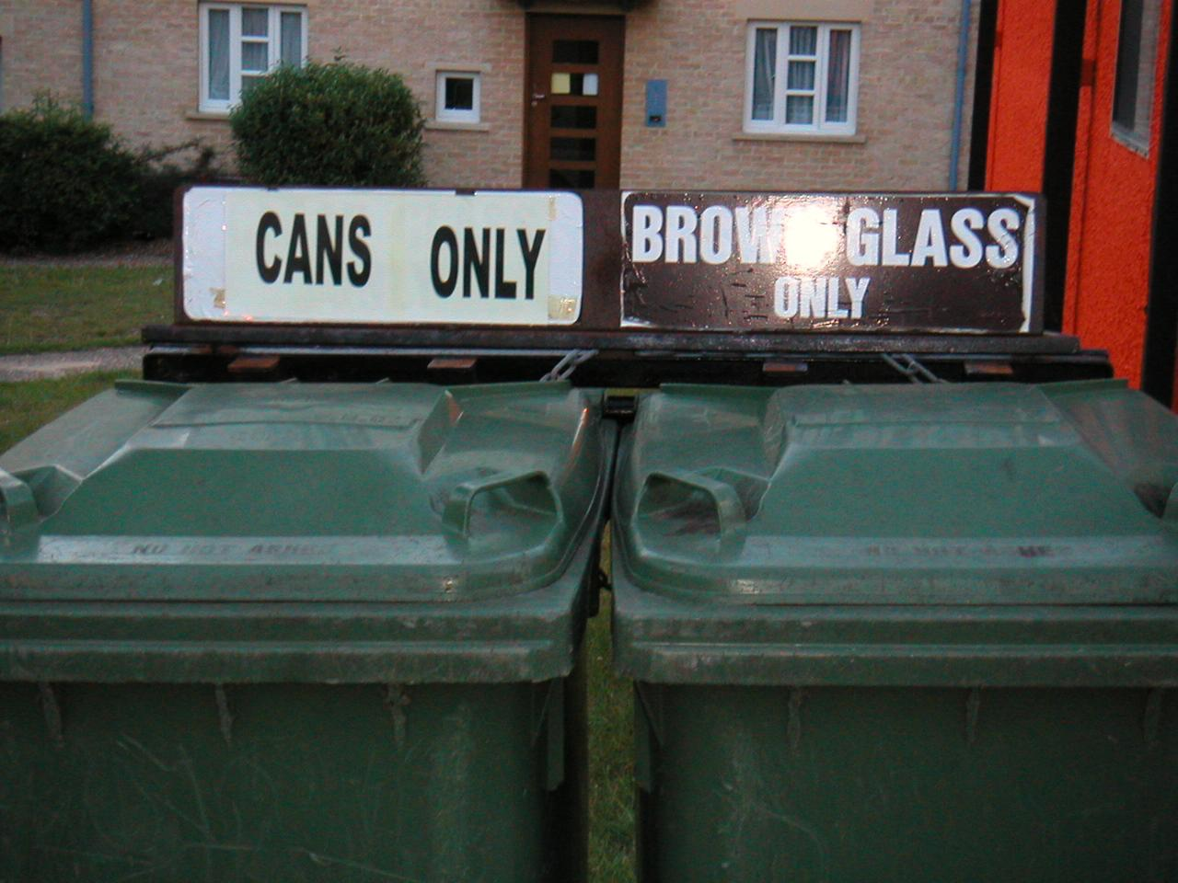
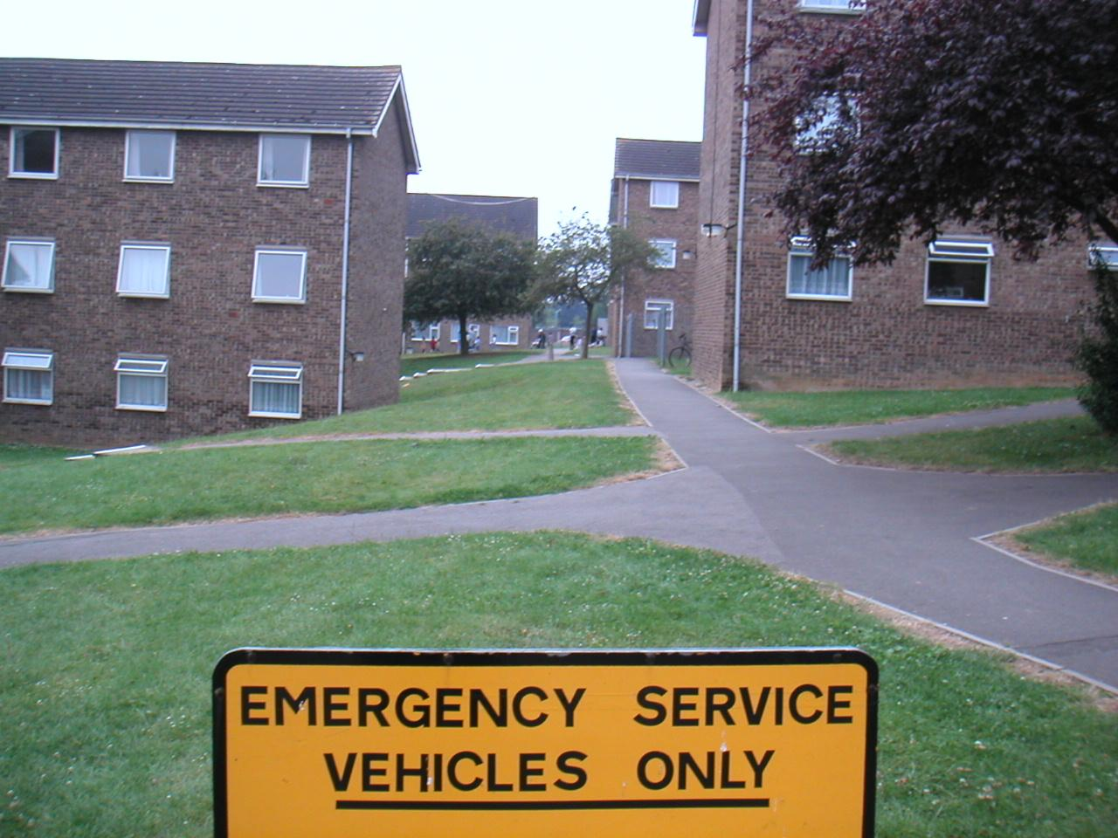
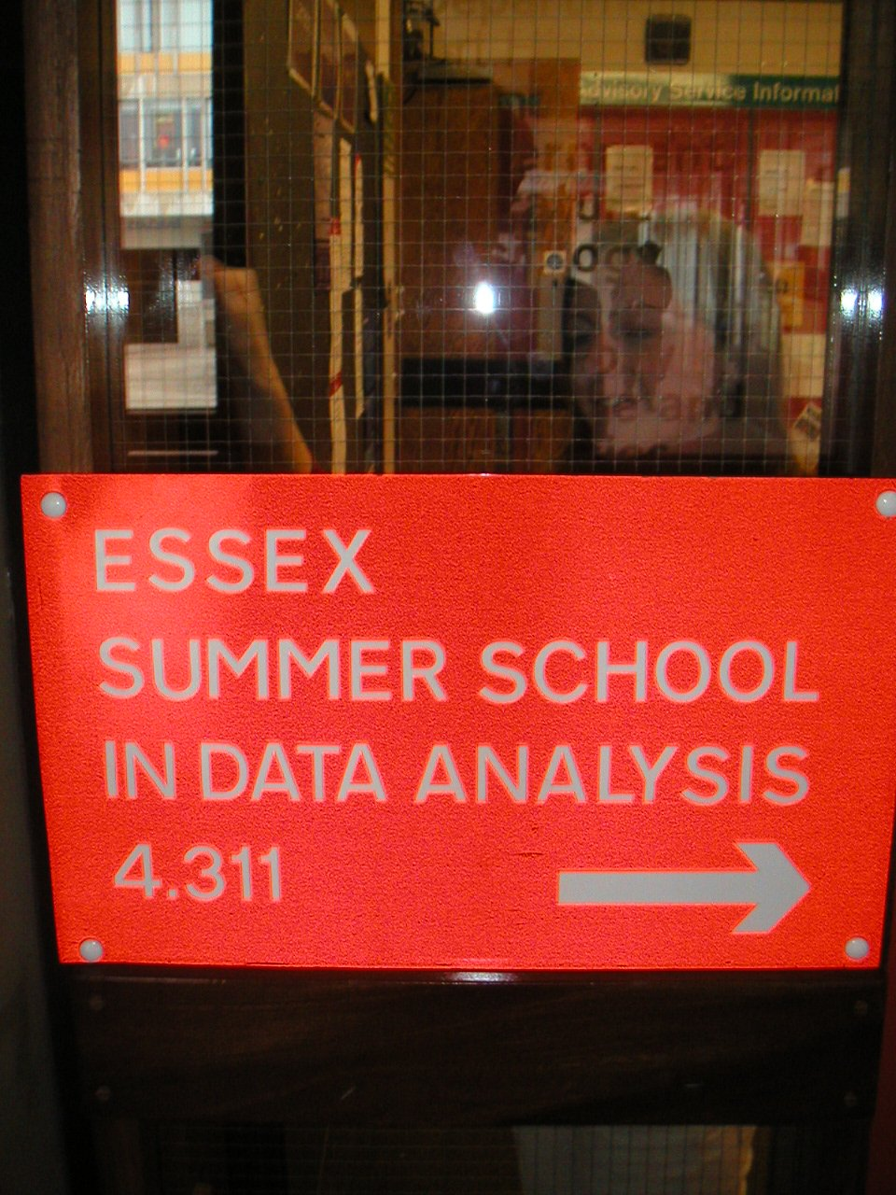


End-to-End Pipelines | Qualitative Results
EMERGENCY
ESSEX
HOUSE
FIRE
ONLY
Top-2 retrieval results ICDAR 2011 dataset with the Region Proposals + CRF approach

Slide 45
Publications
Publications from this thesis,
Udit Roy, Anand Mishra, Karteek Alahari, and C. V. Jawahar “Scene Text Recognition and Retrieval for Large Lexicons” In Asian Conference on Computer Vision (ACCV), 2014
Other publications during MS which are not a part of this thesis,
Udit Roy, Naveen Sankaran, K. Pramod Sankar, and C. V. Jawahar. “Character N-Gram Spotting on Handwritten Documents using Weakly-Supervised Segmentation.” In International Conference on Document Analysis and Recognition (ICDAR), 2013
Udit Roy, Tejaswinee Kelkar, and Bipin Indurkhya “TrAP: An Interactive System to Generate Valid Raga Phrases from Sound-Tracings” In New Interfaces for Musical Expression (NIME), 2014

Slide 46
Summary
Proposed solutions to standard challenges in scene text analysis
Text grouping followed by classification performs better
Word recognition improved by multiple solutions and candidate words
Large lexicons can be effectively reduced
Evaluated two contrasting end-to-end pipelines
Future Directions
Better handling of non-text content - layout analysis
Multi-script scene text analysis
Analysis on large datasets - COCO-Text (60K images)
Thank You!

