Slide 1
Distinctive parts for learning relative attributes
Ramachandruni Naga Sandeep
MS by Research CSE
201207582
Thesis Advisor : Prof C.V. Jawahar

Slide 2
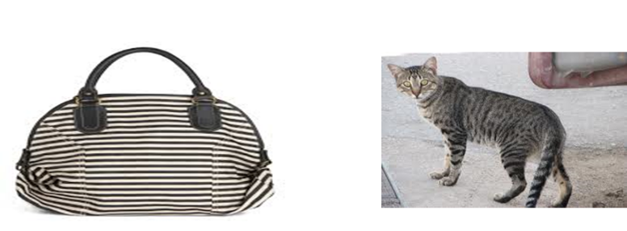
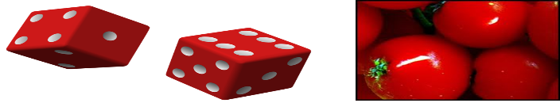
What are Visual Attributes?
Mid level concepts that bridge the gap between low level image features ( texture) and high level concepts (e.g: beach, table, Tom cruise).
Examples are properties of materials (furry, metallic), faces ( young, female) etc.
RED STRIPED

Slide 3
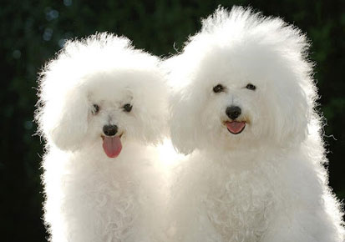



Furry dog
Young Female
Curly hair

Slide 4
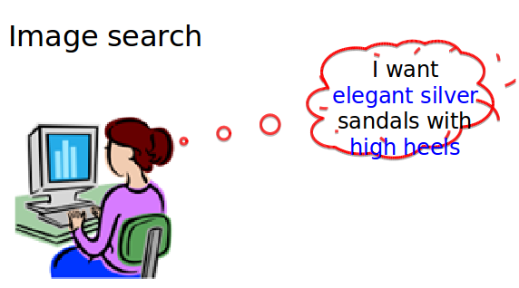
Attribute properties
Shareable across different but related concepts.
e.g: (Red shirt, Red car), ( open street, open corridor)
Both visual and semantic, ideal for communication.
e.g: “ these red flowers are beautiful”
Used in visual search.

Slide 5
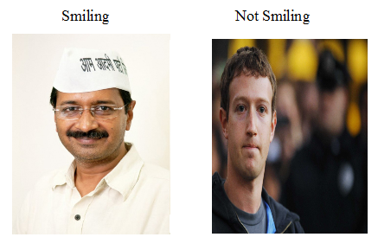
What are relative attributes ?
Binary attributes indicate only the presence and absence of attributes.
Relative attributes introduced by Parikh and Grauman provides more appealing way of comparing two images

Slide 6
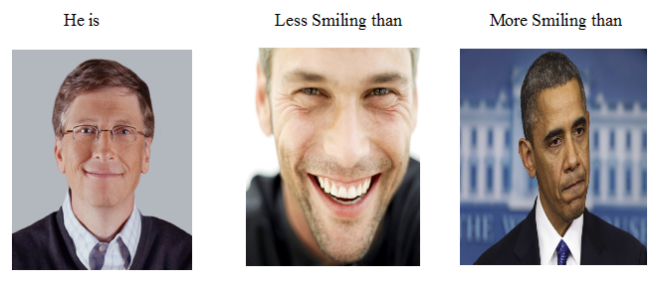
Relative Attributes
Provides a semantic richer way to describe and compare objects in the world.
Help in refining an identifying description or to situate with respect to reference objects ( brighter than a candle and dimmer than a light).
D. Parikh and K. Grauman Relative Attributes, ICCV 2011

Slide 7
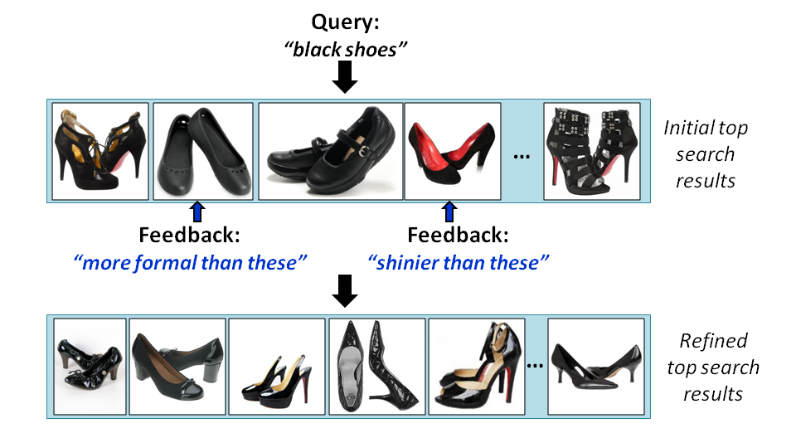
They help in visual search
E.g: Find me black shoes which are more shinier than these and more formal than these.

Slide 8
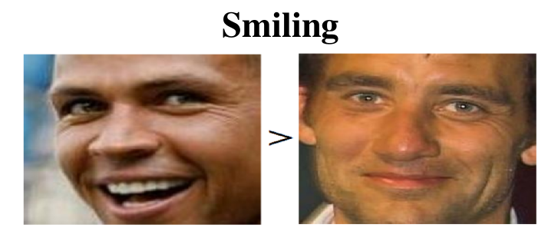
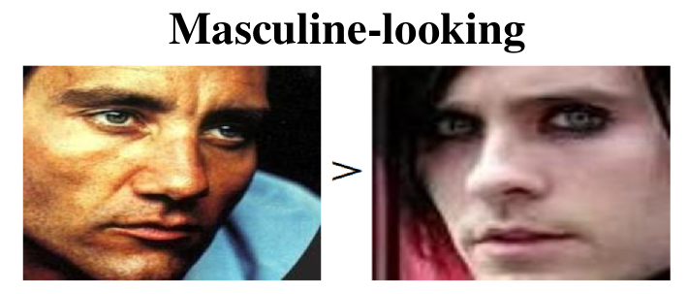
Problem Statement
In this Thesis, we concentrated on the problem of predicting relative attributes for facial domain.
Given two images which contain faces, we aim to predict the relative strength of given attribute.

Slide 9
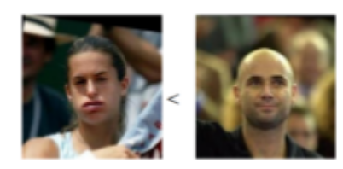
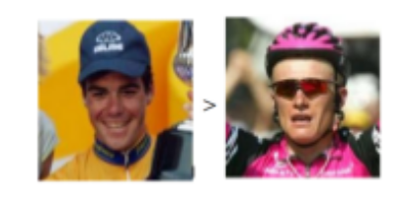
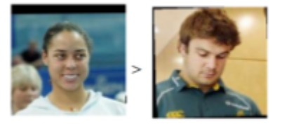
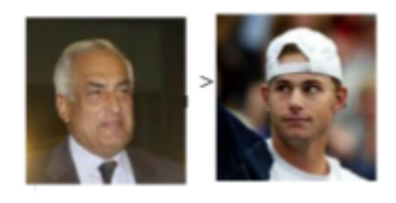
Pairs of images are used for training the model with their relative strengths
Smiling attribute

Slide 10
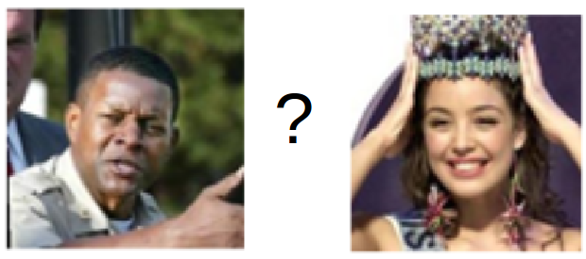
During Testing model predicts the score for each image.
Smiling attribute

Slide 11
Learning of relative attributes classifier
For training of relative attribute classifiers, pair of images with their relative attribute strengths are required.
For testing, given two images, classifier has to give high score for the image which has more strength of attribute than the other.
We have used Ranking SVM classifier to learn the model for ranking images.

Slide 12
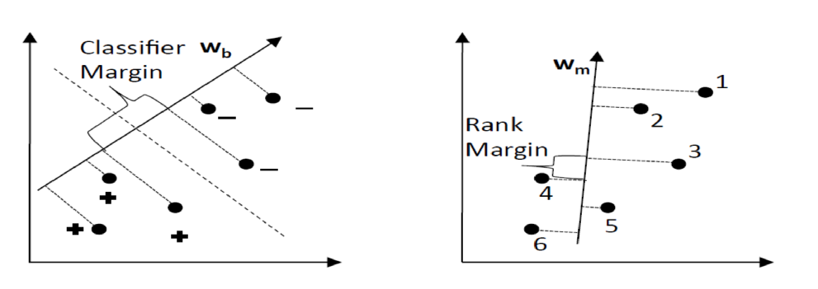
Distinction between Classification SVM and Ranking SVM
Binary classifier tries to separate the positive and negative samples whereas Ranking SVM tries to order the points based on their strength.

Slide 13
Using parts for learning Relative attributes
The visual attributes we have considered are more local in nature
This intuition makes us to use a part based local representation rather than using a global feature representation.
Part-to-Part comparison is effective and accurate.
This helps to distinguish the fine changes in the local regions.

Slide 14
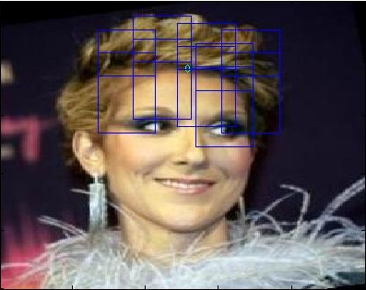
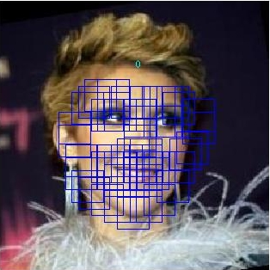
Detecting parts on face
Parts on face need to be detected to compute part specific features.
In our work, we have used the method of “Face detection, pose estimation and landmark localization in the wild CVPR 2012" which uses tree structure models.
Example image where parts are detected using the above method.
The upper parts of face are detected by extending the parts which are already detected.

Slide 15
Feature Representation
Bag of words feature vector is computed for each part.
Dense sift features are used for feature representation.
Feature vector from each part are concatenated to form feature representation for entire image.

Slide 16
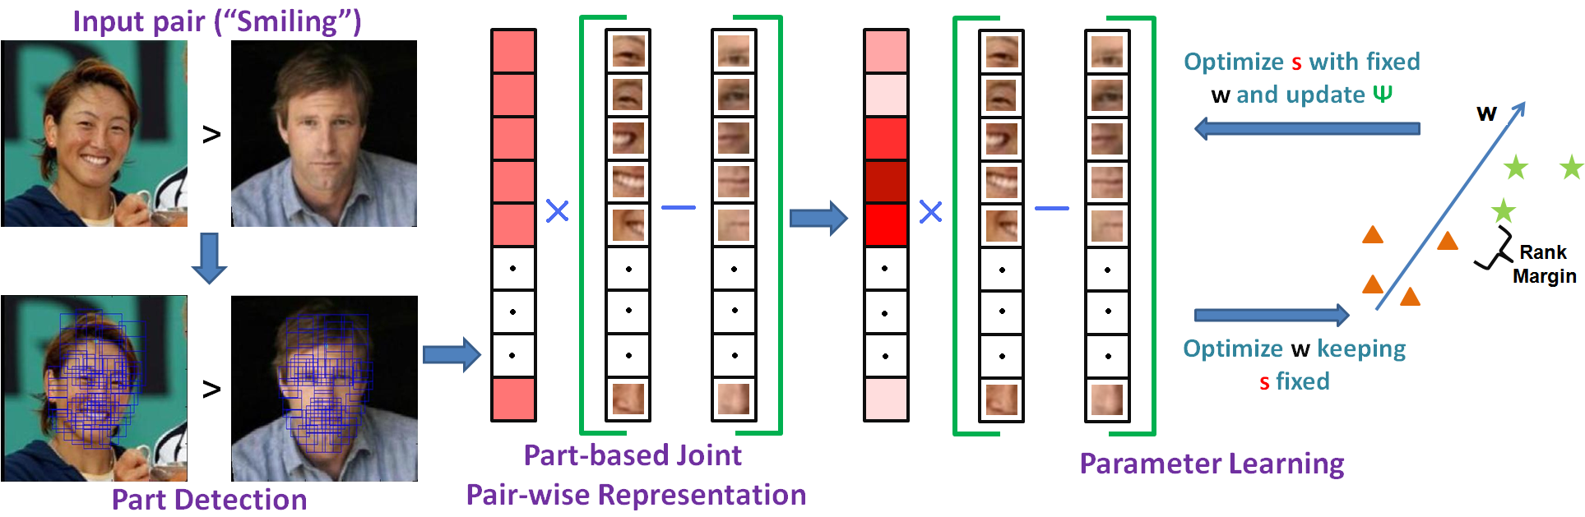
Overview of Our Method

Slide 17
Data Sets and Data Collection
“Pubfig-29” dataset which contains attribute labels for 29 attributes.
“Pubfig-29” contains class specific annotations rather than image level annotations.
We found that image level annotations provide more detailed and accurate information than the class level annotations.
We have collected a new dataset called “LFW-10” which contains attribute labels for 10 different attributes.
Training set contains 500 pairs for each attribute. Testing set contains 500 pairs for each attribute.

Slide 18
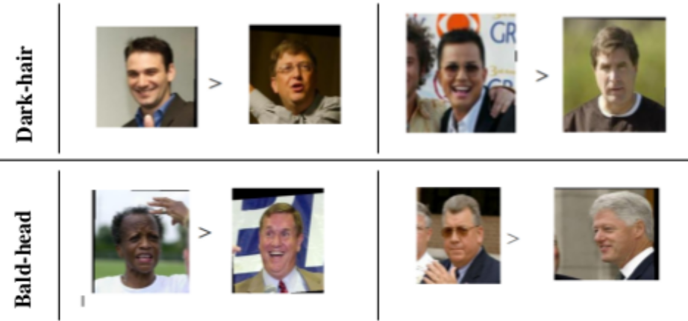
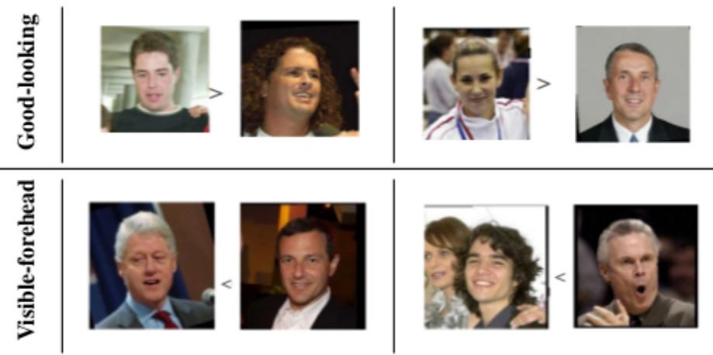
LFW -10 dataset

Slide 19
Learning weights for parts
Learn which parts are more important than the other.
We assign significance coefficients for each part, which tells how significant is that part with respect to other parts in predicting the attribute.

Slide 20
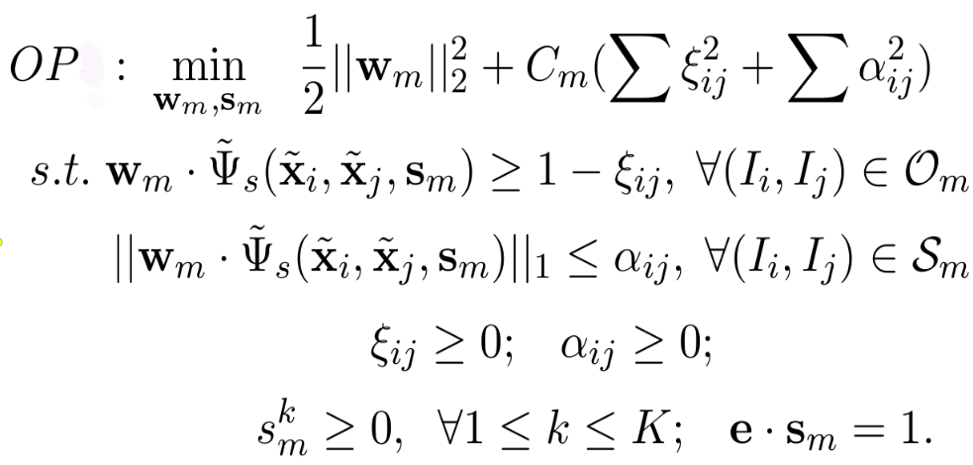
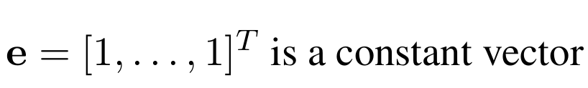
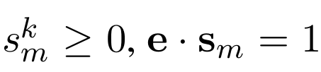
Problem formulation

Slide 21
Solving Optimization Problem
Solved through block co-ordinate descent algorithm.
Consider each set of parameters Wm and Sm as two blocks, and optimize them in an alternate manner.
All entries of Wm are initialized to be zero, and all entries of Sm are initialized to be equal to 1/K. ( K = no of parts)
Alternatively learn the parameters Sm and Wm until accuracy on the validation set stops increasing.

Slide 22
Experiments
We compare our proposed method to the method of Relative Attributes[ ICCV 2011] on LFW dataset under different settings.
Features for parts: we represent a part as BOW histogram over dense SIFT features. We used two different settings for this 1) part specific vocabulary 2) Single vocabulary for all the parts.
Baselines: we compare Ranking SVM method with different features.
1) BOW histogram over 1000 visual words.
2) Global 512 dimensional GIST feature vector over the entire image.
3) Global 512 dimensional GIST and 30 dimensional RGB feature vector over the entire image.
4) Spatial pyramid up to 2 or 3 levels using dense sift + BOW.

Slide 23
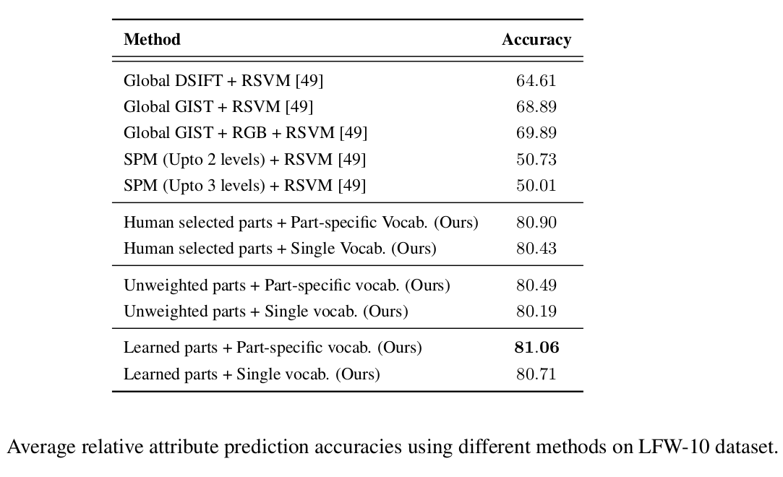
Results

Slide 24
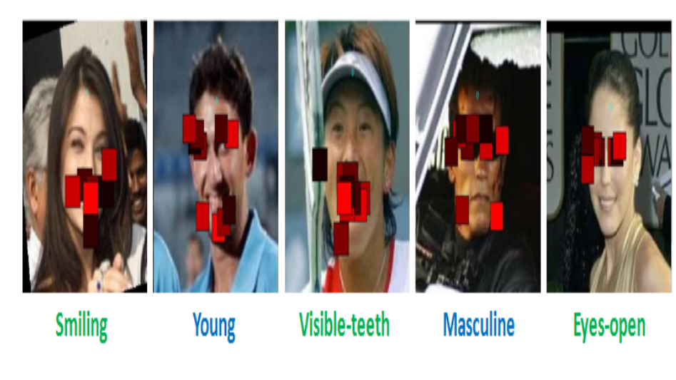
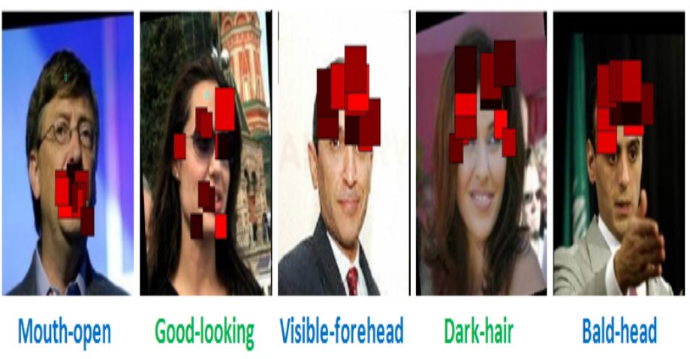
Top 10 parts learned by our method for each attribute

Slide 25
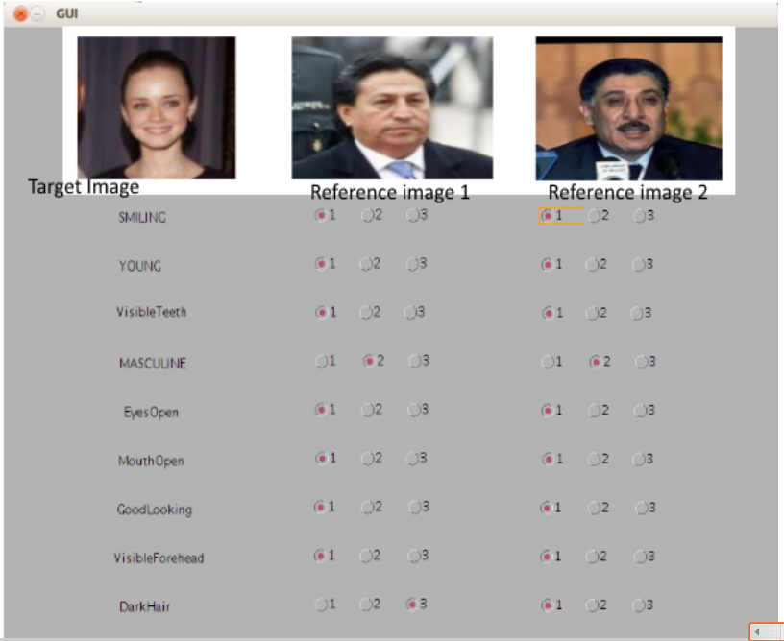
Application to interactive image search
Used to search an image by comparing with other images using relative attribute feedback.
The user can search for a particular image by selecting images from the database and giving feedback

Slide 26
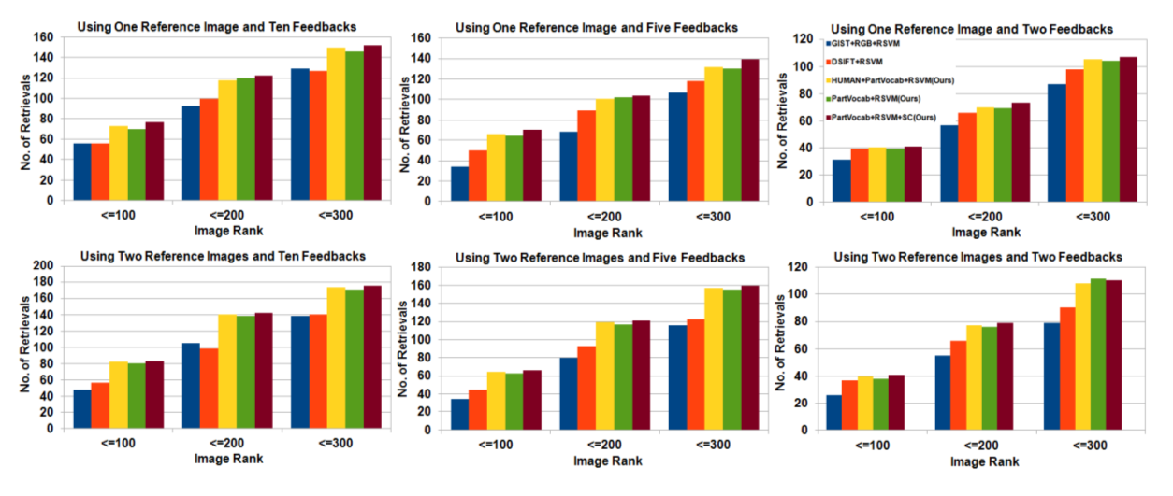
Results for Image search application
Performance variation of different methods on interactive image search with number of reference images and number of feedbacks. Each plot shows the number of searches in which the target image is ranked below a particular rank. Larger is the number of searches falling below a specified rank, better is the accuracy

Slide 27
Relative attributes to relational attributes
Relational Attributes provide a more natural way of comparing two images based on some given attribute than the Relative attribute.
Relational attributes take into account not only the content of the two images but also its relation to the other image pairs. This makes the comparison more robust.
Intuition behind this is when we use difference of features between images the contribution coming from the image pair will not be very significant when compared to contribution coming from all other image pairs.

Slide 28
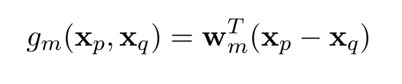
Gaussian process regression
In the method of relative attributes, ranking is based on the image pair. Only the content of two images is taken into consideration.
In our method given two images to rank, we also consider the relationship of this pair with all other pairs using Gaussian process regression.
Gaussian process is a collection of random variables such that each random variable corresponds to a Gaussian distribution.
In our case each random variable is an image pair.

Slide 29
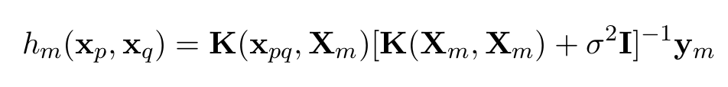
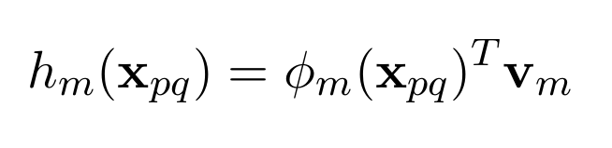
We define a pairwise ranking function as
Where K is predefined kernel that gives a gram matrix.
Xpq ( Xp-Xq) is the difference of features of two images.
The above equation can be written as
Gaussian kernel is used to compute similarity between two images.
Optimized the problem using Newtons method.
Fixed parameter σ = 0.3 and optimize γ using cross validation.

Slide 30
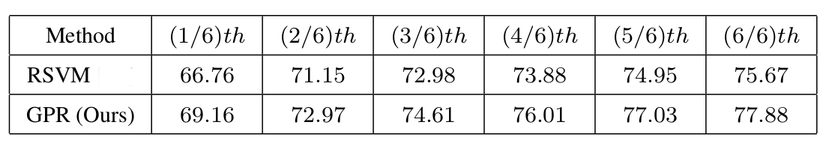
Experiments and results
Dataset : Pub-fig
Training : 3300 pairs, Testing : 1100 pairs.
Five fold cross validation.
Effect of training size on accuracy.
We compare our method with Ranking SVM [Relative Attributes ICCV 2011]

Slide 31
Conclusion
In this thesis, we have explored the problem of Relative attribute Prediction and presented part based solution to solve the problem.
The Part based representation that we have proposed for learning relative attributes gives significant improvement in accuracy over the previous methods.
Apart from the relative attribute prediction, we have shown advantage of our method on Interactive Image search.
Inspired from the success of attributes and relative attributes, we present relational attributes. Despite simplicity of the approach it shows superior results than relative attributes.

Slide 32
References
[1] Relative attributes D.Parikh, K.Grauman ICCV 2011
[2] Relative Parts: Distinctive Parts for Learning Relative Attributes. Ramachandruni N. Sandeep. Yashaswi Verma. C. V. Jawahar. CVPR 2014.
[3] Our Project Page: http://cvit.iiit.ac.in/projects/relativeParts/

Slide 33
Thank you

