Slide 1

Efficient Ray Tracing of Parametric Surfaces for Advanced Effects
Rohit Nigam, P. J. Narayanan
CVIT, IIIT Hyderabad, Hyderabad, India

Slide 2
Ray Tracing
image obtained from
siliconarts.co.kr
Render visually realistic images
Rays start from camera center and move through every pixel
Final color value calculated from intersection with different objects in the scene
High visual realism, but at a much higher computational cost.

Slide 3
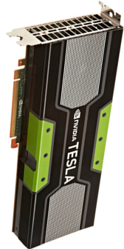
GPU and Hybrid Computing
GPUs are used for many compute intensive problems(GPGPU)
Nvidia GTX 680 has 1536 CUDA cores and can processing power of upto 3.1 TFLOPS.
Processing power of CPU cores have also increased along with their numbers
GPUs are suitable for parallelizable tasks, while CPU works faster for serialized operations.
A hybrid operation uses both GPU and CPU cores to perform compute intensive operations.

Slide 4
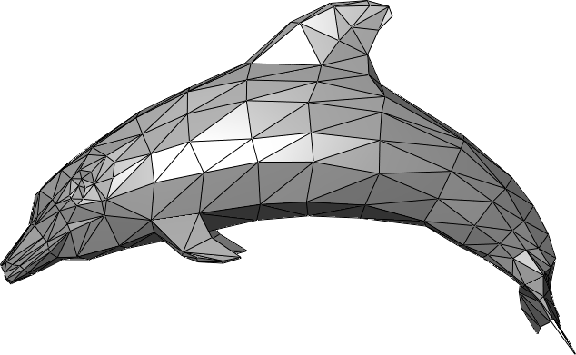
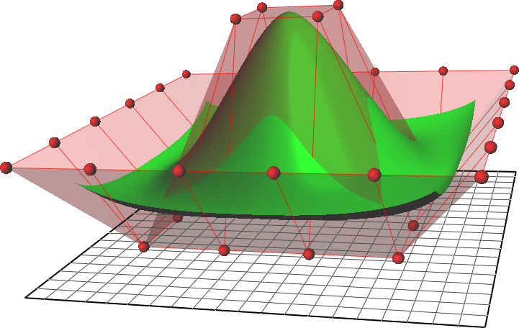
Representing a Scene
f>0
f<0
f=0
Triangular Mesh
Implicit Surface
Parametric Surface

Slide 5
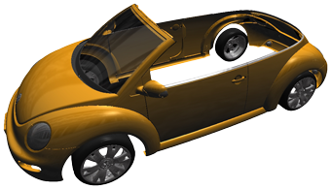
Parametric Surface: Motivation
Provide compact and effective representation.
Remain curved and smooth at arbitrary level of zooming.
Memory efficient, in comparison with triangular mesh.
image obtained from
uni-weimar.de

Slide 6
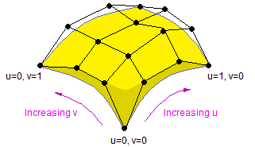
Bezier Surfaces
Most basic form of parametric surfaces
Described as:
Q(u,v) = [U][M][P][M]^{T}[V]^{T}
where [U] = [u³ u² u 1] and [V] = [v³ v² v 1], 0 ≤ u,v ≤ 1
[M] : Bezier Basis Matrix
[P] : set of 16 Control Points defining the patch

Slide 7
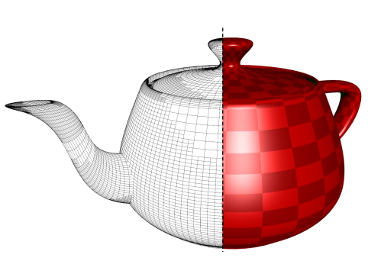
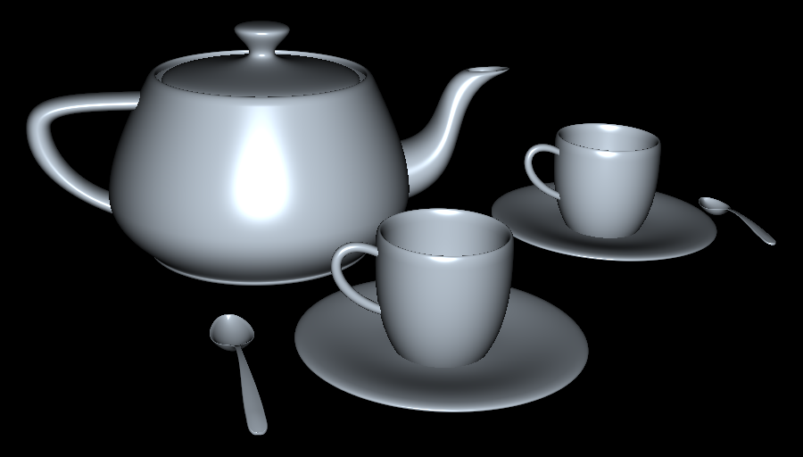
Rendering Bezier Surfaces
Tessellation based approches
Eisenacher et al.(2009) :
View Dependent Adaptive Subdivision
Direct Ray Tracing
Geimer et al.(2005) :
Newton Iteration
Pabst et al.(2006) :
Bezier Clipping + Newton Iteration

Slide 8
Rendering Bezier Surfaces
Kajiya’s Method
Ray represented as two orthogonal planes
Generates an 18 degree polynomial, solved using Laguerre’s method
Lahabar implemented Kajiya’s algorithm on GPU to solve for intersections

Slide 9
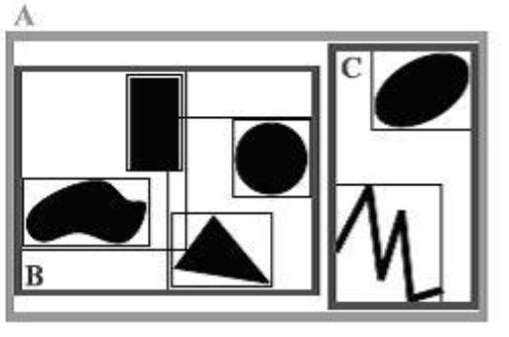
Ray Tracing Bezier Surface
Constructing an Accelaration Structure
Grid
KD-Tree
Bounding Volume Hierarchy(BVH)
image obtained from
uva.onlinejudge.org

Slide 10
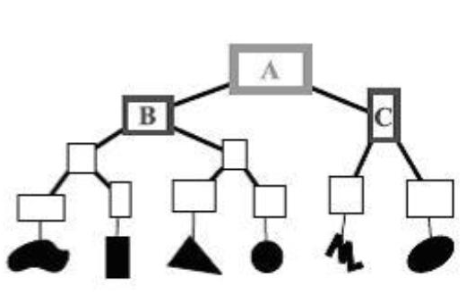
Ray Tracing Bezier Surface
Ray Traversal through BVH
0 | 1 | 2 | 3 | 4 | 5 | 6 | 7 | 8 | 9
Ray List
Outputs
Potential Ray-Patch intersections list
Initial parameter values

Slide 11
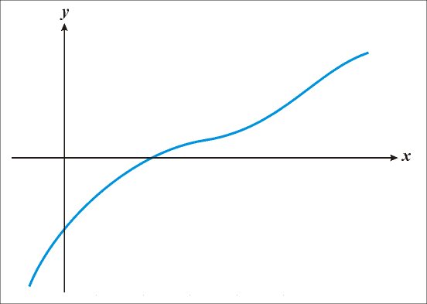

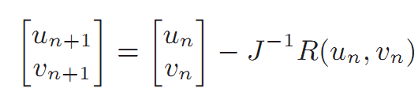
Ray Tracing Bezier Surface
Newton Iteration
Bivariate Newton Iteration
to solve for (u,v)
R is the intersection equation for a ray,
J is the Jacobian matrix of R.
Picture Courtesy : http://steadyserverpages.com

Slide 12
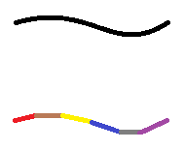
Geimer 2005
Based on the flatness criteria, each patch is divided into subpatches.
BVH for original surfaces
Bounding boxes of subpatches at leaf nodes.
For each potential intersection
Generate initial values for Newton Iteration
Achieve 6.4 fps for 512x512 image.
Original Curve
Subdivided Linear
Curve
1
BVH Nodes
2
3
Patch1
P2
P3
sp1
sp2
sp1
sp2
sp1
sp2
Subpatches at Leaf

Slide 13
Our Approach
Mixed hierarchy: consists of two hierarchical structures.
Top level BVH: Bounding boxes of original patches.
Leaf nodes represent the original Bezier Surfaces.
BVH for
Patches
1
2
3
4
Each Patch is divided into fixed size subpatches, hierarchically, using De Casteljau algorithm.
Subtree for each patch from bounding boxes of the subdivided patches.
Subpatch
Hierarchy

Slide 14
Mixed Hierarchy Advantages
Tighter bounds of subpatch
Eliminates more rays
Better Initialization
Low Additional memory
Intersection performed on original patches.
Better suited for the GPU
Shared memory stores skip pointer and subpatch number.
BVH for
Patches
1
2
3
4
Subpatch
Hierarchy

Slide 15
Mixed Hierarchy Advantages
Discard early in subpatches
Store distance of a hit along the
ray ‘t’
Discard nodes with
high ‘t’ value
Utilize shared memory for ‘t’
We subdivide 6 times.
We discard back-facing patches to reduce the overall list for primary pass
BVH for
Patches
1
2
3
4
Subpatch
Hierarchy

Slide 16
GPU Implementation
A kernel traverses the first level of the BVH.
Atomic operations to provide scalability.
Output: Potential (Ray,Patch) intersections
0 | 1 | 2 | 3 | 4 | 5 | 6 | 7
Ray List
0,1 | 2,2 | 3,6 | 4,3 | 5,7 | 6,1 | 7,3
Potential Ray-Patch
Intersections
Another kernel parallely processes the generated (ray,patch) list.
Tighter subpatch bounding boxes leads to further pruning.
Output:
Reduced potential (Ray,Patch) intersections.
Initial values for each intersection.
0,1 | 2,2 | 4,3 | 5,7 | 7,3
14 | 8 | 7 | 34 | 63
Initial values

Slide 17
GPU Implementation
Newton Iteration
Each Ray-Patch intersection mapped to a thread
Applied till convergence or max iteration
Output: Hit-point and surface normal
Takes 20-30% of the total time
0,1 | 2,2 | 4,3 | 5,7 | 7,3
Potential Intersections
14 | 8 | 7 | 34 | 63
Initial values
H1 | H2 | NH | H3 | H4
Hit Points
N1 | N2 | NH | N3 | N4
Surface Normals

Slide 18
Secondary Rays
Primary rays do not take other surfaces present into consideration
Secondary rays provide more realism to CGI
Secondary ray tracing includes
Shadow
Reflection
Refraction

Slide 19
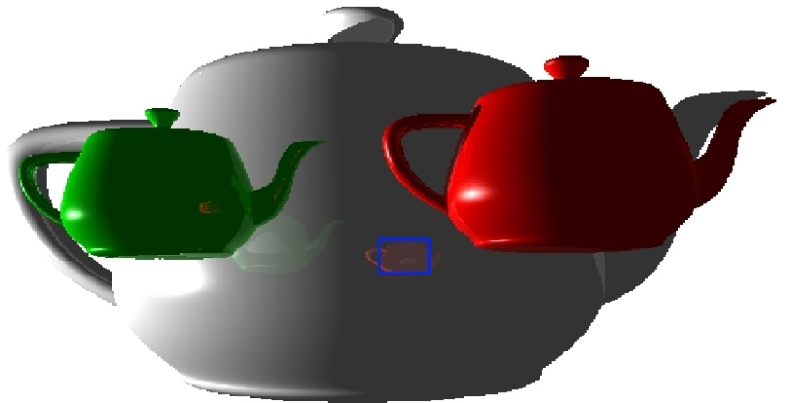
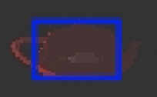
Secondary Rays
Generate direction from hit-point and surface normal.
Generate Ray List.
Apply the same algorithm for secondary Ray List.
Recurse for a fixed depth for reflection/refractions.
H1 | H2 | NH | H3 | H4
N1 | N2 | NH | N3 | N4
0 | 1 | 2 | 3
Secondary Rays
Intersection
Algorithm
C1 | C2 | C3 | C4
Final Color values

Slide 20

Refraction
Occurs when light ray changes direction due to change in medium
Direction of refracted ray computed using Snell’s Law
Each refraction bounce requires 2x normal bounce

Slide 21
Hybrid Ray Tracing
Generate Rays
GPU
CPU
0 | 1 | 2 | 3 | 4 | 5 | 6 | 7
Ray List
0 | 1 | 2 | 3 | 4 | 5
GPU
CPU
6 | 7
rayTraceGPU
rayTraceCPU
Hit Point
Surface Normal
H1 | H2 | NH | H3
H4
N1 | N2 | NH | N3
N4
Secondary Ray List
0 | 1 | 2 | 3

Slide 22
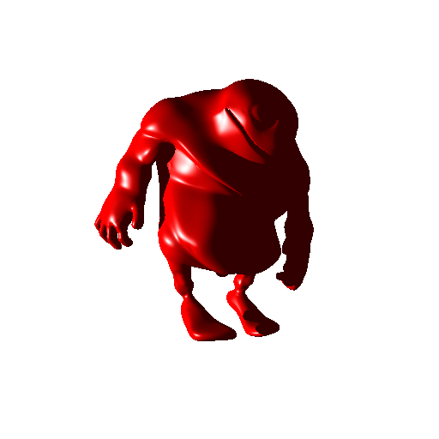
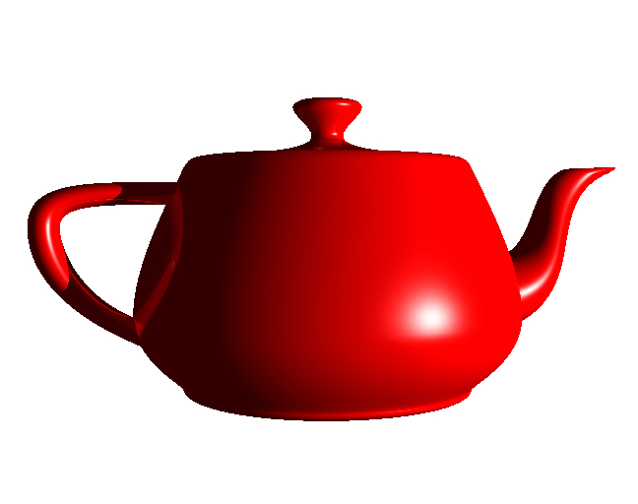
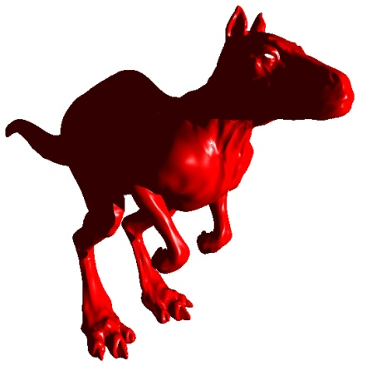
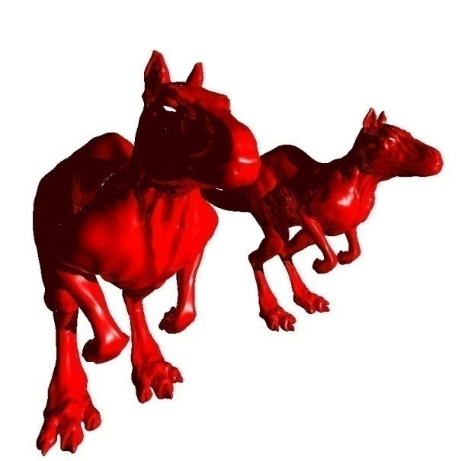
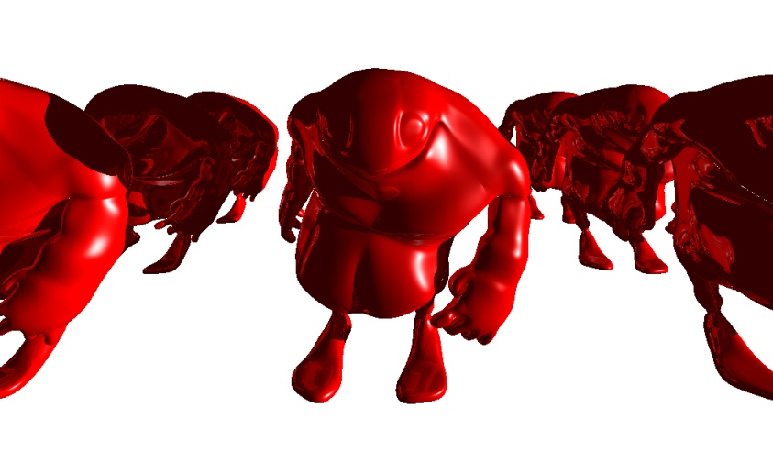
Results
Teapot Model
Fps : 64(115)*
Bigguy Model
Fps : 28.6(68.5)
Killeroo Model
Fps : 19.2(44.7)
System Specs
GTX 580 + i7 920
1024x1024
Primary + Shadow
+ Reflection
2 Killeroos
Fps : 10.6(23)
9 Bigguys
Fps : 5.2(13)
* : Figure in bracket gives Primary fps

Slide 23
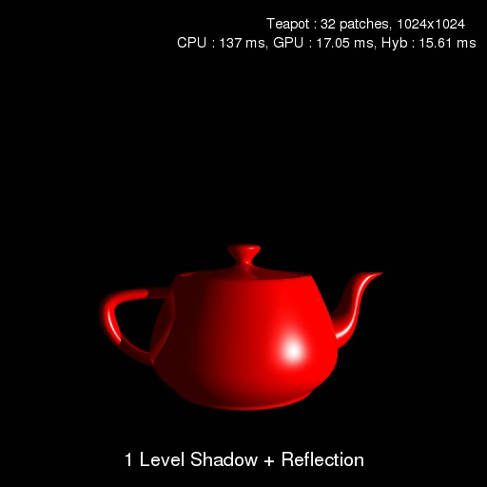
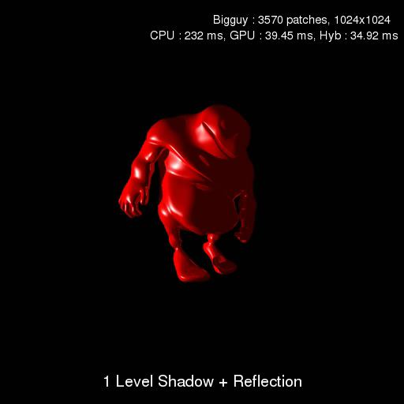
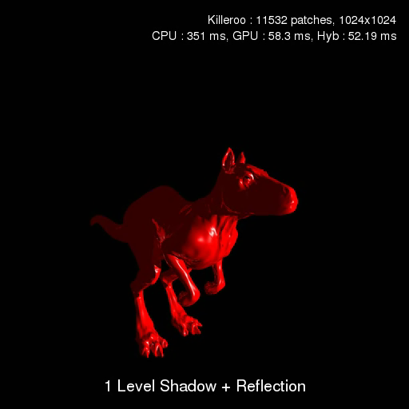
Results (Primary+Secondary)
Model | Patches | Total Frame Time(ms)
 |  | CPU | GPU | Hybrid
Teapot | 32 | 137 | 17.05 | 15.61
Bigguy | 3570 | 232 | 39.45 | 34.92
Killeroo | 11532 | 351 | 58.3 | 52.19
2 Killeroos | 23064 | 726 | 106.03 | 94.55
9 Bigguys | 32130 | 3107 | 196.79 | 191.81

Slide 24
Results
Model | Pure GPU GTX 580 (ms) | Pure GPU Tesla K20c (ms) | Multi-GPU GTX 580 + C2050 (ms)
Teapot | 8.71 | 5.42 | 5.63
Bigguy | 14.59 | 10.61 | 9.84
Killeroo | 22.38 | 17.85 | 15.69
2 Killeroos | 42.29 | 34.19 | 28.75
9 Bigguys | 77.05 | 58.92 | 51.12
Rendering time comparison of Multi-GPU (GTX 580 + C2050) against
Pure GPU (GTX 580) for different models

Slide 25
Comparison
We achieve about 15.4 fps on an Intel Core 2 duo 2.20 Ghz system for teapot scene with 512×512 resolution in comparison to Geimer, who got 6.1 fps on a dual processor PowerMac G5 2GHz processor.
Model | Kajiya (ms) | Improved Kajiya (ms) | Newton (ms)
Teapot | 71 | 12.59 | 1.62
Bigguy | 147 | 18.57 | 4.43
Killeroo | 164 | 21.26 | 6.76
Comparison of different methods, Kajiya’s Method implementation on GPU by
Lahabar, Improved Kajiya’s method by us and Newton Iteration. All the
results are taken on GTX 480 for same screen coverage and screen resolution 512 × 512.

Slide 26
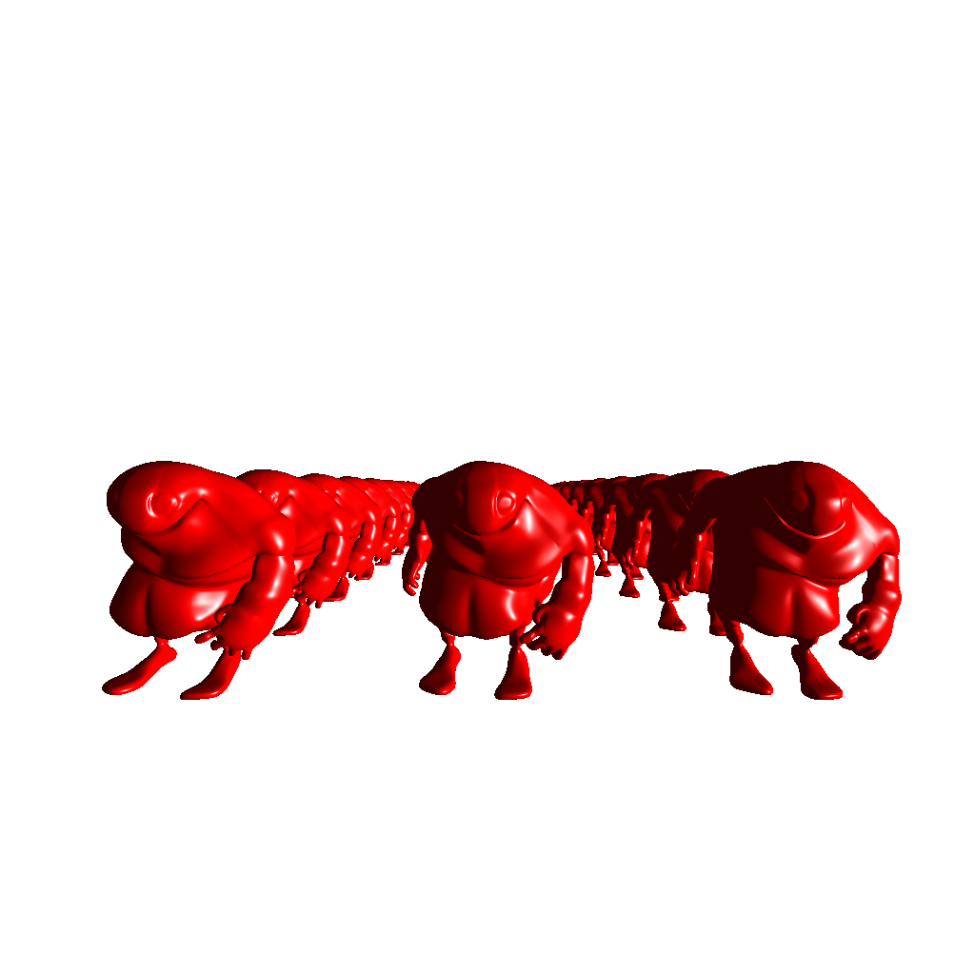
Rendering in parts
24 Bigguys rendered at 12 fps
for 512x512 resolution on Nvidia GTX 580

Slide 27
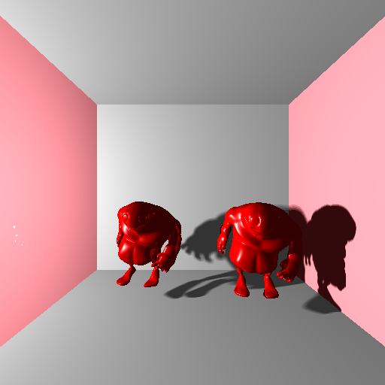
Box Scene
Bigguys in a box scene with soft shadows, 16 light sources,
rendered at 512 × 512 resolution in 158.8 ms on GTX 580

Slide 28
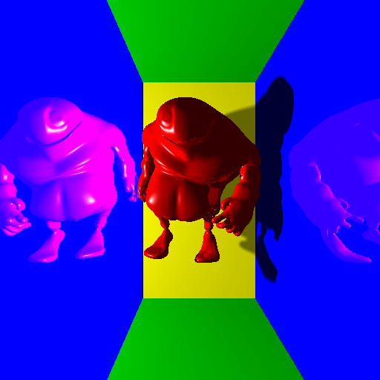
Soft Shadows
Bigguy in a box scene with soft shadows, reflection, 16 light sources,
rendered at 512 × 512 resolution in 167.4 ms on GTX 580

Slide 29
Path Tracing
We extend our ray tracing approach to Global Illumination effects.
We use Cook’s approach
Monte Carlo based Stochastic Sampling
Sample image at appropriate non-uniformly spaced points.
Each pixel sampled for a user defined samples per pixel
-0.5,-0.5
0.5,0.5

Slide 30
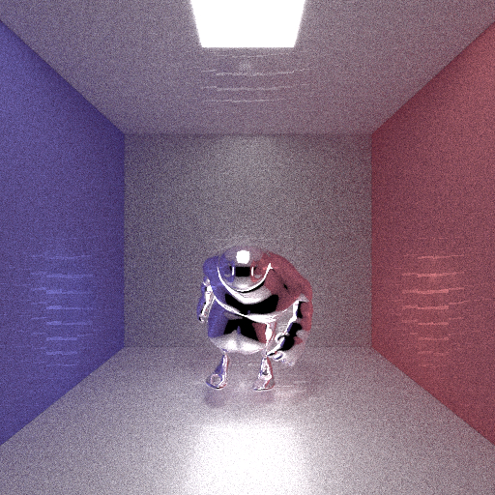
Path Tracing
Bigguy in a box: 400 spp, 512x512 resolution
Rendered in 75 secs

Slide 31

Path Tracing
Bigguy in a box: 1000 spp, 512x512 resolution
Rendered in 165 secs

Slide 32

Path Tracing
Bigguy in a box: 2000 spp, 512x512 resolution
Rendered in 323 secs

Slide 33
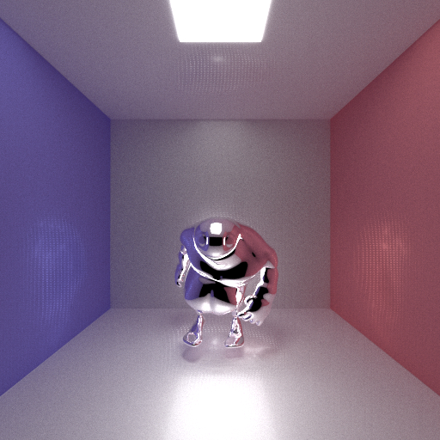
Path Tracing
Bigguy in a box: 5000 spp, 512x512 resolution
Rendered in 14.4 mins

Slide 34

Path Tracing
Bigguy in a box: 10000 spp, 512x512 resolution
Rendered in 28.5 mins

Slide 35

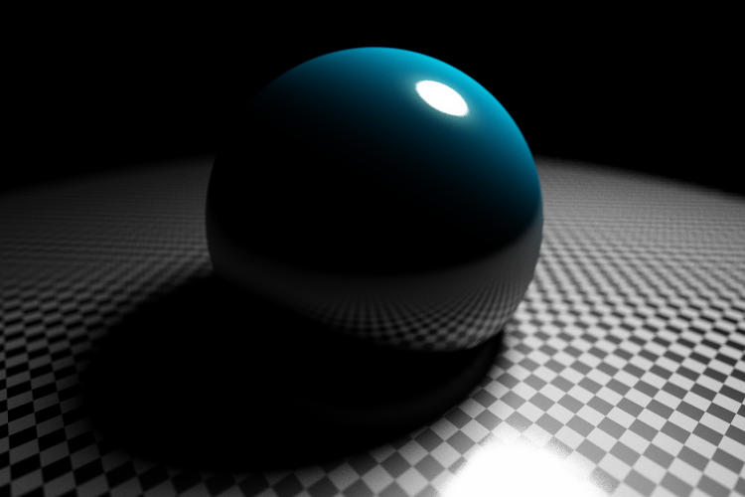
Advance Effects
Apply advanced effects like ambient occlusion, depth of field etc. for Bezier surface
Render advanced effects using mixed hierarchy algorithm
First implementation to render Bezier patches with advanced effects

Slide 36

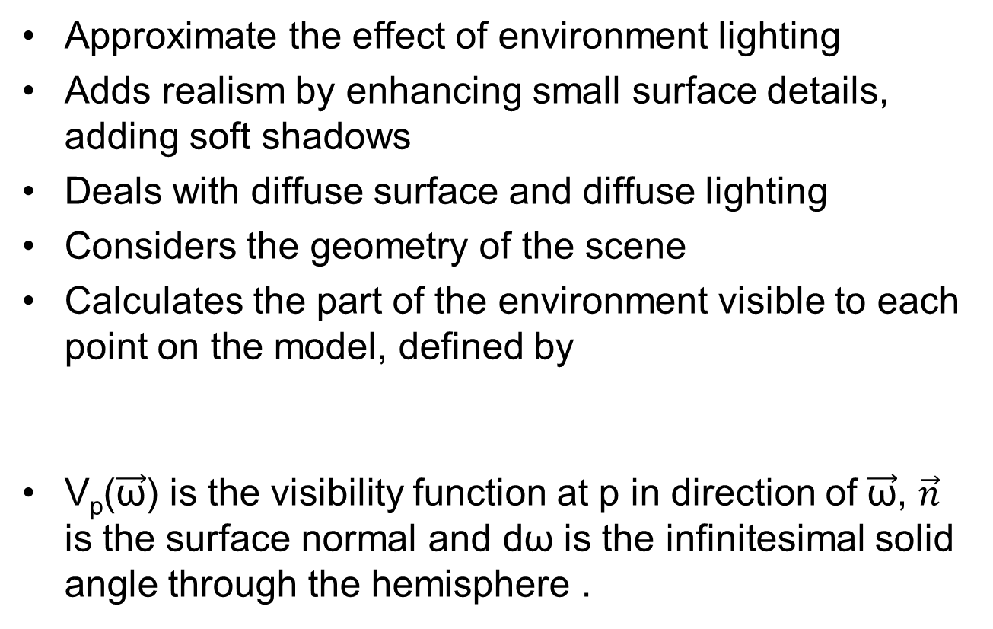
Ambient Occlusion
Approximate the effect of environment lighting
Adds realism by enhancing small surface details, adding soft shadows
Deals with diffuse surface and diffuse lighting
Considers the geometry of the scene
Calculates the part of the environment visible to each point on the model, defined by
V_{p}($\vec{\text{ω}}$) is the visibility function at p in direction of $\vec{\text{ω}}$, $\vec{n}$ is the surface normal and dω is the infinitesimal solid angle through the hemisphere .

Slide 37
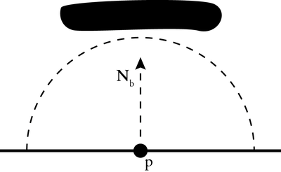
Ambient Occlusion
GPU Algorithm
First pass consists of primary rays
Generates primary intersection points
Shoot a fixed amount of rays, in random directions passing through the hemisphere centered around surface normal, away from surface
Generates a massively large ray list
Ray list is divided into chunks, to be processed parallely on the GPU
To optimize further, each chunk can be categorized by direction, point of origin to provide more coherence for GPU architecture.

Slide 38
Results
Model | Samples per pixel | No of rays | Time (ms) | Time per ray (μs)
Bigguy | 1024 | 70908475 | 7954.6 | 0.112
Killeroo | 1024 | 96016875 | 14019.4 | 0.146
2 Killeroos | 64 | 12303395 | 2299.8 | 0.187
2 Killeroos | 1024 | 194015075 | 33069.7 | 0.170
9 Bigguys | 64 | 17386330 | 4537.7 | 0.261
9 Bigguys | 1024 | 274169050 | 65472.2 | 0.239

Slide 39
Results
2 Killeroos: 1024 spp, 1024x1024 resolution
Rendered in 33 seconds

Slide 40
Results
9 Bigguys: 1024 spp, 1024x1024 resolution
Rendered in 65 seconds

Slide 41
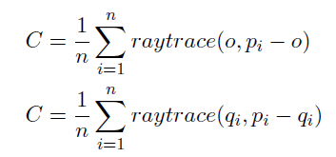
Depth of Field
Range of distance in focus of the camera
Objects to the front or back of this range appear out of focus.
Depth of Field increases the realism in an image.
We shoot rays from a circle, called Circle of Confusion(CoC) centered around origin
Ray Tracing
Depth of Field
Here, n is number of rays, o is origin, p_{i} is point on image plane, q_{i} is point on circle of confusion

Slide 42
Results
Model | Focus | CoC | Time (ms) | Time per ray (μs)
 | Far | 0.8 | 193 | 0.736
Bigguy | Near | 0.8 | 193 | 0.736
 | Near | 0.2 | 192 | 0.733
 | Far | 0.8 | 273.5 | 1.043
2 Bigguys | Near | 0.8 | 272.5 | 1.04
 | Near | 0.2 | 271 | 1.034

Slide 43
Results

Slide 44

Motion Blur
Dynamic scenes are produced by a sequence of still images
Motion blur is produced by motion of object during the time camera shutter is open
To generate motion blur, the scene needs to be sampled temporally also
Distribute the rays both spatially as well as temporally

Slide 45
Results
Image rendered at 512 x 512 resolution,
for 10 time steps, one ray per time step, in 115 ms.

Slide 46

Gloss
Objects not purely specular
Simulated by distributing rays around the reflection direction
Reflected ray direction calculated as
R is reflection direction, s is glossiness index, u and v are orthogonal to R, p,q are random numbers in [-1, 1]
Can model different surfaces by using BRDF.
R
Incident Ray
PoC

Slide 47
Results
No of Rays | Rays per hit | Gloss | Time (ms) | Time per ray (μs)
270768585 | 4 | Low | 244.7 | 0.904
270768585 | 4 | Med | 248.9 | 0.919
270768585 | 4 | High | 252.1 | 0.931
990607950 | 16 | Med | 792.6 | 0.8
Gloss: Low
Gloss: Med
Gloss: High

Slide 48
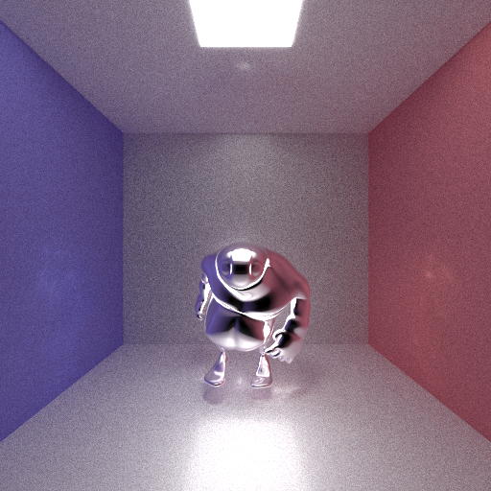
Results
Glossy reflections using 1000 samples per pixel and 16 reflection rays
for each intersection, rendered at 512 × 512 resolution with 0.4 as s value

Slide 49
Conclusions
A mixed hierarchy model is proposed to speed up Ray Tracing process.
GPU benefits greatly from fixed depth subtree.
A hybrid model is proposed, to fully utilize compute power of CPU and GPU.
We demonstrate the capability of our method by producing Global Illumination effects for Bezier patches.

Slide 50
Future Work
Work can be extended to higher order parametric surfaces like NURBS
KD-Trees as the top level hierarchy tree, could prove beneficial, especially for static scenes
Rearrangement of rays, in order to generate more coherence and hence greater speed-ups on the GPU
Our algorithm can be extended to faster and complex global illumination methods like photon mapping, bidirectional path tracing etc.

Slide 51
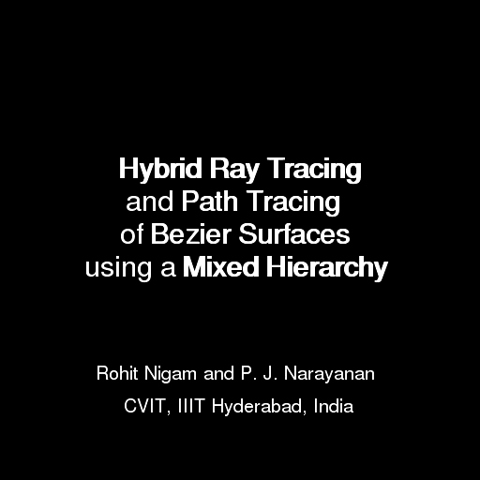
Thank you

Slide 52
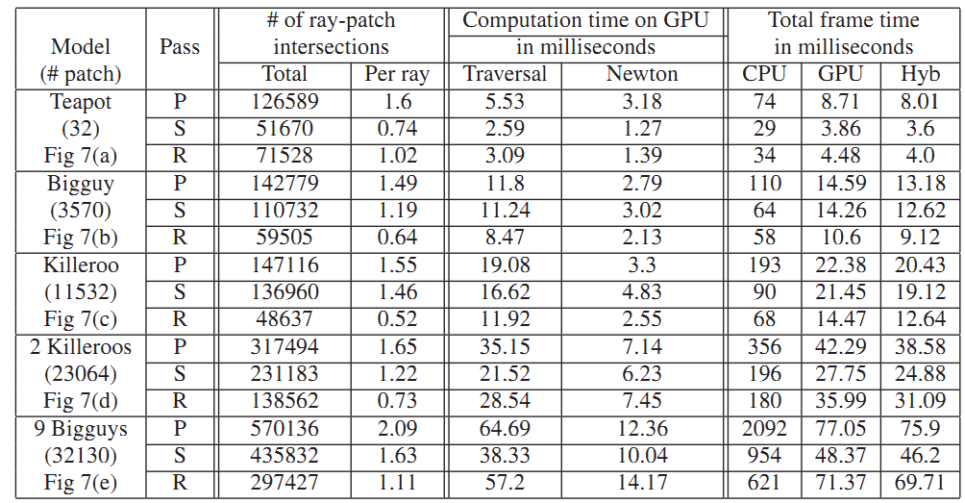
Results
Intel i7 920 + Nvidia GT X580; 1024x1024

