Slide 1


Thesis Defense
Skyline Segmentation using Shape-constrained MRFs
Rashmi Vilas Tonge
Roll No - 200902022
MS by Research, CSE
Advisors : Prof. C. V. Jawahar

Slide 2
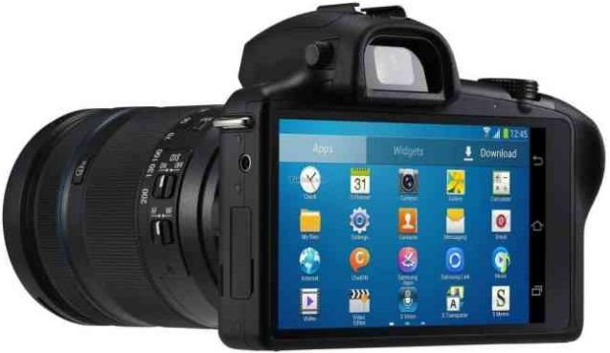
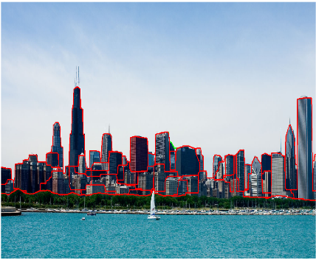
Motivation
Skylines are of great interests among photographers
Interesting applications –
1. 3D Rendering
2. Information overlays
3. Creation of virtual cities
4. Geo-location, etc.

Slide 3
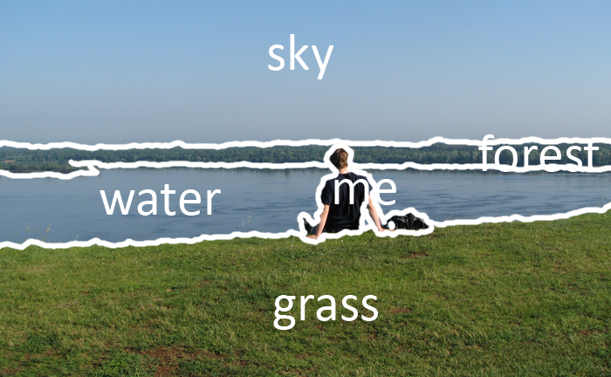
Motivation – Semantic Segmentation
Assign pixels to meaningful labels
Generally, labels are limited, e.g. sky, water, grass, etc.
We aim to extract meaningful labels (buildings) in a setting with unlimited labels

Slide 4

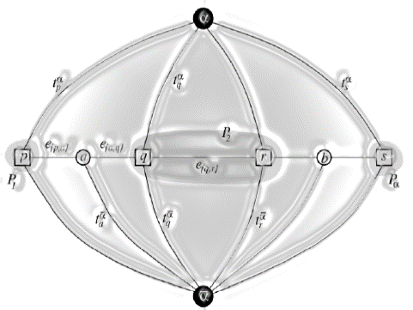
Motivation – Standard MRF
Global minimization is an NP-Hard problem
State-of-the-art Greedy approximation algorithms
α-expansion and αβ-swap moves
Graph Cut to solve the restricted energy formulation

Slide 5
Motivation – Standard MRF
Slow for high resolution images
Incorporating shape priors and higher order priors becomes complex
Only pixel-wise classification is not enough!

Slide 6
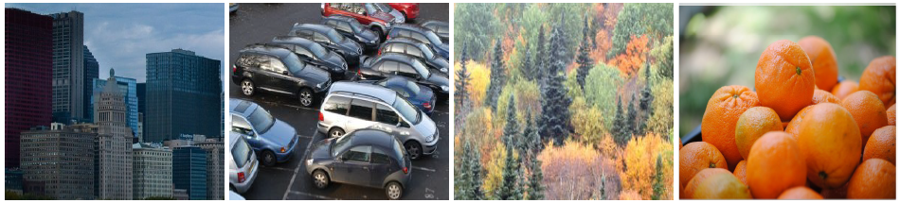
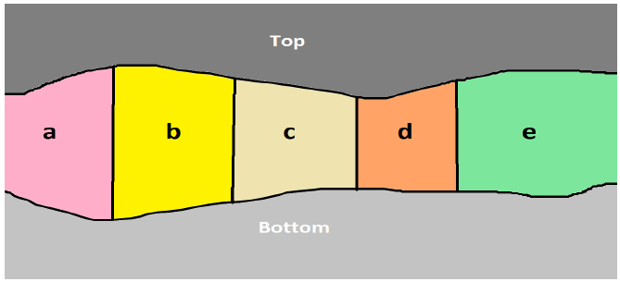
Motivation – Tiered Labelling
Lot of tiered structures in day-to-day scenario
Dynamic programming approach
Structural restrictions
Complexity scales exponentially with number of labels
Cannot incorporate higher order priors such as shape, aspect ratio

Slide 7
We propose MRF based solution to extract buildings from a skyline
Exploit tiered structure of the buildings in a skyline
Incorporate higher order priors such as shape, aspect ratio, etc.
Semantic labelling with no restrictions on number of labels, i.e. not just pixel-wise classification
Relative depth information and occlusion patterns
Fast and robust approach
Motivation

Slide 8

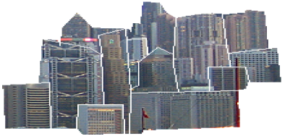
Challenges
Complex Occlusion Patterns
Intra-building Variations
Reflections
Different Viewpoints
Large number of labels

Slide 9
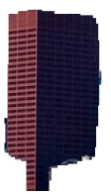
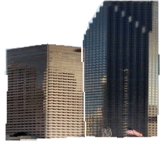
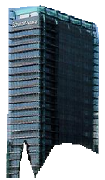
Challenges
Complex Occlusion Patterns
Intra-building Variations
Reflections
Different Viewpoints
Large number of labels

Slide 10
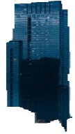
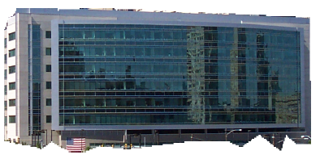
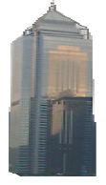
Challenges
Complex Occlusion Patterns
Intra-building Variations
Reflections
Different Viewpoints
Large number of labels

Slide 11
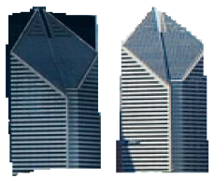
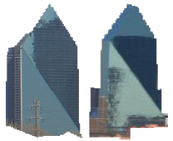
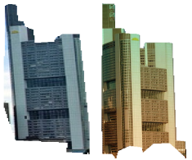
Challenges
Complex Occlusion Patterns
Intra-building Variations
Reflections
Different Viewpoints
Large number of labels

Slide 12

Challenges
Complex Occlusion Patterns
Intra-building Variations
Reflections
Different Viewpoints
Large number of labels

Slide 13
Contribution
We introduce a dataset of skylines – skyline-12
Analysis and integration of low-level features
Fast, accurate and robust method to extract individual buildings of a skyline
Exploit tiered structure of skylines and incorporating rectangular shape prior into MRF formulation
Both interactive and automatic settings

Slide 14
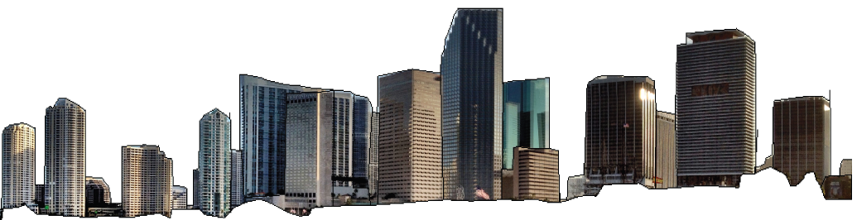

Skyline-12 Dataset
120 images of skylines from 12 cities all around the world

Slide 15
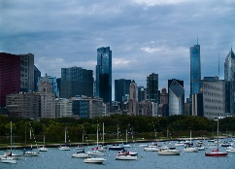

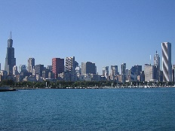
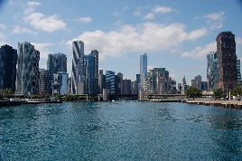

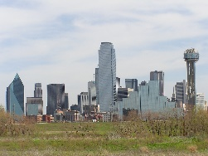
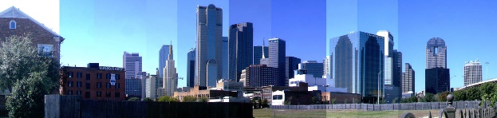
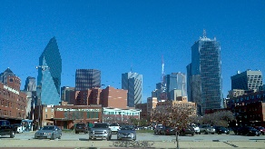
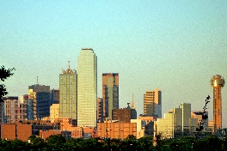
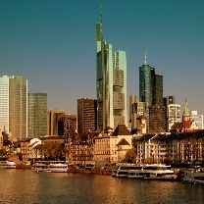
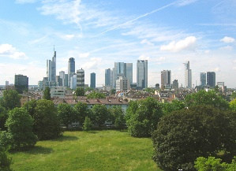
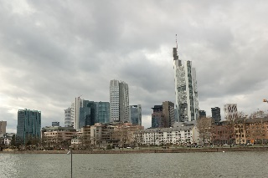
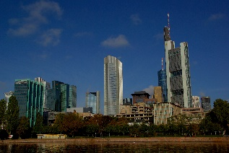
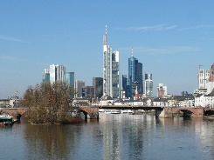
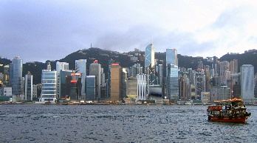
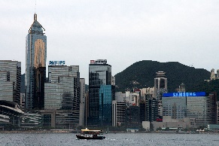
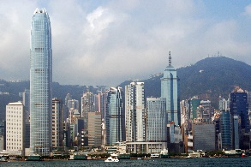
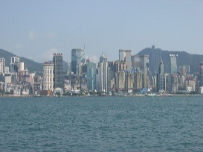
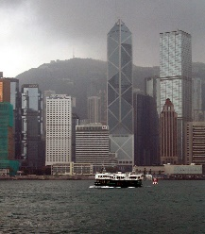
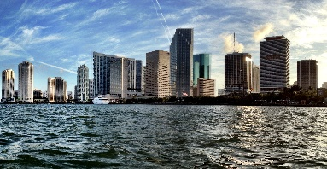
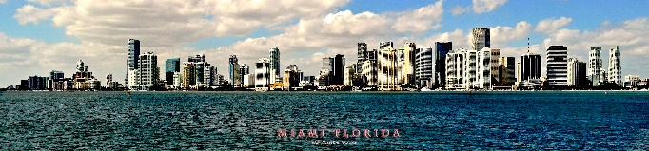
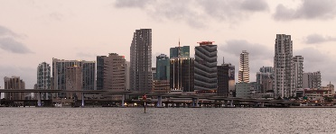
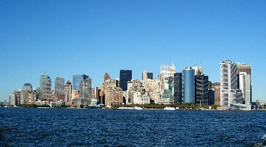
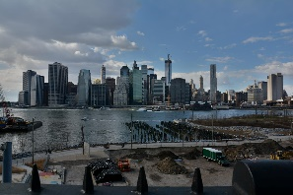
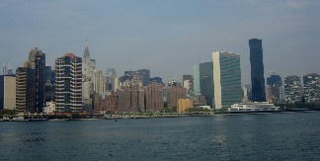
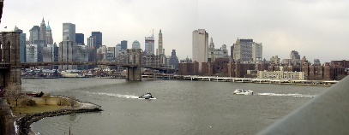
Skyline-12 Dataset
Chicago
Dallas
Frankfurt
Hong Kong
Miami
New York

Slide 16
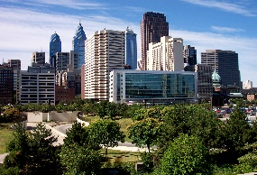
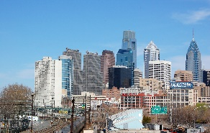
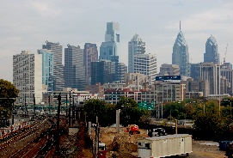
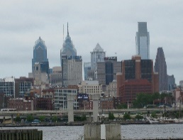
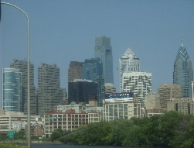
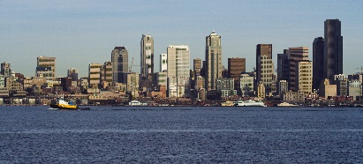
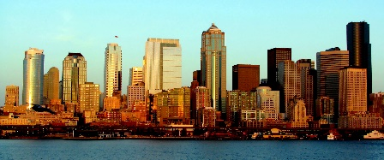
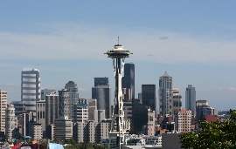
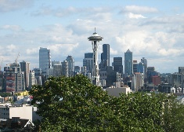















Skyline-12 Dataset
Philadelphia
Seattle
Shanghai
Singapore
Tokyo
Toronto

Slide 17
Skyline-12 Dataset
Annotations consisting Ground Truth label matrix, Input seeds as well as, Initial upper and lower boundaries

Slide 18

Skyline-12 Dataset : Annotations
Upper and lower boundaries, input seeds
Ground Truth Labels

Slide 19
Skyline-12 Dataset
Images from each city are randomly split into train-val-test in 3-3-4 images

Slide 20

Skyline-12 Dataset
All images downloaded from
All images are taken at various times of a day
Dense and complex occlusion patterns
On average 35 buildings
All images high resolution
On average 2500x1500

Slide 21


Evaluation Measure for Interactive Setting
Mapping known through seeds
Intersection of regions divided by their unions
Mean Average Overlap (MAO)

Slide 22



Evaluation Measure for Automatic Setting
Mapping between regions unknown
Matching giving highest intersection by union,
Hungarian Matching Algorithm to get the optimal matching

Slide 23

Interactive Segmentation
Find Labelling F that minimizes E(F)
Pairwise Potential / Smoothness Term
Unary Potential / Data Term
Disagreement between labelling and observed data
Various features such as color, texture and spatial distance are used

Slide 24




Region Representation
Color
Spatial Distance
Image
Compute SLIC superpixels
Unary Term
Seeds
Texture
Assign each pixel to a Texton and Compute Histograms

Slide 25

Color Modelling
Using Gaussian Mixture Models (GMMs) for each building (label)

Slide 26

Color Modelling
Using Gaussian Mixture Models (GMMs) for each building (label)

Slide 27
Color Modelling
Using Gaussian Mixture Models (GMMs) for each building (label)

Slide 28
Color Modelling
Using Gaussian Mixture Models (GMMs) for each building (label)

Slide 29
Texture Modelling
Texture represented using filter responses of various orientations and spatial frequencies
Unit of Texture – “Textons”
Two Steps –
  (Offline)Training Textons on Training Dataset
  (Online)Using pre-trained Textons to compute Texture Contribution

Slide 30

Training Textons
Step 1 : Each image in the Training set is convoluted with a filter bank to get a vector of filter responses to every pixel

Slide 31
Training Textons
Step 2 : The vectors of filter responses are clustered using k-means. Centers of these clusters are Textons

Slide 32

Texture Modelling
Each pixel is assigned to one of the pre-trained textons only once
To compute texture similarity, windowed histograms are compared

Slide 33

Texture Modelling
Window is defined by a disk of radius tr
Then, the histogram is computed as -

Slide 34


Texture Modelling
Similarity between histograms at two different pixels is computed as -

Slide 35


Spatial Distance
Rectangular shape to extract more information
Horizontal spatial distance -

Slide 36
Construction of Unary Potential
Unary Potential as a function of color, texture and spatial distance
Contribution of color, texture and spatial distance is varied using parameters α and β
After cross-validation, α = 0.35 and β = 0.2
Description | MAO
Color + Texture + Spatial | 53.4%
w/o color | 50.3%
w/o texture | 37.2%
w/o spatial distance | 33.1%
Texture and Shape information important!

Slide 37

Region Representation

Slide 38

Standard MRF
Standard approach to solve multi-label MRF
Faster than αβ-swap
In each iteration a label α is picked and binary segmentation problem is formulated by replacing all other labels to background
Cons –
As background labels at the foreground pixels are unknown, only expansion moves are allowed
Graph cut is a slow algorithm, O(m³n³ )

Slide 39

Interactive Skyline Segmentation
Due to unique tiered structure of the skylines, background labels can be deduced
Replace search over binary segmentations by search over a parametric shape family
Tiered structure provides a natural order in buildings according to depth

Slide 40







α
Foreground Label
Induced Background Labels
Find Upper Boundary
Greedy Skyline Segmentation Algorithm
Find the best rectangle.
Hybrid Approach
Dynamic Programming
Rectangle MRF
Refined MRF
Tiered MRF
Update Lower Labels
Update Lower Boundary

Slide 41


Slide 42

Rectangle MRF
Constrain buildings to be exactly rectangular
Search for the best rectangle
Sum of unary and pairwise potential inside each rectangle O(1) using integral images
Complexity :
O(mn²)

Slide 43

Rectangle MRF
Constrains on the rectangular shape prior –
1. L ≤ T ≤ U
2. should enclose seed pixels
3. We can constrain aspect ratio to desired range
4. can enforce width and height constrains learned on training data
5. can limit number of rectangles searched

Slide 44


Tiered MRF
u_{j}
Accurately estimate the upper boundary
Restrict upper boundary to be x-monotonic
Optimal solution can be found using simple extension of dynamic programming
u_{j-1}
k
i
l_{j}
l_{j-1}
i |
Sum of unary potential in column j

Slide 45

Tiered MRF
u_{j}
Accurately estimate the upper boundary
Restrict upper boundary to be x-monotonic
Optimal solution can be found using simple extension of dynamic programming
u_{j-1}
k
i
l_{j}
l_{j-1}
i |
Sum of horizontal smoothness term

Slide 46

Tiered MRF
u_{j}
Accurately estimate the upper boundary
Restrict upper boundary to be x-monotonic
Optimal solution can be found using simple extension of dynamic programming
u_{j-1}
k
i
l_{j}
l_{j-1}
i |
Vertical Smoothness Term

Slide 47
Tiered MRF
u_{j}
Accurately estimate the upper boundary
Restrict upper boundary to be x-monotonic
Optimal solution can be found using simple extension of dynamic programming
u_{j-1}
k
i
l_{j}
l_{j-1}
i |
Forces path to be smoother, i.e. avoids sharp edges

Slide 48

Tiered MRF
U and X are pre-computed using cumulative sums
Complexity –
Does not take shape into account
O(m²n)

Slide 49

Refined MRF
Hybrid Approach
Left and right boundaries constrained to be rectangular
Upper boundary refined to be exact

Slide 50
Interactive Segmentation Results
Method | MAO | Complexity per iteration | Speed per image
Unary only | 54.5% | n/a | n/a
Standard MRF | 62.3% | O(m³n³) | 69.5 s
Tiered MRF | 59.4% | O(m²n) | 7.5 s
Rectangle MRF | 62.0% | O(mn²) | 5.5. s
Refined MRF | 63.4% | O(mn² + m²d) | 9.2 s
Rectangle MRF - 15 times speedup over standard MRF for comparable accuracy
Refined MRF – More accurate and much faster than Standard MRF

Slide 51





Interactive Segmentation Results
Image
Ground Truth
Tiered MRF
Rectangle MRF
Refined MRF

Slide 52


Refined MRF Vs Standard MRF

Slide 53

Refined MRF Vs Standard MRF
Tiered/ Rectangle/ Refined MRF cannot segment concave buildings

Slide 54


Refined MRF Vs Tiered MRF

Slide 55

Refined MRF Vs Tiered MRF

Slide 56
Unsupervised Segmentation
Many low level automatic methods for unsupervised segmentations, For example –
1. SLIC
2. Graph Based Segmentation
3. gPb Detector

Slide 57
Unsupervised Segmentation
Gives coarse, not contiguous segmentations
Does not have Semantic Understanding
None of these methods explicitly consider shape priors
We start with output of one of these methods and improve upon the output using shape priors

Slide 58



Automatic Approach for Skyline Segmentation
1. Initial Segmentation
2. Partition skyline into N vertical divisions of same size
3. Largest K segments are selected from each division
In all experiments, we set N = 20 and K = 2.
The number of pixels within the segments are used as seeds for the interactive methods.

Slide 59
Automatic Approach for Skyline Segmentation
Method | SLIC | Graph Based | gPb
Initial | 24.56% | 20.17% | 26.35%
Tiered MRF | 27.22% | 25.86% | 31.51%
Rectangle MRF | 27.33% | 27.87% | 32.79%
Refined MRF | 27.30% | 27.42% | 33.13%
40% improvement
25% improvement
Few images show as much as 60% improvement over baseline!

Slide 60



Automatic Skyline Segmentation
Rectangle MRF
Refined MRF

Slide 61
Challenges in Automatic Segmentation
Exact number of labels unknown
Outputs of the baseline methods give salt and pepper noise
(Solution – Connected Component Analysis)
Intra-building variation and subsequent choice of incorrect seeds

Slide 62

Geometric Context for Initial Boundaries
Boundary | Upper Boundary | Lower Boundary
K=0.5% | 41.7% | 14.4%
K=1% | 57.5% | 22.9%
K=3% | 70.0% | 44.5%
K=5% | 74.0% | 59.2%
K=10% | 80.0% | 79.2%

Slide 63

Beyond Rectangles and Skylines
For more complex shapes, more than O(1) is required to compute the sums
Unpredictable occlusion patterns
Trees, oranges cannot be differentiated with color and texture

Slide 64

Triangle MRF
Triangular Integral image – represent each triangle as two right angled triangles
Search over triangular parametric shape family

Slide 65
We propose MRF based solution to extract buildings from a skyline
Exploit tiered structure of the buildings in a skyline
Incorporate higher order priors such as shape, aspect ratio, etc.
Relative depth information and occlusion patterns
Fast and robust interactive and automatic approach
A Skyline-12 dataset of 120 annotated skylines
Conclusion

Slide 66
Future Work
Extent method to generalized shapes
Shape matching and shape library
Library of buildings
Depth info and segmentation output for 3D rendering

Slide 67


Slide 68


