Slide 1
Automatic Analysis of Cricket And Soccer Broadcast Videos
Rahul Anand Sharma
201203002
Advisor: Prof. C. V. Jawahar & Dr. Vineet Gandhi
Center for Visual Information Technology,
IIIT-Hyderabad, India

Slide 2
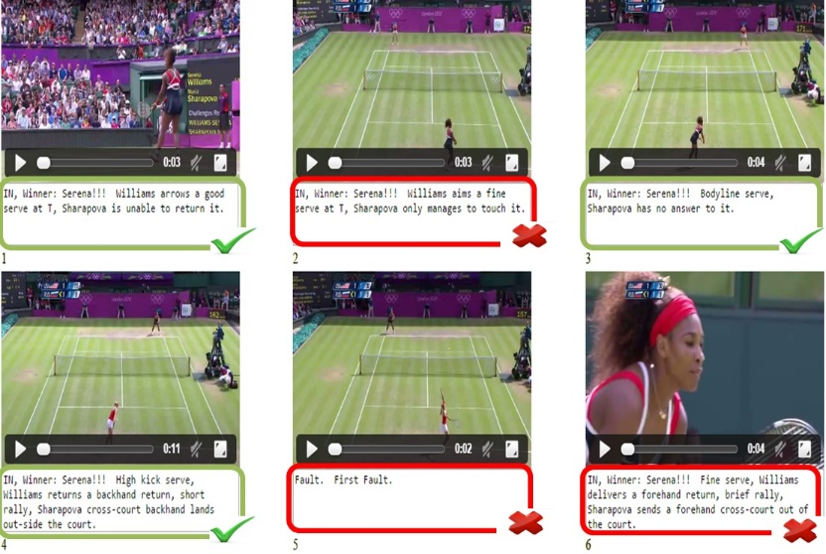
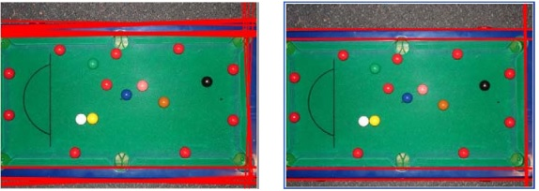
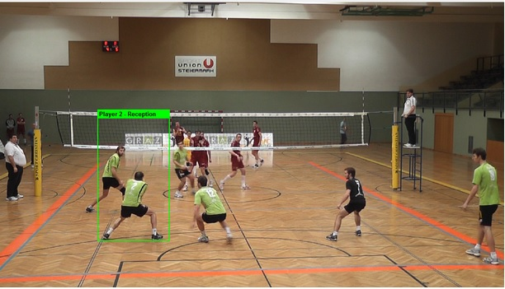
Previous Work
Tennis: Sports Analysis in Tennis: Commentary generation for tennis videos.
Snooker and volley ball: (Left) Analysis of shot trajectories and stroke analysis . (Right) Player identification and action recognition.

Slide 3
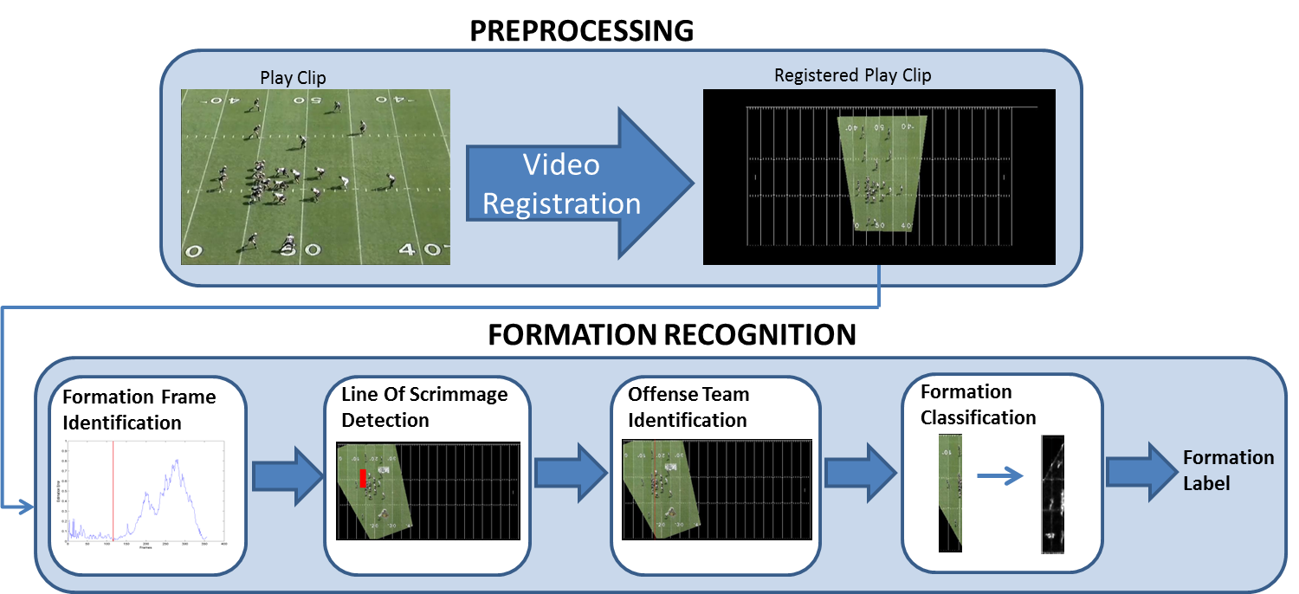
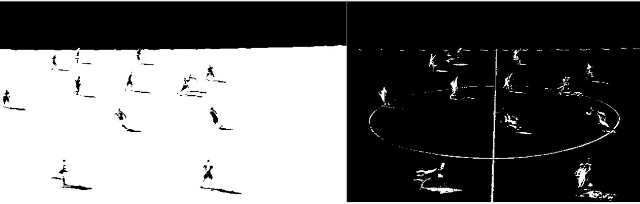
American Football: Automatic Recognition of Offensive Team Formation in American Football Plays
Soccer: Real-time football analysis include automatic game summarization, player tracking, highlight extraction

Slide 4
Problems
require extra equipment's in terms of on field cameras or player sensors
use combination of sensory data from players as well as extra fixed cameras installed in stadiums
manual alignment/tracking of players is then done to get the high level statistics about players and their strategies
In our work we propose a set of solutions that try and extract these high level statistics given just broadcast sports videos

Slide 5
Source Video
Low-level features
Visual Features
Color
Shape
….
Audio Features
MFCC
LPC
….
Text Features
OCR
ASR
….
Mid-level model
Visual Models
Semantic Shot Class
Motion
Ball and Player trajectories
Audio Models
Audio Keywords model
Text Models
Text keywords model
Model selection and Multi-modal fusion
Domain Knowledge and Machine learning
Semantic Concepts
Event & Highlight Extraction
Tactic Analysis
Visual content insertion
Mobile Application

Slide 6
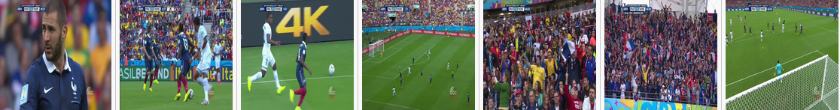
Challenges
View Point Changes :
Since Broadcast Videos are typically compiled from a variety of different ﬁxed/moving cameras.
So typical view point/ﬁxed camera approaches fail to perform given the Broadcast videos
View points in Soccer broadcast videos can be classiﬁed into ﬁve different categories (from left to right) ground zoom-in, ground zoom-out, top zoom-in, top zoom-out and miscellaneous.
View points in Cricket broadcast videos can be classiﬁed into bowler run-up, batsmen shot, ﬁeld, umpire, batsmen close-up, crowd and miscellaneous.

Slide 7
Challenges
Labelled Data Scarcity :
not many publically available datasets for Broadcast Videos.
datasets available for action recognition can not be used directly as they are usually captured using a single moving camera and doesn’t capture typical camera movements in Broadcast sports videos
So for our task of Broadcast sports video analytics we have to create our own datasets.

Slide 8
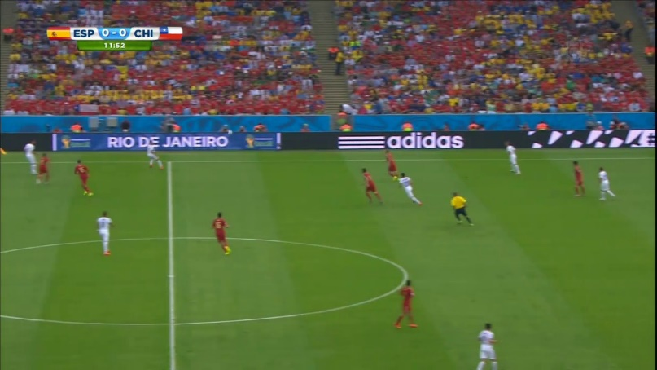
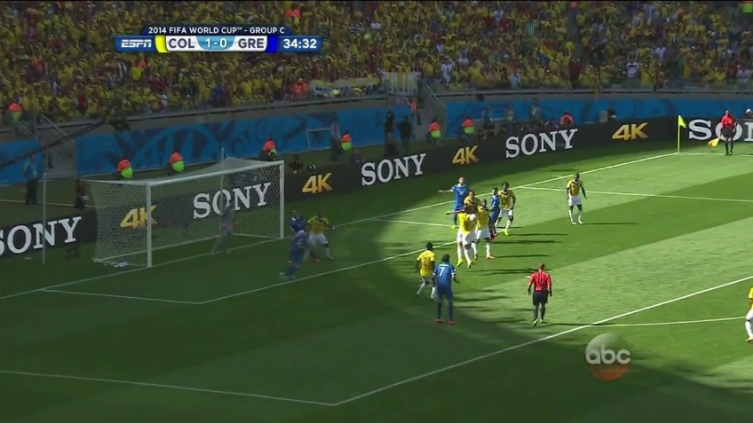
Challenges
Motion Blur
Due to constant camera movement, the images typically suffer from motion blur.
This motion blur can be due to the movement of players or the cameras. This issue becomes even more signiﬁcant when we deal with high paced games like Soccer where cameras can move from one end to another in a span on 1-2 seconds

Slide 9
Challenges
Replays
Typical salient events in Soccer and Cricket Videos are sometimes followed by a replay of the event.
looks exactly like an actual event so our algorithm has to take care of the fact that it should not report the same event twice.
To take care of replays we make use of various cues present in broadcast videos. For e.g. we use scorecard detection in Cricket Videos to ﬁlter out the replays from the actual event as scorecard is there in original event but is not shown in replays

Slide 10
Background

Slide 11
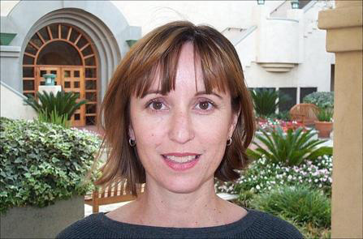


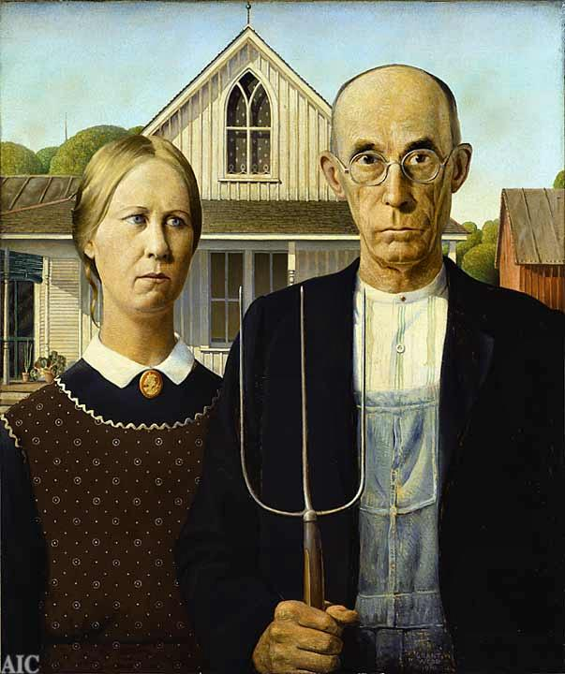














Image Representation
Leverage the classical Information Retrieval methods for Images
Object
Bag of Visual ‘words’
China is forecasting a trade surplus of $90bn (£51bn) to $100bn this year, a threefold increase on 2004's $32bn. The Commerce Ministry said the surplus would be created by a predicted 30% jump in exports to $750bn, compared with a 18% rise in imports to $660bn. The figures are likely to further annoy the US, which has long argued that China's exports are unfairly helped by a deliberately undervalued yuan.
China, trade,
surplus, commerce,
exports, imports, US,
yuan, bank, domestic,
foreign, increase,
trade, value
[Li-Fei-Fei et al Short Course Slides at ICCV 2005]

Slide 12
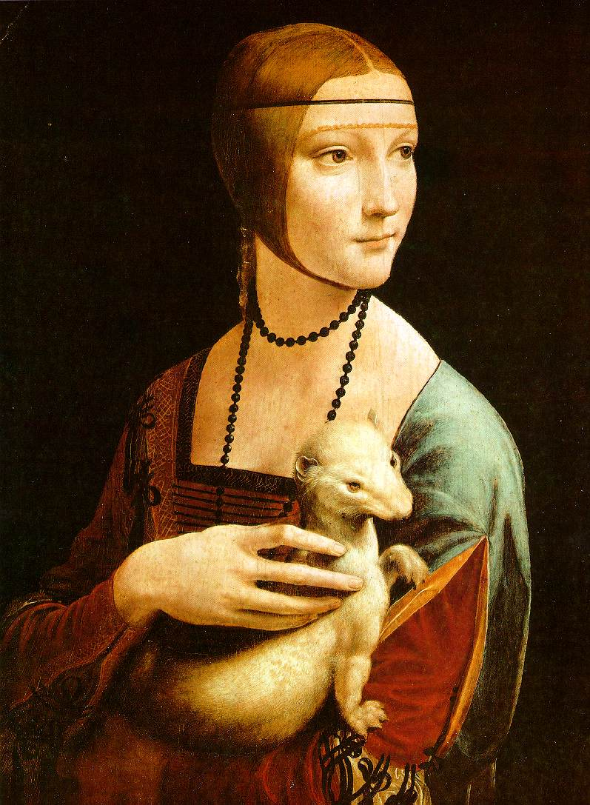
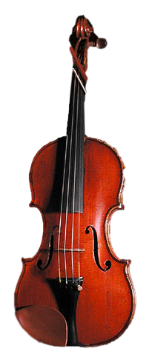
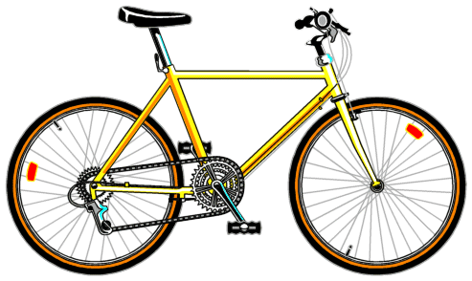
Bag of features: outline
Extract local features from images

Slide 13
Bag of features: outline
Extract local features from images
Learn “visual vocabulary”

Slide 14
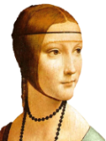

Bag of features: outline
Extract local features from images
Learn “visual vocabulary”
Quantize local features using visual vocabulary
Represent images by frequencies of “visual words”

Slide 15
Learning
Supervised Learning
Semi- Supervised Learning
Unsupervised Learning
discover patterns in the data that relate data attributes with a target (class) attribute
The data have no target attribute
Labeled + unlabeled data
Typically, plenty of unlabeled data available
We want to explore the data to find some intrinsic structures in them
These patterns are then utilized to predict the values of the target attribute in future data instances
Tries to improve the predictive power using both labelled and unlabeled data. (Expected to be better than using one alone)

Slide 16
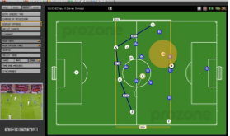
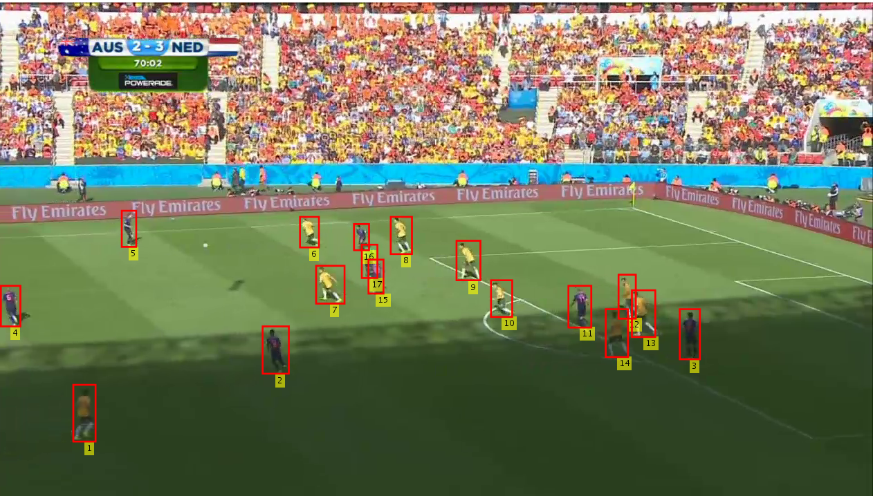
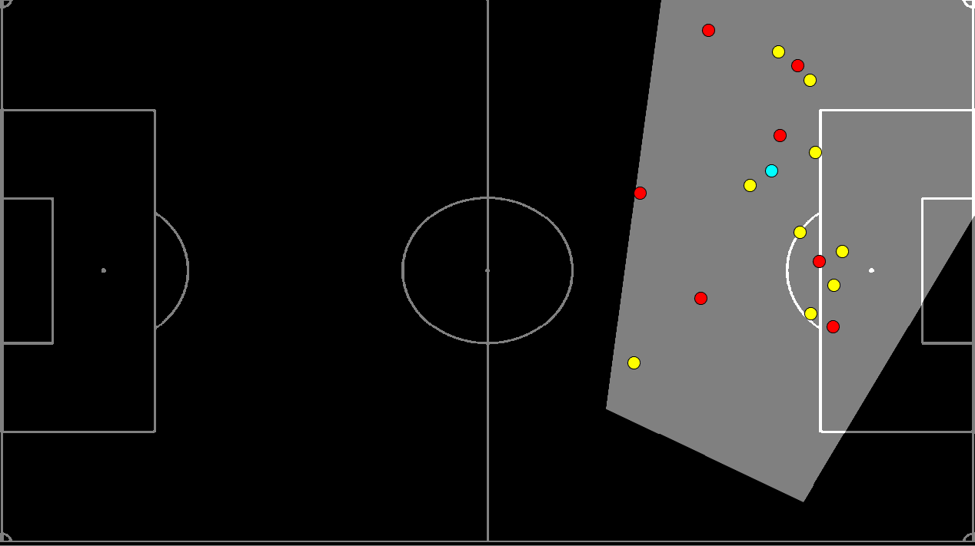
Automated Top View Registration of Broadcast Football Videos
Proposed Approach. The yellow, red and cyan circles denote the players from diﬀerent teams and referee respectively
Prozone Tracking System

Slide 17
Motivation
To register video frames with a static model
Previous approaches by Okuma et al.( ACCV 2004) and Li et al. (CVPR 2011) try computing point correspondences between image and the model
We exploit the field line information and reduce the problem to a nearest neighbour search over a synthetically generated dictionary of edge map and homography pairs.
Requires first image to be manually registered

Slide 18
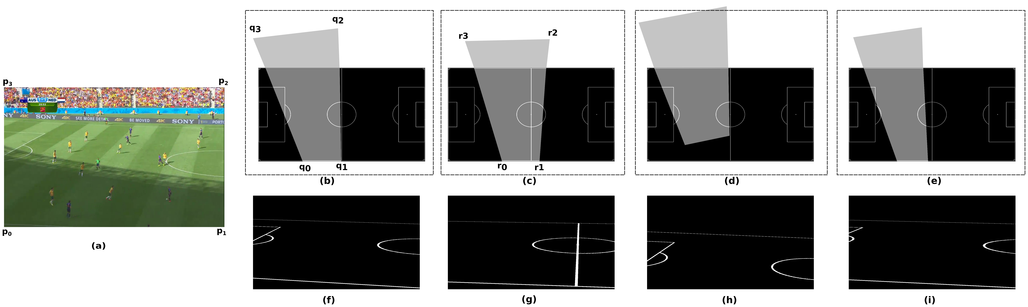
Semi-supervised Dictionary Generation
Manually annotated homography for 200 images using four point correspondences
After Synthetic generation we obtain 100000 edge map-homography pairs

Slide 19
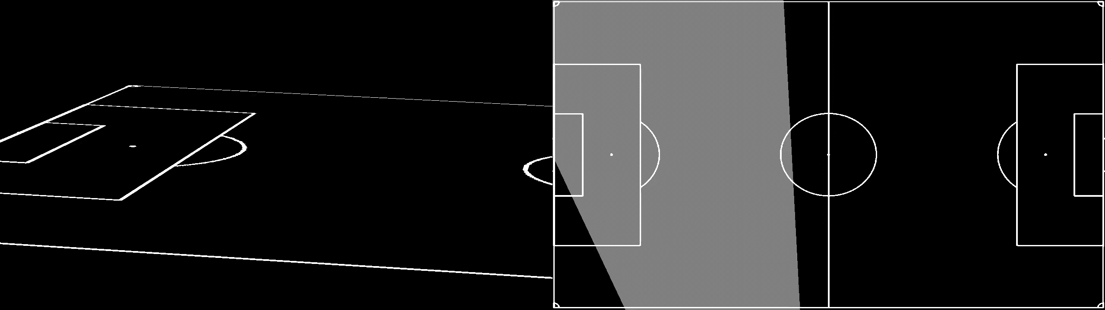
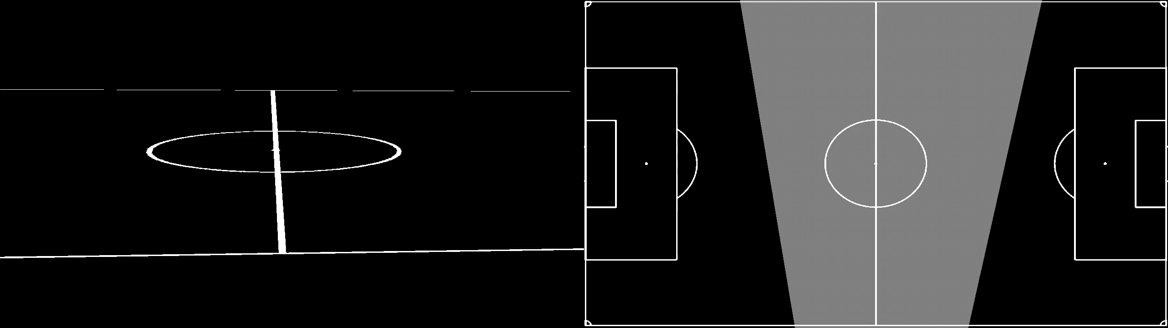
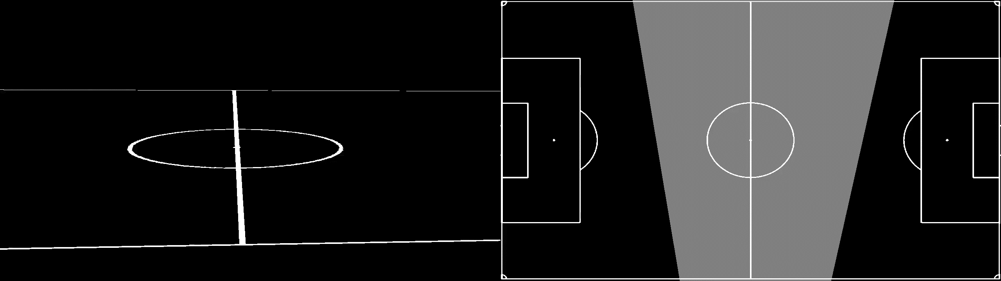
Simulation Example
Pan
Tilt
Zoom

Slide 20
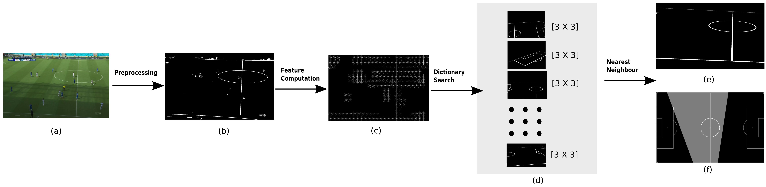
Solution Overview

Slide 21
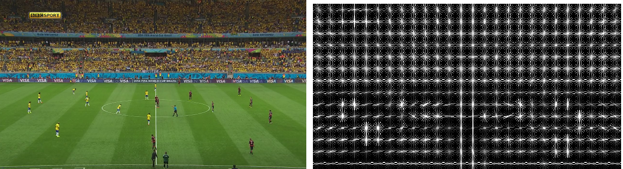
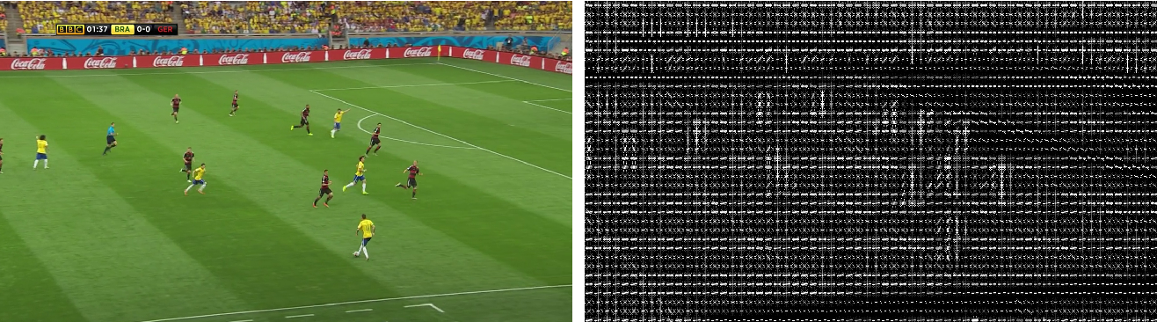
HOG

Slide 22
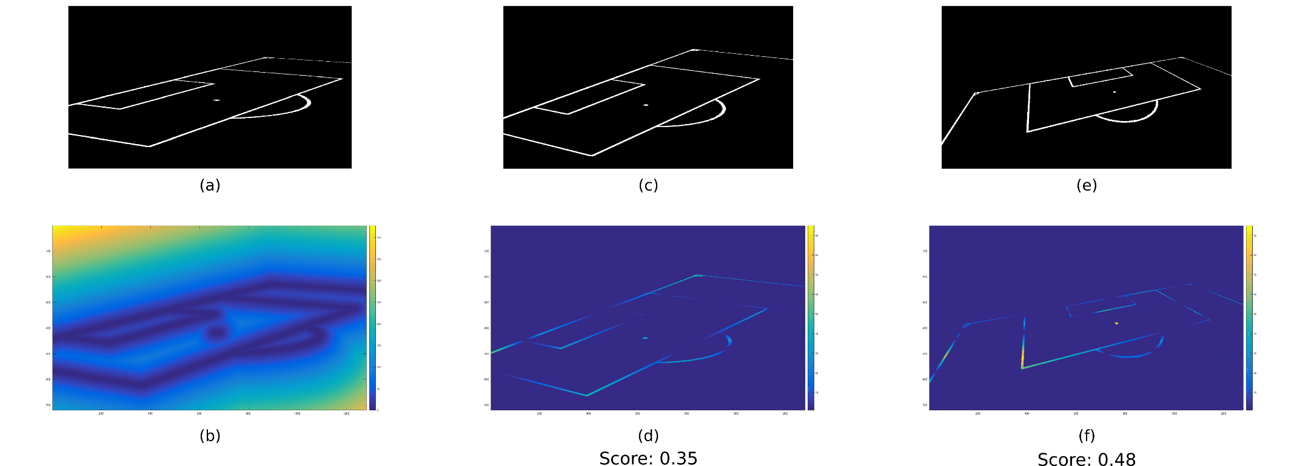
Chamfer

Slide 23
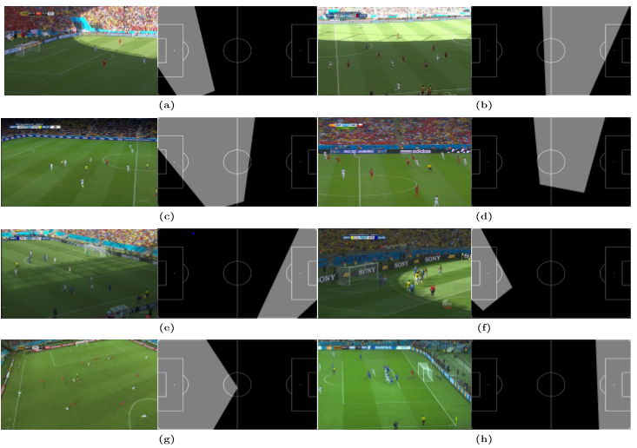
Experimental Results (Images)

Slide 24
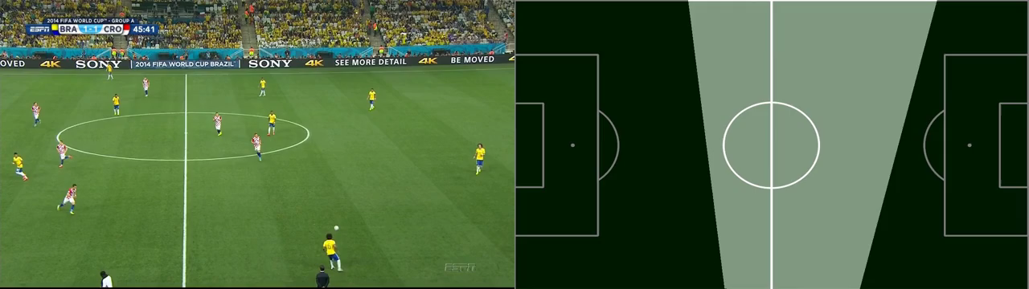
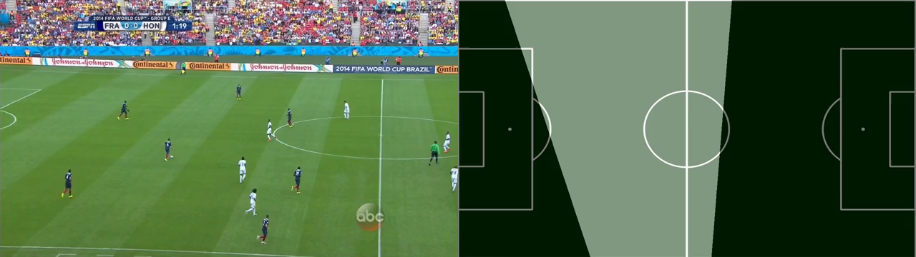
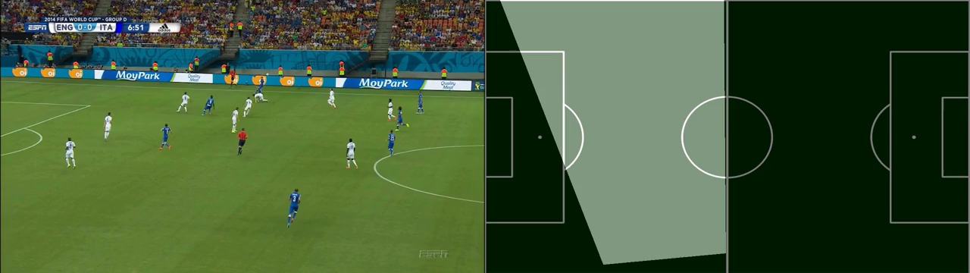
Experimental Results (Videos)

Slide 25
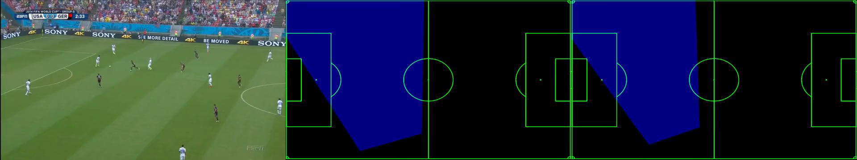
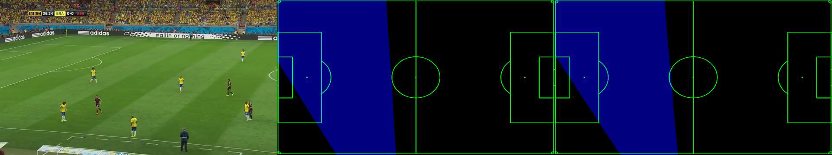
Experimental Results (Videos)
Camera Stabilization

Slide 26
Results
Approach | Simulated Dataset (Accuracy) |  | Broadcast Dataset (Accuracy)
 | Mean | Median | Mean | Median
NN-Chamfer | 83.2 | 89.2 | 80.5 | 83.2
NN-HOG | 90.9 | 92.4 | 85.8 | 88.9
NN-AlexNet | 88.4 | 90.7 | 66.1 | 69.3
NN-SketchNet | 93.1 | 94.4 | 14.1 | 0.0
Simulated Dataset have perfect edge maps and Real Dataset means real broadcast RGB images
Simulated Dataset consist of 10000 images and Real Dataset contains 500 images

Slide 27
Conclusion
We Achieve a very good mean accuracy of 85.8 % for the task of top-view registration on broadcast images
We show the usefulness of proposed approach for the task of player tracking
We have created a very challenging dataset for the task of top-view registration with varying shadows, motion blur, varying zoom, view points and positions.
Can be used to improve event detection algorithms

Slide 28
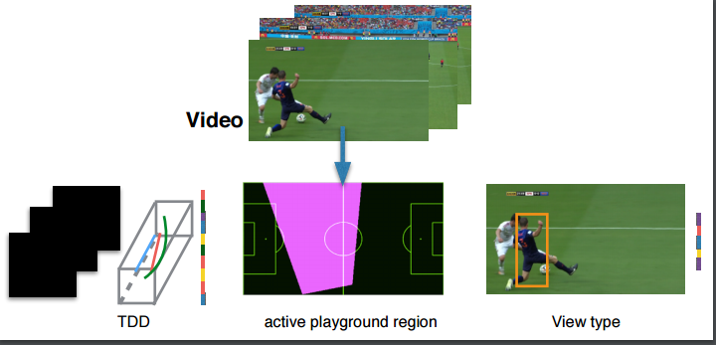
Application
Use of Image registration to improve event detection [ICVGIP]

Slide 29
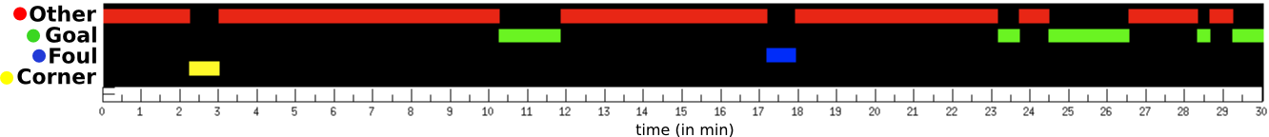
Automatic analysis of broadcast football videos using contextual priors
An example of event tagging using the proposed approach on the ﬁrst thirty minutes of the semi-final match between Brazil and Germany in World Cup 2014

Slide 30
Motivation
Sports videos have strong contextual priors than most generic videos
presence of temporal context (camera angles) for a video, the problem of event tagging (fouls, corners, goals etc.) can be cast as per frame multi-class classiﬁcation problem
even with simple classiﬁers like linear SVM, we get signiﬁcant improvement in the event tagging task

Slide 31
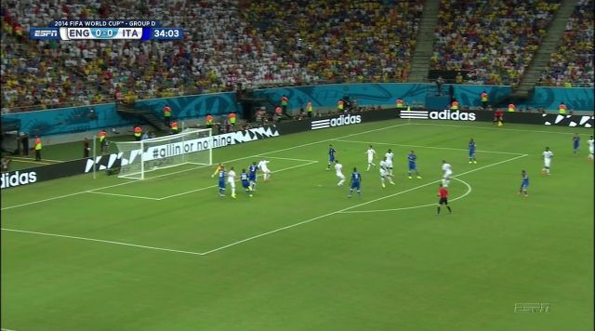
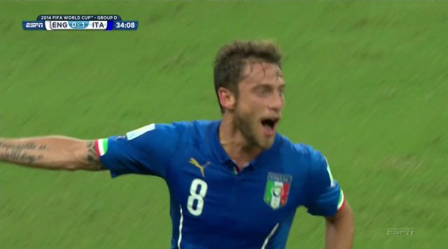
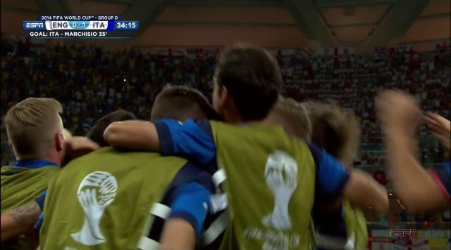

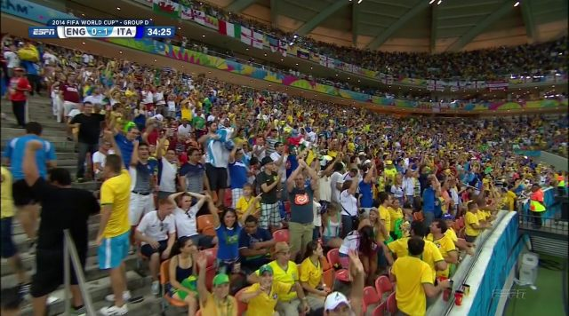
Solution Overview
Typical viewpoint transitions in a goal event (Top zoom out → Top Zoom in → Ground Zoom in → Ground Zoom out → Miscellaneous). The camera framing changes with respect to both size and angle.
Camera label estimation using bag of visual words
We combined this camera label information as one-hot encoding along with motion and Bag of Visual words feature to get final feature vector for event tagging

Slide 32
Results
Event | Corner | Foul | Goal | Gameplay | Substitution
Corner | 75.1 | 5.4 | 18 | 0.6 | 0.9
Foul | 0.2 | 57.4 | 22 | 10.4 | 10
Goal | 2.7 | 3.4 | 84.6 | 4.2 | 5.1
Gameplay | 0.9 | 1.5 | 1.5 | 94.6 | 1.5
Substitution | 1.3 | 9.6 | 24 | 2.7 | 62.4
Method | Corner | Foul | Goal | Gameplay | Substitution
TDD (Wang et al CVPR 2015) | 21.05 | 12.82 | 77.45 | 77.08 | 25.80
HCRF(Qian et al IMCS 2010) | 7.6 | 15.5 | 6.6 | 77.13 | 86.44
Ours | 75.1 | 57.4 | 84.6 | 94.6 | 62.4
For testing 176 clips comprising of 43 goal, 30 corner, 42 substitution, 27 fouls and 34 gameplay sequences were used.

Slide 33
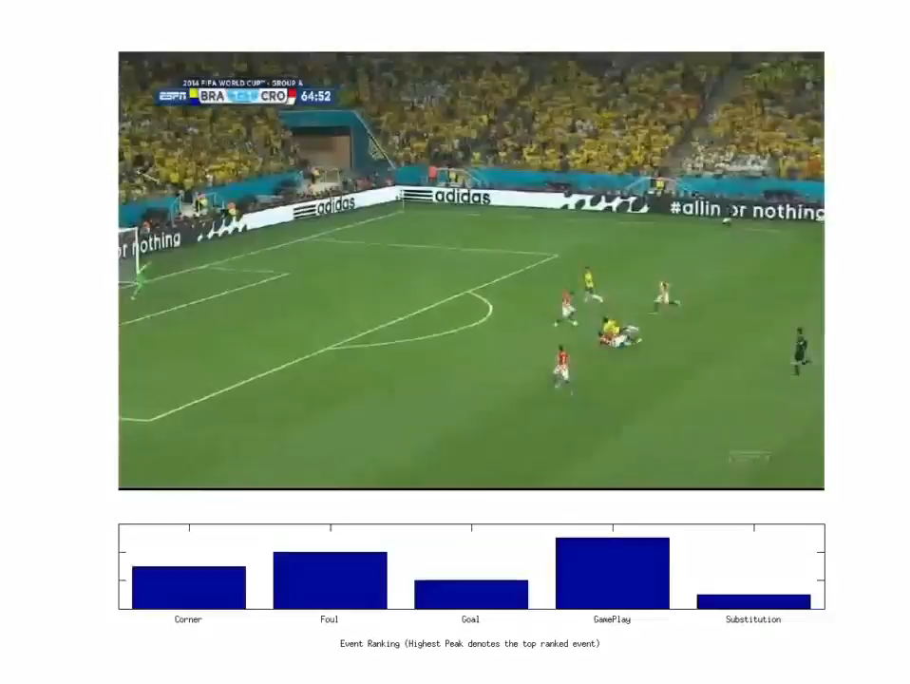
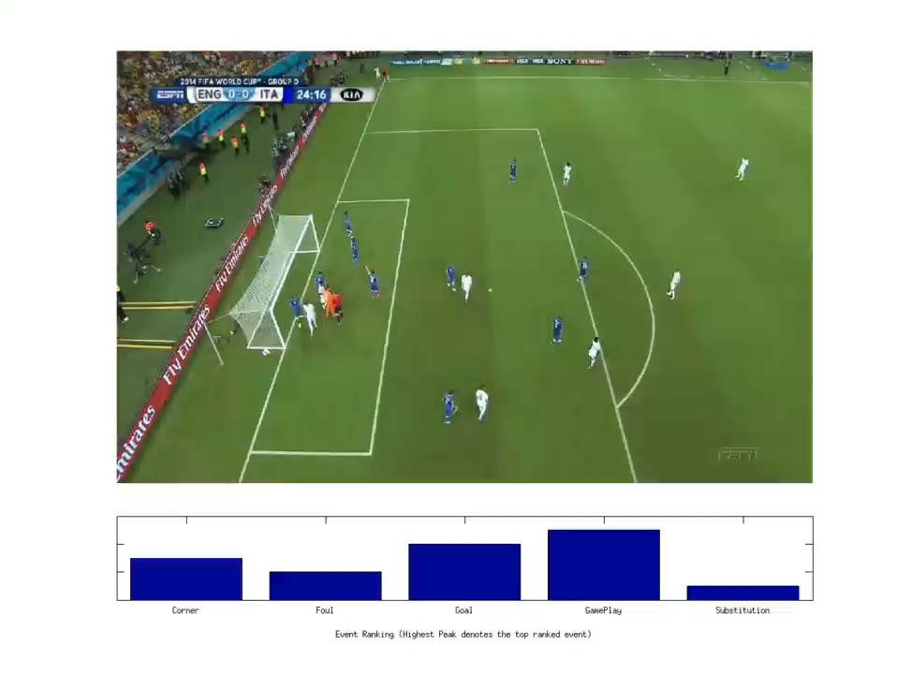
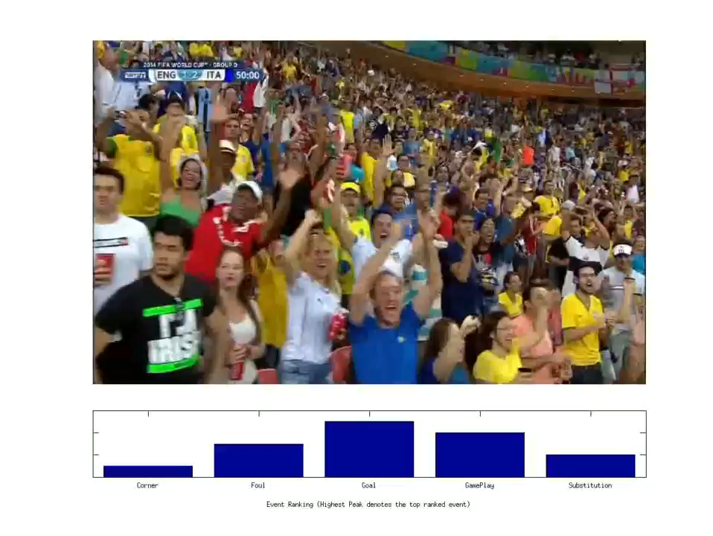
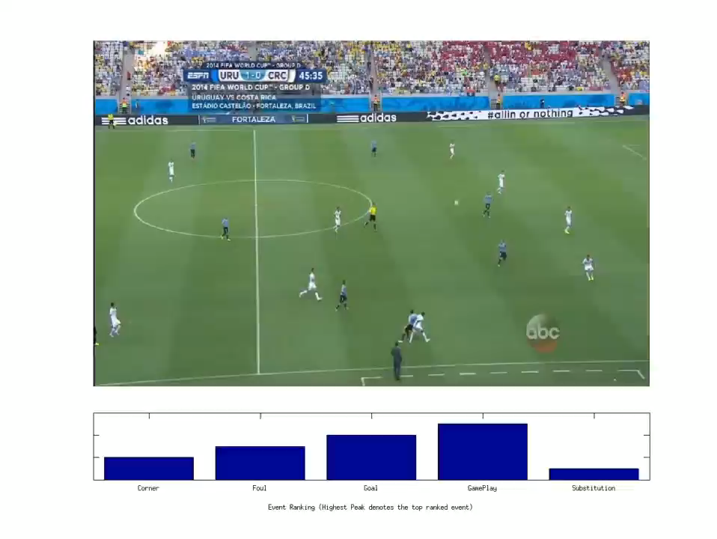
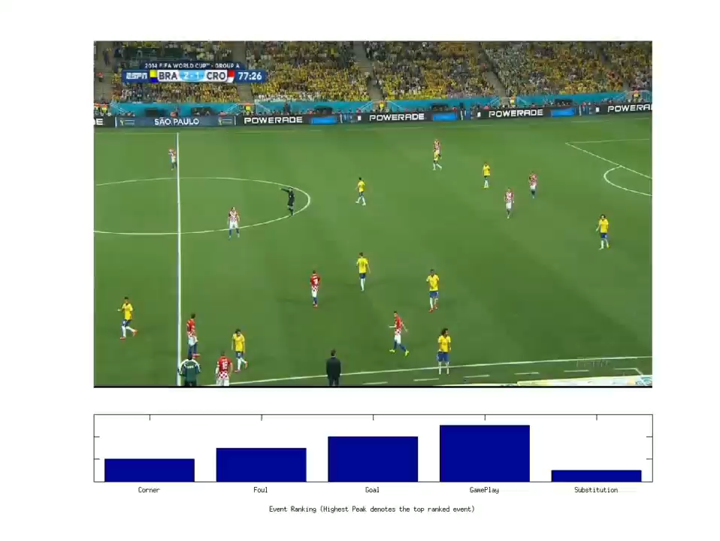
Experimental Results

Slide 34
Conclusion
Our method obtains an overall accuracy of 92.2% for camera viewpoint estimation and 85.5% accuracy for event classiﬁcation for wide variety of clips across several soccer matches
We Outperform state of the art deep learning based action recognition approaches using Contextual priors
spatial semantic segmentation accuracy can be improved by as much as 20% using the context.

Slide 35
Fine-Grain Annotation of Cricket Videos

Slide 36
Motivation
Annotate Cricket Videos with Semantic descriptions at a fine grain spatio-temporal scale.
Leverage parallel information in the form of online text commentaries, to augment visual recognition
Label actions at shot-level with semantic descriptions of actions and activities.

Slide 37
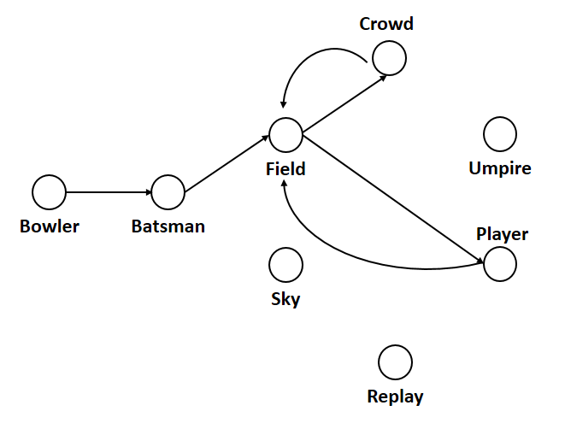
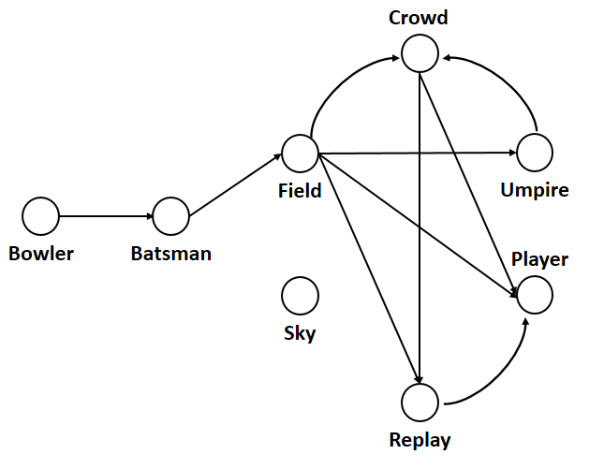
Scene Segmentation
One Run Model
Four Run Model

Slide 38
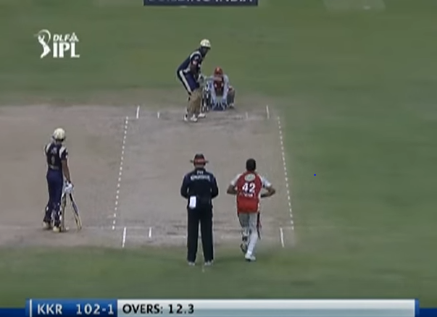
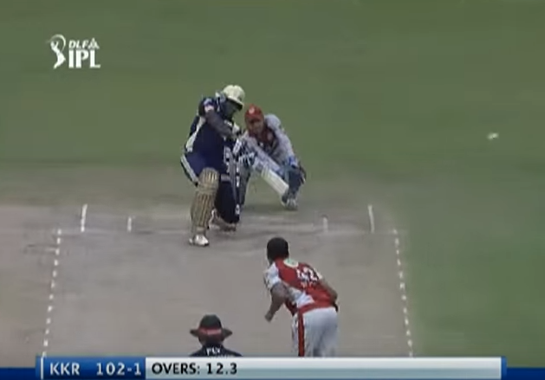
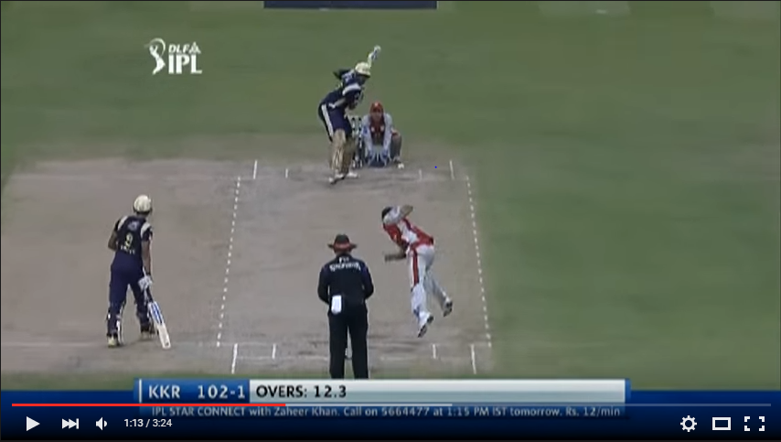
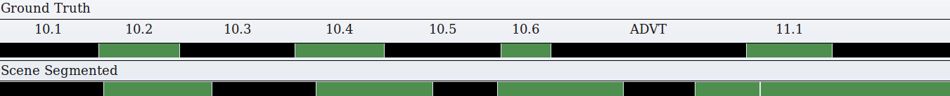
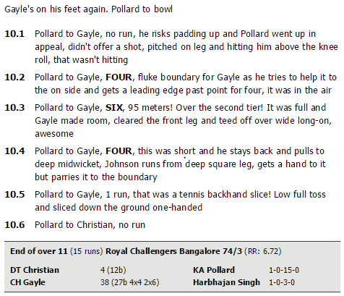
Solution overview
Video Shot Recognition
Bowler Shot
Batsmen Shot
Input Video
Scene Segmentation
Blue and Pink denotes Bowler shot and Batsmen shot respectively
Textual Commentary
10.4, Pollard to Gayle, FOUR, this was short and he stays back and pulls to deep midwicket, Johnson runs from deep square leg, gets a hand to it but parries it to the boundary
Text Classification
event number and players involved along with the outcome (Four run)
(red) bowler actions, (blue) batsman action and (green) other player actions

Slide 39
Results
Phrase Prediction
Video Shot Recognition
R | Bowler Shot | Batsman Shot
2 | 22.15 | 39.4
4 | 43.37 | 47.6
6 | 69.09 | 69.6
8 | 79.94 | 80.8
10 | 87.87 | 88.95
Kernel + CRF | Vocab: 300 | Vocab: 1000
Linear | 78.02 | 82.25
Polynomial | 80.15 | 81.16
RBF | 81 | 82.15
Sigmoid | 77.88 | 80.53
Text Classification
R is neighbourhood to search for correct shot
Method | SVM
Bag of Words (SVM) | 89.09

Slide 40
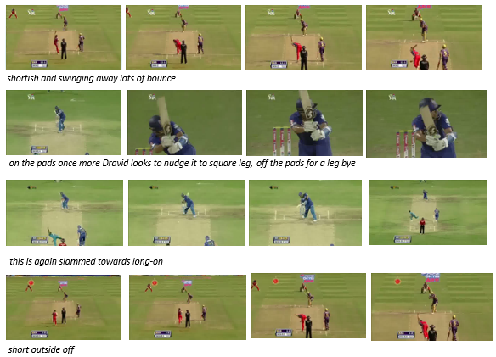
Experimental Results

Slide 41

Application

Slide 42
Conclusion
Rich semantic annotation of cricket videos at a fine temporal scale
Circumvention of technical challenges in visual recognition using online text-commentaries
We obtain high annotation accuracy as evaluated over large video collection
Media Coverage by Washington Post, NDTV, the Stack, the Register etc.

Slide 43
Applications
Search and Retrieval
Summarization
Strategy Analysis

Slide 44
Publications
Rahul Anand Sharma, Pramod Sankar K & C.V. Jawahar : Fine Grain Annotation of Cricket Videos, Asian Conference on Pattern Recognition (ACPR), 03-06 Nov 2015, Kuala Lumpur, Malaysia
Rahul Anand Sharma, Vineet Gandhi, Visesh Chari & C.V. Jawahar : Automatic analysis of broadcast football videos using contextual priors, Springer Journal on Signal, Image and Video Processing(SIVP), Volume 10, Issue 5, July 2016.
Himangi Saraogi, Rahul Anand Sharma & Vijay Kumar: Event Recognition in Broadcast Soccer Videos ,Indian Conference on Computer Vision, Graphics and Image Processing (ICVGIP), 18-22 Dec 2016, Guwahati, India
Rahul Anand Sharma, Bharath Bhat, Vineet Gandhi & C.V. Jawahar : Automated Top View Registration of Broadcast Football Videos, Conference on Computer Vision and Pattern Recognition (CVPR), 2017 (Under Review)

Slide 45
Questions ?

