Slide 1
Instance Retrieval and Image Auto-annotations on Mobile Devices
Jay Guru Panda
MS by Research
200802017

Slide 2

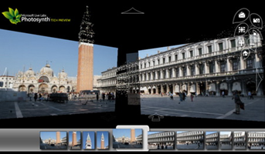

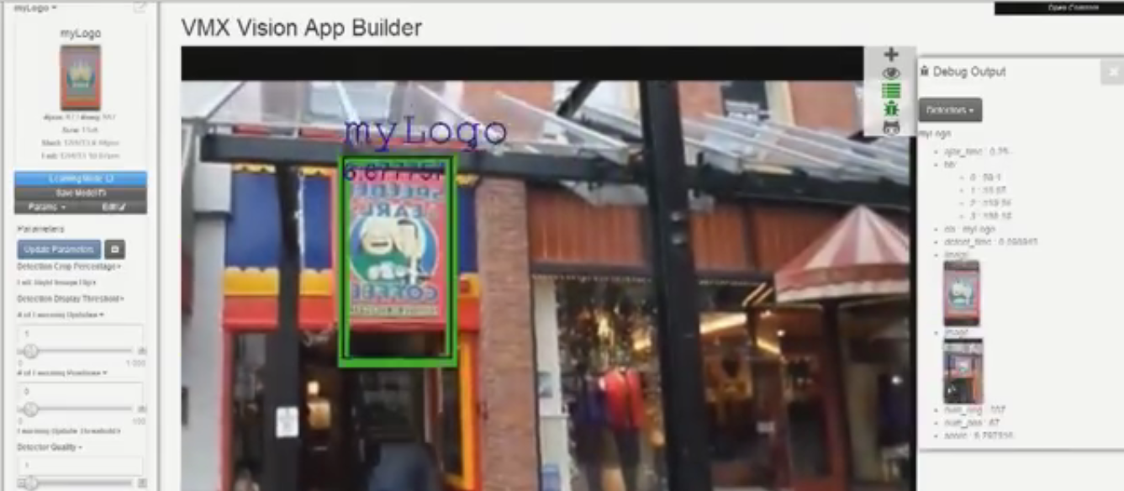

Computer Vision for All
Recent Advances in Computer Vision
Useful, innovative applications delivered over web

Slide 3
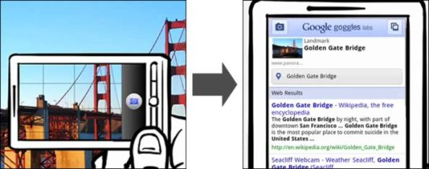
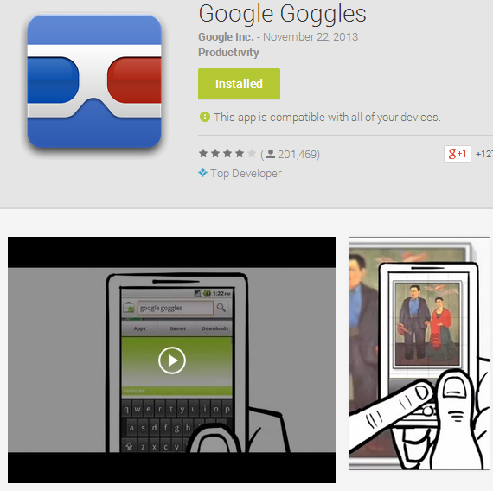

Mobile Computer Vision
Ubiquitous devices: mobiles, tablets
Embedded camera hardware
Intuitive & natural to search/look-up
Image Retrieval for mobile visual search
Applications for mobile visual search:
Product Search
Read scene Text (translate/search/archive)
Apparel Search
Buildings/Landmark search
Augmented Reality
Tourist monuments/places look-up
. . .

Slide 4

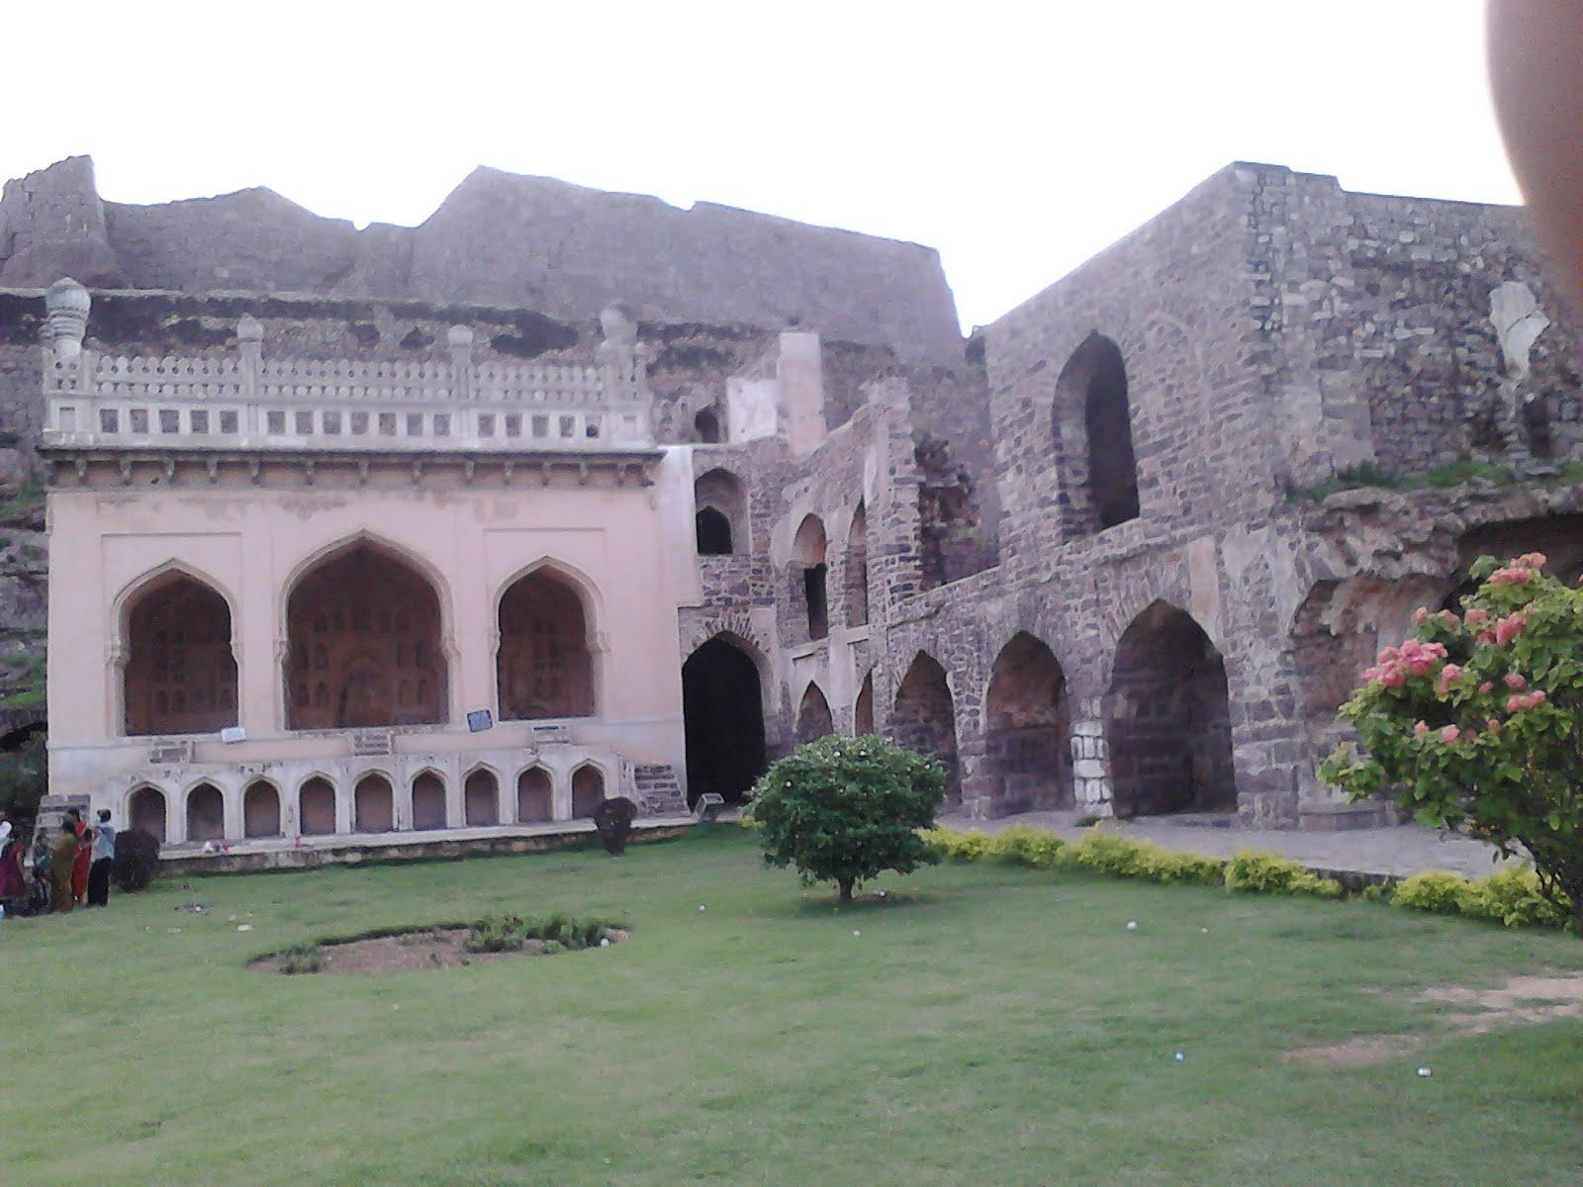





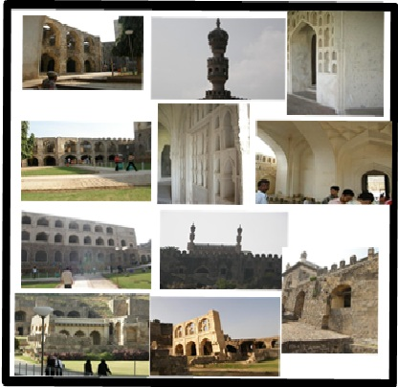
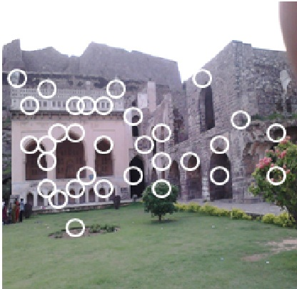
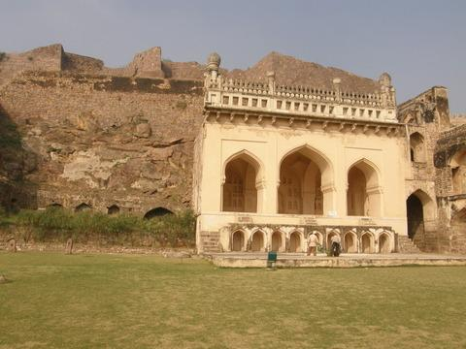
Annotations on a Mobile Phone
Some popular apps for mobile visual search
Output Display
Capture Photo
Taramati Mosque
Text, Landmarks, Logos, books, artwork
Products
Image Retrieval
Extract Features
Annotation Server
Get Annotations
Image Retrieval
Matching
B2B apps for Mobiles
Movie Posters, entertainment
http://www.google.co.in/mobile/goggles/
http://a9.amazon.com/-/company/snaptell.jsp
http://www.pointandfind.nokia.com/
http://www.kooaba.com/
BEST MATCH
[Rublee et al. ORB: An efficient alternative to SIFT or SURF. In ICCV ’12]
[Wagner et al. Pose tracking from natural features on mobile phones. In ISMAR ’08]
Notes:
10/29/11

Slide 5
Search on a Mobile Phone
Our Approach
Output Display
Extract Features
Capture Photo
Taramati Mosque
Compressed
Features
Image Retrieval
Annotation Server
Get Annotations
Image Retrieval
Matching
Everything on the mobile device !
BEST MATCH
[Chandrasekhar et al. Compressed Histogram of Gradients: A low-bitrate descriptor. IJCV ’12]
[Chen et al. Learning Compact Visual Descriptor for Low Bit Rate Mobile Landmark Search. In ICJAI ’11]
Notes:
10/29/11

Slide 6


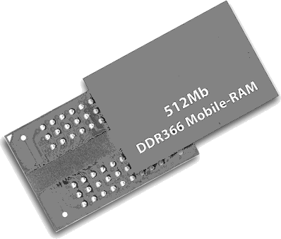



Challenges
Work with a large image dataset (~10 k).
10 k x 100 KB
= 1GB
Millions ( 10 k x 100) of high-dimensional features to match images.
10 k x 500 x 128
= 600 MB
Need high-processing and RAM capacity.
Average RAM usage by mobile app: 24 MB
1GHz – 1.5GHz
1 GB RAM
4-8 GB storage
5-8 MP camera
Only a fraction can be used by a mobile app
App can’t use up all storage
………….
………….
………….
..
..
..
Mid-End Mobiles ( 10-12K )
Notes:
10/29/11

Slide 7
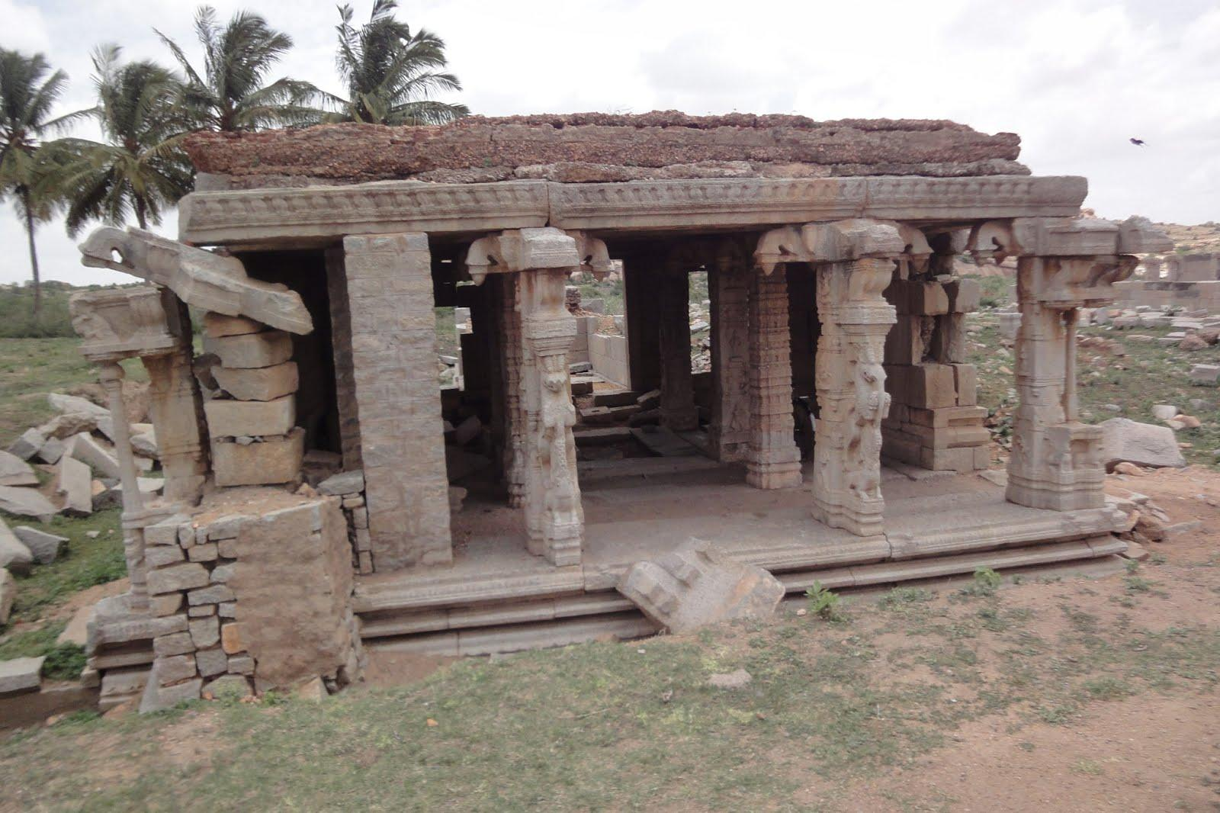
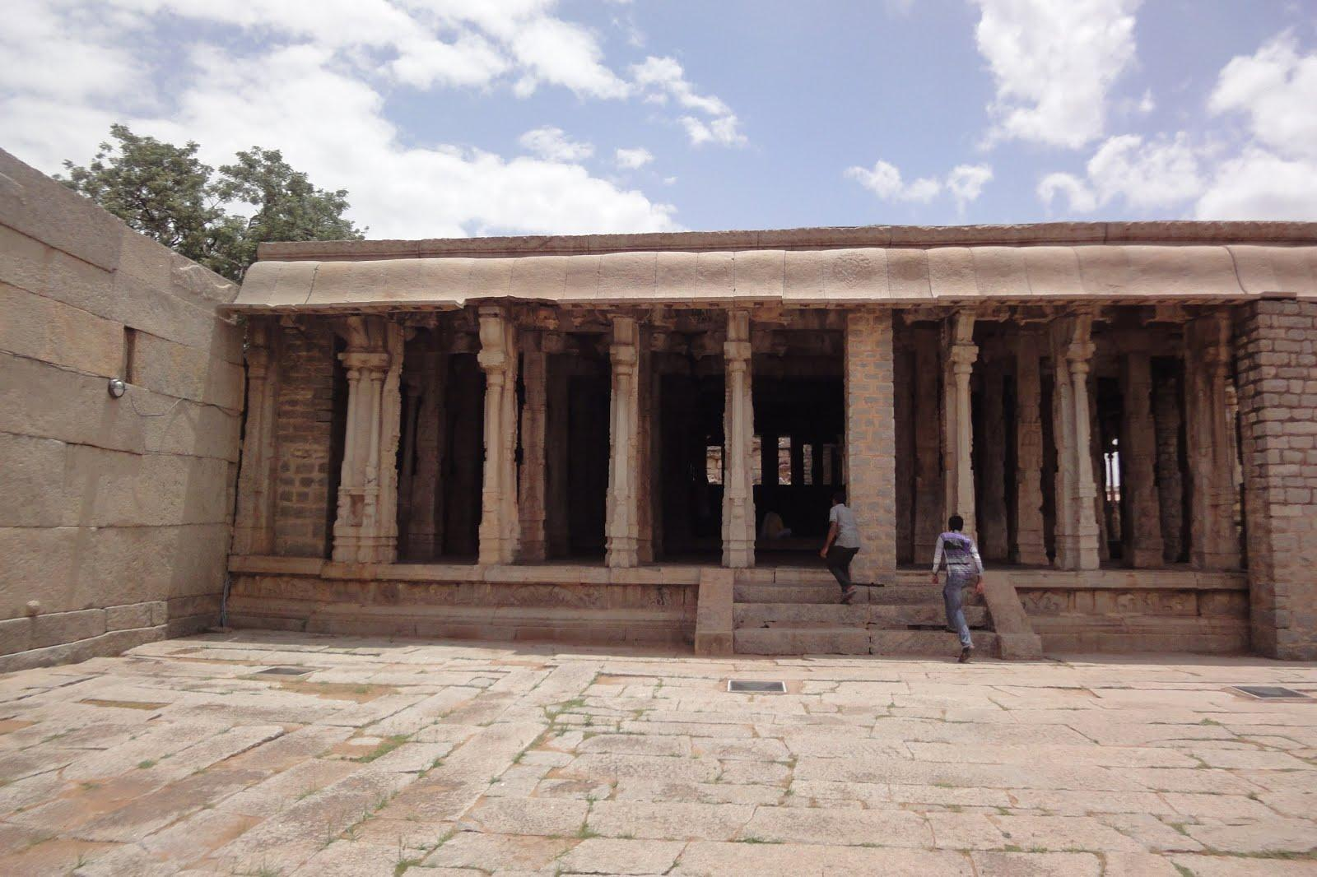



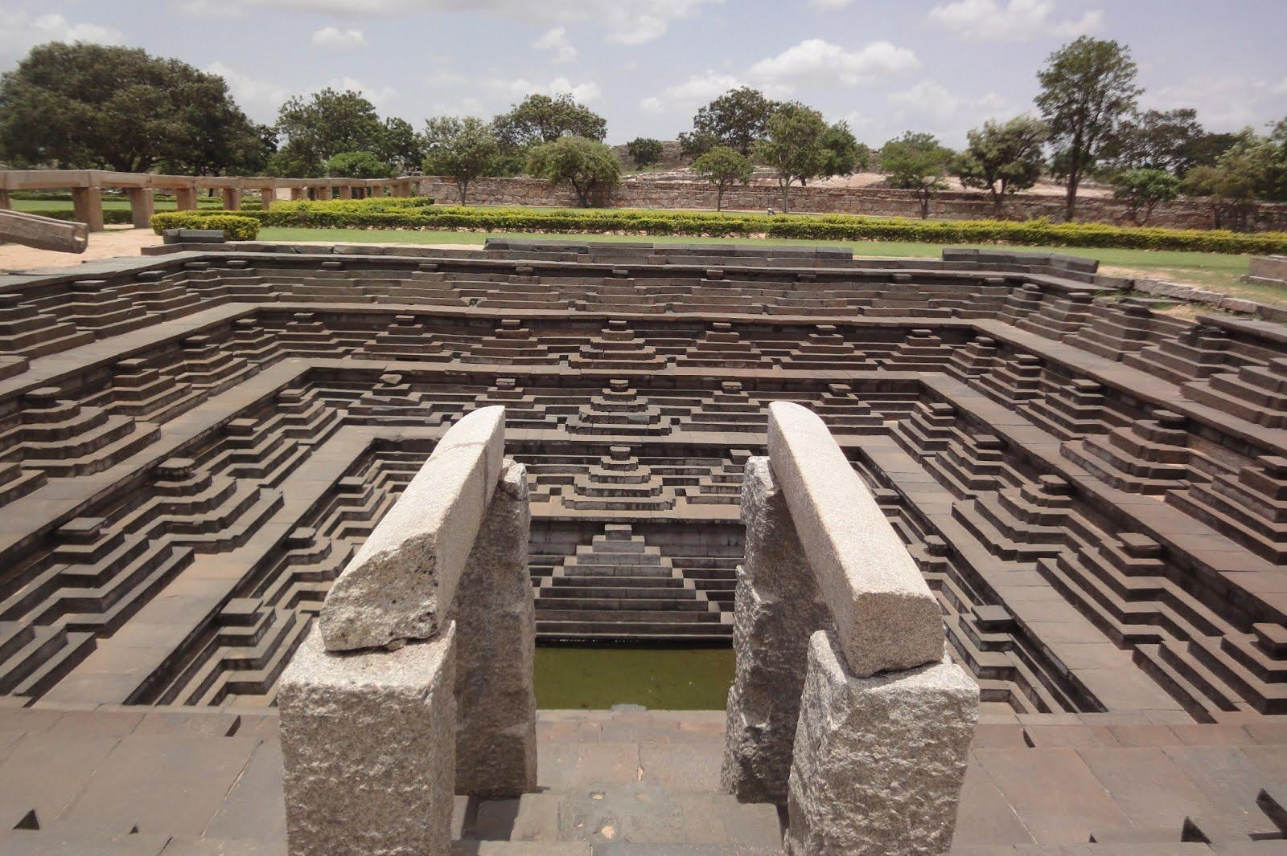
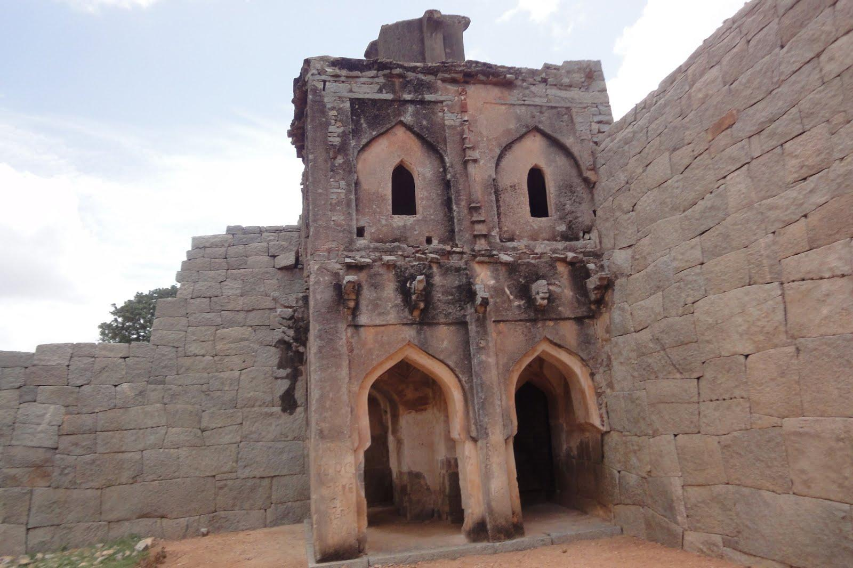
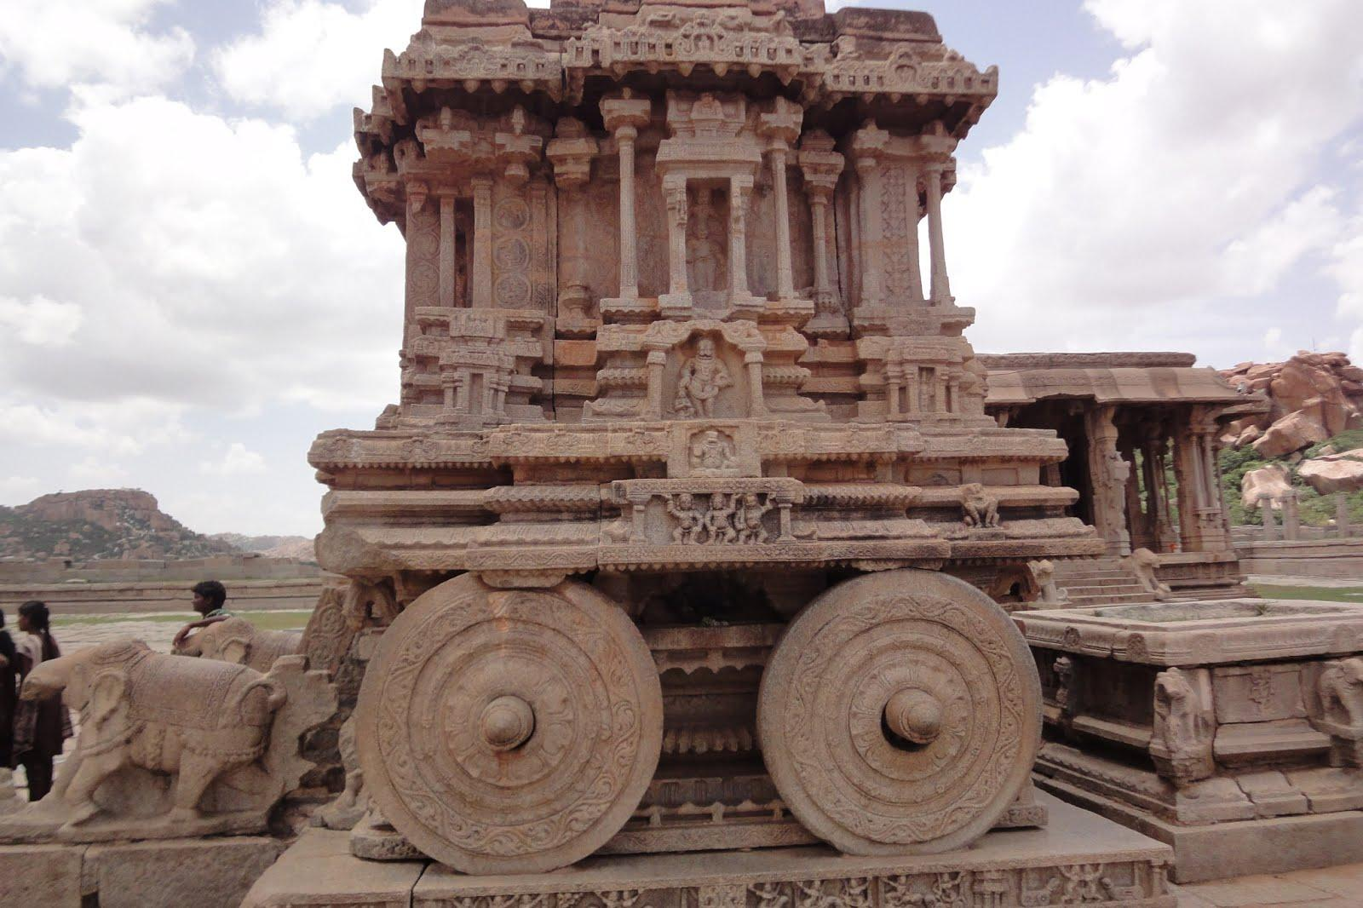
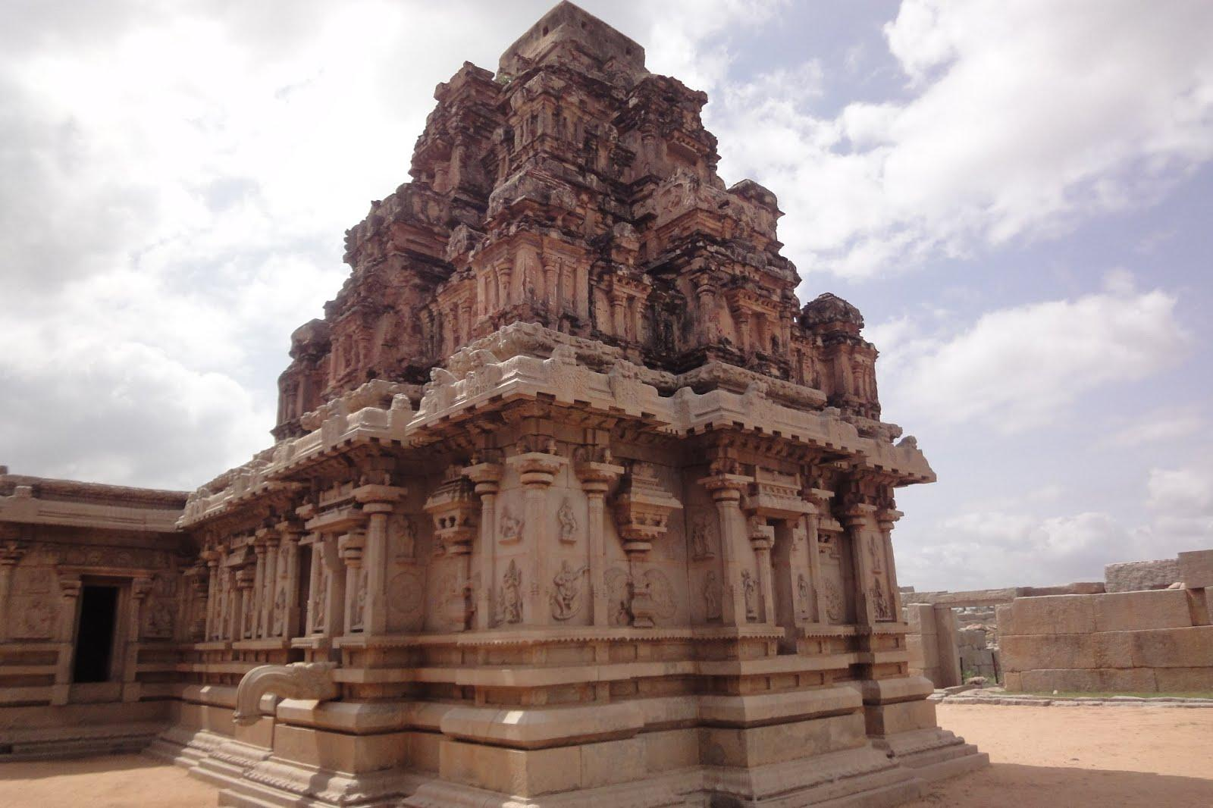


Our Case: Heritage Monuments
How easily a tourist can get information about a monument?
Can we use mobile computer vision to do better ?
Guidebooks/ heritage studies
?
?
Tourist/audio Guides
?
?
Internet Resources
Web Image Search
?
?
Notes:
10/29/11

Slide 8
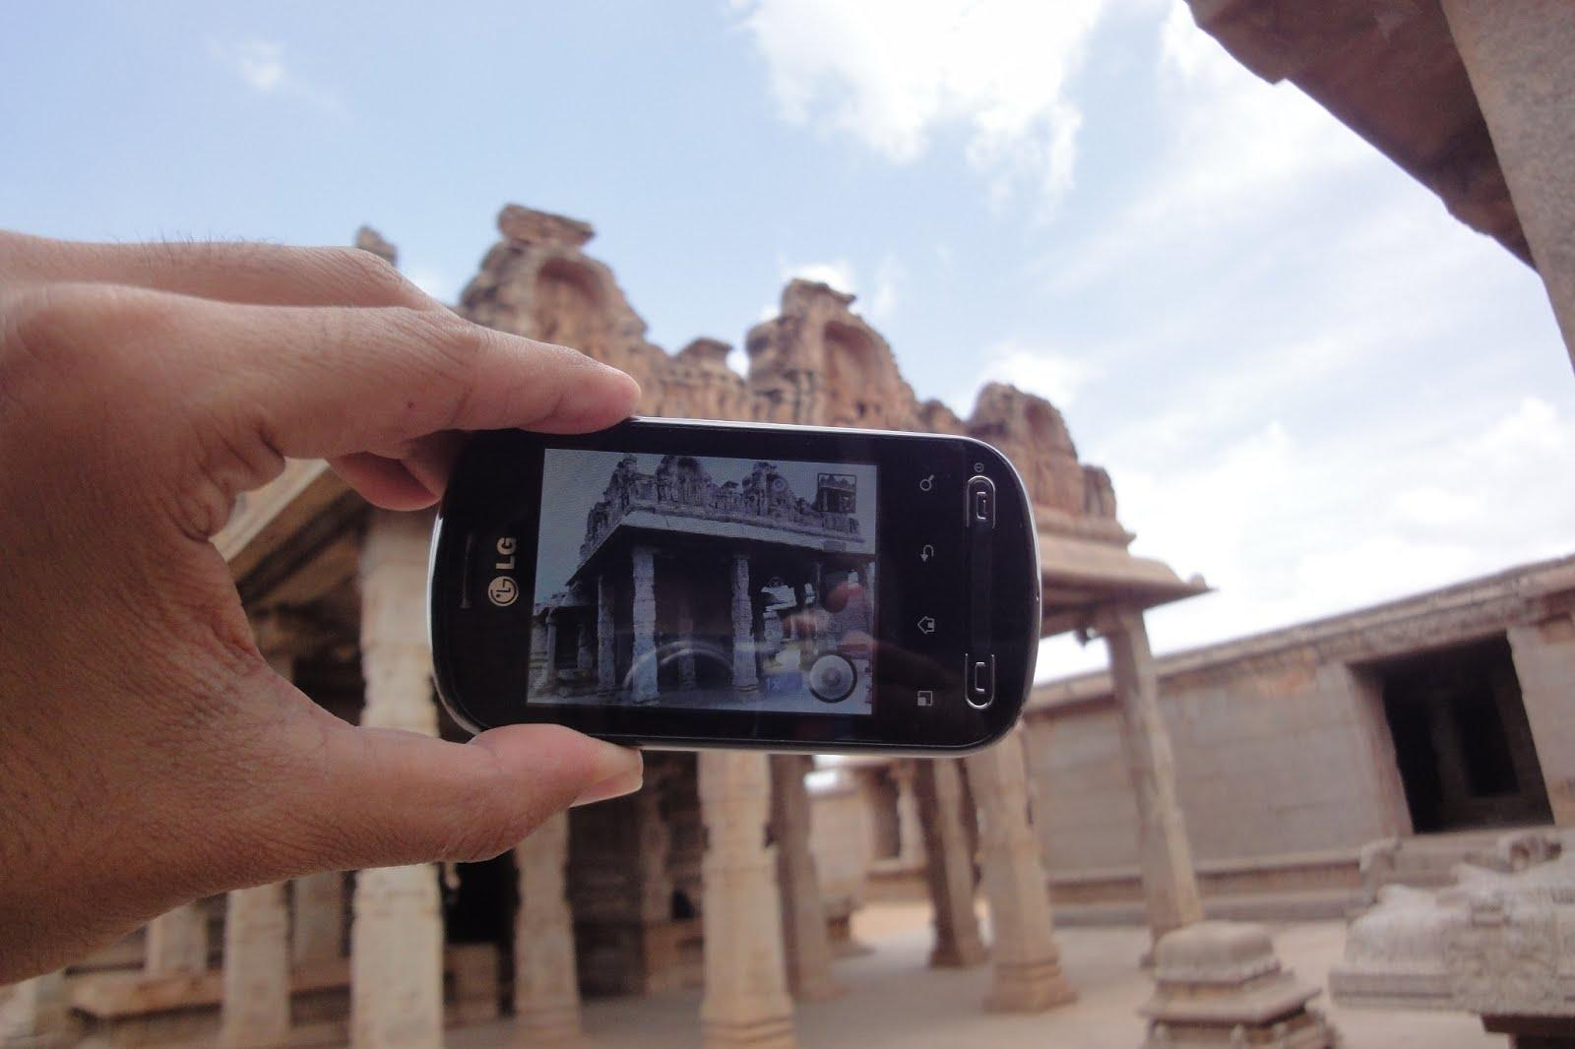
Our Solution: Heritage App
Hazara Rama Main Temple
Notes:
10/29/11

Slide 9
The complete solution
Efficiently Annotate a large number of images
Image retrieval on a mobile phone for upto 10k images
Make it more generic and scalable – upto 100k images

Slide 10
What do we need ?
Annotated Database of Images
Getting images from web/crowd-sourced/self – relatively easy
Getting Annotations (official/authentic information) – tough
- Could get historians/cultural enthusiasts to work on it
Annotating all images, say 10k ! – toughest
However, - #distinct objects/annotations << 10k - Images of same monument/structure have similarities - Solution: Annotate one image and propagate to others

Slide 11
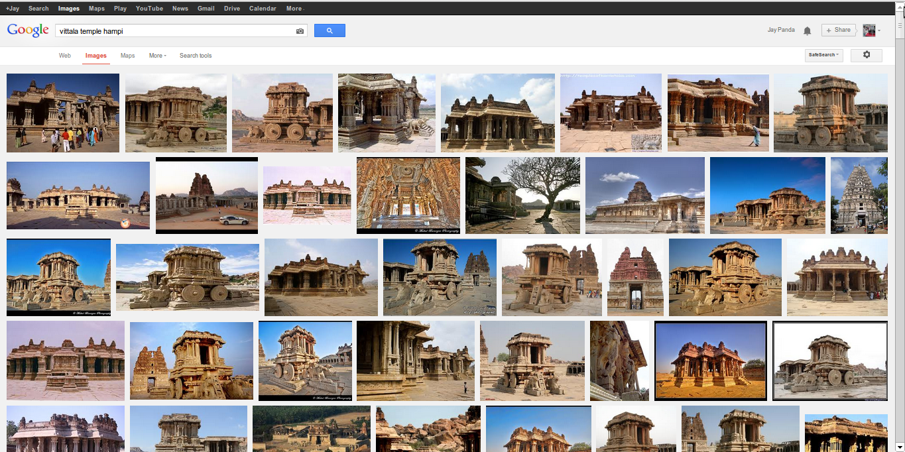



Plenty Images: “loosely” tagged
Search for vittala temple on social platforms Thousands of Results !
Internet Social Platforms

Slide 12
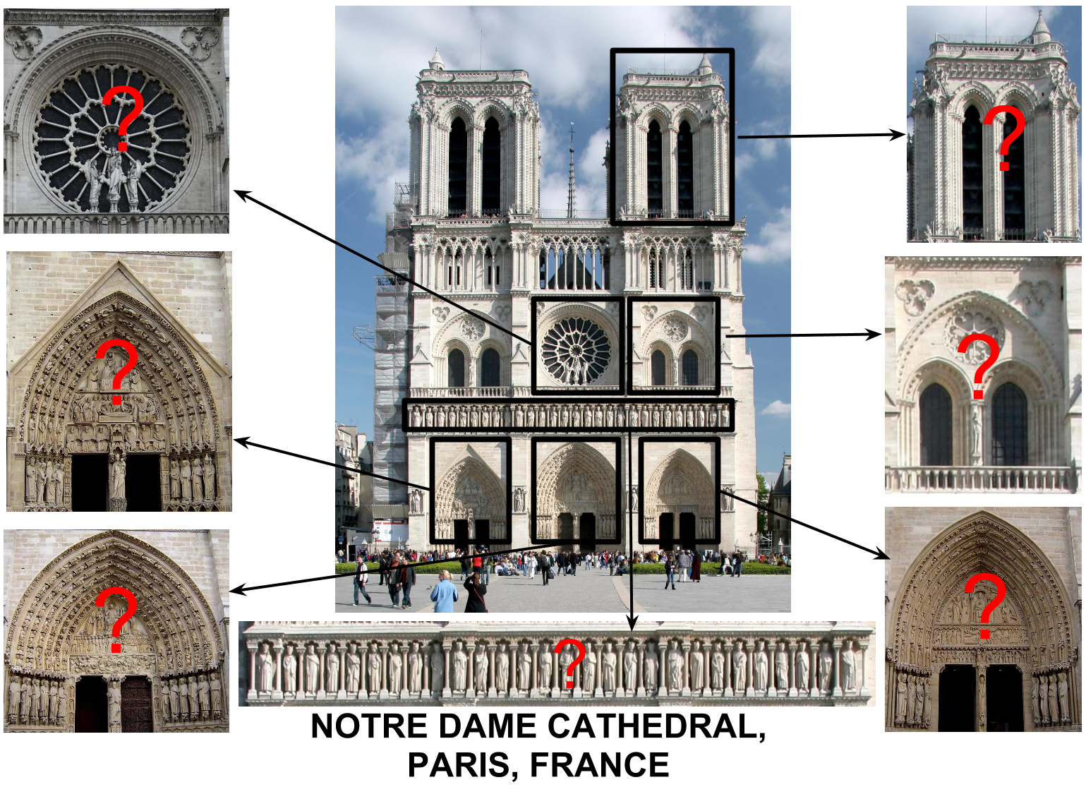
Richer Annotations - Why ?
Image is much more than just a tag !
Image auto-annotation apps for mobiles
Other Advantages:
Better text search to find relevant images
Organized Photo Collections

Slide 13
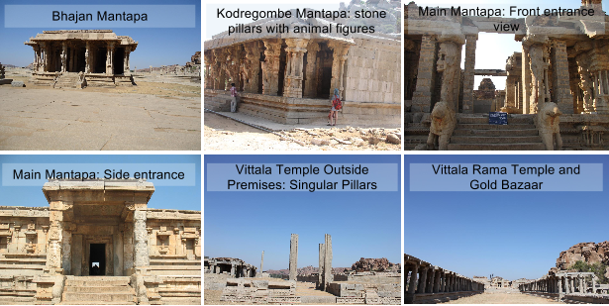
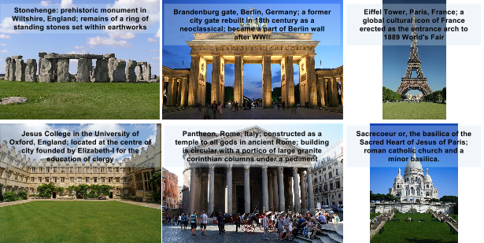
Scene Instances

Slide 14
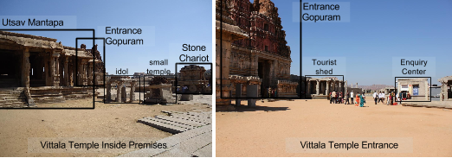
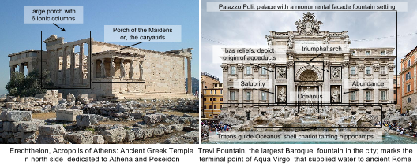
Object Instances

Slide 15
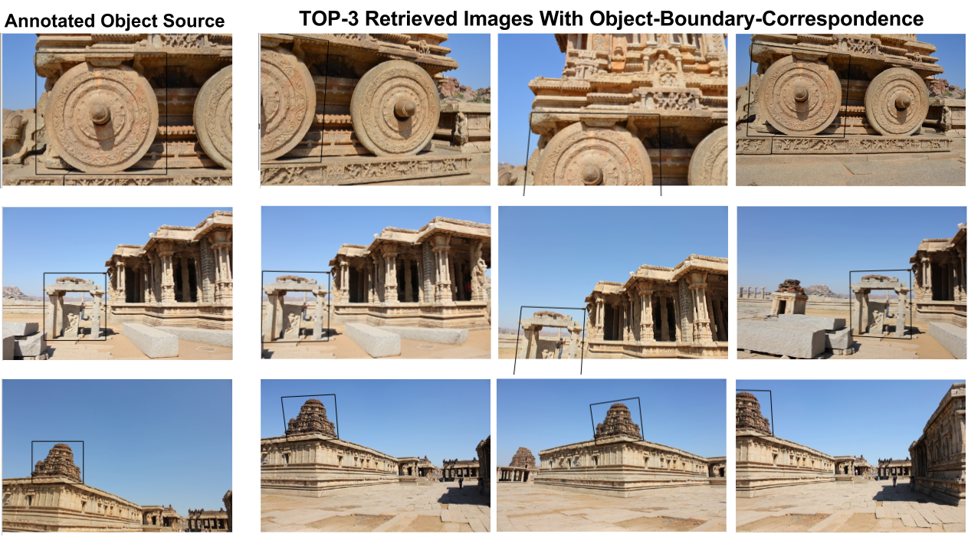
Batch Annotation Approach
Imagine manually annotating thousands of images !
Solution: Annotate for one and propagate to other images in the collection.

Slide 16
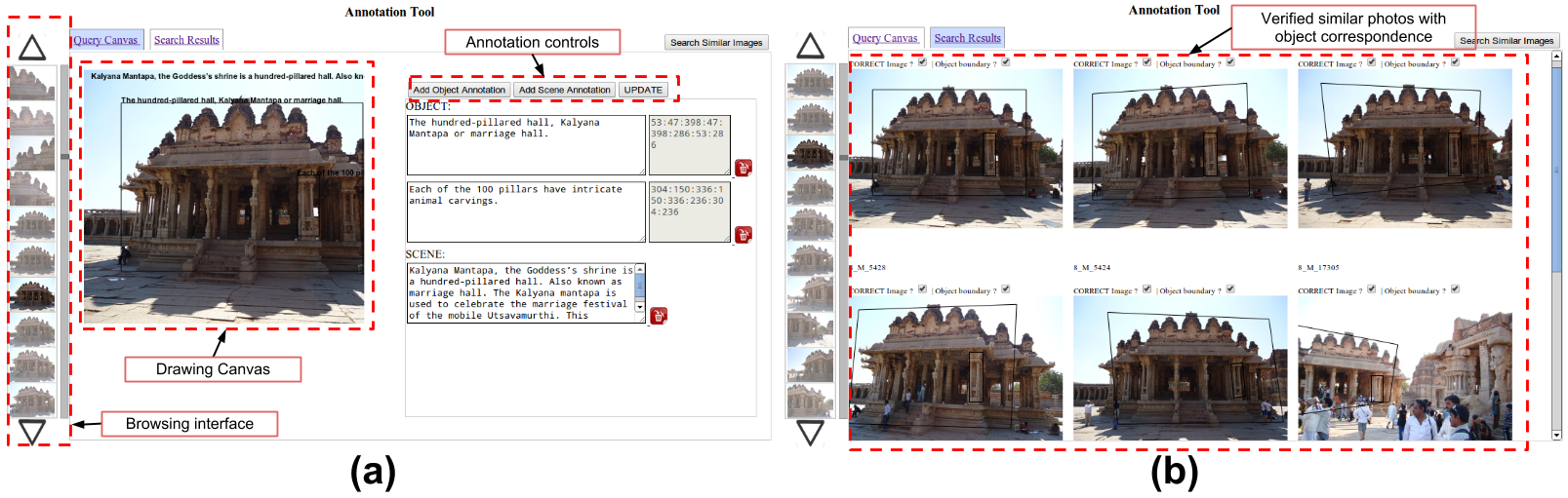
Web-based Social Tool
Annotations on social platforms.
Similar Images grouped together in the tool.
“Popular” images highlighted for priority annotations
[ J Panda and C V Jawahar. Efficient and Rich Annotations for Large Photo Collections. In ACPR - 2013, Naha, Japan]

Slide 17
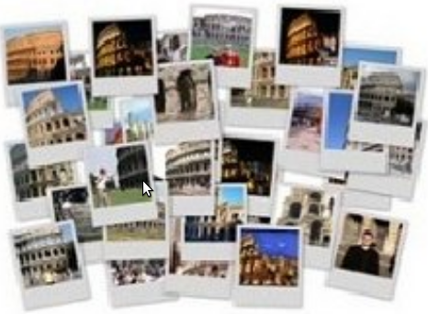
Part-wise, object level finer annotations
Annotate one photo & efficiently propagate
Community Annotation Tool
( EXAMPLE SCREENSHOT )

Slide 18
The complete solution
Efficiently Annotate a large number of images
Image retrieval on a mobile phone for upto 10k images Heritage app requires 50 MB storage and 15 MB RAM. It takes < 1 second for annotations.
Make it more generic and scalable – upto 100k images
[ Heritage App: Annotating Images on Mobile Phones. J Panda, Shashank Sharma, C V Jawahar. ICVGIP-2012, Mumbai, India ]

Slide 19
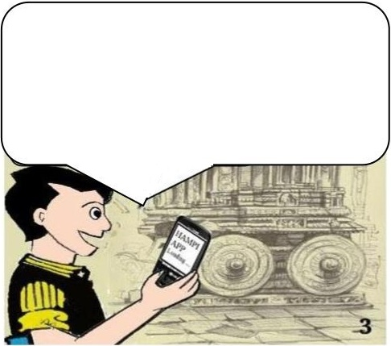
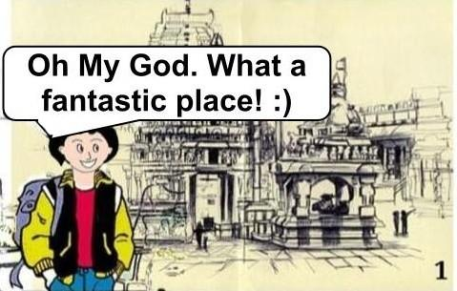
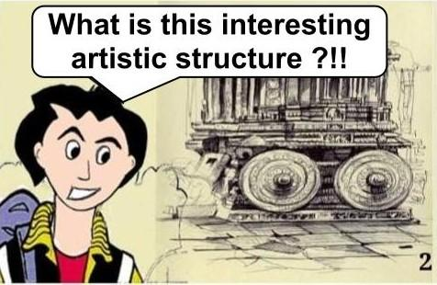
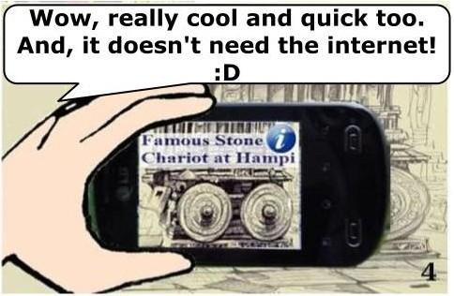
Heritage App: Annotating Images on Mobile Phones
Let me try Heritage App on my phone ☺
Search on your smartphone
Heritage App designed for the location
Works without internet. Well-suited for remote places.
[ Heritage App: Annotating Images on Mobile Phones. J Panda, Shashank Sharma, C V Jawahar. ICVGIP-2012, Mumbai, India ]
Notes:
10/29/11

Slide 20
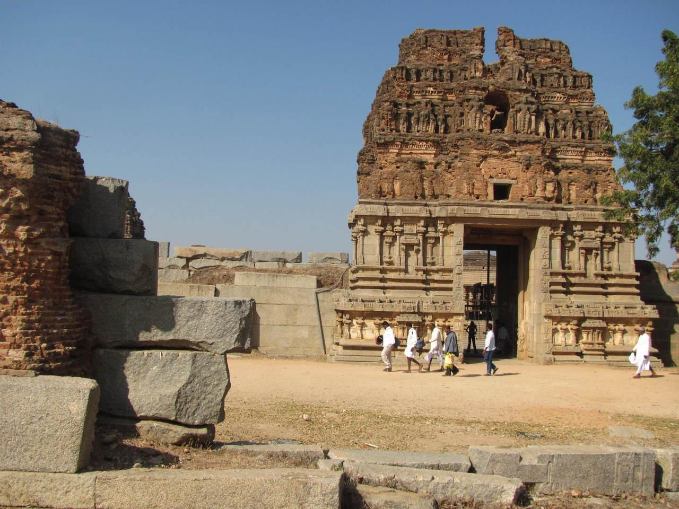
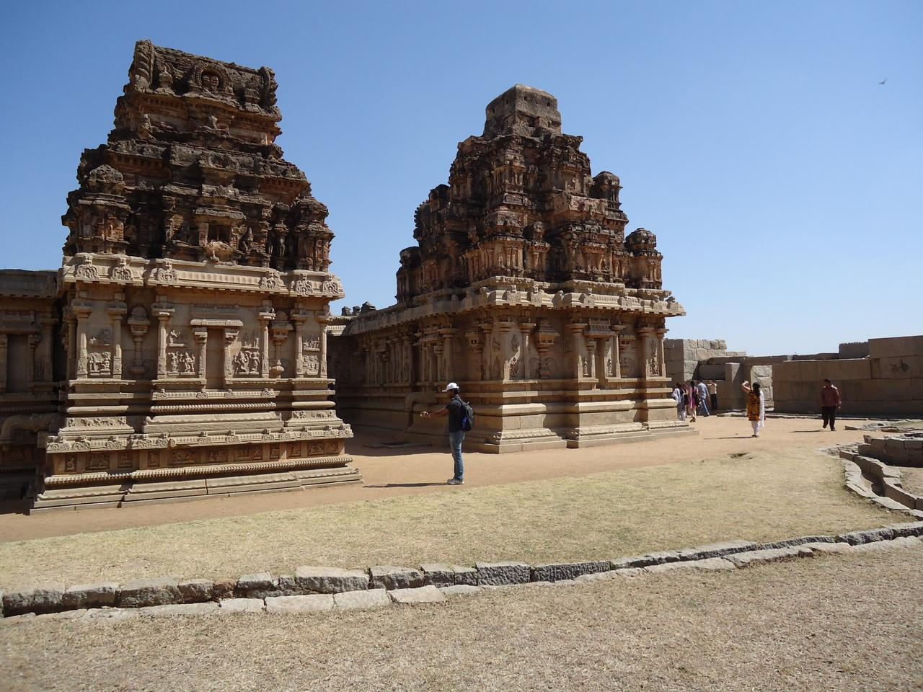
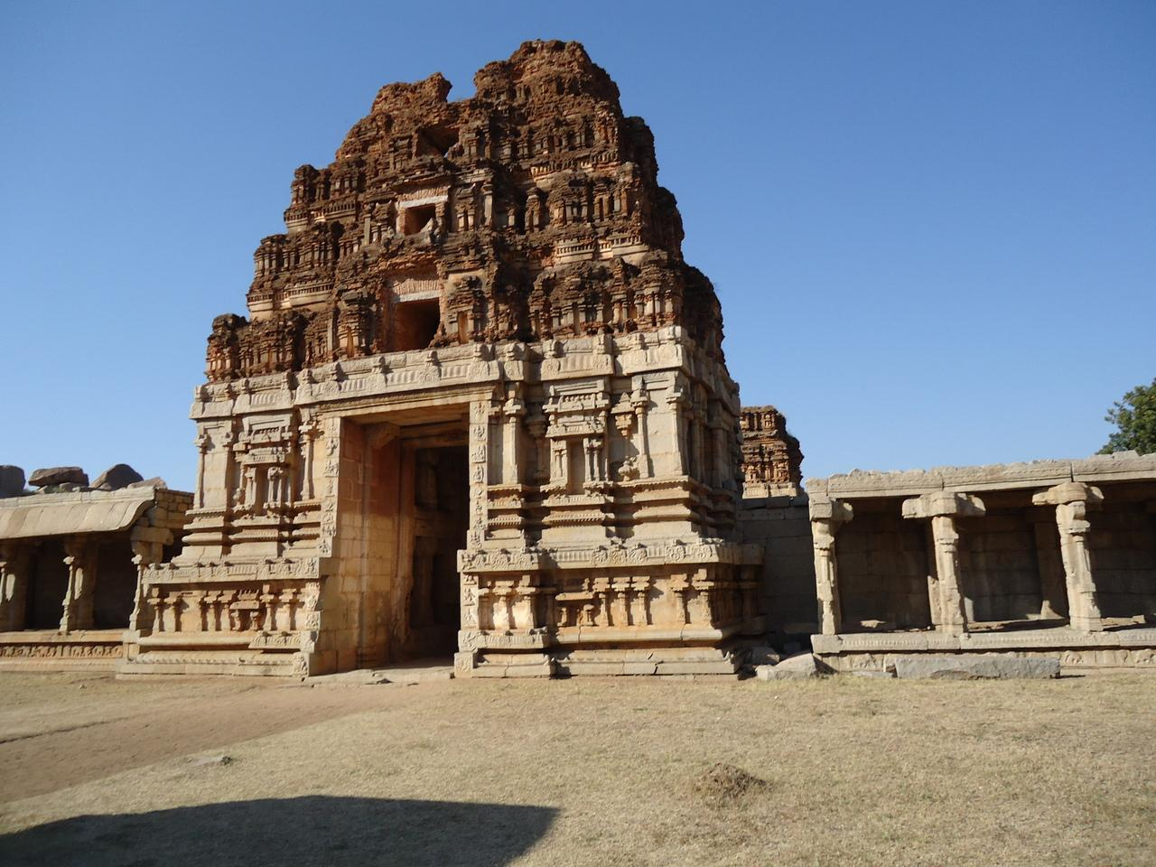
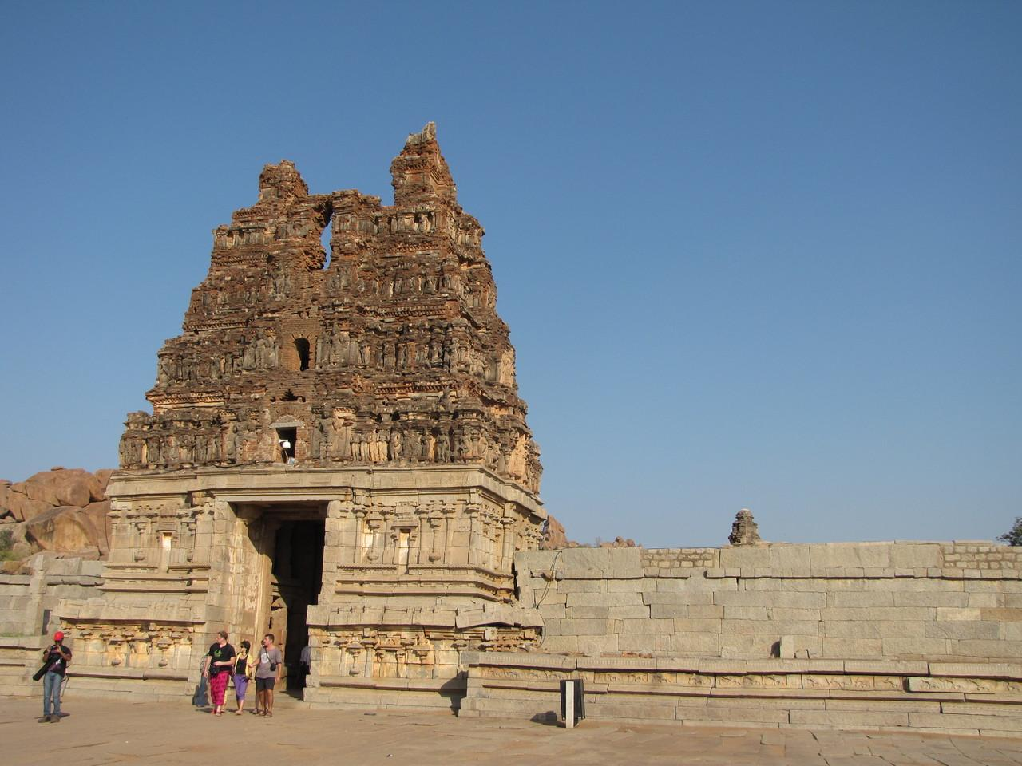
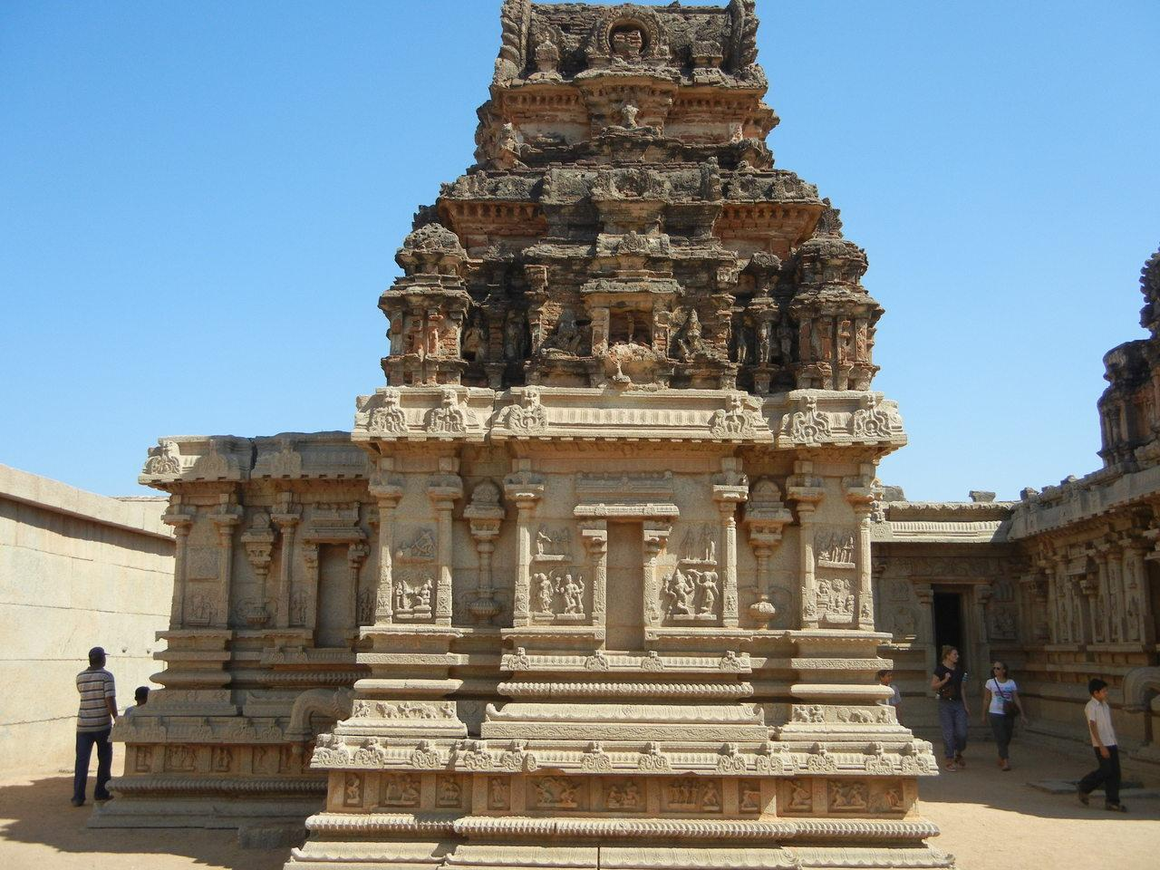
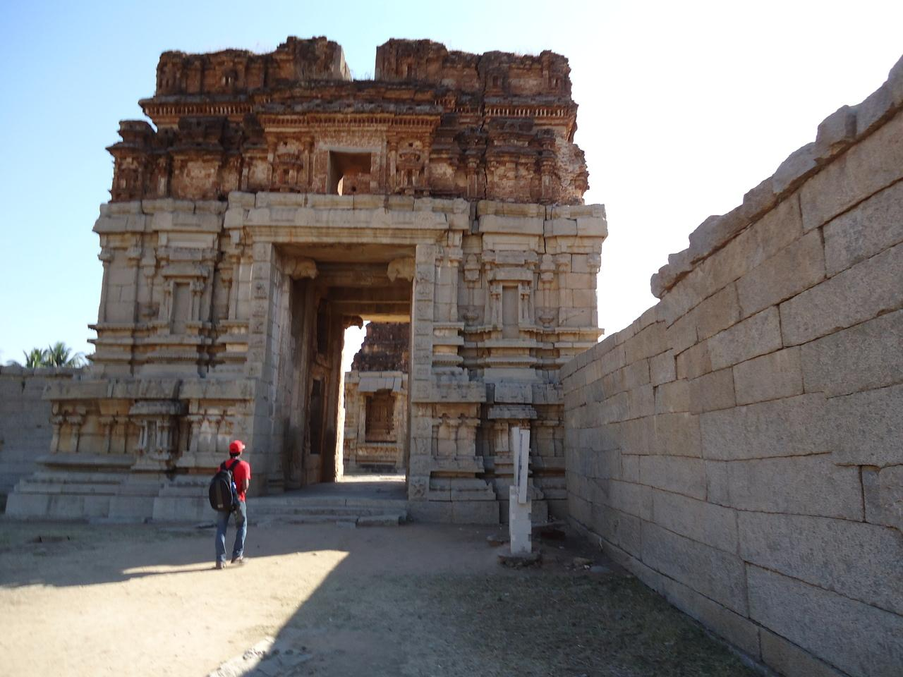
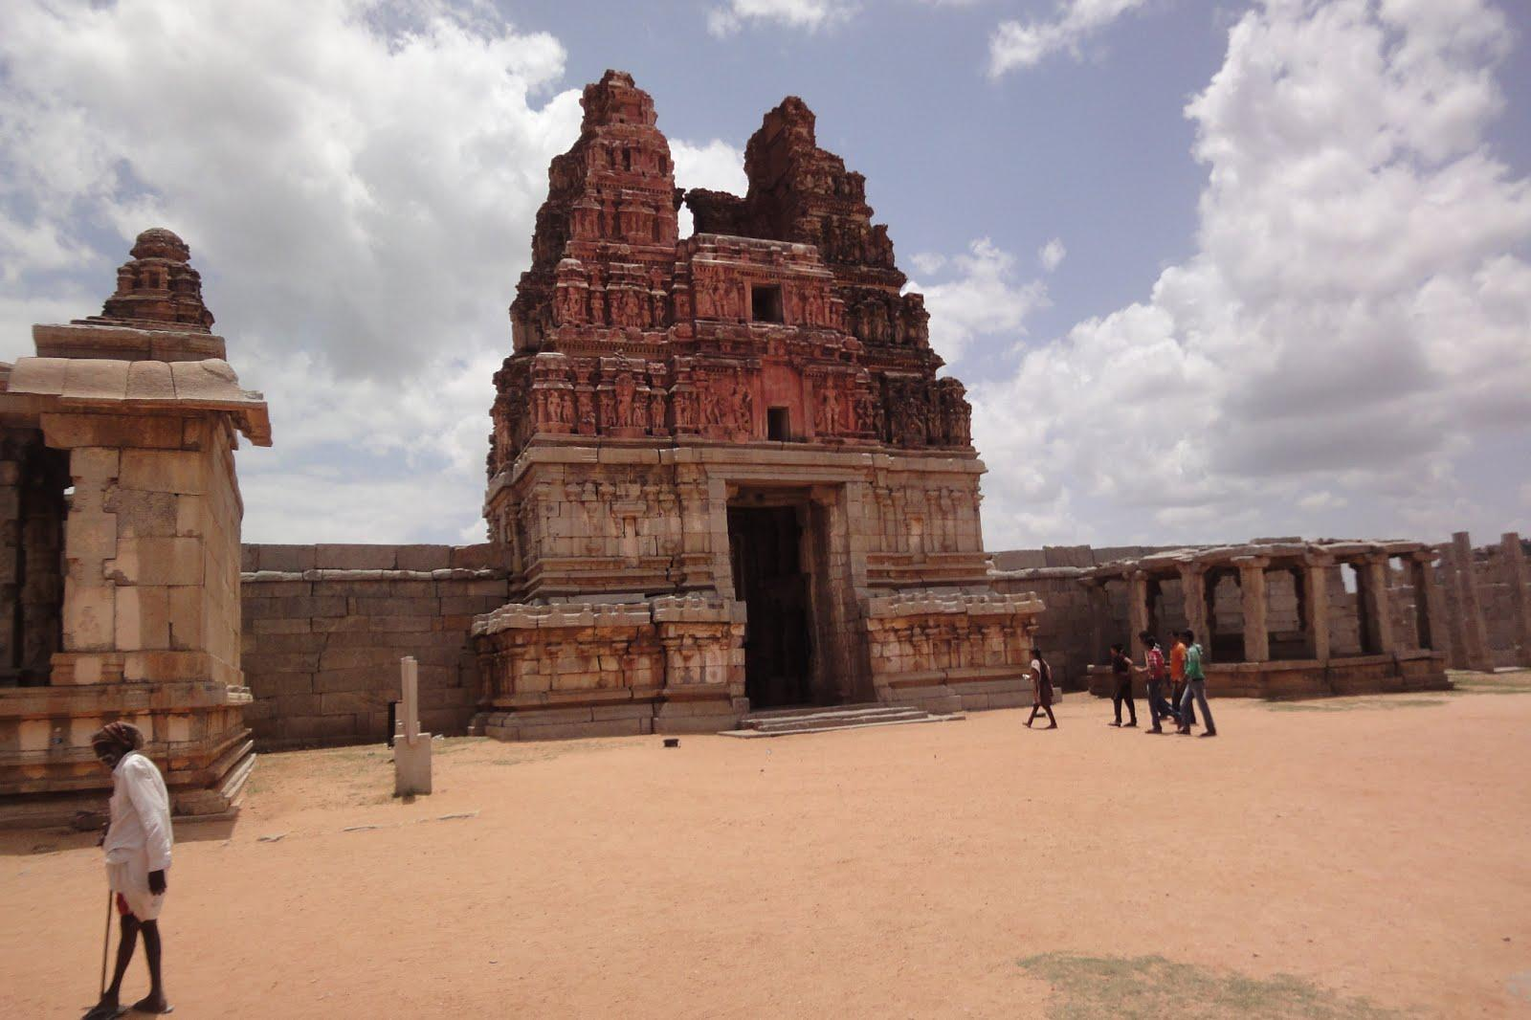
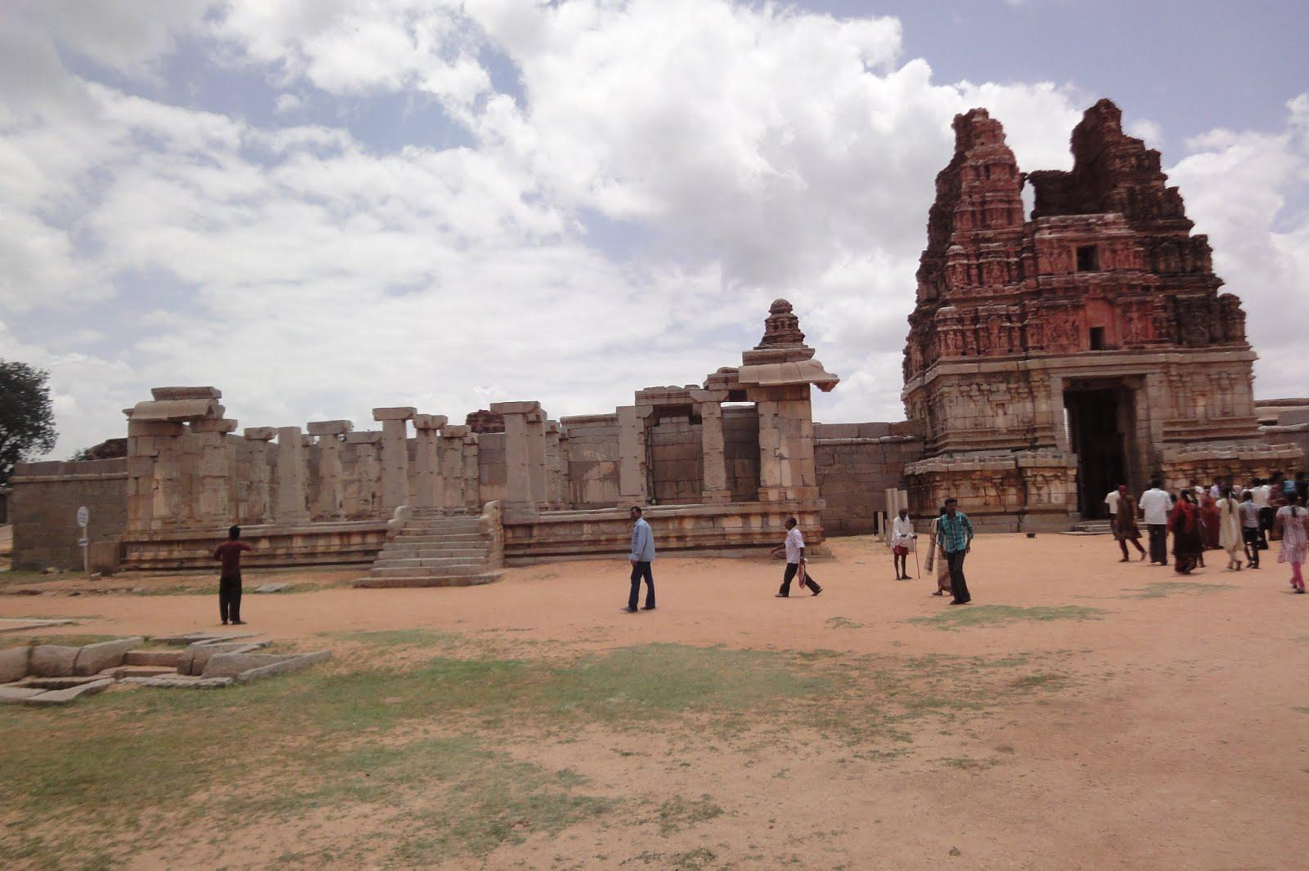
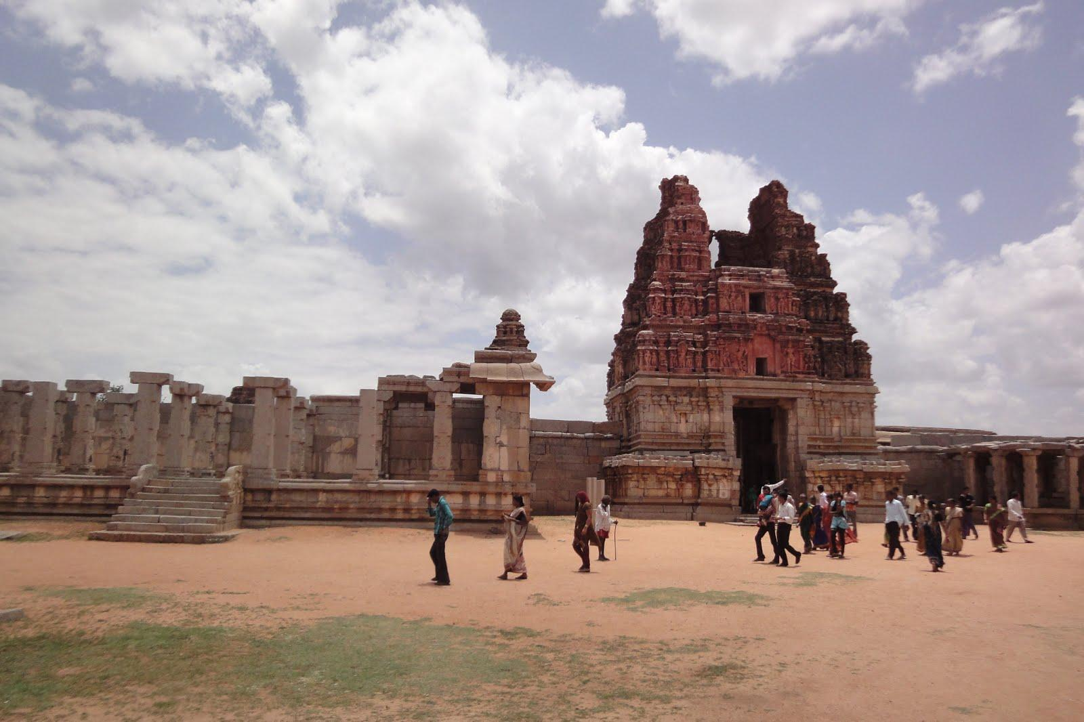
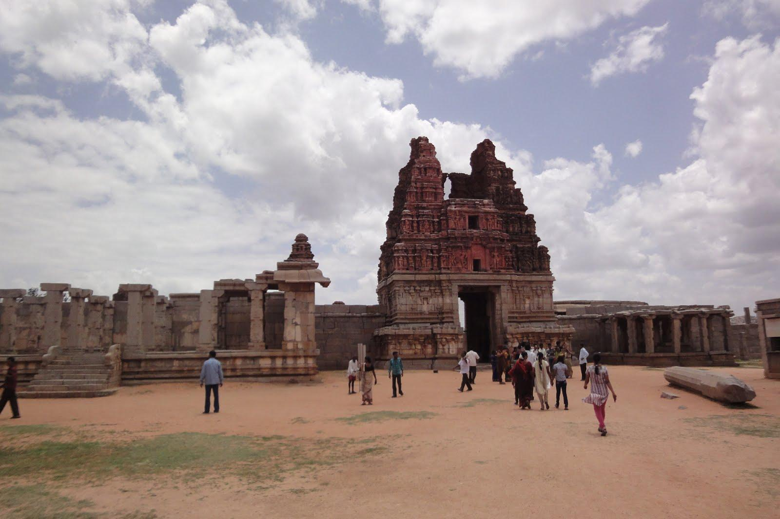
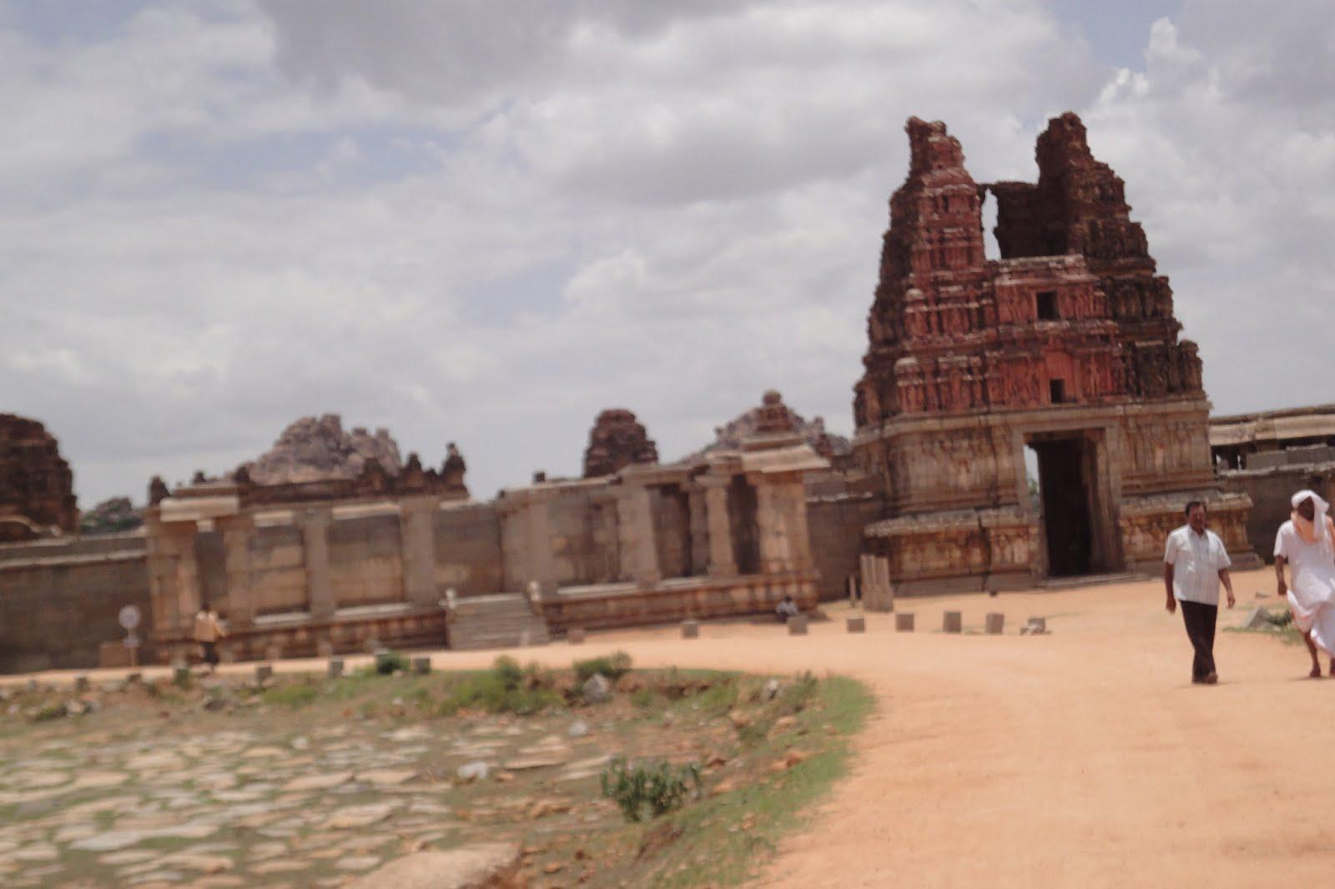

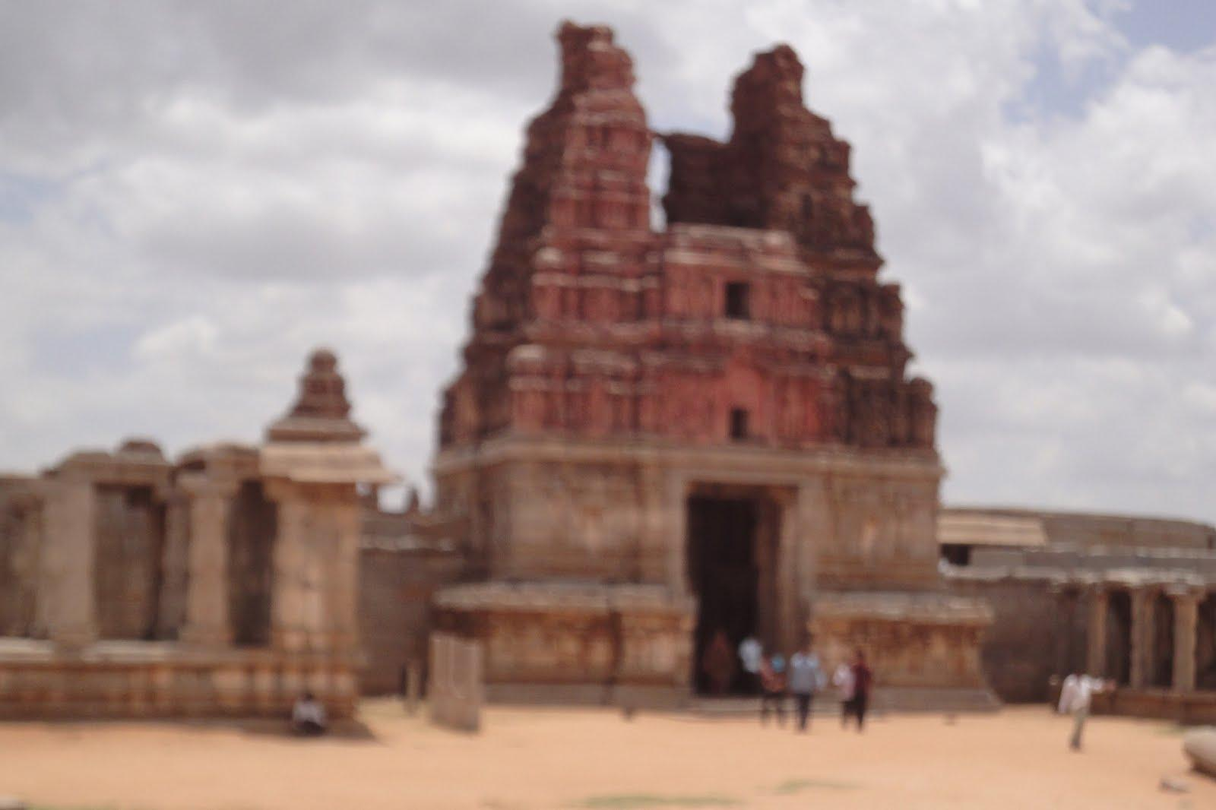
Our Problem:Instance Retrieval
Instance Vs Category Retrieval
CATEGORY Retrieval : Hampi Temples
Vittala Temple Entrance
QUERY IMAGE
INSTANCE Retrieval : Vittala Temple Entrance Images
Notes:
10/29/11

Slide 21
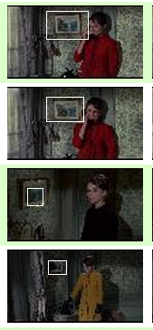
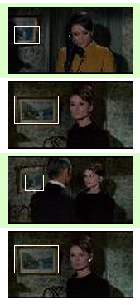
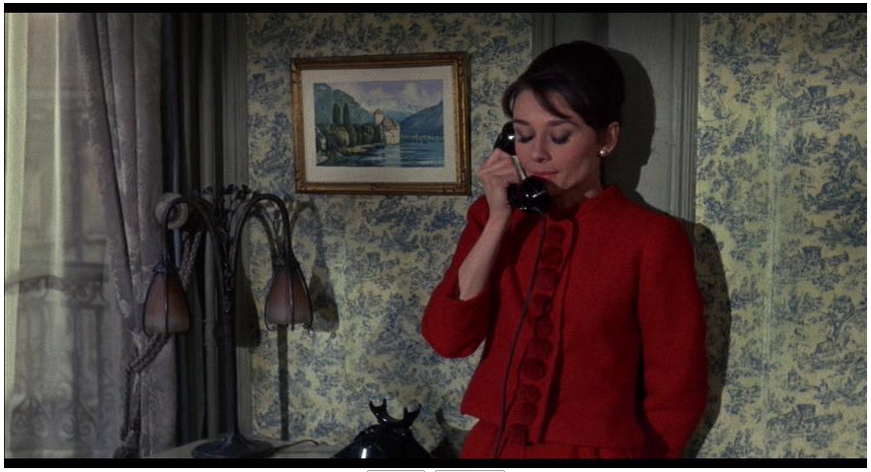

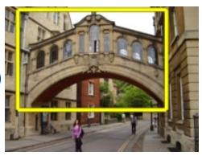
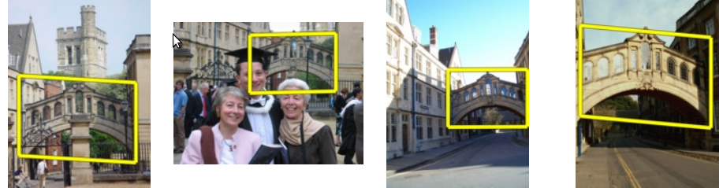
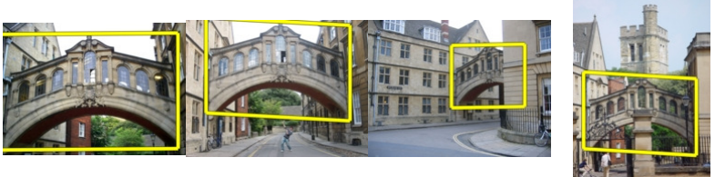
Instance Retrieval
RETRIEVAL RESULTS
QUERY
Oxford Buildings
J Sivic & A Zisserman. Video Google: A Text Retrieval Approach to Object Matching in videos. In ICCV, 2003
Philbin et al. Object retrieval with large vocabularies and fast spatial matching. In CVPR, 2007
Notes:
10/29/11

Slide 22
Instance Retrieval Approach
Bag of Visual Words (BoW)
Summarize entire image based on its distribution (histogram) of word occurrences.
ICCV 2005 short course, L. Fei-Fei
Notes:
10/29/11

Slide 23
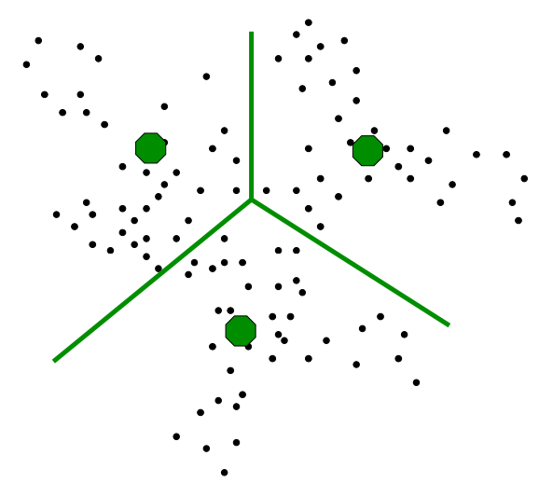

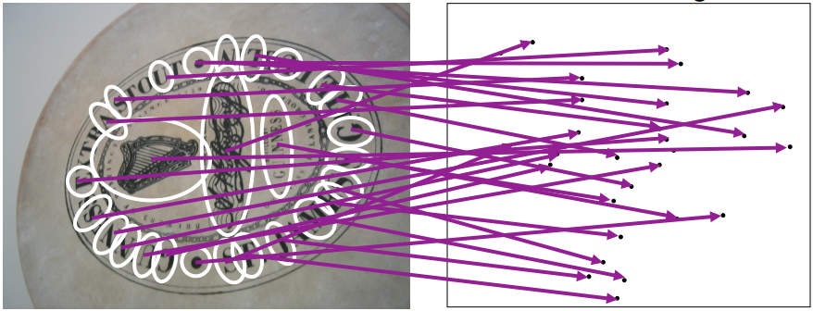
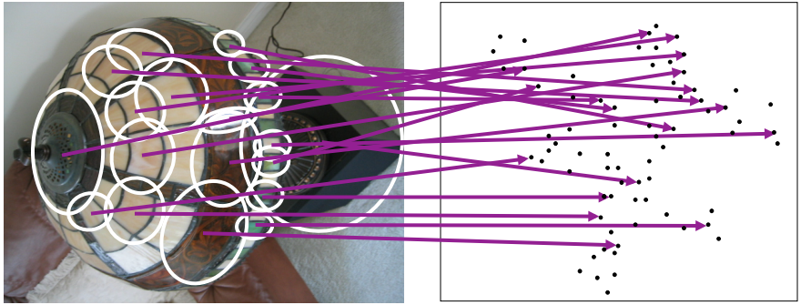


Visual Words: Main Idea
High-dimensional Descriptor Space: For Ex. for SIFT, Each point is 128-dimensional
Each group of patches belong to the same visual word
Scalable Recognition with a Vocabulary Tree, D.Nister, ICCV 2005
Zisserman et al. , ICCV-2003

Slide 24

Comparing Images with BoW
Rank images by normalized scalar product between their (possibly weighted) occurrence counts i.e. nearest neighbor search for similar images.
ICCV 2005 short course, L. Fei-Fei

Slide 25


Efficient Retrieval with Inverted Index
Easy look-up search index
Tf-idf weighting

Slide 26
Instance retrieval on Mobiles
Observation 1: 1GB required for 10K med resolution images.
Only annotations => no image; only features the phone.
1GB -> 600 MB
Observation 2: SIFT requires 128 Bytes. Visual word index needs 4 Bytes.
600MB -> 60Mb
Observation 3: Annotation accuracy is what we need and not average precision.
Precision@1 is the key. No need of ranked list.
Heavy method -> Light-weight method
Observation 4: App is designed for a specific site.
Hampi App need not work for Golkonda and vice-versa.
Optimize parameters for a specific site.
Notes:
10/29/11

Slide 27







Bag of Words on Mobile
OFFLINE:
Extract Features (SIFT)
H-Kmeans Clustering
Codebook
Vocabulary Tree
Vocabulary Tree is stored on mobile phone.
Additional data for internal nodes, but leads to faster quantization.
ONLINE:
SIFT features extracted from query image.
Quantized to visual word indices using Vocabulary Tree.
[ D. Nister and H. Stewenius. Scalable Recognition with a Vocabulary Tree. CVPR '06 ]
Notes:
10/29/11

Slide 28


Fast & Compact Re-ranking
Spatial Matching between the query & the retrieved matches.
Matching 128-dim SIFT vectors b/w images (a).
Our method: Compare the visual word index(b) at the keypoints followed by RANSAC -based Fundamental Matrix fit.
Fewer matches, but no need to carry SIFT vectors anymore !
Not interested in ranked list, just the RANK-1 match.
Each feature: 128-dim SIFT vector
(a) Matching with 128-dim SIFT vectors.
Each feature: an INTEGER index for a visual word.
(b) Matching visual words in two images
Notes:
10/29/11

Slide 29

Vocabulary Pruning
Remove less relevant visual words.
Compact Index with minimal performance loss.
Method-1: Unsupervised
Less discriminating visual words.
Visual word V_{i} is removed if n_{i} <= T_{L} or n_{i} >= T_{H}
n_{i} : no of images that vi is indexed to.
Method-2: Supervised
Perform image retrieval step for a labeled set of training images.
Score visual words on basis of their correct/incorrect scoring to candidate matches during retrieval.
Remove visual words that have a net negative score.
Notes:
10/29/11

Slide 30
Database Pruning
Remove semantically similar & repetitive images.
Further compact index without performance loss.
Reverse Nearest Neighbours (RNN) applied to each database image.
Remove Images from the database that have 0-RNN score.
Performance unaffected.
 | Oxford Buildings | Golkonda
Total Images | 5,062 | 5,500
Pruned Database | 3,206 | 3,536
Original inverted index | 99 MB | 7.9 MB
New inverted index | 76 MB | 4.4 MB
mean AP (before) | 57.55% | -
mean AP (after) | 57.06% | -
Precision at 1 (before) | 92.73% | 96%
Precision at 1 (after) | 97.27% | 94%
Notes:
10/29/11

Slide 31

















Images from Heritage Sites
Golkonda Fort
Hyderabad India
Hampi Temples
Karnataka India
5,500 Images
45 distinct annotations
5,718 Images
120 distinct annotations
Notes:
10/29/11

Slide 32

Scenes and Objects
scene: distinguished structures captured in an image.
object: distinguished monument or building identified by rectangular bounded box.
Notes:
10/29/11

Slide 33

Results on Golkonda Dataset
# of Images | 5500
# of monuments for test | 14
# of Queries | 168
Annotation Accuracy | 96%
Notes:
10/29/11

Slide 34


Results on Hampi Dataset
Vittala Temple Main
Stone Chariot shrine with elephants in front
# of Images | 5718
# of monuments for test | 10
# of Queries | 60
Annotation Accuracy | 93%
Notes:
10/29/11

Slide 35

Pseudo-GPS Navigation
Click few photos of distinctive structures around you.
Your position displayed on map of the site.
Experimented on the 2 km Golkonda Fort tourist route.
Trained on 43 nodal points (discrete locations)
each spanning 4-5 meters & separated by 10-11 meters
Notes:
10/29/11

Slide 36

At HazaraRama Temple, Hampi
Stone carvings on temple walls depicting scenes from The Ramayana.
Each scene represents an event from the epic story. Sample retrieved annotations for 4 diffrent scenes.
Notes:
10/29/11

Slide 37
Query Time Analysis on Mobile
 | Time (in seconds)
App Loading
Reading Data | 12
Frame Processing
SIFT Detection | 0.250
SIFT Descriptor Extraction | 0.270
Assigning to Vocabulary | 0.010
Inverted Index Search | 0.260
Spatial Re-ranking | 0.640
Annotation Retrieval | 0.010
Total | 1.440
Notes:
10/29/11

Slide 38

Identify this scene from Ramayana !
Notes:
10/29/11

Slide 39

Query it on Heritage App
[ Heritage App: Annotating Images on Mobile Phones. J Panda, Shashank Sharma, C V Jawahar. ICVGIP-2012, Mumbai, India ]
Notes:
10/29/11

Slide 40

Demo at Golkonda Fort

Slide 41
The complete solution
Efficiently Annotate a large number of images
Image retrieval on a mobile phone for upto 10k images
Make it more generic and scalable – upto 100k images Heritage app++ extended support for 50K-100K images within 30 MB storage and RAM.
[ Offline Mobile Instance Retrieval with Small Memory Footprint. J Panda, Michael Brown, C V Jawahar. ICCV-2013, Sydney, Australia ]

Slide 42
Scalability Issues
Size of the search index
Increases linearly with the number of images
Image feature locations for Spatial Matching
Lot of extra storage
Consumes half the time during retrieval

Slide 43


Bag of Visual Phrases
Visual Phrase (n-gram): A combination of visual words occurring together in image.
Visual word - no context
Visual Phrase - a phrase in two images may be same context
Geometry-preserving visual phrase (GVP) – spatial consistency
Increases the size of the inverted index
[From Bag-of-Visual-Words to Bag-of-Visual-Phrases using n-Grams. Pedrosa et al. SIBGRAPI-2013]
[Image Retrieval With Geometry-Preserving Visual Phrases. Zhang et al. CVPR-2011]

Slide 44

2-word-phrases based Pruning
Entire space of 2-word-phrase or a bi-gram for a vocabulary. i.e. If |vocabulary| = 10,000 # possible 2-word-phrases = 10^8
Consistent 2-word-phrases i.e. 2-word-phrases that occur in more than 1 image # consistent 2-word-phrases << 10^8
Prune visual words that are not in consistent phrases.
Overfit. Fits our scenario, i.e. solution designed for one site.
Consistent P₁₀, P₅, P₁ without Spatial Matching
Index size reduces without loss in performance

Slide 45

Indexing 2-word-phrases for retrieval
Build search index with only consistent 2-word-phrases

Slide 46

Geometry-Aware 2-word-phrases
Introduces weak geometric constraint
Prunes the 2-word-phrase space and reduces search index size
Scale-aware 2-word-phrases words that are consistent across scale.
|(log(s_{i}) – log(s_{j}))| < Ƭ,
where, s_{i} = scale level of feature w_{i},
s_{j} = scale level of feature w_{j}
Space-aware 2-word-phrases - words that are consistent in space. - loose spatial constraint with 2-bits - Index key:
{p_{k}, q_{ij}} = {w_{i}, w_{j}, q_{ij}},
where q_{ij} = 0,1,2,3

Slide 47

Geometry-Aware 2-word-phrases
Spatial Validity Constraints words that are consistent with spatial matching
Prune useless features - occlusions and unstable points.
Features not consistent in similar views
Unsupervised approach:
For each database image, perform retrieval
Retain features after Geometric Verification
i.e. inlier features after a fundamental matrix fit

Slide 48


Analysis of 2-word-phrases
Geometric Consistency
- Matches consistent with varying view directions
- Much lesser chances of false positive matches as with words
- Geometric verification avoided when matching phrases.
Low Memory Footprint
- Consistent with Precision at K (P_{K}) evaluation measure
Notes:
10/29/11

Slide 49



Experiments & Results
Datasets:
Performance Evaluation:
[ Offline Mobile Instance Retrieval with Small Memory Footprint. J Panda, Michael Brown, C V Jawahar. ICCV-2013, Sydney, Australia ]
Notes:
10/29/11

Slide 50

Experiments & Results
Computational Time Analysis on a 1GHz Mobile Phone
Extracting SIFT descriptors consumes half the time.
Computing 2-word-phrases from query is also costly.
Avoiding geometric verification, the focus is on P_{K}.
[ Offline Mobile Instance Retrieval with Small Memory Footprint. J Panda, Michael Brown, C V Jawahar. ICCV-2013, Sydney, Australia ]
Notes:
10/29/11

Slide 51


Experiments & Results
Heritage App++
50K image dataset, 100K vocabulary
(480x360) resolution images
Compact search Index of 25 MB
Successfully field tested at Hampi
Sample queries and the top-3 retrievals
[ Offline Mobile Instance Retrieval with Small Memory Footprint. J Panda, Michael Brown, C V Jawahar. ICCV-2013, Sydney, Australia ]
Notes:
10/29/11

Slide 52

Demo at Hampi

Slide 53


Future Work
Camera mounted on head
Beyond Heritage App
Localization on wearable computers
Dynamic Multi-resolution “Story Telling”
Configurable mobile computer vision app.
Vision algorithms deal with large number of images
Design configurable app to work in mobile processing environment with low memory footprint.
Audio feedback guide
Notes:
10/29/11

Slide 54




Future Work (contd.)
Revisiting History on a Mobile phone.
How we want to see it
And, all using a mobile device!
What exists now
What existed before

Slide 55


Introduction to Wazzat Labs

Slide 56
THANK YOU
Notes:
10/29/11

