Slide 1
Repetition Detection and Shape Reconstruction in Relief Images
Harshit Agrawal
MS by Research
200802013
Advisor – Dr. Anoop M. Namboodiri

Slide 2
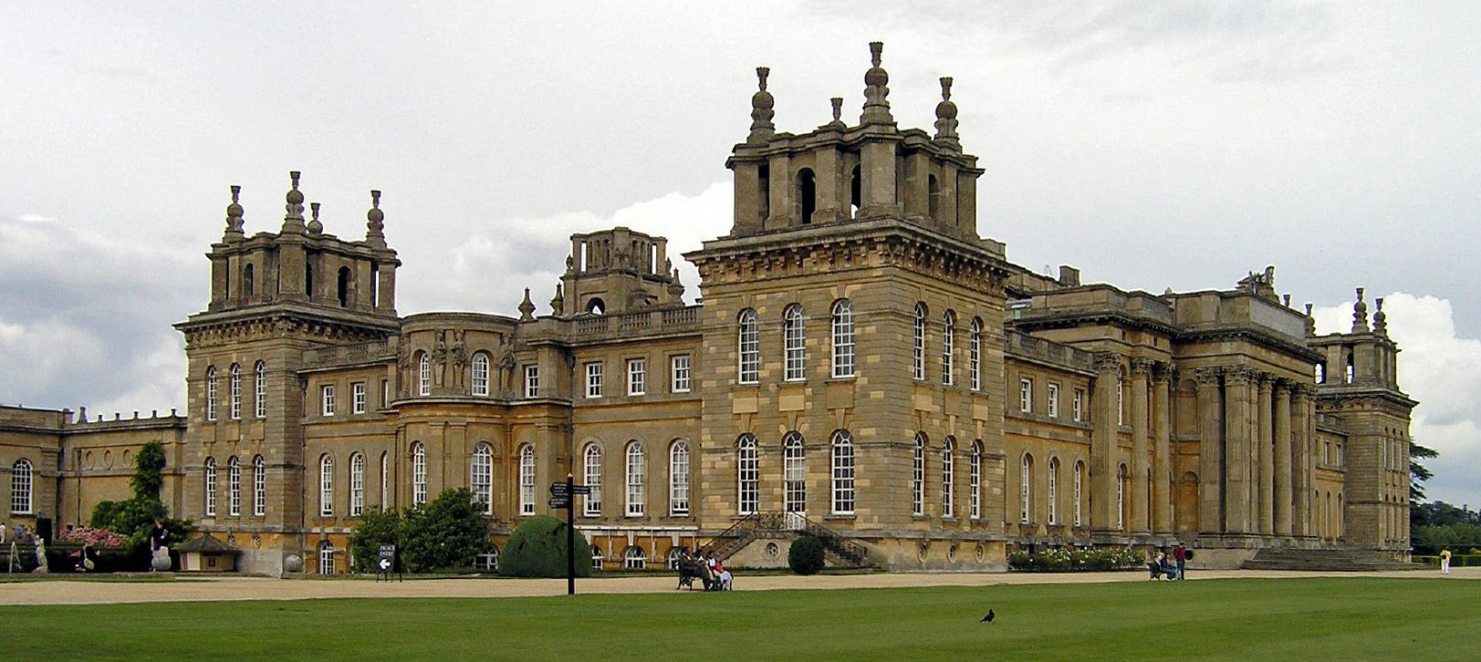
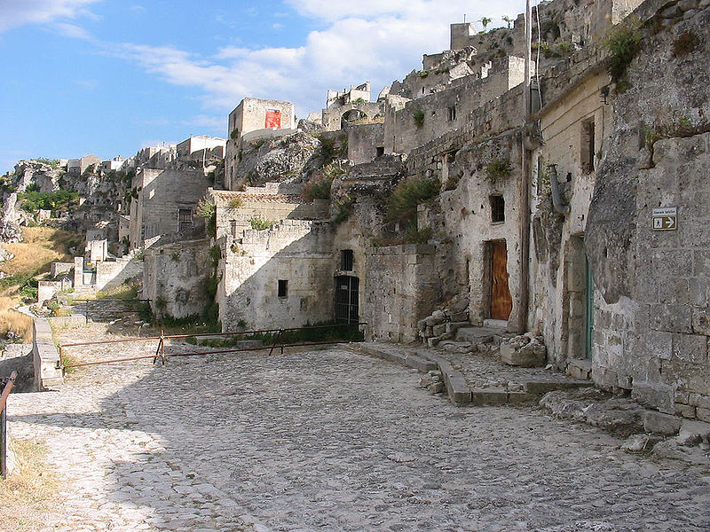
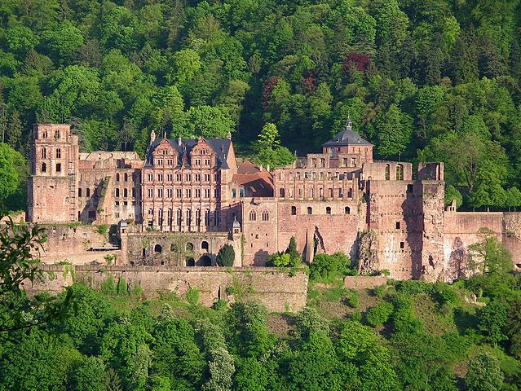
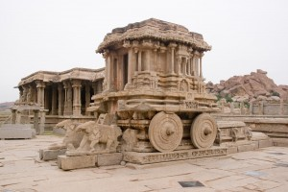
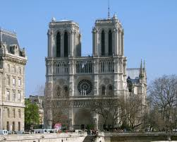
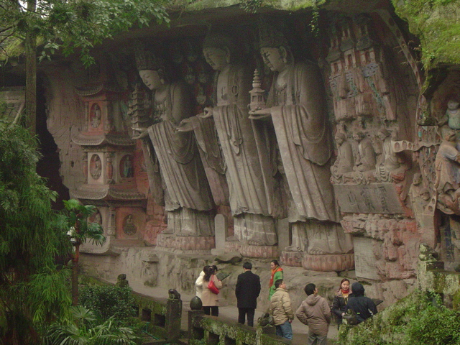
Cultural Heritage Sites of the World
Buildings, Monuments, Places of Worship, Castles and Work of Art.
Blenheim Palace, England
Sassi, Caves in Italy
Heidelberg Castle, Germany
Stone Chariot, Hampi, India
Notre Dame Cathedral, Paris
Dazu Rock Carvings, China
[Image Sources: Wikipedia.org]
Notes:
Blenheim Palace of England,
Sassi, ancient cave dwellings in Italy
Heidelberg Castle and historical town, One of the Germany’s most famous castle ruins
Stone Chariot, Hampi, India
Notre Dame Cathedral in Paris,
Dazu Rock Carvings in China

Slide 3
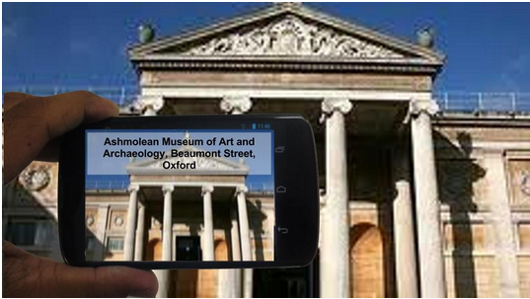
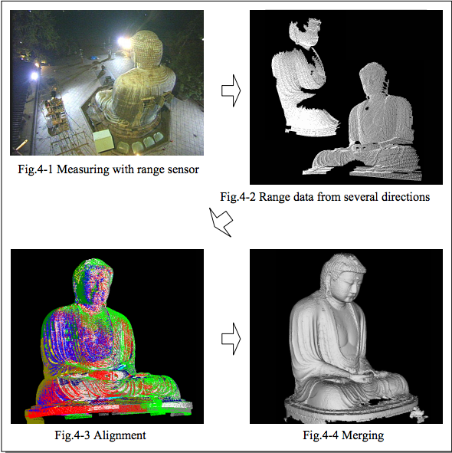
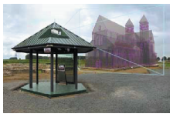
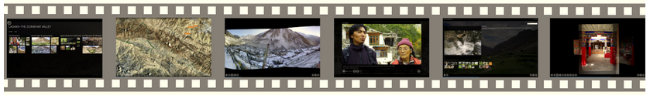
Role of Computer Vision
Offline Mobile Instance Retrieval, Panda et al
Augmented Reality, Pletinckx et al.
Great Buddha Project, Ikeuchi et al.
Rich Interactive Narratives, Microsoft Research
Notes:
CULTURAL HERITAGE RECORDING WITH LASER SCANNING, COMPUTER VISION AND EXPLOITATION OF ARCHITECTURAL RULES
Great Buddha Project

Slide 4
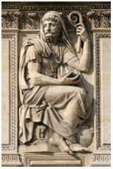
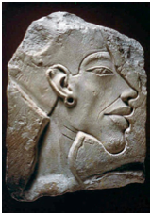
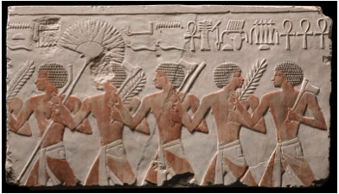
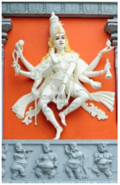
What are Reliefs?
A fascinating sculpture technique where the sculpted material seems to be raised above the background plane.
Reliefs are chiseled out of a flat surface of stone or wood thereby lowering the background field and the unsculpted parts seemingly raised.
Example of High Relief
Example of Bas Relief
Example of Sunken Relief
[Image sources: Wikipedia, Flickr, Google Images]
Example of High Relief
Notes:
10/29/11

Slide 5
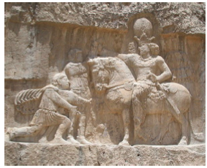
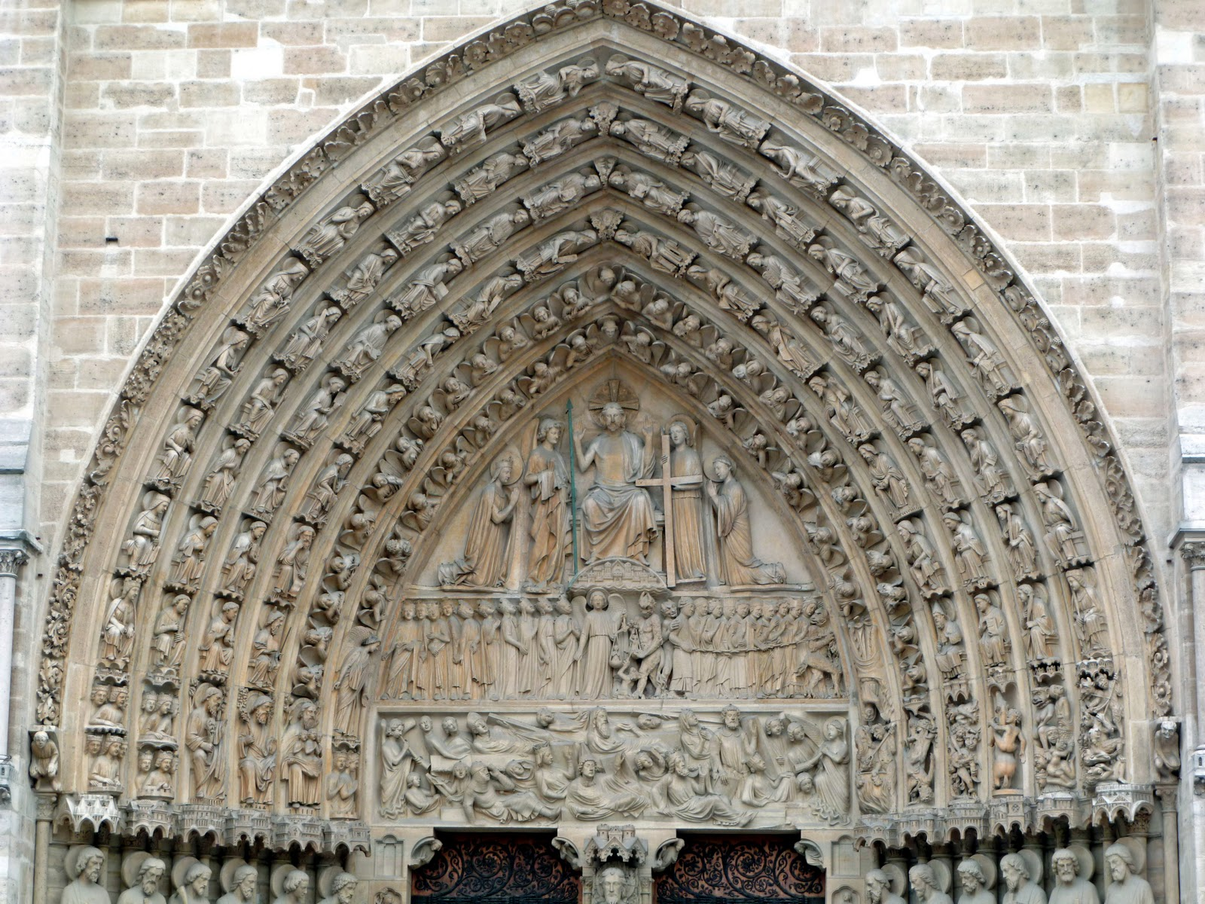
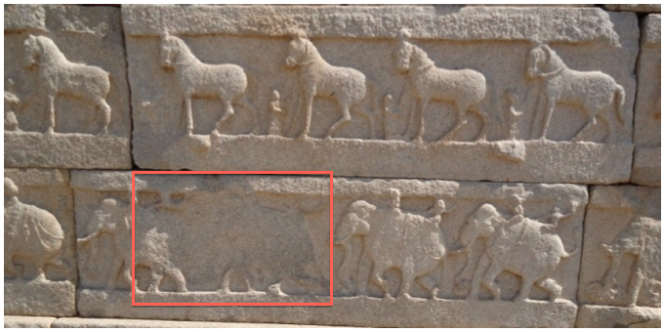
Conserve Reliefs digitally
Popular form of decoration from ancient times.
Fascinating medium to artistically depict stories and events.
Parts of it get broken or damaged with time.
Notes:
10/29/11

Slide 6
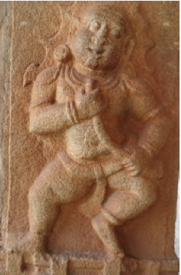
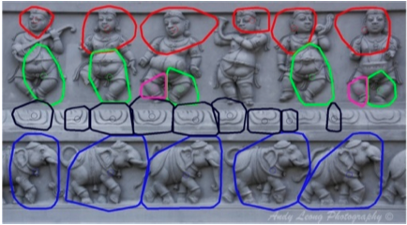
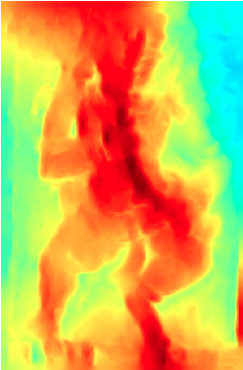
Our Contributions
Detection and Segmentation of Approximate Repetitive patterns in Relief Images.
Shape Reconstruction from a Single Relief Image.
Notes:
10/29/11

Slide 7
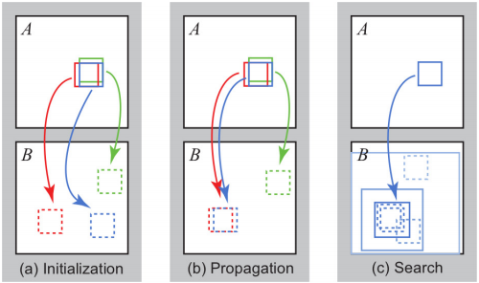
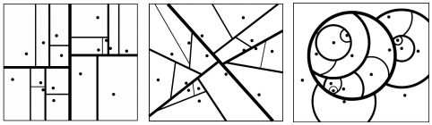
Patch Matching : Significant component in vision applications
General Purpose Nearest Neighbor Algorithms.
Tree-based Methods. kd-trees, PCA trees, vantage point trees
PatchMatch and Generalized PatchMatch
(a) kd-Tree
(b) PCA Tree
(c) vp-Tree
[Kumar et al. What is a good nearest neighbors algorithm for finding similar patches in images?]
[Barnes et al. Patchmatch: a randomized correspondence algorithm for structural image editing.]
Notes:
10/29/11

Slide 8
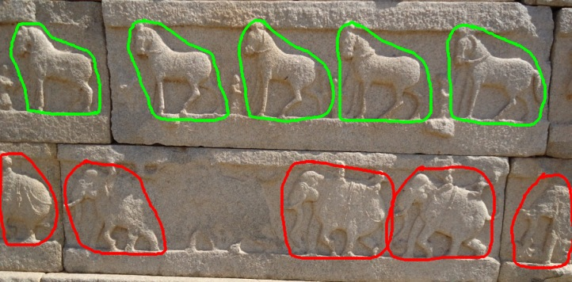
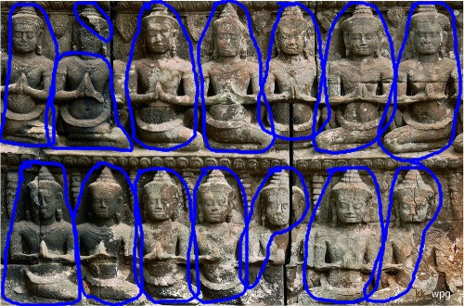
Repetitive patterns in Reliefs
Repetitive patterns can provide useful information.
Reduce redundancy in image.
Fill in for incomplete or missing structures.
Can be exploited in 3D reconstruction from single image.
Can be helpful in image retrieval, image inpainting etc.
Notes:
10/29/11

Slide 9
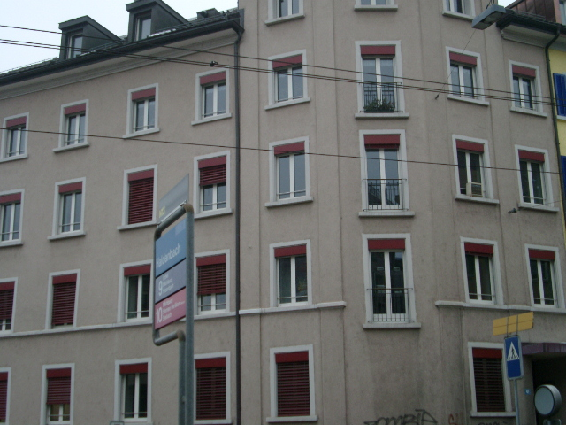
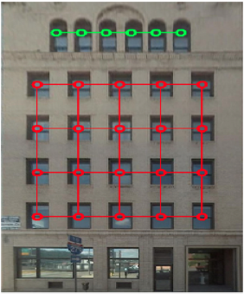
Not Same as Facades …
Wu et al. ECCV 2010, “Detecting Large Repetitive Structures with Salient Boundaries.”
Zhao and Quan CVPR 2011, “Translational symmetry detection in a fronto parallel view.”
Zhao et al. CVPR 2012, “Per-pixel translational symmetry detection, optimization, and segmentation.”
Notes:
10/29/11

Slide 10
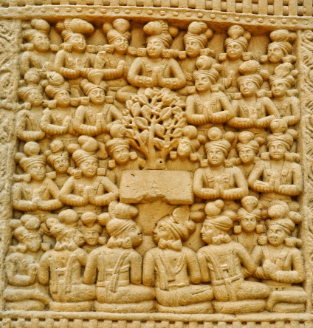
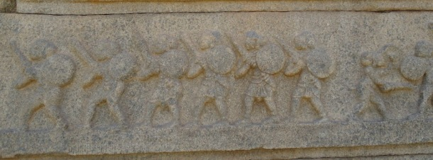
Not Same as Facades …
Repetitions are approximate.
Irregularity in repetitions.
Automatic rectifications to frontal view is difficult.
Unknown repeating instances.
Foreground and background have same texture and color properties.
Notes:
10/29/11

Slide 11
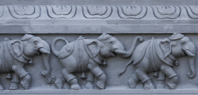
Our Hierarchical Solution
Input Image
Multi-Resolution Pyramid
Pairwise Matching
Grouping Patches
Low-level
matching
High-level
matching
+
Next level matching
+
Merge results from all scales
Detection and Segmentation of Repetitive Patterns
Output
Notes:
Hierarchical Solution: Input Image

Slide 12
Our Hierarchical Solution
Input Image
Scale Factor : 0.95
Total number of levels ~ 12 to 15
Multi-Resolution Pyramid
Pairwise Matching
Grouping Patches
Low-level
matching
High-level
matching
+
Next level matching
+
Merge results from all scales
Detection and Segmentation of Repetitive Patterns
Output
Notes:
Hierarchical Solution: Multi-resolution Pyramid

Slide 13
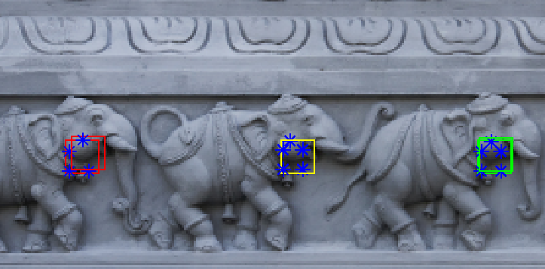
Our Hierarchical Solution
Input Image
Multi-Resolution Pyramid
Pairwise Matching
Grouping Patches
Low-level
matching
High-level
matching
+
Next level matching
+
Merge results from all scales
Detection and Segmentation of Repetitive Patterns
Output
Notes:
Hierarchical Solution: Multi-resolution Pyramid

Slide 14
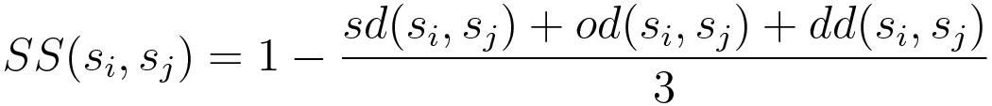
Pairwise Matching
Pairwise Feature Matching (lower level matching)
Extract dense sift feature.
Match each sift feature to its k nearest neighbor.
Keep matches with good similarity score.
Where, sd(si,sj) is scale difference, od(si,sj) is orientation
Difference and dd(si,sj) is descriptor difference
Notes:
Pairwise Matching : Higher Level matching

Slide 15
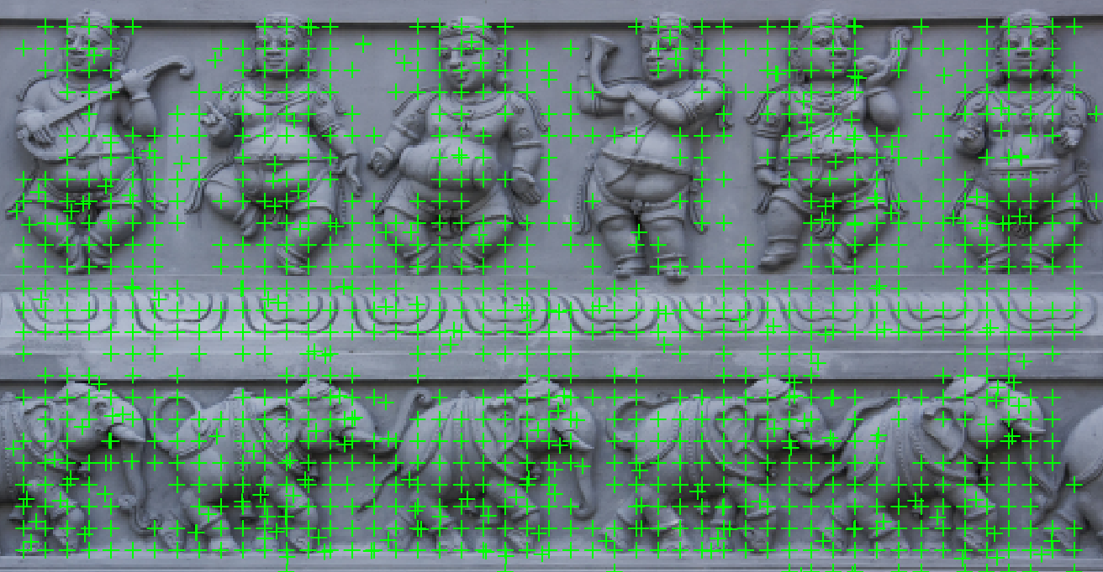
Pairwise Matching
Remove False Matches
Features with trivial and bad matches are removed to increase efficiency and accuracy.
Notes:
Pairwise Matching : Remove False Matches

Slide 16
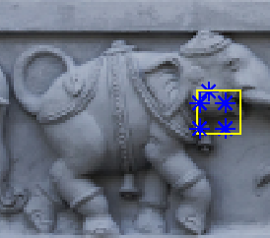

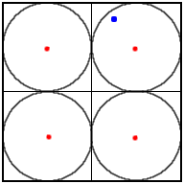
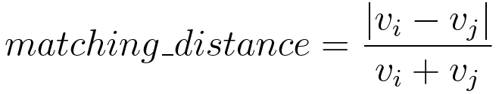

Pairwise Matching
Pairwise Patch Matching (higher level matching)
Find possible matching patches.
Compute matching scores for pairs of patches.
Example
Patch
To find matching scores –
Patches described by v_{i} and v_{j} (4x1 vectors)

Slide 17
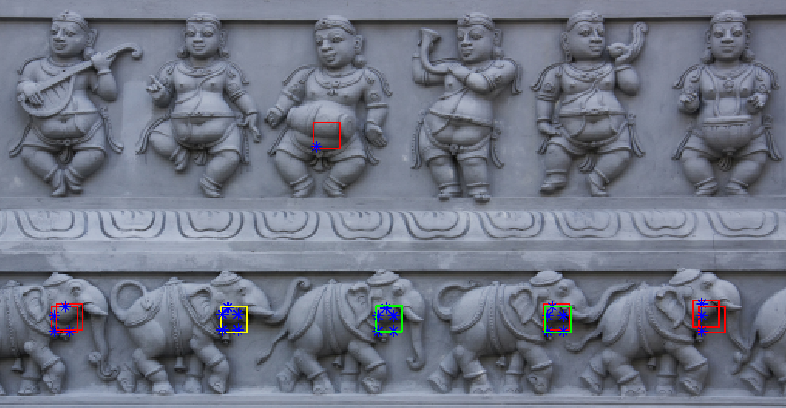
Pairwise Matching
Pairwise Patch Matching (higher level matching)
Yellow patch: source, Green patch: true match, Red patch: false match

Slide 18
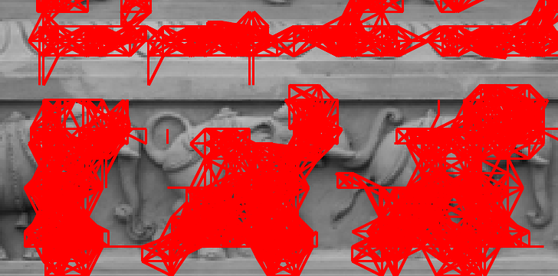
Our Hierarchical Solution
Input Image
Multi-Resolution Pyramid
Pairwise Matching
Grouping Patches
Low-level
matching
High-level
matching
+
Next level matching
+
Merge results from all scales
Detection and Segmentation of Repetitive Patterns
Output
Notes:
Pairwise Matching : Grouping patches

Slide 19
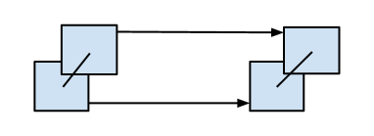
Grouping Patches
Next-level patch matching
Check for similar neighborhood property.
Neighborhood property considers the spatial arrangement of neighboring patches.
p_{b}
matches
p_{bm}
p_{a}
matches
p_{am}
Join p_{a} with p_{b} and p_{am} with p_{bm} if –
Dist(p_{a}, p_{b}) ~ Dist(p_{am}, p_{bm})
Orientation(p_{a}, p_{b}) ~ Orientation(p_{am}, p_{bm})
Notes:
Grouping patches

Slide 20
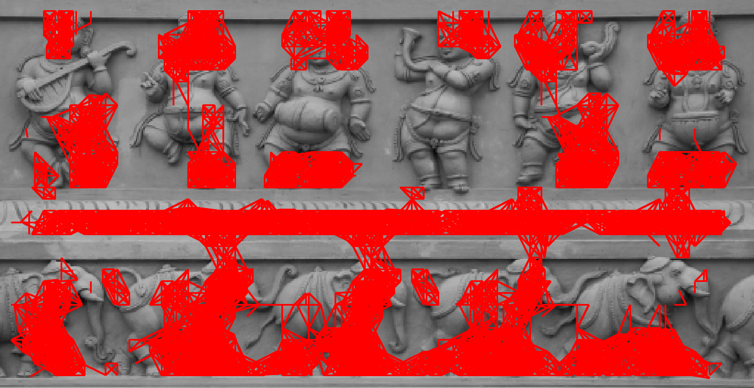
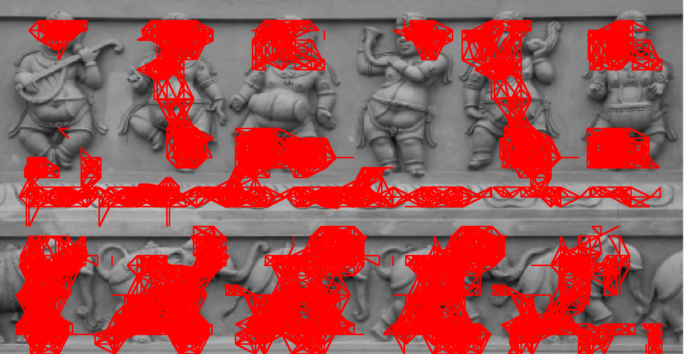
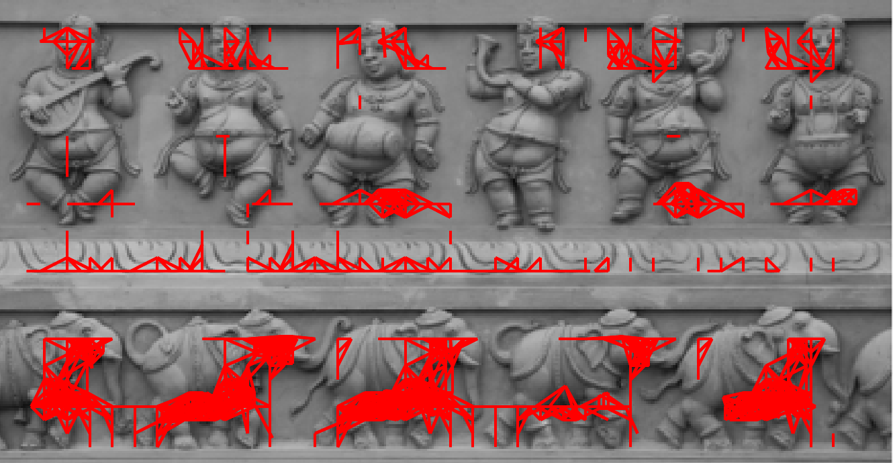
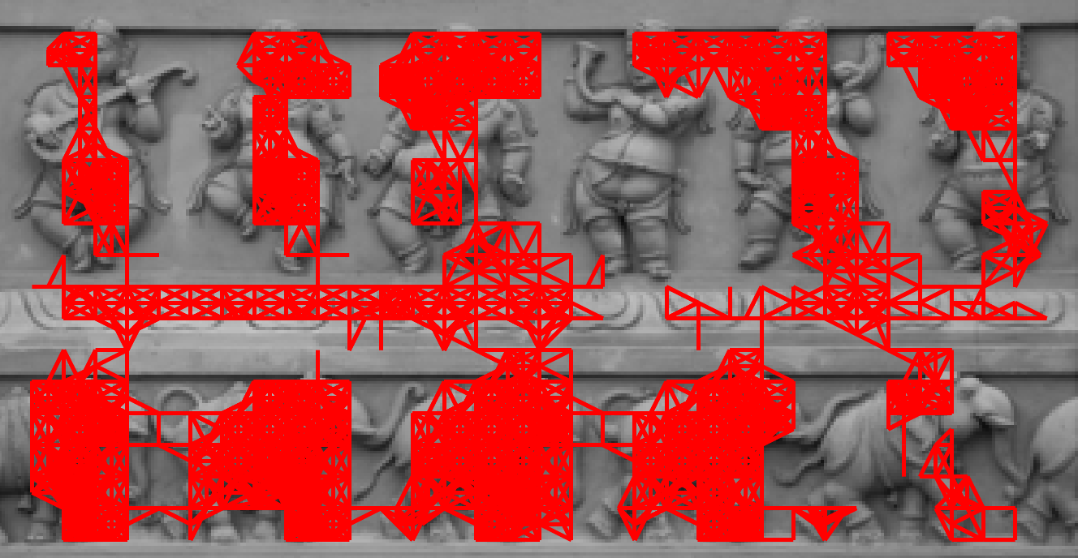
Grouping Patches
Next-level patch matching
Level 1, scale factor = 1.0
Level 3, scale factor = 0.9025
Level 5, scale factor = 0.8128
Level 8, scale factor = 0.6998
Connectivity graphs at various scales of multi-resolution pyramid.
Notes:
Grouping patches

Slide 21
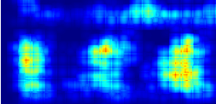
Our Hierarchical Solution
Input Image
Multi-Resolution Pyramid
Pairwise Matching
Grouping Patches
Low-level
matching
High-level
matching
+
Next level matching
+
Merge results from all scales
Detection and Segmentation of Repetitive Patterns
Output
Notes:
Hierarchical Solution: Input Image

Slide 22
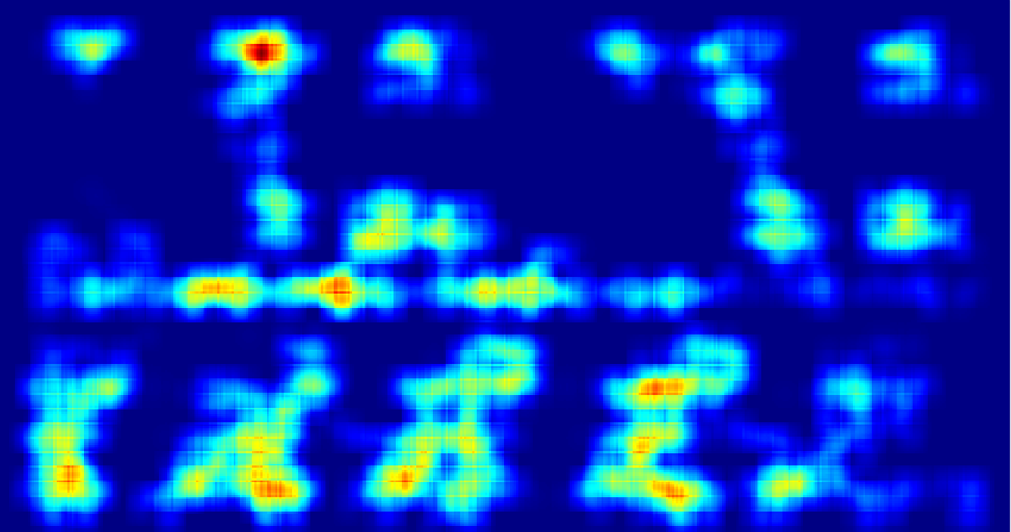
Merge Results of all Scales
Connectivity Graph
Corresponding Score Image
Connectivity Graph to Score Image
Convert each connectivity graph to corresponding score image.
A patch with strong neighborhood grouping will have higher scores.
Merge Score Images
Scale each score image to highest level in multi-resolution pyramid.
At each pixel, keep the maximum score amongst all the score images.

Slide 23
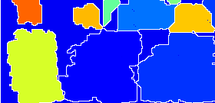
Our Hierarchical Solution
Input Image
Multi-Resolution Pyramid
Pairwise Matching
Grouping Patches
Low-level
matching
High-level
matching
+
Next level matching
+
Merge results from all scales
Detection and Segmentation of Repetitive Patterns
Output
Notes:
Hierarchical Solution: Input Image

Slide 24
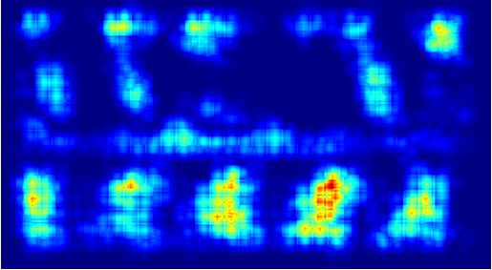
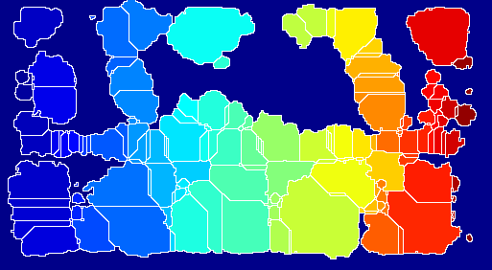
How to find repetitive patterns
from the obtained information ?
We follow a top-down approach.
First segment the score image into regions then detect the repetitive patterns.
We used watershed segmentation algorithm on the score images.
Merged Score Image
After watershed segmentation

Slide 25
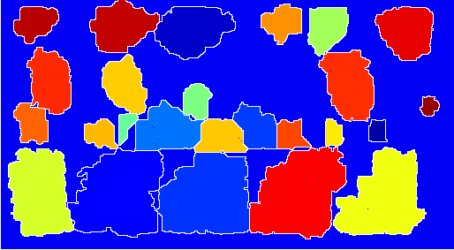
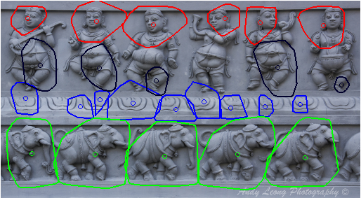
Merge Regions to find
Repetitive Patterns
First remove the regions with low score vales.
Use patch match information to merge regions.
Assign each region to a repetitive pattern.
After merging regions
Our output with color
coded repetitive patterns

Slide 26
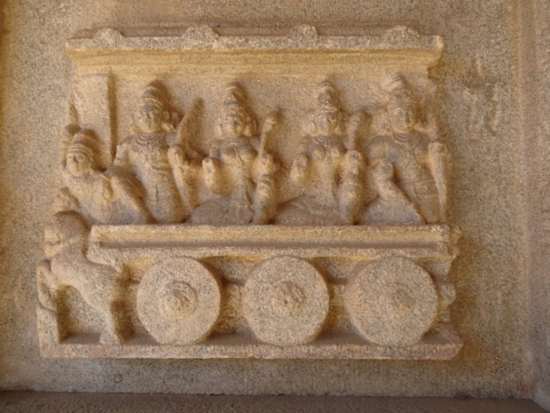


Datasets
Our approach is tested on datasets of three different image types.
Regular
Texture images
Relief Images
Facade Images
Hampi, India
Flickr.com
Google Images
ZuBuD database
PSU Normal Near
Regular Texture
Images
All images were manually annotated.
[H. Agrawal and A. Namboodiri, Detection and Segmentation of Approximate Repetitive Patterns in Relief Images, ICVGIP 2012, Mumbai, India]

Slide 27

Experiments and Results
Evaluation Criteria –
Accuracy – performance of segmentation algorithm
Recall – performance of detection algorithm
True
Positive
Image Type | No. of Images | Average Accuracy | Average Recall
Reliefs | 53 | 89.90% | 79.77%
Facades | 22 | 85.30% | 80.10%
Normal NRT | 13 | 88.10% | 58.30%
False Positive
False
Negative
[H. Agrawal and A. Namboodiri, Detection and Segmentation of Approximate Repetitive Patterns in Relief Images, ICVGIP 2012, Mumbai, India]

Slide 28





Experiments and Results
[H. Agrawal and A. Namboodiri, Detection and Segmentation of Approximate Repetitive Patterns in Relief Images, ICVGIP 2012, Mumbai, India]

Slide 29



Experiments and Results
[H. Agrawal and A. Namboodiri, Detection and Segmentation of Approximate Repetitive Patterns in Relief Images, ICVGIP 2012, Mumbai, India]

Slide 30



Experiments and Results
[H. Agrawal and A. Namboodiri, Detection and Segmentation of Approximate Repetitive Patterns in Relief Images, ICVGIP 2012, Mumbai, India]

Slide 31



Experiments and Results
Failure Cases
[H. Agrawal and A. Namboodiri, Detection and Segmentation of Approximate Repetitive Patterns in Relief Images, ICVGIP 2012, Mumbai, India]

Slide 32
Our Contributions
Detection and Segmentation of Approximate Repetitive patterns in Relief Images.
Shape Reconstruction from a Single Relief Image.
Notes:
10/29/11

Slide 33



Shape Reconstruction from Single Relief Image
Given a single relief image, reconstruct the depth map of the relief surface.
Input Image
Barron et al. ECCV’12
Proposed Approach

Slide 34


Shape Reconstruction Methods
Multi-View Reconstruction Techniques
Structured Lighting Techniques
Shape Reconstruction from Single Images - Shape from Shading - Shape from Multiple Light Sources - Shape from Texture - Shape from Focus/Defocus - Shape from Specularities - Shape from Shadows
Notes:
Expand with examples
http://mesh.brown.edu/3dpgp-2009/homework/hw2/hw2.html

Slide 35
Motivation
Absence of easy to use and inexpensive method for depth data acquisition.
A data-driven approach is more suitable for reliefs.
Human ability to infer shape from reliefs.
Some prior knowledge about the shape is a must.
Surface normal estimation for individual pixels are erroneous for reliefs.
Notes:
Expand with example images

Slide 36

Overview of Proposed Method
Noisy Shape Reconstruction from Shape from Shading (SfS).
Relief Priors - Learned a basis of patches with corresponding surface normals from training data. - Represent each patch in new image by a linear combination of very few basis patches (sparse coding).
Shape Recovery using relief priors - Pose the integration of noisy shape and relief priors as a MAP estimation problem.
Shape From Shading
Relief Priors
Map Estimate
Proposed Approach
Proposed Approach
Computed Depth Map
Noisy Shape Reconstruction from Shape from Shading (SfS).
Relief Priors
Learned a basis of patches with corresponding surface normals from training data.
Represent each patch in new image by a linear combination of very few basis patches (sparse coding).
Shape Recovery using relief priors
Pose the integration of noisy shape and relief priors as a MAP estimation problem.
We used a pair of flash and non-flash images to remove the effect of natural illumination.
Noisy Shape Reconstruction from Shape from Shading (SfS).
Relief Priors
Learned a basis of patches with corresponding surface normals from training data.
Represent each patch in new image by a linear combination of very few basis patches (sparse coding).
Shape Recovery using relief priors
Pose the integration of noisy shape and relief priors as a MAP estimation problem.
We used a pair of flash and non-flash images to remove the effect of natural illumination.
Noisy Shape Reconstruction from Shape from Shading (SfS).
Relief Priors
Learned a basis of patches with corresponding surface normals from training data.
Represent each patch in new image by a linear combination of very few basis patches (sparse coding).
Shape Recovery using relief priors
Pose the integration of noisy shape and relief priors as a MAP estimation problem.
We used a pair of flash and non-flash images to remove the effect of natural illumination.
Shape from Shading
Shape from Shading
Relief Priors
Relief Priors
Shape from Shading
Shape from Shading
Relief Priors
Shape from Shading
Relief Priors
Shape from Shading
Relief Priors
Relief Priors
Shape from Shading
Relief Priors
Shape from Shading
Shape from Shading
Relief Priors
MAP Estimate
MAP Estimate
MAP Estimate
MAP Estimate
MAP Estimate
MAP Estimate
MAP Estimate
MAP Estimate
Computed Depth Map
Computed Depth Map
Computed Depth Map
Computed Depth Map
Computed Depth Map
Computed Depth Map
Computed Depth Map
Computed Depth Map

Slide 37
Learning Relief Priors from Sparse Representation
Relief Prior: An overcomplete dictionary with a composite signal of appearance, surface gradients and light source direction.
Represent appearance and shape as a sparse linear combination of the dictionary elements.
Dictionary Learning :
Exemplar dataset of relief images and their surface gradients is used to learn the basis
Form the signal w using the intensity p, surface gradient x,y and light source direction s from a square patch around each pixel
The dictionary, D is learned as:
where L is a constant that specifies the sparsity.

Slide 38



Learning Relief Priors from Sparse Representation
Shape Reconstruction
Given an image, the query signals q ∈ R^{d} is formed at each pixel, with their gradients set to 0.
The query signal is decomposed sparsely over the basis : q ≈ Dα s.t. ||α||₀ < L
Computing the best α for each query by masking the gradients.
α is then used to recover the surface gradient values for each pixel in the image.
Learned image
intensity patches
Learned surface
x-gradient patches
Learned surface
y-gradient patches
Learned image
intensity patches
Learned surface
x-gradient patches
Learned surface
y-gradient patches
Learned image
intensity patches
Learned surface
x-gradient patches
Learned surface
y-gradient patches
Learned image
intensity patches
Learned surface
x-gradient patches
Learned surface
y-gradient patches
Learned image
intensity patches
Learned surface
x-gradient patches
Learned surface
y-gradient patches

Slide 39
Imaging under known Illumination
Images are captured in a uncontrolled, natural environment with complex illumination
A flash is the most accessible an easy to use source of controlled illumination
Remove the effect of complex illumination using a pair of flash and non-flash images
Approach:
A: Image under ambient illumination
F: Image with flash and ambient illumination
Let t_{A} and t_{F} be the exposure times, a_{A} and a_{F} be the apertures of the ambient and flash images respectively. The pure flash image is:

Slide 40





Dataset Collections
Relief Image Dataset : - For Ground Truth data : Hampi, India - For Qualitative Analysis : Flickr.com, Google Images and other web sources
Human Body Poses Dataset - We used the human body pose dataset from Hassner and Basri [1].
Reliefs used to learn dictionary
Exemplar body pose images
[1] T. Hassner and R. Basri. Example based 3d reconstruction from single 2d images. In CVPR 2006

Slide 41

Experiments and Results
Pixel Wise approach : Learn the gradients for each pixel.
Patch Wise approach : Learn the gradients for each patch. - Query Signals more incomplete, so can be less accurate. - Overall shape will be more smoother.
Error Metrics used for comparison : MSE of surface normals
Where Ň = estimated normal,
N* = Ground truth normal
 | Reliefs | Human Body Poses
Tsai et. al. [1] | 0.03422 | 0.02817
Barron and Malik [2] | 0.01868 | 0.01811
Our Approach (Patch wise) | 0.02278 | 0.01337
Our Approach (Pixel wise) | 0.02212 | 0.01412
[1] T. Ping-Sing and M. Shah. Shape from shading using linear approximation.
[2] J. T. Barron and J. Malik. Color constancy, intrinsic images, and shape estimation.

Slide 42



Experiments and Results
Original Image
Pixel Wise Result
Patch Wise Result
[H. Agrawal and Anoop M. Namboodiri, Shape Reconstruction from Single Relief Image, In ACPR 2013.]

Slide 43



Experiments and Results

Slide 44




Experiments and Results
Original Image
Tsai et. al.
Barron and Malik
Our Result

Slide 45



Experiments and Results
Example Failure Cases
(a)
(b)
(c)

Slide 46
Conclusion and Future Work
Developed a robust and accurate approach to detect approximate repetitive patterns in relief images.
We provide segmented result for the repetitive patterns in color coded segments.
Our hierarchical approach can also be used to find repetitions in facades and other general repetitions.
Proposed a robust shape reconstruction method that works well for relief images and is easy to use unlike other methods.
The relief priors resulted from our method can be used as a initial guess in other methods.
Quantitative and Qualitative analysis of the results shows that our approaches works well for other classes too.

Slide 47
Conclusion and Future Work
Our work provides ample opportunities in future that can be explored in this field.
Multi-core algorithm for detection and segmentation of approximate repetitive patterns.
Pairwise correspondences can be exploited in other computer vision tasks like in-painting, reconstructing partially damaged structures, image denoising etc.
The detected objects can possibly be used to describe and retrieve similar objects.
We can use repetitive patterns to infer shapes for similar structures.
We can explore to solve the shape reconstruction for non-lambertian surfaces.
Learning Illumination model along with learning shape priors can be explored.

Slide 48
Thank You
Questions?

