Slide 1
Optical Character Recognition as Sequence Mapping
Devendra Kumar Sahu
Centre for Visual Information and Technology
IIIT Hyderabad
Advisor: Prof. C.V. Jawahar
Notes:
<number>

Slide 2
Outline
Task and problem motivation
Unsupervised Feature Learning for Printed Text
Sequence to Sequence Learning
Extensions and Future Work

Slide 3




Task
Segmentation Free Word Prediction
Detection and Isolated character classification being performance bottleneck
Segmentation / Alignment data missing
Notes:
<number>

Slide 4
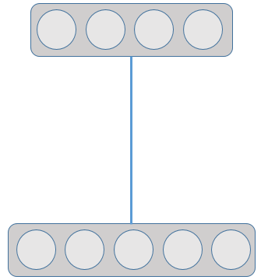
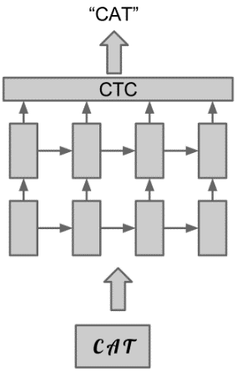








Problem 1 motivation
Learning representations from data
Fast adaptations to new scripts
Data dependent representations
Learn global structures in data like partial characters
Less time and effort in comparison to designing hand engineered features
RBM
Using models which don’t need aligned data
RNN
Notes:
Properties of handcrafted features
based on intuitions
Shape of character
Statistical properties of characters
Variation in structural and statistical properties of scripts
Lot of Effort and long development time
<number>

Slide 5
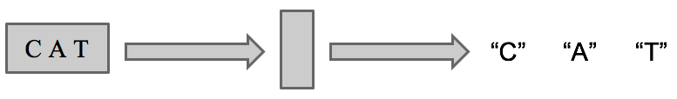
Problem 2 motivation
Segmentation free sequence prediction
Using a recurrent encoder-decoder framework
Learning a compact fixed dimensional representation
Standard RNNs don’t have fixed dimensional representations
Fixed dimensional representation enable fast retrieval with approximate nearest neighbor.
Recurrent
Recurrent
Encoder
Decoder
z
Notes:
<number>

Slide 6
Plan
Task and problem motivation
Unsupervised Feature Learning for Printed Text
Sequence to Sequence Learning
Extensions and Future Work

Slide 7
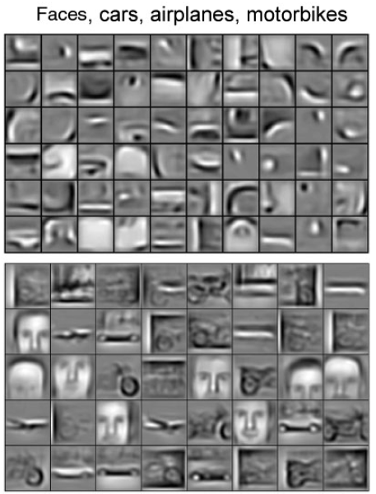
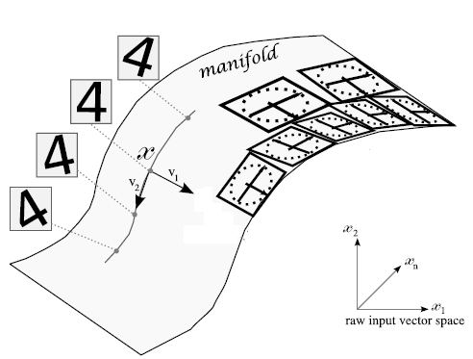
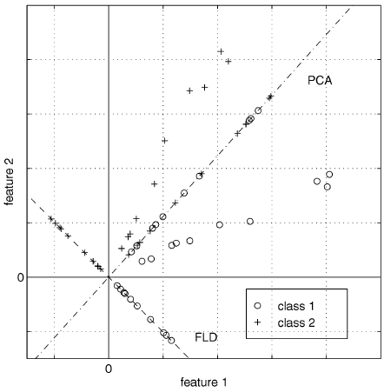
Related Work
Feature Learning
Turk et al. Eigen faces for recognition
Belhumeur et al. Eigenfaces vs. Fisherfaces
Khambhatla et al. Dimension reduction with local PCA
Yang et al. Face recognition using kernel Eigenfaces
S. Chandra et al. Learning Multiple Non-Linear Sub-Spaces using K-RBMs
Gary B. Huang et al. Learning Hierarchical Representations for Face Verification with Convolutional Deep Belief Networks
Linear
Non-linear
Hierarchical
Notes:
<number>

Slide 8
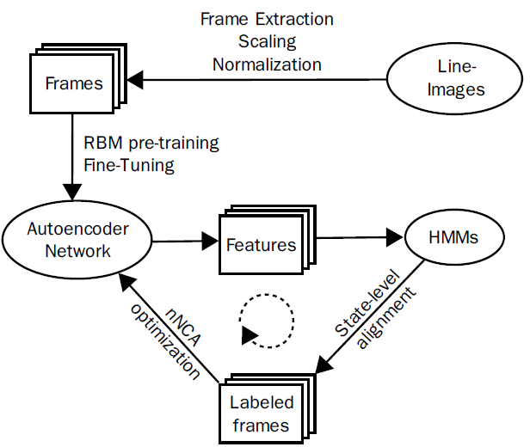
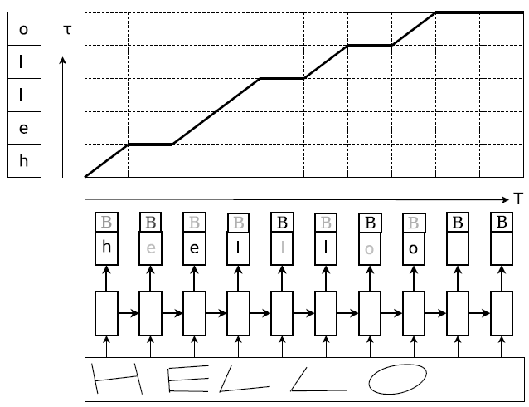
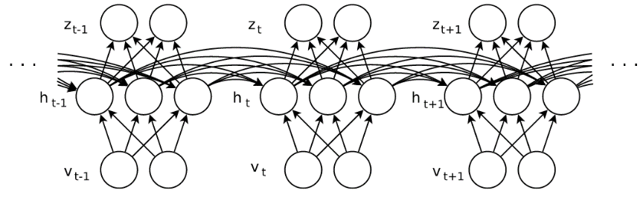
Related Work
Optical Character Recognition
Y. N. Hammerla et al. Towards Feature Learning for HMM-based Offline Handwriting Recognition
Breuel et al. High-Performance OCR for Printed English and Fraktur using LSTM Networks.
P. Krishnan et al. Towards a robust OCR system for Indic scripts
Notes:
<number>

Slide 9
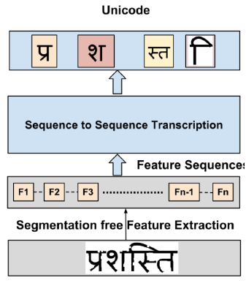
OCR for Indic Scripts
Segmentation free
Segmentation free hand engineered features such as profiles.
LSTM based sequence transcription
N. Sankaran et al.
Notes:
<number>

Slide 10
OCR for Indic Scripts
Segmentation free
Segmentation free hand engineered features such as profiles.
LSTM based sequence transcription
N. Sankaran et al.
Notes:
<number>

Slide 11
Goal
Learn features from data in unsupervised setting
Design goals
Investigate the possibility to learn features from data
Demonstrate limitations of hand engineered profile features
Extend profile features with deep learning (deep profiles)
Use combination of learned feature and RNNs to perform Optical Character Recognition.
Notes:
<number>

Slide 12
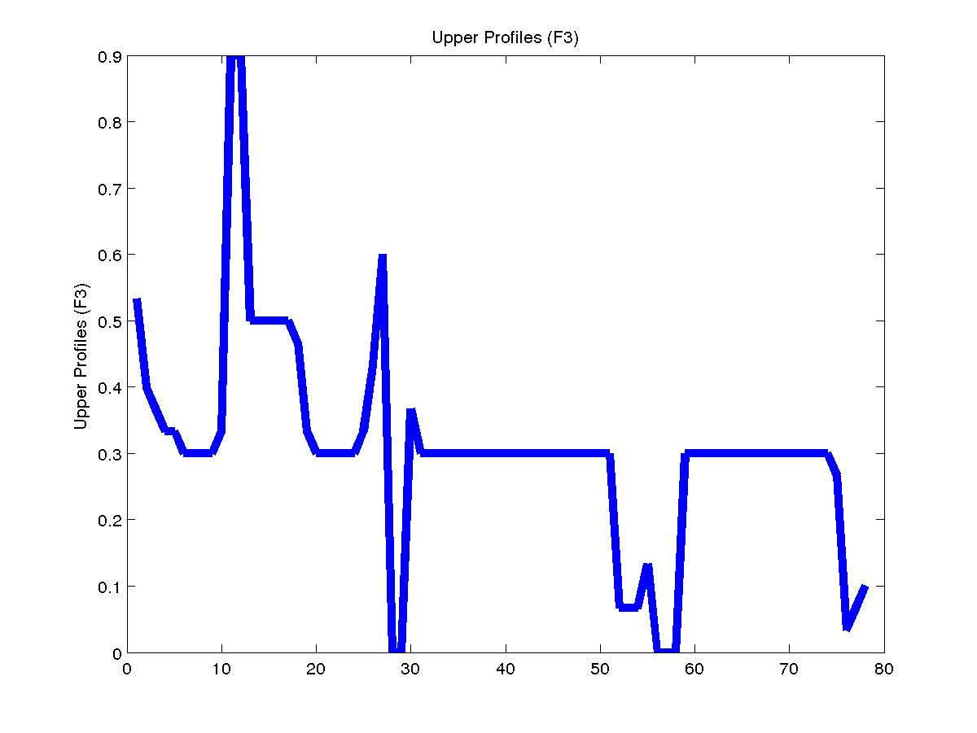
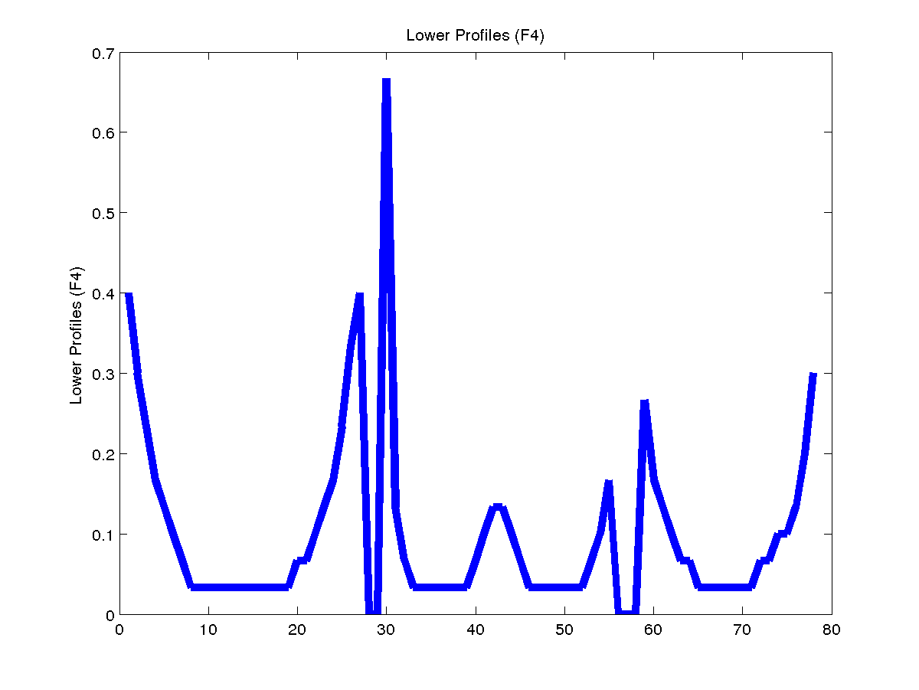
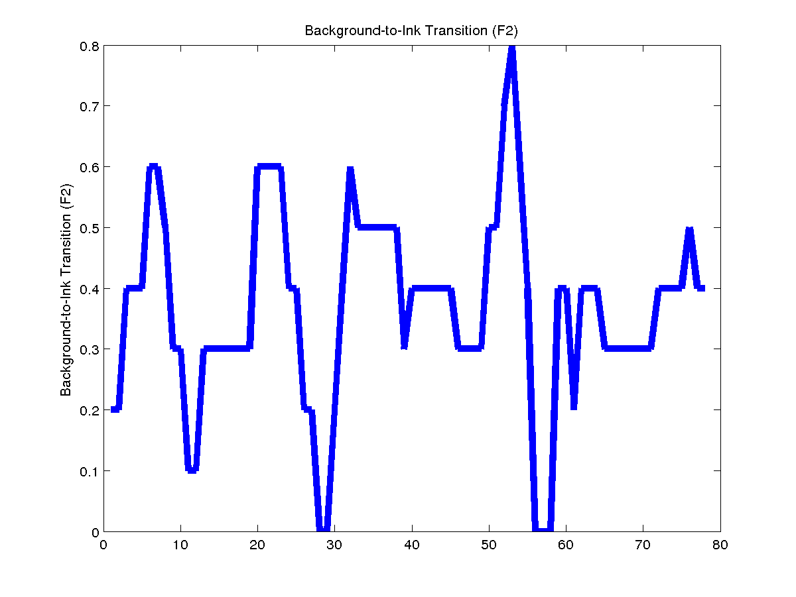
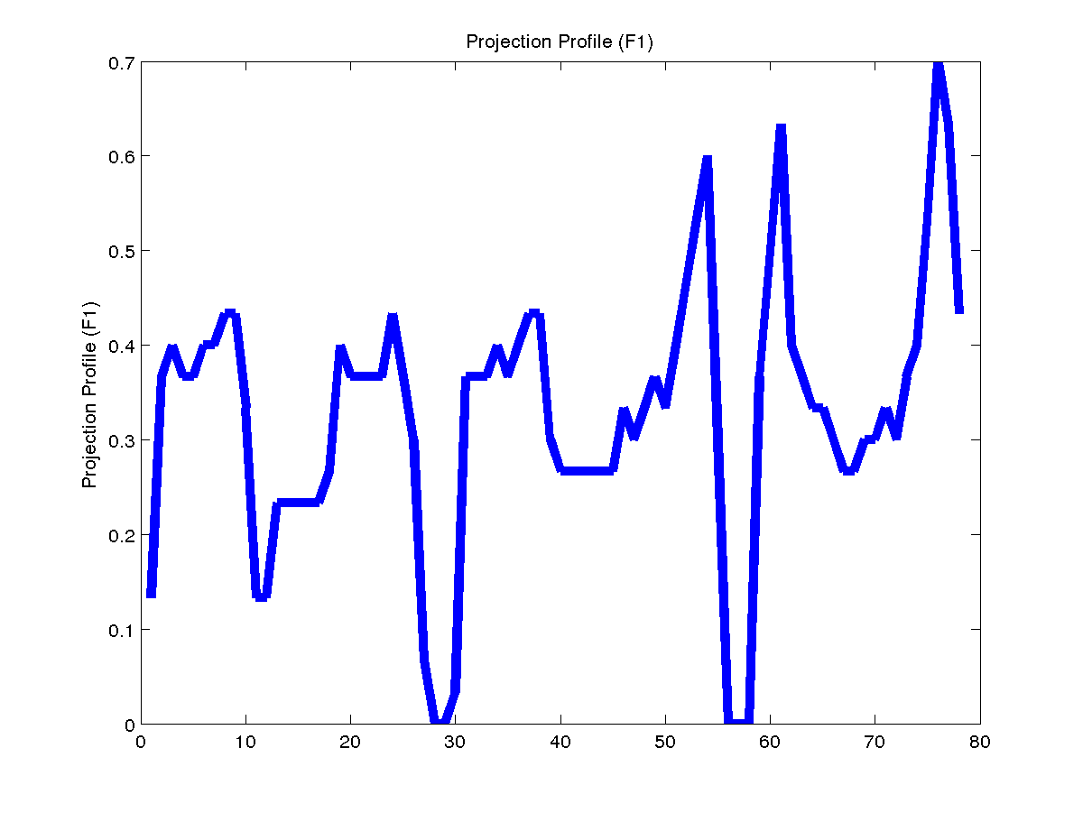
Profile features
Profiles (Rath & Manmatha)
Upper Profile (F1)
Lower Profile (F2)
Ink Transition Profile (F3)
Projection Profile (F4)
F1
F2
F3
F4
Notes:
<number>

Slide 13
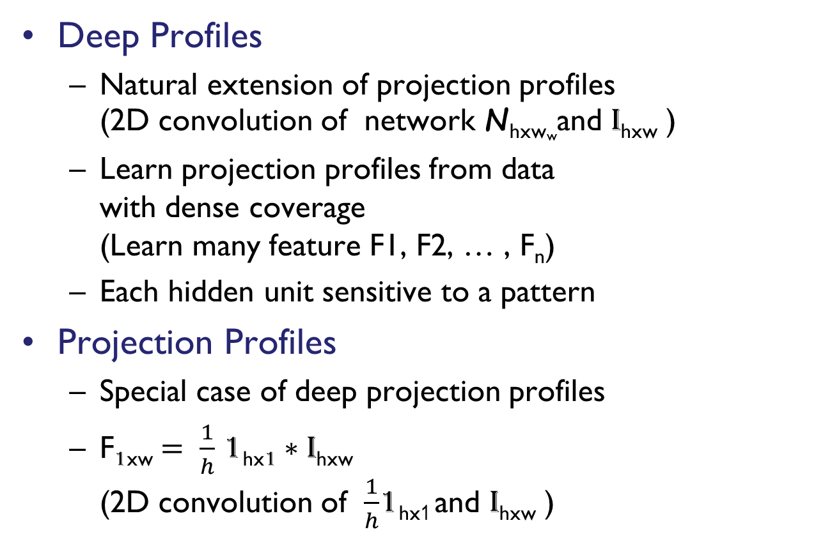
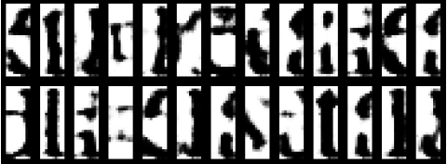
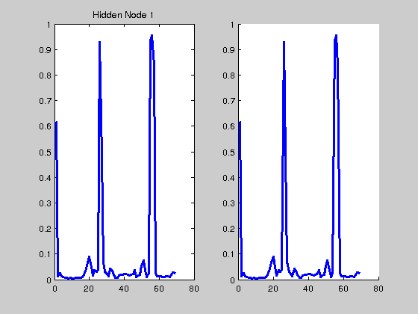
Deep Profile Features
Deep Profiles
Natural extension of projection profiles (2D convolution of network N_{hxww}and I_{hxw} )
Learn projection profiles from data with dense coverage (Learn many feature F1, F2, … , F_{n})
Each hidden unit sensitive to a pattern
Projection Profiles
Special case of deep projection profiles
F_{1xw} 1_{hx1} I_{hxw} (2D convolution of 1_{hx1} and I_{hxw} )
Deep Projection Profiles
Notes:
<number>

Slide 14
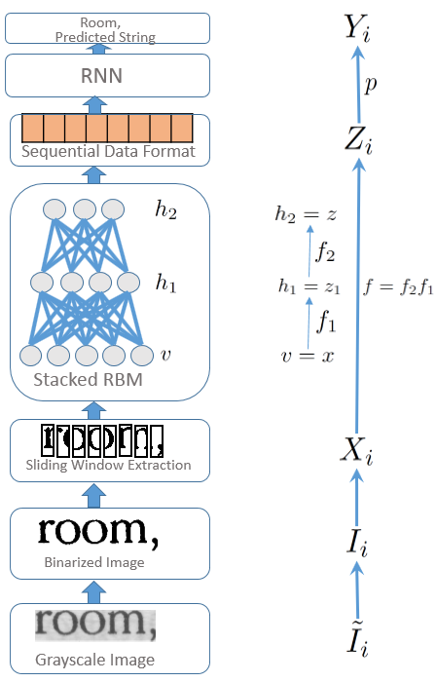
Proposed Pipeline
Binarization
Otsu thresholding
Sliding Window Extraction
Window w_{h}xw_{w} step size s
Feature learning from data using Stacked RBM
L layered stacked RBM learnt on data from sliding window extraction
Notes:
Algorithm asumes the image contains two classes of pixels following a bi-modal histogram. Then calculated optimum threshold separating the two classes so that intra class variance is minimal.
<number>

Slide 15
Proposed Pipeline
Latent representation of sequence
Sequence X_{i} projected to learnt sequence Z_{i} with learnt stacked RBM from previous step
RNN with CTC output layer
Sequence Zi is mapped to predictions Y_{i}
CTC layer aligns prediction and ground truth so error at output layer can be known
Notes:
<number>

Slide 16
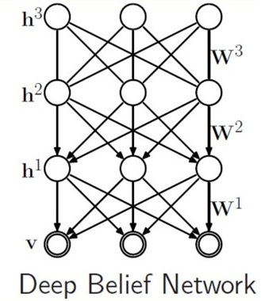

Visualization
Linear Combination of previous units
Sampling from
Build a Deep Belief Network (DBN) with j layers
Clamp h_{ij} = 1 and run gibbs chain for k steps on layer j and j-1
Perform ancestral top down sampling from layer j-1 to input layer
Notes:
<number>

Slide 17
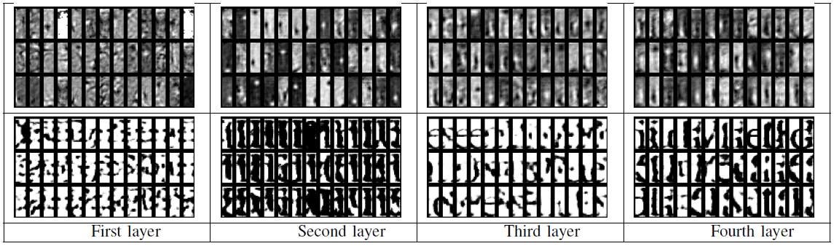
Visualization Results
Linear Combination of previous units
Sampling
Notes:
<number>

Slide 18
Experiments
Datasets:
Performance Measures
Label Error Rate : Edit distance normalized with ground-truth length.
Sequence Error Rate: % of samples incorrectly classified.
Languages | Number of Words
English | 295K
Kannada | 171K
Malayalam | 65K
Marathi | 135K
Telugu | 137K
Notes:
Add slide on performance measure
<number>

Slide 19
Results
Notes:
<number>

Slide 20
Results
Significance testing of performance gain
Languages | Mean Performance Gain (%) | Standard Deviation (%) | T-statistic | P-value
English | 0.75 | 0.0603 | 25.05 | 1.39e-04
Kannada | 2.62 | 0.4340 | 12.08 | 1.20e-03
Malayalam | 0.8 | 0.1433 | 11.16 | 1.50e-03
Marathi | 2.98 | 0.5289 | 11.27 | 1.50e-03
Telugu | 3.28 | 0.4542 | 14.45 | 7.17e-04
Statistically Significant
Significance level = 0.05
Populations generated by training on 1.0, 0.9, 0.8, 0.6 of training data.
Notes:
<number>

Slide 21
Results
Most errors are due to 1-2 characters mismatch
Notes:
<number>

Slide 22
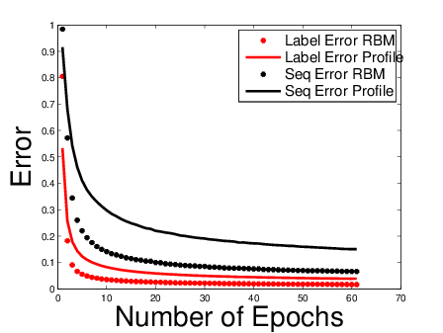
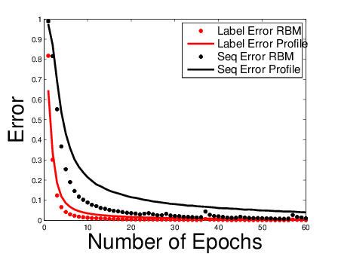
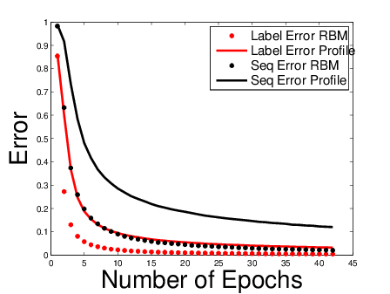
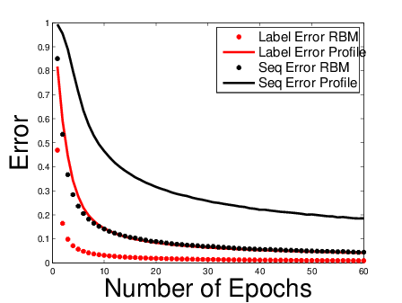
Convergence Results
Kannada
Malayalam
Marathi
Telugu
Notes:
<number>

Slide 23
Plan
Task and problem motivation
Unsupervised Feature Learning for Printed Text
Sequence to Sequence Learning
Extensions and Future Work

Slide 24
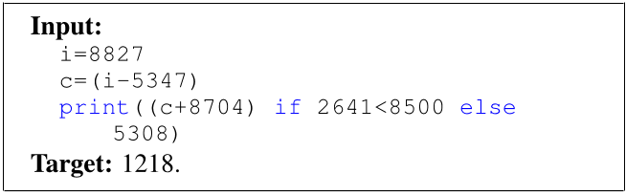
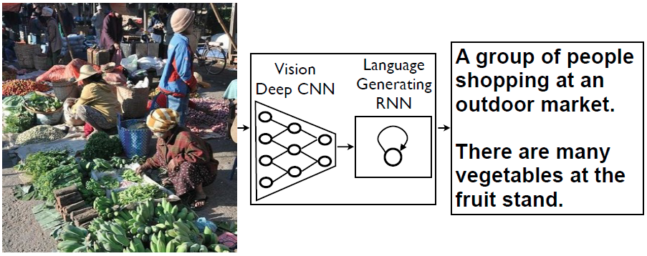
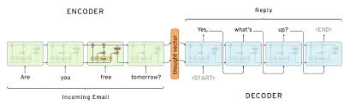
Related Work
Caption Generation (Vinyals et al.)
Learning to execute (Zaremba et al.)
Neural Conversational Networks (Vinyals et al.)
Language translation (Sutskever et al.)

Slide 25
Goal
Optical Character Recognition task in recurrent encoder-decoder framework
Design goals
Learn compact fixed dimensional representation from word image as sequences for recognition.
Investigate its usefulness in retrieval setting.
What kind of structure in learnt representations?
Recurrent
Recurrent
Encoder
Decoder
z
Notes:
<number>

Slide 26
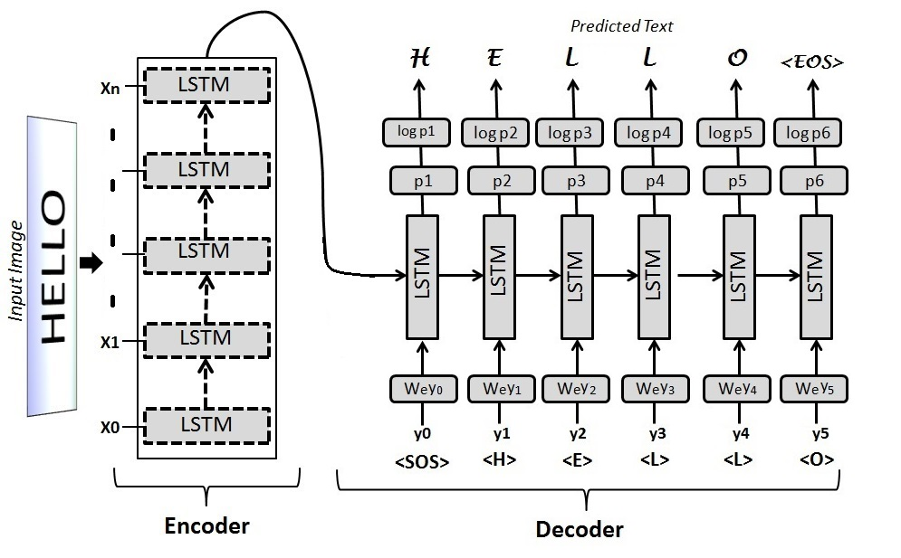
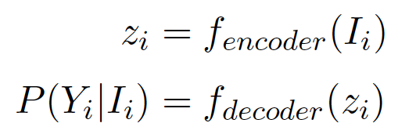

Sequence to Sequence architecture
Notes:
Add cell
<number>

Slide 27
Dataset
Annotated books from DLI
295K annotated English word images from 7 books
60% training, 20% validation and remaining 20% for testing

Slide 28
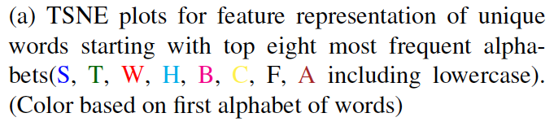
Results

Slide 29
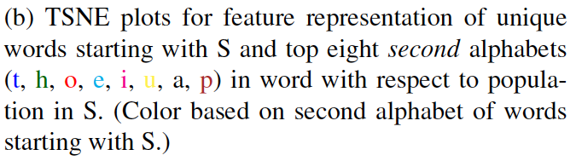
Results

Slide 30
Results
Model | Label Error (%)
ABBYY | 1.84
TESSERACT | 35.80
TESSERACT | 16.95
RNN Encoder-Decoder | 35.57
LSTM-CTC | 0.84
LSTM Encoder-Decoder | 0.84
Feature | mAP-100
h1-h2 | 0.7239
c1-c2 | 0.8548
h1-h2-c1-c2 L1 | 0.8078
h1-h2-c1-c2 L2 | 0.7834
h1-h2-c1-c2 | 0.8545
Notes:
mAP-n mean average precision over top n retrievals
<number>

Slide 31
Results
Features | Dim | mAP-100 | mAP-5000
BOW | 400 | 0.5503 | 0.33
BOW | 2000 | 0.6321 | -
Augmented Profiles | 247 | 0.7371 | 0.6189
LSTM-Encoder | 400 | 0.7402 (h1-h2) 0.8521 (c1-c2) | 0.8521
OCR-TESSERACT | - | 0.6594 | 0.7095
OCR-ABBYY | - | 0.8583 | 0.872
Notes:
mAP-n mean average precision over top n retrievals
<number>

Slide 32
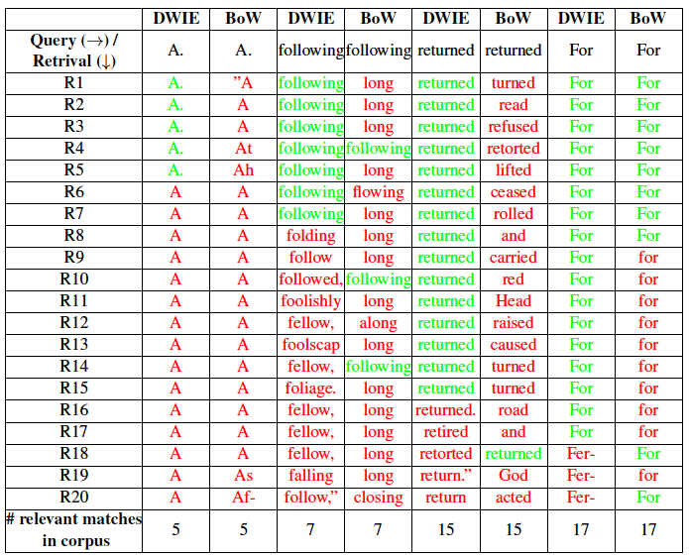
Results

Slide 33
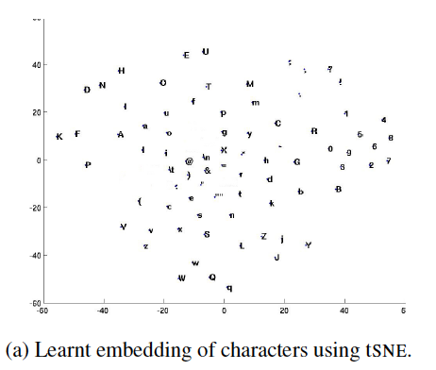
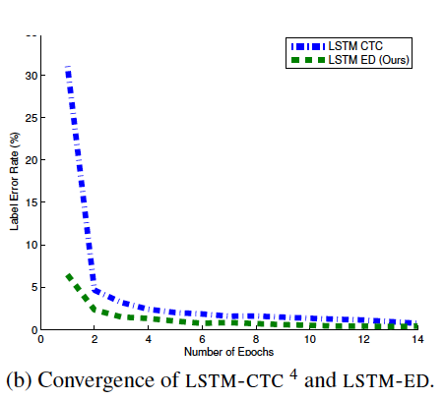
Results
Notes:
Cooccurance reasoning
Part of decoder
<number>

Slide 34
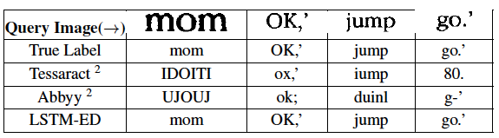
Results
Notes:
<number>

Slide 35
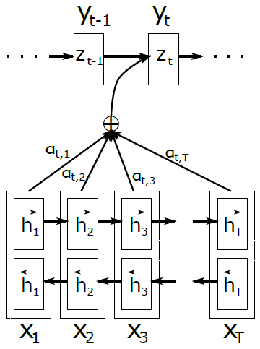
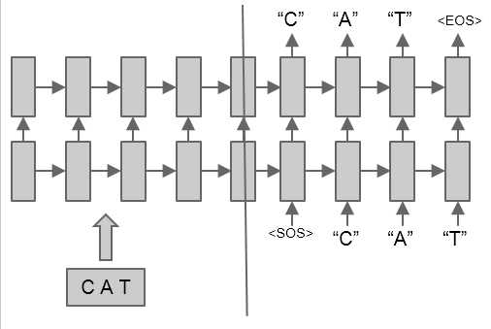
Limitations of sequence to sequence architecture
a) Sequence to Sequence Learning
b) With Soft Attention
Notes:
<number>

Slide 36
Plan
Task and problem motivation
Unsupervised Feature Learning
Sequence to Sequence Learning
Extensions and Future Work

Slide 37
Future Directions
Representation learning for OCRs using recurrent generative models.
Sequence to Sequence Learning with attention for OCRs
Efficient semantic representation of sentences in fixed dimension using hierarchy of recurrent networks
Multi-task recurrent networks for OCRs
Notes:
Multitask for scripts
<number>

Slide 38
Conclusion
Deep profiles suitable for representation learning in OCRs (Compared to profiles)
Sequence to sequence learning can do well in recognition and learnt compact features can be used for efficient retrieval.
Notes:
<number>

Slide 39
Publication
Devendra Kumar Sahu and C. V. Jawahar. ”Unsupervised Feature Learning for Optical Character Recognition.” 13th IAPR International Conference on Document Analysis and Recognition.
Notes:
<number>

Slide 40
Thanks!!
Questions??
Notes:
<number>

