Slide 1
Solving Decomposition Problems in Computer Vision using Linear Optimization
Ankit Gandhi
Centre for Visual Information and Technology (CVIT)
IIIT HYDERABAD
Adviser:
Dr. C. V. Jawahar
Notes:
10/29/11

Slide 2
Special Acknowledgement
Dr. Karteek Alahari
Notes:
10/29/11

Slide 3
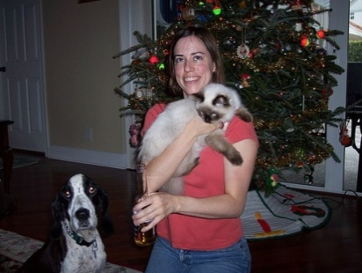
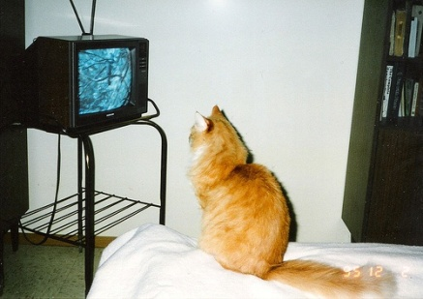
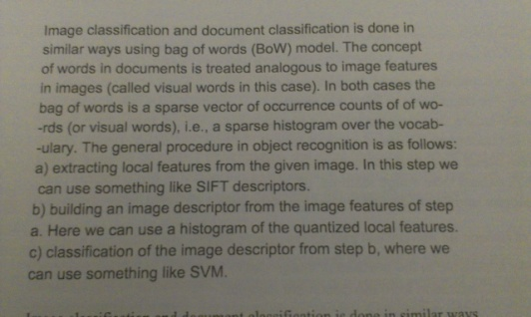
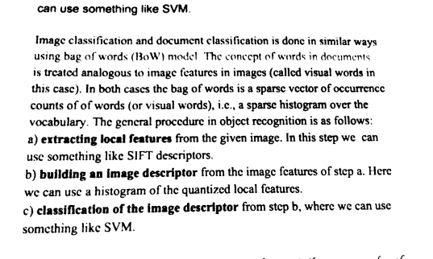
Digital Images
Can be of various forms depending upon their use and method of acquisition.
Medical images, satellite images, 3D images, etc.
Natural Images : taken from large community photo collections like Flickr, Google, Facebook. Also, images captured through robotic navigation and visual surveillance.
Document Images : digitally scanned/captured images of printed/handwritten documents.

Slide 4
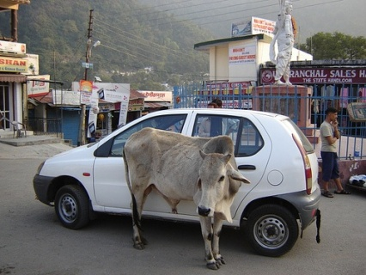
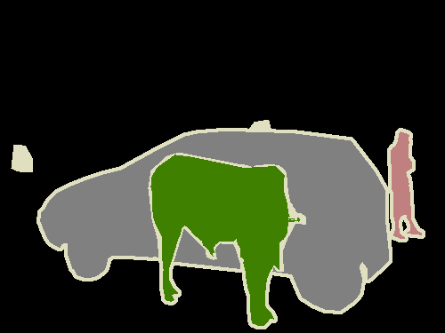
Terminology
Need for associating semantic information with the images.
Object Category Classification and Recognition – Is object present in the image ?
Object Detection – Localize object in an image.
Object Segmentation – Associate labels with each pixel.
Optical Character Recognition – Recognize characters in document images.
Is cow present in the image ?
YES
Object Classification
Object Detection
Object Segmentation

Slide 5
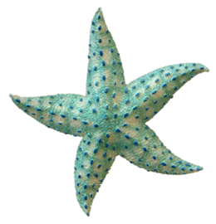
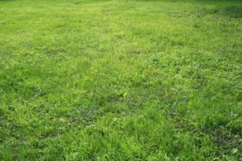
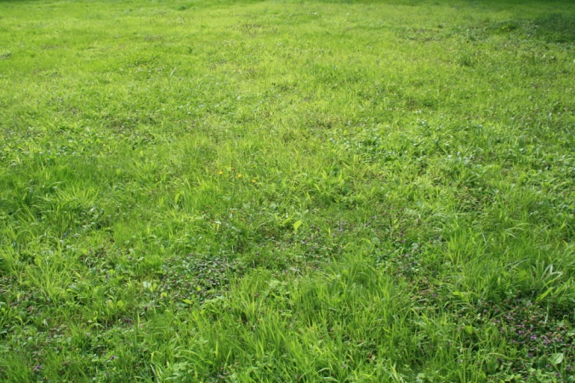
Images as Composition
Foreground
Background

Slide 6
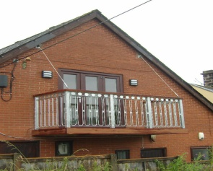


Images as Composition
Scene
Text

Slide 7

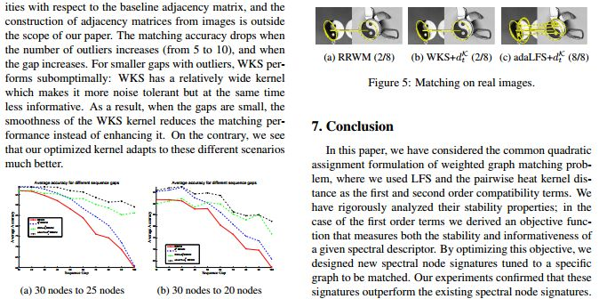
Images as Composition
Images, figures, equations, tables, plots, etc.
Graphics
Text

Slide 8


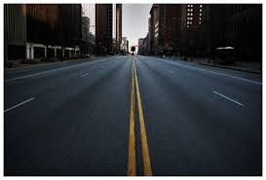
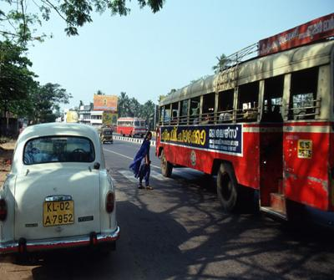
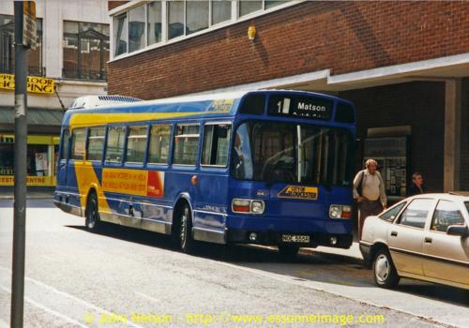
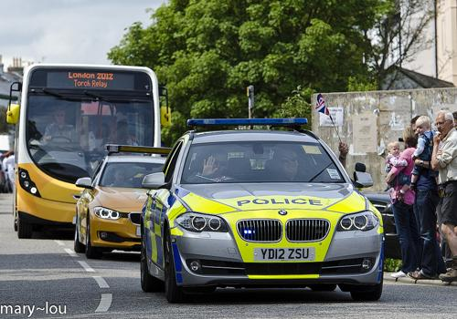
Images as Composition
Objects
Background / Context
?

Slide 9
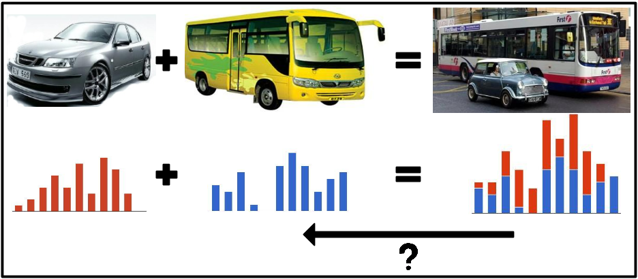
Focus of the Thesis (I)
Can we decompose a given image representation into bus and car representation having looked at past buses and cars ?

Slide 10
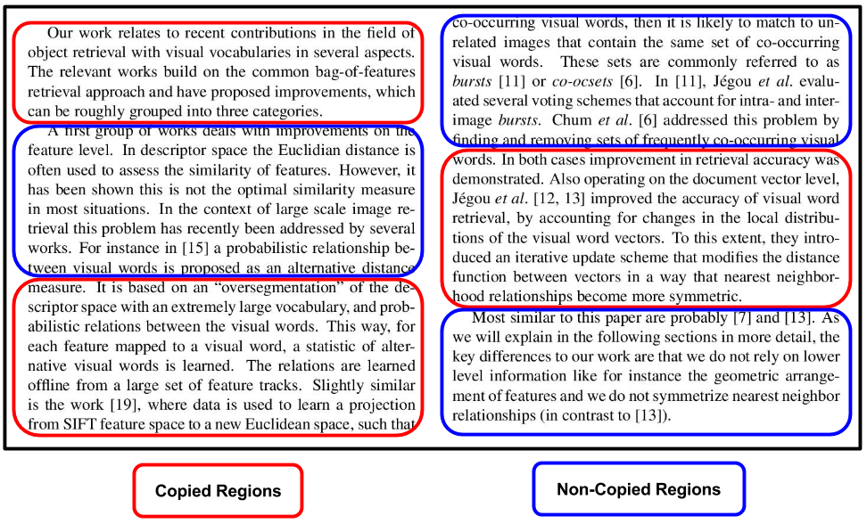
Focus of the Thesis (II)
Can we detect paragraphs in a given document similar to paragraphs seen in past documents ?

Slide 11
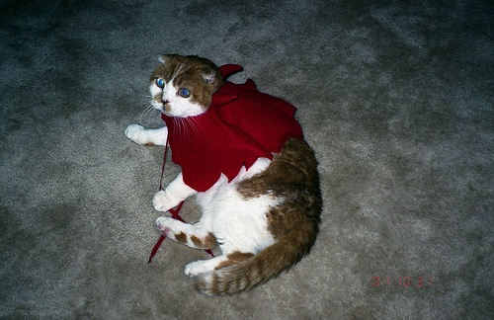
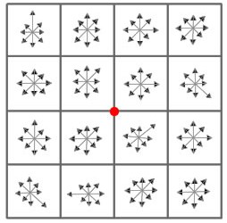
Background: Bag of Words Model
Feature
Extraction
Vocabulary
Creation
Image
Histogram
Creation
Classification
Encoding
Image
Interest Points
Interest Point
Representation (SIFT)

Slide 12
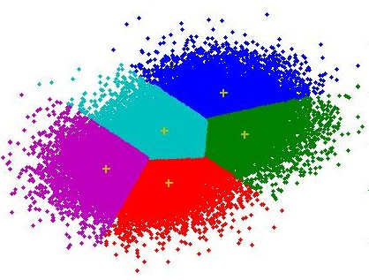
Background: Bag of Words Model
Feature
Extraction
Vocabulary
Creation
Image
Histogram
Creation
Classification
Encoding
K-means Clustering
SIFT Features
K-clusters obtained (visual words)

Slide 13
Background: Bag of Words Model
Feature
Extraction
Vocabulary
Creation
Image
Histogram
Creation
Classification
Encoding
Quantize each of the features to one of the K visual words obtained

Slide 14
Bag of Words Model
Feature
Extraction
Vocabulary
Creation
Image
Histogram
Creation
Classification
Encoding
Counting
occurrences
of each visual
word
Histogram of visual words / Final Image Representation

Slide 15

Bag of Words Model
Feature
Extraction
Vocabulary
Creation
Image
Histogram
Creation
Classification
Encoding
w^{T}x + b = -1
w^{T}x + b = 0
Classifier
w^{T}x + b = 1
w
(SVM)
Image Representation
$$\frac{2}{|\left|w\right||}$$

Slide 16

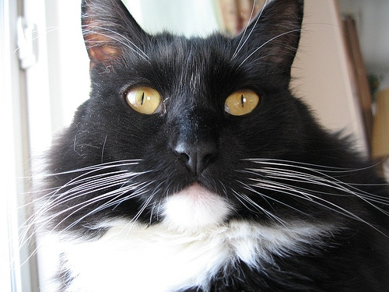
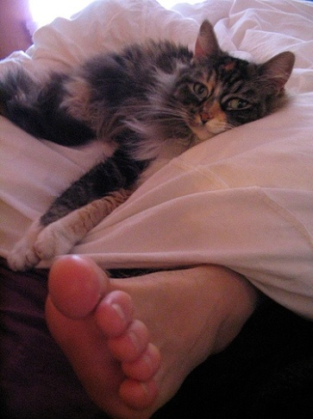


Single V/s Multiple Categories
AP = 0.589
PASCAL-S Images (Cat Category)
Presence of additional Categories.
Presence of Clutter.
Global image representation gets corrupted
AP = 0.189
PASCAL-M Images (Cat Category)

Slide 17
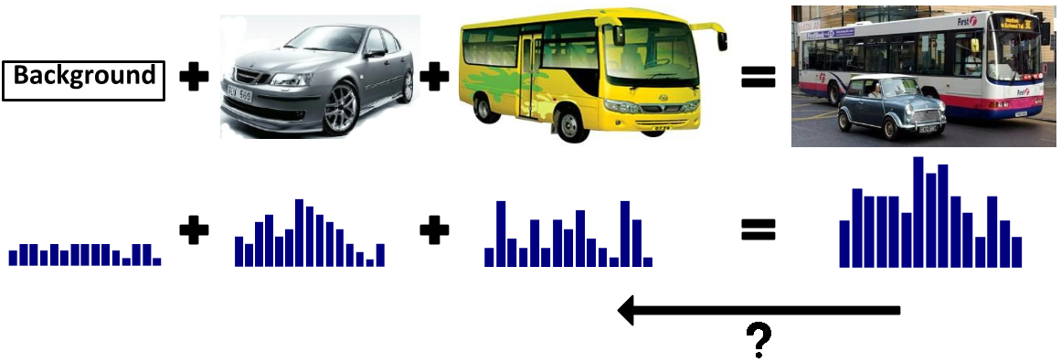
Our solution
Is it possible to filter out the clutter and classify only the signal ?

Slide 18
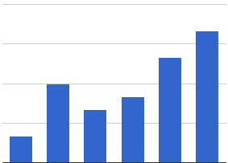
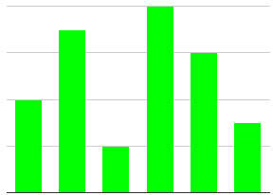
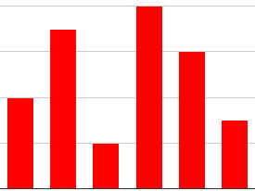
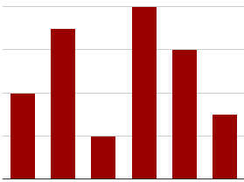
Using Previous Approaches
Existing approaches of object detection and semantic segmentation can be adapted to solve the histogram decomposition problem.
Object
Histogram
Object
Detection
Histogram
binding
Background
Histogram
Final Image
Representation
Object
Histogram
Semantic
Segmentation
Histogram
binding
Background
Histogram
Final Image
Representation

Slide 19
Previous Approaches
Existing approaches of object detection and semantic segmentation can be adapted to solve the histogram decomposition problem.
We are only interested in histogram of objects.
We do not aim at finding tight bounding box around an object or pixel accurate segmentation of an object.
Object
Histogram
Object
Detection
Histogram
binding
Solving histogram decomposition using such methods would be an overkill as they are computationally very expensive.
We present a simple and computationally efficient alternative for this problem.
Background
Histogram
Final Image
Representation
Object
Histogram
Semantic
Segmentation
Histogram
binding
Background
Histogram
Final Image
Representation

Slide 20
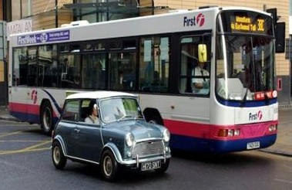


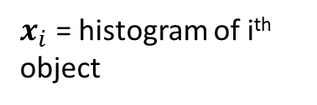

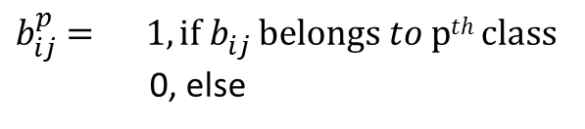


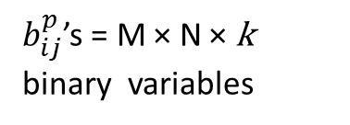

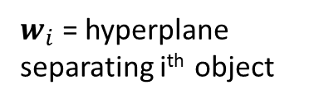

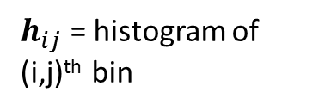
Decomposing Histograms
$x_{i}$ = histogram of i^{th} object
$w_{i}$ = hyperplane separating i^{th} object
unnormalized
histogram (h)
Object 1
Object 2
Object k
(given)
$$w_{1}$$
$$w_{2}$$
$$w_{k}$$
h
→
$$x_{1}$$
$$x_{2}$$
$$x_{k}$$
(to be estimated)
Image
We propose a Linear Programming (LP) formulation to get $x_{i}^{}$’s from h.
1
.
.
.
N
$h_{ij}$ = histogram of (i,j)^{th} bin
1
$$h_{ij}^{}$$
.
.
$b_{ij}^{p}$’s = M × N × k
binary variables
$b_{ij}^{p}$ $= 1, if{ b}_{ij }^{}belongs to pth class$
0, else
.
M

Slide 21



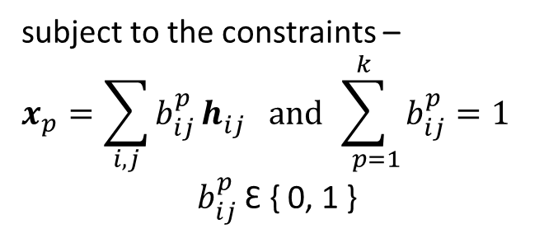
Decomposing Histograms (contd.)
$$\sum_{p=1}^{k}{w_{p}^{T}x_{p}^{}}$$
1
.
.
.
N
Max
1
$$h_{ij}^{}$$
.
subject to the constraints –
$$x_{p}=\sum_{i,j}{b_{ij}^{p}}h_{ij}^{} and\sum_{ p=1}^{k}{b_{ij}^{p}}=1$$
$b_{ij}^{p}$ Ԑ { 0, 1 }
.
.
$$b_{ij}^{p}$$
M
Optima of the problem is not always semantically meaningful.
All the cells do not necessarily belong to one of the k objects of interest.
Scattered and spatially disconnected cells.
Doesn’t incorporate prior knowledge regarding objects (shape, size, etc.).
How to solve the above challenges ?

Slide 22




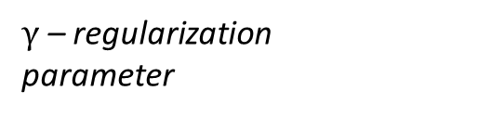

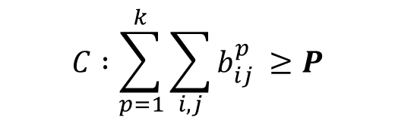
LP formulation
$$\sum_{p=1}^{k}{w_{p}^{T}x_{p}^{}}$$
$$γ\sum_{\left(i,j\right) \text{Ԑ} N}^{ }{| λ_{ij} | }$$
Max
$$−$$
b$,$ λ
subject to the constraints –
$${A : x}_{p}=\sum_{i,j}{b_{ij}^{p}}h_{ij}^{} B :\sum_{ p=1}^{k}{b_{ij}^{p}}≤1$$
$\text{D} \text{:} b_{ij}^{p} \text{Ԑ \{ 0, 1 \}}$
N – Neighbourhood
system of a cell.
$$C :\sum_{p=1}^{k}{\sum_{i,j}{b_{ij}^{p}} ≥P}$$
$γ$ – regularization
parameter
P – lower bound on
the number of cells
assigned to any of
the k classes
${E : b}_{ij}^{p}$ − $b_{i+1,j}^{p}$ $=$ $λ_{i+1,j}$ ${ F : b}_{ij}^{p}$ − $b_{i+1,j}^{p}$ $=$ $λ_{i+1,j}$
to ensure not all cells get assigned to the background
LP is solved by relaxing the integer constraints, 0 ${≤b}_{ij}^{p}$ $≤$ 1

Slide 23
Similarity with MRF
unary potential
$$\sum_{p=1}^{k}{w_{p}^{T}x_{p}^{}}$$
$$γ\sum_{\left(i,j\right) \text{Ԑ} N}^{ }{| λ_{ij} | }$$
pairwise potential
Max
$$−$$
b$,$ λ
subject to the constraints –
$${A : x}_{p}=\sum_{i,j}{b_{ij}^{p}}h_{ij}^{} B :\sum_{ p=1}^{k}{b_{ij}^{p}}≤1$$
$\text{D} \text{:} b_{ij}^{p} \text{Ԑ \{ 0, 1 \}}$
Label Set : {1, 2,….,k}
$$C :\sum_{p=1}^{k}{\sum_{i,j}{b_{ij}^{p}} ≥P}$$
${E : b}_{ij}^{p}$ − $b_{i+1,j}^{p}$ $=$ $λ_{i+1,j}$ ${ F : b}_{ij}^{p}$ − $b_{i+1,j}^{p}$ $=$ $λ_{i+1,j}$
Higher order constraint : Main difference from MRF lies in this constraint.
Global prior : depends on the complete set of unseen variables. (not only on neighbourhood)

Slide 24
Comparison with MRF
Composed Caltech Dataset – images formed by pasting scaled, rotated and translated versions of the original Caltech-256 images.
20 pre-defined candidate categories are selected. 50 images are used for each category to train classifier.
30,000 images are generated containing 2,3 and 4 objects, randomly selected from pre-defined categories.
Baseline | AP
DIR | 0.21
CV | 0.24
k | LP (with-out C) | MRF (TRW-S) | LP (with C)
2 | 1.00 | 1.00 | 1.00
3 | 0.85 | 0.87 | 0.97
5 | 0.67 | 0.69 | 0.83
10 | 0.33 | 0.33 | 0.42
20 | 0.17 | 0.18 | 0.29
DIR – complete histogram is used
CV – cell-based voting

Slide 25
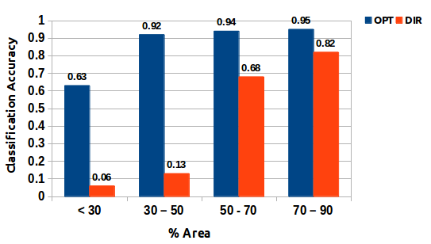
Variation with scale
OPT – LP with the presence of constraint C
DIR – complete histogram is used
Constraint C is very important for decomposing histograms.
Average boost of 30.35% over MRF (TRW-S) and LP (with-out C).
Problem is relatively hard when the object is very small.
Comparison of classification performance with scale variation of objects in the Composed Caltech dataset.

Slide 26

Spatial Histograms
Uptil now, we have assumed that histogram is computed over whole object for learning the classifier.
Limitation : Histogram doesn’t capture any spatial information.
Standard solution in the literature is to use Spatial Histograms.
r₅
r₁
r₂
r₆
r₃
r₄
r₇
r
r₁
r₂
r₃
r₄
r₅
r₆
r₇
Final Object Representation = [ r₁ . r₂ . r₃ . r₄ . r₅ . r₆ . r₇ . r ]
( . represents concatenation)

Slide 27


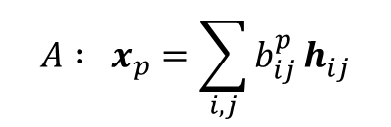




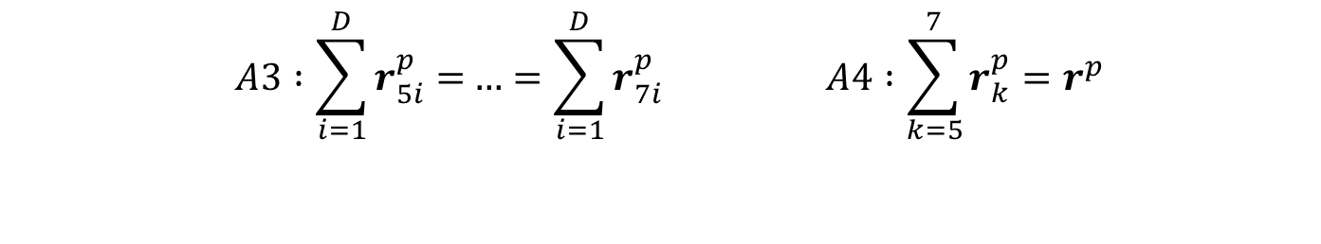

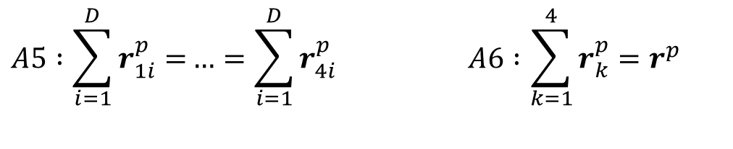


Spatially Constraint Decomposition
$${A : x}_{p}=\sum_{i,j}{b_{ij}^{p}}h_{ij}^{}$$
$$r_{}^{p}$$
replace A with following constraints –
$${A2: x}_{p}=[r_{1}^{p} . r_{2}^{p}…r_{7 }^{p}. r_{ }^{p}] A2:\sum_{i,j}{b_{ij}^{p}}h_{ij}^{}=r_{}^{p}$$
$$r_{5}^{p}$$
$$r_{6}^{p}$$
$$A3 :\sum_{i=1}^{D}{r_{5i}^{p}=}…=\sum_{i=1}^{D}{r_{7i}^{p}} A4 :\sum_{k=5}^{7}{r_{k}^{p}=r_{}^{p}}$$
$$r_{7}^{p}$$
$$r_{1}^{p}$$
$$r_{2}^{p}$$
$$A5 :\sum_{i=1}^{D}{r_{1i}^{p}=}…=\sum_{i=1}^{D}{r_{4i}^{p}} A6 :\sum_{k=1}^{4}{r_{k}^{p}=r_{}^{p}}$$
$$r_{3}^{p}$$
$$r_{4}^{p}$$
Now, variables are -${ b}_{ij}^{p}$ (binary) and $r_{1}^{p} , r_{2}^{p},…{,r}_{7 }^{p},r_{ }^{p}$(real)

Slide 28
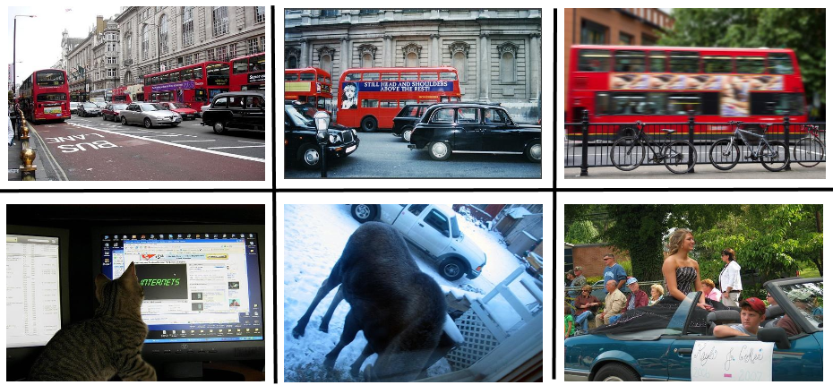
Datasets Used
Flickr Dataset – composed of images downloaded from Flickr with “bus and car” and “bus and bicycle” as text queries (~ 4500 images each).
Negative images in the Flickr dataset are collected from PASCAL VOC 2007 which contain neither of these categories.
PASCAL VOC 2007 Dataset – Most challenging dataset available for the task of object classification in images. It contains 20 categories. Training images ~ 5000 and Testing Images ~ 5000.
Example images from Flickr
Example images from PASCAL VOC 2007

Slide 29
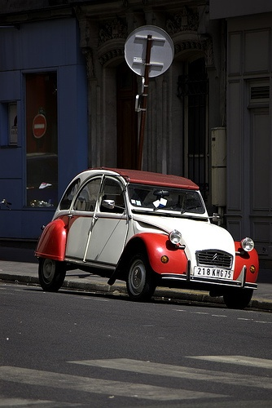
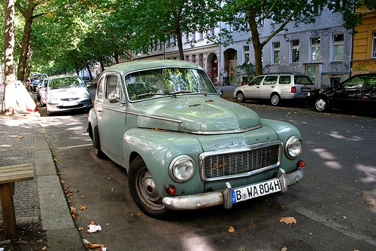
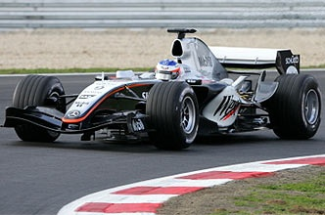
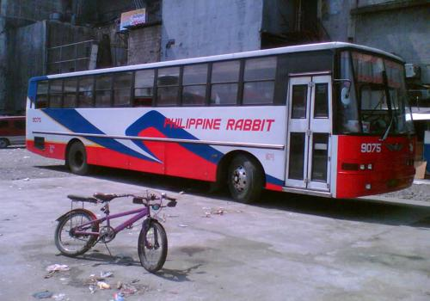
Multiple Object (Flickr) Classification
Classifiers used in LP formulations are trained on histograms of ground truth bounding boxes around the object of PASCAL.
Classifiers used for evaluating AP are trained using features extracted from the bounding boxes around objects concatenated with the features extracted from the remaining portion of the image).
H₁ (bus) + H₂ (bic) + H₃ (background)
Bus representation : [H₁ . H₃]
Bic representation : [H₂ . H₃]
Histogram
Decomposition

Slide 30

Multiple Object (Flickr) Classification
Method | Flickr-M1 |  | Flickr-M2 |  | PASCAL-M
 | bus | car | bus | bic
BoW | 0.522 | 0.516 | 0.302 | 0.108 | 0.287
LP (round) | 0.561 | 0.574 | 0.373 | 0.235 | 0.312
LP (relax) | 0.582 | 0.590 | 0.397 | 0.246 | 0.331
LP-SVM | 0.598 | 0.612 | 0.408 | 0.278 | 0.348

Slide 31


Decomposition into object and background
Classifiers used for solving LP and evaluating AP are same as previous.
Histogram
H₁ (object) + H₂ (background)
Object representation : [H₁ . H₂]
Decomposition

Slide 32
Decomposition into object and background
Method | Pascal |  | Comments
 | Simple | SPM + Ex. F. M.
BoW | 0.379 | 0.538 | Baseline
TestBB | 0.659 | 0.834 | Golden Baseline
DPM | 0.386 | 0.543 | Decomposition using existing methods
Sem. Seg. | 0.434 | 0.561
LP (round) | 0.418 | 0.536 | Decomposition using LP based methods
LP (relax) | 0.435 | 0.558
LP - SVM | 0.447 | 0.567
BoW – Complete histogram is used
TestBB – Decomposition is done using ground truth bounding boxes.
DPM - Decomposition is done using object detection. (Felzenszwalb et al, 2010)
Sem. Seg – Decomposition is done using semantic segmentation. (Ladicky et al, 2009)

Slide 33
Decomposition in a weakly supervised setting
Supervised : Bounding box is also available along with label information.
Weakly-supervised : Only label information is available.
Can we learn the classifiers used in LP in a weakly supervised setting ?
H₁
Histogram
H₁ (cat) +
H₂ (background)
Training
Samples
(new)
Training
samples
Histogram
Decomposition
Decomposition
learn classifier w
(SVM)
initialize w
Iterative procedure
w is initialized using a hyperplane learned from 10 bounding boxes of an object.

Slide 34
Decomposition in a weakly supervised setting
Method | Vocab. | AP
OCP [1] | - | 0.572
Chatfield et al. [2] | 4k | 0.538
 | 25k | 0.573
LP | 4k | 0.560
 | 25k | 0.589
LP-SPM | 4k | 0.571
 | 25k | 0.594
[1] Object-centric spatial pooling for image classification, Russakovsky et al., ECCV 2012
[2] Devil is in the details, Chatfield et al., BMVC 2011

Slide 35
Summary (I)
We propose an effective method to decompose a global histogram of an image into histograms of its associated objects and regions.
We take an intermediate path between two harder problems, namely bounding box accurate object detection and pixel-accurate object segmentation.
Method | DPM | Sem. Seg. | LP | LP-SPM
Testing time (/image) | 5-6 sec | 4-5 minutes | 0.5-1 sec | 3-4 sec
We also show application of histogram decomposition for improving the classification performance on multiple object and PASCAL VOC 2007 datasets using object-background representation of an image.
The use of our formulation for improving object localization is a possible avenue for future research.

Slide 36

Decomposing questioned document images into regions containing copied and non-copied content

Slide 37
Optimization and Duplicates Retrieval
Two models are proposed to solve the problem of duplicates retrieval.
First model is the geometric-based model which involves matching of documents using homography.
Second model is the histogram-based model which represent document images as a histogram of visual words.
The framework can be used for detecting forgery and plagiarism in documents.

Slide 38
Geometric-based Model
The model can be used for detecting exact duplicate only.
Independent of imaging process – camera or scanner based.
Matching using single Homography:
What if geometric transformations have been applied to paragraphs, figures, and other contents in one image ?

Slide 39
Geometric-based Model
Matching using multiple Homographies:
Chicken and egg dilemma. To estimate multiple homographies, membership of each matching-point pair is required. To find membership, the information of each homography is required.

Slide 40
Mixture of Homographies Model
– matching point-pair correspondences between two documents.
For fitting single homography, error function of following form is minimized –
But we have to find multiple homographies simultaneously.
– membership variable
Assume, we also have a list of M candidate homographies, and it contains all the true homographies.
Now, in our case, we define the error function as –

Slide 41
LP formulation
subject to the constraints -
The objective function models the data and complexity term.
A : a matching point-pair can belong to only one homography.
B : ith correspondence can be assigned to kth homography only if exists in the true homography set
C : and are binary variables.

Slide 42
LP formulation
subject to the constraints -
The objective function models the data and complexity term.
A : a matching point-pair can belong to only one homography.
B : ith correspondence can be assigned to kth homography only if exists in the true homography set
C : and are binary variables.
Assigning every correspondence to a homography, what about outliers (e.g. repetition of characters, presence of stop words, etc.)?

Slide 43
LP formulation (Handling Outliers)
subject to the constraints -
– variable denoting whether outlier or not
P – upper bound on the number of outliers
Assigning every correspondence to a homography, what about outliers (e.g. repetition of characters, presence of stop words, etc.)?

Slide 44

Candidate Homography Set Generation
Select M random points uniformly distributed across image1.
Using their neighbouring points and RANSAC algorithm, estimate homographies.
Each point will give rise to a candidate homography.

Slide 45
Using Outlier LP-formulation

Slide 46

Histogram-based Model
Can handle small variations in text.
Summarization, formatting, re-writing, etc.
The model is based on Bag of Visual Words.
Feature Extraction and Histogram Creation
Dense SIFT descriptors at multiple scales.
Features should not capture the relative geometry of the words.
We have to find near duplicates!

Slide 47


Histogram-based Model
Learning Classifier
Discriminative approach to duplicate detection.
Exemplar-SVM for learning
We have to find near duplicates!
Sliding Window Search
Search at multiple scales and positions for possible duplicates.
For ith document, the score is given by -

Slide 48

Method Pipeline

Slide 49
Datasets Used
Exact & Near Duplicates dataset considered in the work .
Cut And Paste Dataset cut and pasting contents from multiple sources.
Dataset based on text-formatting
bold, italics, font changes, etc.
Dataset based on human translated text
text rewritten by human.
Dataset based on machine translated text
text rewritten by Google Translator.
Camera-based documents document images captured from camera.
Handwritten assignments documents from course assignments.
Multi-lingual documents Hindi, Telugu, English.

Slide 50

Datasets Used

Slide 51


Geometric-based Model
Camera-captured and Cut And Paste document as queries
Corpus of ~ 10,000 images

Slide 52

Histogram-based Model
Accuracy is measured in the retrieval framework.
% of correct documents obtained in top-20.
[6] Vitaladevuni et. al., Detecting near-duplicate document images using interest point matching, ICPR-2012

Slide 53
Summary (II)
We propose an effective method to decompose a questioned document image into regions containing copied and non-copied contents.
We propose two models for the same – geometric-based model and histogram-based model.
Geometric-based model uses mixture of homographies to detect duplicates.
Histogram-based model is a more generic model which can handle variations in text by learning a discriminative classifier.
We presented results in wide range of document images including handwritten and camera captured documents.

Slide 54
Future Work
Decomposing Bag of Words
Speeding up object detection task
Including shape priors in formulation
Use of non-additive features such as HoG, LBP
Better binding of object and background histograms
Exact and Near Duplicate Documents Retrieval
Avoiding the two step nature to solve the problem
Semantic linking of documents
Testing of method in large real datasets (~million images)

Slide 55
Related Publications
Decomposing Bag of Words Histograms Ankit Gandhi, Karteek Alahari, and C. V. Jawahar in IEEE International Conference on Computer Vision (ICCV), Sydney, Australia, 2013
Detection of Cut-And-Paste in Document Images Ankit Gandhi and C. V. Jawahar in Proceedings of the IEEE Conf. on International Conference on Document Analysis and Recognition (ICDAR), Washington DC, USA, 2013

Slide 56
Thank You! Questions ?

