Slide 1
Script and Language Identification in Document Images and Scene Texts
Ajeet Kumar Singh
Adviser: Prof. C. V. Jawahar
Center for Visual Information Technology
IIIT-Hyderabad, India
Notes:
Good morning, I am ajeet kumar singh. I worked at CVIT with Prof. C.V. Jawahar. I am here to present my thesis on <thesis-title>

Slide 2
Contents
Motivation
Script Identification in Wild
Script and Language Identification in Document Images
Notes:
First I will talk about the motivation and rationale behind this thesis.
Then I will talk about the script identification in wild images containing texts from indic scripts.
Finally I will talk about the script and language identification in document images

Slide 3
Contents
Motivation
Script Identification in Wild
Script and Language Identification in Document Images

Slide 4


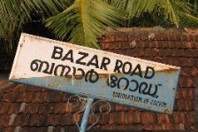
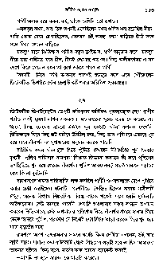
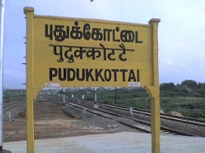
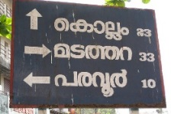
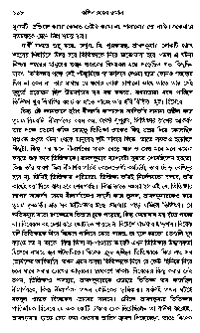
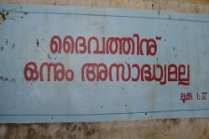
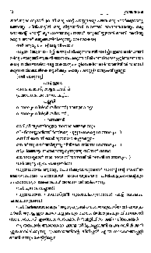
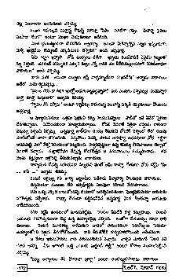
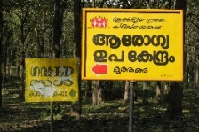
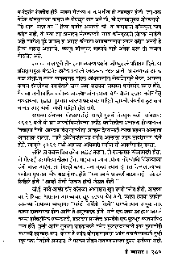
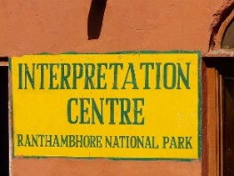
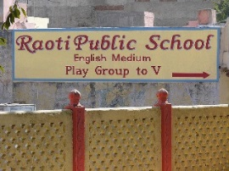

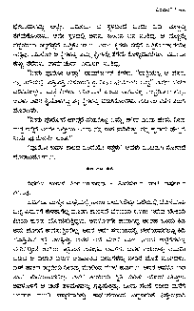
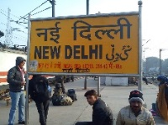
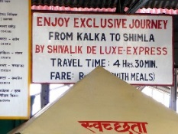
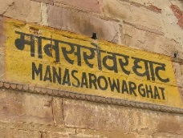
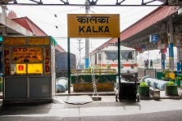

Motivation
Text Extractor or OCR
What’s the script?
Notes:
We live in a world which is increasingly becoming digital and automated.
The amount of multimedia and captured data are rapidly increasing and stored in digital format. These data also includes multilingual document images, scene images, and videos which contains texts which can play a crucial role in understanding the context and environments.
For this, many OCRs and scene text recognition tools have been developed over the years. These solutions work very efficiently for individual script or language. But, in a multilingual country like India, where you find documents and scene texts in many languages, they fail miserably.
We need to explicitly specify the script or the language of the inherent text in the document or the scene texts before the actual recognition task.
In this thesis, we present two simple and effective solution for the script and language identification, one each for scene text and document images.
With the advent of smartphones and digitial cameras, it has become very easy for everyone to capture any document or any sign board necessary for navigation.
Try to understand the data.
Using OCR and scene-text readers.
These tools extract the text from the document or the sign board and provide back to the user.
Problem of script identification.
<what’s the problem without script identification> I know English, document/signboard is in another alien language. How do I tell the system, which OCR to run?

Slide 5
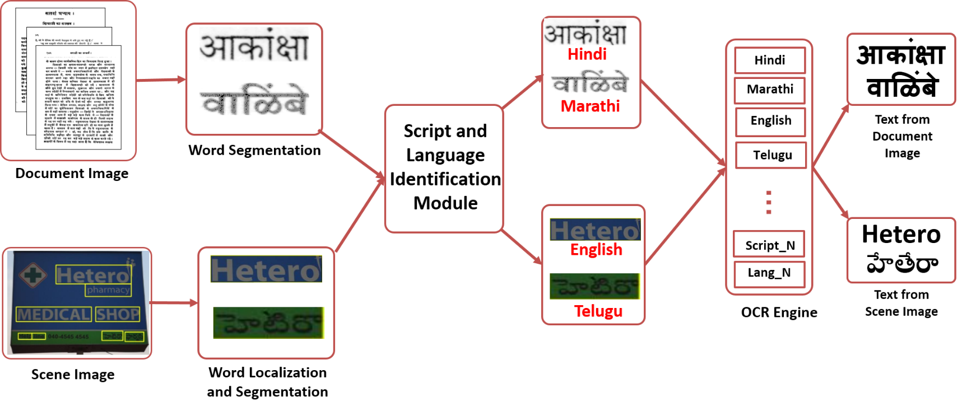

Motivation
Typical Optical Character Recognition System
Manual Intervention
Notes:
Based on these observation, we will briefly talk about the traditional ocr/scene-text recognition system.
<how do we capture the documents or the signboards>
Then talk about the manual intervention. How is it preventing us from the fully automated system, accessible by all.

Slide 6
Motivation
Automated Optical Character Recognition System

Slide 7
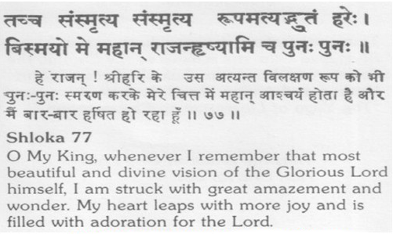



Motivation
Why do we need Script and Language Identification?
(a)
(b)
(c)
Notes:
Here are three sample cases of documents:
And if we ask any user to identify the script in these cases,
No correct script or language identification no correct recognition

Slide 8

Motivation
Why do we need Script and Language Identification?
(a)
(b)
(c)
Red: German; Green: French; Blue: Spanish
Purple: Hindi; Orange: Telugu;
Brown: Malayalam
Notes:
But, if we pass through these to a script identification, 9 out 10 times we will get the correct script labels.
And these word images can be then forwarded to their corresponding OCR to get the correct text outputs.
-

Slide 9

Motivation
Script Identification
Kannada or Telugu?
Telugu or Kannada?
Bangla or Assamese?
Assamese or Bangla?
Language Identification
Marathi or Hindi?
Hindi or Marathi?
German or French?
French or German?
Notes:
I am going to ask prof. amitava if he could identify the script in the first row of the word images. I presume that
Prof. amitava do not understand the difference between telugu and kannada. Or Prof. Gangasetty sir, if he could identify the languages in the second row of the images. Take a guess.
In case of Bangla and Assamese, prof. amitava and in case of kannada and telugu prof. svg would notice the subtle
Nuances which a layman cannot.

Slide 10
Motivation
Script Identification
Kannada
Telugu
Bangla
Assamese
Language Identification
Marathi
Hindi
German
French
Notes:
But, if we are passing it through our script and language identification module, we get correct script labels for the same.

Slide 11
Contents
Need of Script and Language Identification
Script Identification in Wild
Script and Language Identification in Document Images

Slide 12
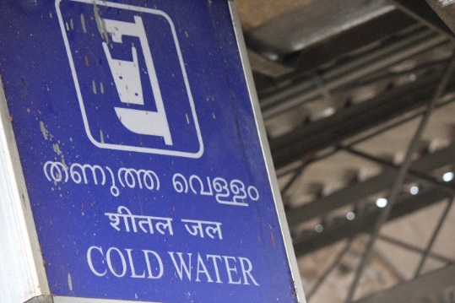

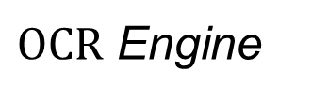
The Problem Statement
Script_1
Automatic Identification
Of
Scripts
Script_2
Recognized Text
$$…$$
Script_N
$OCR$ Engine
Challenges
Contributions
Lack of context
Stylish fonts
Complex background
A simple and effective solution
Indian Language Scene Text Dataset
Notes:
Lack of context – single word or a group of words where it is hard to find the contextual cues.

Slide 13
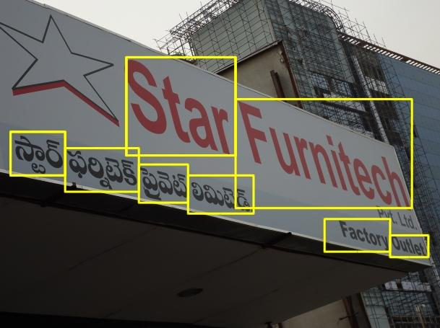
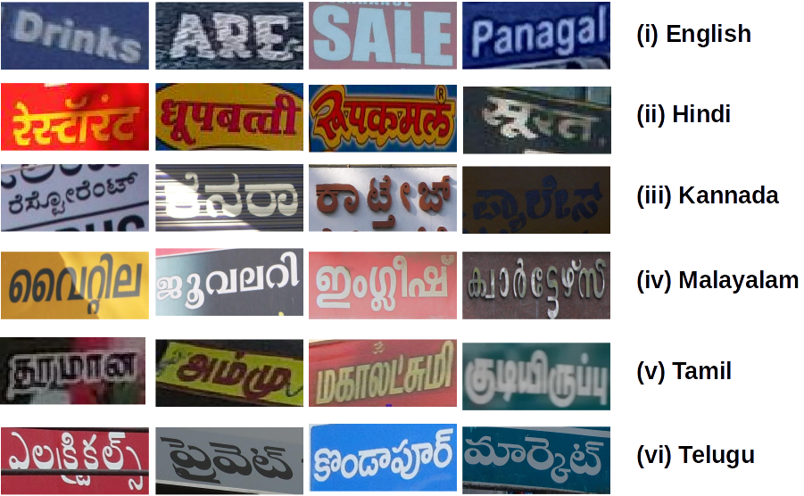
Indian Language Scene Text Dataset
(ILST)
Largest scene text dataset for the Indian languages.
The ILST dataset can be used for:
Script Identification
Word Recognition
Text Localization
GT Bounding box, script and text
Few Cropped Images from dataset

Slide 14
Indian Language Scene Text Dataset
(ILST)
Dataset Statistics
Script | # Scene Images | # Word Images | Mode of Collection
Hindi | 76 | 514 | Authors, Google Images
Malayalam | 121 | 515 | Authors, Google Images
Kannada | 115 | 534 | Char74K¹
Tamil | 59 | 563 | Authors
Telugu | 79 | 510 | Authors
English | 128 | 850 | Authors
Total | 578 | 3486 | -
LabelMe² is used for the annotations
Train and test splits of the dataset
¹ T. E. de Campos, B. R. Babu, and M. Varma, “Character recognition in natural images,” in VISAPP, 2009.
² “LabelMe - The Open Annotation Tool,” http://labelme.csail.mit.edu/

Slide 15
Proposed Method
Mid Level Features
Distinctive
Robust
Better than naïve bag-of-visual-words based features
Captures the larger context
Can be grouped into three categories:
Supervised
Weakly-supervised
Unsupervised
Notes:
We propose a mid level features based representation which are both distinctive and robust to the subtle changes in the images.
We have found these features to be better than naïve bag-of-words based features.
These features captures the larger context in the word images

Slide 16


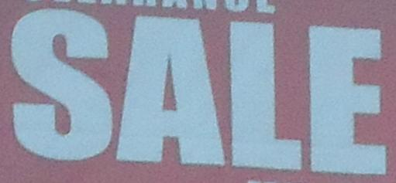


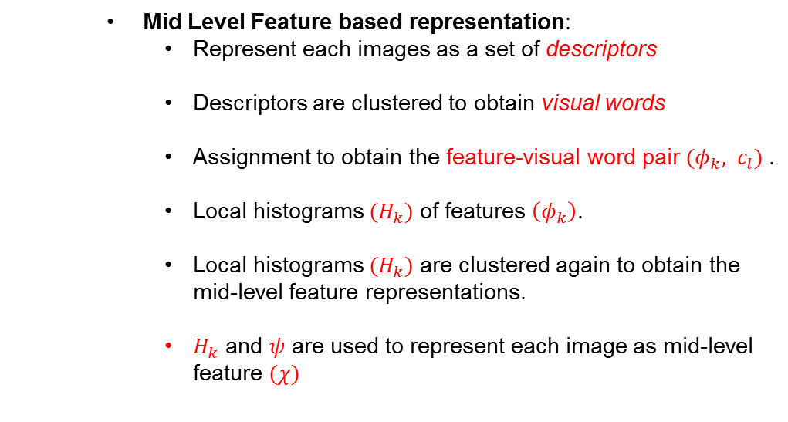


Proposed Method
…..
Training Images
Local Features
Visual Words
Local Histogram of Visual Words
Mid-Level Features
Mid Level Feature based representation:
Represent each images as a set of descriptors
Descriptors are clustered to obtain visual words
Assignment to obtain the feature-visual word pair ${(φ}_{k}, c_{l})$.
Local histograms ${(H}_{k})$ of features $\left(φ_{k}\right)$.
Local histograms ${(H}_{k})$ are clustered again to obtain the mid-level feature representations.
$H_{k}$ and $ψ$ are used to represent each image as mid-level feature $(χ)$
$$I_{i}=D_{ki}$$
$$C=\{c_{1},c_{2}, …, c_{m}\}$$
$$ψ=\{ψ_{1},ψ_{2},…, ψ_{n}\}$$
Notes:
Here is the architecture of the proposed algorithm, where we first represent each images
P x q rectangular neighborhood around feature phi_k . H_ks capture larger context and are more discriminative patterns.
Each image is presented as a bag of mid-level features.

Slide 17
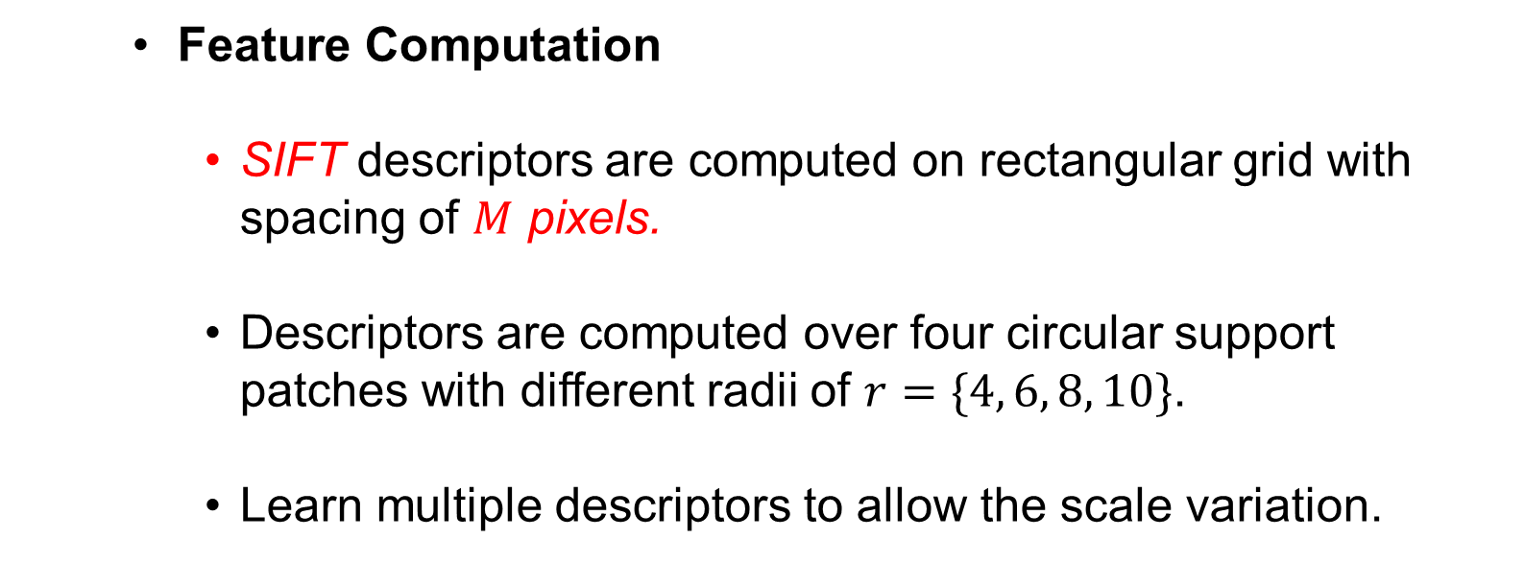
Proposed Method
…..
Training Images
Local Features
Visual Words
Local Histogram of Visual Words
Mid-Level Features
Feature Computation
SIFT descriptors are computed on rectangular grid with spacing of $M$ pixels.
Descriptors are computed over four circular support patches with different radii of $r=\{4, 6, 8, 10\}$.
Learn multiple descriptors to allow the scale variation.
Notes:
Given a text image we compute
the SIFT descriptors at points on a regular grid with spacing of
M pixels. At each point the descriptors are computed over four
circular support patches with different radii, consequently each
point is represented by four SIFT descriptors. We also learn
the multiple descriptors to allow the scale variation between
images. At each grid point the descriptors are computed over
circular support patches with radii r = 4; 6; 8 and 10.

Slide 18
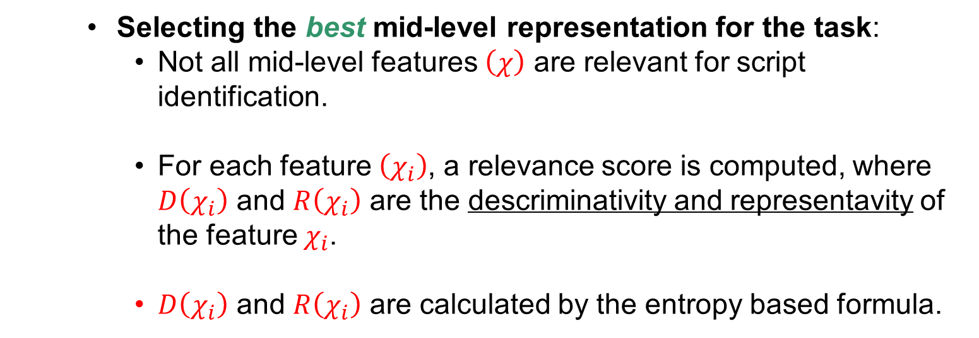

Proposed Method
…..
Training Images
Local Features
Visual Words
Local Histogram of Visual Words
Mid-Level Features
Selecting the best mid-level representation for the task:
Not all mid-level features $\left(χ\right)$ are relevant for script identification.
For each feature $\left(χ_{i}\right)$, a relevance score is computed, where $D\left(χ_{i}\right)$ and $R\left(χ_{i}\right)$ are the descriminativity and representavity of the feature $χ_{i}$.
$D\left(χ_{i}\right)$ and $R\left(χ_{i}\right)$ are calculated by the entropy based formula.
$$rel\left(χ_{i}\right)=D\left(χ_{i}\right)×R(χ_{i})$$
Notes:
We wish to use the mid-level features as a novel set of midlevel features to describe the text image. But not all mid-level
features are are relevant for the task of script identification, e.g., a representation commonly occurring in all the scripts,

Slide 19
Experiments
Cropped word script identification
Comparison with Baseline Methods
Results on ILST Dataset
Results on CVSI¹ Dataset
End-to-End pipeline
N. Sharma, R. Mandal, R. Sharma, U. Pal, and M. Blumenstein,“ICDAR2015 Competition on Video Script Identification(CVSI 2015),” in ICDAR, 2015

Slide 20
Cropped Word Script Identification
Comparison with baseline methods
Comparison of proposed method with various algorithms used in document script identification.
Task | Accuracy (%)
Baseline Methods
Gabor Features | 59.25
Gradient features | 47.74
Profile Features | 49.24
Linear Binary Patterns | 78.08
Proposed Method | 88.67

Slide 21
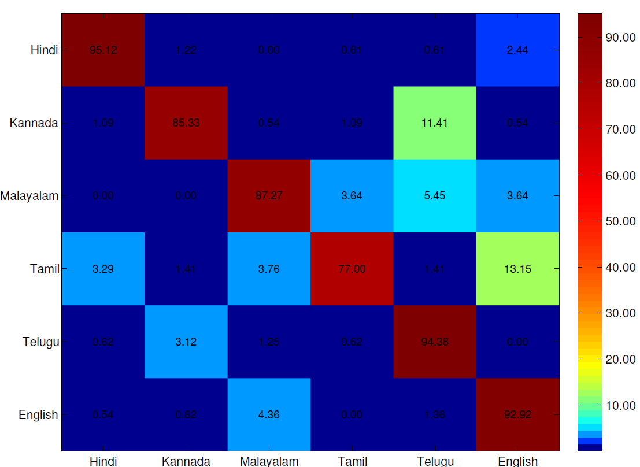
Cropped Word Script Identification
Cropped word script identification
Results on Indian Language Scene Text Dataset (ILST) - Quantitative
Best performance: Hindi (95.71%)
Least performance: Tamil (77.00%)
Confusion between Tamil and Malayalam due to script similarity.
Confusion between Kannada and Telugu

Slide 22
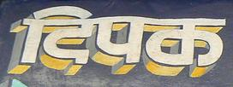









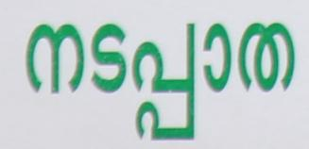

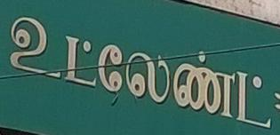











Cropped Word Script Identification
Cropped word script identification
Results on Indian Language Scene Text Dataset (ILST) - Qualitative
Hindi
✓
Tamil
✗
Kannada
✓
Telugu
✗
Malayalam
✓
✗
Tamil
Tamil
✓
Malayalam
✗
Telugu
✗
✓
Kannada
English
✓
Kannada
✗
Success Cases
Failure Cases

Slide 23
Cropped Word Script Identification
Results on CVSI¹ Dataset
ICDAR2015 Competition on Video Script Identification
10 scripts from India. (Hindi, Bangla, Arabic, English, Gujarati, Kannada, Oriya, Punjabi, Tamil,
Telugu)
Tasks:..
Task-1: Script Identification on script triplets
Task-2: North Indian Script Identification
Task-3: South Indian Script Identification
Task-4: Script Identification across all languages
Task | Methods
 | C-DAC | CUK | HUST | CVC-1 | CVC-2 | Google | Shi et al.² | Ours
Task 1 | 91.75 | - | 99.07 | 95.92 | 95.91 | 99.51 | - | 99.10
Task 2 | 96.79 | 79.50 | 97.69 | 95.73 | 95.91 | 99.19 | 93.80 | 97.99
Task 3 | 86.95 | 79.14 | 97.53 | 95.38 | 95.75 | 98.95 | 96.70 | 96.11
Task 4 | 84.66 | 74.06 | 96.69 | 95.88 | 96.00 | 98.91 | 94.30 | 96.70
N. Sharma, R. Mandal, R. Sharma, U. Pal, and M. Blumenstein,“ICDAR2015 Competition on Video Script Identification(CVSI 2015),” in ICDAR, 2015
B. Shi, X. Bai, and C. Yao, “Script Identification in the Wild via Discriminative Convolutional Neural Network,” in Pattern Recognition, 2015.

Slide 24
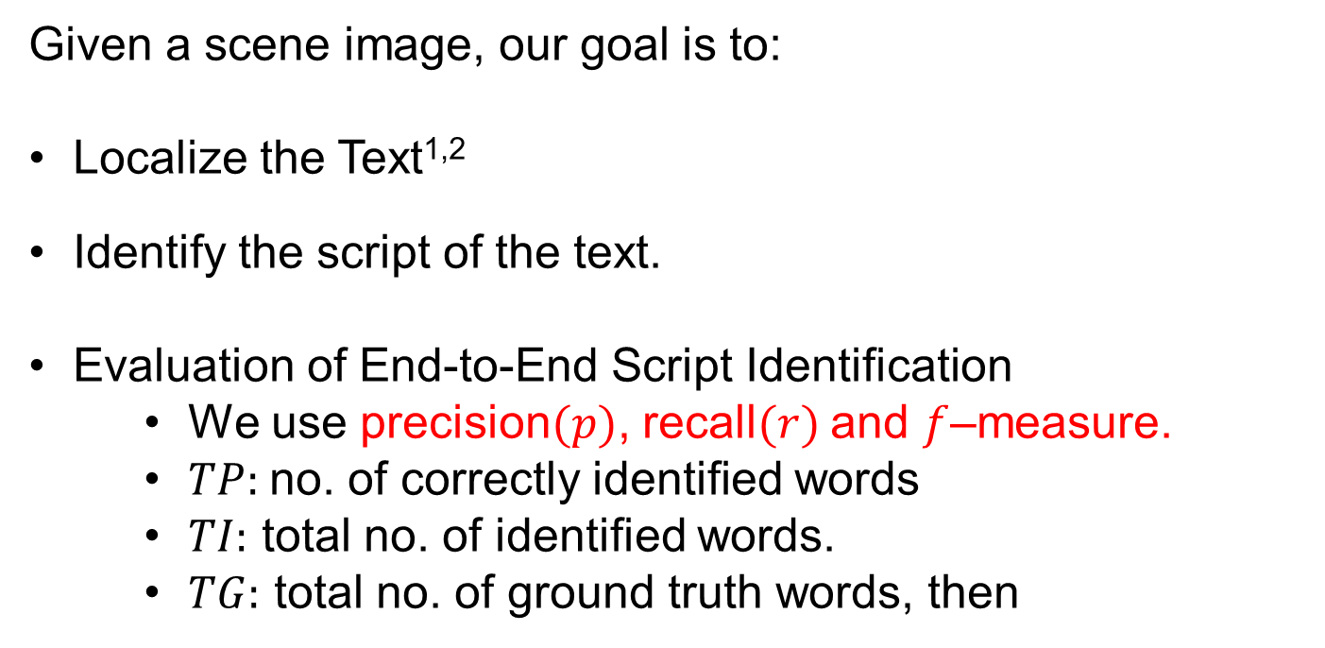
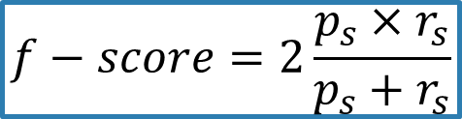
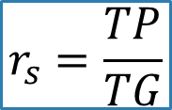
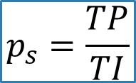
End-to-End Pipeline
Given a scene image, our goal is to:
Localize the Text^{1,2}
Identify the script of the text.
Evaluation of End-to-End Script Identification
We use precision$(p)$, recall$(r)$ and $f$–measure.
$TP:$no. of correctly identified words
$TI:$ total no. of identified words.
$TG:$ total no. of ground truth words, then
$$p_{s}=\frac{TP}{TI}$$
$$r_{s}=\frac{TP}{TG}$$
$$f−score=2\frac{p_{s}×r_{s}}{p_{s}+r_{s}}$$
D. K. Lluis Gomez, “A Fast Hierarchical Method for Multi-script and Arbitrary Oriented Scene Text Extraction,” in arXiv:1407.7504, 2014.
Tesseract OCR, http://code.google.com/p/tesseract-ocr/
Notes:
- In end-to-end pipeline, we try to apply the script identification module on whole image rather than the cropped word. First we detect and localize the text in scene image. And then we apply our script identifier on the detected words. There is good chance that we may miss some of the texts in image, hence we can’t identify the scripts. So, in order to evaluate the performance we use f-measure.

Slide 25
End-to-End Pipeline
Quantitative Results
Script | Precision | Recall | f-score
Telugu | 0.47 | 0.54 | 0.50
Tamil | 0.41 | 0.44 | 0.42
Malayalam | 0.49 | 0.45 | 0.47
Kannada | 0.39 | 0.47 | 0.43
Hindi | 0.42 | 0.48 | 0.45
English | 0.46 | 0.56 | 0.50

Slide 26
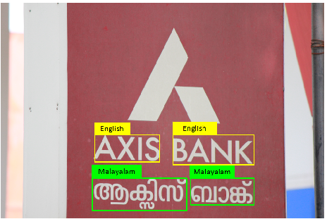
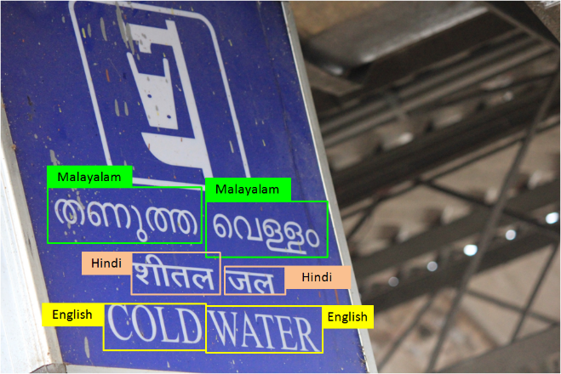
End-to-End Pipeline
Qualitative Results
Images showing results of successful script identification

Slide 27
Contents
Need of Script and Language Identification
Script Identification in Wild
Script and Language Identification in Document Images

Slide 28
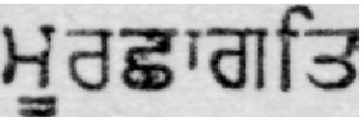



The Problem Statement
Can $RNNs$ identify the scripts?
vs.
Gurumukhi
Hindi
Can $RNNs$ identify the languages?
vs.
French
Spanish
Notes:
Today, rnns are used for many recognition task for handwritten and printed documented images. Also, they are used heavily in text classification.
Here, we are investintg if RNN can be used for script identification? Also, if it’s also possible to identify the languages from the word images. As you can see that the base script of the two words are latin.

Slide 29
Overview of Script Identification
Many methods has been approached in the past :
Page Level, Line Level, Word Level
Use the texture and orientation of image segments like:
Upward Concavities, Optical Densities
Character height densities and top-bottom profiles
Textures have also been used extensively. Some of them are:
Multi-channel Gabor filters.
Gray-level co-occurrence matrix
Gabor energy
Local Binary Pattern
Convolutional Neural Networks(CNN) are used to learn the discriminative features.

Slide 30
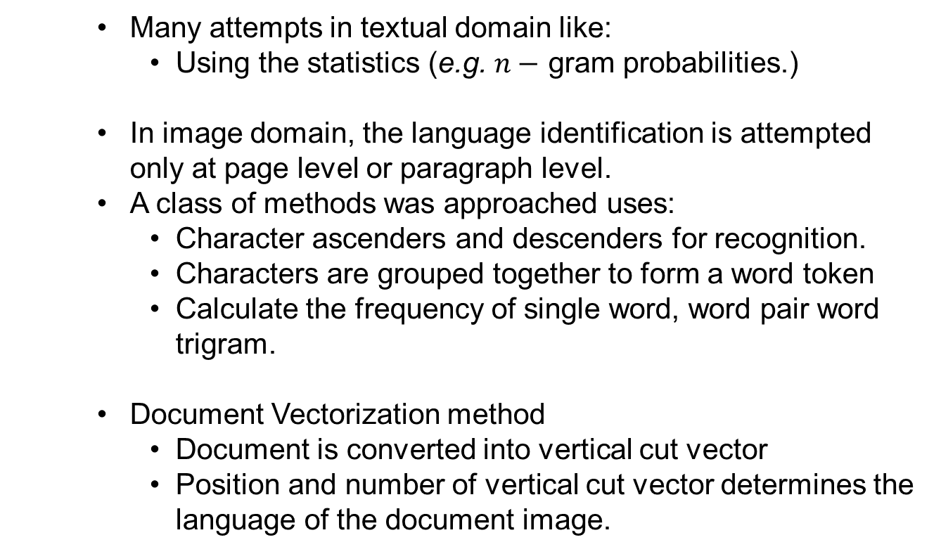
Overview of Language Identification
Language identification is hard because:
Inherent scripts are same
Many attempts in textual domain like:
Using the statistics (e.g. $n−$ gram probabilities.)
In image domain, the language identification is attempted only at page level or paragraph level.
A class of methods was approached uses:
Character ascenders and descenders for recognition.
Characters are grouped together to form a word token
Calculate the frequency of single word, word pair word trigram.
Document Vectorization method
Document is converted into vertical cut vector
Position and number of vertical cut vector determines the language of the document image.

Slide 31
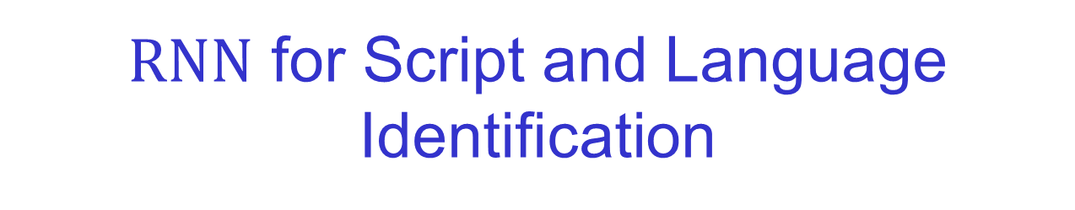
$RNN$ for Script and Language Identification
Recurrent Neural Networks with Long-Short Term Memory (LSTM Networks)
feed forward neural networks with cyclical connections
handles the sequential data
powerful classification tool
preserve the contextual information of previous states.
does not require any explicit labeling of all the feature sequences
Notes:
RNN most popular deep learning tool for optical character recognition.

Slide 32
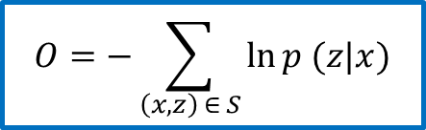
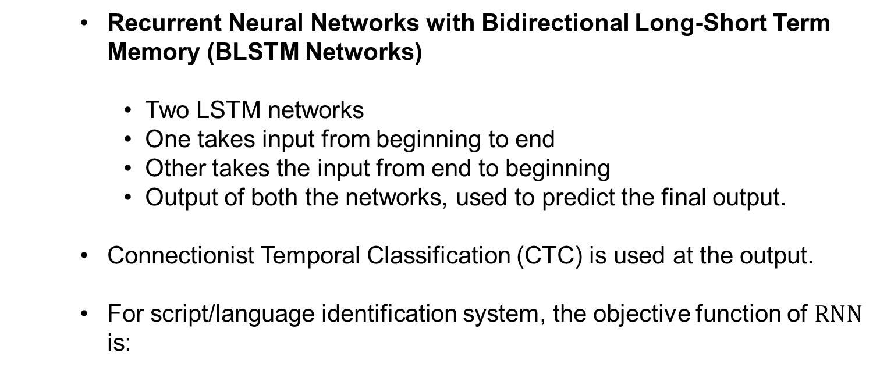
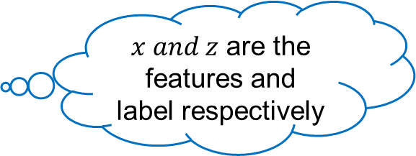
$RNN$ for Script and Language Identification
Recurrent Neural Networks with Bidirectional Long-Short Term Memory (BLSTM Networks)
Two LSTM networks
One takes input from beginning to end
Other takes the input from end to beginning
Output of both the networks, used to predict the final output.
Connectionist Temporal Classification (CTC) is used at the output.
For script/language identification system, the objective function of $RNN$ is:
$x and z$ are the features and label respectively
$$O=−\sum_{\left(x, z\right) ∈ S}{\ln{p (z|x)}}$$

Slide 33
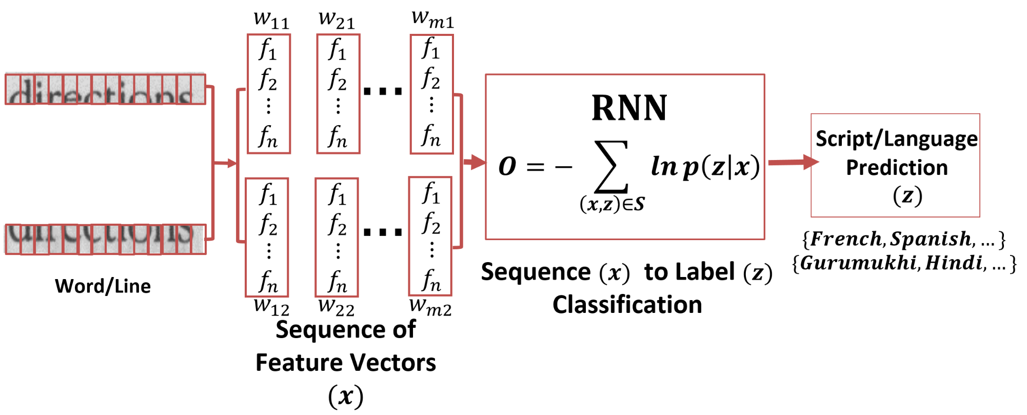
Script and Language Identification Architecture

Slide 34
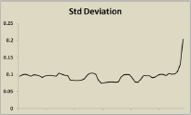
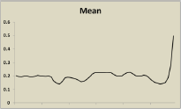
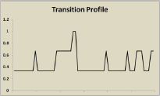
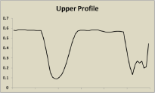
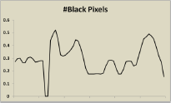
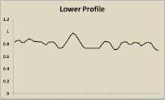








Representation of Words and Lines
$$f_{6}$$
$$f_{5}$$
$$f_{4}$$
Grey Image
$$f_{3}$$
Binarized Image
$$f_{1}$$
$$f_{2}$$
Notes:
F1, vertical profile (i.e. number of pixels in column)
F2, location of uppermost ink pixel
F3, location of lowermost ink pixel
F4, number of ink-to-background pixels
F5, mean value
F6, standard deviation
F1-F4 on binary image
F5-F6 on gray image
Features are calculated on a window size of 20px and with 75% overlap.

Slide 35

Datasets
To validate the proposed method for script and language identification, we use:
Indian Multilingual Dataset¹ which contains:
12 Indic scripts and 3 Latin-based languages.
55K Pages and 15M words.
Scripts/ Languages | $$D1[2]$$
 | Books | Pages | Lines | Words
Hindi | 34 | 5.0K | 133K | 1.66M
Malayalam | 31 | 5.0K | 93K | 0.96M
Gurumukhi | 33 | 5.0K | 125K | 1.62M
Kannada | 27 | 3.8K | 90K | 0.72M
Tamil | 23 | 4.8K | 88K | 0.64M
Telugu | 28 | 5.0K | 102K | 0.83M
Bangla | 14 | 2.8K | 50K | 0.95M
Marathi | 20 | 5.0K | 127K | 1.44M
Gujarati | 26 | 5.2K | 124K | 1.25M
Assamese | 19 | 3.5K | 73K | 0.59M
Manipuri | 25 | 3.6K | 69K | 0.72M
Odiya | 17 | 5.0K | 109K | 1.44M
French | 6 | 1.9K | 51K | 0.71M
German | 4 | 2.1K | 55K | 0.74M
Spanish | 5 | 1.9K | 48K | 0.63M

Slide 36


Datasets
To test the generality of our method, we compare it with the method [1] on the reported dataset (D2) .
The dataset contains 220K words from 11 Indic scripts
Implementation Details
Experiments | Type | Training* | Validation* | Testing* | Training Time $(hrs/epoch)$* | Testing Time*
Script | Line | 120K | 60K | 1.003M | 4.11 | 0.5 $ms/line$
 | Words | 960K | 240K | 11.64M | 3.75 | 0.1 $ms/word$
Language | Line | 30K | 15K | 100K | 0.80 | 0.5 $ms/line$
 | Words | 600K | 150K | 1.000M | 2.00 | 0.1 $ms/word$
Implementation Details to train and test the $RNNs$ for script and language Identification. * Approx.

Slide 37
Results and Discussions
Script Identification: Quantitative Results on Our Dataset¹
Scripts/ Languages | Accuracies (in %)
 | Lines | Words
Hindi | 96.6 | 85.8
Malayalam | 99.2 | 99.0
Gurumukhi | 97.9 | 93.2
Kannada | 98.0 | 93.8
Tamil | 98.5 | 98.1
Telugu | 98.4 | 96.0
Bangla | 98.6 | 98.5
Marathi | 97.6 | 95.8
Gujarati | 98.6 | 98.4
Assamese | 95.3 | 93.3
Manipuri | 98.2 | 71.4
Odiya | 99.5 | 97.5
1. C. V. Jawahar and A. Kumar, “Content-level Annotation of Large Collection of Printed Document Images,” in ICDAR, 2007

Slide 38


Results and Discussions
Comparison with state-of-the-art Pati[1]
$220K$ words; $77K$used for training, $143K$ used for testing
$[1]$ uses Gabor features with $SVM$classifier in hierarchical setting.
Our method achieves an error reduction of $11.17\%$ when compared with $\left[1\right]$.
Our method is simple and uses multiclass handcrafted classifier architecture unlike $[1]$.
Scripts/ Languages | Accuracies (in %)
 | Ours | Pati$[1]$
Hindi | 93.6 | 96.2
Malayalam | 96.5 | 93.3
Gurumukhi | 93.9 | 93.6
Kannada | 94.4 | 93.8
Tamil | 96.7 | 95.2
Telugu | 93.1 | 92.3
Bangla | 94.3 | 96.2
Marathi | - | -
Gujarati | 96.2 | 95.5
Assamese | - | -
Manipuri | - | -
Odiya | 97.1 | 94
1. Peeta Basa Pati and A. G. Ramakrishnan, “Word Level Multi-script Identification”, Pattern Recognition Letters, 2008

Slide 39
Results and Discussions
Script Identification: Qualitative Results
Script/ Language | Correctly Identified Words |  |  | Wrong Words
Hindi |  |  |  |  | Marathi
Malayalam |  |  |  |  | Tamil
Gurumukhi |  |  |  |  | Bangla
Kannada |  |  |  |  | Telugu
Tamil |  |  |  |  | Malayalam
Telugu |  |  |  |  | Kannada
Bangla |  |  |  |  | Hindi
Marathi |  |  |  |  | Hindi
Gujarati |  |  |  |  | Hindi
Assamese |  |  |  |  | Manipuri
Manipuri |  |  |  |  | Assamese
Odiya |  |  |  |  | Bangla

Slide 40

Results and Discussions
Script Identification: Confusion Matrix

Slide 41
Results and Discussions
Language Identification: Quantitative Results
Languages | Conf. Matrix (Word Level) |  |  | Accuracy(%)
 | French | German | Spanish | Line | Word
French | 93.32 | 3.47 | 3.21 | 94.51 | 93.32
German | 5.44 | 92.19 | 2.37 | 94.77 | 92.19
Spanish | 3.63 | 1.70 | 94.67 | 96.47 | 94.67
Lexical Similarity: Measure of the degree to which the word sets of two given languages are similar.

Slide 42


Results and Discussions
Language Identification: Qualitative Results
Script/ Language | Correctly Identified Words |  |  | Wrong Words
French |  |  |  |  | Spanish
German |  |  |  |  | French
Spanish |  |  |  |  | French
Lexical Similarity:¹
French and Spanish: $75\%$
French and German: $29\%$
1. “Ethnologue - webpage,” https://www.ethnologue.com/.

Slide 43

Multilingual OCR: To Separate or Not?
Two ways to build a Multilingual OCR (mOCR):
Hindi
Malayalam
Gurumukhi
Text Outputs
$$…$$
RNN
Tamil
Telugu
A Single OCR trained for all the scripts and languages
A single OCR would,
require very large dataset
cardinality of output space would increase manifolds.
long time to train the OCR

Slide 44


Multilingual OCR: To Separate or Not?
Two ways to build a Multilingual OCR (mOCR):
Hindi
Hindi
Script Separation Module
Bangla
Bangla
$$…$$
$$…$$
Text Output
``
Telugu
Telugu
OCRs for different scripts and languages are trained separately, individually.
Multiple OCRs would,
require less data
small output space
less time to train the OCR

Slide 45
Experiments
Script Identification Results:
Two groups”
South Indian Scripts + English
North Indian Scripts + English
Training: 100K words from each script
Testing: 25K words from each script
North Indian Scripts | Accuracy
English | 99.99
Hindi | 98.40
Bangla | 99.16
Gurumukhi | 98.63
Gujarati | 99.29
South Indian Scripts | Accuracy
English | 99.98
Kannada | 98.78
Malayalam | 99.57
Tamil | 99.13
Telugu | 99.15

Slide 46

Experiments
Need of Script Separation Module in OCR
Bilingual OCR ($bOCR)$ and Trilingual OCR$(tOCR)$ are trained.
$bOCRs$ are:
English + Hindi – $B1$
English + Bangla – $B2$
English + Kannada – $B3$
$tOCRs$ are:
English + Hindi + Bangla – $T1$
English + Kannada + Telugu – $T2$
A$hOCR$ (hierarchical system) which constitutes a script separation module and script/language specific OCRs.

Slide 47







Experiments
Comparison of $bOCR$, $tOCR$ with $hOCR$
 | L1+L2 |  |  |  |  |  |  |  | L1+L2+L3
(Bi/Tri)-lingual | B1 |  | B2 |  | B3 |  | B4 |  | T1 |  | T2
OCR | $$b$$ | $$h$$ | $$b$$ | $$h$$ | $$b$$ | $$h$$ | $$b$$ | $$h$$ | $$t$$ | $$h$$ | $$t$$ | $$h$$
Char. Error Rate | 3.88 | 2.87 | 2.16 | 1.65 | 2.31 | 2.13 | 1.11 | 0.61 | 3.85 | 3.31 | 2.65 | 2.02
Relative Error Reduction
$$26\%$$
$$24\%$$
$$8\%$$
$$45\%$$
$$14\%$$
$$24\%$$
Hierarchical OCR $\left(hOCR\right)$ is better than flat bi-lingual or tri-lingual OCRs.

Slide 48
Summary
Indian Language Scene Text (ILST) Dataset
Over 600 scene images containing 3500 words from 5 Indic Scripts
Text Localization, Text Detection and Text Recognition in the wild
Script Identification in the Wild
A Simple and Effective Solution for script identification
Uses robust mid-level features with SVM
Script and Language Identification in Document Images
Recurrent Neural Networks for Script and Language Identification
Hierarchical Multilingual OCR with script and language identification module for one-stop recognition solution

Slide 49
Possible Extensions
Script Identification in Wild
Use CNN for end-to-end script identification task
Exploring the usage of multiple cues from the texts
Extending the ILST dataset to 10-15 popular Indic scripts
Script and Language Identification in Document Images
Integration of the script identification and text recognition modules
Script and Language Identification in Handwritten document images
A fully automated multilingual OCR for scene texts and document images

Slide 50
Thank You
Related Publications
1. Ajeet Kumar Singh and C.V. Jawahar: Can RNNs Reliably Separate Script and Languages in Document Images. 13th IAPR International Conference on Document Analysis and Recognition (ICDAR). 2015
2. Ajeet Kumar Singh, Anand Mishra, Pranav Dabral and C.V. Jawahar: A Simple and Effective Solution for Script Identification in Wild, 12th IAPR International Workshop on Document Analysis and Systems (DAS), 2016
3. Minesh Mathew, Ajeet Kumar Singh and C.V. Jawahar: Multilingual OCR for Indic Scripts, 12th IAPR International Workshop on Document Analysis and Systems (DAS), 2016

